Slide 1
AI LAB HANDS-ON TRAINING • DAY 2 • SESSION 3 • 13:15 – 15:15
Amazon SageMaker
Part 2 — Deployment & MLOps
From artifact to live service — and back to zero cost.

Slide 2
SESSION 3 • 13:15 – 15:15
Objectives & Outcomes
Deploy this morning's trained model as a live prediction endpoint
Send real-time requests and read back predictions
Understand MLOps basics: monitoring, drift, and cost hygiene
Practice the single most important cloud habit: deleting what you started
Evidence by 15:15
Endpoint deployed and status showed InService
predictor.predict(...) returned real predictions
CloudWatch invocation graph viewed at least once
Endpoint list confirmed EMPTY before the break
AI Lab Training — Day 2, Session 3: SageMaker Part 2
2

Slide 3
SESSION 3 • 13:15 – 15:15
Deployment & MLOps — Key Terms
Deployment
Turning a model file into a service applications can use
Endpoint
An always-on prediction server behind a URL — billed hourly until deleted
Real-time inference
One request, one instant answer (drone camera, chatbot)
Batch transform
Predict a whole file at once — no permanent server, cheaper
MLOps
Versioning, pipelines, monitoring, retraining — models as an operation
Drift
The world changed, the model went stale → monitoring catches it → retrain
AI Lab Training — Day 2, Session 3: SageMaker Part 2
3

Slide 4
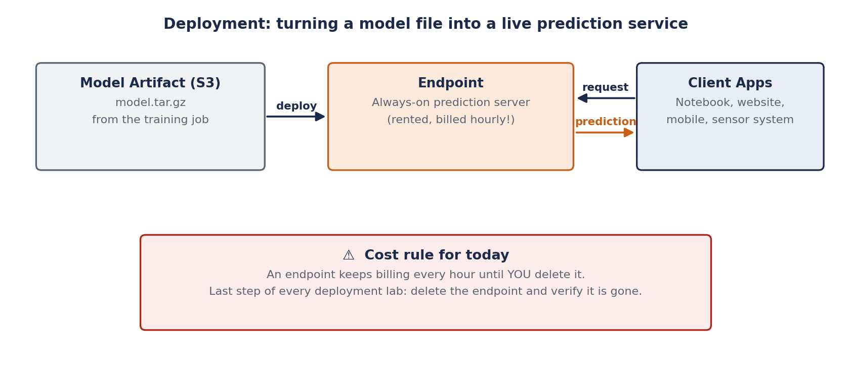
SESSION 3 • THE BIG IDEA
From Artifact to Live Service
AI Lab Training — Day 2, Session 3: SageMaker Part 2
4

Slide 5
SESSION 3 • HANDS-ON LAB E
Deploy It. Invoke It.
Cells 4–5 — same notebook, same estimator
Talk track
predictor = est.deploy(initial_instance_count=1,
instance_type="ml.m5.large")
# ~5 minutes of dashes … then ----!
recruits = pd.DataFrame([[24,48,23],[40,15,36]],
columns=["age","pushups_per_min","run_5km_minutes"])
print(predictor.predict(recruits))
# → ['high', 'low']
Your model just answered over the internet — any app could call this URL
Open the Monitoring tab: invocations & latency = MLOps in miniature
Whiteboard the loop: data → train → deploy → monitor → drift → retrain
Day 4 dives into the train / fine-tune stages of this loop
[ SCREENSHOT ]
SageMaker → Endpoints: status InService + CloudWatch invocation graph
AI Lab Training — Day 2, Session 3: SageMaker Part 2
5

Slide 6
Before the break:
DELETE YOUR ENDPOINT
predictor.delete_endpoint()
Training jobs shut themselves down. Endpoints NEVER do.
A forgotten ml.m5.large endpoint ≈ $80–100 every month.
Verify: SageMaker → Endpoints must be EMPTY. Trainer checks every screen.

Slide 7
SESSION 3 • TROUBLESHOOTING
If Something Doesn't Work
Deploy stuck “Creating”
Normal for 3–5 minutes — the hosting instance is provisioning
predict() throws a shape error
Column order/count must match training exactly — check the DataFrame columns
Endpoint shows Failed
Check CloudWatch Logs under the endpoint — usually a missing dependency in inference code
Can't find delete_endpoint()
Use predictor.delete_endpoint() or delete manually: SageMaker → Endpoints → Delete
Not sure if it's really deleted
Refresh the Endpoints console list — it must show zero rows, not just “Deleting”
AI Lab Training — Day 2, Session 3: SageMaker Part 2
7

Slide 8
SESSION 3 RECAP
Live, Then Zero
You deployed a model behind a URL and got real answers back
You practiced the discipline every cloud engineer needs: delete what you started
Next: Session 4 proves this whole pattern isn't AWS-specific — it's cloud ML

