Slide 1

DAY 3 · MICROSOFT AZURE · SESSION 1 · 09:00 – 10:30
Azure Foundations & Getting Your Access
What the cloud actually is, how Azure is organised, and how you get your own working area inside the trainer's subscription.
Ethiopian Defense University · Day 3 of 5 · 1.5 hours

Slide 2


SESSION 1 · OBJECTIVES
What This Session Covers — and What You Walk Away With
We will cover
You will be able to
What cloud computing means in practice, and what Azure is
The four levels: tenant, subscription, resource group, resource
What a guest user is and why you are invited as one
What the Contributor role lets you do — and what it does not
How Azure charges money, and how we keep the cost near zero
Accept your invitation and sign in to the Azure portal
Switch to the University of Gondar directory
Find your own resource group and confirm you can use it
Explain the difference between a subscription and a resource group
Name the three things that cost money and must be switched off

Slide 3





SESSION 1 · VOCABULARY
Six Words You Need Today
Cloud computing
Azure
Tenant
Renting somebody else's computers over the internet instead of buying your own.
Microsoft's cloud. Thousands of computers in data centres you can rent by the minute.
Your organisation's directory of user accounts. Ours is University of Gondar.
Subscription
Resource group
Resource
The billing container. Everything created inside it is paid for by the trainer.
A folder holding your resources. Each student gets one. Delete it and everything inside goes.
An actual thing you create: a storage account, a workspace, a machine.

Slide 4
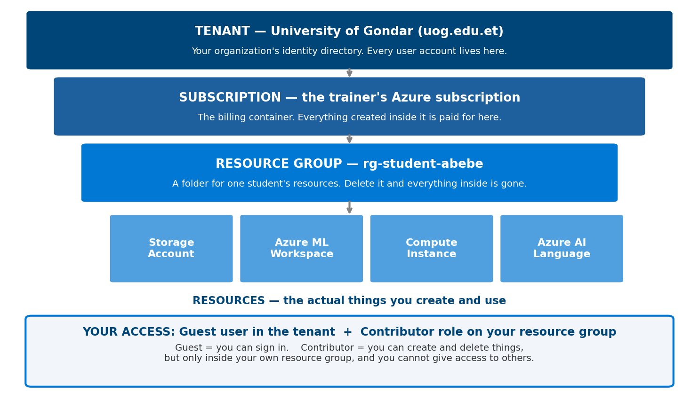
SESSION 1 · THE BIG PICTURE
How Azure Is Organised
Read it top to bottom. You will work only at the bottom two levels.

Slide 5


SESSION 1 · YOUR ACCESS
Guest User and Contributor — What They Mean
Guest user
Contributor role
You keep your own email account
You are added to the university's directory as a visitor
You sign in with your normal Microsoft account
You can see only what you are given access to
CAN create, change and delete resources
CAN run notebooks, train models, use AI services
CANNOT give access to anybody else
CANNOT touch other students' resource groups
In one sentence: guest = you can sign in; Contributor = you can build things, but only in your own folder.

Slide 6
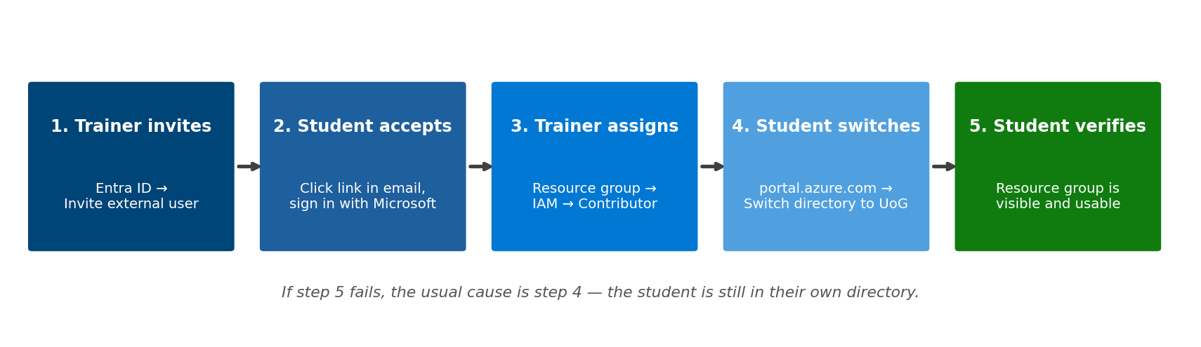
SESSION 1 · THE PROCESS
How You Get Access — Five Steps
Trainer does 1 and 3. You do 2, 4 and 5. Steps 1 and 3 happen before class — your invitation email is already waiting.

Slide 7
SESSION 1 · HANDS-ON (15 MIN)
Lab 1A: Accept Your Invitation
Open your email inbox and look for a message from Microsoft Invitations
1
Click the big Accept invitation button in that email
2
Sign in with your Microsoft account (or create one — it is free)
3
Read the permission request and click Accept
4
A page opens showing you are now part of University of Gondar
5
No email? Check your Spam or Junk folder first. If it is not there, tell the trainer — they can resend it in one click.

Slide 8
SESSION 1 · HANDS-ON (20 MIN)
Lab 1B: Sign In and Find Your Resource Group
Go to portal.azure.com and sign in with the same account
1
Click your name or the icon at the top-right corner
2
Click Switch directory, then choose UNIVERSITY OF GONDAR
3
In the search bar at the top, type: Resource groups
4
You should see one group named rg-student-yourname. Click it.
5
Most common problem: you see nothing at all. That means step 3 was skipped — you are still in your own directory.

Slide 9

SESSION 1 · TROUBLESHOOTING
Signing In: The Two Mistakes Everyone Makes
1. Wrong directory
2. Wrong account
The portal looks empty. It says “no subscriptions found”.
You are signed in to YOUR OWN directory, not the university's.
FIX: click your name (top right) → Switch directory → UNIVERSITY OF GONDAR
Most people have more than one Microsoft account — a work one and a personal one.
The browser signs you in with the wrong one automatically.
FIX: check the email shown top right. Sign out fully, or use a private / incognito window.
Before you ask for help: check the top-right corner. It must show YOUR email and UNIVERSITY OF GONDAR. That solves most problems.

Slide 10
SESSION 1 · WHY GUEST ACCESS
You Do Not Need an Azure Account
If you made your own account
What we do instead
A credit card is required to verify you
“Azure for Students” needs full-time student status — instructors are blocked
Free credit runs out after $100
The trainer cannot see or help with your work
You are a guest on the university's subscription
No credit card, no eligibility check, nothing to sign up for
Any email works — Gmail, Yahoo, Outlook, uog.edu.et
The trainer can see your work and help you
Already tested: a personal Yahoo address was invited into the University of Gondar tenant and signed in successfully.

Slide 11
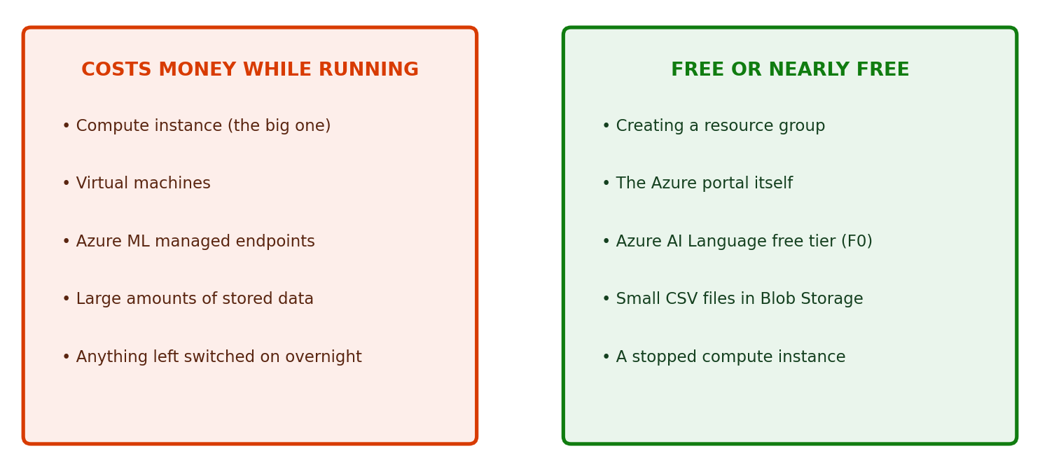
SESSION 1 · COST DISCIPLINE
What Costs Money — and What Does Not
The one rule: if you switch on a compute instance, you switch it off before you leave. We do this together at 16:20.

Slide 12

SESSION 1 · CHECKPOINT
Before the Break
I accepted the invitation email
I can sign in at portal.azure.com
I switched the directory to University of Gondar
I can see my own resource group
I can explain what Contributor lets me do
I know which three things cost money
If any box is unticked, raise your hand now — everything after the break depends on these.

Slide 13
SESSION 1 — THREE IDEAS TO CARRY FORWARD
1
Four levels
Tenant holds people. Subscription holds the bill. Resource group holds your work. Resources are the things you build.
2
You are a guest with Contributor rights
You can build freely inside your own resource group, and you cannot break anybody else's.
3
Compute costs money, clicking does not
Browsing the portal is free. A running compute instance is not. Switch it off.
Next — Session 2 (10:45): Create your first real resources: a storage account, and your dataset uploaded into the cloud. Using both the portal and the command line.

