Slide 1

DAY 4 · FINE-TUNING · SESSION 1 · 09:00 – 10:30
From One Neuron to the Resource Wall
Watch a single neuron learn a rule nobody told it. Scale that idea to a real language model. Then try to load Meta's Llama-2-7B and watch it crash.
Ethiopian Defense University · Day 4 of 5 · 1.5 hours · Google Colab

Slide 2


SESSION 1 · OBJECTIVES
What This Session Covers — and What You Walk Away With
We will cover
You will be able to
How a single neuron learns — guess, measure blame, nudge, repeat
Why a language model is that same loop across 494 million numbers
What a model really outputs: a probability for every possible next word
How to calculate memory needs before wasting an hour downloading
Why Meta's Llama-2-7B will not run on a free Colab GPU
Train a neuron to solve a puzzle it was never given the rule for
Load Qwen2-0.5B, prompt it, and inspect its next-word probabilities
Predict whether any model will fit BEFORE downloading it
Find the real usable memory of your GPU by crashing it
Explain why a small model you can train beats a big one you cannot

Slide 3
SESSION 1 · WARM-UP (5 MIN)
A Puzzle: Nobody Will Tell You the Rule
Someone invented an operation called ⭗ . Here is everything you know about it:
4 ⭗ 6 ⭗ 8 = 100
5 ⭗ 7 ⭗ 9 = 110
6 ⭗ 8 ⭗ 10 = 120
8 ⭗ 10 ⭗ 12 = 140
What is 14 ⭗ 16 ⭗ 18 ? What is 22 ⭗ 24 ⭗ 26 ?
Two minutes. Try it by hand. You have only examples, never the rule. That is exactly the situation every machine learning model is in.
Then we will let a single neuron — four numbers — work it out for itself.

Slide 4
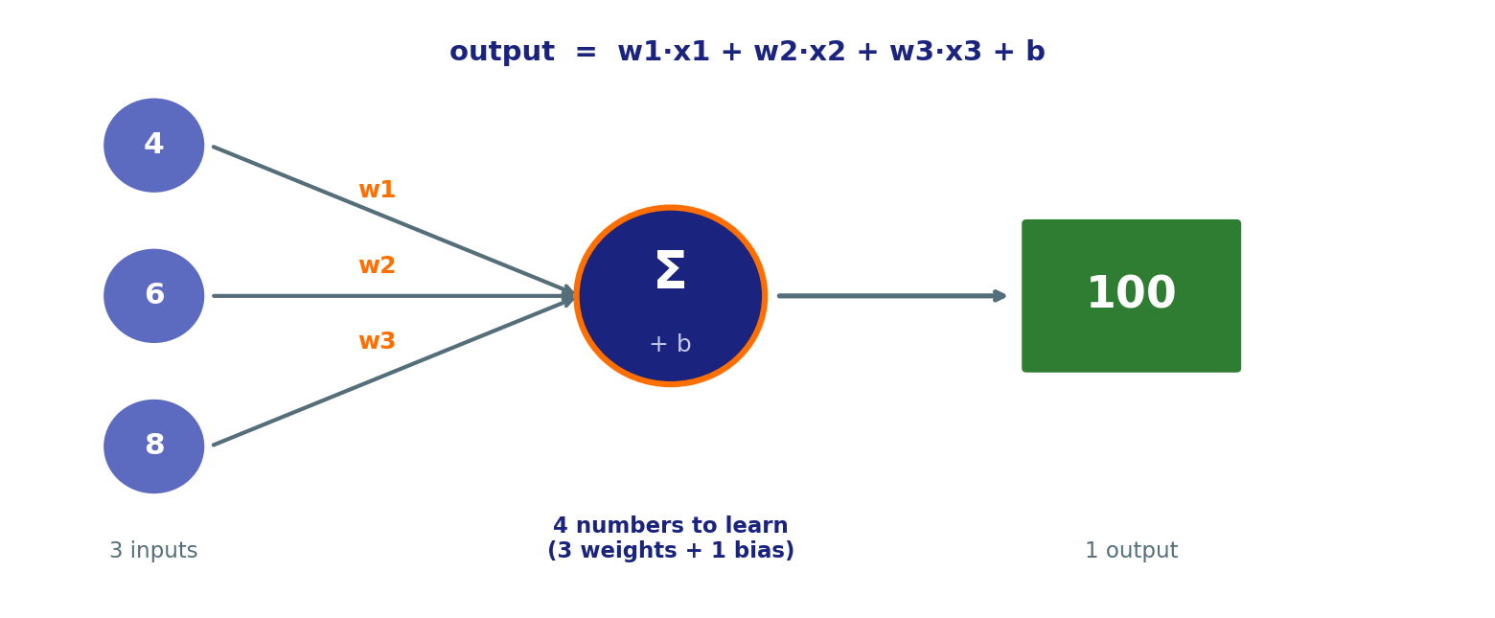
SESSION 1 · THE BUILDING BLOCK
One Neuron Is Four Numbers
That is the entire model. Three weights and one bias. It starts random and knows nothing at all.

Slide 5




SESSION 1 · THE LOOP
How It Learns: Four Steps, Repeated
1. Guess
output = w1·x1 + w2·x2 + w3·x3 + b — at first, badly.
2. Measure the error (loss)
How far off was it? Think of loss as an overall BLAME SCORE.
3. Share out the blame (backpropagation)
Work out how much each individual weight contributed to that error.
4. Nudge every number against its blame
Then go back to step 1. Do it 1,500 times.
Everything in this course is this loop. GPT, PaLM, Qwen — same four steps, just across billions of numbers instead of four.

Slide 6
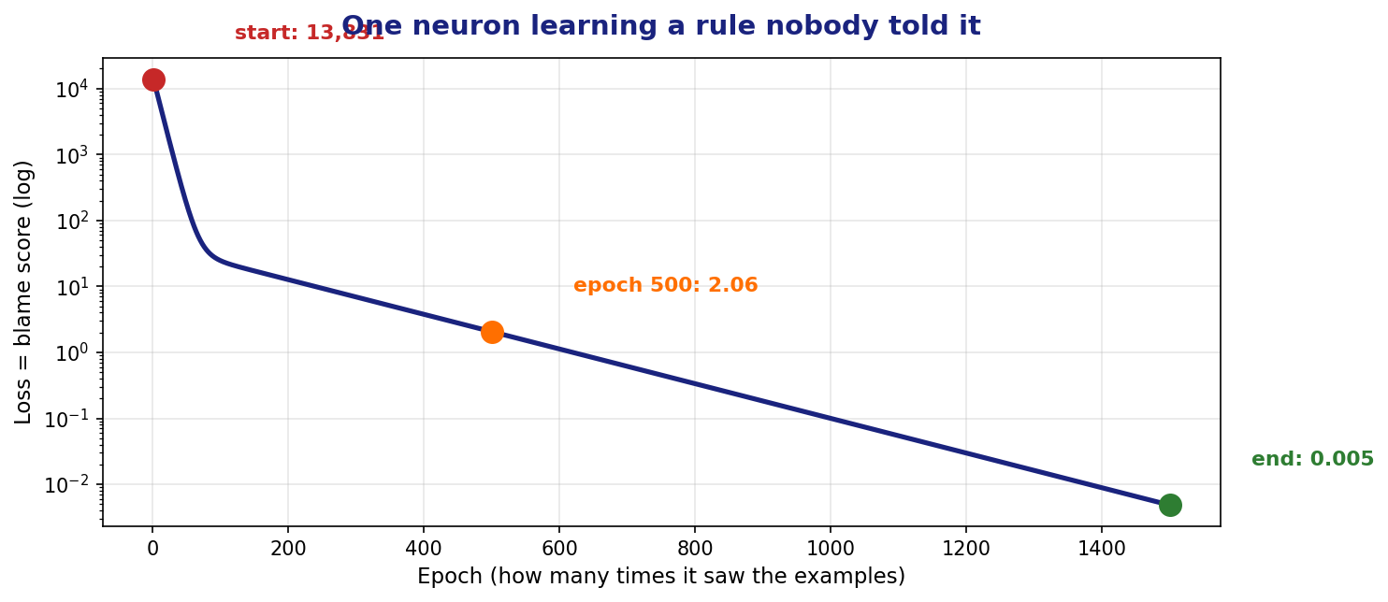
SESSION 1 · THE RESULT
Watch It Learn
It answers 200.4 and 280.7. The true answers are 200 and 280 — and it had never seen those numbers. It learned the RULE.

Slide 7
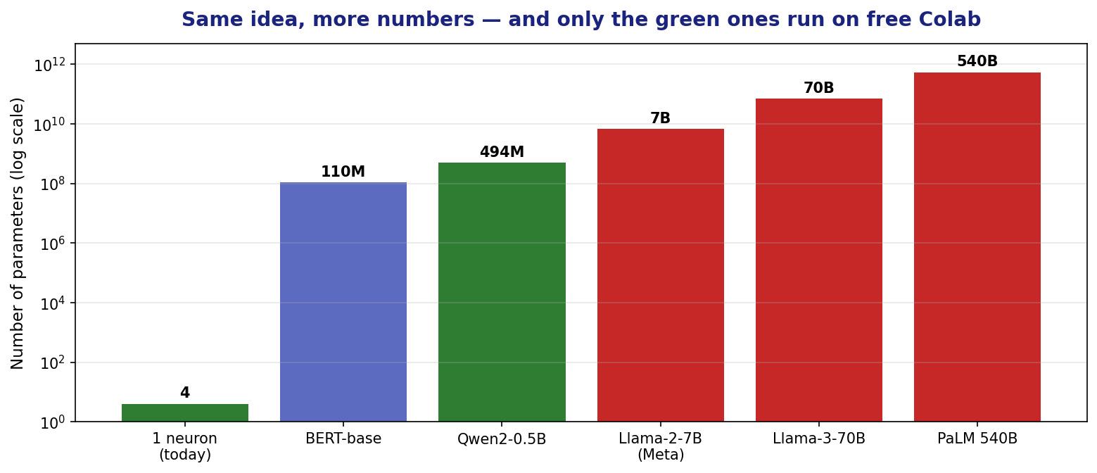
SESSION 1 · FROM 4 TO 494,000,000
Now Scale the Same Idea Up
Qwen2-0.5B is 494 million of those numbers. Same loop, same maths — but trained on trillions of words instead of four examples.

Slide 8
SESSION 1 · PREDICTION
What a Language Model Actually Does
It predicts the next word. That is all. Everything else emerges from doing it extremely well.
prompt = "The capital city of Ethiopia is ___"
next word probability
--------------------------------------
' Addis' 84.2% ################
' the' 4.1% #
' located' 2.8% #
' a' 1.9%
' now' 1.1%
No lookup table. No database. Just a probability for every word in the vocabulary, learned by the same guess-blame-nudge loop.
You will run this yourself in Cell 10 — and see the numbers for your own prompts.

Slide 9





SESSION 1 · VOCABULARY
Six Words That Decide Everything Today
GPU
VRAM
Parameters
The chip that does AI maths. Free Colab gives you a T4 with about 15 GB of usable memory.
Memory ON the GPU. This is the hard limit. Your laptop's RAM does not help.
The numbers inside a model. 0.5B means 500 million of them.
Precision
OOM
LoRA
Bytes per number. fp32 = 4 bytes, fp16 = 2 bytes. Halving precision halves memory.
Out Of Memory. The model needed more than the GPU had. The session dies.
Freeze the big model, train tiny add-ons. Turns impossible into 10 minutes.

Slide 10
SESSION 1 · THE MATHS
The Only Formula You Need
memory_GB = parameters x bytes_per_parameter / 1,000,000,000
Just loading it (fp16): 2 bytes per parameter
Fine-tuning with LoRA: ~2.5 bytes per parameter
FULL fine-tuning: ~16 bytes per parameter
(4 weights + 4 gradients + 8 optimizer)
Worked example: Qwen2-0.5B, full fine-tune = 0.5 x 16 = 8 GB. It fits. Qwen2-7B = 7 x 16 = 112 GB. It does not.
Do this calculation before you download anything. It takes ten seconds and saves an hour.
Remember Day 1? PaLM has 540B parameters. Full fine-tuning it would need about 8,600 GB — roughly 110 A100 GPUs.

Slide 11
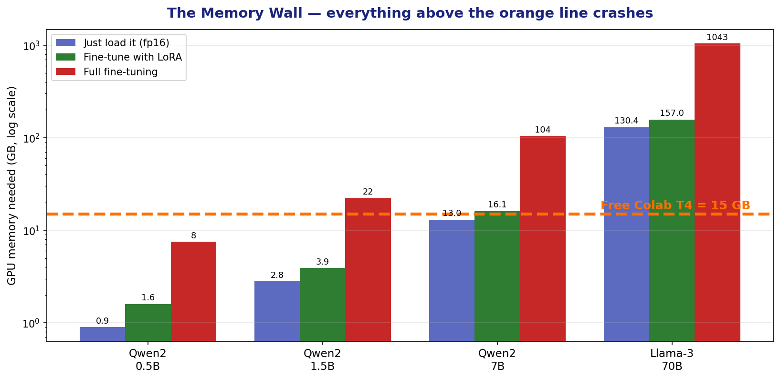
SESSION 1 · SEE IT
The Memory Wall
Log scale. Anything above the orange line crashes on free Colab.

Slide 12
SESSION 1 · HANDS-ON (20 MIN)
Lab 1A: What Did Colab Give You?
Open colab.research.google.com and sign in
!nvidia-smi
import torch
print(torch.cuda.is_available())
props = torch.cuda.get_device_properties(0)
print(props.name)
print(props.total_memory/1024**3, 'GB')
1
File -> New notebook
2
Runtime -> Change runtime type -> T4 GPU -> Save
3
Paste the code on the right into the first cell and press Shift+Enter
4
You should see: Tesla T4 and about 15 GB. If it says False, you did not switch the runtime — go back to step 3.

Slide 13
SESSION 1 · HANDS-ON (20 MIN)
Lab 1B: Load a Small Model — It Works
from transformers import AutoModelForCausalLM
import torch
model = AutoModelForCausalLM.from_pretrained(
"Qwen/Qwen2-0.5B-Instruct",
torch_dtype=torch.float16,
device_map="auto")
used = torch.cuda.memory_allocated(0)/1024**3
print(f"Model is using {used:.2f} GB")
Expected
Model is using
0.94 GB
Predicted 0.9 GB, got 0.94 GB. The formula works.
0.94 GB out of 15 GB. You have used 6% of the GPU. There is room to train. This is the whole reason small models matter.

Slide 14
SESSION 1 · THE WALL
Now Try Meta's Llama-2-7B
Qwen used 6% of the GPU. So why not use a bigger, better model? Do the arithmetic first.
Model load fp16 LoRA full FT verdict
----------------------------------------------------------------------
Qwen2-0.5B 0.9GB 1.2GB 7.4GB full FT fits
Llama-2-7B (Meta) 12.6GB 15.7GB 100.4GB TOO TIGHT -> crashes
Llama-3-70B (Meta) 130.4GB 163.0GB 1043.1GB WILL NOT LOAD
PaLM 540B 1005.8GB 1257.3GB 8046.6GB WILL NOT LOAD
GPU reports : 15.0 GB
CUDA overhead : 1.3 GB (context, kernels, workspace)
Actually usable : 13.7 GB <-- the REAL wall
12.6 GB of weights against 13.7 GB usable. Under a gigabyte left for activations — not enough to run even one short prompt.
"It has 15 GB and the model is 12.6 GB, so it fits" is wrong. You never get all 15.

Slide 15
SESSION 1 · HANDS-ON (20 MIN)
Find the Real Wall — By Hitting It
Allocate half a gigabyte at a time until the GPU refuses. This crashes on purpose.
allocated 0.5 GB
allocated 1.0 GB
...
allocated 12.5 GB <-- Llama-2-7B needs this much
allocated 13.0 GB
allocated 13.5 GB
>>> CRASHED - torch.cuda.OutOfMemoryError <<<
>>> The GPU refused at 13.5 GB <<<
What to notice
You never reach the advertised 15 GB
Llama's weights alone nearly fill it
Nothing left for actually running it
Recovery: Runtime -> Restart session
The arithmetic predicted this in 10 seconds. Downloading Llama-2-7B to find out would have taken 15+ minutes. Always do the maths first.

Slide 16

SESSION 1 · CHECKPOINT
Before the Break
I trained a single neuron and watched the loss fall to almost zero
It correctly answered 200 and 280 for numbers it had never seen
I can describe the four-step learning loop in my own words
I loaded Qwen2-0.5B and saw about 0.94 GB used
I prompted it and looked at the next-word probabilities
I found my GPU's real usable memory by crashing it
I can explain why Meta's Llama-2-7B will not run here
If you cannot do the memory calculation, ask now — the whole afternoon depends on it.

Slide 17
SESSION 1 — THREE IDEAS TO CARRY FORWARD
1
Learning is guess, blame, nudge, repeat
One neuron with four numbers did it. Qwen2-0.5B does the same thing across 494 million.
2
You never get the whole GPU
15 GB advertised, about 13.7 GB usable. Meta's Llama-2-7B needs 12.6 GB and still fails.
3
Do the maths before the download
Ten seconds of arithmetic beats fifteen minutes of downloading and crashing.
Next — Session 2 (10:45): Hugging Face and Amharic. You will see why the model struggles with Ge'ez script before you fix anything.

