Slide 1

DAY 4 · FINE-TUNING · SESSION 2 · 10:45 – 12:45
Hugging Face & the Amharic Problem
Find a model, find a dataset, and prove — with evidence — that the model is bad at Amharic before you try to fix it.
Ethiopian Defense University · Day 4 of 5 · 2 hours · 4 hands-on labs

Slide 2


SESSION 2 · OBJECTIVES
What This Session Covers — and What You Walk Away With
We will cover
You will be able to
How to search the Hugging Face Hub for models and datasets
What a tokenizer is, and why Amharic costs 3x more tokens than English
How to load and inspect a real 83,000-example Amharic dataset
Why you must test the model BEFORE fine-tuning, not after
How to format raw conversations into training examples
Search the Hub and read a model card critically
Measure how many tokens Amharic uses versus English
Load addisai/FineTome Amharic and inspect its structure
Record baseline answers to five Amharic questions
Turn the dataset into text the model can learn from

Slide 3





SESSION 2 · VOCABULARY
Words You Need This Session
Hugging Face Hub
Tokenizer
Dataset
The GitHub of AI. Over a million models and hundreds of thousands of datasets, mostly free.
Cuts text into pieces the model understands. Each model has its own — they are not interchangeable.
The examples you train on. Today: 83,000 Amharic conversations.
Model card
Baseline
Instruction format
The documentation page. Says what data it saw, its licence, and where it fails.
How the model performs BEFORE you change anything. Skip this and you can prove nothing.
Rewriting raw data as 'question then answer' so the model learns to respond.

Slide 4
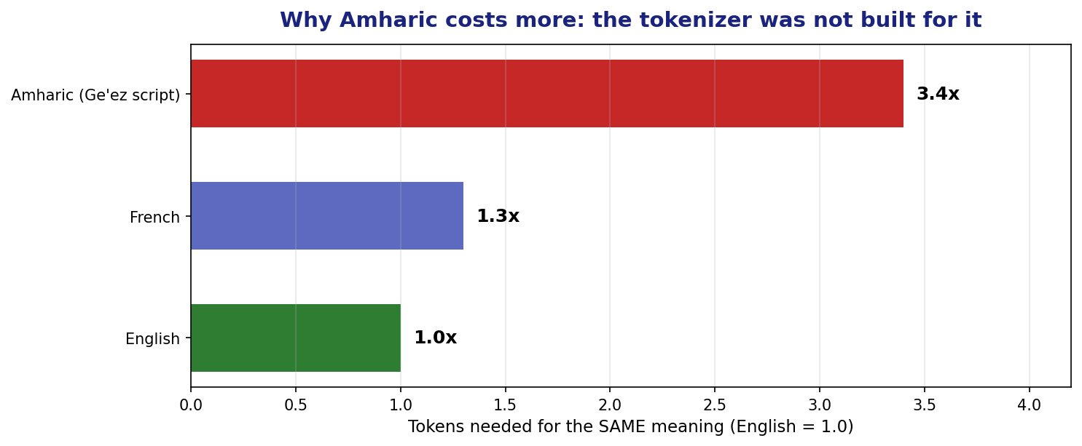
SESSION 2 · THE TOKENIZER PROBLEM
Why Amharic Costs Three Times More
Qwen's tokenizer was trained mostly on English and Chinese. Ge'ez script gets chopped into many small pieces.
What this means in practice: the same sentence costs 3x more memory, 3x more time, and hits the length limit 3x sooner.

Slide 5
SESSION 2 · HANDS-ON (25 MIN)
Lab 2A: Measure It Yourself
from transformers import AutoTokenizer
tok = AutoTokenizer.from_pretrained("Qwen/Qwen2-0.5B-Instruct")
en = "How can I track my order?"
am = "ትዕዛዜን እንዴት ልከታተለው እችላለሁ?"
print("English:", len(tok.encode(en)), "tokens")
print("Amharic:", len(tok.encode(am)), "tokens")
# Look at HOW it splits the Amharic
print(tok.tokenize(am))
What to notice
Amharic uses far more tokens for the same meaning
Many tokens are single characters or fragments
Some show as broken bytes
This is a fairness problem, not just a technical one
Discuss: if every Amharic query costs 3x an English one, who pays for that — and what does it mean for local AI?

Slide 6

SESSION 2 · HANDS-ON (30 MIN)
Lab 2B: The Baseline — Do This FIRST
If you fine-tune first and test afterwards, you have no proof anything improved. Record the baseline NOW.
QUESTIONS = [
"ስለ ምርታችሁ ዋጋ ማወቅ እፈልጋለሁ።", # pricing
"ትዕዛዜን እንዴት ልከታተለው እችላለሁ?", # order tracking
"ምርቱን መመለስ ከፈለኩ ምን ማድረግ አለብኝ?", # returns
]
before = {}
for q in QUESTIONS:
before[q] = ask(model, q) # save every answer
print(q, '->', before[q][:120])
Keep the 'before' dictionary alive all day. Session 4 compares against it. If your session restarts, you must re-run this cell.

Slide 7
SESSION 2 · HANDS-ON (35 MIN)
Lab 2C: Load a Real Amharic Dataset
from datasets import load_dataset
raw = load_dataset("addisai/FineTome-single-turn-dedup-amharic",
split="train")
print(f"{len(raw):,} examples")
print(raw.column_names)
# Always LOOK at your data before training on it
print(raw[0])
83,000 examples
Real Amharic conversations
Built by Ethiopian researchers
Free to download
We will use only 1,000 today so training finishes inside the lesson
Rule that will save you months: look at ten real examples before you train on 83,000. Bad data trains bad models, silently.
This dataset exists because people chose to build it. Amharic AI is not going to arrive by accident.

Slide 8
SESSION 2 · HANDS-ON (25 MIN)
Lab 2D: Shape the Data for Training
A model does not learn from a table. It learns from text that shows a question followed by a good answer.
def to_text(ex):
turns = ex.get("conversations_amharic") or []
if len(turns) < 2:
return {"text": ""}
question = turns[0].get("content", "")
answer = turns[1].get("content", "")
return {"text": f"### ጥያቄ:\n{question}\n\n### መልስ:\n{answer}{tok.eos_token}"}
data = raw.select(range(1000)).map(to_text, remove_columns=raw.column_names)
data = data.filter(lambda x: len(x["text"]) > 40)
print(data[0]['text'][:300])
eos_token matters. It tells the model where the answer STOPS. Leave it out and your model rambles forever.

Slide 9

SESSION 2 · CHECKPOINT
Before Lunch
I searched the Hugging Face Hub and read a model card
I measured Amharic vs English token counts
I recorded baseline answers and saved them in a variable
I loaded the 83,000-example Amharic dataset
I looked at real examples before training on them
I formatted 1,000 examples into question/answer text
The baseline answers are the most important thing you have. Do not lose them.

Slide 10
SESSION 2 — THREE IDEAS TO CARRY FORWARD
1
Tokenizers are not neutral
Amharic costs 3x English on this model. That is a design choice someone made, and it has a real cost.
2
Baseline before you build
Without a 'before', your 'after' proves nothing. This is the discipline that separates engineering from guessing.
3
Look at your data
Ten real examples read carefully will teach you more than 83,000 rows you never opened.
Next — Session 3 (13:45): LoRA. The trick that makes fine-tuning fit in 2 GB — then you actually train the model.

