Slide 1

DAY 4 · FINE-TUNING · SESSION 3 · 13:45 – 15:15
LoRA: Fine-Tuning That Actually Fits
Freeze 99.8% of the model, train the other 0.2%, and get most of the benefit for a fraction of the memory. Then run it for real.
Ethiopian Defense University · Day 4 of 5 · 1.5 hours

Slide 2


SESSION 3 · OBJECTIVES
What This Session Covers — and What You Walk Away With
We will cover
You will be able to
What actually changes inside a model when you fine-tune it
Why full fine-tuning needs 16 bytes per parameter and LoRA needs ~2.5
What rank, alpha and target modules mean in plain language
How to read a training loss curve and know if it is working
Why we train on 1,000 examples and not 83,000 today
Explain LoRA to someone who has never heard of it
Attach LoRA adapters and see the trainable-parameter count drop
Launch a real fine-tuning run on a free Colab GPU
Watch loss fall and know what a healthy curve looks like
Save an adapter that is 5 MB instead of 1 GB

Slide 3



SESSION 3 · THE IDEA
What Fine-Tuning Actually Does
A model is just a huge pile of numbers
Qwen2-0.5B is 494 million numbers, learned from reading enormous amounts of text.
Fine-tuning nudges those numbers
You show it examples of the behaviour you want, and it adjusts to match them.
Changing ALL of them is brutally expensive
Every number needs a gradient and two optimizer values. That is the 16 bytes per parameter.
LoRA changes almost none of them
Freeze the original. Add small side-matrices. Train only those. 0.2% of the work, most of the benefit.

Slide 4
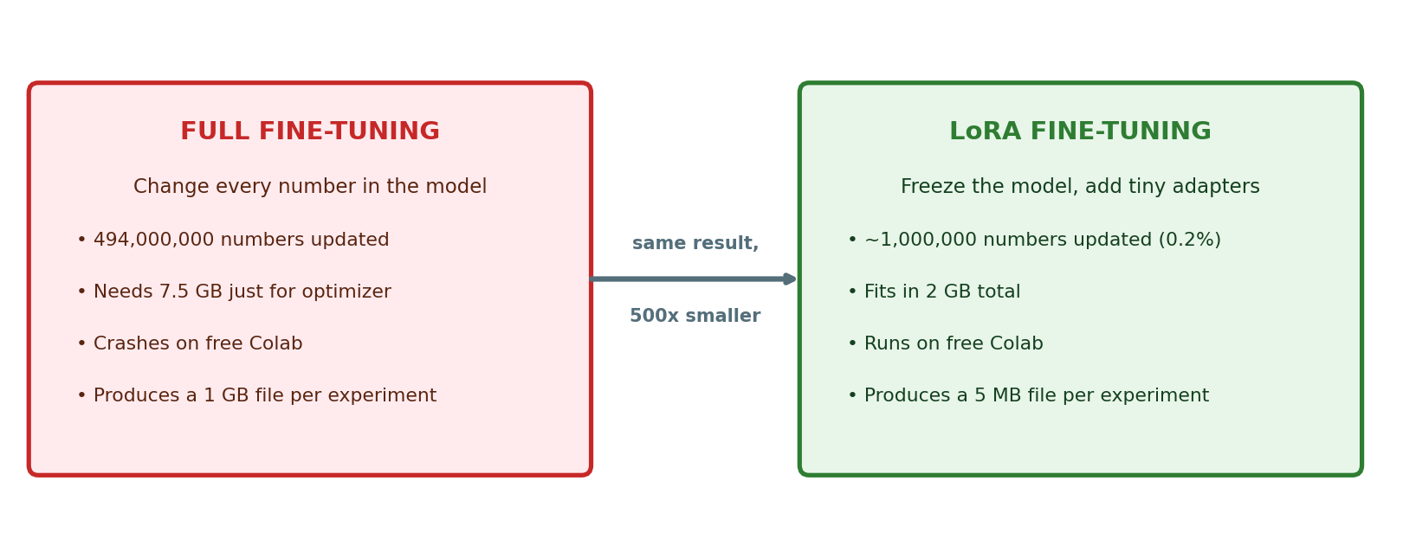
SESSION 3 · THE TRICK
LoRA in One Picture
The number that matters: your fine-tuned result is a 5 MB file, not a 1 GB file. You can email it, or keep fifty of them.

Slide 5



SESSION 3 · CONFIGURATION
The Three Settings You Will Touch
r (rank) = 16
lora_alpha = 32
target_modules
How much capacity the adapter has. Higher learns more but uses more memory. 8-32 is the normal range.
How strongly the adapter affects the model. A common rule is alpha = 2 x r.
Which parts of the model get adapters. q_proj and v_proj are the attention layers — the usual choice.
from peft import LoraConfig, get_peft_model, TaskType
config = LoraConfig(task_type=TaskType.CAUSAL_LM,
r=16, lora_alpha=32, lora_dropout=0.05,
target_modules=["q_proj","v_proj"])
model = get_peft_model(model, config)
model.print_trainable_parameters()
Expected output: trainable params: ~1,081,344 | all params: ~495,114,240 | trainable%: 0.22

Slide 6

SESSION 3 · HANDS-ON (20 MIN)
Lab 3A: Attach the Adapters
1
Run the LoRA config cell from the previous slide
2
Read the printed trainable-parameter count out loud — about 1 million out of 495 million
3
Check GPU memory again: still around 1-2 GB, not 8 GB
4
Understand what just happened: the big model is frozen, only the adapters will learn
This is the moment the impossible became possible. Full fine-tuning would need 8 GB of optimizer state alone. You are about to train a model on a free GPU with room to spare.

Slide 7
SESSION 3 · HANDS-ON (40 MIN)
Lab 3B: Train It
from transformers import TrainingArguments, Trainer
args = TrainingArguments(
output_dir="./qwen-amharic-lora",
num_train_epochs=1,
per_device_train_batch_size=4,
gradient_accumulation_steps=2,
learning_rate=2e-4,
fp16=True,
logging_steps=10,
save_strategy="no",
report_to="none")
trainer = Trainer(model=model, args=args,
train_dataset=train_ds,
data_collator=collator)
trainer.train()
While it runs (~10 min)
Watch the loss column. It should FALL.
Typical: starts ~2.5, ends ~1.5
Falling = learning
Flat = learning rate too low, or data is broken
Jumping wildly = learning rate too high
Do NOT close the tab or Colab disconnects
Why only 1,000 examples and 1 epoch? So it finishes inside the lesson. Real projects use all 83,000 and run for hours — same code, more patience.

Slide 8

SESSION 3 · HANDS-ON (10 MIN)
Lab 3C: Save the Adapter
model.save_pretrained("./qwen-amharic-lora")
tok.save_pretrained("./qwen-amharic-lora")
# How big is what you just made?
!du -sh ./qwen-amharic-lora
!ls -la ./qwen-amharic-lora
A few megabytes. The full model is over 900 MB — but your adapter holds everything you taught it. Keep the base model once, and one small adapter per task.
Download it before you leave. Colab deletes everything when the session ends. Right-click the folder in the file panel -> Download.

Slide 9

SESSION 3 · CHECKPOINT
Before the Break
I can explain LoRA in my own words
I attached adapters and saw ~0.2% trainable parameters
GPU memory stayed low — no OOM
My training run started and the loss went DOWN
Training finished without crashing
I saved the adapter and checked how small it is
If your loss did not fall, tell the trainer now — Session 4 compares against it.

Slide 10
SESSION 3 — THREE IDEAS TO CARRY FORWARD
1
Freeze most, train little
LoRA trains 0.2% of the parameters and gets most of the benefit. This is why fine-tuning is affordable.
2
Loss falling means learning
It is the single number to watch. Flat or exploding loss tells you something is wrong before you waste an hour.
3
An adapter is 5 MB
One base model plus many tiny adapters — one per language, per task, per customer. That is how real teams ship.
Next — Session 4 (15:30): The moment of truth. Same questions, same model, before and after — and an honest look at when NOT to fine-tune.

