Slide 1

DAY 5 · WORKING WITH APIs · SESSION 1 · 09:00 – 10:30
What Is an API — and Your First Call
Yesterday you ran a model on your own GPU. Today you borrow somebody else's — a far bigger one — for free, in five minutes.
Ethiopian Defense University · Day 5 of 5 · 1.5 hours · Google Colab

Slide 2


SESSION 1 · OBJECTIVES
What This Session Covers — and What You Walk Away With
We will cover
You will be able to
What an API actually is, in plain language
Why you would rent a model instead of running your own
How to get a free Gemini API key with no credit card
How to keep that key secret — the most important habit today
Making your first successful API call
Explain an API to somebody who has never programmed
Create your own API key from Google AI Studio
Store it safely using Colab Secrets, never in your code
Send a prompt and get a real answer back
Decide when an API beats a self-hosted model, and when it does not

Slide 3





SESSION 1 · VOCABULARY
Six Words for Today
API
API key
Endpoint
Application Programming Interface. A way for your code to ask somebody else's program to do something.
Your password to that service. It identifies you and bills you. Treat it like a bank PIN.
The web address your request goes to. For Gemini it is a Google server.
SDK
Token
Rate limit
A library that hides the messy HTTP details so calling AI looks like calling a normal function.
A chunk of text, as on Day 4. APIs charge and rate-limit by tokens, not by words.
How many requests you may send per minute and per day. Free tiers have strict ones.

Slide 4
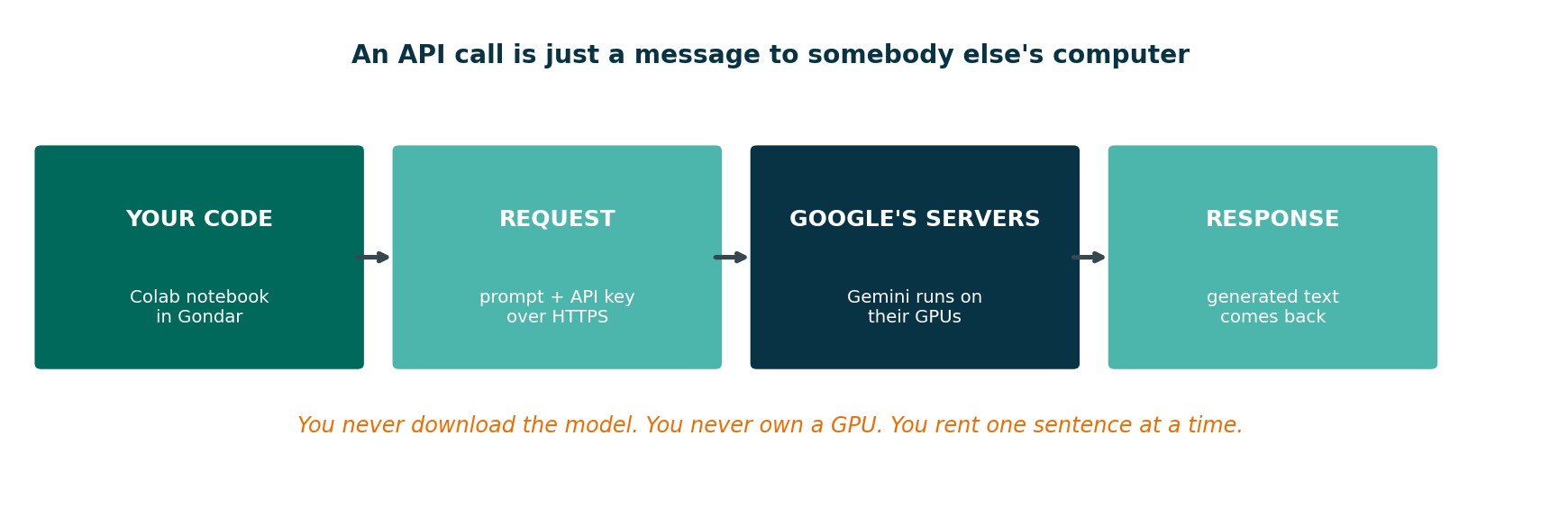
SESSION 1 · THE IDEA
What Actually Happens When You Call an API
Nothing is installed on your machine. Your laptop sends a sentence and receives a sentence. All the computing happens in a Google data centre.

Slide 5
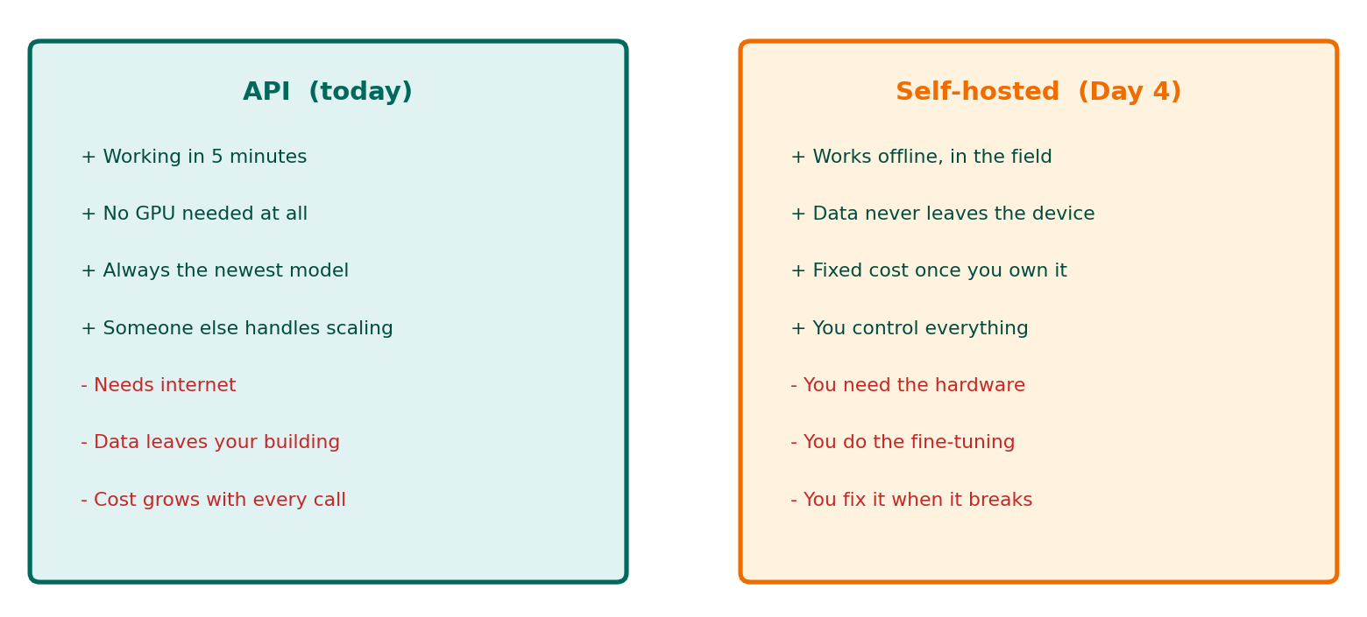
SESSION 1 · TWO WAYS TO GET AI
Yesterday vs Today
Neither is the winner. A serious organisation uses both — API for reach and capability, self-hosted for offline, private and cheap-at-scale.

Slide 6
SESSION 1 · HANDS-ON (20 MIN)
Lab 1A: Get Your Free API Key
1
Go to aistudio.google.com/apikey and sign in with any Google account
2
Click Create API key (no credit card is asked for)
3
Choose or create a project when prompted
4
COPY the key. It looks like AIzaSy... and is shown clearly only once
5
Paste it somewhere private for the next five minutes — not in a chat group
Free tier, no card required. Limits and model names change often — the current numbers are always at ai.google.dev/gemini-api/docs/rate-limits
If your account cannot create a key, pair with a classmate. One key is enough for two people today.

Slide 7
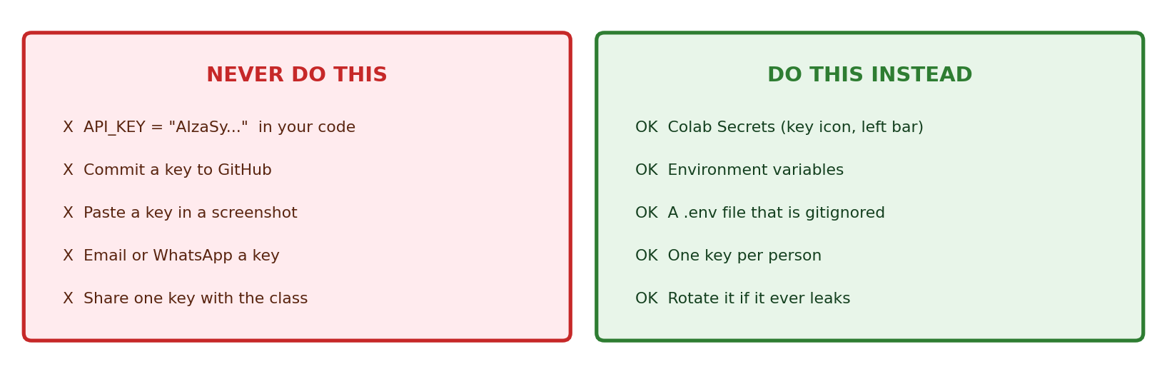

SESSION 1 · SECURITY
Your Key Is a Password. Treat It Like One.
People scan GitHub for leaked API keys automatically, within minutes of a commit. A leaked key gets used by strangers — and if billing is enabled, you pay for it.

Slide 8
SESSION 1 · HANDS-ON (15 MIN)
Lab 1B: Store the Key Safely in Colab
1
In Colab, click the key icon in the left sidebar (Secrets)
from google.colab import userdata
import os
os.environ["GEMINI_API_KEY"] = \
userdata.get("GEMINI_API_KEY")
print("key loaded:",
len(os.environ["GEMINI_API_KEY"]), "chars")
2
Click Add new secret
3
Name: GEMINI_API_KEY — spelled exactly like that
4
Value: paste your key
Turn ON Notebook access for this notebook
The key now lives in Colab's secret store, not in your notebook — so you can share the notebook safely.
5
Golden rule: if a key appears anywhere in a cell you can read, it is in the wrong place.

Slide 9
SESSION 1 · HANDS-ON (25 MIN)
Lab 1C: Your First API Call
!pip install -q -U google-genai
from google import genai
client = genai.Client() # reads GEMINI_API_KEY automatically
response = client.models.generate_content(
model="gemini-3.5-flash",
contents="Explain what an API is, in two sentences, for a beginner."
)
print(response.text)
Three lines that matter
Client — who you are
model — which brain to use
contents — what you are asking
response.text — the answer
That is the whole thing. No GPU, no download, no 13 GB model. You just used a system far larger than anything that fits on a T4.
Model names change. The notebook includes a cell that LISTS the models your key can actually use.

Slide 10

SESSION 1 · CHECKPOINT
Before the Break
I created a Gemini API key at aistudio.google.com/apikey
I stored it in Colab Secrets, NOT in a code cell
I loaded it with userdata.get()
I installed google-genai and created a Client
I sent a prompt and printed a real answer
I can explain why a key must never go into GitHub
If your key is visible anywhere in your notebook, fix that now before we go further.

Slide 11
SESSION 1 — THREE IDEAS TO CARRY FORWARD
1
An API is renting, not owning
You send a sentence, you get a sentence. Someone else buys the GPUs and keeps the model updated.
2
The key IS the account
Anyone holding it can spend on your behalf. Secrets store, never source code, never a screenshot.
3
Five minutes to working AI
Yesterday took a day to fine-tune 0.5B. Today you reached a far larger model before the first break.
Next — Session 2 (10:45): Controlling the model: system instructions, streaming, multi-turn chat, JSON output, and staying inside the free quota.

