Slide 1
Closest Two Points in the Plane: An approach using randomization

Slide 2
The problem:
Given a set of n points in the in the plane, what two points are closest together?
Different solutions to problem:
Brute-force with double for-loop -> O(n^2)
Divide-and-Conquer -> O(n*logn)
Using randomization -> O(n)

Slide 3
Outline of the algorithm and why it works
We have a set of n points, and we consider them in random order
As we process the points in this order, we maintain a value δ for the closest pair found so far
As the next point p is considered, we may or may not find a new closest pair, involving p. As we consider p:
- let δ be the closest distance of any pair of points considered before p
- to see if p forms a new closest pairing with another point, we have to see if there is a point within a radius of δ of p
The crux of the algorthim

Slide 4
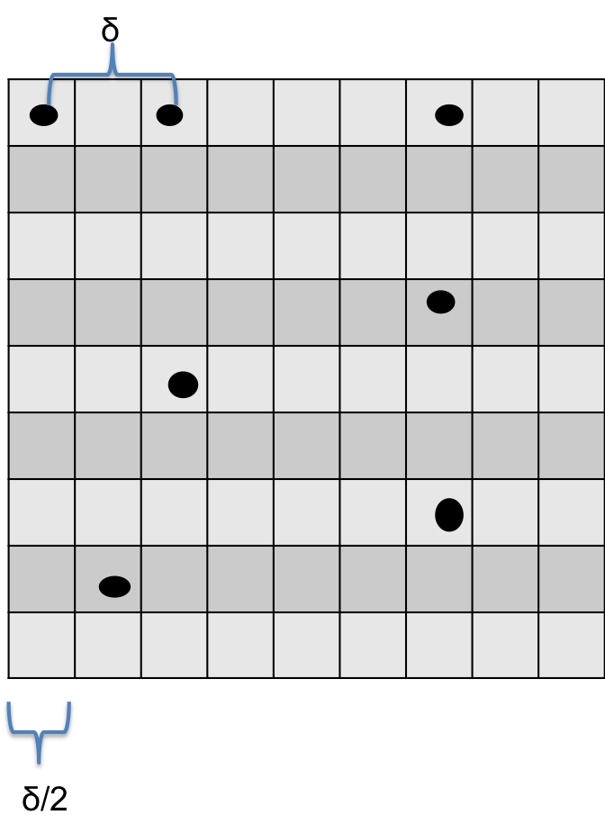
P1
P3
P2
Points
not yet considered
P7
P4
P5
P6
If for two points p, q ∈ P we have d(p, q) < δ, then the subsquares containing them are close.

Slide 5
Outline of the algorithm and why it works
We have a set of n points, and we consider them one at a time in random order
As we process the points in this order, we maintain a value δ for the closest pair found so far
As the next point p is considered, we may or may not find a new closest pair, involving p. As we consider p:
- let δ be the closest distance of any pair of points considered before p
- to see if p forms a new closest pairing with another point, we have to see if there is a point within a radius of δ of p
We maintain a dictionairy datastructure, mapping each subsquare to the point it contains, or to None
Note that every time a new closest pair is found, the dictionairy has to be re-constructed to account for a new value of δ
The crux of the algorthim

Slide 6
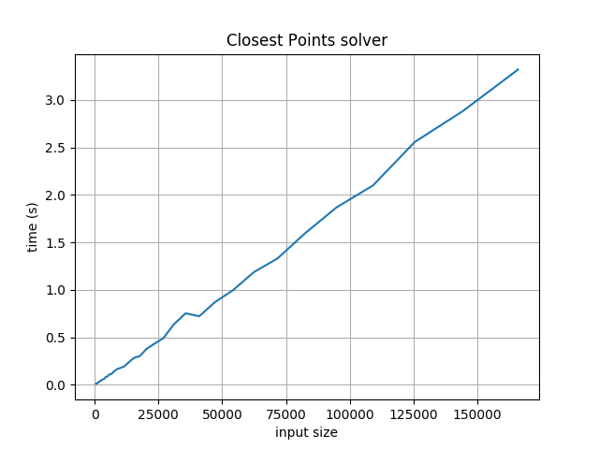
How does the algorthim achieve O(n) running time?

Slide 7
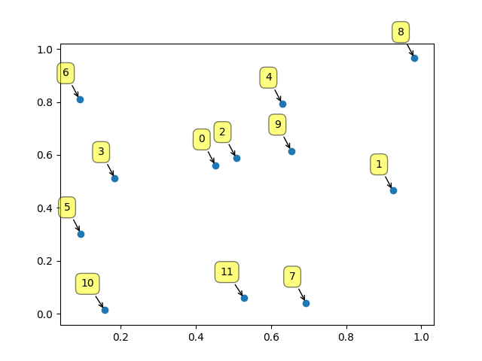
1. Randomize input elements

Slide 8
δ
δ/2

