Slide 1



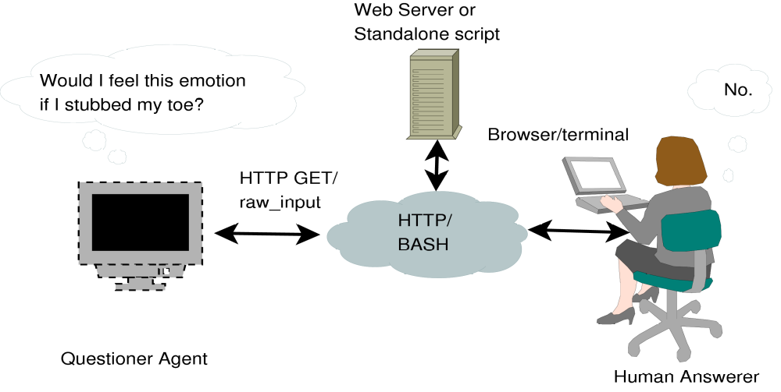
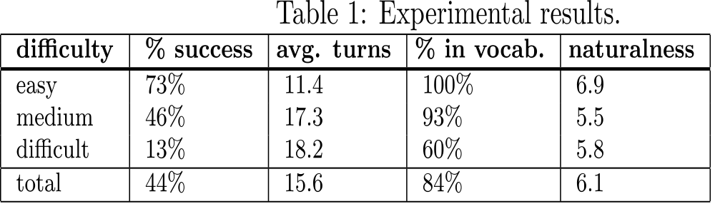
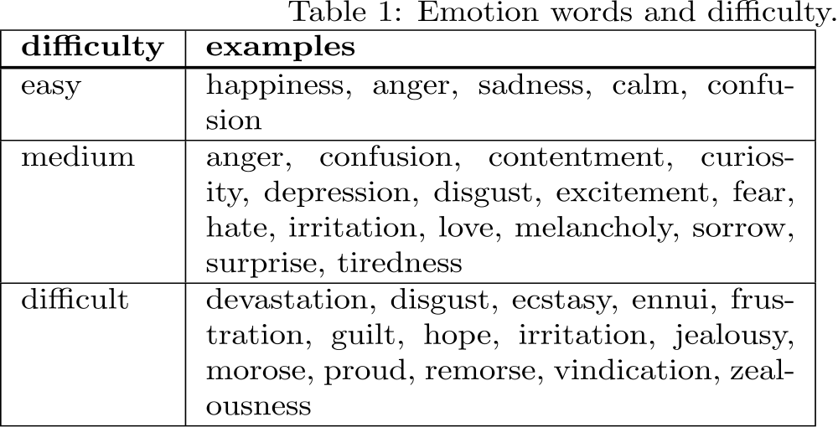
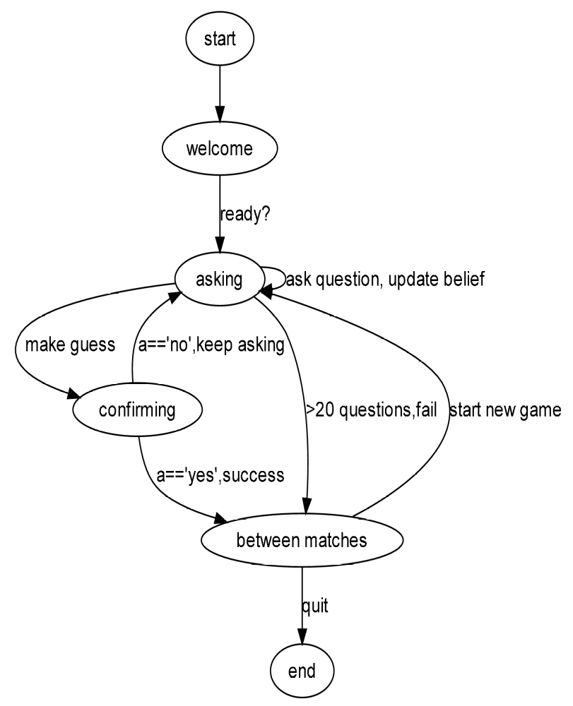
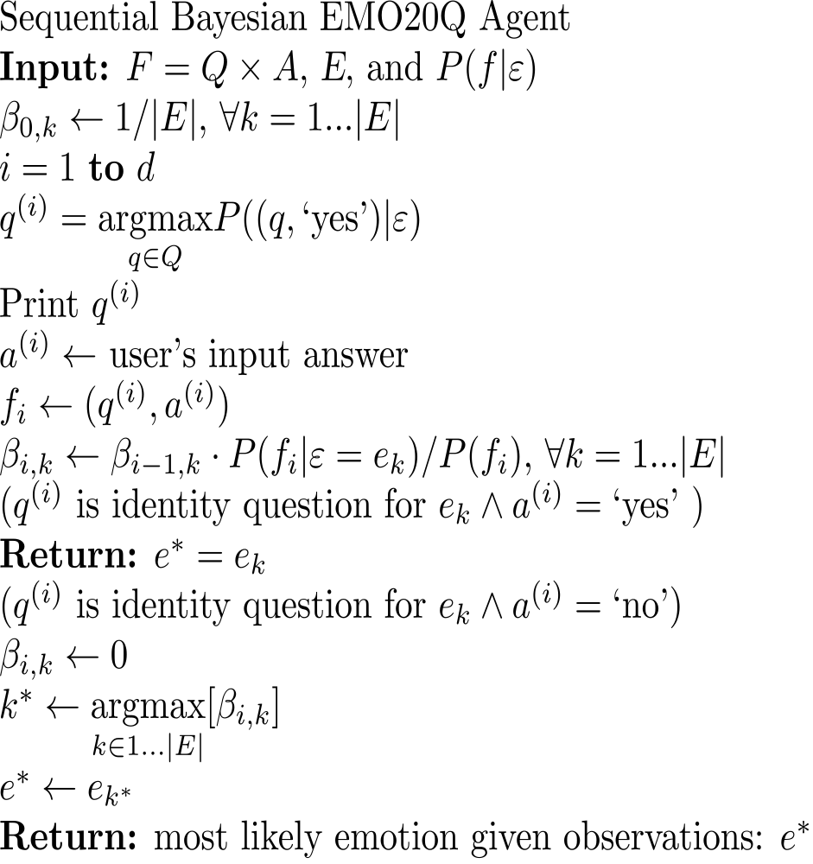
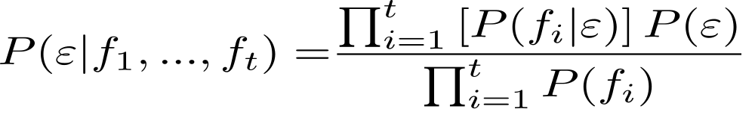
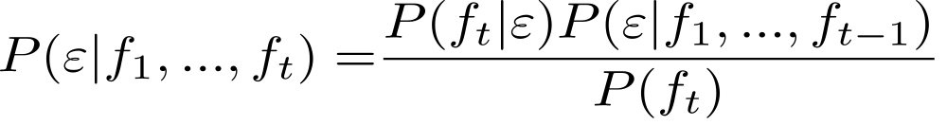
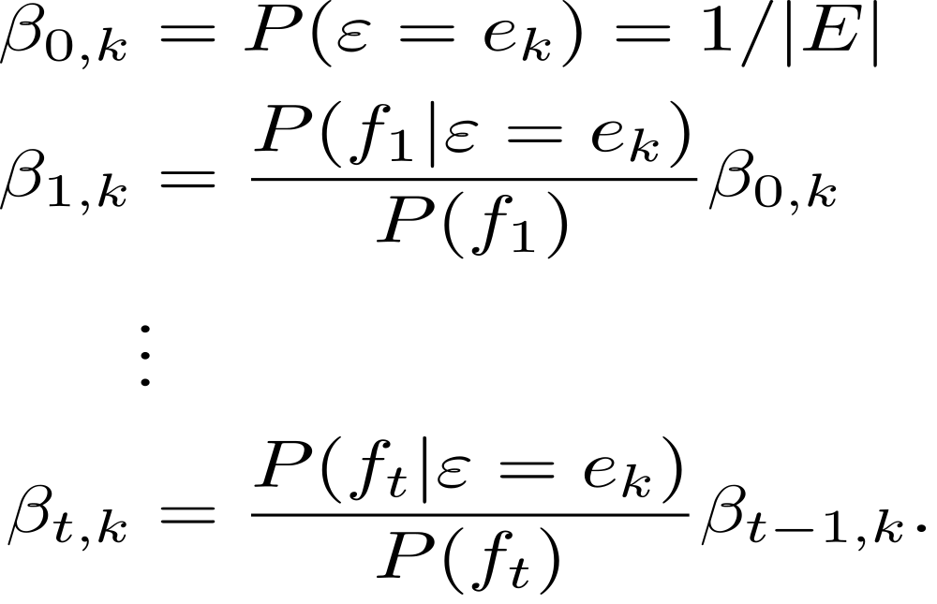
A Sequential Bayes Dialog Agent
For Computational Ethnography
Research from Sail Lab by:
Abe Kazemzadeh • James Gibson
Juanchen Li • Sunbbok Lee
Panayiotis Georgiou • Shrikanth Narayanan
The EMO20Q Dialog Game Scenario
Goals and Motivation
Collect ethnographic data about natural language description of emotion using an emotion twenty questions (EMO20Q) dialog agent.
Model emotion description as a game-based social process.
Robustly and naturally interact with speakers to acquire information about language usage and folk theories of emotion.
Design an automated agent whose algorithm models a human interlocutor.
Account for interpersonal similarities and differences in emotion description.
Results
15 subjects x 3 EMO20Q matches.
C.f. 85% human-human performance.
Naturalness was relatively constant → algorithm/model is good but needs more data.
People do not agree on a strict ordering, but difficulty was useful for elicitation.
Dialog State Machine
Algorithm
Sequential Bayes Model
Naive Bayes
Sequential Bayes
Or, iteratively
Acknowledgments
We would like to thank the players of EMO20Q, and also Nassos Katsamanis, Jeremy Chi-Chun Lee, Ben Alderson-Day, the anonymous reviewers, and Carbon 5 Hack Night.
This work was supported by the NSF and DARPA.

