Slide 1
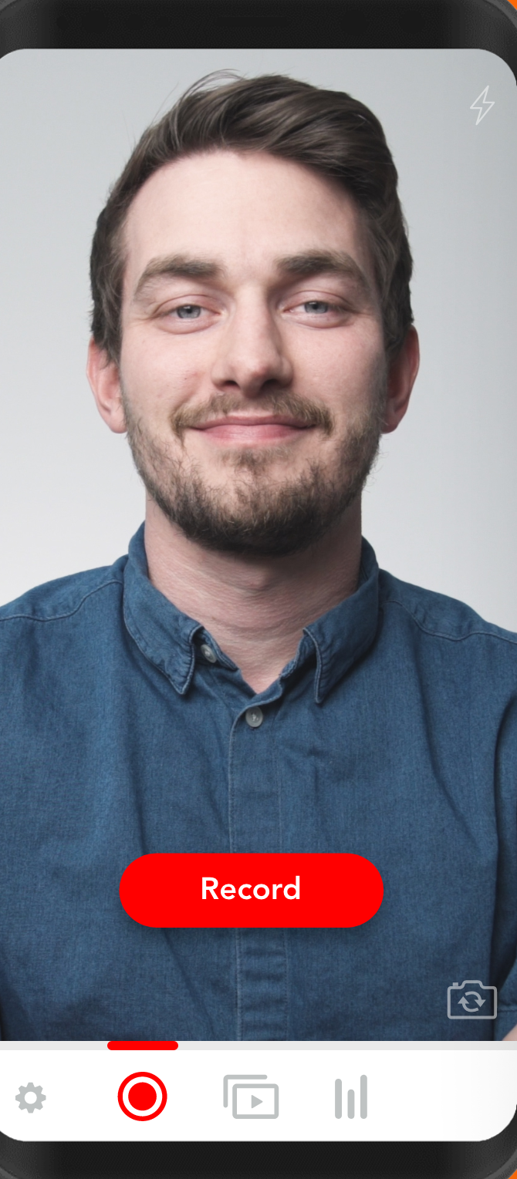
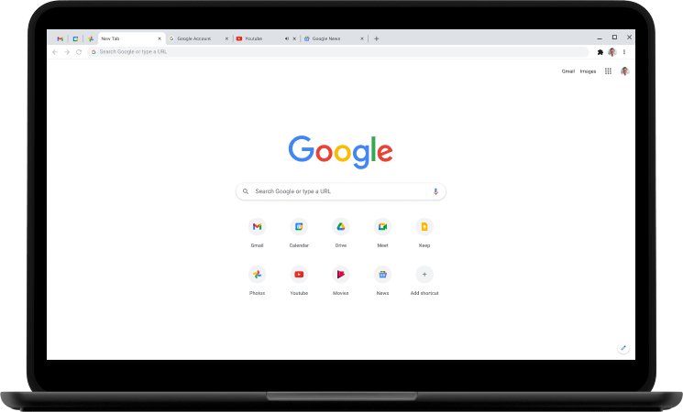
InstaHMS
1- Schedule Appointment
Mobile Server
2- Notify Doctor
4- Notify Client
3- Start Appointemnt
5- Accept Call
Doctor
Client
Conference Server

