Slide 1

Image Classification Model Comparison
This presentation compares the performance of ResNet50 and a Convolutional Neural Network (CNN) for image classification on the CIFAR-10 dataset.

Slide 2
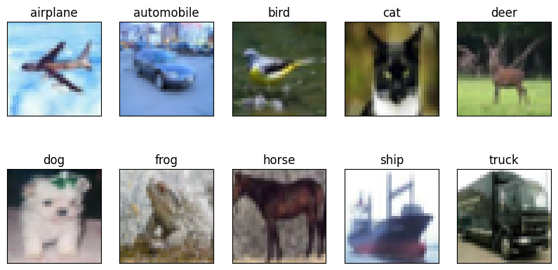
Project Objective
Goal
Dataset
Compare the performance of ResNet50 and a CNN for image classification on the CIFAR-10 dataset.
The CIFAR-10 dataset includes ten distinct categories, encompassing a variety of images such as birds, cars, dogs, and more.

Slide 3
Data Preprocessing
Normalization
One-Hot Encoding
Pixel values are adjusted to fall within a using Standardization Normalization or min-max.
Categorical labels are converted into a binary vector format suitable for deep learning models.
Data Augmentation
Random transformations are applied to images to increase the diversity of training data and reduce overfitting.

Slide 4
Data Augmentation Techniques
1
Random Rotation
2
Width and Height Shift
Rotating images within a range of 5 degrees.
Translating images horizontally or vertically.
3
Shearing
4
Zooming
Applying geometric transformations to alter the angles.
Scaling images up or down.
5
Horizontal Flipping
6
Fill Mode
Mirroring images horizontally.
Filling empty spaces created during transformations.

Slide 5
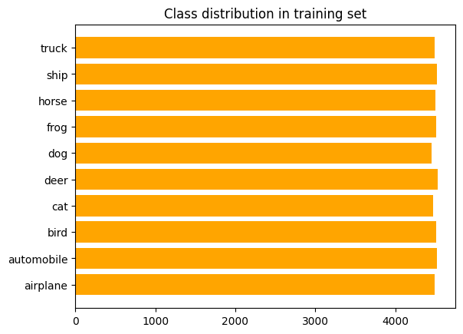
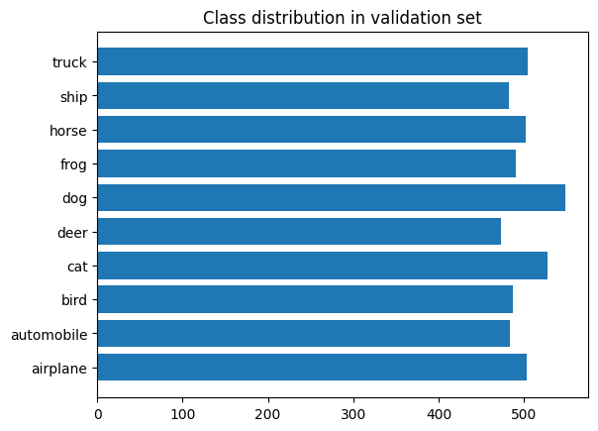
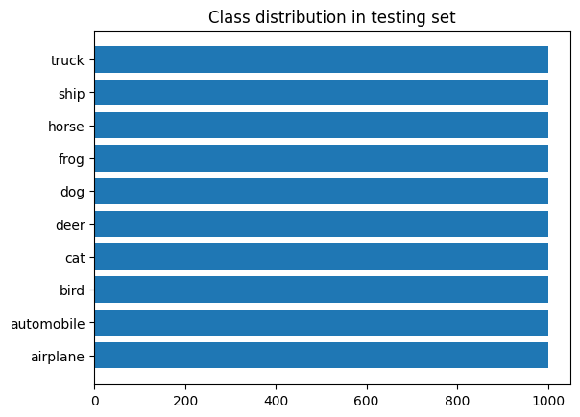
Train Images Shape: (45000, 32, 32, 3)
Test Images Shape: (10000,32,32, 3)
Validation Images Shape: (5000, 32,23,3)

Slide 6
Model Architectures
ResNet50
Custom CNN
A pretrained model adapted for CIFAR-10 by replacing its final layers for 10-class classification.
A simpler, custom-designed model with convolutional layers, Batch Normalization, and Dropout, processing images in their native 32x32 resolution.

Slide 7
Custom CNN Architectures
1- Convolutional Layers (Conv2D):
First and second layers (Conv2D): The model begins with 32 filters for each convolutional layer, using a 3x3 kernel and ReLU activation to learn patterns from the input images.
Subsequent layers (Conv2D): The number of filters increases progressively—64 filters in the third and fourth layers, 128 filters in the fifth and sixth, and 256 filters in the seventh and eighth. This gradual increase in filters allows the model to learn more complex features as the network deepens.
2- Batch Normalization:
BatchNormalization layers are added after each convolutional layer. These layers help stabilize training by normalizing the output of previous layers and reducing the internal covariate shift, which speeds up training and helps in achieving better performance.
3- Max Pooling Layers:
MaxPooling2D layers are used to reduce the spatial dimensions of the images progressively. Each pooling layer uses a 2x2 window to downsample the image while retaining the most significant features.
The pooling layers are followed by increasing the dropout rate to help with regularization and reduce overfitting.

Slide 8
4- Dropout Layers:
Dropout layers are used to reduce overfitting by randomly setting a fraction of input units to zero during training. This forces the network to generalize better.
The dropout rate increases gradually from 0.2 to 0.5 as the depth of the model increases to prevent overfitting in deeper layers.
5- Flatten Layer:
After passing through the convolutional and pooling layers, the output tensor is flattened using the Flatten layer. This converts the multidimensional output into a one-dimensional vector suitable for input into fully connected layers.
6- Fully Connected Layer (Dense):
The model ends with a Dense layer of 10 units with a softmax activation function to output the class probabilities. The number 10 corresponds to the number of classes for the classification task, as softmax is used to predict probabilities for each class.

Slide 9
7- Regularization:
L2 Regularization: L2 regularization is applied to the convolutional layers to penalize large weights, helping to avoid overfitting by enforcing smaller weight values.
8- callbacks :
ReduceLROnPlateau: This callback reduces the learning rate if the validation loss doesn’t improve, allowing the model to fine-tune itself as it converges.
EarlyStopping: The training stops early if the validation loss does not improve after a set number of epochs (40 epochs in this case), preserving the best weights and preventing overfitting.
ModelCheckpoint: This callback saves the best model weights during training based on the validation loss, ensuring the model with the best performance is retained.

Slide 10
ResNet50 Architecture
ResNet50 Backbone: Uses a pre-trained ResNet50 model without the top layers to leverage learned features.
Fine-tuning: Freezes the last 7 layers of the base model to retain learned features while training only the custom classification layers.
Custom Layers: Adds fully connected layers, and pooling layers tailored for CIFAR-10 classification.
Callbacks: Uses EarlyStopping, ModelCheckpoint, and ReduceLROnPlateau for better model training and to avoid overfitting.

Slide 11
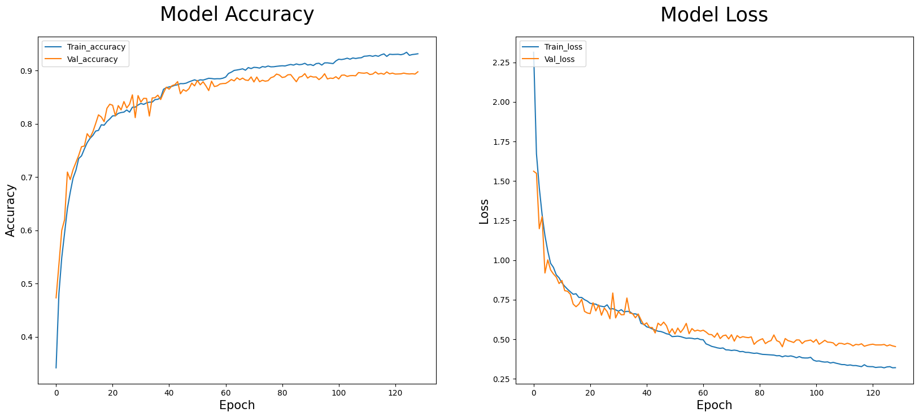
Plotting the Model Accuracy & Model Loss vs Epochs(CNN)

Slide 12
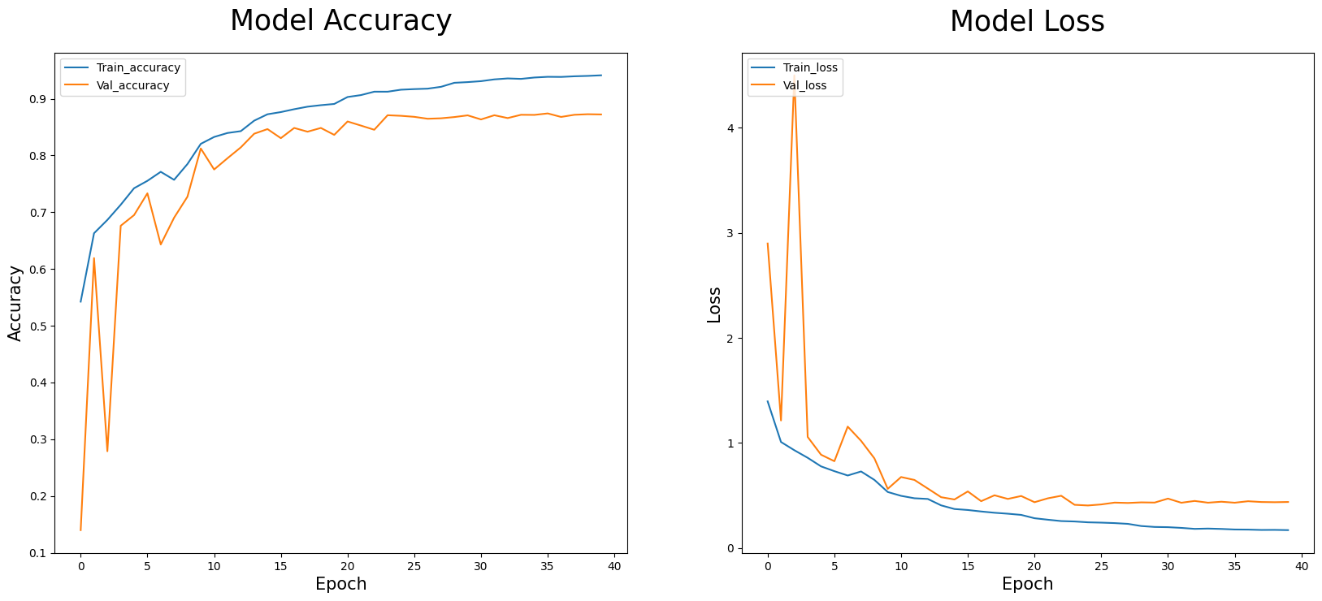
Plotting the Model Accuracy & Model Loss vs Epochs(ResNet50)

Slide 13
Evaluating the Performance
86%
90%
Overall Accuracy
CNN Accuracy
ResNet50 achieved an accuracy of 86% on the test dataset.
The CNN model achieved an accuracy of 90% on the test dataset.

Slide 14
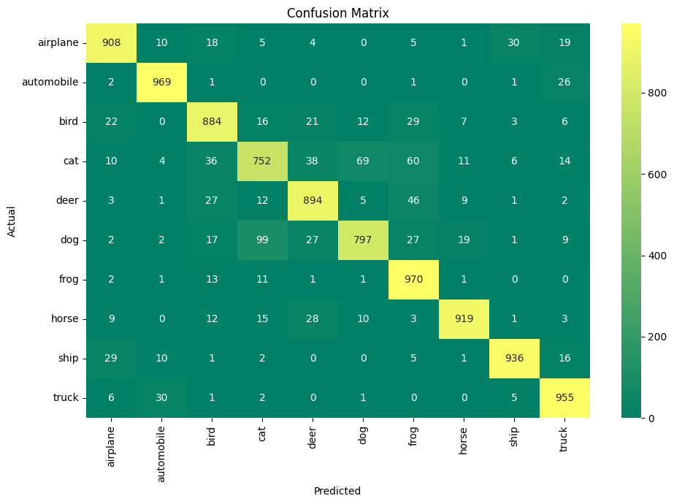
Confusion Matrix for CNN Model
Mistakes Between Similar Categories: There are some misclassifications between categories with similar visual features, such as "cat" vs. "dog".
Excellent Performance on Specific Categories: Certain categories, like "frog" and “automobile," are classified with very high accuracy, showcasing the model's strong ability to distinguish these classes effectively.

Slide 15

Confusion Matrix for RestNet50:
Categories with distinct visual features, such as "automobile" and “frog," exhibit high precision and recall.
Misclassifications are more frequent in visually similar categories, such as "cat" and "dog."

Slide 16
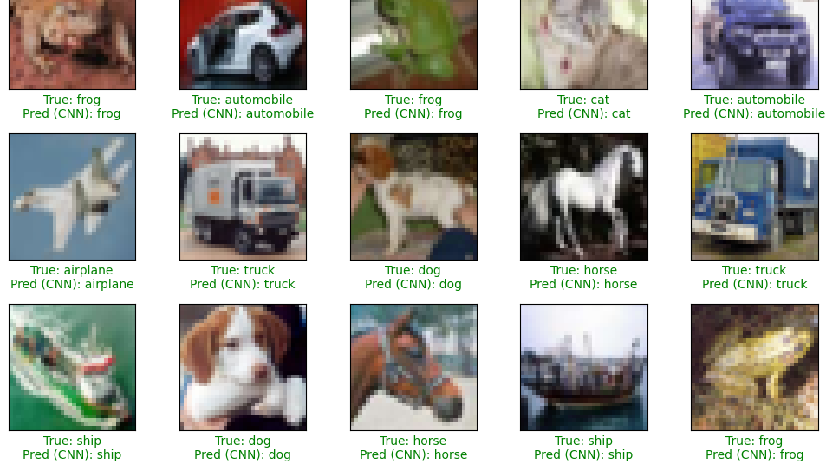
Display Sample Predictions

