Slide 1
All Pair Shortest Path
Efficient solution of

Slide 2
Group Members
Abeda Sultana Khanam
ID: 2016-1-60-011
Shakil Mahmud
ID: 2016-1-60-007
Amit Khan
ID: 2016-1-60-012

Slide 3
Overview
History
Introduction to Johnson Algorithms
Advantages
Steps of Johnson Algorithms
Graphical example
Pseudocode
Complexity analysis
Application
Conclusion.

Slide 4
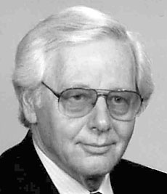
History of Johnson’s Algorithm
Donald Bruce Johnson (born December 16, 1933)(died 1994) was an American computer scientist, a researcher in the design and analysis of algorithms, and the founding chair of the computer science department at Dartmouth College. He invented the Johnson’s Algorithm and published it first in 1977.

Slide 5
Introduction to Johnson’s Algorithm
Johnson's algorithm is a shortest path algorithm that deals with the all pairs shortest path problem. The all pairs shortest path problem takes in a graph with vertices and edges, and it outputs the shortest path between every pair of vertices in that graph. Johnson's algorithm is very similar to the Floyd-Warshall algorithm; however, Floyd-Warshall is most effective for dense graphs (many edges), while Johnson's algorithm is most effective for sparse graphs (few edges).
The reason that Johnson's algorithm is better for sparse graphs is that its time complexity depends on the number of edges in the graph, while Floyd-Warshall's does not. Johnson's algorithm runs in O(V²logV+VE). time. So, if the number of edges is small (i.e. the graph is sparse), it will run faster than the O(V³) runtime of Floyd-Warshall.

Slide 6
Advantages
Algorithm solves all pair shortest path, in directed graph.
It allow negative weight and make all negative weight into non-negative edge, to make Dijkstra’s algorithm applicable.
Johnson’s algorithm use both Dijkstra’s and Bellman Ford algorithm as a sub-ordinate.
Johnson’s algorithm uses the technique of reweighting.
Total time complexity is faster than Floyd-War shall algorithm.

Slide 7
Steps of Johnson’s Algorithm
Let the given graph be G. Add a new vertex s to the graph, add edges from new vertex to all vertices of G. Let the modified graph be G’.
Run Bellman-Ford algorithm on G’ with s as source. Let the distances calculated by Bellman-Ford be h[0], h[1], .. h[V-1]. If we find a negative weight cycle, then return. Note that the negative weight cycle cannot be created by new vertex s as there is no edge to s. All edges are from s.
Reweight the edges of original graph. For each edge (u, v), assign the new weight as “original weight + h[u] – h[v]”.
Remove the added vertex s and run Dijkstra’s algorithm for every vertex.

Slide 8
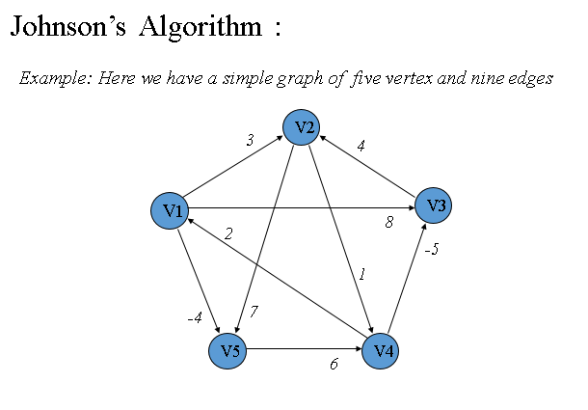
Graphical Example

Slide 9
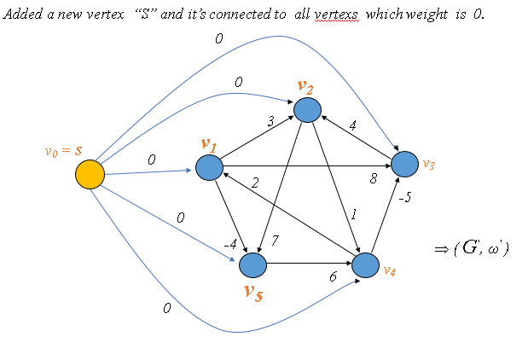

Slide 10

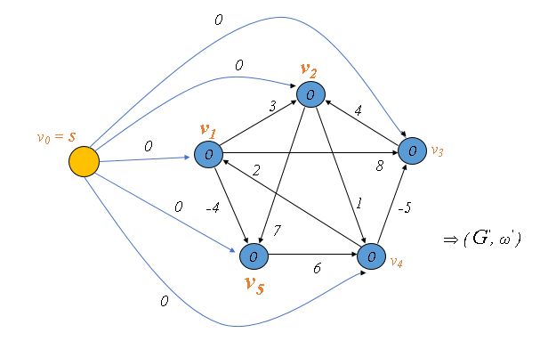

Slide 11
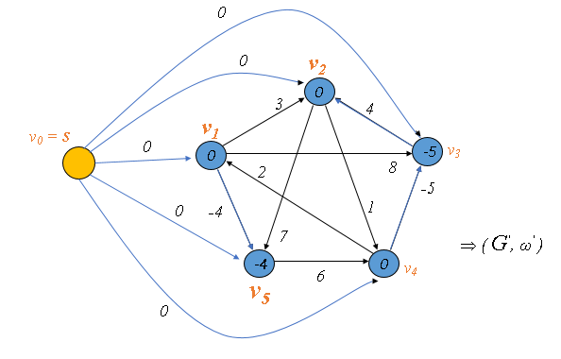

Slide 12

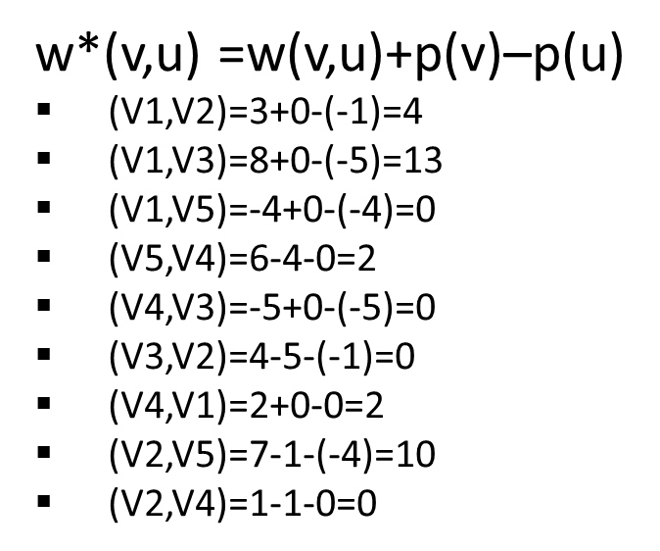
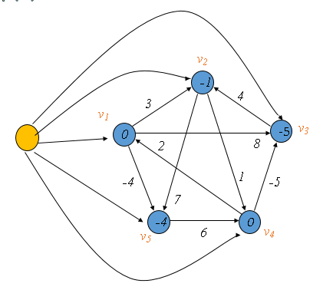

Slide 13
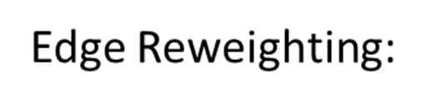
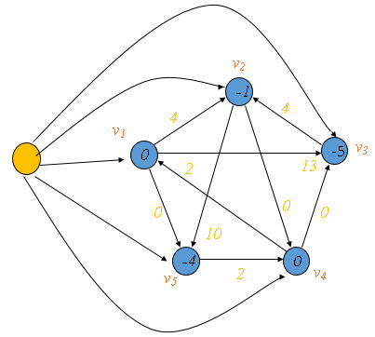

Slide 14
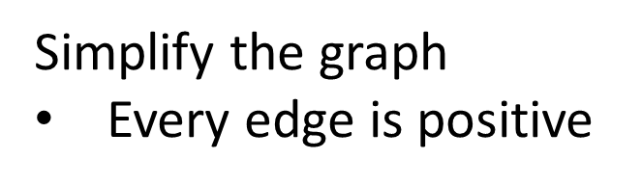
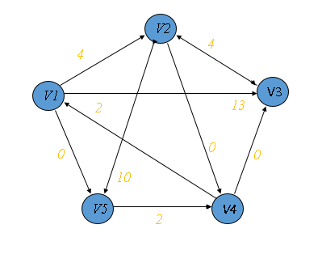

Slide 15
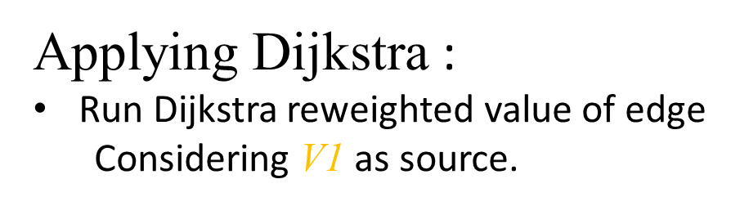
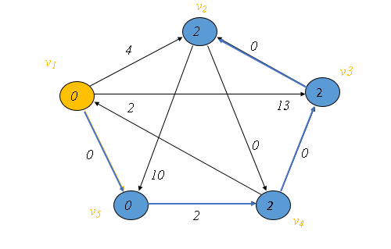

Slide 16
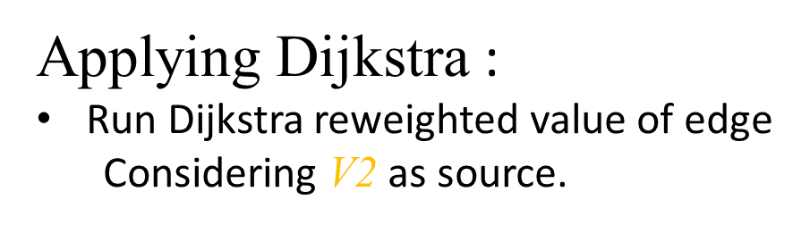
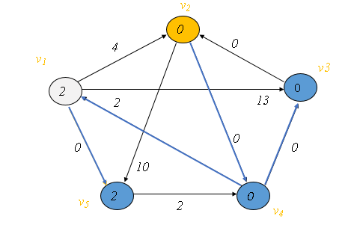

Slide 17

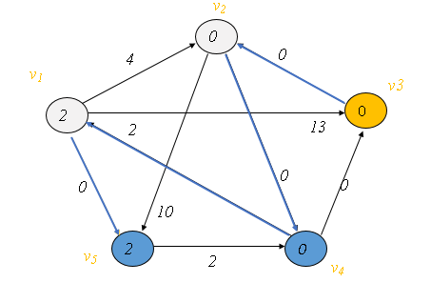

Slide 18

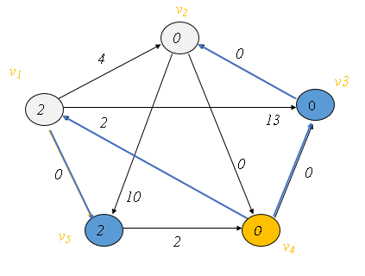

Slide 19

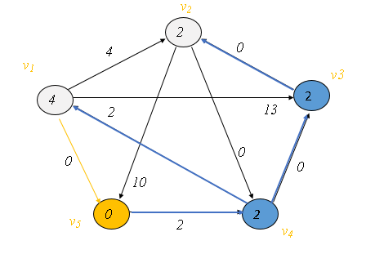

Slide 20
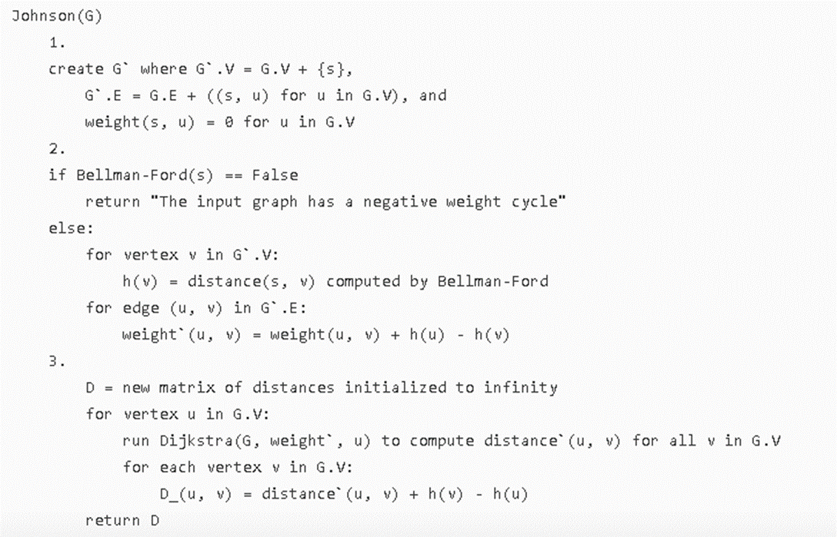
Pseudocode

Slide 21
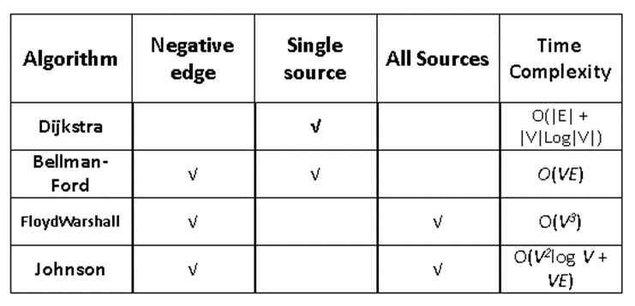
Complexity Analysis

Slide 22
Application
In networking we need to choose efficient paths for data to travel from point A to point B. We can use Johnson’s algorithm to find the shortest paths between nodes.
Action game developer use Johnson’s algorithm to find the nearest and easiest target.
Widest paths or Maximum Bandwidth paths
Computing canonical form of difference bound matrices (DBMs)
Computing the similarity between graphs

Slide 23
Conclusion
Johnson's algorithm is interesting because it uses two other shortest path algorithms as subroutines. It uses Bellman-Ford in order to reweight the input graph to eliminate negative edges and detect negative cycles. With this new, altered graph, it then uses Dijkstra's shortest path algorithm to calculate the shortest path between all pairs of vertices. The output of the algorithm is then the set of shortest paths in the original graph.

Slide 24


