Slide 1

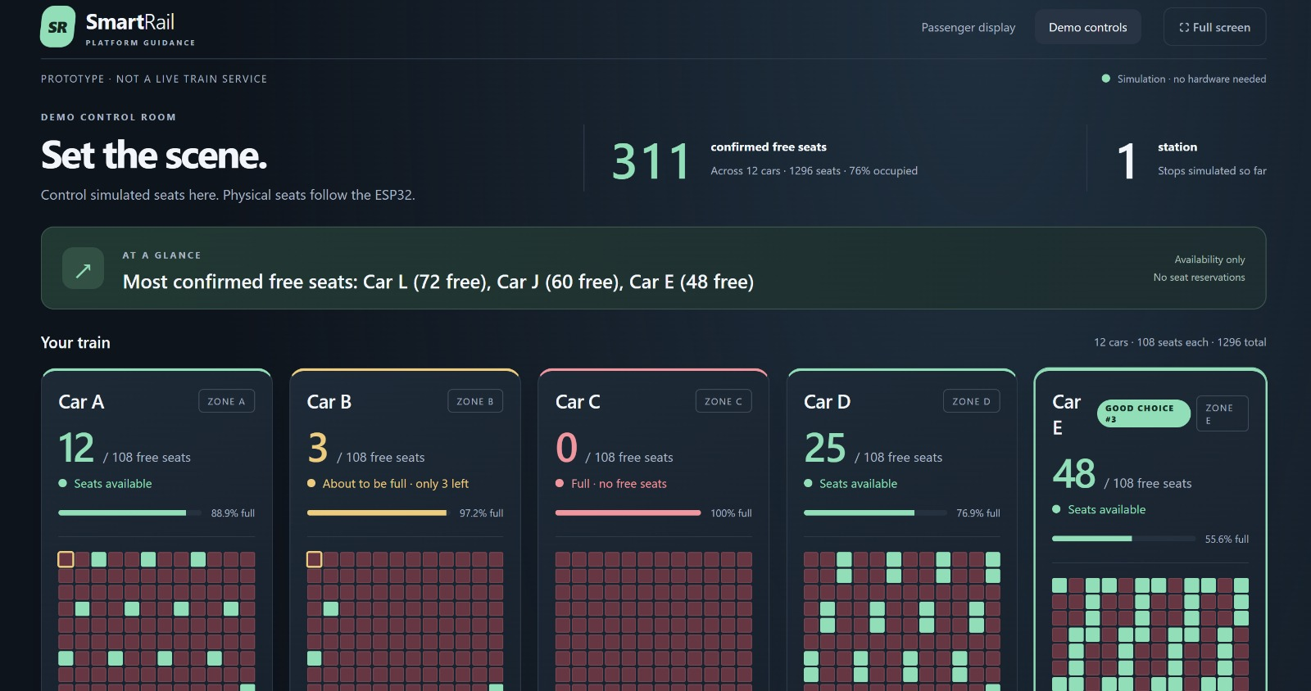
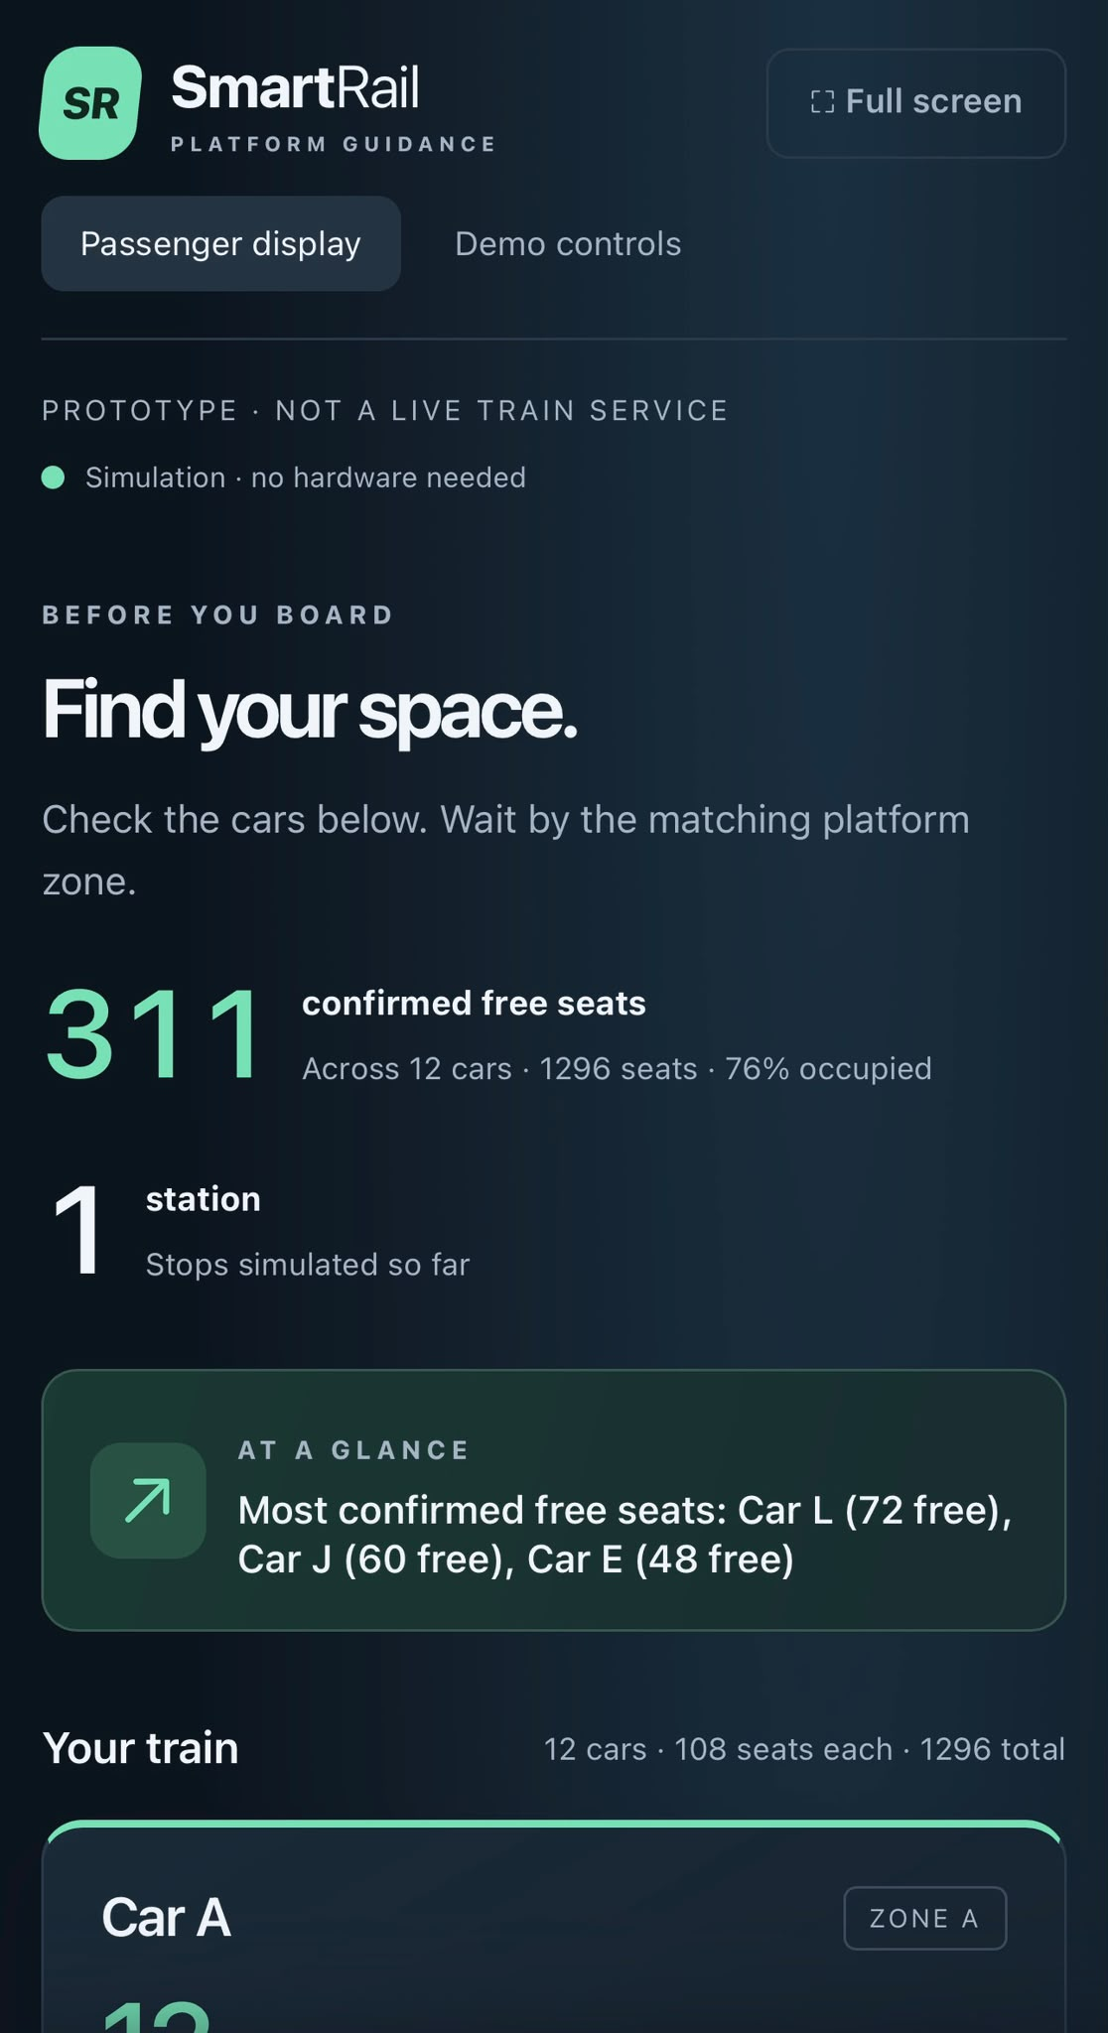
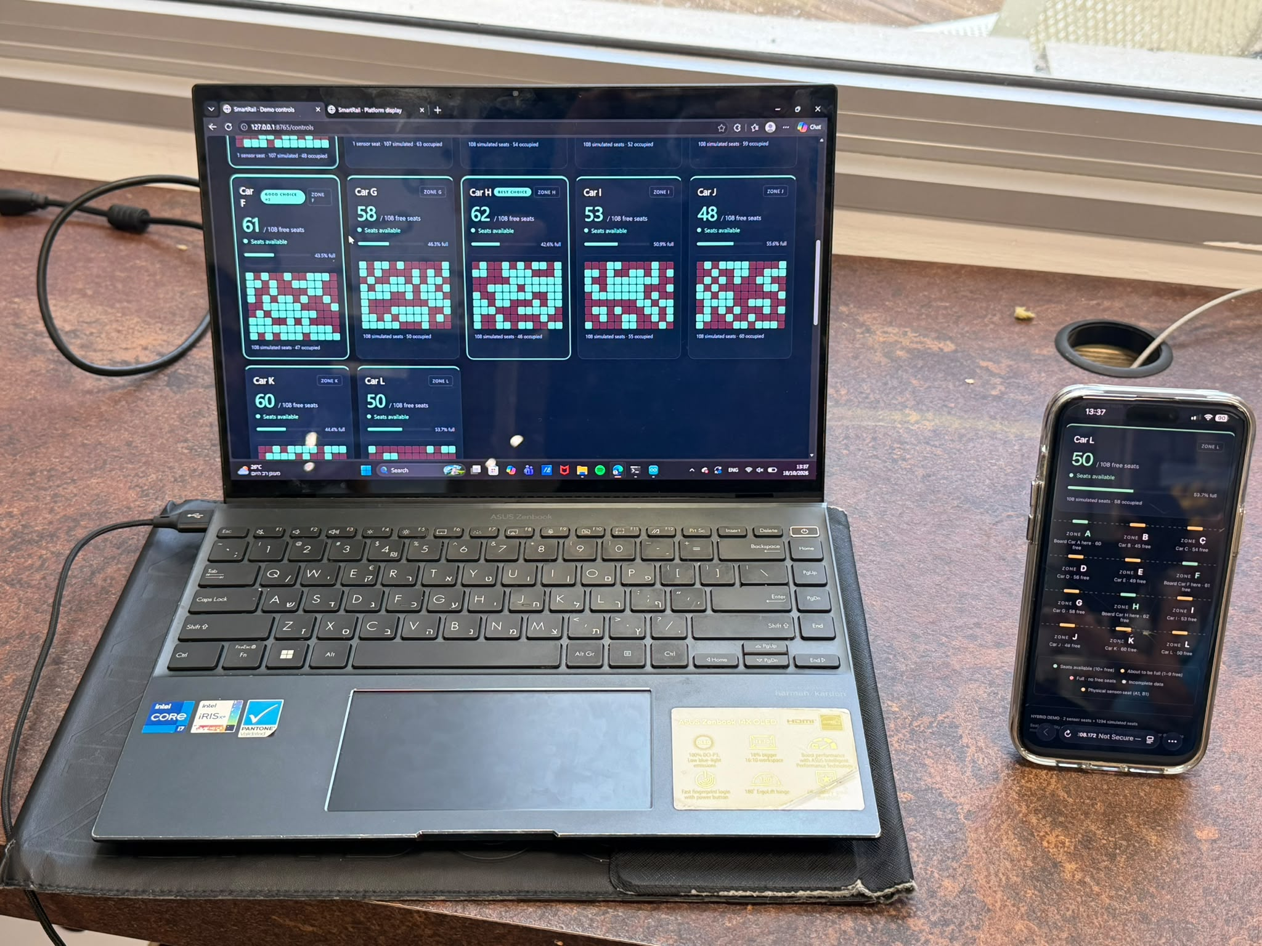
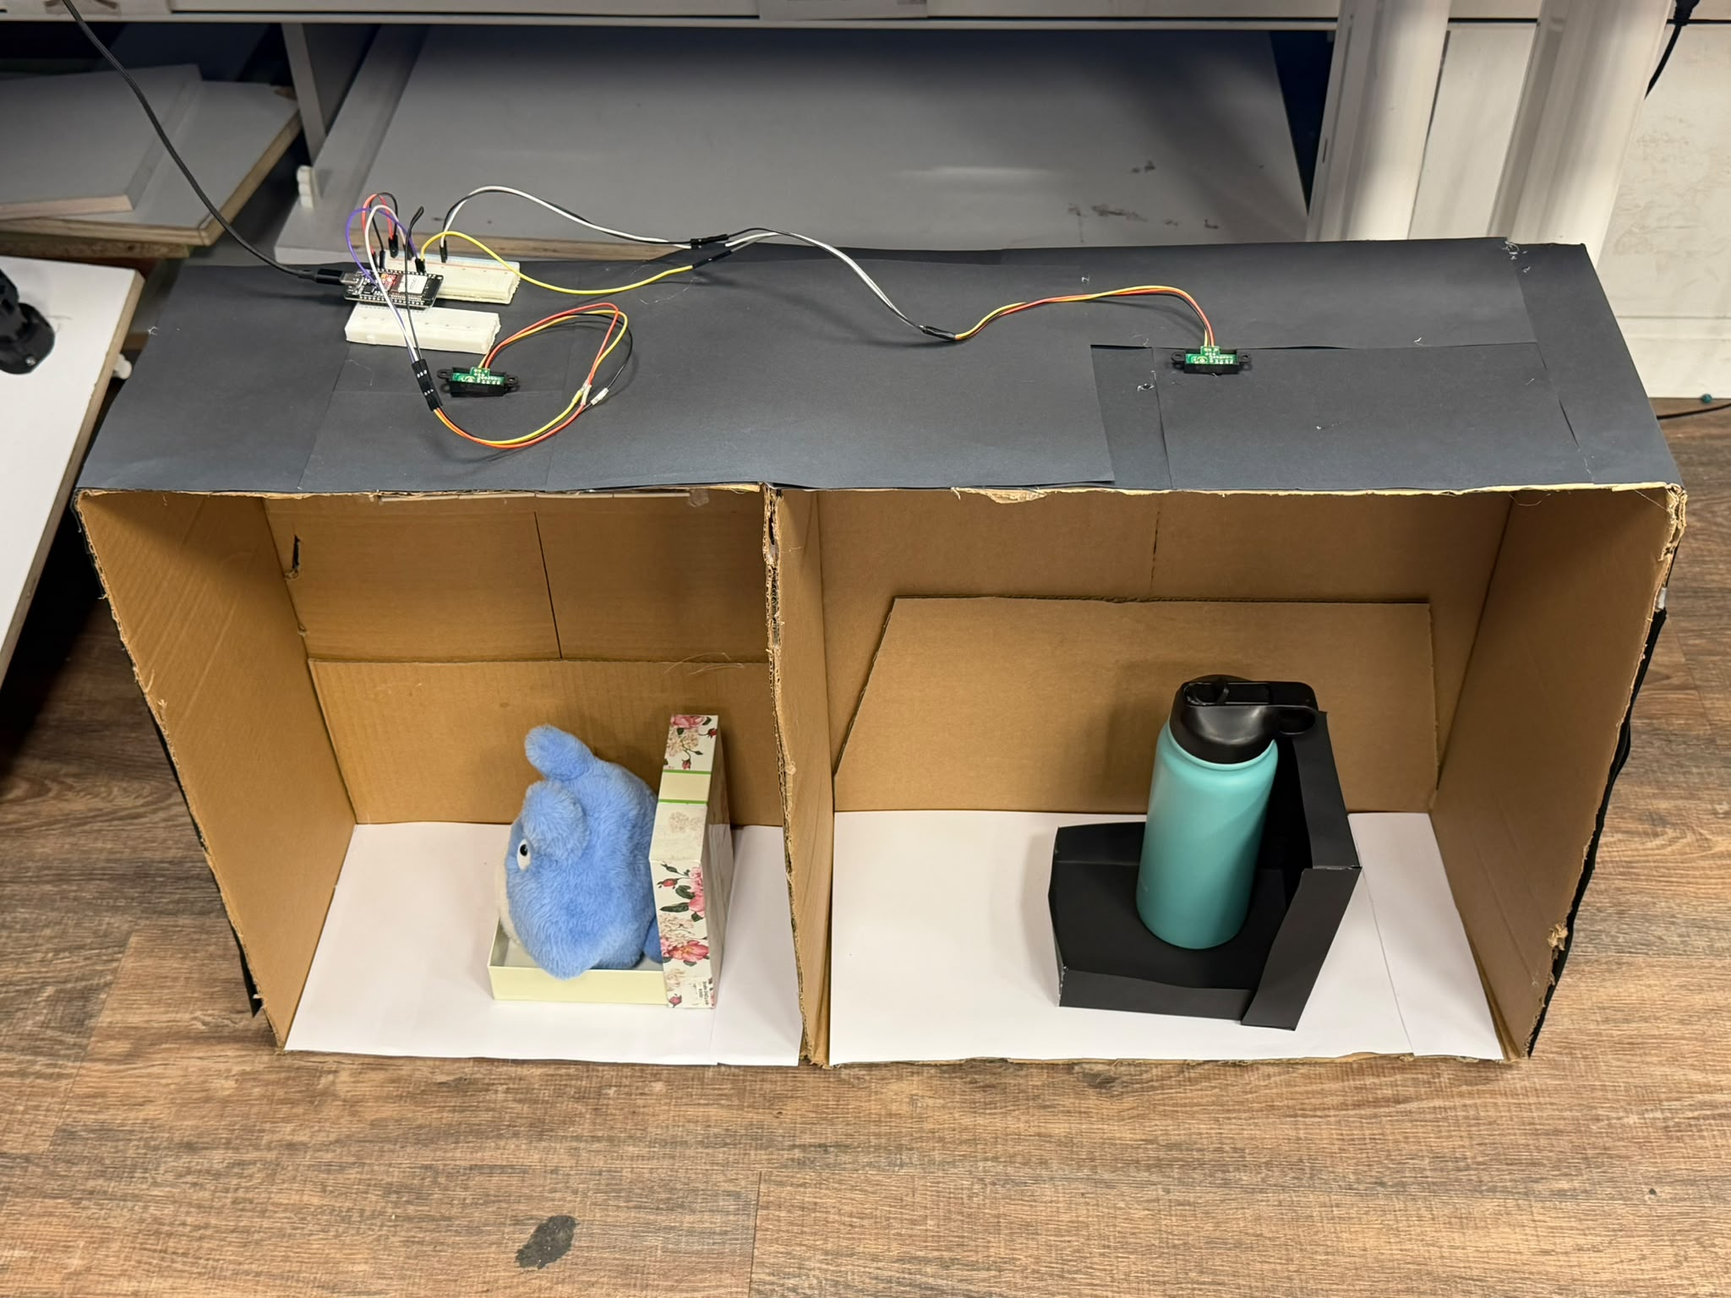
SR
SmartRail
Know where to board.
Problem: Passengers lack seat information before boarding.
They may crowd near one door or search inside the train.
SmartRail: Our IoT prototype monitors train-seat availability.
It guides passengers toward cars with more free seats.
Seat sensing: ESP32 and IR sensors detect occupied seats.
Hybrid train: 12 x 108 seats (1,296); two physical inputs.
Web guidance: Car counts, seat maps and zone suggestions.
Advantage: Check before boarding, not after entering a car.
Demonstration: 2 physical seats + 1,294 simulated seats.
Conclusion: One display combines real and simulated seats.
METHOD / PROCESS — FROM SENSING TO GUIDANCE
1. Calibrate
At startup
2. Detect
Filtered IR
3. Send
USB state
4. Merge
Real + sim.
5. Count
Free / car
6. Guide
Show zones
Desktop controls (simulation example)
Laptop + mobile display
Two sensor seat models
Passenger view (simulation)
Team: Yazan Rabea • Abed Azem • Samar Khatib
Mentor: Itai Dabran
github.com/abedazem13/SmartRail
Notes:
Revised 24 October 2026: Problem and SmartRail each have two sentences. Exactly the four user-selected source images are embedded without further cropping: laptop/phone photo, two-seat-model photo, desktop control screenshot, mobile passenger screenshot. Screenshots are labeled simulation, not claimed as sensor measurements. Six process steps show startup calibration, filtered detection, USB transmission, merging real/simulated states, per-car counting and platform guidance. Original institutional template retained. No measured accuracy/dwell-time benefit, private email or external collaborator invented.

