Slide 1

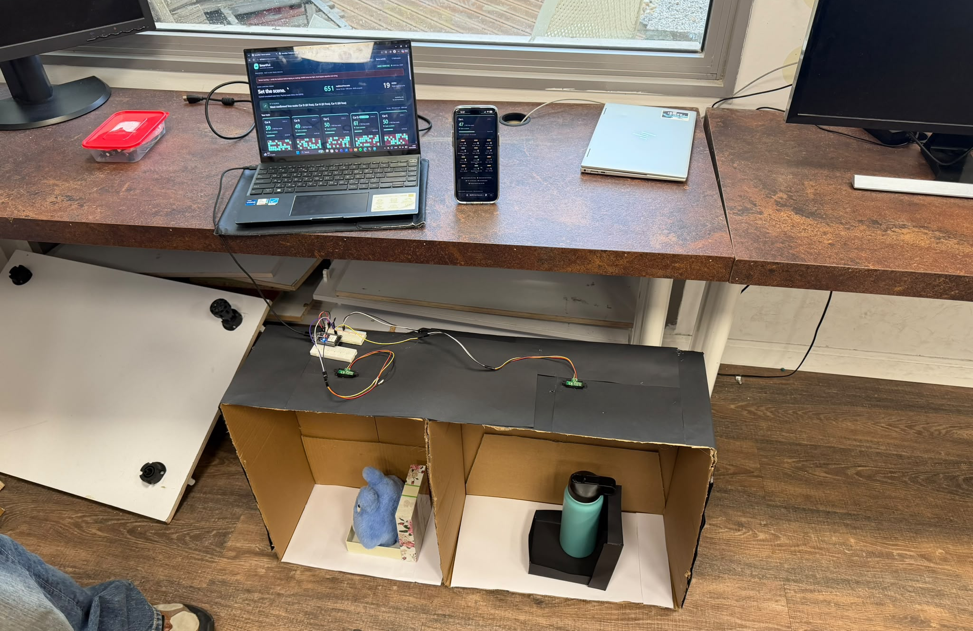
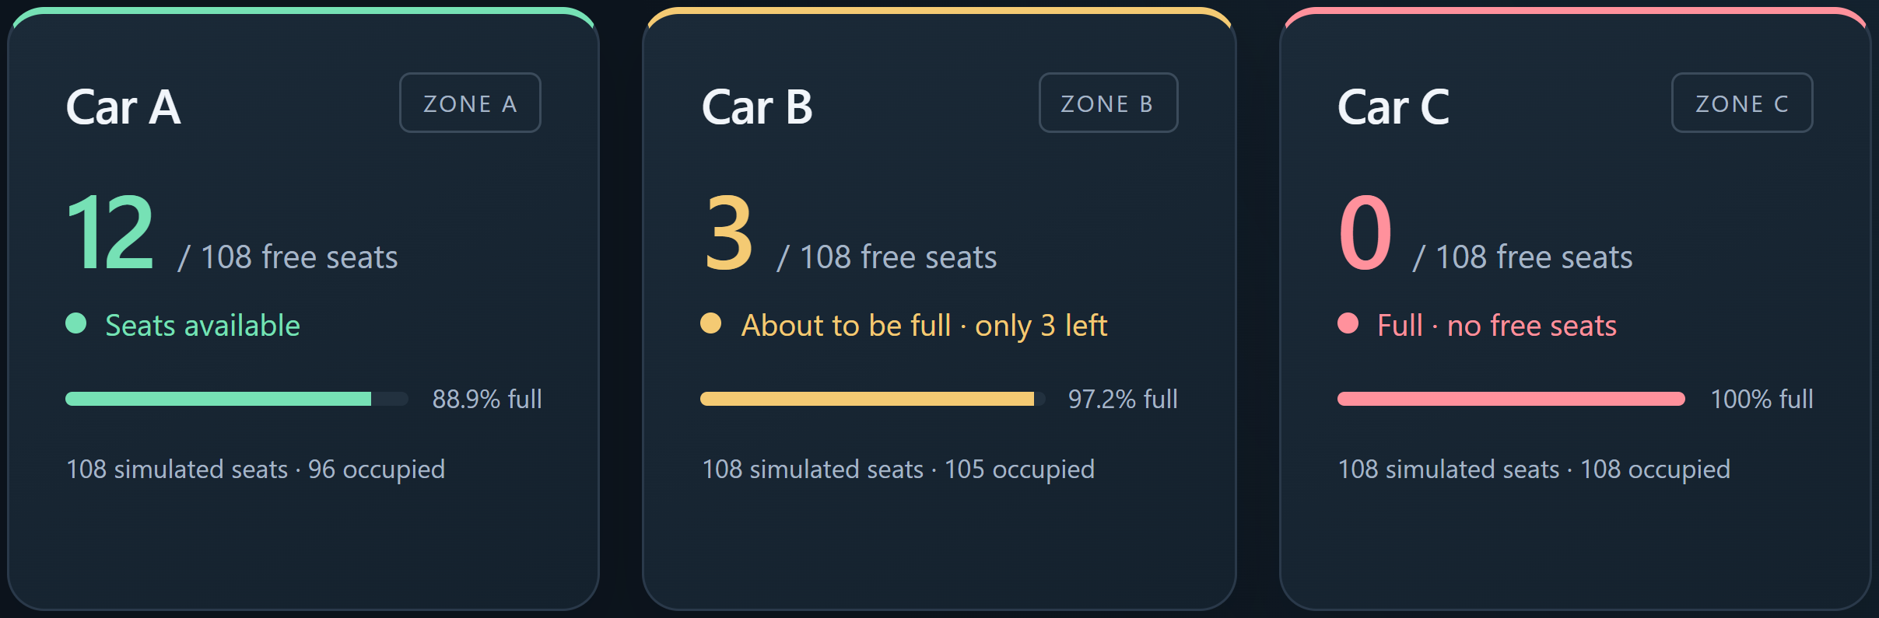
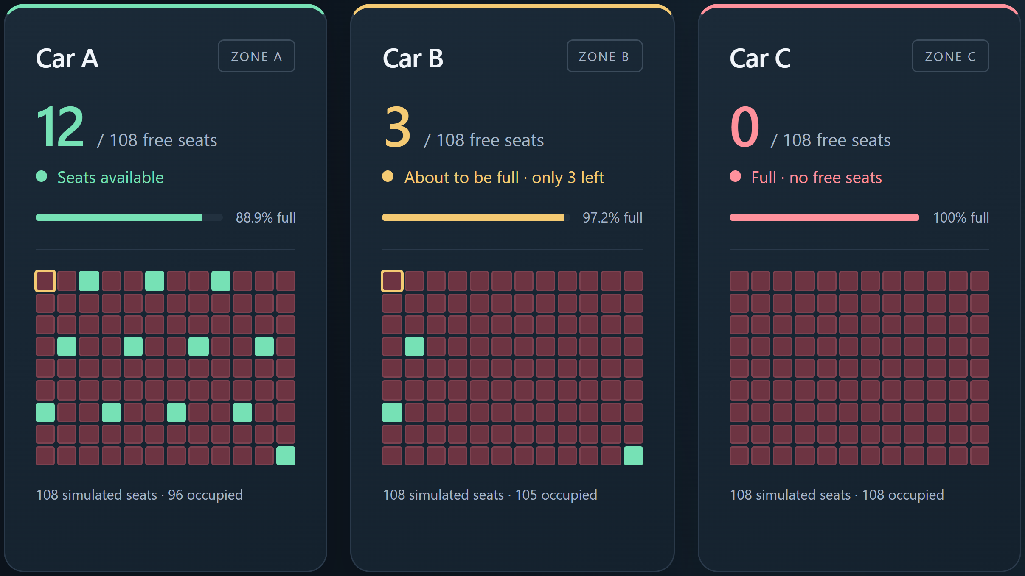
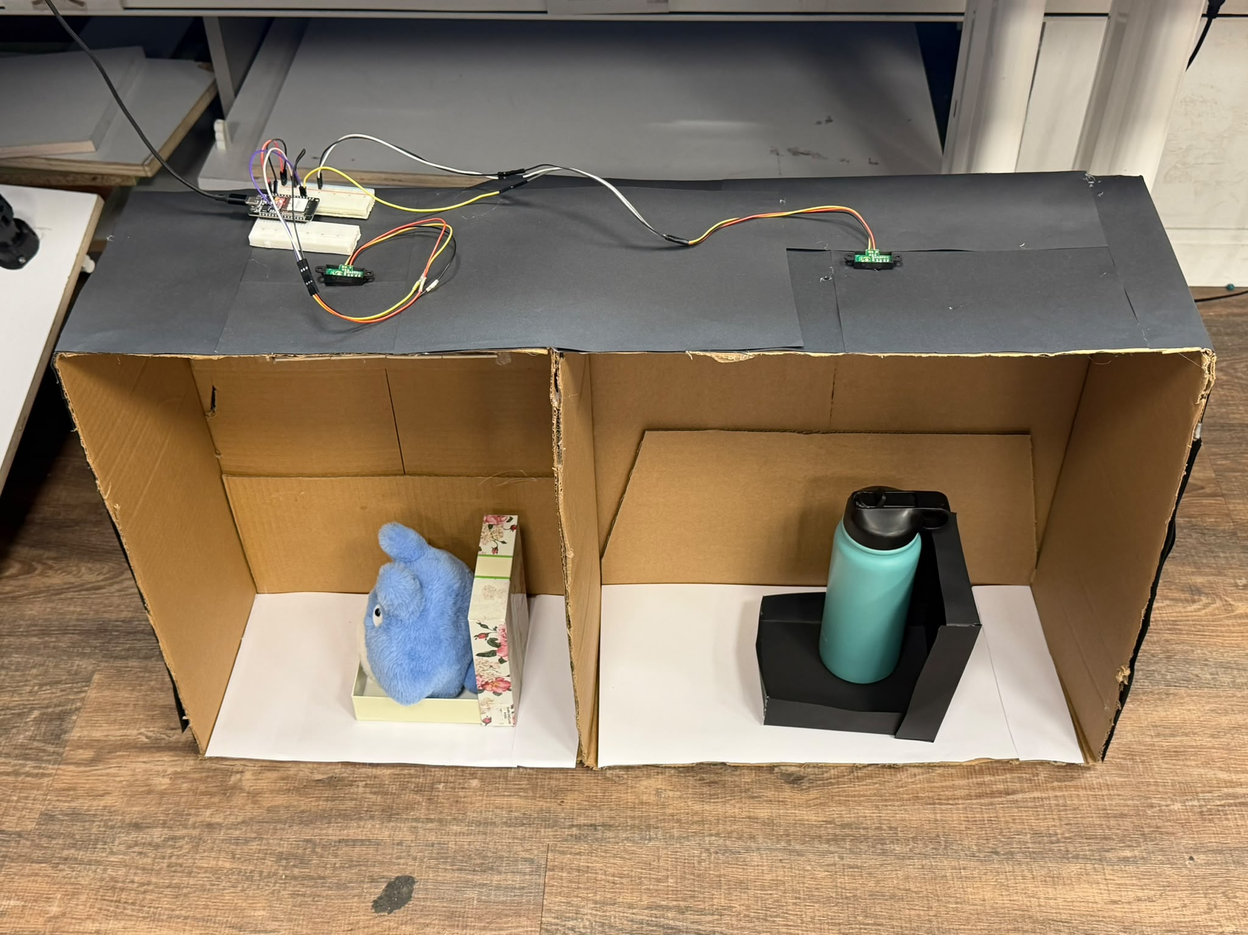
SR
SmartRail
Know where to board.
Problem: Passengers lack seat information before boarding.
SmartRail: An IoT system for seat-aware platform guidance.
Seat sensing: ESP32 and IR sensors detect occupied seats.
Hybrid train: 12 x 108 seats (1,296); two physical inputs.
Web guidance: Car counts, seat maps and zone suggestions.
Method: Calibration, filtering and USB state updates.
Advantage: Check before boarding, not after entering a car.
Demonstration: 2 physical seats + 1,294 simulated seats.
Conclusion: One display combines real and simulated seats.
IR sensors
ESP32
USB
Laptop server
Passenger UI
Passenger availability display — simulation excerpt
Integrated hardware + web demo
Two IR-sensed seat models
Operator seat map — simulation excerpt (A–C)
Team: Yazan Rabea • Abed Azem • Samar Khatib
Mentor: Itai Dabran
github.com/abedazem13/SmartRail
Notes:
Revised 24 October 2026 using the reference poster's clear section structure, not its traffic-project claims or credits. Original SmartRail course template retained. Problem, one-sentence project definition, three features, method, advantage, demonstration scope and conclusion are explicit. Two actual prototype photos and two large screenshots of the existing app are used. Both screenshots are cropped simulation examples A-C, not measured live sensor results. The process diagram and all body text are editable. 12 logical cars x108 seats: 2 physical,1294 simulated. No measured accuracy or dwell-time benefit claimed. Contact uses the repository URL; no email or external collaborator was supplied. Mentor name follows repository records.

