Slide 1

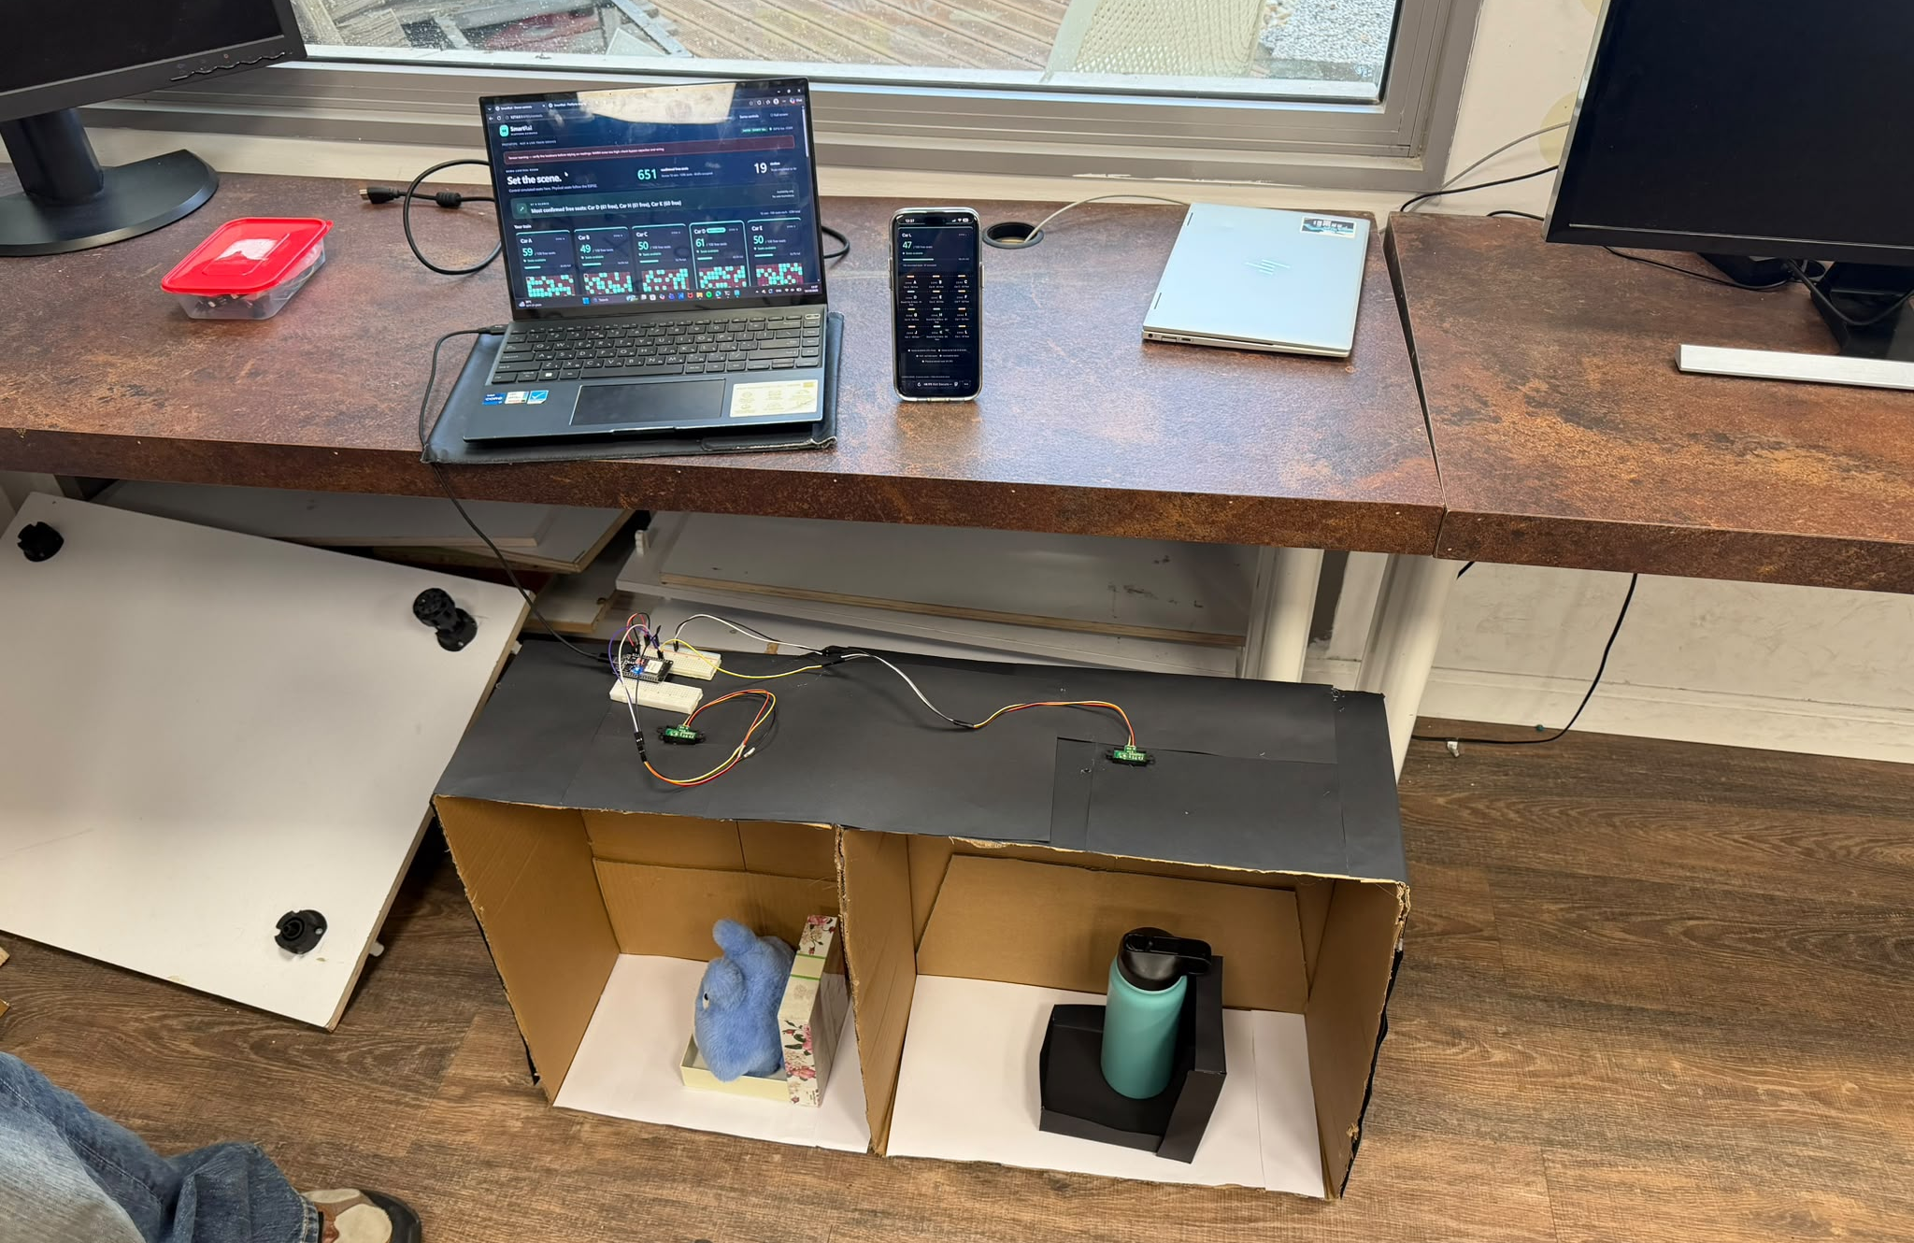
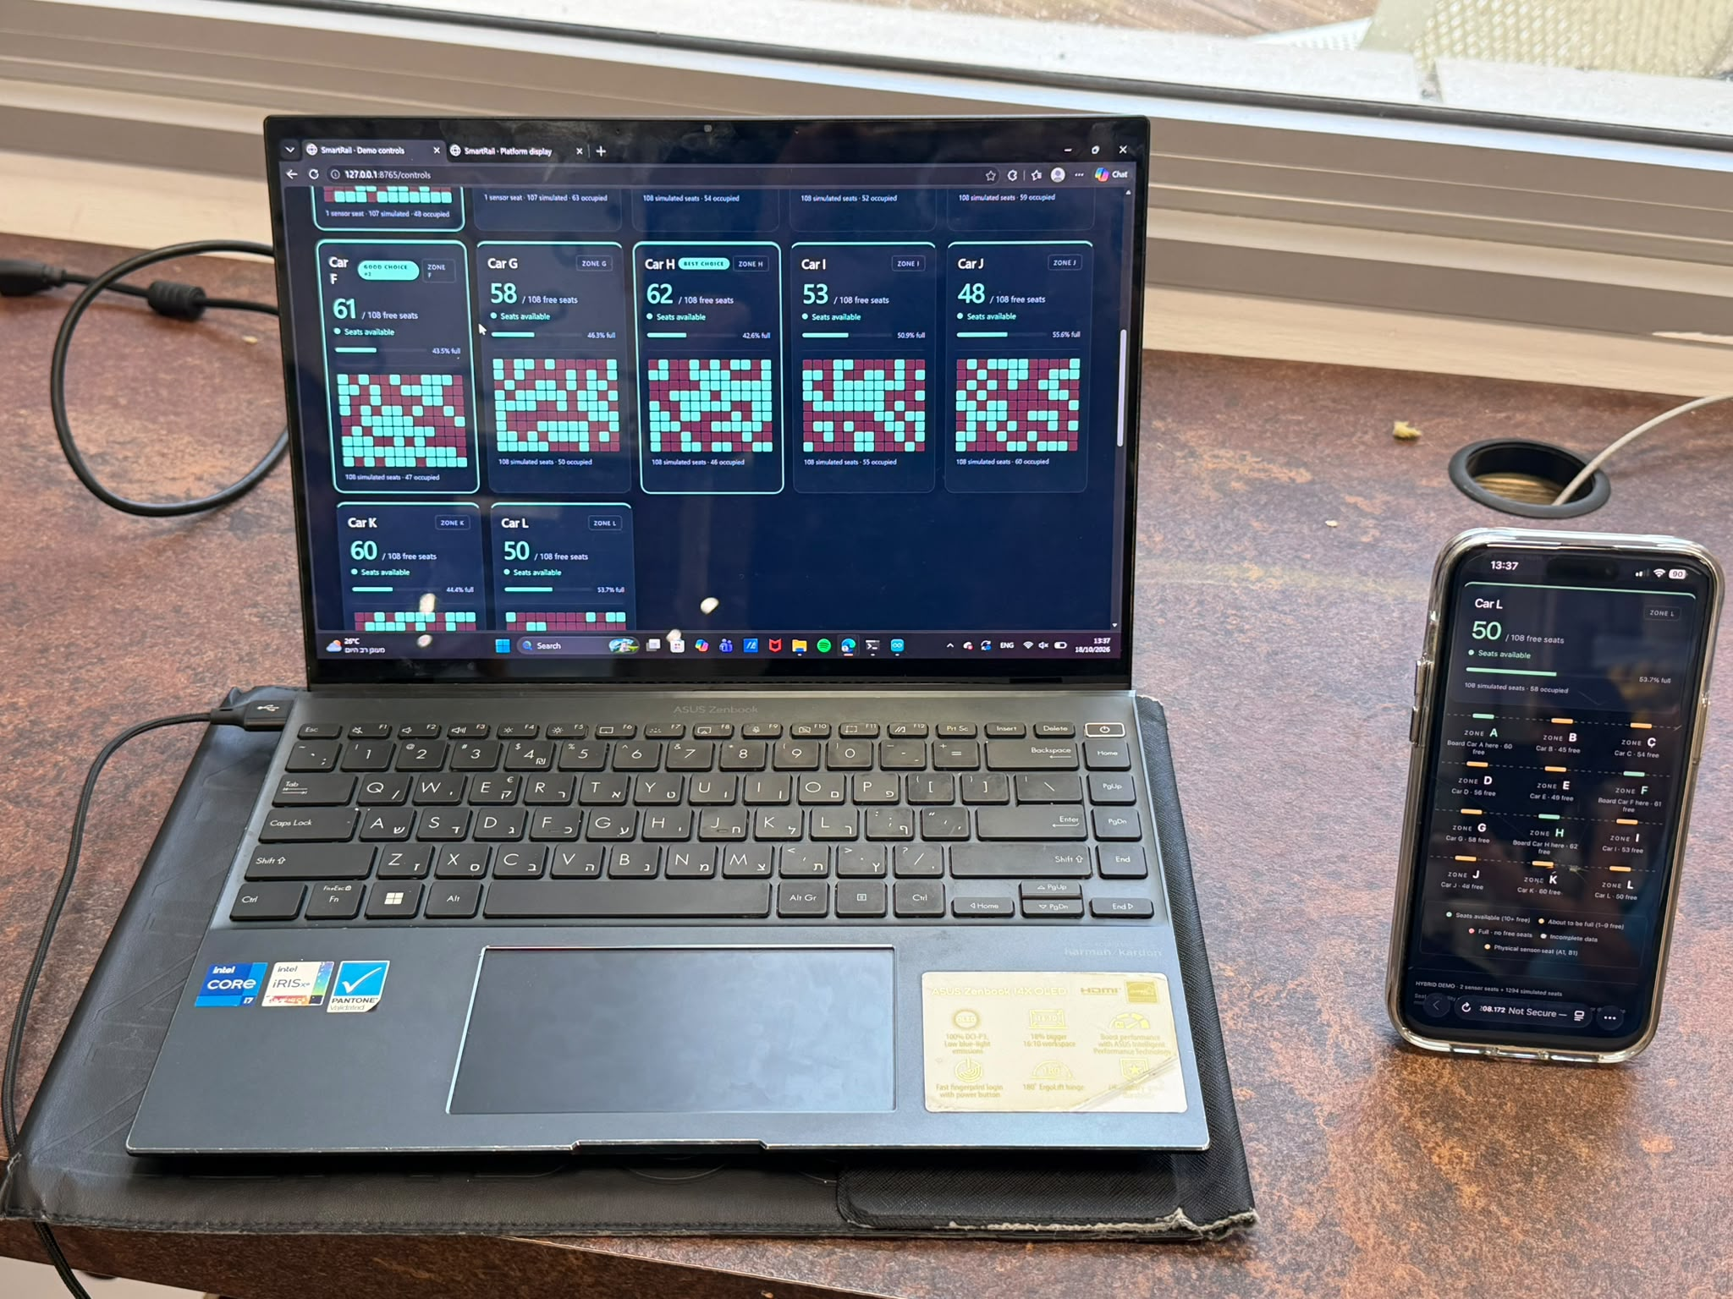
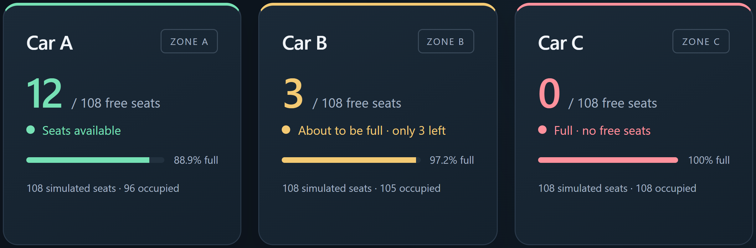
SR
SmartRail
Know where to board.
SmartRail monitors train-seat availability and shows
passengers which cars have more free seats.
SENSE
IR sensors + ESP32 detect occupied seats.
GUIDE
A browser display highlights available cars.
SCALE
2 physical inputs + 1,294 simulated seats.
12 virtual cars | 108 seats per car | 1,296 total
THE PROTOTYPE
Laptop controls; phone display.
Viewing over local Wi-Fi;
sensor link remains USB.
Two seat models, ESP32 and live interfaces.
PASSENGER VIEW
HOW IT CONNECTS
IR sensors
ESP32
USB
Passenger
display
Laptop
server
Simulation example: free seats by car.
Unknown readings are never counted free.
Simulated seats also feed the server.
Availability guidance, not reservations.
Yazan Rabea • Abed Azem • Samar Khatib
Mentor: Itai Dabran
github.com/abedazem13/SmartRail
Notes:
SmartRail course poster, prepared 24 October 2026. Original course template retained; two actual user-supplied prototype photos and a cropped actual dashboard screenshot. Screenshot is a software simulation example, not measured physical availability. 12 logical cars x108 seats: two physical sensor inputs, 1294 simulated. No quantified boarding/dwell-time improvement is claimed. Project diagram and all text are editable. No team photo is included. Mentor name follows the repository documentation; confirm spelling before submission.

