Slide 1


Structure Controls and LOOps
Abdulkarim Albanna
www.facebook/abdulkarimalbanna

Slide 2
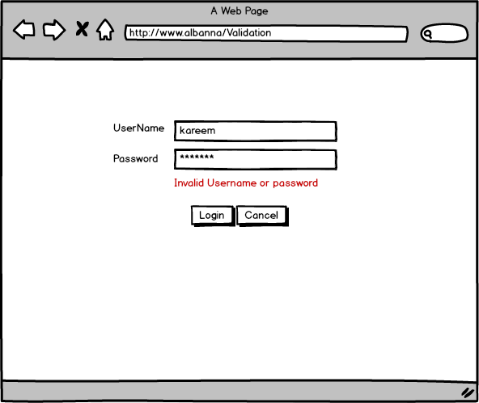
Validation Mockup
Notes:
A markup language is a set of tags and/or a set of rules for creating tags that can be embedded in digital text to provide additional information about the text in order to facilitate automated processing of it, including editing and formatting for display or printing.Dec 13, 2006
The browsers we will talk about
There are five major browsers used on desktop today: Chrome, Internet Explorer, Firefox, Safari and Opera. On mobile, the main browsers are Android Browser, iPhone, Opera Mini and Opera Mobile, UC Browser, the Nokia S40/S60 browsers and Chrome–all of which, except for the Opera browsers, are based on WebKit. I will give examples from the open source browsers Firefox and Chrome, and Safari (which is partly open source). According to StatCounter statistics (as of June 2013) Chrome, Firefox and Safari make up around 71% of global desktop browser usage. On mobile, Android Browser, iPhone and Chrome constitute around 54% of usage.
The browser's main functionality
The main function of a browser is to present the web resource you choose, by requesting it from the server and displaying it in the browser window. The resource is usually an HTML document, but may also be a PDF, image, or some other type of content. The location of the resource is specified by the user using a URI (Uniform Resource Identifier).
The way the browser interprets and displays HTML files is specified in the HTML and CSS specifications. These specifications are maintained by the W3C (World Wide Web Consortium) organization, which is the standards organization for the web. For years browsers conformed to only a part of the specifications and developed their own extensions. That caused serious compatibility issues for web authors. Today most of the browsers more or less conform to the specifications.

Slide 3
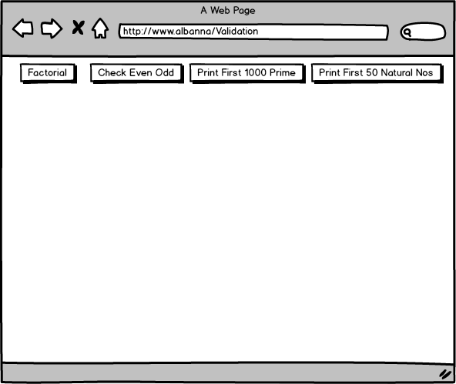
Loops Mockup
Notes:
A markup language is a set of tags and/or a set of rules for creating tags that can be embedded in digital text to provide additional information about the text in order to facilitate automated processing of it, including editing and formatting for display or printing.Dec 13, 2006
The browsers we will talk about
There are five major browsers used on desktop today: Chrome, Internet Explorer, Firefox, Safari and Opera. On mobile, the main browsers are Android Browser, iPhone, Opera Mini and Opera Mobile, UC Browser, the Nokia S40/S60 browsers and Chrome–all of which, except for the Opera browsers, are based on WebKit. I will give examples from the open source browsers Firefox and Chrome, and Safari (which is partly open source). According to StatCounter statistics (as of June 2013) Chrome, Firefox and Safari make up around 71% of global desktop browser usage. On mobile, Android Browser, iPhone and Chrome constitute around 54% of usage.
The browser's main functionality
The main function of a browser is to present the web resource you choose, by requesting it from the server and displaying it in the browser window. The resource is usually an HTML document, but may also be a PDF, image, or some other type of content. The location of the resource is specified by the user using a URI (Uniform Resource Identifier).
The way the browser interprets and displays HTML files is specified in the HTML and CSS specifications. These specifications are maintained by the W3C (World Wide Web Consortium) organization, which is the standards organization for the web. For years browsers conformed to only a part of the specifications and developed their own extensions. That caused serious compatibility issues for web authors. Today most of the browsers more or less conform to the specifications.

Slide 4
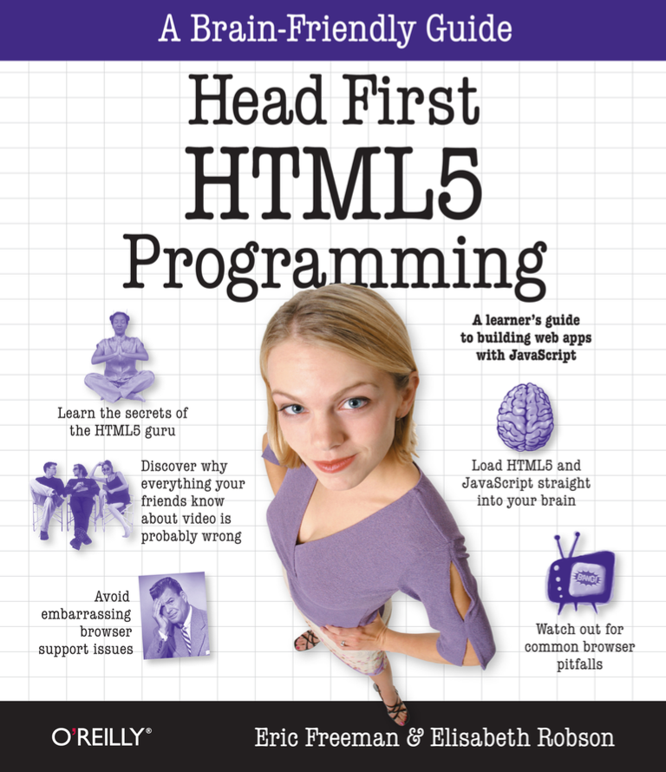
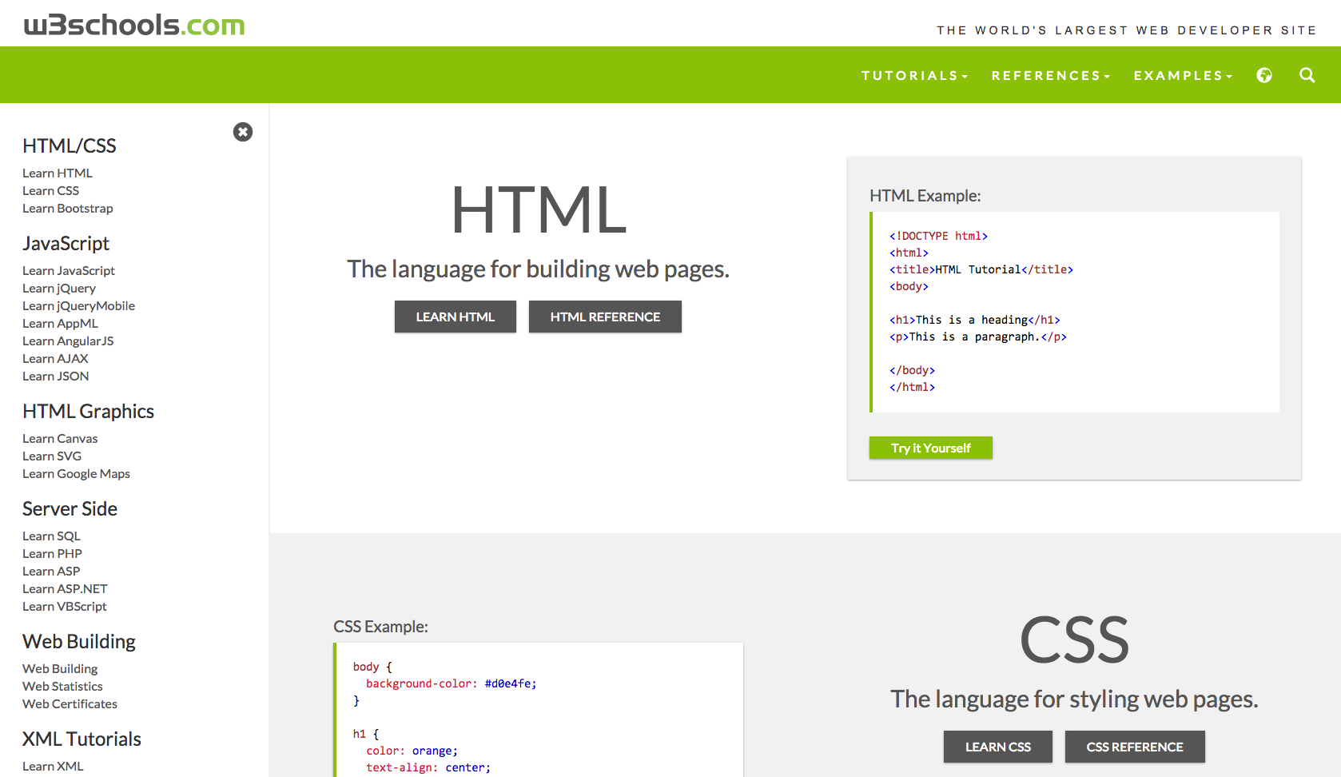
References...

