Slide 1

Automation Basics with n8n
AI Administrator: Agentic Workflows & Automation · Day 3 · Session 5
Lead instructors: Mousa AL-Akhras, Mohammed Abdelmajeed
120 minutes · Module online: albanna-tutorials.com/ai-administrator/05_automation_basics_n8n.html
IEEE CS Region 8 AI Caravan 2026 · AI Administrator · Day 3 · Session 5
1
Notes:
Welcome to Day 3. One-sentence promise: by the end of these two hours everyone has an n8n workspace, has watched the leave request from Session 4 run as a real workflow, and has built and tested their own first automation. Still no code for participants.

Slide 2

Where this session sits
• Session 3: the leave request mapped as it really runs (25 minutes of work, about 4 days of waiting, 8 hand-offs)
• Session 4: the future state, an Automation lane, and one chosen first build
• Session 5 (now): that first build, running in n8n, and your own first workflow
• Session 6: AI steps inside the workflow (classify, extract, draft)
• At minute 108: a 20-question Kahoot. Keep your phone handy.
IEEE CS Region 8 AI Caravan 2026 · AI Administrator · Day 3 · Session 5
2
Notes:
Ask everyone to have two things ready: an e-mail inbox they can open now, and their M4-future-state file. We open n8n together in five minutes.

Slide 3
What you will be able to do after this session
• Open an n8n trial and keep your work safe (export every day)
• Say what an automation platform does, and how n8n differs from Make, Zapier and Power Automate
• Tell a trigger from an action, and follow items from node to node
• Read a workflow against a future-state map
• Build, test and publish a Form, Sheets, IF and Gmail workflow
• Add a guard, Retry on Fail and an error workflow
IEEE CS Region 8 AI Caravan 2026 · AI Administrator · Day 3 · Session 5
3
Notes:
The deliverable is the lab: a published request-intake workflow with three test runs, plus the exported JSON.

Slide 4
Run of show (120 minutes)
Minutes | Block | What happens
0 to 5 | Welcome | Where we are, objectives
5 to 20 | Sign up together | n8n Cloud trial, step by step; a breakout room for anyone stuck
20 to 35 | What an automation platform is | Four platforms; triggers, actions, items; credentials
35 to 55 | Demo: the leave request runs | One step, one node; three test runs; the Executions log
55 to 60 | Break
60 to 100 | Lab: request intake | Build in breakout rooms; form, sheet, IF, two e-mails, guard
100 to 108 | Make it safe | Retry on Fail, error workflow, test then publish
108 to 118 | Kahoot | 20 questions
118 to 120 | Close | Export your JSON; preview Session 6
IEEE CS Region 8 AI Caravan 2026 · AI Administrator · Day 3 · Session 5
4
Notes:
Ten seconds on screen. The lab is in the session this time, not homework: forty minutes in breakout rooms.

Slide 5
Section · minute 5
1. Open n8n together
Same clicks, same minute, everyone
About 15 minutes
IEEE CS Region 8 AI Caravan 2026 · AI Administrator · Day 3 · Session 5
5
Notes:
The co-host posts n8n.io/pricing and Day3_S5_n8n_Signup_Sheet.pdf in the chat now. You sign up on screen at the same pace.

Slide 6
Sign up in six clicks
1
1. n8n.io/pricing, then 'Start free trial'
n8n Cloud. No credit card required.
2
2. Your e-mail and a password
Later you connect one Google account to Sheets and Gmail: the same account that owns your sheet.
3
3. Verify
Open the verification e-mail (check spam and Promotions). Stuck? The co-host moves you to the 'Stuck' room.
4
4. Name your workspace
Your workspace gets its own address, like yourname.app.n8n.cloud. Write it down.
5
5. Two onboarding questions
Answer or skip; they only tailor suggestions.
6
6. 'Start automating'
You land on 'Let's build your first automation'. Stop there and wait for the group.
IEEE CS Region 8 AI Caravan 2026 · AI Administrator · Day 3 · Session 5
6
Notes:
Go slowly; do every click yourself on screen. At minute 12 ask for a Raise Hand from anyone who is not yet on the 'Let's build your first automation' page; the co-host takes them to the breakout room.

Slide 7
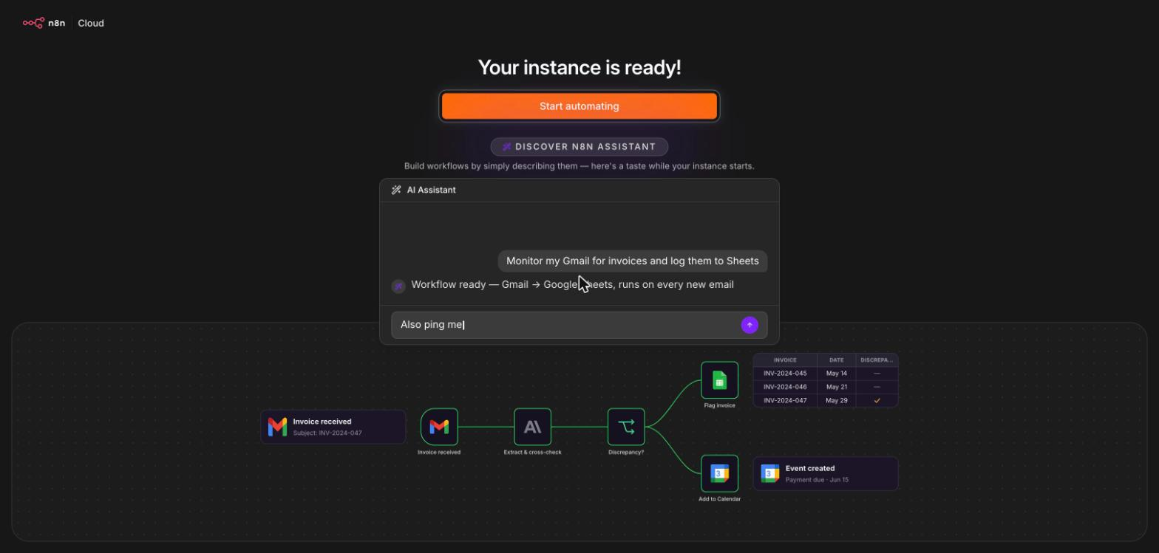
What you see while the workspace starts
'Your instance is ready!' after about a minute. Click Start automating.
Screenshot: n8n Cloud (n8n GmbH), captured 11 October 2026 on the course trial workspace
IEEE CS Region 8 AI Caravan 2026 · AI Administrator · Day 3 · Session 5
7
Notes:
The animated preview below the button is a sample workflow; ignore it for now. Some participants will see the AI Assistant ask questions first; skipping is fine.

Slide 8
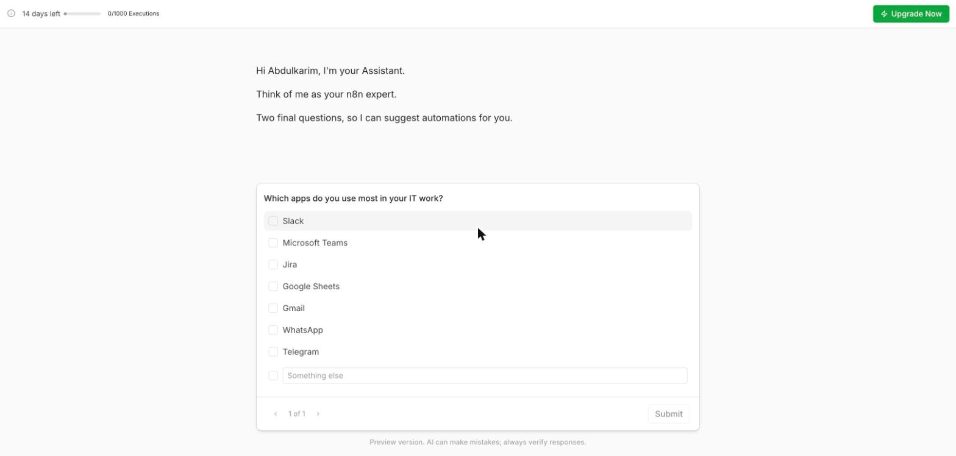
The trial clock is always on screen
Top left: 14 days left, 0/1000 executions. Every test run counts as one execution.
Screenshot: n8n Cloud (n8n GmbH), captured 11 October 2026 on the course trial workspace
IEEE CS Region 8 AI Caravan 2026 · AI Administrator · Day 3 · Session 5
8
Notes:
Point at the counter. 1,000 executions is plenty for the course if nobody publishes a schedule that runs every minute.

Slide 9
Three rules for the trial
1. It lasts 14 days from today, and then the workspace is deleted. 2. It allows 1,000 executions; a test run is one. 3. At the end of every session: menu, Export JSON. Your workflows live in your Downloads folder, not only in n8n.
IEEE CS Region 8 AI Caravan 2026 · AI Administrator · Day 3 · Session 5
9
Notes:
Make this the one thing everyone remembers. We repeat it at the close of every n8n session. If the course ran past 14 days, exported JSON is what lets them continue in a new trial.

Slide 10
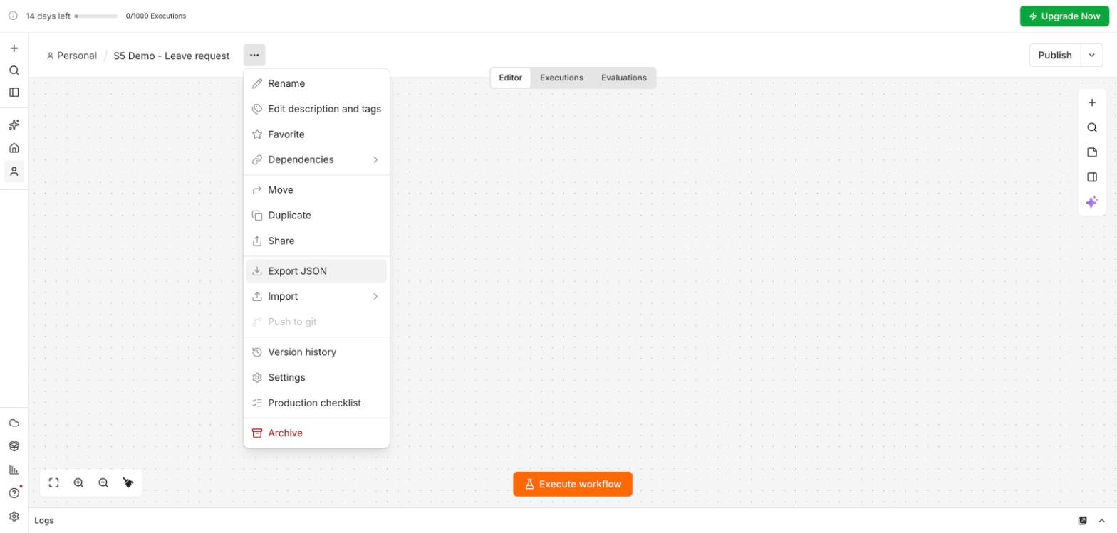
Your daily habit: Export JSON
The three-dots menu next to the workflow name. Import, From file loads it back into any workspace.
Screenshot: n8n Cloud (n8n GmbH), captured 11 October 2026 on the course trial workspace
IEEE CS Region 8 AI Caravan 2026 · AI Administrator · Day 3 · Session 5
10
Notes:
Show where the menu is now, even with an empty workflow. Settings in the same menu is where the error workflow is chosen later.

Slide 11
Section · minute 20
2. What an automation platform is
A trigger, then actions, with data flowing between them
About 15 minutes
IEEE CS Region 8 AI Caravan 2026 · AI Administrator · Day 3 · Session 5
11
Notes:
Fifteen minutes of concepts, each tied to a screen they now have open.

Slide 12
Four platforms, one idea
Platform | Strength | Watch out for | Cost model
n8n | Self-host or cloud; branching; code when needed; AI nodes | More technical settings | Per workflow execution (cloud); free self-hosted
Make | Visual scenarios, many apps | Operations add up fast | Per operation
Zapier | Largest app catalogue, simplest start | Price per task at scale | Per task
Power Automate | Inside Microsoft 365 | Licensing tiers | Per user or per flow
IEEE CS Region 8 AI Caravan 2026 · AI Administrator · Day 3 · Session 5
12
Notes:
The module has the full table. The skills transfer: every one of these has triggers, actions, data mapping, conditions and credentials. We use n8n because it can also run on your own server, which matters for data that must not leave the organisation.

Slide 13
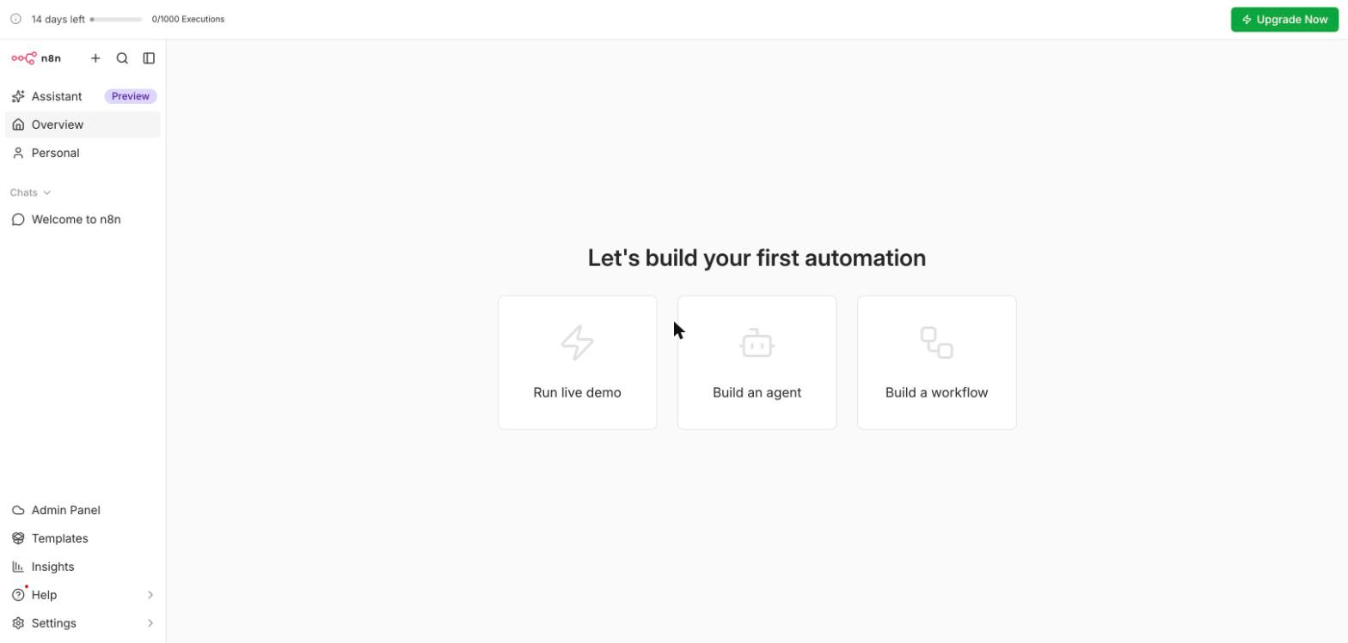
Where you are now
Build a workflow opens an empty canvas. (Run live demo and Build an agent come later.)
Screenshot: n8n Cloud (n8n GmbH), captured 11 October 2026 on the course trial workspace
IEEE CS Region 8 AI Caravan 2026 · AI Administrator · Day 3 · Session 5
13
Notes:
Everyone clicks Build a workflow now. We do not use the AI builder today: you should know what each node does before you let anything generate one.

Slide 14
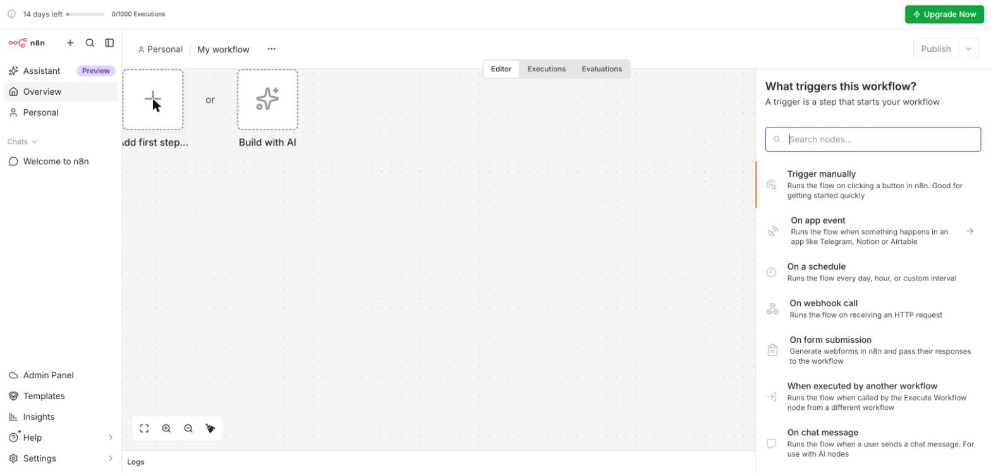
Every workflow starts with one trigger
'What triggers this workflow?' Manually, on an app event, on a schedule, a webhook, a form, another workflow, a chat message.
Screenshot: n8n Cloud (n8n GmbH), captured 11 October 2026 on the course trial workspace
IEEE CS Region 8 AI Caravan 2026 · AI Administrator · Day 3 · Session 5
14
Notes:
Read the list. The trigger answers 'when does this run?'. Today's trigger is On form submission.

Slide 15
Trigger and actions
Trigger (exactly one)
Actions (one or many)
• When does this run?
• A form is submitted, a schedule fires, an e-mail arrives, a webhook is called
• In Session 4 terms: the start event of the future-state map
• What happens next, in order
• Read or write a sheet, send an e-mail, check a condition, call an API
• In Session 4 terms: the steps in the Automation lane
IEEE CS Region 8 AI Caravan 2026 · AI Administrator · Day 3 · Session 5
15
Notes:
A second event needs a second workflow, or a trigger that covers both. Quiz question.

Slide 16
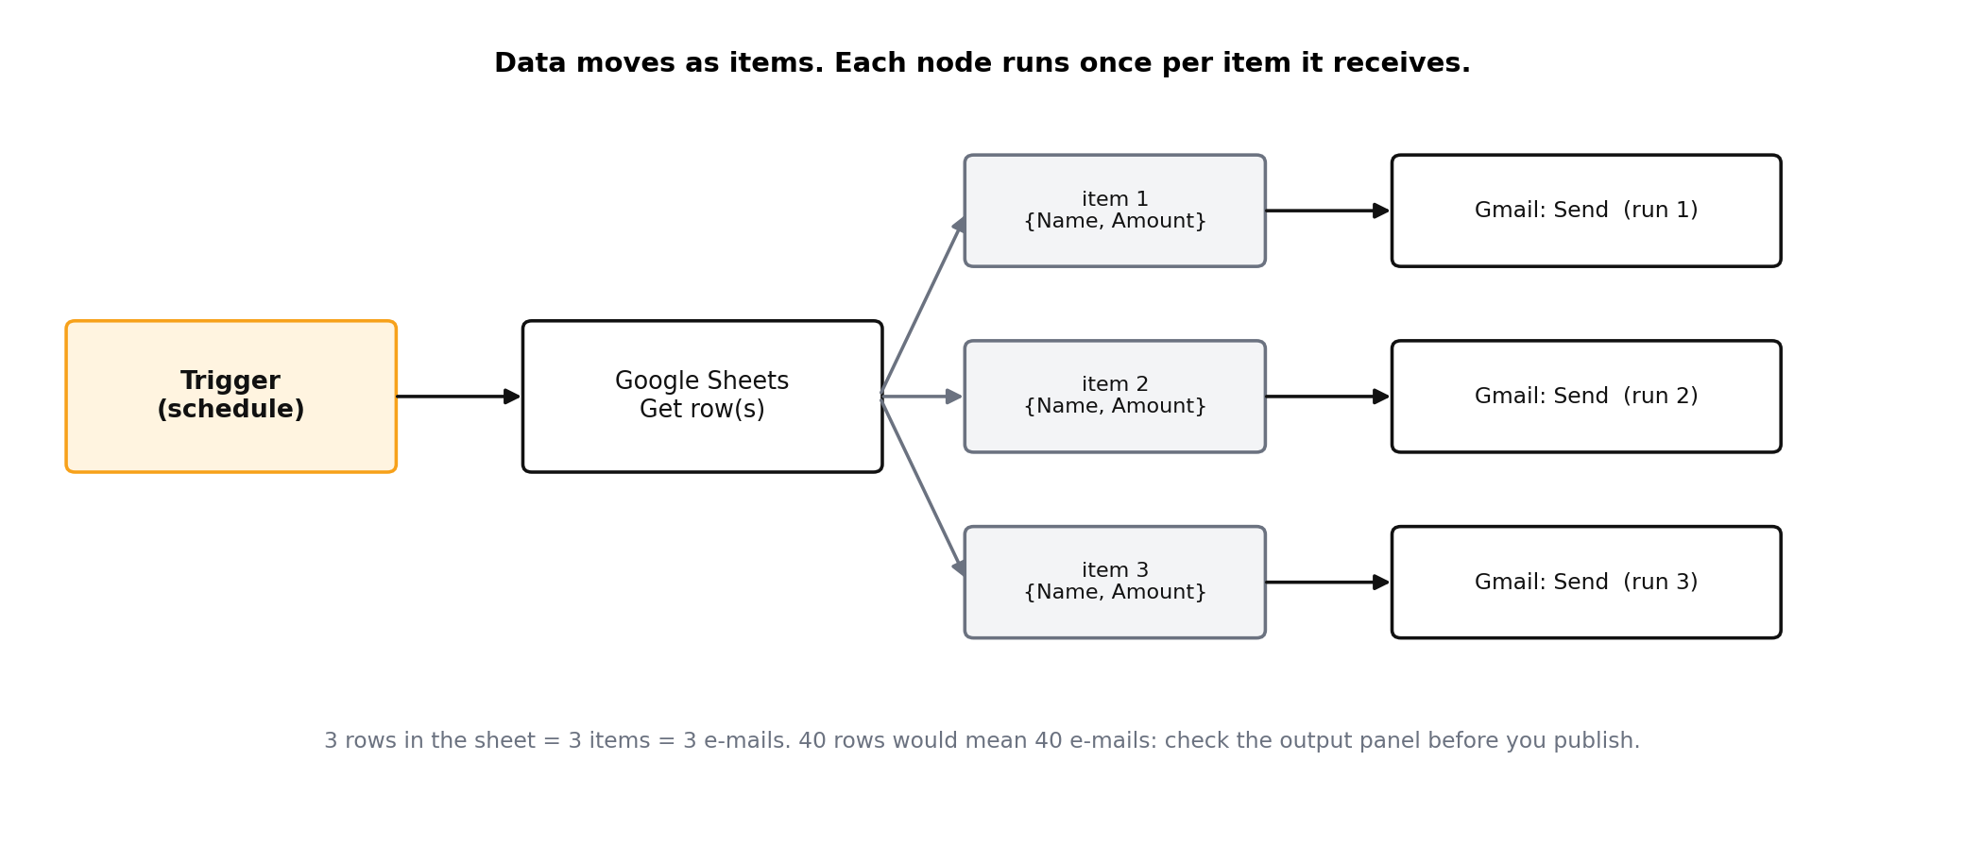
Data moves as items
Each node runs once per item it receives. Three rows, three e-mails.
Figure: AI Administrator course material (A. Al-Banna, 2026)
IEEE CS Region 8 AI Caravan 2026 · AI Administrator · Day 3 · Session 5
16
Notes:
The single most useful idea in n8n. Many 'it sent 40 e-mails' accidents come from forgetting it.

Slide 17
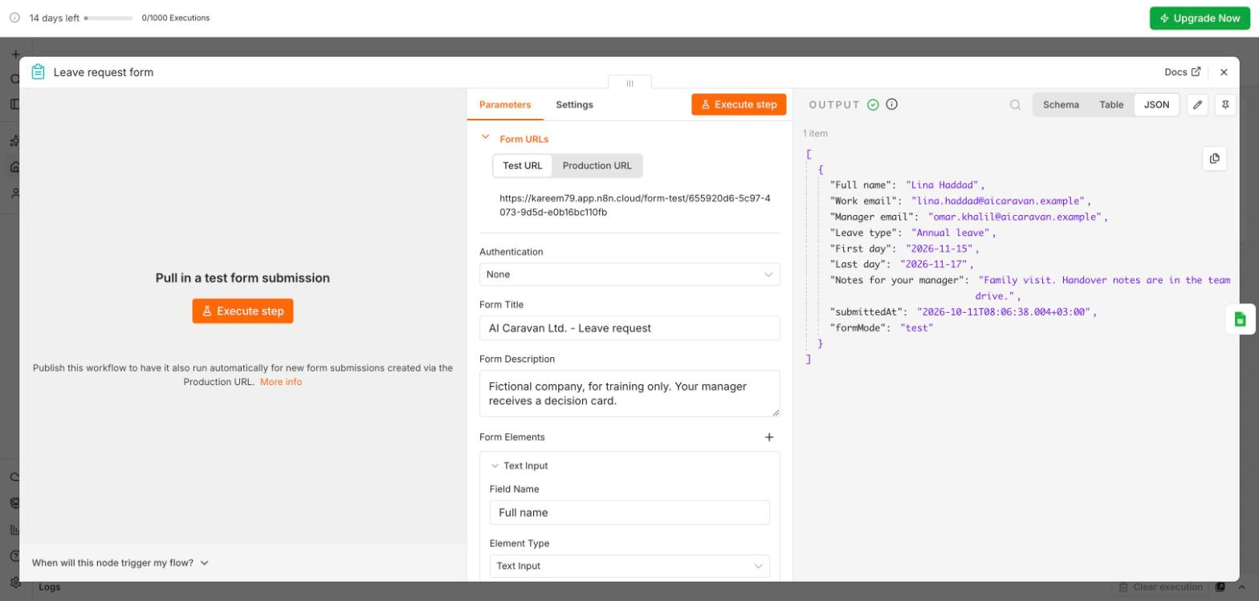
An item is a set of fields
One form submission = 1 item with 7 fields (plus submittedAt and formMode). Switch Schema, Table, JSON to read it.
Screenshot: n8n Cloud (n8n GmbH), captured 11 October 2026 on the course trial workspace
IEEE CS Region 8 AI Caravan 2026 · AI Administrator · Day 3 · Session 5
17
Notes:
This is the real output of the leave form. Point at '1 item' above the JSON. Fields are what you drag into the next node.

Slide 18
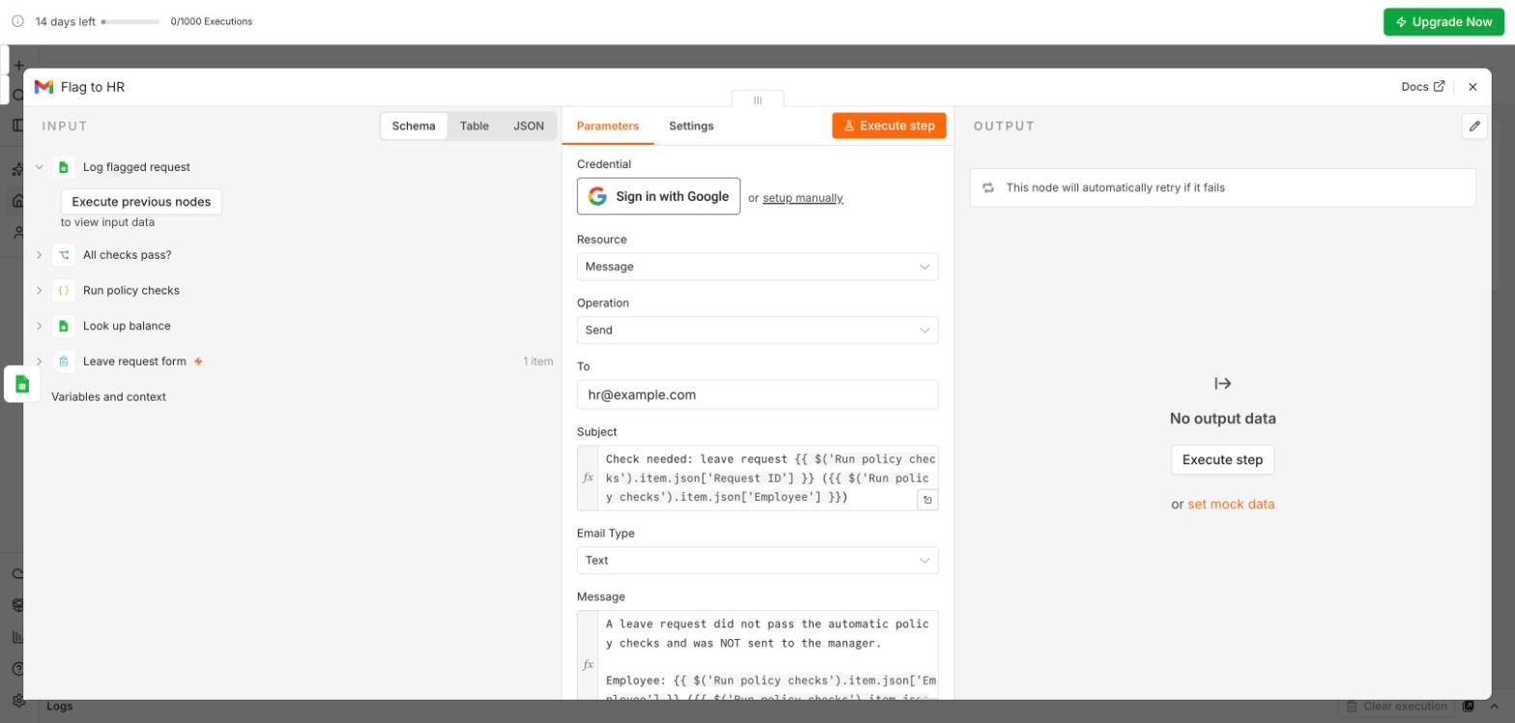
Credentials: sign in once, reuse everywhere
Sign in with Google creates a credential in n8n's credential store. Nodes refer to it; the secret never sits in a node.
Screenshot: n8n Cloud (n8n GmbH), captured 11 October 2026 on the course trial workspace
IEEE CS Region 8 AI Caravan 2026 · AI Administrator · Day 3 · Session 5
18
Notes:
Three rules from the module: least privilege, a shared or service account for production work, never paste a key into a node field or a sticky note.

Slide 19
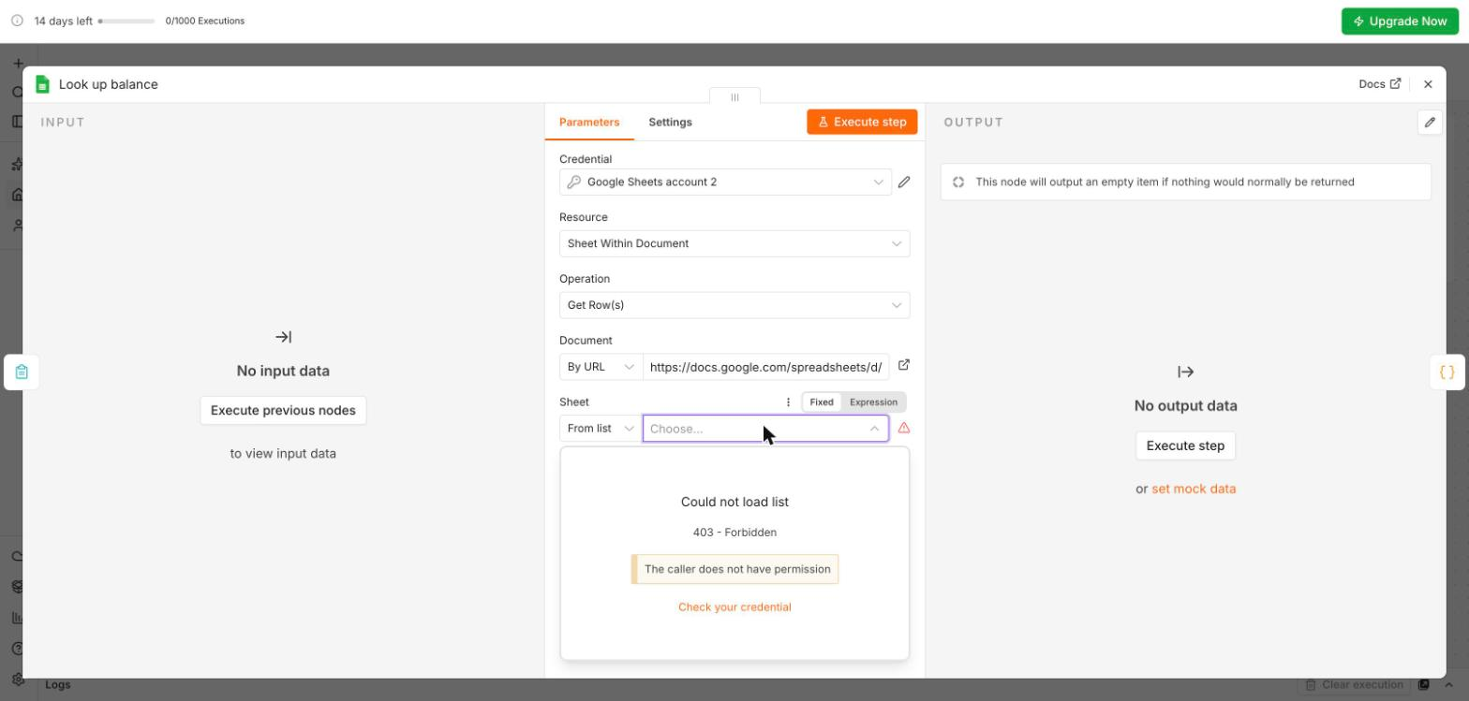
The trap we hit while preparing: 403 Forbidden
'The caller does not have permission': n8n was connected to a different Google account from the one that owns the sheet.
Screenshot: n8n Cloud (n8n GmbH), captured 11 October 2026 on the course trial workspace
IEEE CS Region 8 AI Caravan 2026 · AI Administrator · Day 3 · Session 5
19
Notes:
Real error from preparing this session. Two causes: a different Google account, or an unticked box on Google's consent screen. Fix: open the credential, Switch account, same account as the sheet, tick every box. And the sheet must be a native Google Sheet, not an uploaded .xlsx.

Slide 20
Section · minute 35
3. Demo: the leave request runs
Session 4's first build, as a real workflow
About 20 minutes
IEEE CS Region 8 AI Caravan 2026 · AI Administrator · Day 3 · Session 5
20
Notes:
Switch to the browser window with the prepared workspace. Participants watch; they do not build this one.

Slide 21
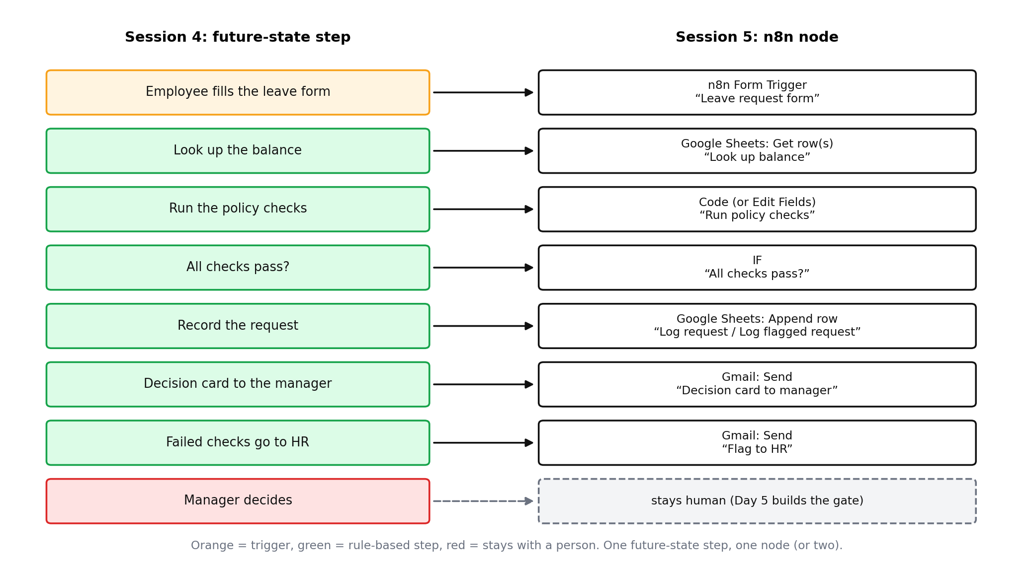
One step, one node
The Automation lane from Session 4, read as n8n nodes. The manager's decision stays human.
Figure: AI Administrator course material (A. Al-Banna, 2026)
IEEE CS Region 8 AI Caravan 2026 · AI Administrator · Day 3 · Session 5
21
Notes:
This is the bridge from Session 4. Ask the chat: which Session 4 candidate is this? (Candidates 2 and 3: look up the balance, run the policy checks, prepare the decision card.)

Slide 22
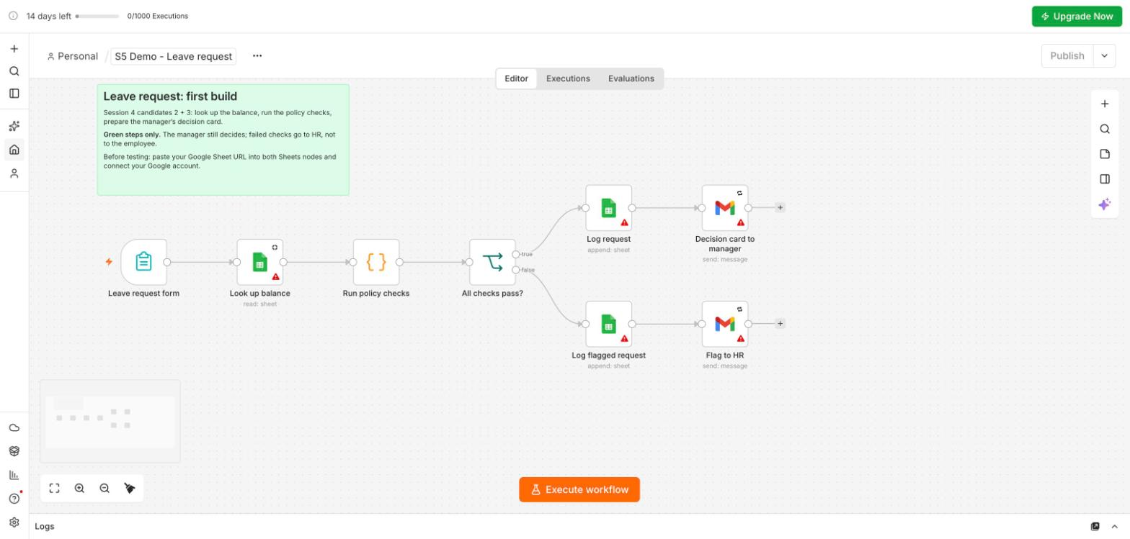
The workflow, before credentials
Red triangles = something to fill in, here the Google credentials and the sheet link. Publish stays disabled until they are gone.
Screenshot: n8n Cloud (n8n GmbH), captured 11 October 2026 on the course trial workspace
IEEE CS Region 8 AI Caravan 2026 · AI Administrator · Day 3 · Session 5
22
Notes:
Imported from Day3_S5_Leave_Request_Demo.json. The sticky note says what the workflow is for; a good habit.

Slide 23
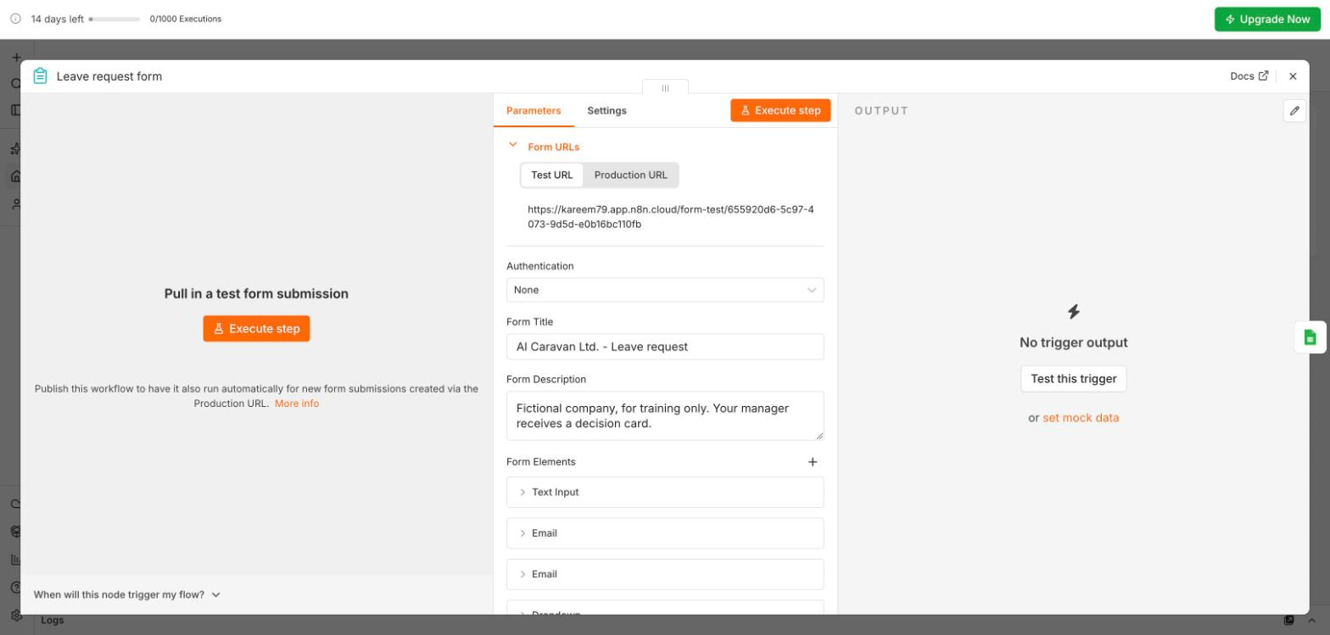
The trigger: an n8n form
Test URL works while you click Execute; Production URL works after you publish. Fields: name, two e-mails, type, dates, notes.
Screenshot: n8n Cloud (n8n GmbH), captured 11 October 2026 on the course trial workspace
IEEE CS Region 8 AI Caravan 2026 · AI Administrator · Day 3 · Session 5
23
Notes:
Click Production URL to show the second address. The form is hosted by n8n; nothing to install.

Slide 24
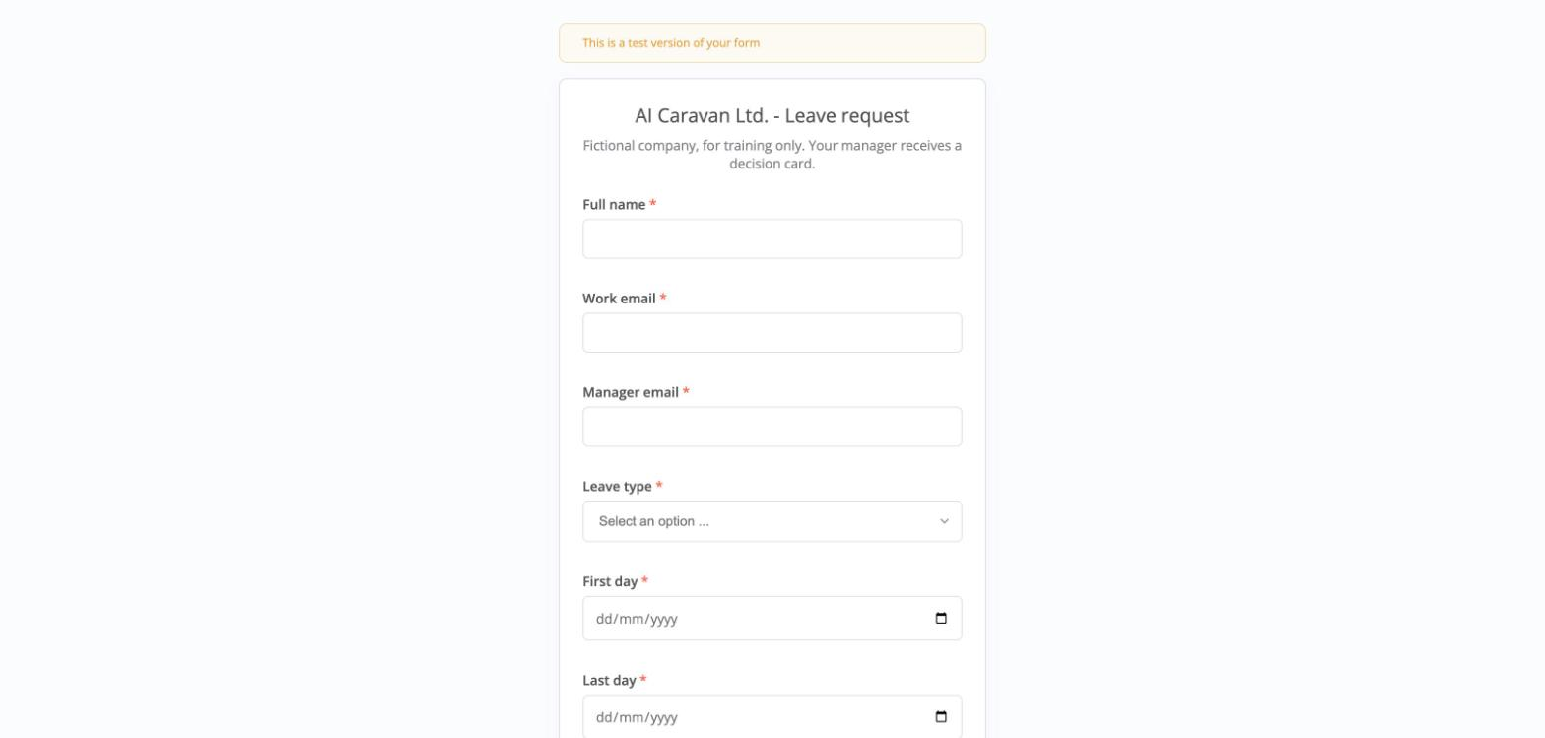
What the employee sees
'This is a test version of your form' disappears on the production URL.
Screenshot: n8n Cloud (n8n GmbH), captured 11 October 2026 on the course trial workspace
IEEE CS Region 8 AI Caravan 2026 · AI Administrator · Day 3 · Session 5
24
Notes:
Submit Omar Khalil, Annual leave, 15 to 17 November, your own address as manager. Then go back to the editor.

Slide 25
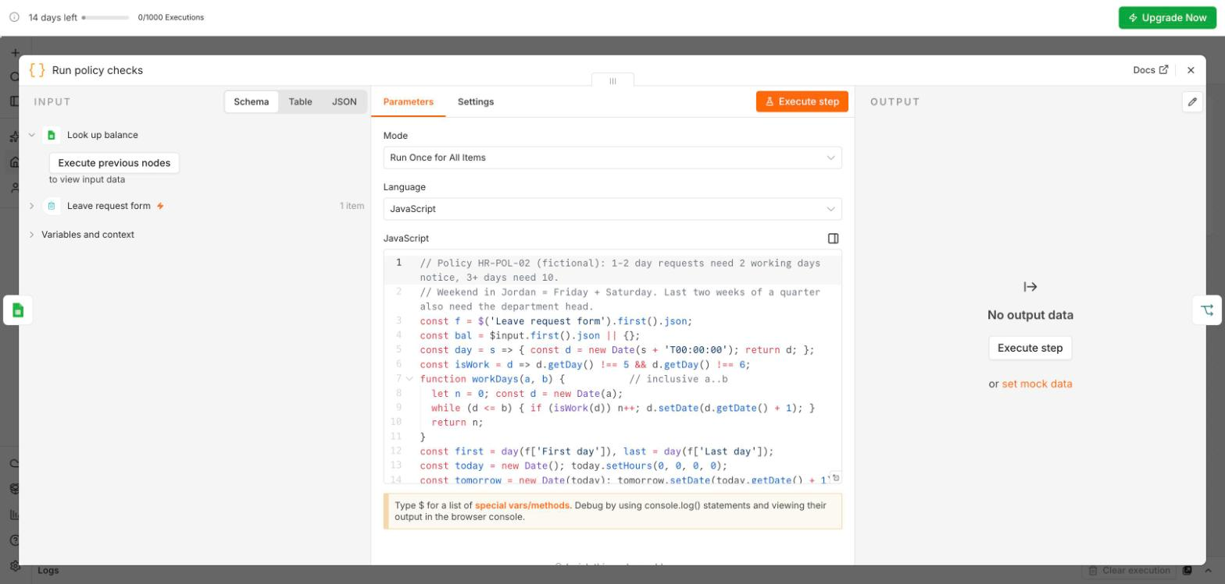
The policy checks (written once by the instructor)
Working days, notice needed (2 or 10), balance, quarter end. You will not write code today; Edit Fields and IF can do simple checks.
Screenshot: n8n Cloud (n8n GmbH), captured 11 October 2026 on the course trial workspace
IEEE CS Region 8 AI Caravan 2026 · AI Administrator · Day 3 · Session 5
25
Notes:
Keep this short. The point is that every rule here is one sentence from the leave policy (HR-POL-02): exactly the green steps of Session 4. Session 6 adds the amber step (reading the free-text note).

Slide 26
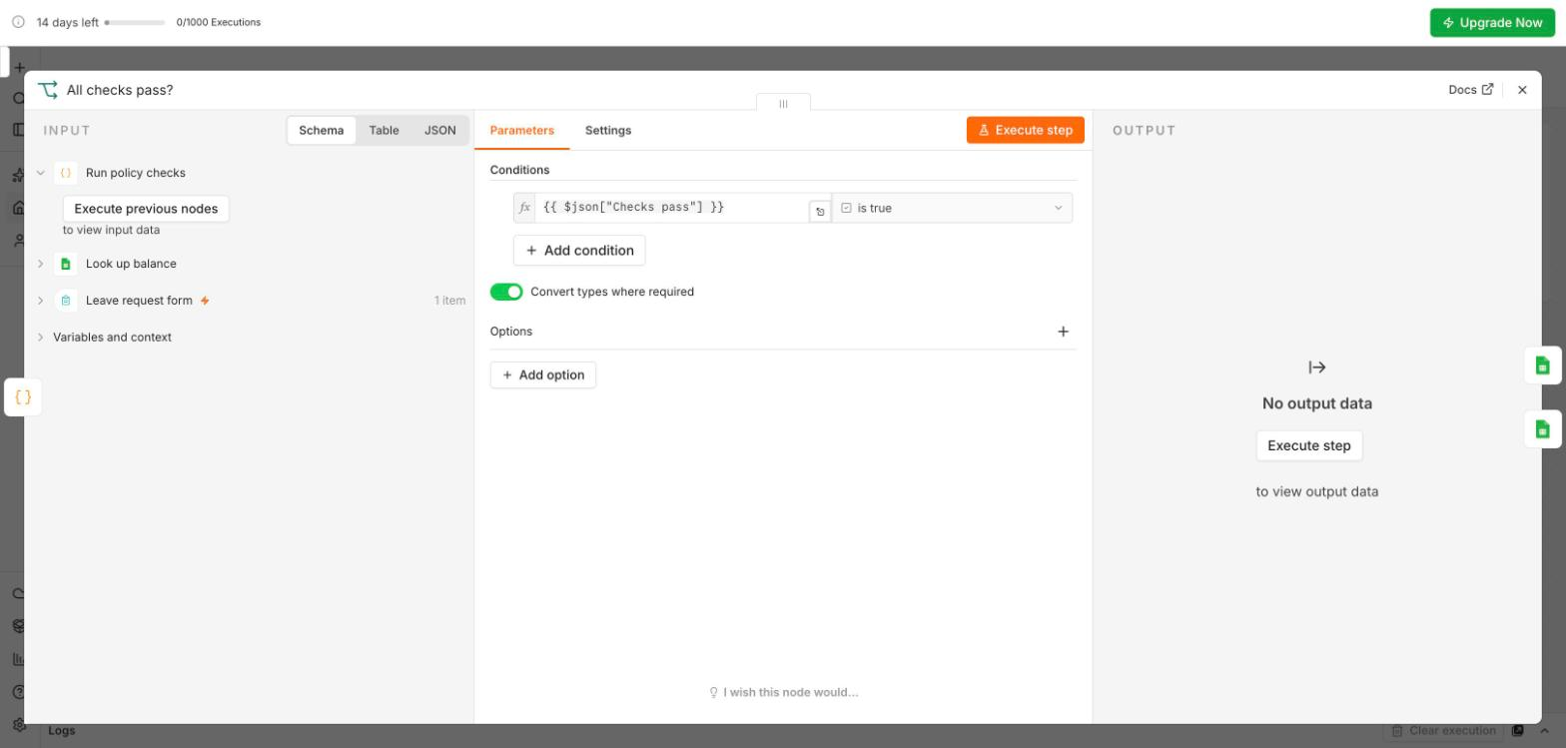
The condition: All checks pass?
One condition, 'Checks pass' is true. True goes to the manager, false goes to HR.
Screenshot: n8n Cloud (n8n GmbH), captured 11 October 2026 on the course trial workspace
IEEE CS Region 8 AI Caravan 2026 · AI Administrator · Day 3 · Session 5
26
Notes:
Point at 'Convert types where required'. Then run the workflow.

Slide 27
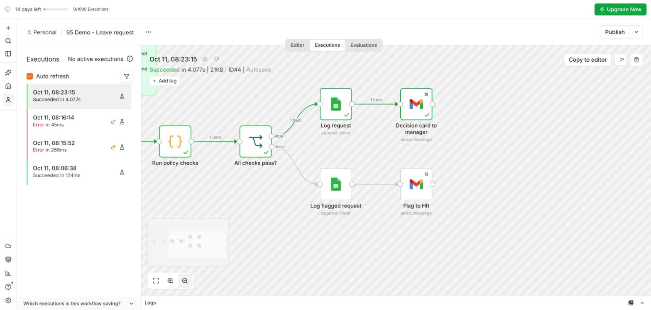
Run 1: checks pass
Green path: logged as 'Pending manager', decision card e-mailed. '1 item' on every arrow.
Screenshot: n8n Cloud (n8n GmbH), captured 11 October 2026 on the course trial workspace
IEEE CS Region 8 AI Caravan 2026 · AI Administrator · Day 3 · Session 5
27
Notes:
Open your inbox and show the decision card. The manager still decides: the workflow prepared, it did not approve.

Slide 28
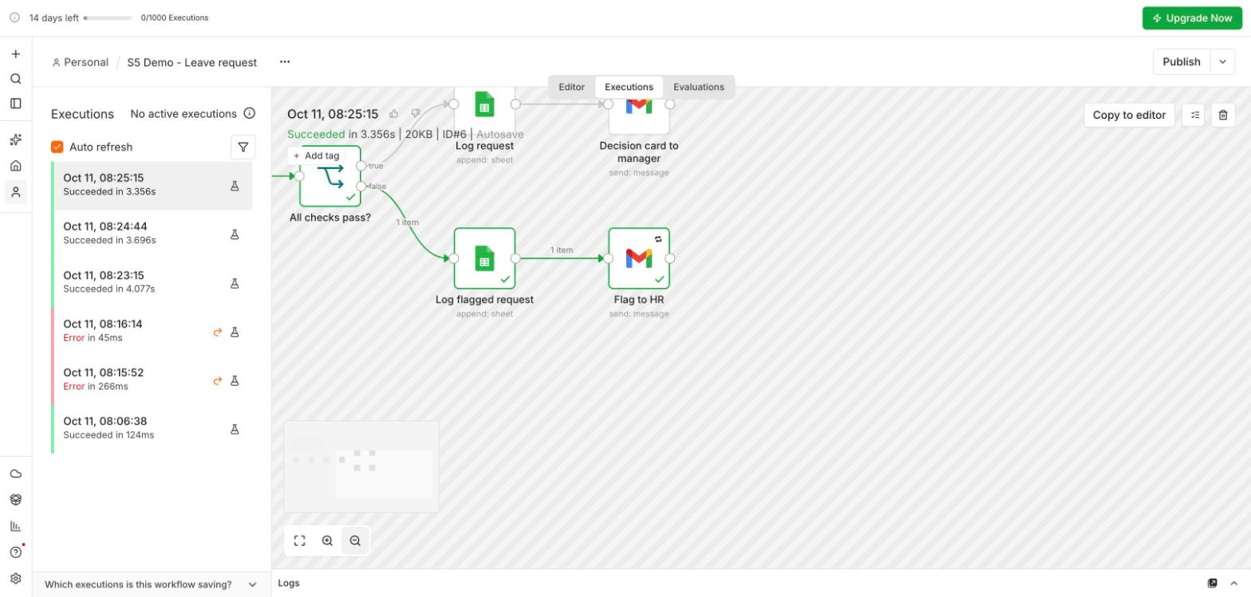
Runs 2 and 3: flagged for HR
False path: logged and sent to HR, not to the manager. Left: the Executions list, every run kept.
Screenshot: n8n Cloud (n8n GmbH), captured 11 October 2026 on the course trial workspace
IEEE CS Region 8 AI Caravan 2026 · AI Administrator · Day 3 · Session 5
28
Notes:
Sara asks for tomorrow with one day's notice; Lina asks for 3 days with 2 left. The Executions tab is the audit log: click any run to see exactly what happened.

Slide 29
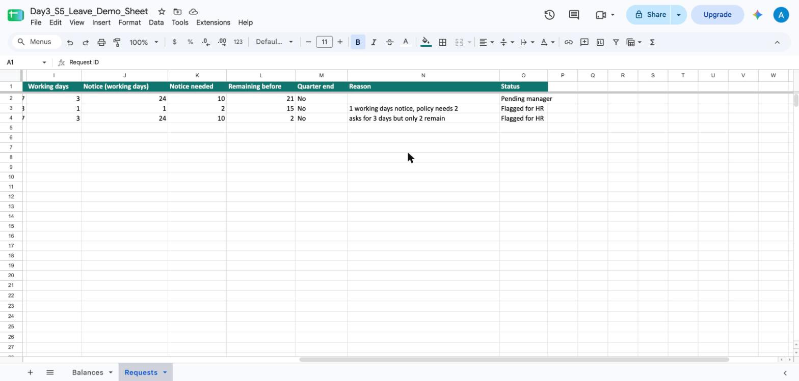
The record
Reason and Status written by the workflow: one 'Pending manager', two 'Flagged for HR' with the reason in plain words.
Screenshot: n8n Cloud (n8n GmbH), captured 11 October 2026 on the course trial workspace
IEEE CS Region 8 AI Caravan 2026 · AI Administrator · Day 3 · Session 5
29
Notes:
The sheet stands in for the HR portal. Note what changed from Session 3: no re-typing, the checks are done before the manager sees anything, and HR only sees the exceptions.

Slide 30
What the demo deliberately does not do
It does not approve or decline: the manager decides (Day 5 builds the approval gate). It does not chase the manager yet (candidate 4, a reminder, comes later). It does not read the free-text note (Session 6 adds the AI step).
IEEE CS Region 8 AI Caravan 2026 · AI Administrator · Day 3 · Session 5
30
Notes:
Tie back to the prioritisation matrix: we built the high value, low risk candidates first.

Slide 31
Section · minute 55
Break
Five minutes. Keep your n8n tab open.
About 5 minutes
IEEE CS Region 8 AI Caravan 2026 · AI Administrator · Day 3 · Session 5
31
Notes:
The co-host prepares breakout rooms of three or four, mixing faster and slower participants.

Slide 32
Section · minute 60
4. Lab: request intake
Build it yourself, in breakout rooms, 40 minutes
About 40 minutes
IEEE CS Region 8 AI Caravan 2026 · AI Administrator · Day 3 · Session 5
32
Notes:
The co-host posts Day3_S5_Lab_Handout.pdf and Day3_S5_Requests_Template.xlsx. Open the rooms at minute 63.

Slide 33
Lab steps 1 to 4
1
1. The sheet
Google Sheets, new sheet 'Requests', headers: Timestamp, Name, Email, Department, Amount, Description, Status. Same Google account as n8n.
2
2. The trigger
New workflow 'M5 Request intake'. On form submission: Name, Email, Department (dropdown), Amount (number), Description. Execute step, submit once, read the output.
3
3. Log the row
Google Sheets, Append row. Sign in with Google. Drag each field into its column; Status = New. Execute step; check the sheet.
4
4. Branch on amount
IF: Amount, Number, is greater than, 500. Test once above and once below 500.
IEEE CS Region 8 AI Caravan 2026 · AI Administrator · Day 3 · Session 5
33
Notes:
Steps follow the module. Rooms of three or four: one shares their screen, all build in their own workspace.

Slide 34
Lab steps 5 to 8
1
5. Two e-mails
Gmail, Send on each branch: 'needs approval' (true) and 'being processed' (false). To: drag Email; body with Name and Amount.
2
6. Guard
IF right after the form: Email is not empty AND Amount is greater than 0. False: Edit Fields Status = Incomplete, then append the row. No e-mail.
3
7. Retry and error workflow
Gmail Settings: Retry On Fail, 3 tries, 5000 ms. A second workflow 'Error notifier': Error Trigger, then Gmail to you.
4
8. Test, then publish
Three tests: small, large, no amount. Three rows, two e-mails. Then Publish, copy the production URL, open Executions.
IEEE CS Region 8 AI Caravan 2026 · AI Administrator · Day 3 · Session 5
34
Notes:
Step 6 is corrected from the module text; next slide. 'Activate' in the module is 'Publish' in today's n8n.

Slide 35
Trap 1: an empty number is 0, not empty
Tested on 11 October 2026: when Amount is left blank, the n8n form sends Amount = 0. A guard 'Amount is not empty' lets it through, logs it as New and sends an e-mail. Use 'Amount is greater than 0'.
IEEE CS Region 8 AI Caravan 2026 · AI Administrator · Day 3 · Session 5
35
Notes:
We found this by running the lab ourselves. It is a good lesson in itself: test the empty case, do not assume. The module text will be updated to match.

Slide 36
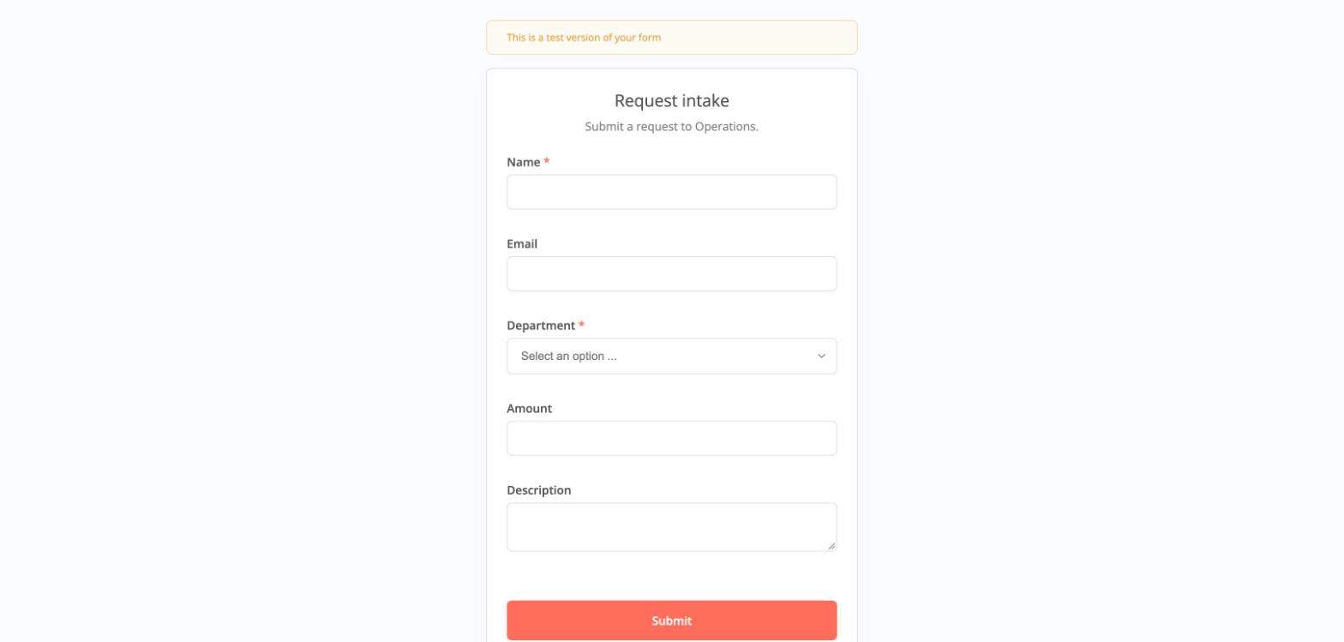
The form participants build
Name and Department required; Email and Amount optional on purpose, so the guard has something to catch.
Screenshot: n8n Cloud (n8n GmbH), captured 11 October 2026 on the course trial workspace
IEEE CS Region 8 AI Caravan 2026 · AI Administrator · Day 3 · Session 5
36
Notes:
If a participant makes every field required, the guard never fires. That is fine in real life; for the lab, leave Amount optional.

Slide 37
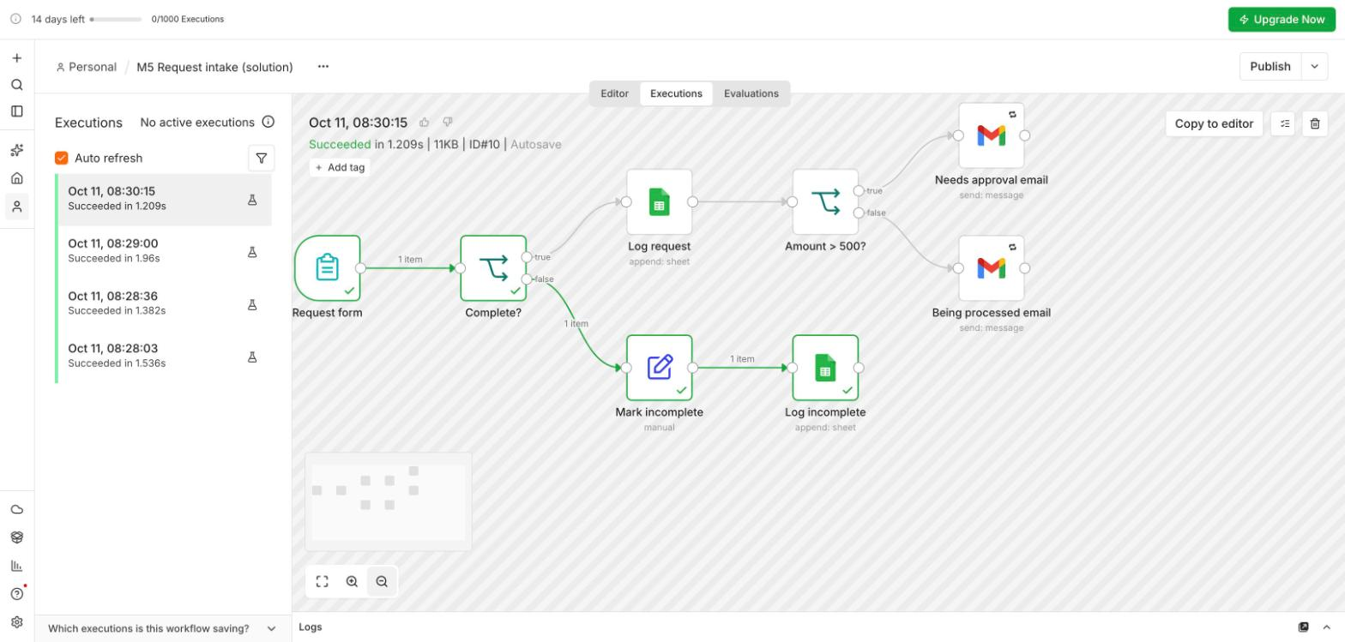
The finished lab, run 3: incomplete
Form, Complete?, then either Log request and Amount > 500 (two e-mails) or Mark incomplete and Log incomplete.
Screenshot: n8n Cloud (n8n GmbH), captured 11 October 2026 on the course trial workspace
IEEE CS Region 8 AI Caravan 2026 · AI Administrator · Day 3 · Session 5
37
Notes:
The solution file Day3_S5_Request_Intake_Solution.json is shared after the session, not during the lab.

Slide 38
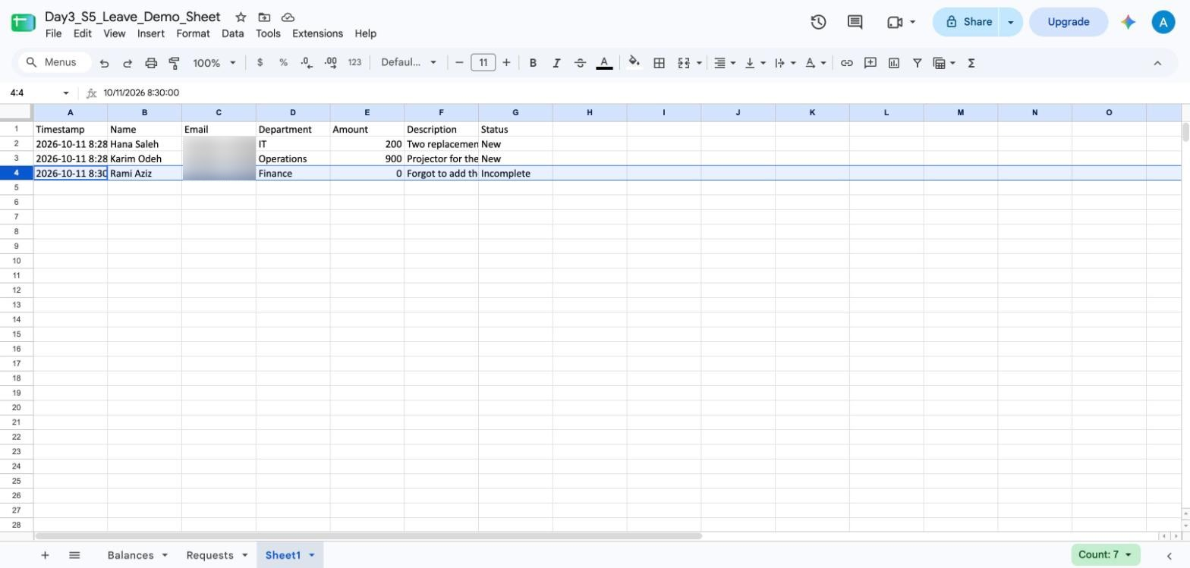
Three tests, three rows
200 = New (being processed), 900 = New (needs approval), blank = Incomplete with no e-mail.
Screenshot: n8n Cloud (n8n GmbH), captured 11 October 2026 on the course trial workspace
IEEE CS Region 8 AI Caravan 2026 · AI Administrator · Day 3 · Session 5
38
Notes:
This is what each room should show the co-host before minute 100.

Slide 39
In your breakout room
• Everyone builds in their own workspace; one person shares their screen at a time
• Stuck for more than three minutes? Ask for help (button at the bottom of Zoom)
• Execute step after every node, and read the output panel before adding the next
• Done early? Add the Error notifier, then help someone in your room
• At minute 98 the rooms close; bring a screenshot of your sheet
IEEE CS Region 8 AI Caravan 2026 · AI Administrator · Day 3 · Session 5
39
Notes:
The two instructors rotate through the rooms. Most common issues: wrong Google account (403), uploaded .xlsx, forgetting to click Execute before submitting the test form, IF set to String instead of Number.

Slide 40
Section · minute 100
5. Make it safe, then publish
Retry, an error workflow, and the difference between test and production
About 8 minutes
IEEE CS Region 8 AI Caravan 2026 · AI Administrator · Day 3 · Session 5
40
Notes:
Back in the main room. Eight minutes.

Slide 41
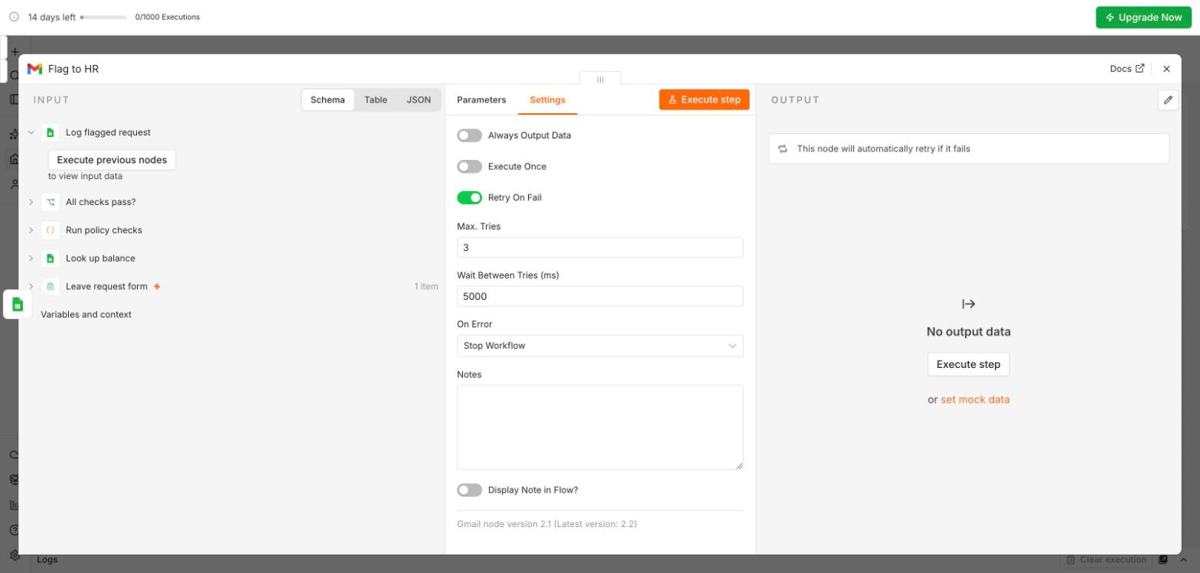
Retry on Fail
Node Settings: Retry On Fail, Max. Tries 3, Wait 5000 ms. Most failures are a mail server or an API that hiccups once.
Screenshot: n8n Cloud (n8n GmbH), captured 11 October 2026 on the course trial workspace
IEEE CS Region 8 AI Caravan 2026 · AI Administrator · Day 3 · Session 5
41
Notes:
'On Error' below it decides what happens after the last try: stop the workflow (default) or continue.

Slide 42
When it still fails: the error workflow
Build once
Attach to every workflow
• A separate workflow: Error Trigger, then Gmail to you
• Message: workflow name and the execution link
• Publish it
• Workflow menu, Settings, Error workflow
• Now a silent failure becomes an e-mail
• The link opens the failed run in Executions
IEEE CS Region 8 AI Caravan 2026 · AI Administrator · Day 3 · Session 5
42
Notes:
An automation that fails silently is worse than no automation: people stop checking because they think it works.

Slide 43
Test, then publish
Testing
Published
• Execute step: one node, with the data before it
• Execute workflow: the whole run, once
• Test URL listens for one submission
• Runs show in Executions with a flask icon
• Publish (top right) makes it live
• Production URL works for everyone, any time
• n8n 2.43 and later: no publishing with unconnected required inputs
• Change something? Test again, publish again
IEEE CS Region 8 AI Caravan 2026 · AI Administrator · Day 3 · Session 5
43
Notes:
The module and older tutorials say 'Activate'; today's n8n says Publish. Same idea.

Slide 44
Section · minute 108
Kahoot
20 questions on today
About 10 minutes
IEEE CS Region 8 AI Caravan 2026 · AI Administrator · Day 3 · Session 5
44
Notes:
Launch the kahoot imported from Day3_S5_Kahoot.xlsx; PIN on screen.

Slide 45
Join the Kahoot
How to join
The rules
• kahoot.it on your phone, or the Kahoot app
• Enter the PIN on the screen
• Use your real first name
• 20 seconds per question
• Correct answers are spread evenly over the four colours
• The rest arrive as a challenge link for homework
IEEE CS Region 8 AI Caravan 2026 · AI Administrator · Day 3 · Session 5
45
Notes:
Answer key with all 20 questions: Day3_S5_Kahoot_Answer_Key.pdf.

Slide 46
Deliverable
A published 'M5 Request intake' workflow with three test runs (small, large, incomplete), the Requests sheet showing three rows, and the exported JSON file. Optional: the Error notifier attached. Saved as M5-request-intake.
IEEE CS Region 8 AI Caravan 2026 · AI Administrator · Day 3 · Session 5
46
Notes:
Anyone who did not finish completes it before Session 6; the solution JSON is shared after the session.

Slide 47
Before you close the tab
Menu, Export JSON, for every workflow you built today. The trial deletes the workspace after 14 days; your JSON files are your copy.
IEEE CS Region 8 AI Caravan 2026 · AI Administrator · Day 3 · Session 5
47
Notes:
Wait twenty seconds while they do it. Ask for a thumbs-up reaction in Zoom when done.

Slide 48
Key takeaways
• One trigger, then actions; data moves as items and each node runs once per item.
• Every node implements one step of the future-state map; the human decisions stay human.
• Execute step after every node and read its output; test the empty case on purpose.
• Credentials live in the credential store, on the same account as your data.
• Retry, an error workflow, then publish. Export your JSON every day.
IEEE CS Region 8 AI Caravan 2026 · AI Administrator · Day 3 · Session 5
48
Notes:
Preview Session 6: the same request intake gets an AI step that classifies the description, with an 'unsure' route to a person.

Slide 49
Latest reading: n8n and automation at scale (2026)
n8n 2.43.0 release
n8n release notes · 6 October 2026 · docs.n8n.io/release-notes
Stronger guardrails and better publishing: a workflow with unconnected required inputs can no longer be published. The red triangles you saw today now block Publish.
No-Code Workflow Automation at Scale for IT Operations Teams
Intellistack · 16 September 2026 · intellistack.com/resources/blog/no-code-workflow-automation-at-scale-for-it-operations-teams
When building outruns governance you get workflow sprawl and unknown owners. Why every automation needs an owner (Session 4) and an error workflow (today).
In The Loop 2026, n8n's first conference
n8n · 13 to 14 October 2026, Berlin · n8n.io/intheloop
Talks and workshops on production automation and agents, this week. Recordings are a good follow-up to Sessions 5 and 6.
IEEE CS Region 8 AI Caravan 2026 · AI Administrator · Day 3 · Session 5
49
Notes:
Optional two minutes or self-study. Checked on 11 October 2026; instructors may swap in newer pieces, keeping source, date and a one-line takeaway tied to the session.

Slide 50
References
1. Al-Banna, A. (2026). AI Administrator, Module 5: Automation Basics with n8n. albanna-tutorials.com/ai-administrator/05_automation_basics_n8n.html
2. n8n documentation: n8n Form Trigger node. docs.n8n.io/integrations/builtin/core-nodes/n8n-nodes-base.formtrigger
3. n8n documentation: Google credentials and the Google Sheets node. docs.n8n.io/integrations/builtin/credentials/google
4. n8n documentation: Error handling, Error Trigger and Retry on Fail. docs.n8n.io/flow-logic/error-handling
5. n8n documentation: Data structure, items. docs.n8n.io/data/data-structure
6. n8n release notes 2.43.0 (6 October 2026): publishing blocked for workflows with unconnected required inputs. docs.n8n.io/release-notes
7. n8n Cloud pricing and free trial (14 days, 1,000 executions). n8n.io/pricing
8. Al-Banna, A. (2026). AI Administrator, Module 4: Workflow Mapping II, Designing the Future State (the leave-request future state used in the demo).
9. IEEE CS Region 8 AI Caravan (2026). AI Administrator Track Curriculum. aicaravan.org
IEEE CS Region 8 AI Caravan 2026 · AI Administrator · Day 3 · Session 5
50
Notes:
Leave on screen during questions. All n8n screens are real screenshots; AI Caravan Ltd., its employees and its leave policy are fictional.

