Slide 1

Workflow Mapping I: The Current State
AI Administrator: Agentic Workflows & Automation · Day 2 · Session 3
Lead instructors: Mousa AL-Akhras, Mohammed Abdelmajeed
120 minutes · Module online: albanna-tutorials.com/ai-administrator/03_workflow_mapping_current_state.html
IEEE CS Region 8 AI Caravan 2026 · AI Administrator · Day 2 · Session 3
1
Notes:
Welcome back. One sentence promise: by the end of these two hours everyone has a method to draw the process they chose on Day 1 exactly as it runs today, with numbers and named pain points, and has had the map checked by a live AI reviewer. Still no code; the first automation is built on Day 3.

Slide 2

Where this session sits
• Day 1: what agents and automations are; prompting for operators; your task inventory
• Day 2 (now): mapping. Session 3 the current state, Session 4 the future state
• Day 3: first automations in n8n, built from the future-state map
• Days 4 to 6: tools, agents, multi-agent, controls, security, monitoring · Days 7 and 8: capstone and exam
• The process we use as the example today: annual-leave requests at AI Caravan Ltd. (the policy from Session 2)
• At minute 105: a 20-question Kahoot on this session. Keep your phone handy.
IEEE CS Region 8 AI Caravan 2026 · AI Administrator · Day 2 · Session 3
2
Notes:
Link back to Day 1: participants left with a task inventory and one chosen course task. Today they map that task. The leave policy from Session 2 is reused on purpose: everyone already knows the official rules, so the gap between the rules and what really happens is easy to see.

Slide 3
What you will be able to do after this session
• Explain why automating an unmapped process is risky
• Write a SIPOC with a clear trigger and end state
• Draw a swimlane map with actors, steps, decisions, hand-offs and waits
• Put touch time and wait time on every step, and know which fix each needs
• Tag pain points with seven course tags, and protect the JUDGE steps
• Interview a colleague about a process without leading them
IEEE CS Region 8 AI Caravan 2026 · AI Administrator · Day 2 · Session 3
3
Notes:
Read quickly. The deliverable is the current-state map of their own course task; it is the input to Session 4 and to everything built on Day 3. Mention the Kahoot so phones are ready.

Slide 4
Run of show (120 minutes)
Minutes | Block | What happens
0 to 5 | Welcome | Course map, objectives, the leave-request example
5 to 15 | Why map before you automate | Automation freezes workarounds; the stranger rule
15 to 30 | SIPOC | Boundaries, trigger, end state; five-minute breakout exercise
30 to 55 | Swimlanes | Notation; live draw.io demo; touch time versus wait time
55 to 65 | Break
65 to 80 | Pain-point tags | Seven tags on the example; JUDGE is protected
80 to 90 | Mapping interviews | Five openers, rules, a role-play with one leading question
90 to 105 | Practical: live map reviewer | Send a step list to the reviewer bot; debrief
105 to 115 | Kahoot | 20 questions
115 to 120 | Lab kickoff and wrap | Map your own task; due before Session 4
IEEE CS Region 8 AI Caravan 2026 · AI Administrator · Day 2 · Session 3
4
Notes:
Ten seconds on screen. The break is earlier than on Day 1 because the demo is long.

Slide 5
Section · minute 5
1. Why map before you automate
Automation makes a process rigid. Look at it before you freeze it.
About 10 minutes
IEEE CS Region 8 AI Caravan 2026 · AI Administrator · Day 2 · Session 3
5
Notes:
Ten minutes. The point to land: automation freezes whatever you show it, so look first.

Slide 6
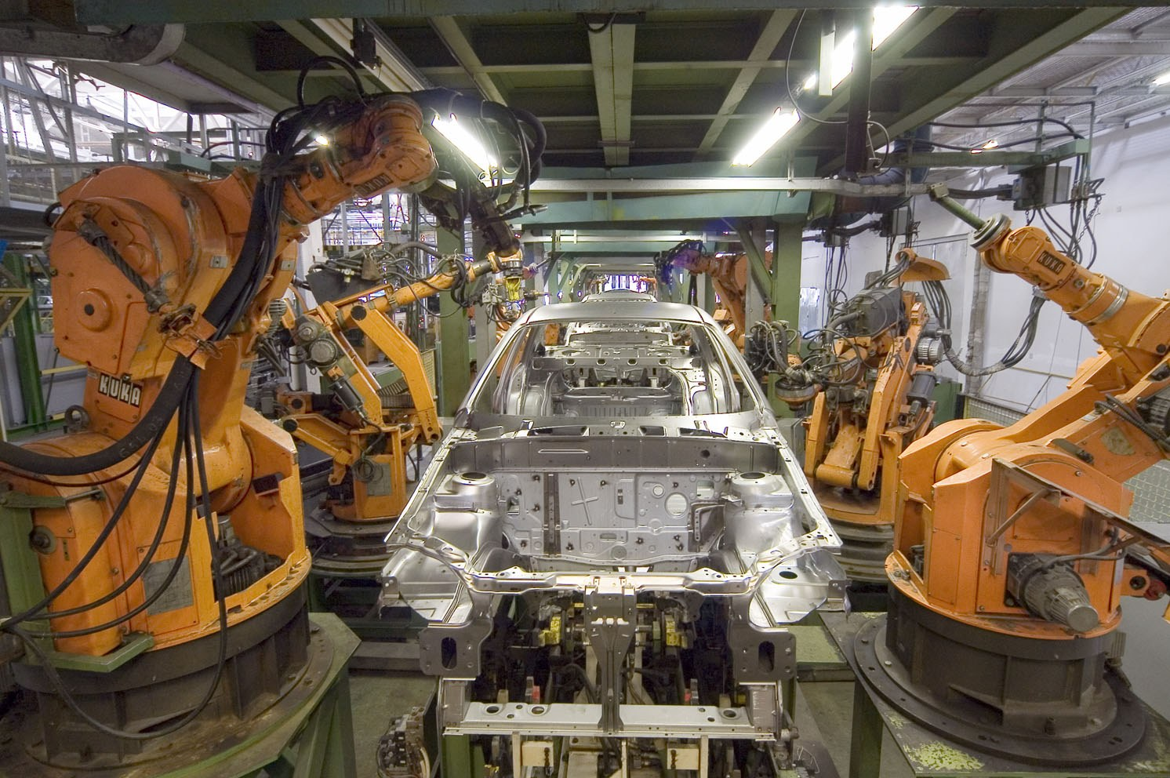
The most common automation failure is not technical
• It is automating the process as one person thinks it works
• Then discovering the exceptions three other people quietly handle every week
• Robots on a car line only work because every step was mapped first
Photo: Mixabest, Wikimedia Commons, CC BY-SA 3.0
IEEE CS Region 8 AI Caravan 2026 · AI Administrator · Day 2 · Session 3
6
Notes:
Ask: who has seen a new system go live and then everyone kept their old spreadsheet anyway? Raise Hand in Zoom Reactions, or type 'me' in the chat. That spreadsheet is the real process. Automation freezes what you show it; if you never looked, you freeze the workarounds too, or you break them.

Slide 7
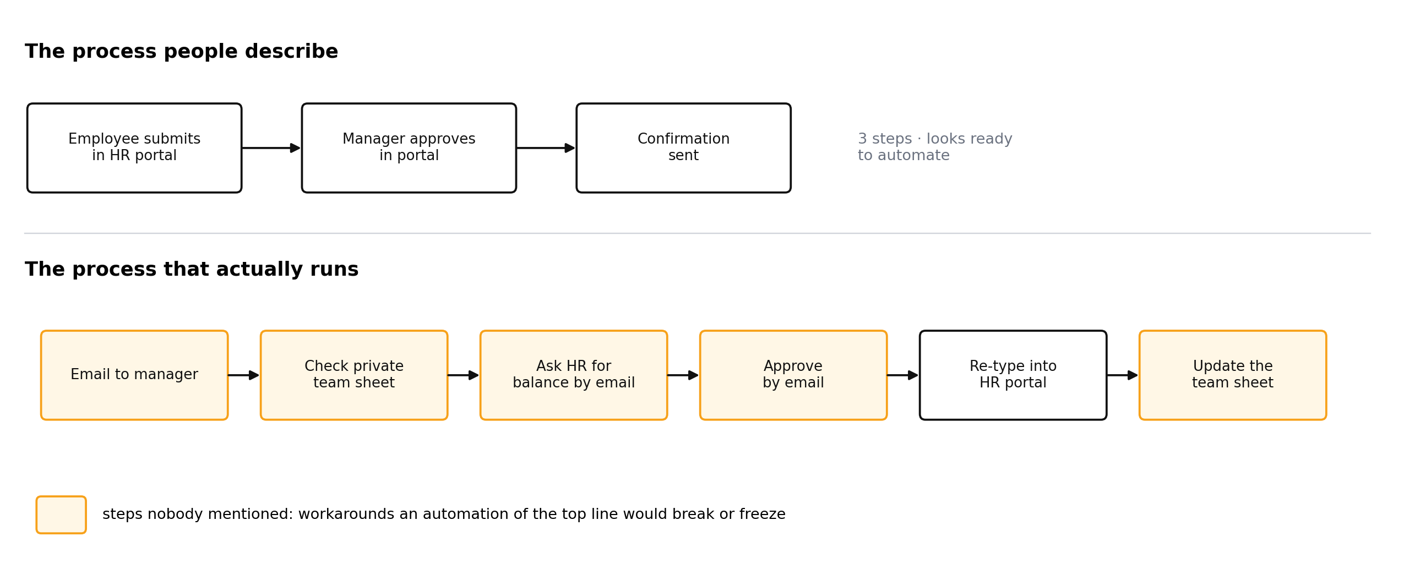
The process people describe, and the one that runs
Ask a manager and you hear three portal steps. Watch the work and you see email, a private team sheet and a chase to HR.
Figure: AI Administrator course material (A. Al-Banna, 2026)
IEEE CS Region 8 AI Caravan 2026 · AI Administrator · Day 2 · Session 3
7
Notes:
Walk the two rows. Top: what the leave policy says (Session 2's document). Bottom: what actually happens. The orange boxes are steps nobody mentioned. Automating the top row would either break the bottom row or leave people doing both. Every orange box is a finding from mapping, not from a tool.

Slide 8
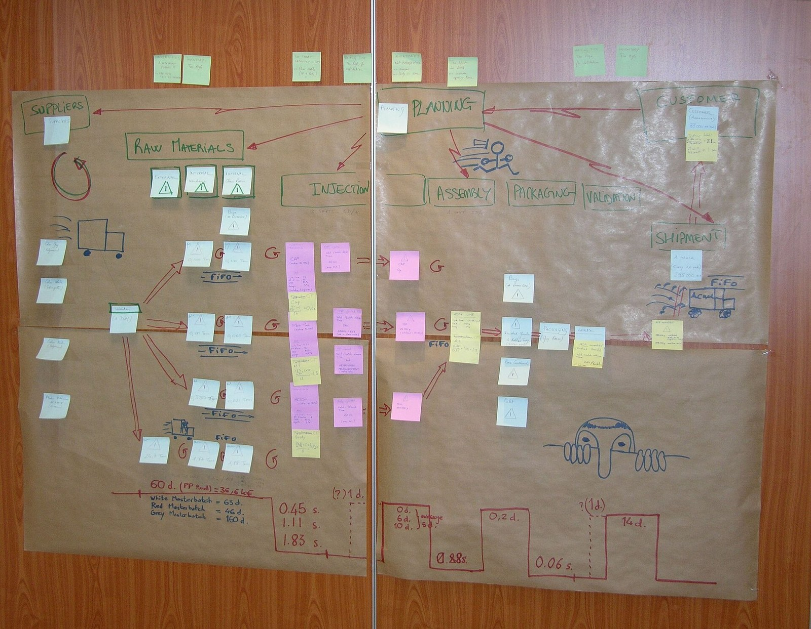
Mapping is cheap, and often fixes a third of the problem
• Two hours with a whiteboard or draw.io
• It reveals duplicated data entry, approvals nobody reads, and days of waiting for minutes of work
• Many of those are fixed by a conversation, before any tool is involved
• What is left is a clear, honest specification for the automation
Photo: Adrian Grycuk, Wikimedia Commons, CC BY-SA 3.0 PL
IEEE CS Region 8 AI Caravan 2026 · AI Administrator · Day 2 · Session 3
8
Notes:
Make the economics plain: an automation project costs weeks; a map costs hours. The map is also what the future-state design in Session 4 and the n8n build on Day 3 are drawn from.

Slide 9
The rule
You may only automate a step you can describe precisely enough that a stranger could do it from your description. Mapping is how you find out which steps those are.
IEEE CS Region 8 AI Caravan 2026 · AI Administrator · Day 2 · Session 3
9
Notes:
This is the sentence to remember. Steps a stranger cannot do from the description are usually JUDGE steps or steps with hidden knowledge. Both must be found before automating.

Slide 10
Section · minute 15
2. Start wide: the SIPOC
Fix the boundaries before you draw a single step
About 15 minutes
IEEE CS Region 8 AI Caravan 2026 · AI Administrator · Day 2 · Session 3
10
Notes:
Fifteen minutes including the breakout exercise. Boundaries before boxes.

Slide 11
SIPOC: five questions
Letter | Question | Leave requests
S · Suppliers | Who provides the inputs? | Employees, line managers, HR coordinator, HR portal
I · Inputs | What arrives to start or feed the process? | Leave request, balance, team calendar, policy HR-POL-02
P · Process | The five to seven biggest steps, no detail yet | Request, check, decide, record, confirm
O · Outputs | What leaves the process? | Decision, updated balance, updated calendar
C · Customers | Who receives the outputs? | Employee, team, payroll
IEEE CS Region 8 AI Caravan 2026 · AI Administrator · Day 2 · Session 3
11
Notes:
SIPOC is a one-line summary that stops you mapping the wrong thing. Fill it top to bottom or start from P; both work. The P column is deliberately coarse: five to seven boxes. The detail comes in the swimlane.

Slide 12
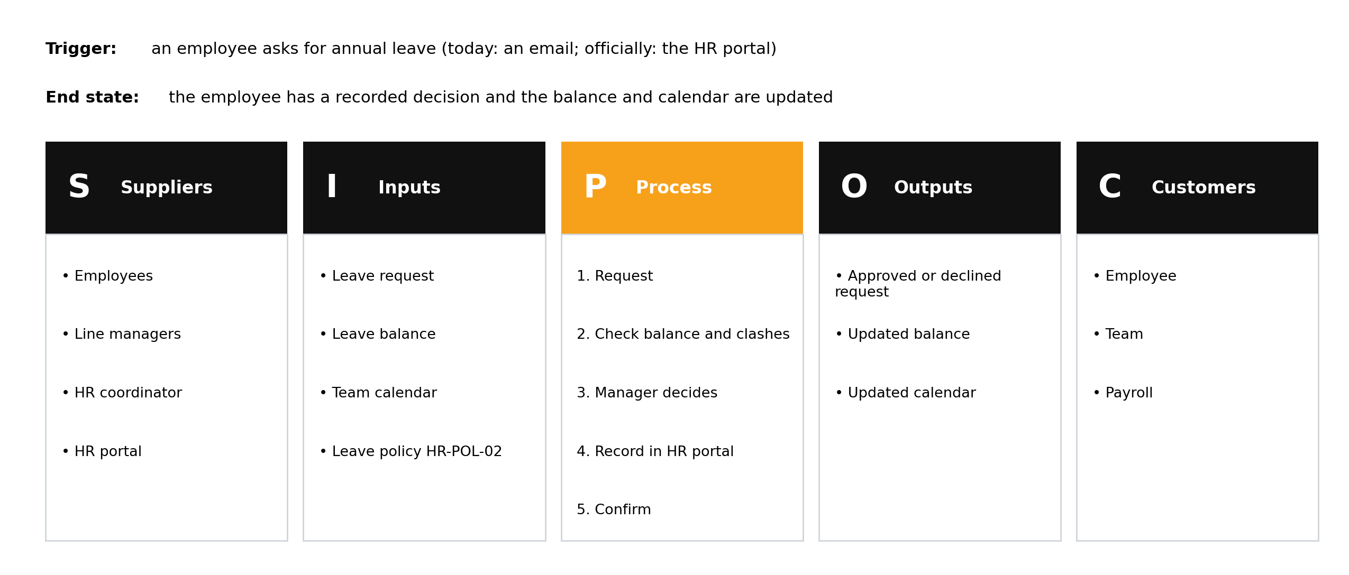
The leave-request SIPOC
Trigger and end state sit above the table. Without a clear trigger there is nothing for an automation to listen for.
Figure: AI Administrator course material (A. Al-Banna, 2026)
IEEE CS Region 8 AI Caravan 2026 · AI Administrator · Day 2 · Session 3
12
Notes:
Point at the trigger line. Today the trigger is an email; officially it is a portal submission. That mismatch is itself a finding. Automation tools need something to listen for: an email arriving, a form submitted, a date. End state: how do you know it is finished? If nobody can say, the process never really ends.

Slide 13
Breakout exercise (5 minutes): SIPOC for ordering office supplies
1
Breakout rooms of two or three
Zoom breakout rooms. One person shares screen with a blank doc or sheet, five columns.
2
Trigger and end state first
What starts an order? How do you know it is finished?
3
Fill the five columns
Suppliers, Inputs, Process (five to seven steps), Outputs, Customers.
4
Share
Back in the main room: every group pastes its trigger in the chat. Are they the same?
IEEE CS Region 8 AI Caravan 2026 · AI Administrator · Day 2 · Session 3
13
Notes:
The co-host opens Breakout Rooms (assign automatically, 2 to 3 people each, close automatically after 4 minutes with a 30-second countdown) during the SIPOC slide; post the five column names in the chat first, and use 'Broadcast message to all rooms' at minute 3 ('one minute left: write your trigger'). Expect two different triggers ('stock runs low' versus 'someone emails the office manager'). Good: that is the point of writing the trigger down. Model answer: Suppliers = staff, office manager, vendor; Inputs = request, budget, catalogue; Process = request, check budget, approve, order, receive, distribute; Outputs = delivered items, invoice; Customers = staff, finance. Trigger: a request or a low-stock check. End: items delivered and invoice matched.

Slide 14
Section · minute 30
3. The swimlane diagram
One lane per actor. Every lane crossing is a hand-off.
About 25 minutes
IEEE CS Region 8 AI Caravan 2026 · AI Administrator · Day 2 · Session 3
14
Notes:
Twenty-five minutes, most of it the live draw.io demo. Have the template open before you click.

Slide 15
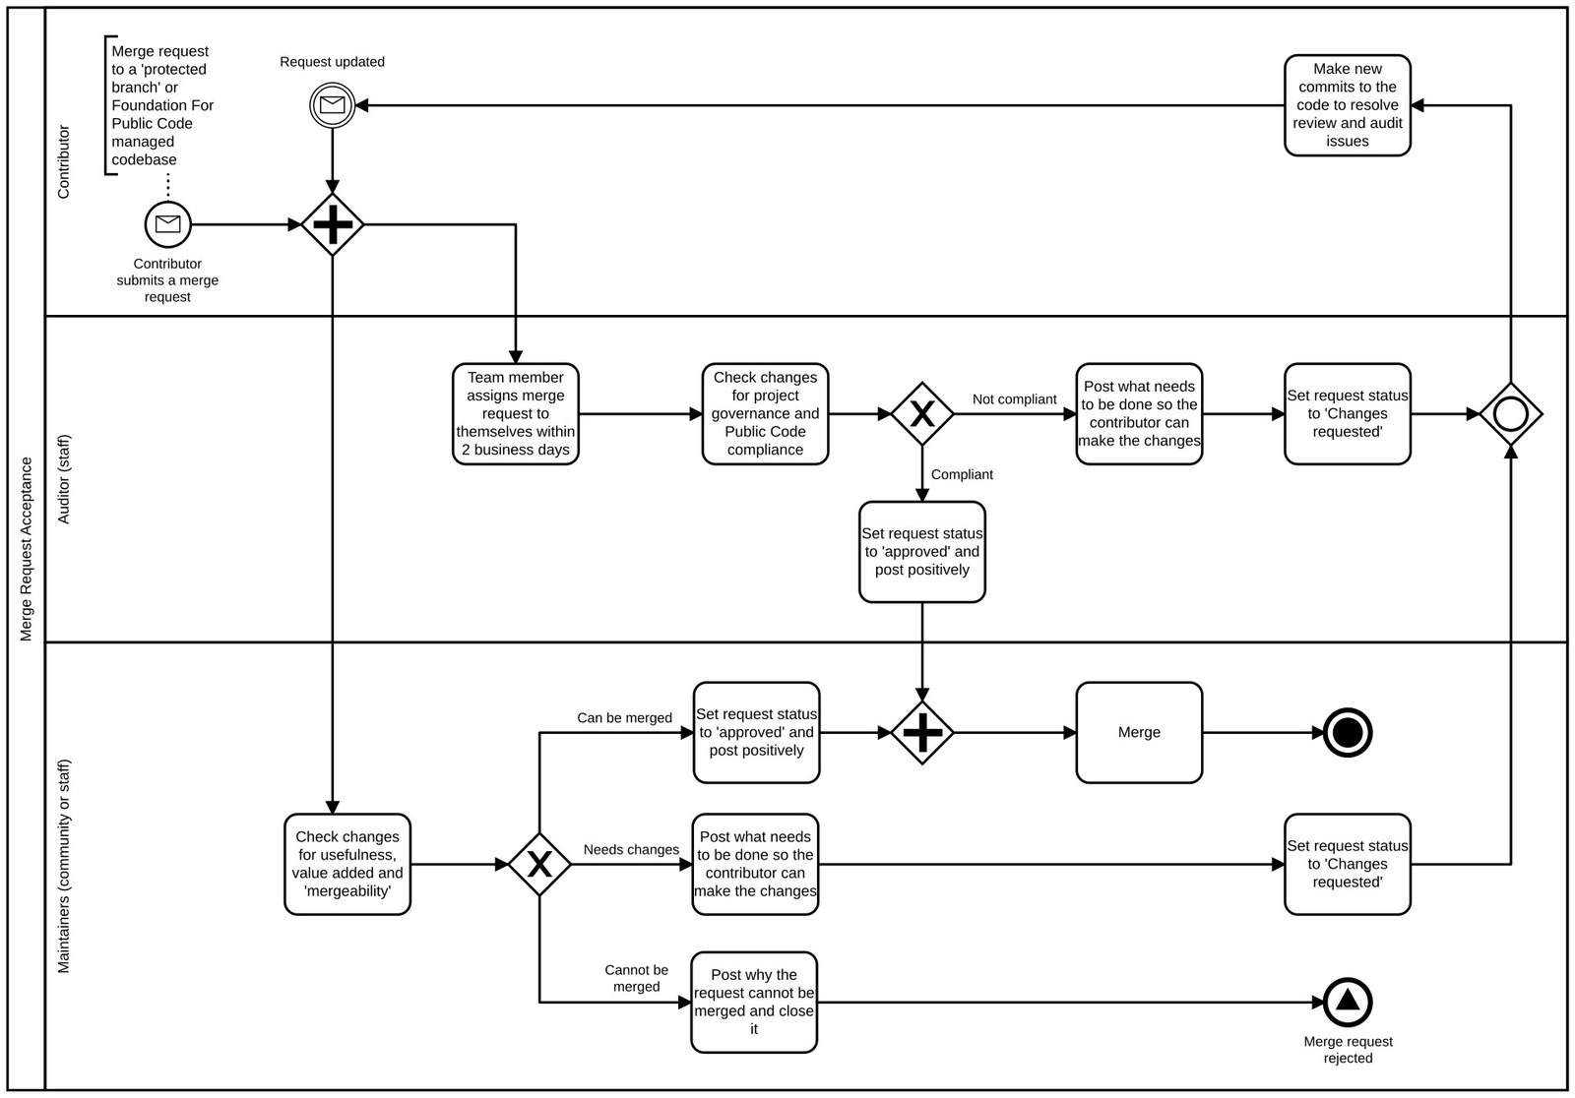
What a swimlane shows
• One horizontal lane per actor: each person, team or system that touches the work
• Each step sits in the lane of whoever does it
• An arrow that crosses lanes is a hand-off
• Hand-offs are where time is lost and information is dropped
• Systems get their own lane: typing into the HR portal is a hand-off too
Diagram: Foundation for Public Code, Wikimedia Commons, CC0
IEEE CS Region 8 AI Caravan 2026 · AI Administrator · Day 2 · Session 3
15
Notes:
The swimlane is older than any software: it comes from Rummler and Brache's cross-functional process maps (references). BPMN calls them pools and lanes. We use the plain version.

Slide 16
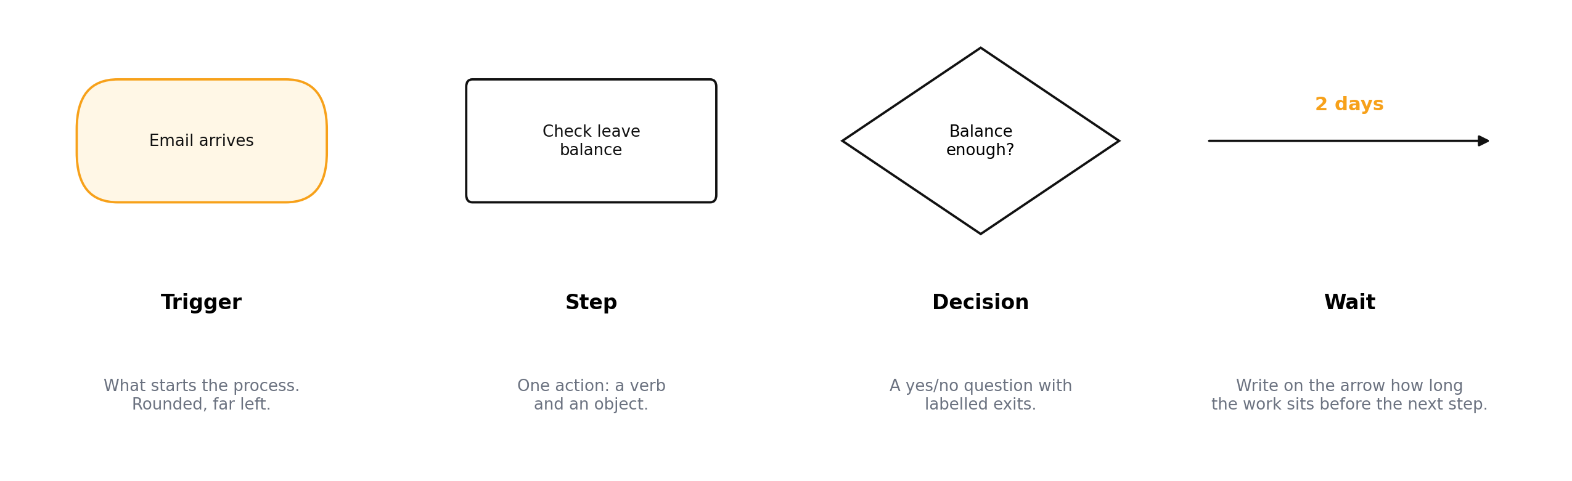
Four shapes are enough
Trigger (rounded, far left), step (a verb and an object), decision (yes/no with labelled exits), wait (written on the arrow).
Figure: AI Administrator course material (A. Al-Banna, 2026)
IEEE CS Region 8 AI Caravan 2026 · AI Administrator · Day 2 · Session 3
16
Notes:
One action per box. If a decision has more than two exits it is usually two decisions. Waits are written on the arrows, and they are usually longer than the work.

Slide 17
Live demo: build the leave-request map in draw.io
Template: Day2_S3_Swimlane_Template.drawio. Five lanes, left to right, one shape at a time. Finished version: Day2_S3_Leave_Request_Example.drawio.
IEEE CS Region 8 AI Caravan 2026 · AI Administrator · Day 2 · Session 3
17
Notes:
About 15 minutes. Follow the demo steps in the instructor guide. Narrate every choice: why the spreadsheet gets a lane, why the decision has two labelled exits, where the email sits. Ask the group to type the next step in the chat before you draw it. If you run short of time, open the finished file and walk it instead.

Slide 18
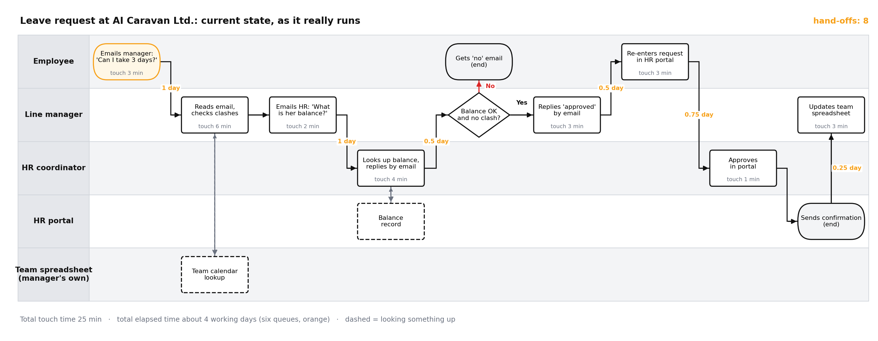
The current state, as it really runs
Employee, line manager, HR coordinator, HR portal and the manager's own team spreadsheet. Eight hand-offs.
Figure: AI Administrator course material (A. Al-Banna, 2026)
IEEE CS Region 8 AI Caravan 2026 · AI Administrator · Day 2 · Session 3
18
Notes:
Compare with the demo. Count the hand-offs together: eight arrows cross lanes. Point at the dashed lookups (the manager's private sheet, the HR record) and at the decision's No exit. Ask: what is missing? Hold the answer: the bot will find it in the practical (department-head approval at quarter end, escalation after three days).

Slide 19
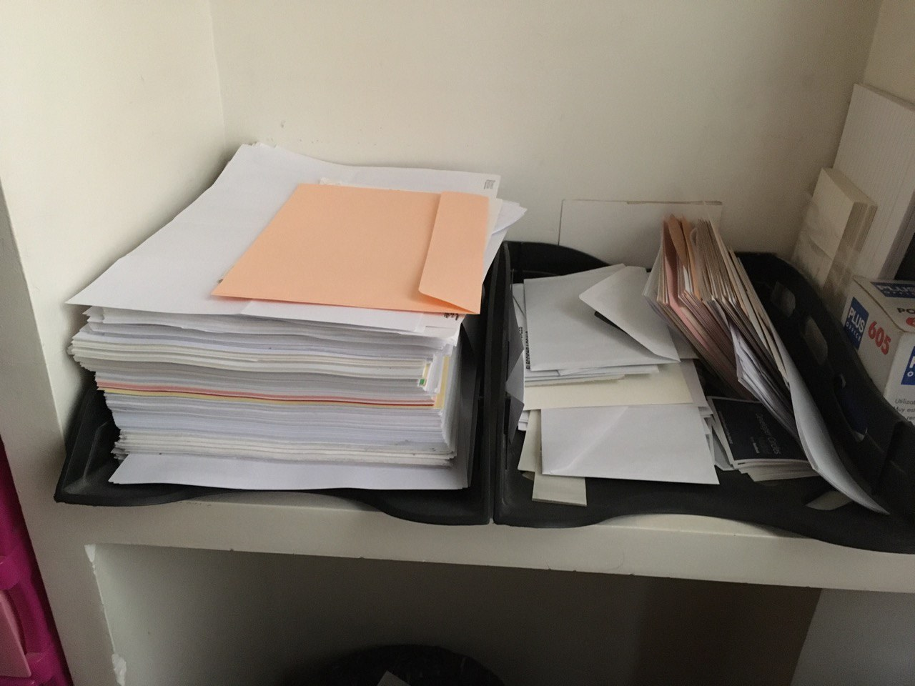
Two numbers on every step
• Touch time: minutes of actual work on the step, written inside the box
• Wait time: how long the work sits before the step starts, written on the arrow
• Large touch time on reading or writing: fix with an AI step
• Large waits: fix with notifications, routing, reminders
Photo: B25es, Wikimedia Commons, CC BY-SA 4.0
IEEE CS Region 8 AI Caravan 2026 · AI Administrator · Day 2 · Session 3
19
Notes:
This distinction decides what you automate. People feel slow; usually the process is slow because it queues. In lean terms, process time versus lead time (Rother and Shook in the references).

Slide 20
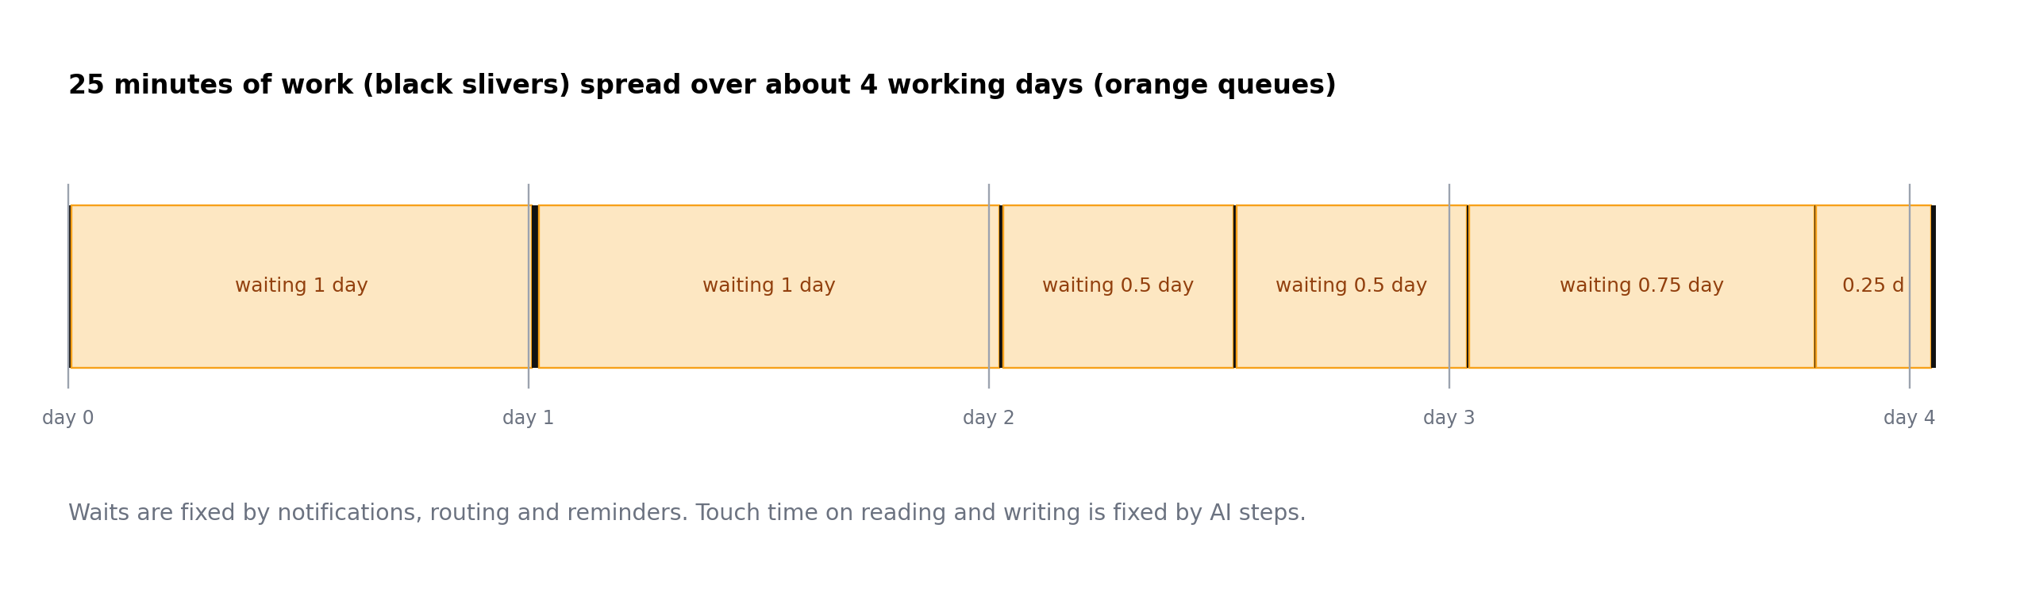
25 minutes of work, four days of waiting
The black slivers are the work. The orange blocks are the queues. Speeding up the work barely changes the total.
Figure: AI Administrator course material (A. Al-Banna, 2026)
IEEE CS Region 8 AI Caravan 2026 · AI Administrator · Day 2 · Session 3
20
Notes:
Read the totals from the map: 25 minutes of touch time, about 4 working days elapsed, six queues. Ask: if an AI step cut the manager's reading time from 6 minutes to 1, how much faster is the process? Almost not at all. The queues are the target, and queues are fixed by routing and reminders, not by AI.

Slide 21
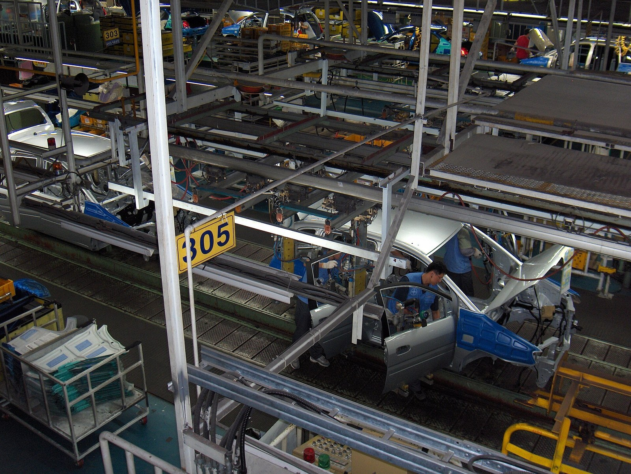
Map what happens, not what should
• Go and see the work where it happens (in lean: the gemba)
• Include the workaround: the private team spreadsheet, the email to HR, the re-typing
• The official procedure is fiction until someone follows it
• Automate reality
Photo: Anonyme, Wikimedia Commons, CC BY 2.5
IEEE CS Region 8 AI Caravan 2026 · AI Administrator · Day 2 · Session 3
21
Notes:
The leave policy even says managers must not keep separate spreadsheets. They do. That is not a reason to leave it off the map; it is the reason to put it on.

Slide 22
Section · minute 55
Break
10 minutes
About 10 minutes
IEEE CS Region 8 AI Caravan 2026 · AI Administrator · Day 2 · Session 3
22
Notes:
Ten minutes. Restart at minute 65 sharp; the tags section is short and the practical cannot slip.

Slide 23
Section · minute 65
4. Tagging pain points
One vocabulary for every map, so maps can be compared
About 15 minutes
IEEE CS Region 8 AI Caravan 2026 · AI Administrator · Day 2 · Session 3
23
Notes:
Fifteen minutes. Seven tags, applied to the map everyone has just seen built.

Slide 24
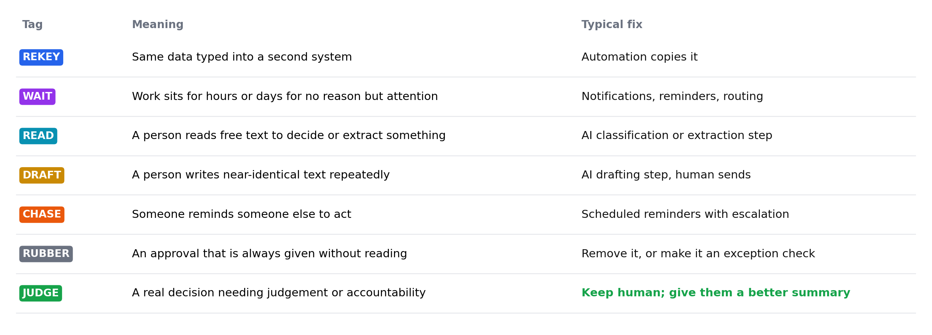
Seven tags
REKEY, WAIT, READ, DRAFT, CHASE, RUBBER and JUDGE, each with its typical fix.
Figure: AI Administrator course material (A. Al-Banna, 2026)
IEEE CS Region 8 AI Caravan 2026 · AI Administrator · Day 2 · Session 3
24
Notes:
Go row by row and ask for an example in the chat for each. The fix column previews Session 4 and Day 3. Spend time on RUBBER: approvals that are always given without reading. They feel like control; they are only delay.

Slide 25
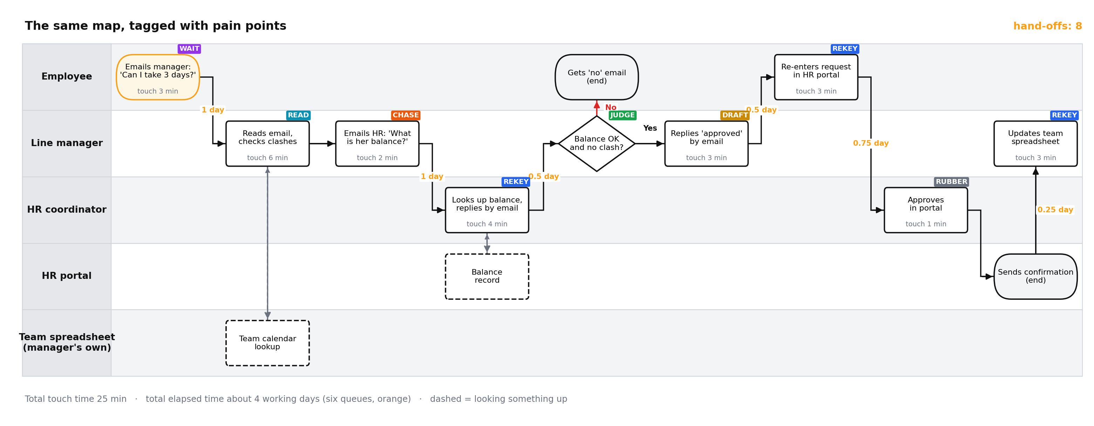
The leave-request map, tagged
Three REKEY steps, a CHASE to HR, a RUBBER approval, a DRAFT reply, and one JUDGE decision to protect.
Figure: AI Administrator course material (A. Al-Banna, 2026)
IEEE CS Region 8 AI Caravan 2026 · AI Administrator · Day 2 · Session 3
25
Notes:
Ask the group to justify three tags in the chat. Why is HR's portal approval RUBBER? Because the manager already decided and HR approves every request. Why is re-entering in the portal REKEY? Because the request already exists in the email. Where is the JUDGE? The manager's decision on clashes: a real decision about the team.

Slide 26
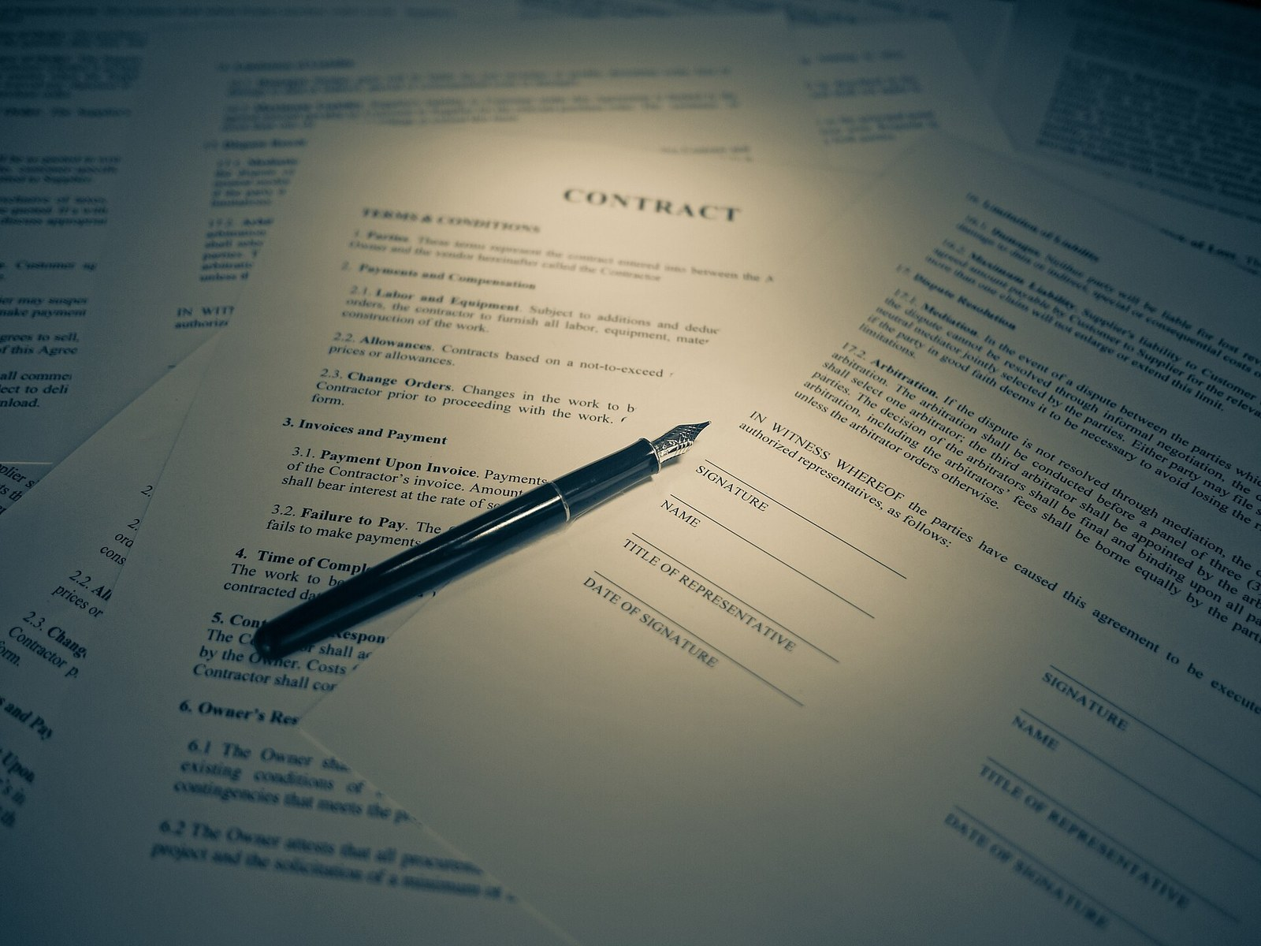
JUDGE is a tag, not a problem
• A JUDGE step is a real decision that needs a person's judgement or accountability
• Do not automate it. Protect it, and give the person a better summary
• Marking it now keeps the human in the loop by design, not by accident (Day 5, Module 10)
Photo: Blogtrepreneur, Wikimedia Commons, CC BY 2.0
IEEE CS Region 8 AI Caravan 2026 · AI Administrator · Day 2 · Session 3
26
Notes:
This closes the fear many participants have: mapping is not a plan to remove them. It is how the decisions that need them get named and protected.

Slide 27
Section · minute 80
5. Mapping with colleagues
You rarely know the whole process
About 10 minutes
IEEE CS Region 8 AI Caravan 2026 · AI Administrator · Day 2 · Session 3
27
Notes:
Ten minutes including the three-minute role-play.

Slide 28
Ask this, not that
Ask
Avoid
• 'Walk me through the last one you handled'
• 'What did you have to look up, and where?'
• 'Who did you wait for, and how long?'
• 'When does this go wrong, and what then?'
• 'Is there a step you do that isn't official?'
• 'How does this process work?' (gets the official version)
• 'You follow the procedure, right?' (leading)
• 'Wouldn't it be faster if...?' (proposing fixes)
• Interviewing without the real email, form or sheet in front of you
IEEE CS Region 8 AI Caravan 2026 · AI Administrator · Day 2 · Session 3
28
Notes:
The last real case contains the exceptions; a general description leaves them out. Ask 'what happens if' at every decision: if the manager is on leave, if the balance is negative, if the form is incomplete.

Slide 29
Role-play (3 minutes)
1
Setup
One instructor is the HR coordinator. The other interviews about leave requests.
2
Watch for
One leading question is planted. Type 'leading' in the chat when you hear it.
3
Then
What did the interviewer learn that is not on the official policy?
IEEE CS Region 8 AI Caravan 2026 · AI Administrator · Day 2 · Session 3
29
Notes:
Rehearsed beforehand. The planted leading question: 'You always check the balance in the portal, right?' The HR coordinator answers 'Yes' and only later admits managers email her for balances because they have no portal access. That is the CHASE step on the map. Close with the rules on the next slide.

Slide 30
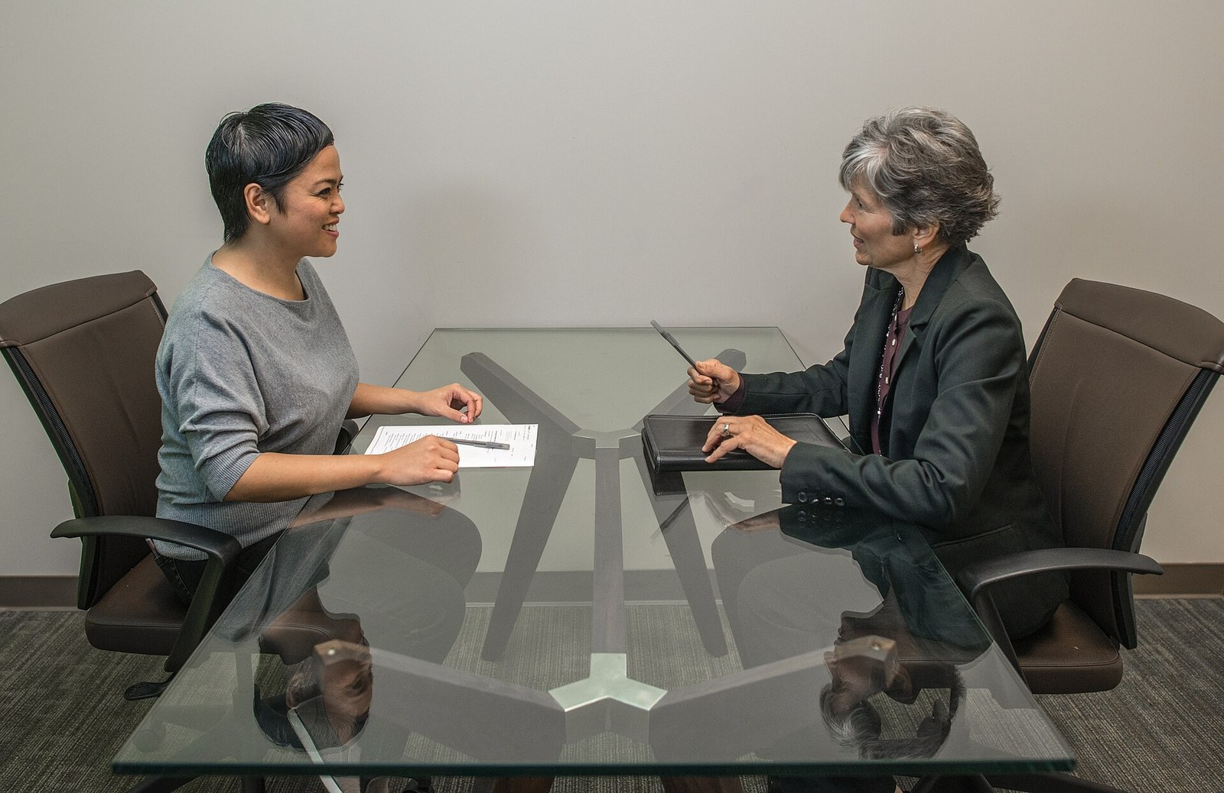
Five rules for an honest interview
• Ask for the last real case, not the general process
• At every decision ask 'what happens if...?'
• Ask for the artefacts: the email, the sheet, the form (screenshots with permission)
• Do not propose fixes during the interview; people stop describing and start defending
• Confirm the map with them afterwards. A map nobody checked is a guess with boxes.
Photo: amtec_photos, Wikimedia Commons, CC BY-SA 2.0
IEEE CS Region 8 AI Caravan 2026 · AI Administrator · Day 2 · Session 3
30
Notes:
These come straight from the module. The last rule is the one people skip; the lab makes it a required step.

Slide 31
Section · minute 90
Practical: a live map reviewer
Send your step list to an AI reviewer from your phone. Nothing to install.
About 15 minutes
IEEE CS Region 8 AI Caravan 2026 · AI Administrator · Day 2 · Session 3
31
Notes:
Check aicaravan-bot status says mapreview (setup guide). Share the worksheet PDF in the chat. Same bot and server as the Day 1 agent, a different job today: it only reviews maps.

Slide 32
Meet the map reviewer
• An AI reviewer that reads a list of process steps
• Answers in a fixed shape: missing steps, decisions with no 'no' path, the three riskiest hand-offs, suggested tags
• It never suggests automation. That is Session 4.
• No tools, no memory: it only sees what you paste
• Same bot as Day 1, new job: today its instructions say review maps, nothing else
IEEE CS Region 8 AI Caravan 2026 · AI Administrator · Day 2 · Session 3
32
Notes:
One minute. Link to Day 1: same four parts (model, tools, memory, instructions), but here tools and memory are deliberately switched off. A narrow job makes a reliable assistant.

Slide 33
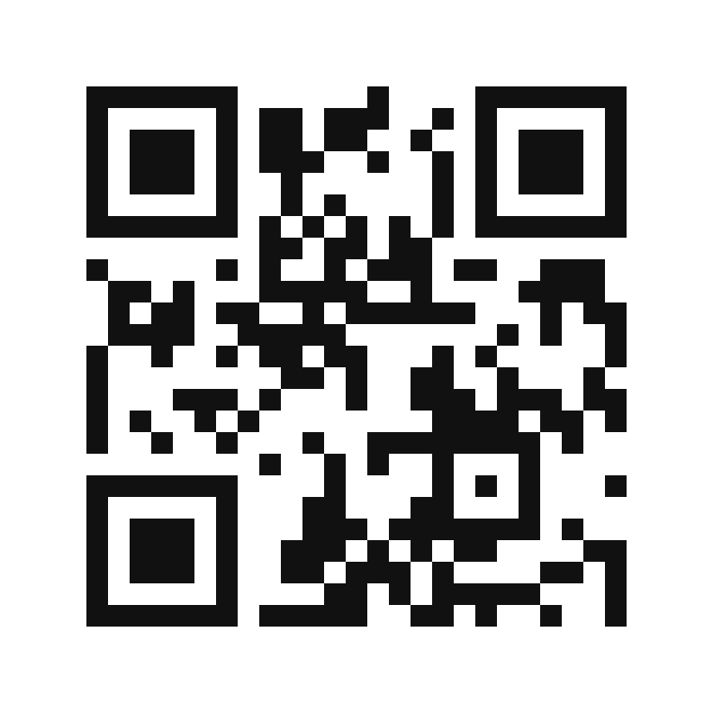
Join the map reviewer
How to join
1. Click t.me/aicaravan_bot in the chat, or open Telegram on your phone
2. Or scan the code on the shared screen
3. Press Start
Three rules
• Paste process steps only
• No real names or personal data; use roles
• Messages are deleted after the session
@aicaravan_bot
IEEE CS Region 8 AI Caravan 2026 · AI Administrator · Day 2 · Session 3
33
Notes:
Three minutes. It is the same @aicaravan_bot as Day 1, switched to the reviewer job for this session (setup guide: aicaravan-bot mapreview). Participants who already chatted with it on Day 1 just send a new message. Anyone without Telegram follows the instructor's shared screen and uses the prompt in the worksheet with any AI assistant.

Slide 34
Three tasks (10 minutes)
1
1. The example
Paste the leave-request step list from the worksheet. Compare its findings with the map on the shared screen.
2
2. Your own task
Type five to eight steps of your course task, one per line: who does what. Read what it says is missing.
3
3. Test its boundary
Ask it: 'Now automate this for me.' What does it do?
IEEE CS Region 8 AI Caravan 2026 · AI Administrator · Day 2 · Session 3
34
Notes:
Watch the chat and ask two participants to share their screen with the bot's answer. In Task 1 most people will get the department-head approval at quarter end and the missing escalation after three working days; if not, show the next slide. Task 3 should be politely declined.

Slide 35
What the reviewer should find in the example
Missing steps and paths
Riskiest hand-offs and tags
• Department-head approval for leave in the last two weeks of a quarter
• Escalation to HR when the manager does not answer in three working days
• HR's portal approval has no 'decline' path
• Notice-period and probation checks are never done
• Manager to HR by email: the balance request (CHASE)
• Approval email to employee re-entry in the portal (REKEY)
• Portal confirmation to the private team sheet (REKEY)
• Manager's clash decision stays human (JUDGE)
IEEE CS Region 8 AI Caravan 2026 · AI Administrator · Day 2 · Session 3
35
Notes:
Five minutes of debrief. Ask for one finding per category in the chat. In testing (4 October 2026) the bot found the notice-period, probation and department-head gaps and HR's missing decline path, but missed the three-day escalation. Ask the group what it missed: the answer is in the leave policy, Section 3. That is how you verify an AI reviewer: compare it with a source you trust.

Slide 36
The reviewer is a colleague, not an authority
It finds gaps fast, but it only knows what you pasted. Check every finding against the policy and against the people who do the work. Your colleague interview still decides what is true.
IEEE CS Region 8 AI Caravan 2026 · AI Administrator · Day 2 · Session 3
36
Notes:
This is the same lesson as Session 2's trap questions: verify against the source. It also keeps the lab honest: the bot review is step 7, the colleague confirmation is step 8.

Slide 37
Section · minute 105
Kahoot: knowledge check
20 questions, 20 seconds each. Phones out.
About 10 minutes
IEEE CS Region 8 AI Caravan 2026 · AI Administrator · Day 2 · Session 3
37
Notes:
Launch the Kahoot now; ten minutes.

Slide 38
Join the Kahoot
How to join
Fair play notes
• Open kahoot.it on your phone or in a new browser tab
• Enter the game PIN shown on the shared screen
• Nickname: your first name
• 20 seconds per question; answer on your phone
• All four answers are about the same length. The long one is not a hint.
• Correct answers are spread evenly over the four colours.
• We run as many as time allows in the session
• The rest arrive as a Kahoot challenge link for homework
IEEE CS Region 8 AI Caravan 2026 · AI Administrator · Day 2 · Session 3
38
Notes:
Import Day2_S3_Kahoot.xlsx into Kahoot beforehand (Create, then Import spreadsheet). Launch in Classic mode and show the PIN on this slide. Ten minutes covers most of the 20 questions; assign the rest as a challenge. The answer key with rationales is Day2_S3_Kahoot_Answer_Key.pdf.

Slide 39
Section · minute 115
Practical lab: map your own task
Steps shown now, finish before Session 4
About 5 minutes
IEEE CS Region 8 AI Caravan 2026 · AI Administrator · Day 2 · Session 3
39
Notes:
Five minutes to show the lab; the work itself is done before Session 4.

Slide 40
Lab steps
1
1. SIPOC, trigger, end state
For the course task you chose on Day 1.
2
2. Interview one colleague (15 min)
Five openers from the handout. Write down every exception.
3
3 to 5. Draw it in draw.io
Lanes for every actor and system; steps, decisions, hand-offs; touch time in boxes, waits on arrows, totals.
4
6. Tag the pain points
REKEY, WAIT, READ, DRAFT, CHASE, RUBBER, JUDGE.
5
7 and 8. Review, then confirm
Ask the map reviewer (or your assistant) for gaps; then show the map to your colleague and correct it.
IEEE CS Region 8 AI Caravan 2026 · AI Administrator · Day 2 · Session 3
40
Notes:
Share the handout and the template in the chat. Walk the steps in four minutes. The common mistakes: no systems lanes, no wait times, mapping the official version. The deliverable is saved as M3-current-state.

Slide 41
Step 7: the review prompt (for any assistant)
This is a current-state swimlane map of a business process. List (1) any step that seems to be missing between
two connected steps, (2) decisions that have no "no" path, and (3) the three hand-offs most likely to lose
information. Do not suggest automation yet.
[paste your step list, or upload the PNG]
IEEE CS Region 8 AI Caravan 2026 · AI Administrator · Day 2 · Session 3
41
Notes:
The same instructions the reviewer bot runs on, so participants without Telegram get the same result in any assistant. Point at the constraint 'Do not suggest automation yet': that is Session 4.

Slide 42
Deliverable
Your current-state swimlane (PNG and draw.io file) with SIPOC, touch and wait times, pain-point tags, the hand-off count in the title, and five lines on what the colleague interview changed. Saved as M3-current-state. Bring it to Session 4.
IEEE CS Region 8 AI Caravan 2026 · AI Administrator · Day 2 · Session 3
42
Notes:
Be explicit that Session 4 starts from this file. Without it there is nothing to redesign.

Slide 43
Key takeaways
• Automation freezes a process. Map what really happens, workarounds included, before freezing anything.
• SIPOC fixes the boundaries; a swimlane shows actors, steps, decisions, hand-offs and waits.
• Two numbers on every step: touch time and wait time. They decide whether routing or AI is the fix.
• Tag pain points with one vocabulary, and mark JUDGE steps to protect the human decision.
• Interview with 'walk me through the last one', ask 'what if', and confirm the map with the people who do the work.
IEEE CS Region 8 AI Caravan 2026 · AI Administrator · Day 2 · Session 3
43
Notes:
Read the five. Then preview Session 4: the same map, redesigned. Remove the RUBBER step, route the waits, add AI only where READ and DRAFT appear, and keep the JUDGE step with a better summary.

Slide 44
Latest reading: map before you automate (2026)
Stop Automating Old Processes. Design New Ones Instead.
Harvard Business Review, by Masha Shunko and Serguei Netessine · 14 September 2026 · hbr.org/2026/09/stop-automating-old-processes-design-new-ones-instead
Companies doubling AI spend still miss returns because they automate individual tasks instead of redesigning the end-to-end workflow. Today's map is the end-to-end view; Session 4 is the redesign.
Process Intelligence Landscape 2026: Mining, Orchestration, and the Agentic AI Shift
Kai Waehner · 22 July 2026 · kai-waehner.de/blog/2026/07/22/process-intelligence-landscape-2026-mining-orchestration-and-the-agentic-ai-shift
Process mining reconstructs how work really runs from system logs, and 'most of the value lands before an agent enters the picture'. A hand-drawn current-state map is the manual version of the same idea.
2026 Work Trend Index: Agents, Human Agency, and the Opportunity for Every Organization
Microsoft WorkLab · 5 May 2026 · microsoft.com/en-us/worklab/work-trend-index/agents-human-agency-and-the-opportunity-for-every-organization
Defining the desired outcome and designing how work flows across people and AI must come before handing work to agents; organisational factors matter more than individual skill. The JUDGE tag is where that design starts.
IEEE CS Region 8 AI Caravan 2026 · AI Administrator · Day 2 · Session 3
44
Notes:
Optional two minutes or self-study. Instructors may swap in newer pieces; keep the pattern of source, date and a one-line takeaway tied to the session.

Slide 45
References
1. Al-Banna, A. (2026). AI Administrator, Module 3: Workflow Mapping I, The Current State. albanna-tutorials.com/ai-administrator/03_workflow_mapping_current_state.html
2. Rummler, G. A. and Brache, A. P. (2012). Improving Performance: How to Manage the White Space on the Organization Chart, 3rd ed. Jossey-Bass (origin of the swimlane 'process map' with cross-functional lanes)
3. George, M. L., Rowlands, D., Price, M. and Maxey, J. (2005). The Lean Six Sigma Pocket Toolbook. McGraw-Hill (SIPOC, value-stream and process-mapping tools)
4. Rother, M. and Shook, J. (2003). Learning to See: Value Stream Mapping to Add Value and Eliminate Muda. Lean Enterprise Institute (process time versus lead time)
5. Object Management Group (2013). Business Process Model and Notation (BPMN) 2.0.2. omg.org/spec/BPMN (the formal notation behind pools and lanes)
6. draw.io / diagrams.net documentation: swimlanes and containers. drawio.com/doc
7. Hermes Agent documentation and source (Nous Research, MIT licence). hermes-agent.nousresearch.com/docs · github.com/NousResearch/hermes-agent
8. IEEE CS Region 8 AI Caravan (2026). AI Administrator Track Curriculum. aicaravan.org
IEEE CS Region 8 AI Caravan 2026 · AI Administrator · Day 2 · Session 3
45
Notes:
Leave on screen during questions. Course figures were drawn for this course (photos: see Image credits); the leave process and AI Caravan Ltd. are fictional.

Slide 46
Image credits
1. KUKA Industrial Robots IR.jpg: Mixabest, CC BY-SA 3.0 (creativecommons.org/licenses/by-sa/3.0). commons.wikimedia.org/wiki/File:KUKA_Industrial_Robots_IR.jpg
2. Value Stream Mapping map 015.jpg: Adrian Grycuk, CC BY-SA 3.0 PL (creativecommons.org/licenses/by-sa/3.0/pl/deed.en). commons.wikimedia.org/wiki/File:Value_Stream_Mapping_map_015.jpg
3. Audit-flow.svg: Foundation for Public Code, CC0 (creativecommons.org/publicdomain/zero/1.0/deed.en). commons.wikimedia.org/wiki/File:Audit-flow.svg
4. Bandejas de correo.jpg: B25es, CC BY-SA 4.0 (creativecommons.org/licenses/by-sa/4.0). commons.wikimedia.org/wiki/File:Bandejas_de_correo.jpg
5. Hyundai car assembly line.jpg: Anonyme (Wikimedia Commons user), CC BY 2.5 (creativecommons.org/licenses/by/2.5). commons.wikimedia.org/wiki/File:Hyundai_car_assembly_line.jpg
6. Legal Contract & Signature - Warm Tones.jpg: Blogtrepreneur, CC BY 2.0 (creativecommons.org/licenses/by/2.0). commons.wikimedia.org/wiki/File:Legal_Contract_%26_Signature_-_Warm_Tones.jpg
7. Job Interview - 38630953066.jpg: amtec_photos (Amtec Photos, https://www.amtec.us.com), CC BY-SA 2.0 (creativecommons.org/licenses/by-sa/2.0). commons.wikimedia.org/wiki/File:Job_Interview_-_38630953066.jpg
IEEE CS Region 8 AI Caravan 2026 · AI Administrator · Day 2 · Session 3
46
Notes:
Third-party photos and the swimlane example are from Wikimedia Commons under the licences listed; all other figures were drawn for this course. Images were resized; no other changes.

