Slide 1

Prompting for Operators
AI Administrator: Agentic Workflows & Automation · Day 1 · Session 2
Lead instructors: Robina Mirbahar
120 minutes · Module online: albanna-tutorials.com/ai-administrator/02_prompting_for_operators.html
IEEE CS Region 8 AI Caravan 2026 · AI Administrator · Day 1 · Session 2
1
Notes:
Welcome. Recap Session 1 in two sentences: an agent is model, tools, memory and instructions; the instructions are the part you own. This session is about writing those instructions so they work inside an automation, not just in a chat.

Slide 2
What you will be able to do after this session
• Use the five parts of a working prompt: role, context, task, constraints, output format
• Ask for structured outputs that can be copied straight into a spreadsheet or a workflow
• Turn a good prompt into a reusable template with placeholders, and improve it with examples
• Set up a project or custom assistant with uploaded documents, and test where it is reliable
• Recognise hallucination and over-confidence, and know the three habits that catch them
• Test your prompts on the live course bot, and finish with a 20-question Kahoot
IEEE CS Region 8 AI Caravan 2026 · AI Administrator · Day 1 · Session 2
2
Notes:
Read quickly. Mention the Kahoot so phones are ready. The deliverable is a five-template prompt library plus a tested department assistant. Both are reused on Day 3 (the templates go into n8n AI nodes) and Day 4 (the assistant becomes an agent).

Slide 3
Run of show (120 minutes)
Minutes | Block | What happens
0 to 10 | Recap and the standard | A prompt is a work instruction; repeatability
10 to 35 | The five parts | Before and after, the parts table, the most valuable sentence; demo burst 1
35 to 55 | Structured outputs and examples | Fields not prose, few-shot, iterating with a test set; demo burst 2
55 to 65 | Break
65 to 85 | Assistants that know your documents | Projects, custom GPTs, Gems, Copilot agents; how retrieval works; data rules; demo burst 3
85 to 95 | Where prompts fail | Hallucination, over-confidence, three habits, symptom table
95 to 112 | Lab | Prompt library, classifier on the live test bench, department assistant, trap test on two assistants
112 to 120 | Kahoot and wrap | As many of the 20 questions as time allows; the rest as a challenge link; takeaways
IEEE CS Region 8 AI Caravan 2026 · AI Administrator · Day 1 · Session 2
3
Notes:
The demo is split into three short bursts so participants see each idea working right after hearing it. Keep each burst under five minutes.

Slide 4
Section · minute 2
1. A prompt is a work instruction
Vague instruction, vague output
About 8 minutes
IEEE CS Region 8 AI Caravan 2026 · AI Administrator · Day 1 · Session 2
4

Slide 5
How you brief a new temp
• You do not say 'deal with the inbox'
• You say who they are standing in for, what the team does, what exactly to do
• What they must not do, and what the finished result should look like
• A prompt is the same instruction, written for a model
IEEE CS Region 8 AI Caravan 2026 · AI Administrator · Day 1 · Session 2
5
Notes:
The temp analogy carries the whole session. Every time a prompt fails, ask 'what would a temp have needed to know?'. Participants who manage people find this immediately natural.

Slide 6
The standard: repeatability
• A chat you enjoyed is not the same as a prompt you can put inside an automation
• On Day 3 the same prompt runs hundreds of times a day without you watching
• It must produce the same shape of answer for every input
• That is the standard you are learning to write to now
IEEE CS Region 8 AI Caravan 2026 · AI Administrator · Day 1 · Session 2
6
Notes:
This reframes prompting from a creative skill to an operations skill. The test is not 'did I like the answer' but 'would the same prompt give the same shape of answer on the next hundred emails'.

Slide 7
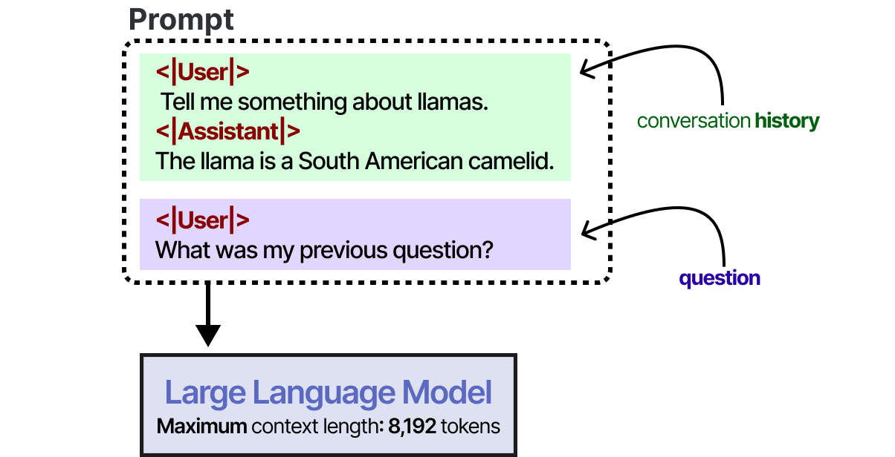
Why the model needs everything spelled out
The model knows only what is in its context window right now: your prompt, the pasted text, the uploaded files.
Figure: Alammar, J. and Grootendorst, M. (2024). Hands-On Large Language Models. O'Reilly Media
IEEE CS Region 8 AI Caravan 2026 · AI Administrator · Day 1 · Session 2
7
Notes:
Link to Session 1: the context window is the model's whole world for this task. Your policies, your definitions of 'urgent', your team's vocabulary are not in it unless you put them there. That is what the 'context' part of a prompt does.

Slide 8
The five parts of a working prompt
1
Role
Who the model is standing in for.
2
Context
What it needs to know: facts and definitions it cannot guess.
3
Task
The one thing to do. One verb, one deliverable.
4
Constraints
Limits, tone, what not to do, what to do when unsure.
5
Output format
The exact shape of the answer.
IEEE CS Region 8 AI Caravan 2026 · AI Administrator · Day 1 · Session 2
8
Notes:
Most weak prompts are missing two of these, usually context and output format. Have participants hold up fingers for the five parts; you will refer to them by number for the rest of the session.

Slide 9
Section · minute 10
2. The five parts, with a before and after
A real request from an office coordinator
About 25 minutes
IEEE CS Region 8 AI Caravan 2026 · AI Administrator · Day 1 · Session 2
9

Slide 10
Before
Summarise this email and tell me what to do.
IEEE CS Region 8 AI Caravan 2026 · AI Administrator · Day 1 · Session 2
10
Notes:
Run it live (demo burst 1). The answer will be fluent and useless: a paragraph, a different one each time, and the model has decided for itself what 'what to do' means.

Slide 11
After
Role: You are an assistant to the facilities coordinator of a 200-person office.
Context: We receive maintenance requests by email. Urgent means a safety risk or a stopped
service (lift, water, power, access).
Task: Read the email below and produce a triage note.
Constraints: Do not invent details that are not in the email. If the urgency is unclear,
say "unclear" rather than guessing. Maximum 80 words.
Output format, exactly these labelled lines:
Requester:
Location:
Issue (one sentence):
Urgency (urgent / normal / unclear):
Suggested next action:
Email: [paste email here]
IEEE CS Region 8 AI Caravan 2026 · AI Administrator · Day 1 · Session 2
11
Notes:
Run it on the same email. Point at each of the five parts as you read. Then edit the email so the urgency is genuinely ambiguous and run again: the model writes 'unclear'. That moment is the whole point of constraints.

Slide 12
What each part does, and what goes wrong without it
Part | What it does | What goes wrong without it
Role | Sets vocabulary, tone and assumed knowledge | Generic, over-long answers
Context | Gives the facts and definitions the model cannot know | The model guesses your policies
Task | One verb, one deliverable | The model does three things badly
Constraints | Length, tone, forbidden actions, what to do when unsure | Invented details, wrong register
Output format | Makes the answer machine- and colleague-readable | Different shape every run; nothing downstream can use it
IEEE CS Region 8 AI Caravan 2026 · AI Administrator · Day 1 · Session 2
12
Notes:
The right-hand column is a diagnostic table. When a prompt misbehaves, find the symptom here and add the missing part. Participants will use the same idea in the symptom table at the end of the session.

Slide 13
The most valuable sentence in the prompt
If the urgency is unclear, say "unclear" rather than guessing. It turns a confident wrong answer into a flag a person can act on. You will reuse it in every AI step you build.
IEEE CS Region 8 AI Caravan 2026 · AI Administrator · Day 1 · Session 2
13
Notes:
Say it twice. On Day 3 the 'unclear' output becomes a branch in n8n that routes the item to a person. On Day 5 it is the basis of the human-in-the-loop pattern. One sentence in a prompt, one control in a workflow.

Slide 14
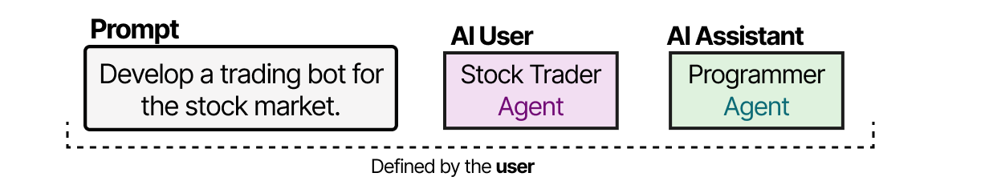
Role is powerful enough to build whole systems on
Research on role-playing agents (CAMEL): two models given clear roles solve tasks together that neither does alone.
Figure: Alammar, J. and Grootendorst, M. (2024). Hands-On Large Language Models. O'Reilly Media
IEEE CS Region 8 AI Caravan 2026 · AI Administrator · Day 1 · Session 2
14
Notes:
Thirty seconds. The point for operators: the 'Role' line is not decoration. It changes vocabulary, assumed knowledge and tone so much that research systems are built from nothing but roles talking to each other. Skip if behind.

Slide 15
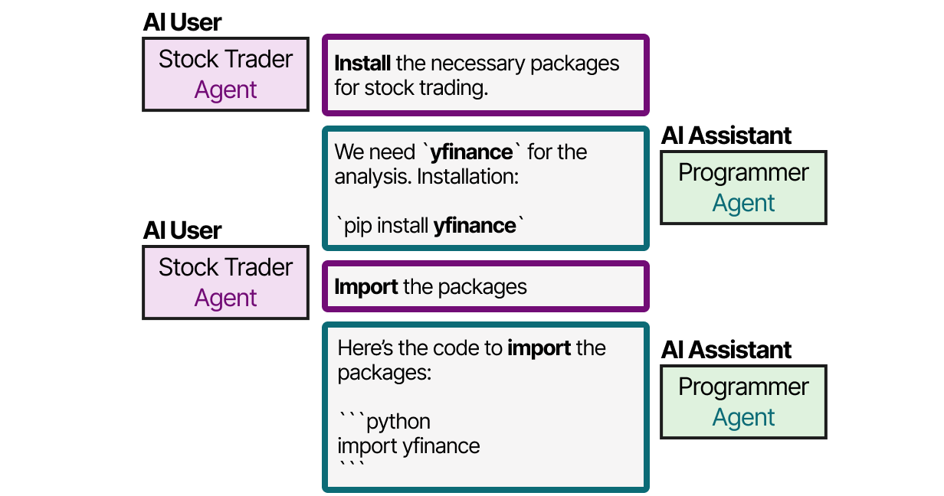
Roles in collaboration
A user-role agent and an assistant-role agent exchanging instructions and results. Day 5 uses this pattern with a supervisor.
Figure: Alammar, J. and Grootendorst, M. (2024). Hands-On Large Language Models. O'Reilly Media
IEEE CS Region 8 AI Caravan 2026 · AI Administrator · Day 1 · Session 2
15
Notes:
Optional. Preview of Day 5's multi-agent patterns. Keep it to one sentence and move on.

Slide 16
Section · minute 35
3. Structured outputs and few-shot examples
An automation cannot read prose. It reads fields.
About 20 minutes
IEEE CS Region 8 AI Caravan 2026 · AI Administrator · Day 1 · Session 2
16

Slide 17
Ask for fields, and say the allowed values out loud
• Labelled lines, a fixed set of categories, a markdown table, or a few key-value pairs
• 'Category must be one of: billing, technical, sales, other'
• Allowed values stop the model inventing a fifth category on Tuesday
• Fields are what a spreadsheet column or an n8n node can consume
IEEE CS Region 8 AI Caravan 2026 · AI Administrator · Day 1 · Session 2
17
Notes:
Show the triage note from the 'After' prompt again and point out that each labelled line is a column. On Day 3 those lines are mapped to spreadsheet columns and Slack messages with no code.

Slide 18
Few-shot examples: show the pattern instead of describing it
Classify each message as billing, technical, sales or other.
Example 1: "My invoice shows the old price" -> billing
Example 2: "The portal logs me out every minute" -> technical
Example 3: "Do you offer a plan for schools?" -> sales
Example 4: "Thanks for the quick help yesterday" -> other
Now classify: "[message]"
Answer with the category only.
IEEE CS Region 8 AI Caravan 2026 · AI Administrator · Day 1 · Session 2
18
Notes:
Demo burst 2. Classify three messages, one awkward ('My invoice is wrong AND the portal is down'). Then change an example and show the classification move. Models copy patterns better than they follow descriptions; two or three worked examples beat a paragraph of rules.

Slide 19
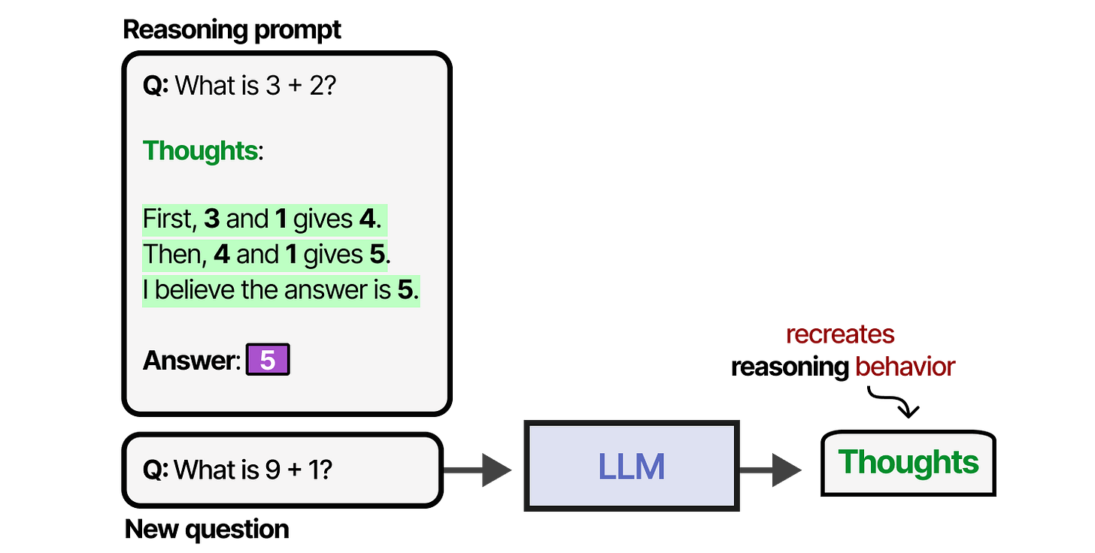
Examples with reasoning: chain-of-thought
When the examples show the reasoning as well as the answer, the model reasons before answering too.
Figure: Alammar, J. and Grootendorst, M. (2024). Hands-On Large Language Models. O'Reilly Media
IEEE CS Region 8 AI Caravan 2026 · AI Administrator · Day 1 · Session 2
19
Notes:
For operators: if a classification needs a judgement ('is this a complaint or a question?'), write the example as 'message -> reason -> category'. The model will then give its reason, which a reviewer can check.

Slide 20
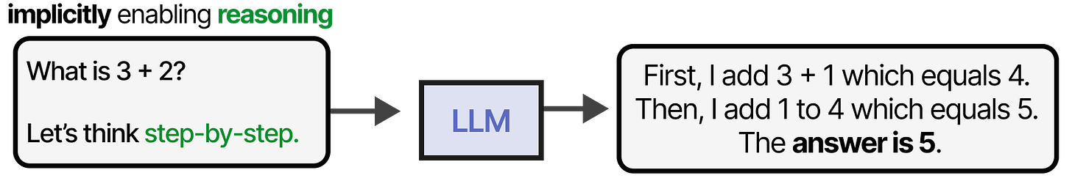
The one-line version: 'think step by step'
A single constraint asking the model to reason first improves accuracy on multi-step tasks, with no examples.
Figure: Alammar, J. and Grootendorst, M. (2024). Hands-On Large Language Models. O'Reilly Media
IEEE CS Region 8 AI Caravan 2026 · AI Administrator · Day 1 · Session 2
20
Notes:
Cheap trick worth knowing. Add 'Work through the steps before giving the final answer' to the constraints when the task has more than one step. Not needed for simple classification; useful for summaries that must reconcile several sources.

Slide 21
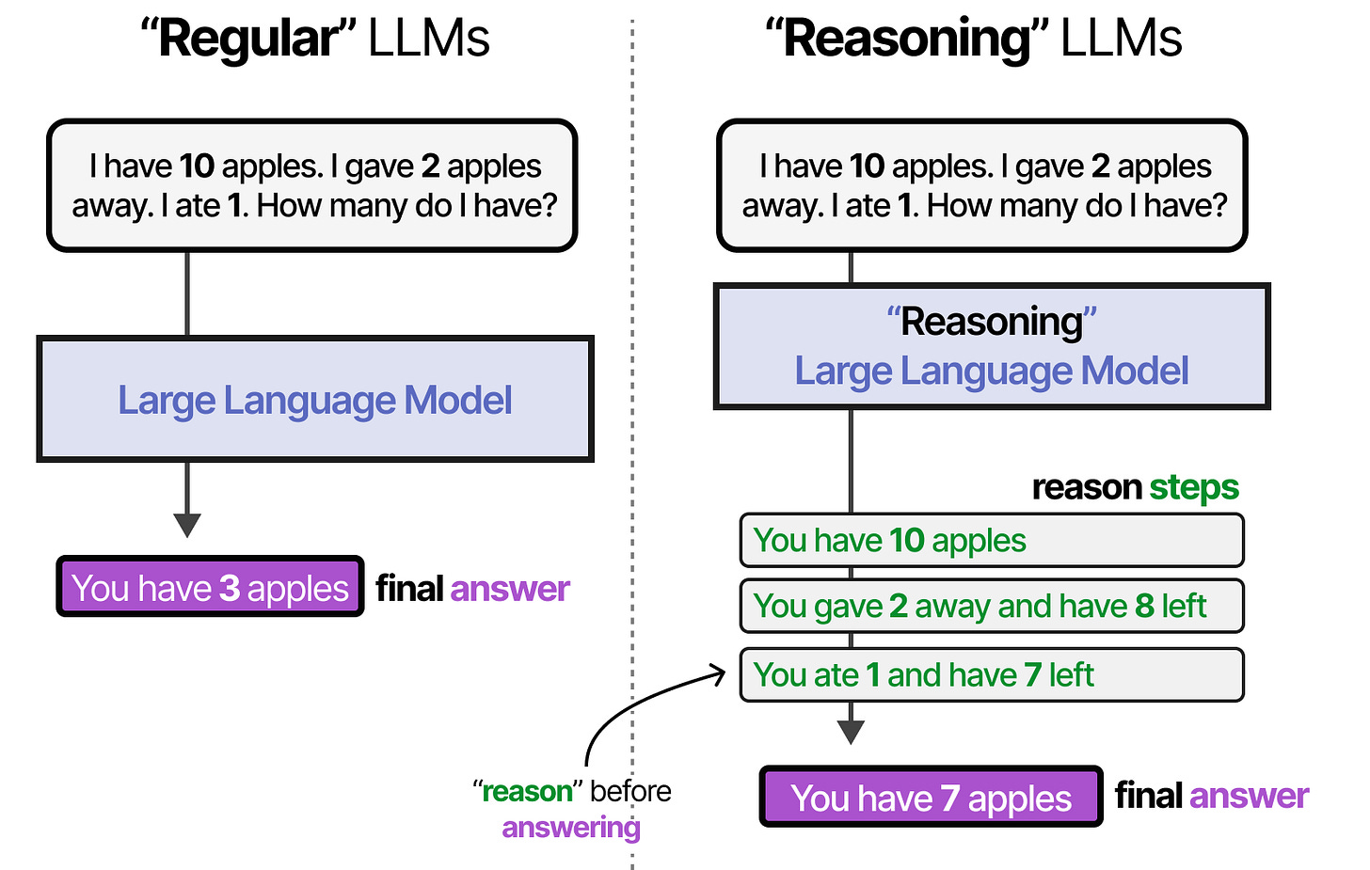
Ask for the reasoning, then the answer
Reasoning first, conclusion last. The reasoning is also your audit trail when something goes wrong.
Figure: Alammar, J. and Grootendorst, M. (2024). Hands-On Large Language Models. O'Reilly Media
IEEE CS Region 8 AI Caravan 2026 · AI Administrator · Day 1 · Session 2
21
Notes:
Link to Day 5 and Day 6: a model that writes 'Urgent because the email mentions a stopped lift' is auditable; one that writes only 'Urgent' is not. Put the reason line in the output format when a human will review.

Slide 22
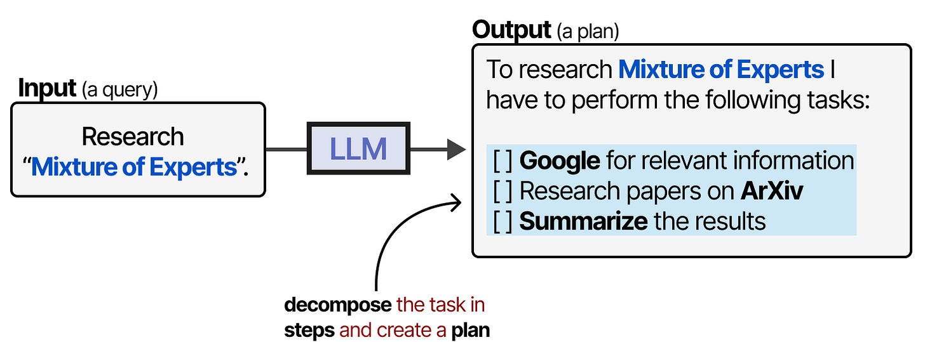
One verb, one deliverable: break big tasks into steps
A large request is split into sub-tasks, each with a clear output. Do that split yourself when you design the prompt.
Figure: Alammar, J. and Grootendorst, M. (2024). Hands-On Large Language Models. O'Reilly Media
IEEE CS Region 8 AI Caravan 2026 · AI Administrator · Day 1 · Session 2
22
Notes:
'Summarise this and tell me what to do' is two tasks. Make it two prompts, or one prompt with two clearly labelled output sections. On Day 3 the split becomes two AI nodes in a row.

Slide 23
Iterating on a prompt
1
1. Collect ten real inputs
Including two awkward ones.
2
2. Run and mark
Run the prompt on all ten; mark each answer right or wrong in a sheet.
3
3. Fix specifically
Add a constraint or an example for the wrong ones. Never fix by adding 'be more accurate'.
4
4. Re-run all ten
Stop when you are at nine or ten out of ten twice in a row.
IEEE CS Region 8 AI Caravan 2026 · AI Administrator · Day 1 · Session 2
23
Notes:
Open the three-column sheet in the demo and do two rows. The discipline is re-running all ten, not just the ones that failed; fixes often break something that worked.

Slide 24
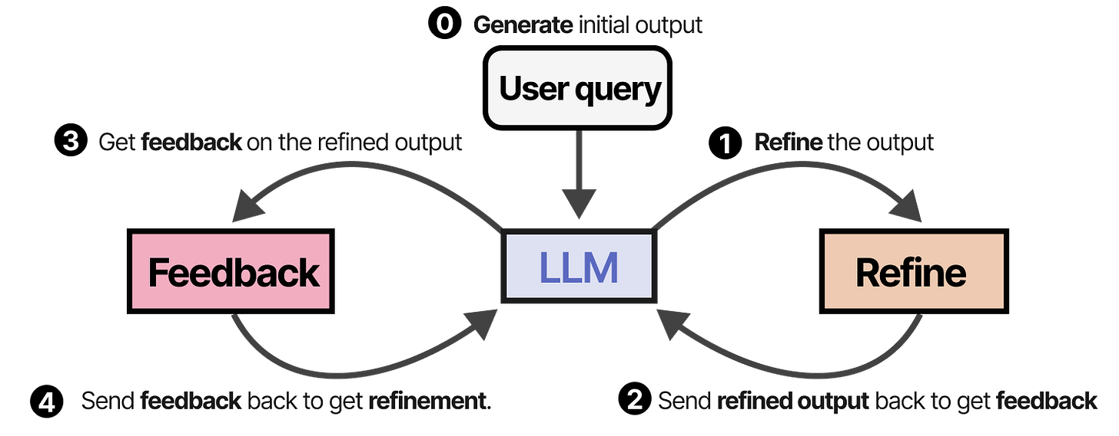
Models can refine their own output (Self-Refine)
Draft, critique, revise. You can ask for this inside one prompt: 'Draft, then check against the constraints, then give the final version.'
Figure: Alammar, J. and Grootendorst, M. (2024). Hands-On Large Language Models. O'Reilly Media
IEEE CS Region 8 AI Caravan 2026 · AI Administrator · Day 1 · Session 2
24
Notes:
Useful for drafting tasks (replies, reports). Ask the model to review its own draft against the constraints before output. Costs more tokens, catches obvious misses. It does not replace your ten-row test set.

Slide 25
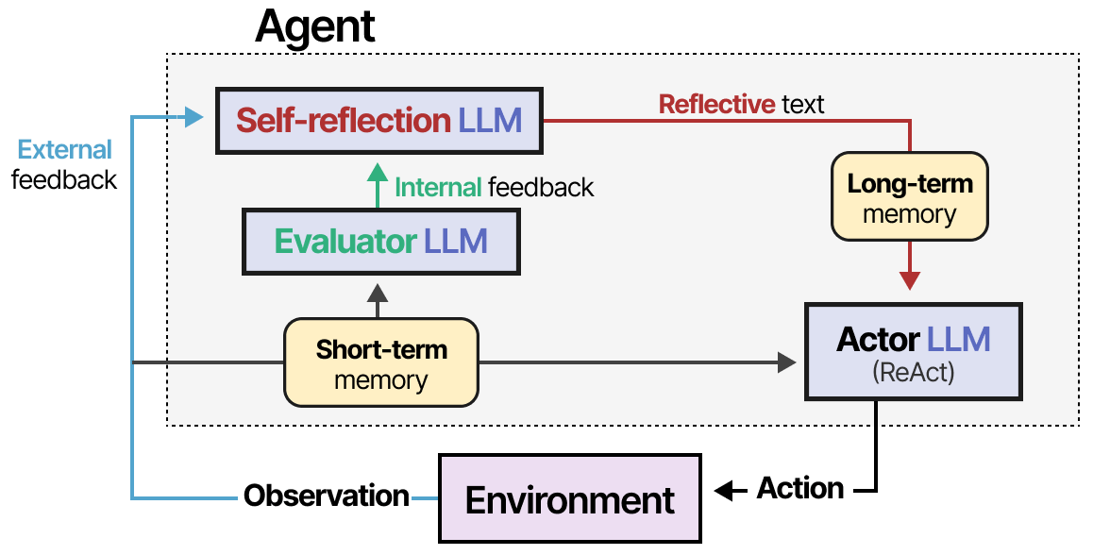
Learning from mistakes (Reflexion)
An agent that records what went wrong and feeds it into the next attempt. Your test set is the human version.
Figure: Alammar, J. and Grootendorst, M. (2024). Hands-On Large Language Models. O'Reilly Media
IEEE CS Region 8 AI Caravan 2026 · AI Administrator · Day 1 · Session 2
25
Notes:
Two sentences: research agents keep a memory of failures to improve the next run. Your ten-row sheet and the notes you add to a template are the same loop, run by you. Skip if behind.

Slide 26
That ten-row sheet is your first test set
Keep it. On Day 6 (Module 12) you will run it again every time you change the prompt or the model, and it will tell you immediately whether quality dropped.
IEEE CS Region 8 AI Caravan 2026 · AI Administrator · Day 1 · Session 2
26
Notes:
Participants tend to throw the sheet away once the prompt works. Make the case for keeping it: models get updated by vendors without notice; the sheet is how you find out.

Slide 27
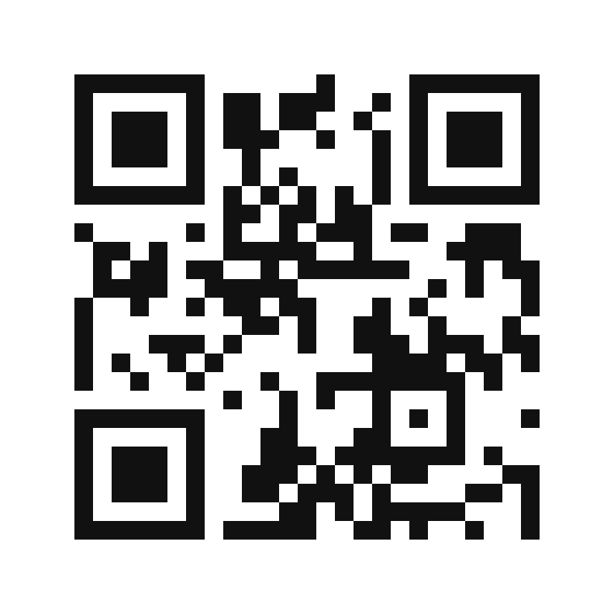
Try it on the live agent
Prompt test bench
1. Paste your template plus one input: you get the output in the shape you asked for
2. Paste your classifier plus the ten test rows (input | expected)
3. Read the table it returns: input, expected, model answer, match, and the score
4. Fix the prompt, paste again, compare score 1 with score 2
Rules
• It runs your prompt as written; it will not improve it unless you ask
• Made-up inputs only; no real customer messages
• Same bot as Session 1, same three rules
@aicaravan_bot
IEEE CS Region 8 AI Caravan 2026 · AI Administrator · Day 1 · Session 2
27
Notes:
The Day 1 bot now acts as a prompt test bench. Demo burst 2 can use it instead of the three-column sheet: paste the few-shot classifier and five inputs, show the table and the score, change one example, paste again. Students do the same in the lab with their ten rows.

Slide 28
Section · minute 65
4. Assistants that know your documents
Projects, custom GPTs, Gems, Copilot agents
About 20 minutes
IEEE CS Region 8 AI Caravan 2026 · AI Administrator · Day 1 · Session 2
28

Slide 29
The names differ; the idea is the same
Product | Feature | What you can upload | Sharing
ChatGPT | Projects, custom GPTs | PDF, Word, spreadsheets, text | Custom GPTs can be shared with a team or link
Claude | Projects with project knowledge | PDF, Word, text, images | Shared within a Team or Enterprise workspace
Microsoft Copilot | Copilot agents, Copilot Notebooks | SharePoint and OneDrive files | Through Microsoft 365 permissions
Google Gemini | Gems | Google Drive files | Shared with Workspace users
IEEE CS Region 8 AI Caravan 2026 · AI Administrator · Day 1 · Session 2
29
Notes:
Every major assistant lets you save standing instructions together with uploaded files so you do not repeat the context each time. Ask who uses which product at work; most rooms are split between Microsoft and Google, with ChatGPT on personal accounts.

Slide 30
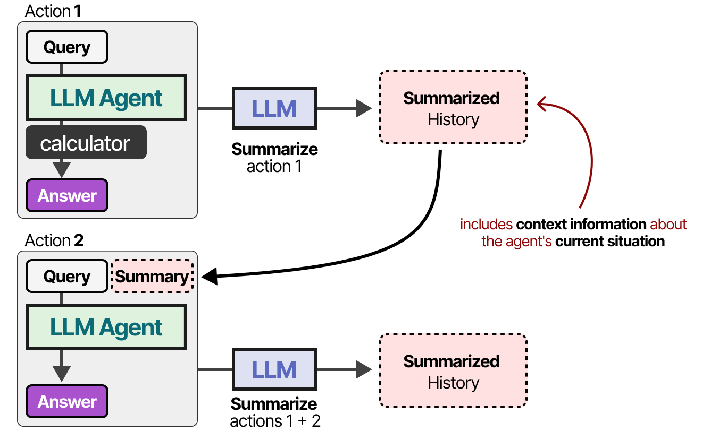
How documents become memory: summarise what does not fit
Long material is condensed so the essentials fit in the context window.
Figure: Alammar, J. and Grootendorst, M. (2024). Hands-On Large Language Models. O'Reilly Media
IEEE CS Region 8 AI Caravan 2026 · AI Administrator · Day 1 · Session 2
30
Notes:
First of two mechanisms. When a document or a long conversation would not fit, the platform summarises it. Good for gist, bad for exact clauses, which is why the next mechanism exists.

Slide 31
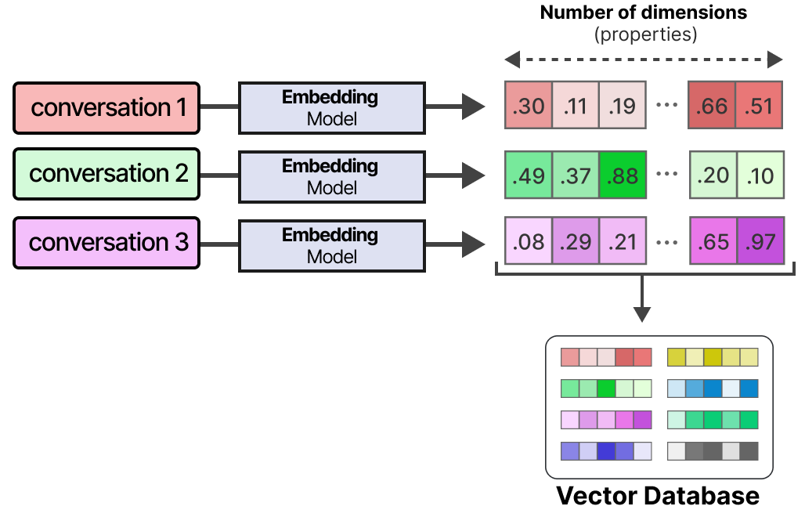
How documents become memory: index them
Uploaded files are cut into chunks and indexed by meaning, so the right passage can be found later.
Figure: Alammar, J. and Grootendorst, M. (2024). Hands-On Large Language Models. O'Reilly Media
IEEE CS Region 8 AI Caravan 2026 · AI Administrator · Day 1 · Session 2
31
Notes:
Keep it to the metaphor of a very good index at the back of a book. No maths. This is what happens when you click 'upload' in a Project. Day 4 calls this RAG and builds it in n8n.

Slide 32
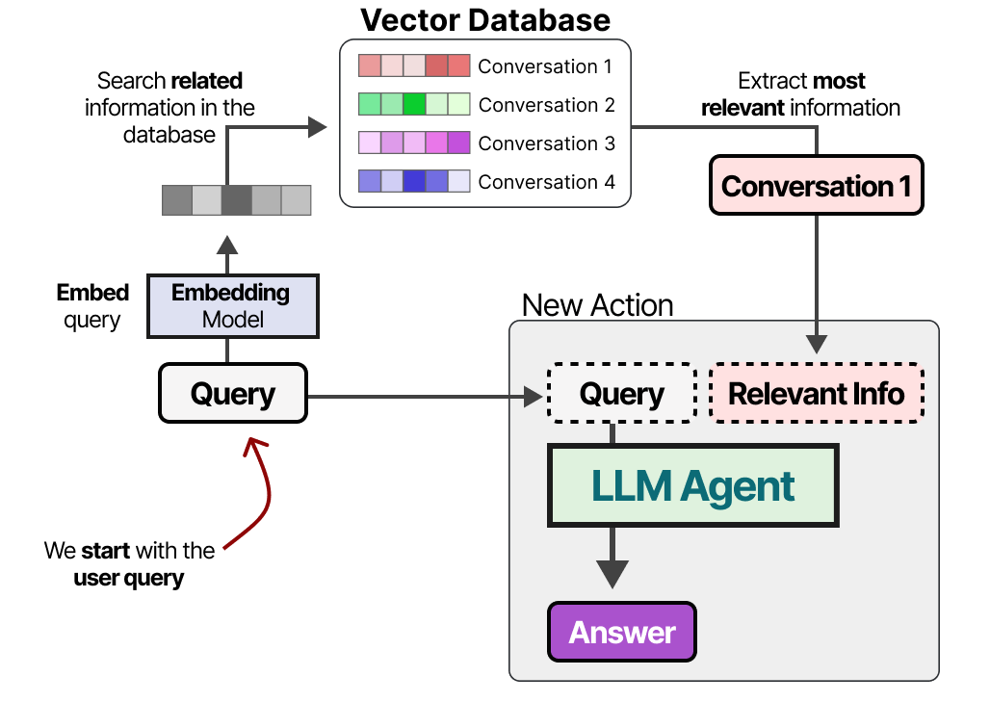
...and fetch only the relevant passage
Your question finds the closest chunks; they are placed in the context window; the model answers from them.
Figure: Alammar, J. and Grootendorst, M. (2024). Hands-On Large Language Models. O'Reilly Media
IEEE CS Region 8 AI Caravan 2026 · AI Administrator · Day 1 · Session 2
32
Notes:
This explains both the power and the failure mode: if the right passage is not retrieved, the model answers from general knowledge and may invent. Hence the instruction 'quote the sentence you relied on'.

Slide 33
The department assistant: the simplest agent you will meet
• A model, instructions, and memory in the form of your documents
• No tools yet, so it can answer but not act
• That is a good thing while you learn what it gets wrong
• On Day 4 (Module 8) the same assistant gets tools and becomes an agent
IEEE CS Region 8 AI Caravan 2026 · AI Administrator · Day 1 · Session 2
33
Notes:
Tie back to the four parts from Session 1: three of four present. Participants build exactly this in the lab today and extend it on Day 4.

Slide 34
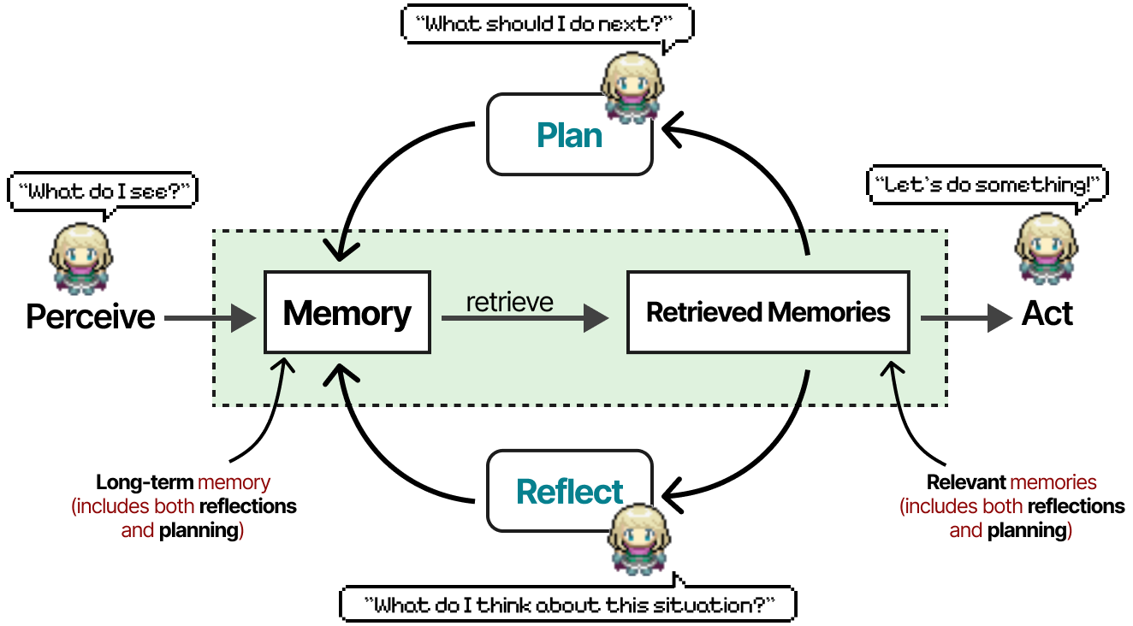
Preview: memory at full scale (Generative Agents, 2023)
Simulated characters with a memory stream, reflection and planning. Your department assistant is the first rung of this ladder.
Figure: Alammar, J. and Grootendorst, M. (2024). Hands-On Large Language Models. O'Reilly Media
IEEE CS Region 8 AI Caravan 2026 · AI Administrator · Day 1 · Session 2
34
Notes:
Optional, one sentence. Shows where document memory leads: agents that remember, reflect and plan over long periods. Day 5 touches on this with always-on personal agents.

Slide 35
Data goes where the model goes
Before you upload a policy, a contract or anything with personal data, check your organisation's rules and the product's data terms. Consumer tiers may use uploads for training; business tiers usually do not. Until Day 6 covers this properly, use public or dummy documents in the labs.
IEEE CS Region 8 AI Caravan 2026 · AI Administrator · Day 1 · Session 2
35
Notes:
Non-negotiable. State clearly that today's lab uses public documents only. If anyone has uploaded a real internal file during the session, ask them to delete the Project afterwards.

Slide 36
Section · minute 85
5. Where prompts fail: hallucination and over-confidence
A plausible fact looks exactly like a correct one
About 10 minutes
IEEE CS Region 8 AI Caravan 2026 · AI Administrator · Day 1 · Session 2
36

Slide 37
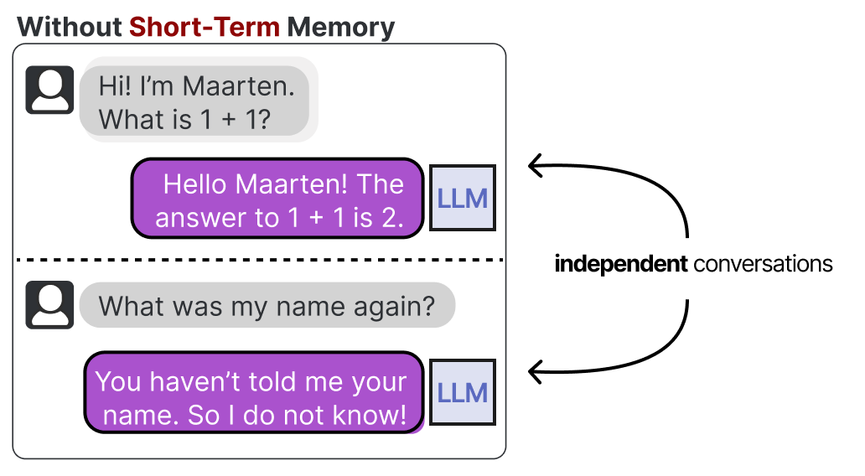
What hallucination is
• It looks exactly like a correct answer
• It is more likely when the source is missing or not retrieved
The model produces the most plausible next words. When it lacks a fact, it produces a plausible fact instead.
Figure: Alammar, J. and Grootendorst, M. (2024). Hands-On Large Language Models. O'Reilly Media
IEEE CS Region 8 AI Caravan 2026 · AI Administrator · Day 1 · Session 2
37
Notes:
Return to the first idea of the day: next-word prediction. Hallucination is not a bug to be patched away; it is what the mechanism does when starved of facts. The remedy is to feed it facts and give it an exit.

Slide 38
Three habits that catch most of it
1
Ground it
Give the model the source (paste the email, upload the policy) and instruct it to answer only from that source, quoting the line it used.
2
Give it an exit
'If the answer is not in the document, say so.' A model told it may say 'not found' will say it.
3
Check the checkable
Names, dates, numbers, order IDs and policy clauses can be verified in seconds. Verify them before they leave your desk.
IEEE CS Region 8 AI Caravan 2026 · AI Administrator · Day 1 · Session 2
38
Notes:
These three go on the wall. They also map onto the course: grounding is Day 4 (RAG), the exit is Day 5 (routing to a human), checking the checkable is Day 6 (evaluation).

Slide 39
Symptom, likely cause, fix
Symptom | Likely cause | Fix
Cites a policy section that does not exist | No source provided, or source not searched | Upload the policy, require a quote
Different category for the same email on two runs | Categories not defined, no examples | List allowed values, add few-shot examples
Long, polite, says nothing | No task, no format | One verb, labelled output lines, word limit
Confident answer to an ambiguous request | No 'unclear' option | Add the unsure clause and route unclear items to a person
IEEE CS Region 8 AI Caravan 2026 · AI Administrator · Day 1 · Session 2
39
Notes:
Participants can use this table during the lab when the classifier misbehaves. Every fix is a missing prompt part or a missing example; none of them is 'be more accurate'.

Slide 40
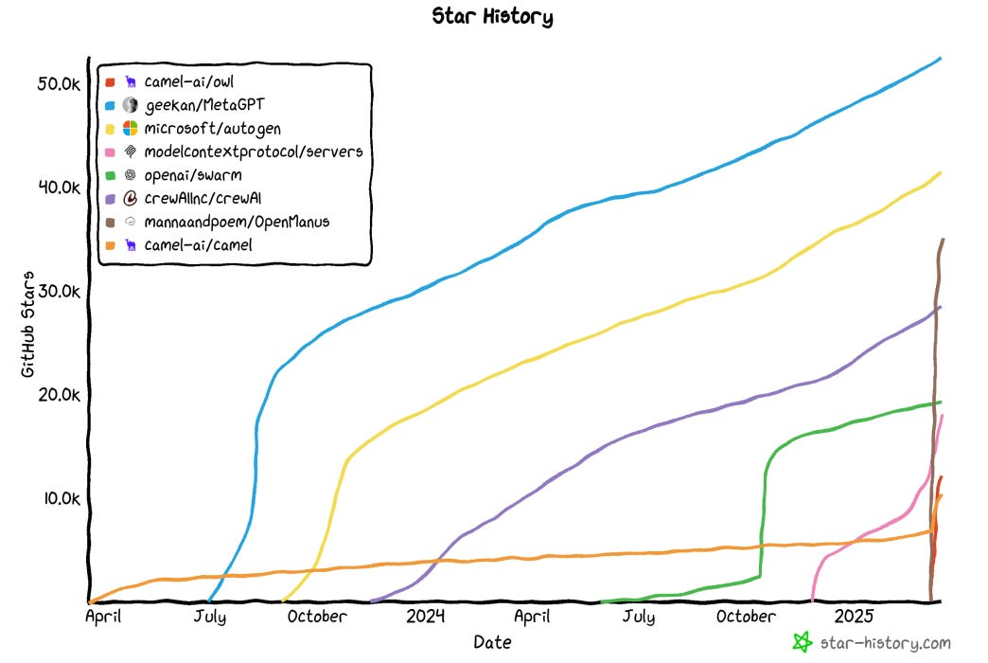
Tools change fast; your templates and test set travel with you
The number of agent frameworks and products keeps growing. The five parts and the ten-row test set work in all of them.
Figure: Alammar, J. and Grootendorst, M. (2024). Hands-On Large Language Models. O'Reilly Media
IEEE CS Region 8 AI Caravan 2026 · AI Administrator · Day 1 · Session 2
40
Notes:
Closing thought before the lab. Participants worry about picking the wrong product. The skills in this session are product-independent: a template written in five parts pastes into ChatGPT, Claude, Copilot, Gemini or an n8n node unchanged.

Slide 41
Section · minute 95
Practical lab: prompt library and department assistant
Steps shown now, finish at home, due before the next session
About 17 minutes
IEEE CS Region 8 AI Caravan 2026 · AI Administrator · Day 1 · Session 2
41

Slide 42
Lab steps (1 to 4)
1
1. Create the library document
Name it M2-prompt-library. Five headings: Triage an email, Summarise a meeting transcript, Draft a reply, Extract fields from a form, Classify a request.
2
2. Write each template with the five parts
Role, context, task, constraints, output format, with [square-bracket] placeholders a colleague can fill in.
3
3. Add examples to the classifier
Four allowed categories, one example each, plus a fifth awkward example that should be 'other'.
4
4. Build the ten-row test set
Ten realistic inputs with the expected category; run the prompt; record the model's answer; count matches.
IEEE CS Region 8 AI Caravan 2026 · AI Administrator · Day 1 · Session 2
42
Notes:
Share the handout and the three-column sheet. Most participants will write two or three templates in the room and finish the rest at home. Make sure everyone reaches step 4 at least once so the test-set habit is formed.

Slide 43
Lab steps (5 to 7)
1
5. Fix and re-run
For every mismatch, change the prompt (a constraint or an example) and run all ten again. Record the second score.
2
6. Create the department assistant
A Project, custom GPT, Gem or Copilot agent. Paste the instructions on the next slide; upload two public policy documents.
3
7. Test the assistant with a trap
Three questions the documents answer, two they do not. Does it say 'not covered' or invent? Record the results.
IEEE CS Region 8 AI Caravan 2026 · AI Administrator · Day 1 · Session 2
43
Notes:
The trap test is the most memorable five minutes of the day. Ask two or three participants to report what their assistant did with the trap questions.

Slide 44
Trap test: two assistants, same five questions
Your own Project (step 6)
The course policy bot @aicaravan_policy_bot
• ChatGPT Project, Claude Project, Gem or Copilot agent
• Your two public or made-up policy documents uploaded
• The assistant instructions from the next slide
• Same instructions, two fictional AI Caravan Ltd. policies built in
• No tools, no memory: it can only answer from the documents
• Ask: annual leave days; carry-over; daily allowance in Jordan (covered)
• Then: parental leave; mileage rate (not covered). Does it admit it?
IEEE CS Region 8 AI Caravan 2026 · AI Administrator · Day 1 · Session 2
44
Notes:
The point: two assistants, same instructions, same trap questions. The course bot is the reference run; the instructor can show the gateway log while a student asks it something, to make "data goes where the model goes" concrete.

Slide 45
Template skeleton (step 2)
Role: You are an assistant to the [role] in [department].
Context: [two or three facts and definitions the model must know]
Task: [one verb, one deliverable]
Constraints: Use only the information provided. If something is unclear or missing,
write "unclear". Maximum [N] words. Tone: [plain / formal].
Output format (exactly these lines):
[Field 1]:
[Field 2]:
[Field 3]:
Input: [paste text]
IEEE CS Region 8 AI Caravan 2026 · AI Administrator · Day 1 · Session 2
45
Notes:
Point out that the constraints line is pre-filled with the unsure clause. Participants should never remove it.

Slide 46
Assistant instructions (step 6)
You are the [department] policy assistant. Answer questions only from the uploaded documents.
For every answer, quote the sentence you relied on and name the document.
If the answer is not in the documents, reply: "Not covered by the uploaded policies.
Please ask [named person]." Keep answers under 120 words.
IEEE CS Region 8 AI Caravan 2026 · AI Administrator · Day 1 · Session 2
46
Notes:
Demo burst 3 uses exactly this text. Note the three habits inside it: grounded (only from the documents), an exit (not covered), and checkable (quote the sentence).

Slide 47
Deliverable
The M2-prompt-library document (five templates, test scores before and after, the assistant's trap-test results) plus a screenshot of the assistant answering one question with a quotation. Bring it to the next session.
IEEE CS Region 8 AI Caravan 2026 · AI Administrator · Day 1 · Session 2
47
Notes:
The templates are reused on Day 3 inside n8n AI nodes, so quality here saves time later.

Slide 48

Section · minute 112
Kahoot: knowledge check
20 questions, 20 seconds each. Phones out.
About 8 minutes
IEEE CS Region 8 AI Caravan 2026 · AI Administrator · Day 1 · Session 2
48

Slide 49
Join the Kahoot
How to join
Fair play notes
• Open kahoot.it on your phone, or the Kahoot app
• Enter the game PIN shown on the screen
• Nickname: your first name
• 20 seconds per question; answer on your phone
• All four answers are about the same length. The long one is not a hint.
• Correct answers are spread evenly over the four colours.
• We run as many as time allows in the room
• The rest arrive as a Kahoot challenge link for homework
IEEE CS Region 8 AI Caravan 2026 · AI Administrator · Day 1 · Session 2
49
Notes:
Import Day1_S2_Kahoot.xlsx into Kahoot beforehand (Create, then Import spreadsheet). Launch in Classic mode and show the PIN on this slide. Eight minutes covers roughly 15 questions; assign the remainder as a challenge. The answer key with rationales is Day1_S2_Kahoot_Answer_Key.pdf.

Slide 50
Key takeaways
• A prompt is a work instruction: role, context, task, constraints, output format. Missing parts cause most failures.
• Ask for labelled fields and allowed values, and show examples; that is what makes an answer usable by an automation.
• Improve prompts with a ten-row test set, one constraint or example at a time, and keep the set for later.
• Projects and custom assistants give the model your documents as memory; check data rules before uploading anything real.
• Ground the model, give it an exit, and verify the checkable facts.
IEEE CS Region 8 AI Caravan 2026 · AI Administrator · Day 1 · Session 2
50
Notes:
Read the five takeaways. Then set up the next session (Day 2, workflow mapping): bring the M1 task inventory and the M2 prompt library; next time we map the chosen task as a current-state process in Miro or draw.io.

Slide 51
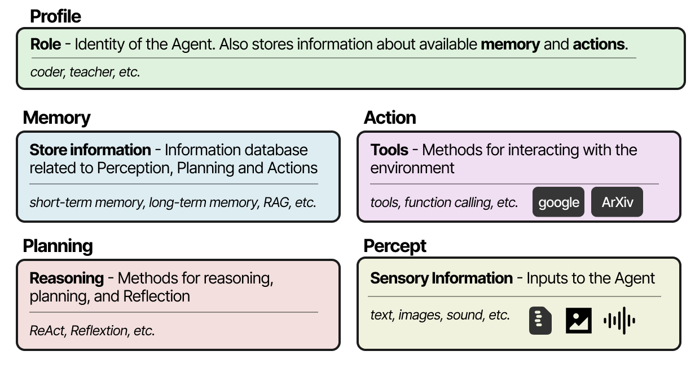
Preview of Day 5: many assistants, one system
• Module 2 online, with the lab and quiz: albanna-tutorials.com/ai-administrator
• LLM Agents explained visually: albanna-tutorials.com/llm_agents.html
• Next: Day 2, Workflow Mapping I and II
Each agent is model, tools, memory, instructions; a supervisor hands out work; a critic reviews it. Everything today scales up to this.
Figure: Alammar, J. and Grootendorst, M. (2024). Hands-On Large Language Models. O'Reilly Media
IEEE CS Region 8 AI Caravan 2026 · AI Administrator · Day 1 · Session 2
51
Notes:
Close on the big picture. Day 2 goes back to the process itself: before building anything, map it.

Slide 52
Latest reading on prompting for work (2026)
Prompting best practices (official Claude platform documentation)
Anthropic, living document updated with each model release · 2026 · platform.claude.com/docs/en/build-with-claude/prompt-engineering/claude-prompting-best-practices
Be explicit about output format and constraints, give 2 to 5 worked examples, and separate context, instructions and examples with clear labels. The vendor's own version of today's five parts and few-shot examples.
Prompt engineering for business: the 2026 practical guide
Gend · 5 January 2026 (updated 30 March 2026) · gend.co/blog/prompt-engineering-for-business
Proposes a business template, R-TCC-COE: role, task, context, content, constraints, output, evaluation. Same skeleton as today's template, plus an explicit evaluation rubric, which is what your ten-row test set provides.
Production prompt engineering in 2026: structured outputs, prompt chaining and optimisation
AI Workflow Lab, by Marcus Holloway · 13 February 2026 (updated 2 June 2026) · aiworkflowlab.dev/article/production-prompt-engineering-2026-structured-outputs-prompt-chaining-dspy
Treat prompts as engineered, versioned, tested artefacts; constrain outputs to a fixed shape; split big tasks into chains of small prompts. The 'one verb, one deliverable' and 'fields not prose' rules, written for engineers.
Context Engineering: from prompts to corporate multi-agent architecture
V. Vishnyakova, arXiv 2603.09619 · 10 March 2026 · arxiv.org/abs/2603.09619
Beyond the prompt, what matters is the whole information environment the model works in: documents, definitions, memory. Today's 'context' part and the department assistant's uploaded policies are the first step of that discipline.
IEEE CS Region 8 AI Caravan 2026 · AI Administrator · Day 1 · Session 2
52
Notes:
Optional two minutes, or leave for self-study. Each item ties a recent piece to something taught today. Instructors may swap in newer pieces; keep the pattern: source, date, one-line takeaway tied to the session.

Slide 53
References
1. Alammar, J. and Grootendorst, M. (2024). Hands-On Large Language Models. O'Reilly Media (source of the figures in this deck)
2. Al-Banna, A. (2026). AI Administrator, Module 2: Prompting for Operators. albanna-tutorials.com/ai-administrator/02_prompting_for_operators.html
3. Al-Banna, A. (2025). LLM Agents, explained visually (tutorial). albanna-tutorials.com/llm_agents.html
4. Grootendorst, M. (2025). A Visual Guide to LLM Agents. newsletter.maartengrootendorst.com (online version of the same diagrams)
5. Wei, J. et al. (2022). Chain-of-Thought Prompting Elicits Reasoning in Large Language Models. NeurIPS 2022
6. Kojima, T. et al. (2022). Large Language Models are Zero-Shot Reasoners. NeurIPS 2022
7. Madaan, A. et al. (2023). Self-Refine: Iterative Refinement with Self-Feedback. NeurIPS 2023
8. Shinn, N. et al. (2023). Reflexion: Language Agents with Verbal Reinforcement Learning. NeurIPS 2023
9. Li, G. et al. (2023). CAMEL: Communicative Agents for 'Mind' Exploration of Large Language Model Society. NeurIPS 2023
10. Park, J. S. et al. (2023). Generative Agents: Interactive Simulacra of Human Behavior. UIST 2023
11. Lewis, P. et al. (2020). Retrieval-Augmented Generation for Knowledge-Intensive NLP Tasks. NeurIPS 2020
12. OpenAI Help Center: Projects in ChatGPT; Creating a GPT. help.openai.com
13. Anthropic Help Center: What are Projects? support.claude.com
14. Microsoft Learn: Copilot agents and Copilot Notebooks. learn.microsoft.com
15. Google: Gems in Gemini. support.google.com/gemini
16. IEEE CS Region 8 AI Caravan (2026). AI Administrator Track Curriculum. aicaravan.org
IEEE CS Region 8 AI Caravan 2026 · AI Administrator · Day 1 · Session 2
53
Notes:
Leave on screen during questions. All diagrams in this deck are from Alammar and Grootendorst, Hands-On Large Language Models (O'Reilly, 2024), credited on each slide; the same figures appear in Grootendorst's online Visual Guide.

