Slide 1
Healthcare Scenario: Healthy Living and Wellness Clustering Exercise

Slide 2
GitHub Documents
This is an R Markdown format used for publishing markdown documents to GitHub. When you click the Knit button all R code chunks are run and a markdown file (.md) suitable for publishing to GitHub is generated.

Slide 3
Including Code
You can include R code in the document as follows:
summary(cars)
## speed dist ## Min. : 4.0 Min. : 2.00 ## 1st Qu.:12.0 1st Qu.: 26.00 ## Median :15.0 Median : 36.00 ## Mean :15.4 Mean : 42.98 ## 3rd Qu.:19.0 3rd Qu.: 56.00 ## Max. :25.0 Max. :120.00

Slide 4
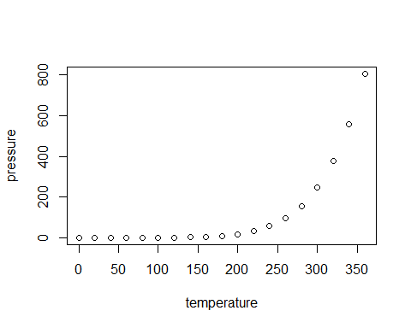
Including Plots
You can also embed plots, for example:

Slide 5
Note that the echo = FALSE parameter was added to the code chunk to prevent printing of the R code that generated the plot.

