Slide 1
Coen 6501 Project
By
Group 5:
Chirag Jhamb
Yara Nouaiser
Yuvraj Prabhakar
Abdul Rahman Koleilat

Slide 2
Design of ALU (8-bit)
Conversion of unsigned input operands to signed
Multiplier
Division by Four and Increment by One
Control Unit
Registers
Simulation
Synthesis

Slide 3
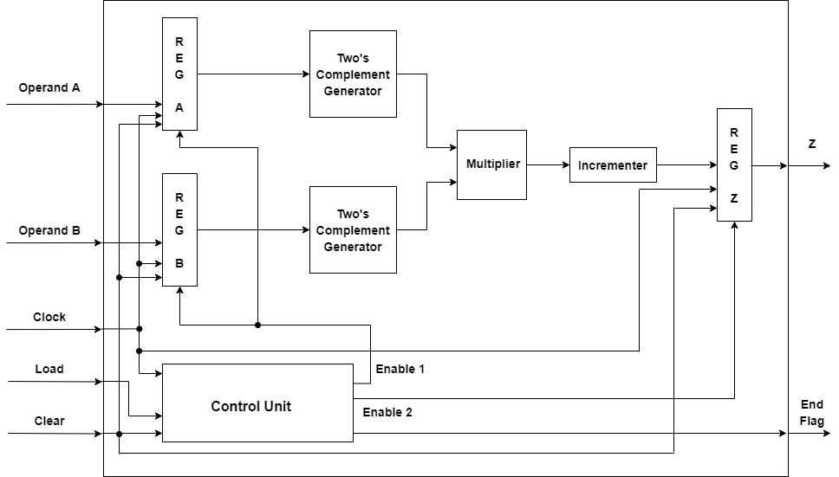

Slide 4
Conversion of unsigned input operands to signed
2 Two’s complement generators are required.
All the input bits are inverted.
An incrementer will then add a 1.

Slide 5
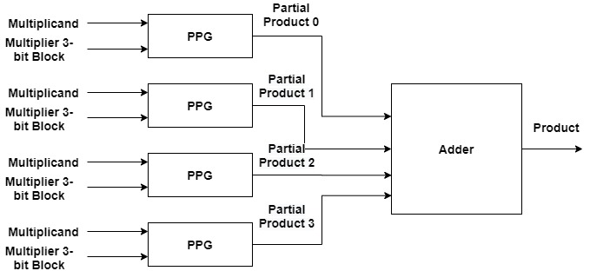
Multiplier
Algorithm
Partial Product Generator (PPG)
Adder

Slide 6
Algorithm: Radix-4 Booth Multiplication
Extend the sign bit of the multiplier term so the number of bits are even.
A zero is appended to the right of the multiplier term.
Each 3-bit block of the multiplier will determine the operation performed on the multiplicand giving the partial product: Mx0, Mx1, Mx-1, Mx-2.
Multiplier Bits Block |  |  | Multiplier Value | Partial Product
X_{i+1} | X_{i} | X_{i-1}
0 | 0 | 0 | 0 | Mx0
0 | 0 | 1 | 1 | Mx1
0 | 1 | 0 | 1 | Mx1
0 | 1 | 1 | 2 | Mx2
1 | 0 | 0 | -2 | Mx-2
1 | 0 | 1 | -1 | Mx-1
1 | 1 | 0 | -1 | Mx-1
1 | 1 | 1 | 0 | Mx0

Slide 7

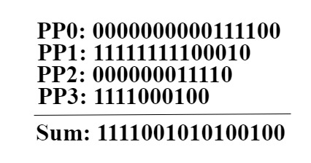
Example
Consider "11100010" (-30) and "01110010" (114).
Going from right to the left, the 4 multiplier 3-bits are: 100, 001, 110, and 011.
Therefore, the four partial products will be:
PP0: 0000000000111100
PP1: 11111111100010
PP2: 000000011110
PP3: 1111000100
Adding the four partial products will give a sum of “1111001010100100” (-3420) which is correct.

Slide 8
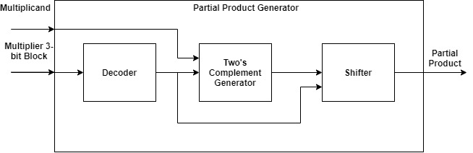
Partial Product Generator (PPG)
Decoder
Two’s Complement Generator
Shifter

Slide 9
Decoder
Multiplier Bits Block |  |  | Control Signal
X_{i+1} | X_{i} | X_{i-1}
0 | 0 | 0 | 000
0 | 0 | 1 | 010
0 | 1 | 0 | 010
0 | 1 | 1 | 100
1 | 0 | 0 | 101
1 | 0 | 1 | 011
1 | 1 | 0 | 011
1 | 1 | 1 | 000
The decoder will take the corresponding 3-bit multiplier block and give a 3-bit control signal.
The LSB will be the enable for the two’s complement generator.
The other 2 MSBs will be used for the shifter.

Slide 10
Two’s complement Generator
The multiplicand bits will be xored with the enable bit.
An incrementer will then add it with the enable bit.

Slide 11
Shifter
The role of the shifter is to multiply the multiplicand by either 0, 1, or 2 depending on the first 2 bits of the control signal from the decoder.
It will either give a zero output, the multiplicand itself, or shift it to the left by 1 bit (x2).
When ctrl1 is 0, the output will be 0 if ctrl0 is 0 otherwise it’s the multiplicand itself (x1).
When ctrl1 is 1, the output will be the multiplicand shifted 1 bit to the left (x2).

Slide 12
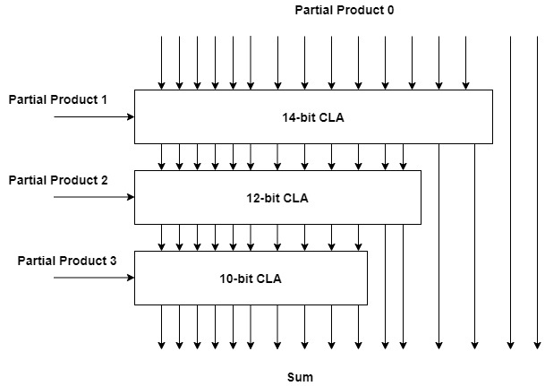
Adder
The adder is made up of 3 CLA’s to add the 4 partial products.

Slide 13
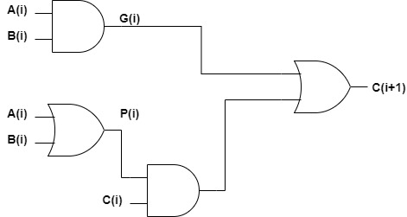
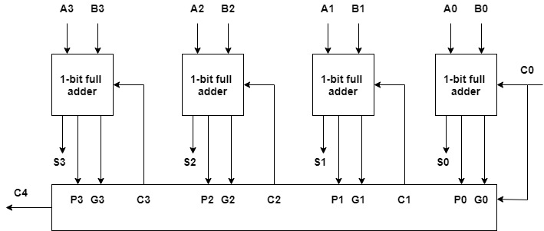
Carry Look-Ahead Adder (CLA)
CLA is faster RCA since it computes the carry bits at the same time.

Slide 14
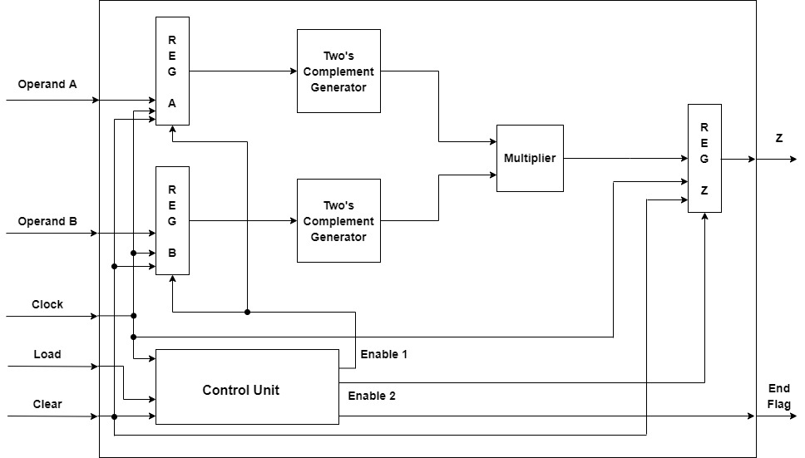
Division by Four and Increment by One
Instead of using an incrementer, we could add 4 to the product of the multiplier by adding an input carry bit to the first CLA in the adder since the first two bits of the first partial product are not added. After that, shifting 2 bits to the right will give the final result.

Slide 15
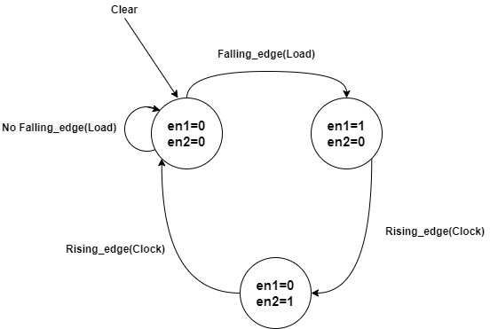
Control Unit
When the load signal transitions from 1 to 0, en1=1.
At the first rising edge of the clock, en1=0 and en2=1. End flag is 0.
At the second rising edge of the clock, both en1 and en2 are 0. End flag is 1.

Slide 16
Registers
Two 8-bit registers are needed to latch the input operands A and B when en1=1.
One 16-bit register is needed to latch the output Z when en2=1.

Slide 17
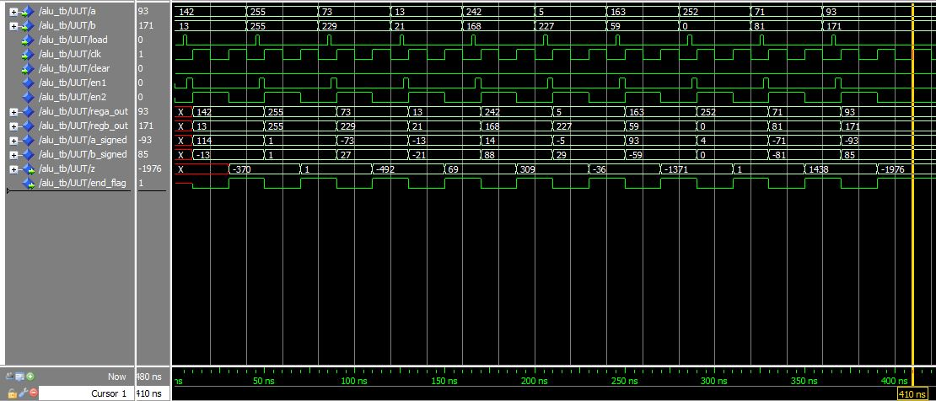
Simulation Result

Slide 18
Area and Delay
 | LUTs | CLB Slices | Dffs or Latches
ALU with regular multiplier | 301 | 151 | 32
ALU with radix-2 booth multiplier | 348 | 174 | 32
ALU with radix-4 booth multiplier | 204 | 102 | 32
 | Delay
ALU with regular multiplier | 16.786 ns
ALU with radix-2 booth multiplier | 15.774 ns
ALU with radix-4 booth multiplier | 10.642 ns

Slide 19
Expansion To 16 bits
Components are expanded to 16 bits.
8 PPG’s required.
The adder is made up of 7 CLA’s.

Slide 20
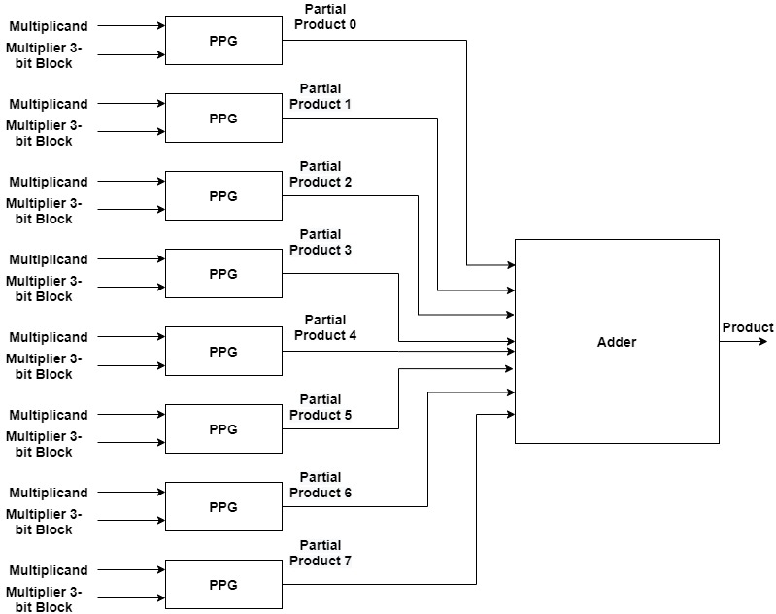
Multiplier

Slide 21
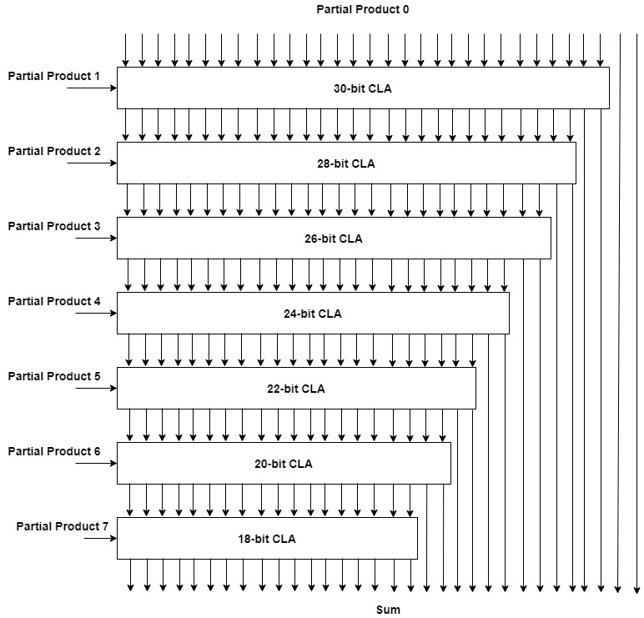
Adder

Slide 22
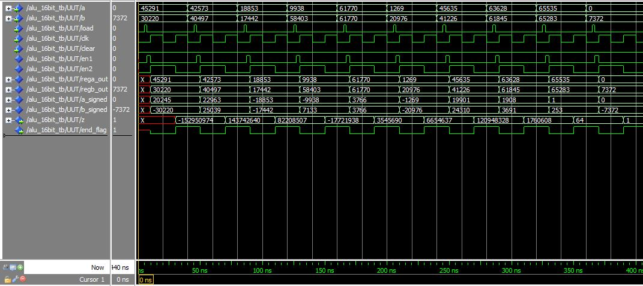
Simulation Result

Slide 23
Area and Delay
 | LUTs | CLB Slices | Dffs or Latches
8-bit ALU | 204 | 102 | 32
16-bit ALU | 886 | 443 | 64
 | Delay
8-bit ALU | 10.642 ns
16-bit ALU | 23.617 ns

Slide 24
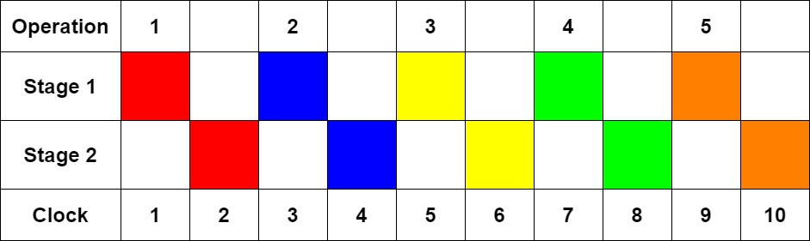
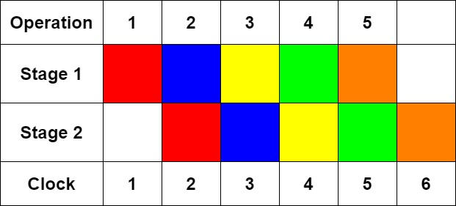
Pipelining of The Design
The original design uses 2 clock cycles for each operation.
The control unit needs to be modified and needs a counter.

Slide 25
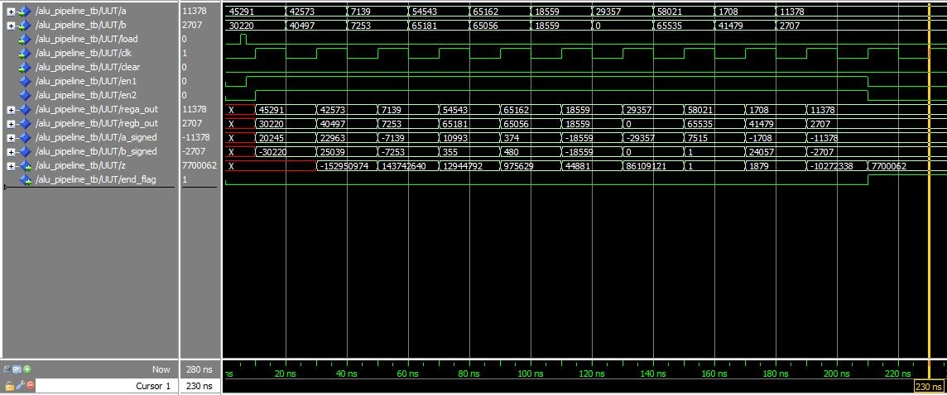
Simulation Result

Slide 26
Area and Delay
 | LUTs | CLB Slices | Dffs or Latches
16-bit ALU | 886 | 443 | 64
16-bit ALU pipelined | 893 | 447 | 68
 | Delay
16-bit ALU | 23.617 ns
16-bit ALU pipelined | 23.617 ns

Slide 27
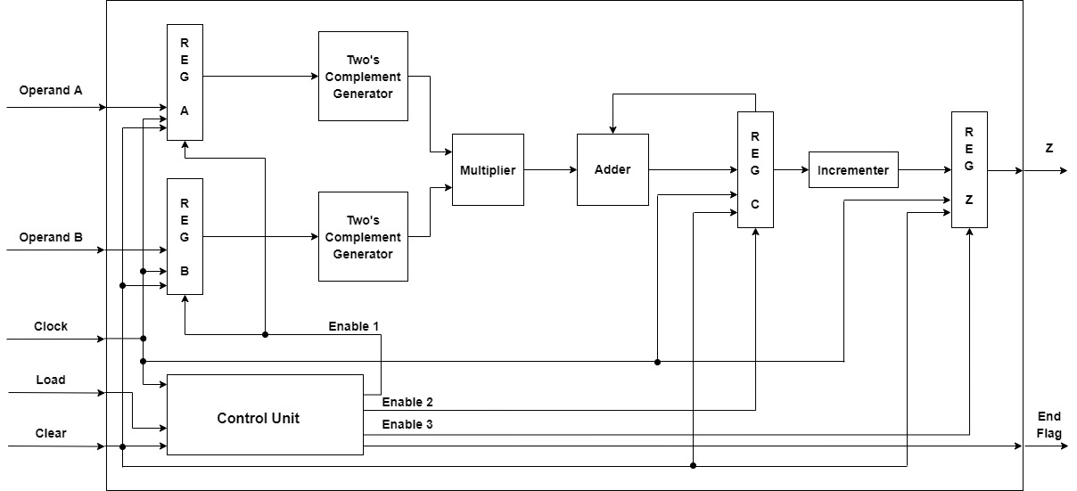
Multiply Accumulate for Additional operands

Slide 28
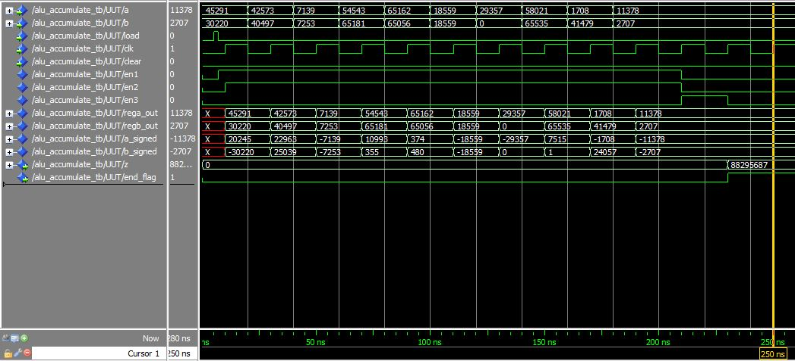
Simulation Result

Slide 29
Area and Delay
 | LUTs | CLB Slices | Dffs or Latches
16-bit ALU | 886 | 443 | 64
16-bit ALU with Accumulator | 1043 | 522 | 109
 | Delay
16-bit ALU | 23.617 ns
16-bit ALU with Accumulator | 25.823 ns

