Slide 1
[ TWO METHODS · ONE COMPARISON ]
Opening the
Black Box
Linear Probe
Sparse Autoencoder
one direction
many directions
sentiment
sentiment
Comparing Linear Probes and Sparse
Autoencoders for Understanding
Language Models
finds ONE direction
finds MANY directions
for ONE concept
for MANY concepts
“We use AI everywhere , but we still don’t know how it thinks.”
Github repo: https://github.com/abedkkhan/Linear-Probes-vs-SAEs
which method better captures the model?
Aabid Karim · ID 30468176

Slide 2
The Problem
[ ONE NEURON · MANY MEANINGS ]
polysemantic activation
— Language models like GPT, Gemma, and Claude generate impressive outputs
— But we don't understand what's happening inside
— Their internal mechanisms remain opaque , a "black box"
— Neurons are polysemantic , one neuron fires for multiple unrelated concepts
— This makes it impossible to interpret, trust, or control these models
— Two methods exist to look inside: Linear Probes and Sparse Autoencoders
— But which one actually works better?
"citations"
"baseball"
"HTTP requests"
neuron 42
fires!
"Korean text"
"poetry"
same neuron fires for unrelated concepts
Aabid Karim · ID 30468176

Slide 3
How Models Represent Knowledge
[ GRAPH · CIRCUIT ]
how features flow across layers
prediction
positive
— Language models convert text into high-dimensional activation vectors
— These vectors pass through many layers, each one transforming the representation before producing the final output
— The Linear Representation Hypothesis: concepts are encoded as directions in this vector space
— A "sentiment direction" — a "gender direction" — a "language direction"
— If we can find these directions, we can understand the model
— The question becomes: how do we find them?
layer 12
layer 3
sentiment direction
layer 2
layer 1
the
movie
was
input tokens
features at each layer connect to form a circuit
Aabid Karim · ID 30468176

Slide 4
Why This Matters
Finding internal representations isn't just academic , it has direct, real-world applications.
AI Safety
Bias Detection
Model Steering
Detect deception, harmful content, or unsafe outputs before they reach users
Find and measure racial, gender, or political biases inside model representations
Control model behaviour by amplifying or suppressing specific concept directions
Hallucination Detection
Medical & Legal AI
Mechanistic Interpretability
Identify when a model is uncertain or fabricating facts it doesn't actually know
Audit high-stakes models for what they actually "know" before deployment
Foundation for understanding how AI systems actually think and reason

Slide 5
Linear Probes
A simple classifier trained on frozen model activations to detect a specific concept.
— Take a frozen language model (e.g., Gemma 2 2B)
— Run sentences through it , half positive, half negative
— Grab the activation vector at a chosen layer for each sentence
— Train a logistic regression: predict sentiment from activations
— If it predicts well, sentiment lives at that layer, as a direction
— That direction is the probe's learned weights
[ WORKFLOW · HOW IT WORKS ]
from text to concept direction
Frozen LLM (Gemma 2)
Extract Activations at Layer 12
Train Logistic Regression
Sentiment Direction
Aabid Karim · ID 30468176
the probe's weights become the direction

Slide 6
Sparse Autoencoders
A small network that decomposes activations into thousands of interpretable features.
— Inside the model, many concepts are stuffed into the same neurons
— An SAE takes one activation vector and expands it into thousands of features
— Most of those features stay silent, only a few fire at a time
— The SAE reconstructs the original activation from those few features
— Each feature ends up representing one clean concept, sentiment, gender, syntax
— We use Gemma Scope, pretrained SAEs by DeepMind (Lieberum et al., 2024)
[ SAE · EXPAND THEN RECONSTRUCT ]
encoder expands · decoder rebuilds
activation
(2,304 dims · mixed)
ENCODER ↓ expands
16,384 sparse features · only a few active
DECODER ↓ rebuilds
reconstructed
(same dim · cleaner)
active features = interpretable concepts
Aabid Karim · ID 30468176

Slide 7
Literature Review
Concepts live as directions in activation space.
Park et al. (2024) formalised the Linear Representation Hypothesis., and Tomihari & Sato (2024) deepened the theory through LP-FT dynamics. Alain & Bengio (2017) showed linear probes could extract these directions
Together, these papers establish the geometric view of how models represent meaning.
Sparse autoencoders scale interpretability.
Cunningham et al. (2023) showed SAEs can disentangle features hidden in superposition. Rajamanoharan et al. (2024) refined the architecture with Gated SAEs. Lieberum et al. (2024) released Gemma Scope , the pretrained SAEs this project uses.
This line of work pushed interpretability from one direction at a time to thousands.
But SAEs may not deliver on their promise.
Smith et al. (2025) found SAEs underperformed linear probes on downstream tasks — raising a critical question that this project sets out to answer empirically.
If the simpler tool wins, the field's investment in SAEs may need rethinking.
Aabid Karim · ID 30468176

Slide 8
What's Missing
The two methods have never been directly compared.
Linear probes and SAEs are studied separately , papers introduce each method on different models, layers, and tasks. There is no clean head-to-head comparison.
Without a controlled comparison, we can't say which method truly captures more.
We don't know if SAEs and probes find the same directions.
Both claim to extract concept directions, but no study has measured whether the directions agree geometrically, or whether each method captures something the other misses.
Geometric alignment between methods would tell us whether they see the same model.
It's unclear if these methods are domain-specific.
Smith et al. (2025) tested SAEs on one task. We don't know whether linear probes excel for some kinds of concepts (like sentiment) while SAEs work better for others.
This project tests both on sentiment to begin answering that question.
Aabid Karim · ID 30468176

Slide 9
What We're Asking
Research Questions
RQ1
Do linear probes and SAEs find sentiment as a linear direction at the same layer?
RQ2
Which method achieves higher classification accuracy on held-out test data?
RQ3
Do the directions found by each method align geometrically?
RQ4
Are these methods domain-specific, does one work better for sentiment than the other?
Research Objectives
O1
Advance empirical understanding of how language models represent meaning internally
O2
Contribute to AI safety by validating the tools we use to inspect model behaviour
O3
Inform the choice between linear probes and SAEs for future interpretability research
O4
Lay groundwork for domain-specific analysis of how different concepts are encoded
Aabid Karim · ID 30468176

Slide 10
What We Predict
Hypotheses
H0 · NULL HYPOTHESIS
Linear probes and sparse autoencoders show no meaningful difference in their ability to capture sentiment representations in Gemma 2 2B.
H1 · ALTERNATE HYPOTHESIS
Linear probes will outperform SAEs for sentiment classification accuracy, while finding overlapping but distinct sentiment directions.
Variables
INDEPENDENT
DEPENDENT
what we control
what we measure
— Method (Linear Probe vs SAE)
— Model layer (Layer 12, residual stream)
— Input data (SST-2 sentiment samples)
— Classification accuracy & F1 score
— Cosine similarity between found directions
— Interpretability of extracted features

Slide 11
Methodology — The Setup
MODEL
DATASET
Gemma 2 2B
SST-2 — Sentiment Treebank
— 2 billion parameters
— 26 transformer layers
— Residual stream dimension: 2,304
— Hugging Face: google/gemma-2-2b
— Frozen during all experiments
— Compatible with pretrained Gemma Scope SAEs
— Stanford Sentiment Treebank (SST-2)
— Binary sentiment task: positive vs negative
— Movie review sentences
— 67,349 training samples
— 872 validation · 1,821 test
— Hugging Face: stanfordnlp/sst2
We chose Gemma 2 2B because DeepMind released pretrained SAEs for it, no SAE training needed.
We chose SST-2 because sentiment is well-defined, small enough to iterate quickly, and widely benchmarked.
Aabid Karim · ID 30468176

Slide 12
Methodology — How We Measure
LAYER
METHODS
EVALUATION
Layer 12 · Residual Stream
Linear Probe & SAE
How We Compare
— Layer 12 (mid-depth)
— Residual stream output
— 2,304-dimensional vector
— Mid-layers encode semantic concepts
— Mean pooling across tokens
— Linear Probe , logistic regression
— L2 regularization
— scikit-learn implementation
— SAE , Gemma Scope 16K features
— JumpReLU architecture (pretrained)
— Loaded via SAELens library
— Accuracy (overall correctness)
— F1 score (balanced precision/recall)
— AUC-ROC (probabilistic confidence)
— Cosine similarity between directions
— Top SAE features for sentiment
— Qualitative interpretability check
Same model. Same layer. Same data. Different methods , a controlled, head-to-head comparison.
Aabid Karim · ID 30468176

Slide 13
End-to-End Pipeline
What happens to a single sentence , from input to comparison.
"the movie was great"
input sentence
Tokenize → Gemma 2 2B (frozen)
Extract activations @ Layer 12
(N × 2,304 vectors)
Mean pool across tokens
Per-token activations
(1 × 2,304)
(N × 2,304)
Linear Probe
Gemma Scope SAE
logistic regression → direction
sparse features per token
Mean pool features
(1 × 16,384)
Compare · accuracy · F1 · cosine similarity
Aabid Karim · ID 30468176

Slide 14
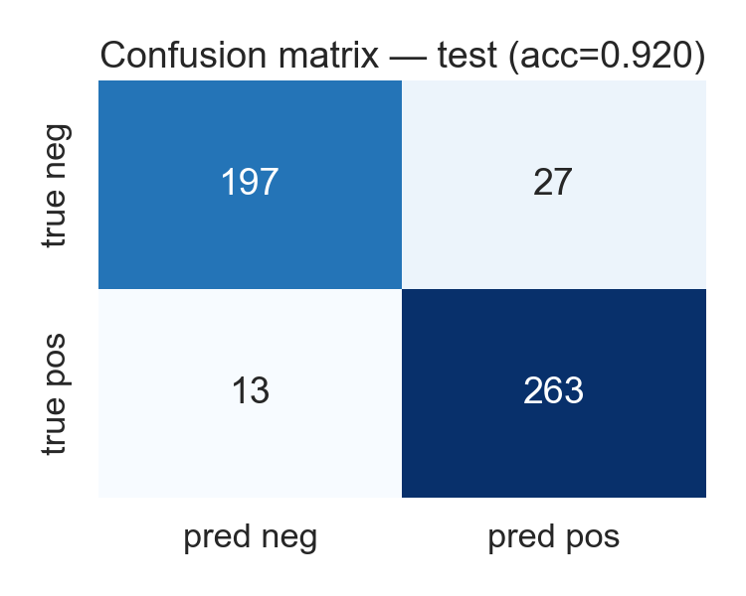
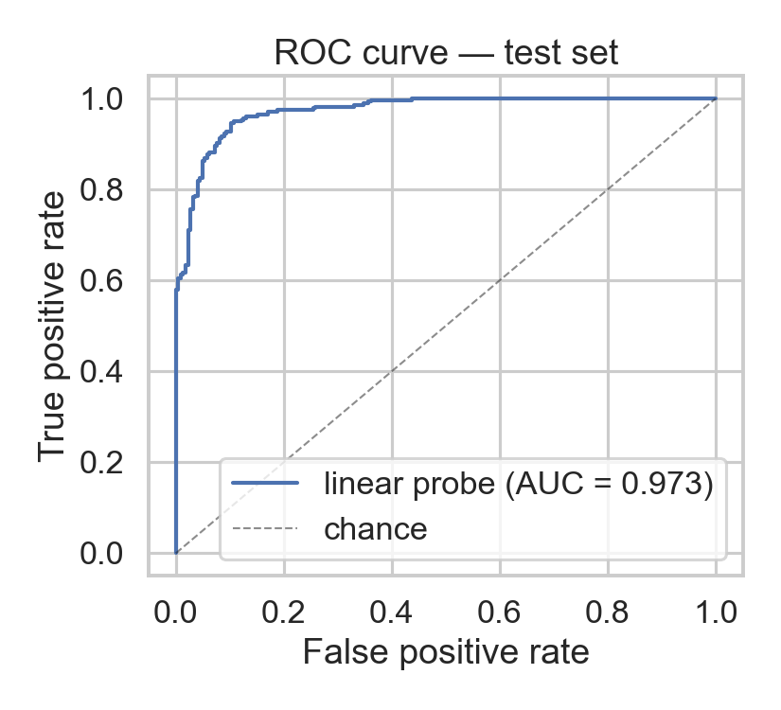
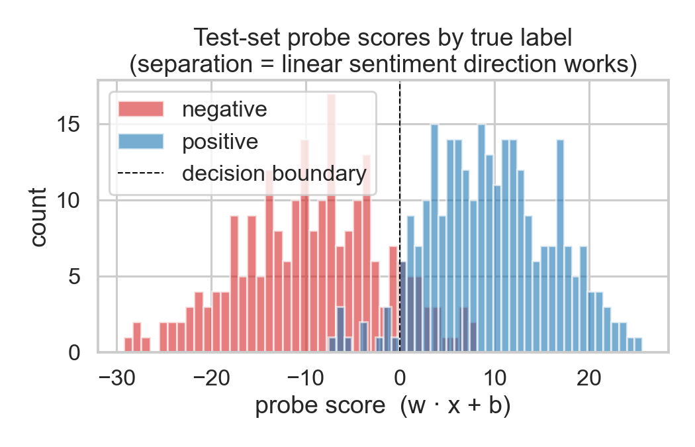
[ RESULTS · LINEAR PROBE · 15 ]
Linear Probe — Results
92.0%
0.929
0.973
TEST ACCURACY
F1 SCORE
AUC-ROC
train 100% · val 91.4%
balanced precision & recall
near-perfect ranking quality
Confusion matrix (test set, n = 500)
ROC curve — AUC = 0.973
Probe scores cleanly separate positives & negatives
Sentiment is linearly separable at layer 12 , the probe finds a single direction that classifies unseen sentences at 92%.
Aabid Karim · ID 30468176
15

Slide 15
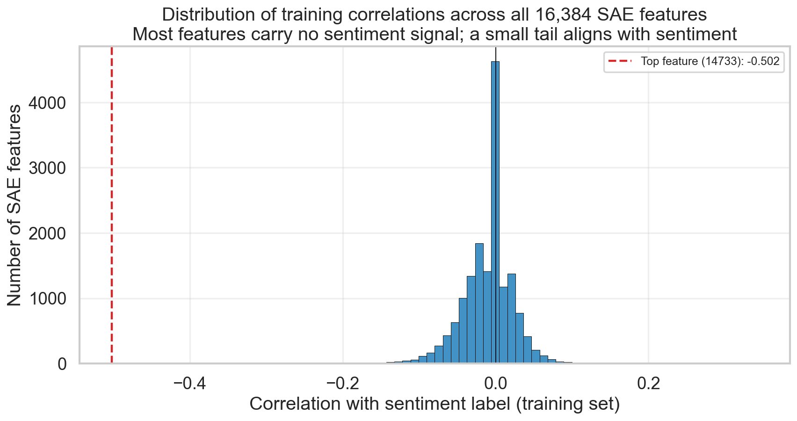
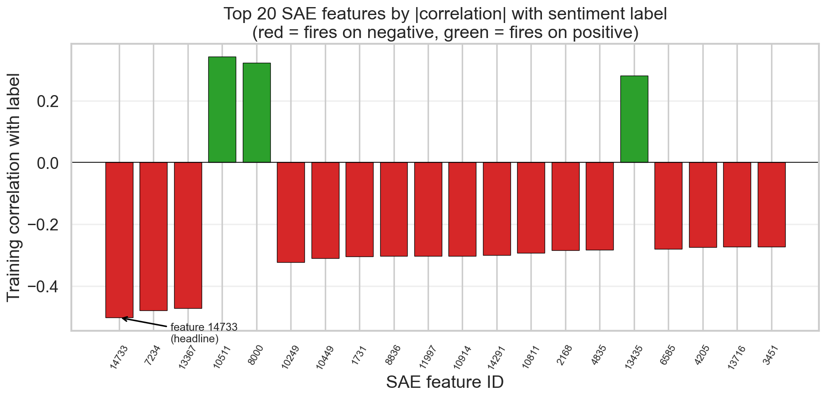
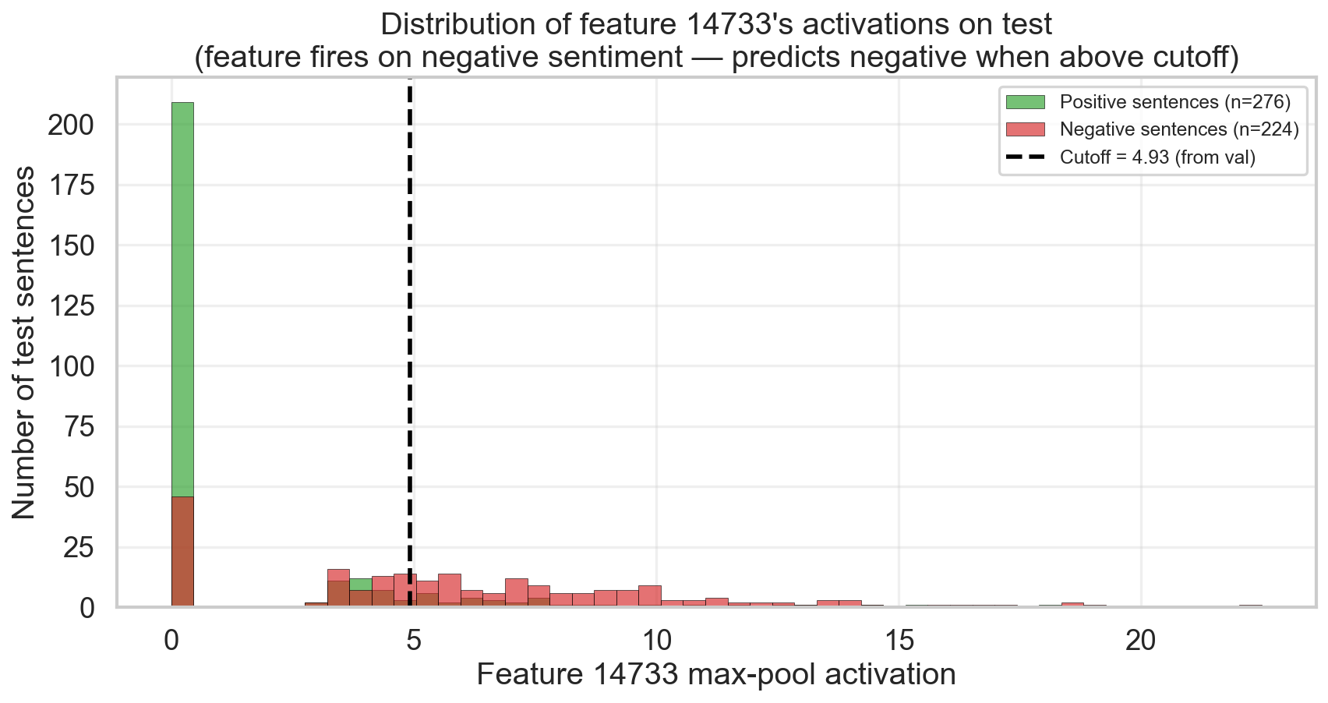
SAE Finding the Sentiment Feature
16,384
#14733
−0.50
FEATURES SEARCHED
TOP FEATURE
CORRELATION (TRAIN)
every SAE feature scored vs labels
fires on negative sentiment
highest |r| of any feature
Distribution of correlations across all 16,384 features
Top-20 features by |correlation| — #14733 leads
Feature 14733 fires on negative test sentences
Out of 16,384 unsupervised features, one — #14733 , emerges as a sentiment detector, discovered with no labels.
Aabid Karim · ID 30468176
16

Slide 16
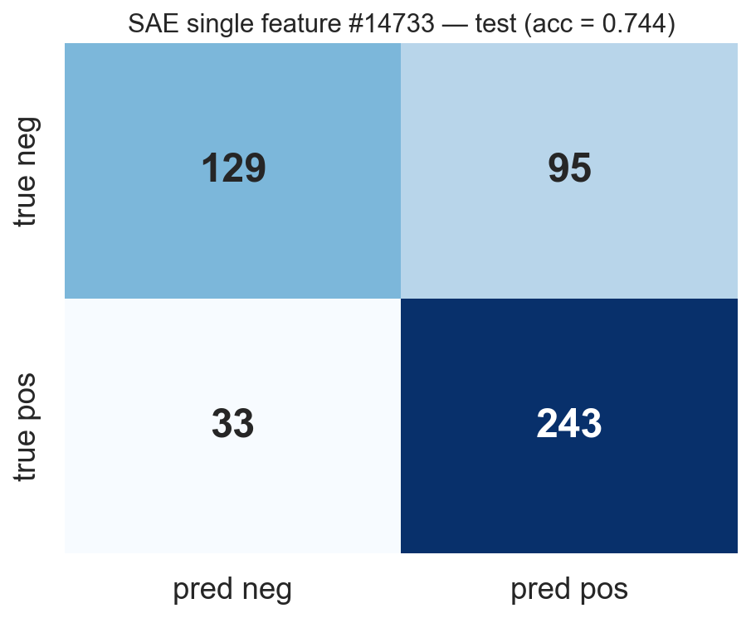
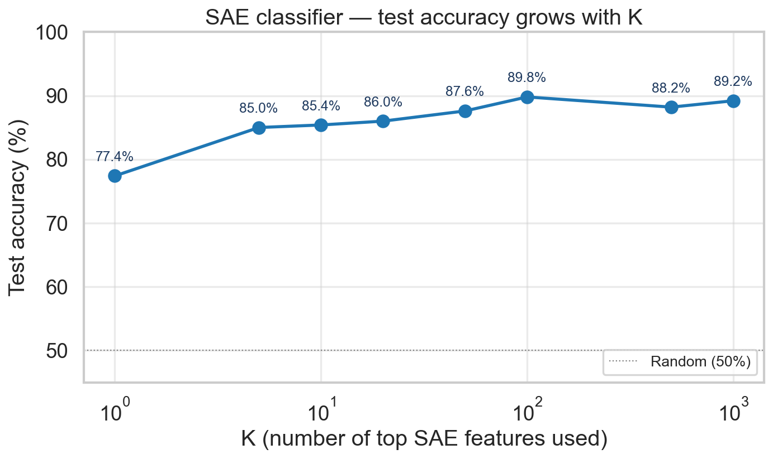
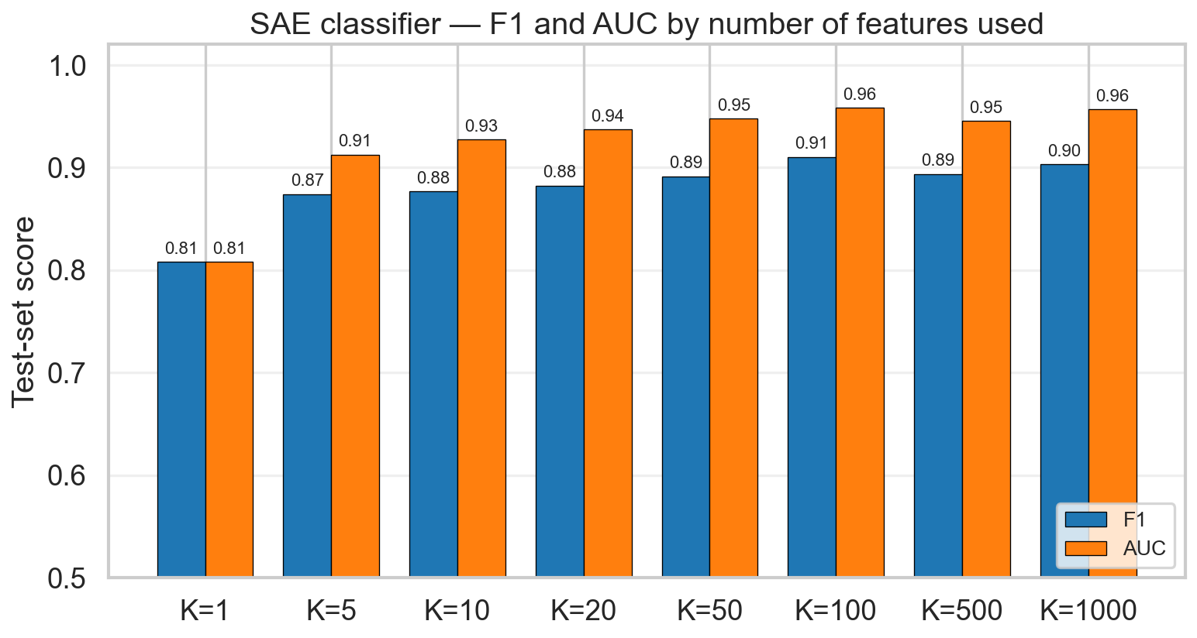
SAE — Classifier Performance
77.4%
89.8%
0.96
TEST ACC · 1 FEATURE
TEST ACC · TOP-100
AUC · TOP-100
feature #14733 alone, val-tuned cutoff
logistic regression on top-100 features
near-perfect ranking from few features
Single-feature confusion matrix (test set, n = 500)
Test accuracy grows as more SAE features are used
F1 and AUC across K — same shape as accuracy
One SAE feature reaches 77%, adding a small cluster lifts it to ~90%. Sentiment is spread across a handful of features, not one.
Aabid Karim · ID 30468176
17

Slide 17
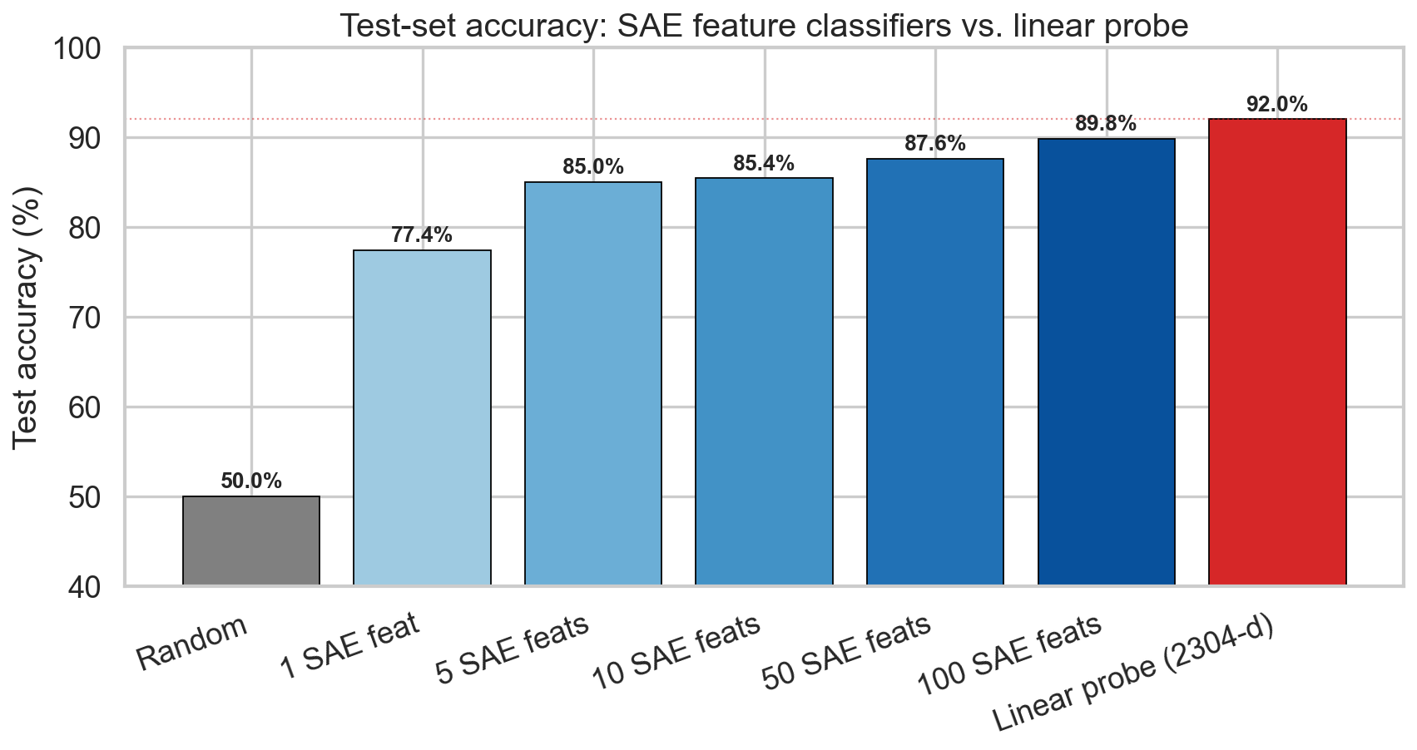
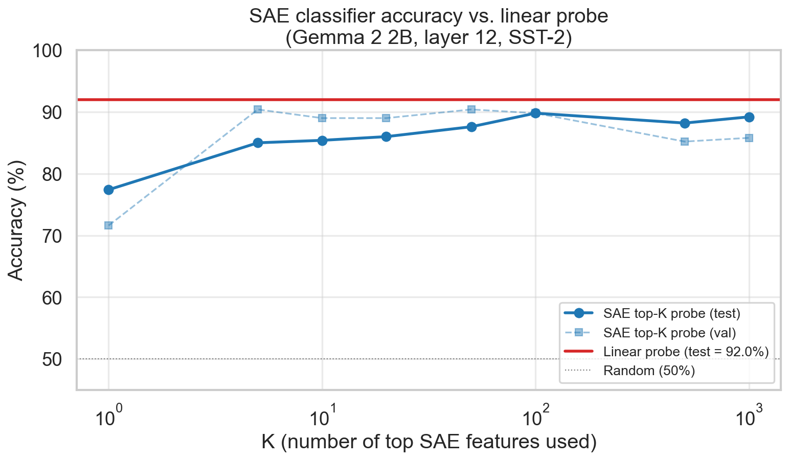
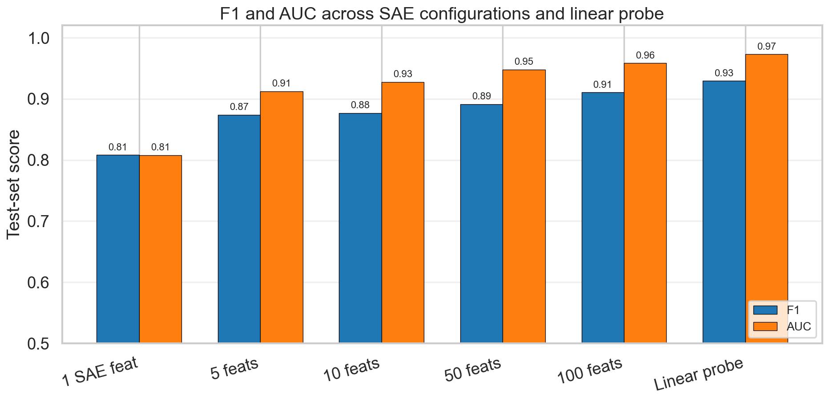
[ RESULTS · HEAD-TO-HEAD · 18 ]
Probe vs SAE — Head-to-Head
92.0%
89.8%
−2.2 pp
LINEAR PROBE
SAE · TOP-100
GAP · PROBE vs SAE
1 supervised direction across 2,304 dims
~100 unsupervised features, no labels used
probe wins by a narrow margin on accuracy
Accuracy side-by-side across configurations
SAE accuracy curve approaches the probe baseline
F1 and AUC — same gap, same shape
The probe wins on accuracy by ~2 pp; the SAE wins on interpretability, each feature can be named, ranked, and inspected.
Aabid Karim · ID 30468176
18

Slide 18
References
Alain, G., & Bengio, Y. (2017). Understanding intermediate layers using linear classifier probes. arXiv preprint arXiv:1610.01644.
Cunningham, H., Ewart, A., Riggs, L., Huben, R., & Sharkey, L. (2023). Sparse autoencoders find highly interpretable features in language models. arXiv preprint arXiv:2309.08600.
Lieberum, T., Rajamanoharan, S., Conmy, A., Smith, L., Sonnerat, N., Varma, V., Kramár, J., Dragan, A., Shah, R., & Nanda, N. (2024). Gemma Scope: Open sparse autoencoders everywhere all at once on Gemma 2. arXiv preprint arXiv:2408.05147.
Park, K., Choe, Y. J., & Veitch, V. (2024). The linear representation hypothesis and the geometry of large language models. Proceedings of the 41st International Conference on Machine Learning.
Rajamanoharan, S., Conmy, A., Smith, L., Lieberum, T., Varma, V., Kramár, J., Shah, R., & Nanda, N. (2024). Improving dictionary learning with gated sparse autoencoders. arXiv preprint arXiv:2404.16014.
Tomihari, A., & Sato, I. (2024). Understanding linear probing then fine-tuning language models from NTK perspective. Advances in Neural Information Processing Systems, 38.

