Slide 1
[ FIGURES · DISCUSSION DECK ]
Results, Figure by Figure
Linear Probes vs Sparse Autoencoders · Gemma 2 2B · SST-2 sentiment
Each slide: what the figure shows, in plain terms.
Aabid Karim · ID 30468176

Slide 2
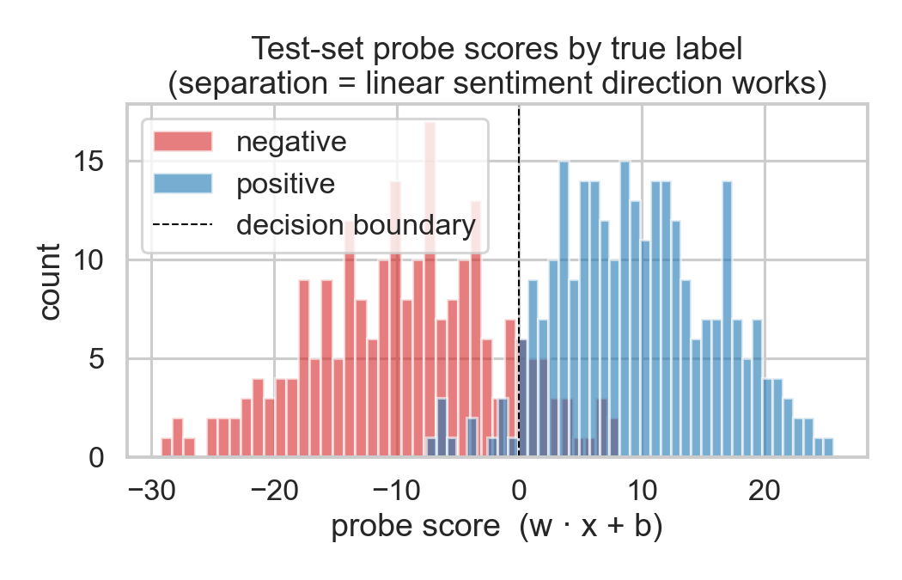
[ LINEAR PROBE · 01 ]
The probe separates positive from negative
WHAT THIS SHOWS
Each sentence gets one score from the probe.
Negative sentences (red) score low; positive (blue) score high.
The two groups barely overlap , clean separation.
Q What is a “probe score”?
A One number the probe gives each sentence. Below the dashed line = predicted negative; above = positive. The gap between the two colours is what makes it accurate.
Aabid Karim · ID 30468176 · Figures Discussion Deck

Slide 3
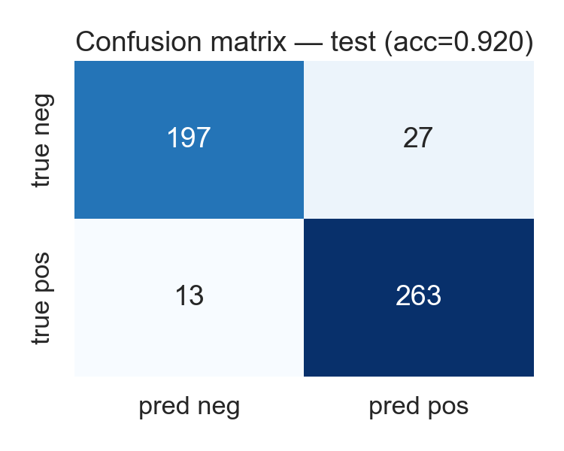
[ LINEAR PROBE · 02 ]
92% correct on unseen sentences
WHAT THIS SHOWS
500 test sentences the probe never saw in training.
Only 40 mistakes total (27 + 13).
197 negatives and 263 positives correctly identified.
Q Is 92% good?
A Yes. Our success target was 75%, and 92% is competitive with published results on this dataset. Random guessing would be 50%.
Aabid Karim · ID 30468176 · Figures Discussion Deck

Slide 4
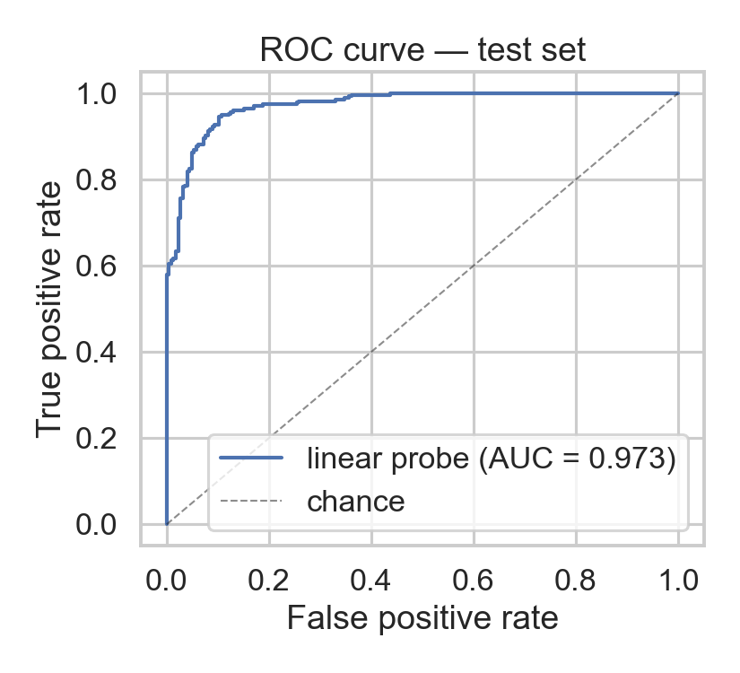
[ LINEAR PROBE · 03 ]
Near-perfect ranking (ROC curve)
WHAT THIS SHOWS
The curve hugging the top-left corner means very few errors.
AUC = 0.97 (1.0 would be perfect, 0.5 is random).
Q What is AUC?
A If you pick one positive and one negative sentence at random, AUC is the chance the probe scores the positive one higher. 0.97 means it gets the order right 97% of the time.
Aabid Karim · ID 30468176 · Figures Discussion Deck

Slide 5
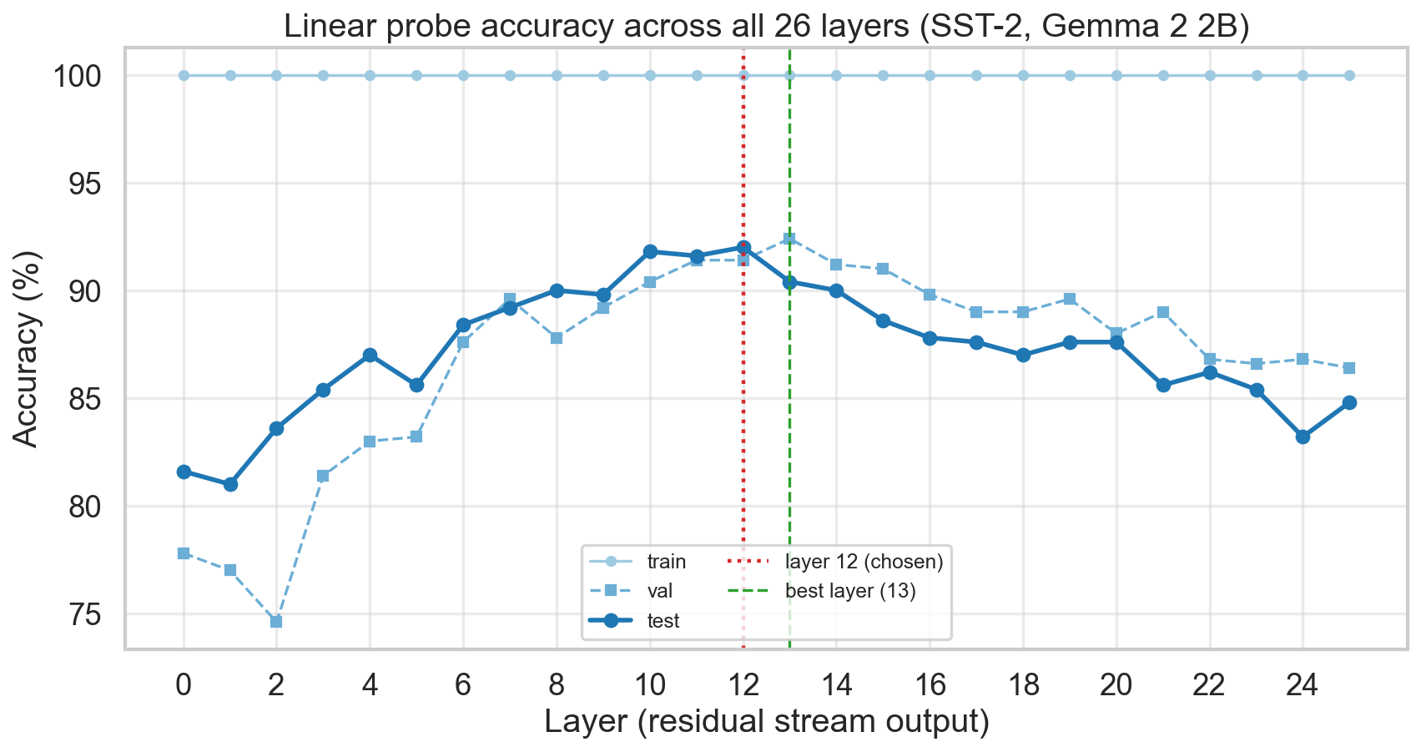
[ LAYER CHOICE · 04 ]
Why layer 12? We tested all 26
WHAT THIS SHOWS
We trained a probe at every one of Gemma’s 26 layers.
Accuracy peaks in the middle layers (10–13).
Layer 12 gives the best test accuracy of all.
Q Why did you pick layer 12 specifically?
A Not arbitrarily — the data shows the middle is best. Early layers handle raw words; late layers focus on predicting the next word. Sentiment lives cleanest in the middle, and layer 12 is the peak.
Aabid Karim · ID 30468176 · Figures Discussion Deck

Slide 6
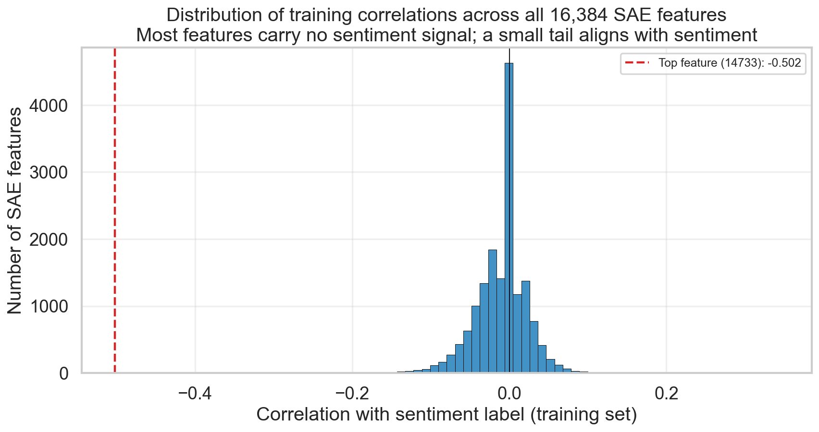
[ SAE DISCOVERY · 05 ]
Searching 16,384 features for sentiment
WHAT THIS SHOWS
The SAE breaks each activation into 16,384 features.
Most features have nothing to do with sentiment (pile near zero).
A few stand out — feature 14733 is the strongest (red line).
Q How did you find the sentiment feature?
A We measured how strongly each of the 16,384 features lines up with the positive/negative labels, then picked the single strongest one. No labels were used to build the SAE itself.
Aabid Karim · ID 30468176 · Figures Discussion Deck

Slide 7
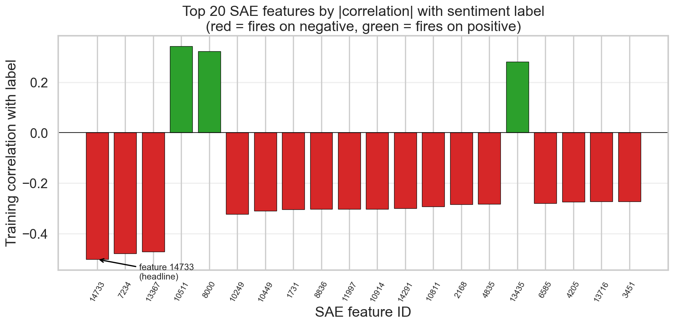
[ SAE DISCOVERY · 06 ]
The top sentiment features
WHAT THIS SHOWS
Top 20 features ranked by how well they track sentiment.
Red bars fire on negative sentences, green on positive.
Feature 14733 leads the ranking.
Q Why are most of them ‘negative’ features?
A Negative sentiment in reviews tends to use sharper, more distinctive language, so the SAE gives it cleaner dedicated features. Positive sentiment is spread more thinly.
Aabid Karim · ID 30468176 · Figures Discussion Deck

Slide 8
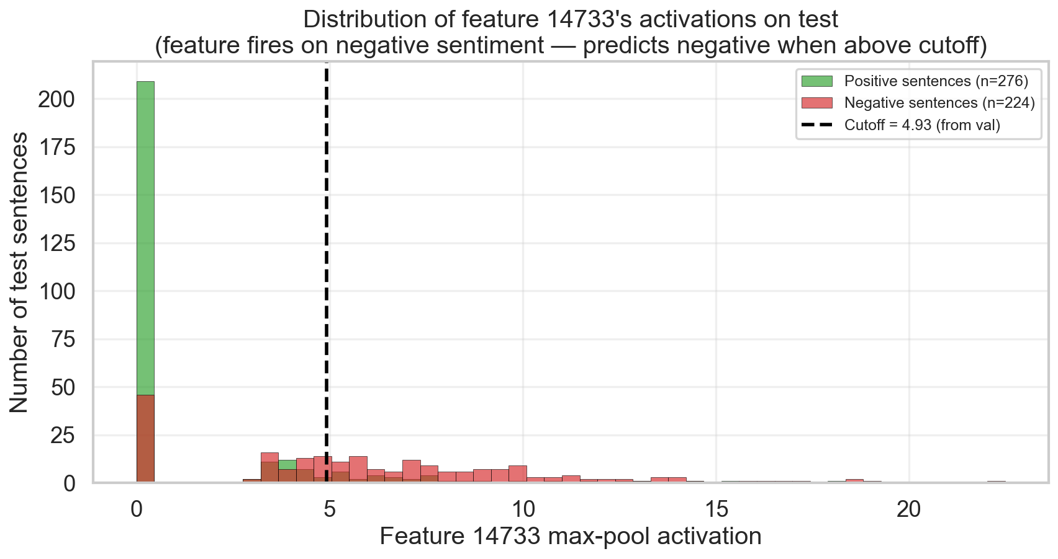
[ SAE DISCOVERY · 07 ]
Feature 14733 fires on negative sentences
WHAT THIS SHOWS
How strongly the feature fires across test sentences.
Negative sentences (red) push it high; positive (blue) stay near zero.
The dashed line is the cutoff we use to classify.
Q Where did the cutoff come from?
A From the validation set, not the test set — we chose the line that best separated the classes on data held aside, then applied it untouched to the test set.
Aabid Karim · ID 30468176 · Figures Discussion Deck

Slide 9
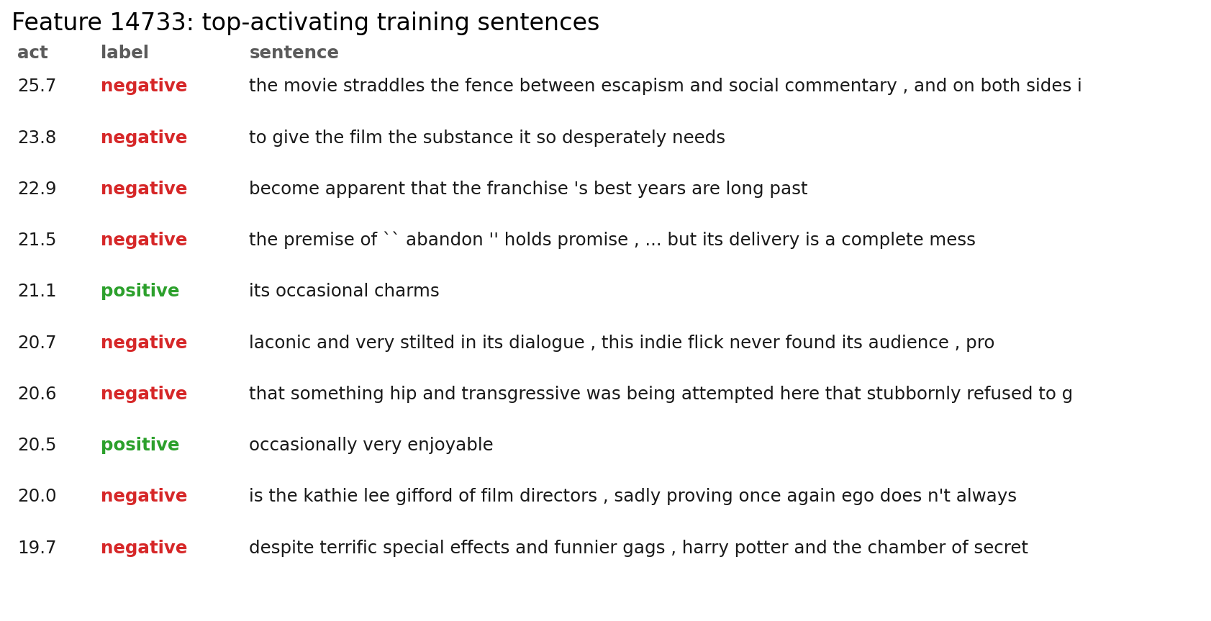
[ SAE INTERPRETABILITY · 08 ]
What the feature actually responds to
WHAT THIS SHOWS
The training sentences that make feature 14733 fire hardest.
Almost all are clearly negative movie reviews.
Evidence the feature is genuinely about negativity — not noise.
Q Two of them are labelled positive — isn’t that a problem?
A Those two are hedged (“its occasional charms”) — faint praise that reads half-negative. The feature tracks negativity strongly but not perfectly, which is expected and honest.
Aabid Karim · ID 30468176 · Figures Discussion Deck

Slide 10
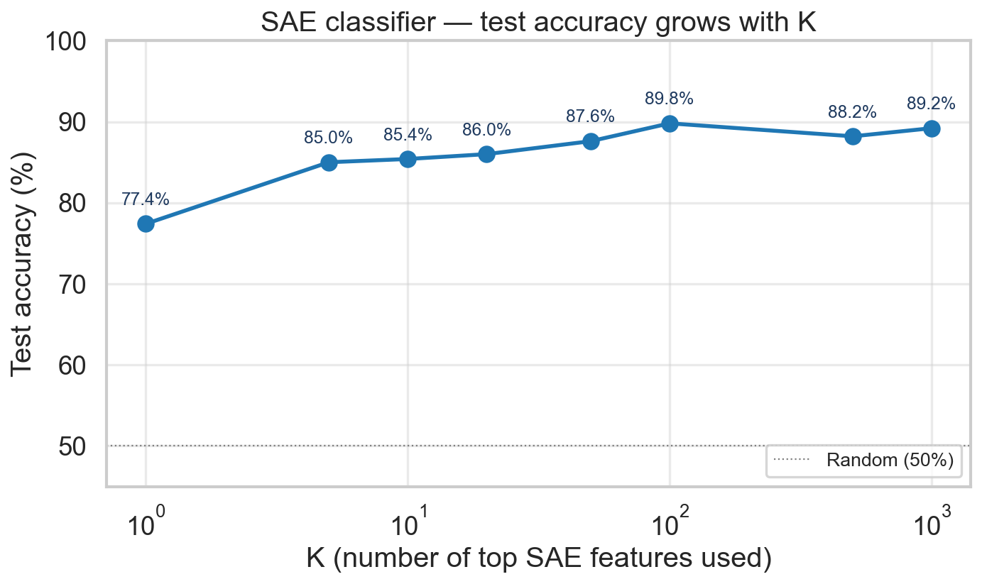
[ SAE CLASSIFIER · 09 ]
More features → higher accuracy
WHAT THIS SHOWS
Using just feature 14733: 77% accuracy.
Using the top 5: 85%. Top 100: ~90%.
Sentiment is spread across a handful of features, not one.
Q Why not just use the single best feature?
A Because sentiment isn’t one single thing — intensity, negation, specific words all contribute. Each is a separate SAE feature, so combining a few gives a big jump.
Aabid Karim · ID 30468176 · Figures Discussion Deck

Slide 11
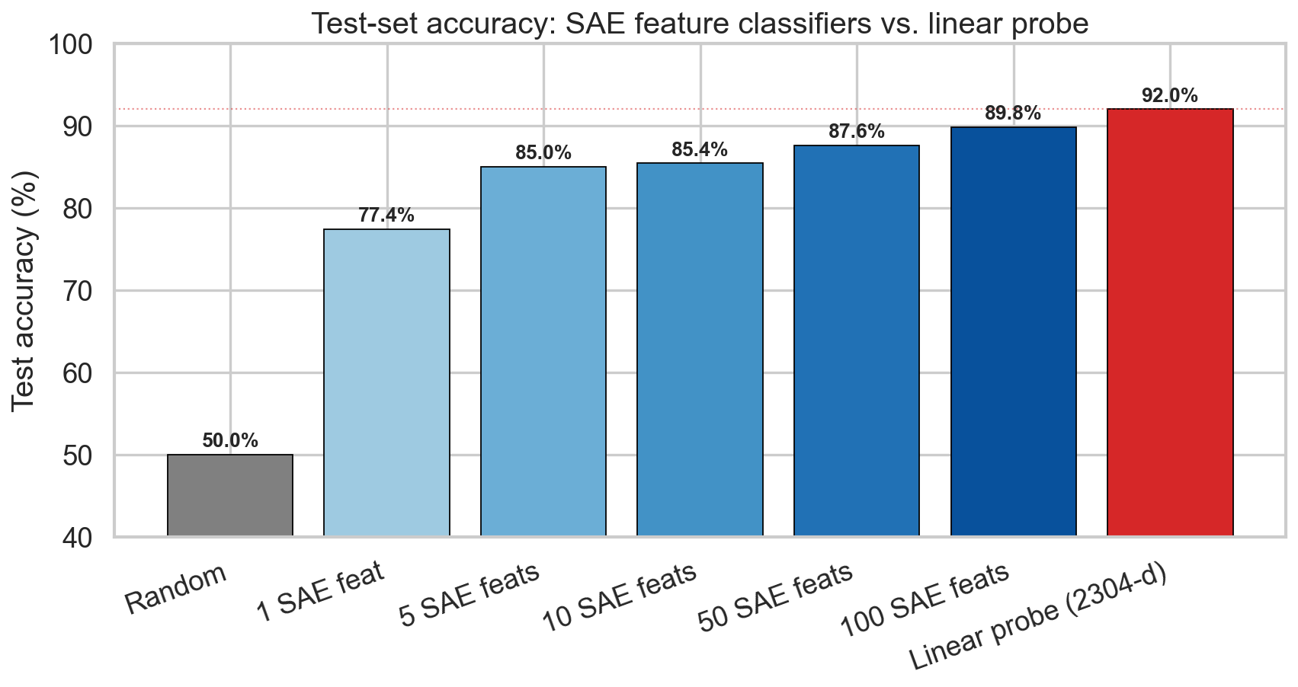
[ COMPARISON · 10 ]
Probe vs SAE — head to head
WHAT THIS SHOWS
Linear probe: 92%. Best SAE (top-100): ~90%.
Single SAE feature: 77%. Random guessing: 50%.
The probe wins on accuracy by a small margin.
Q So the SAE lost?
A On raw accuracy, yes — by about 2 points. But the SAE was never given labels, and it gives interpretable features you can read and inspect.
Aabid Karim · ID 30468176 · Figures Discussion Deck

Slide 12
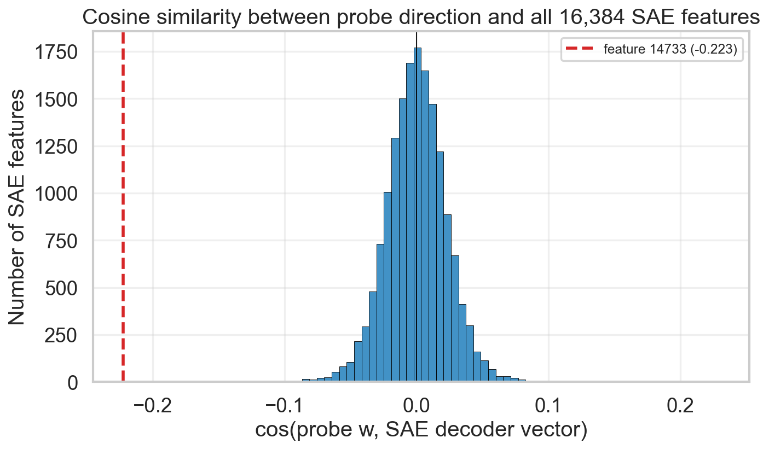
[ COMPARISON · 11 ]
Do both methods point the same way?
WHAT THIS SHOWS
How aligned each SAE feature is with the probe’s direction.
Almost all features are unrelated (pile near zero).
Feature 14733 (red line) sits far out in the tail.
Q Is −0.22 really ‘aligned’? It sounds small.
A In 2,304 dimensions, random alignment is essentially zero. −0.22 is over 10 standard deviations above chance — statistically, an extremely strong signal, even if the number looks modest.
Aabid Karim · ID 30468176 · Figures Discussion Deck

Slide 13
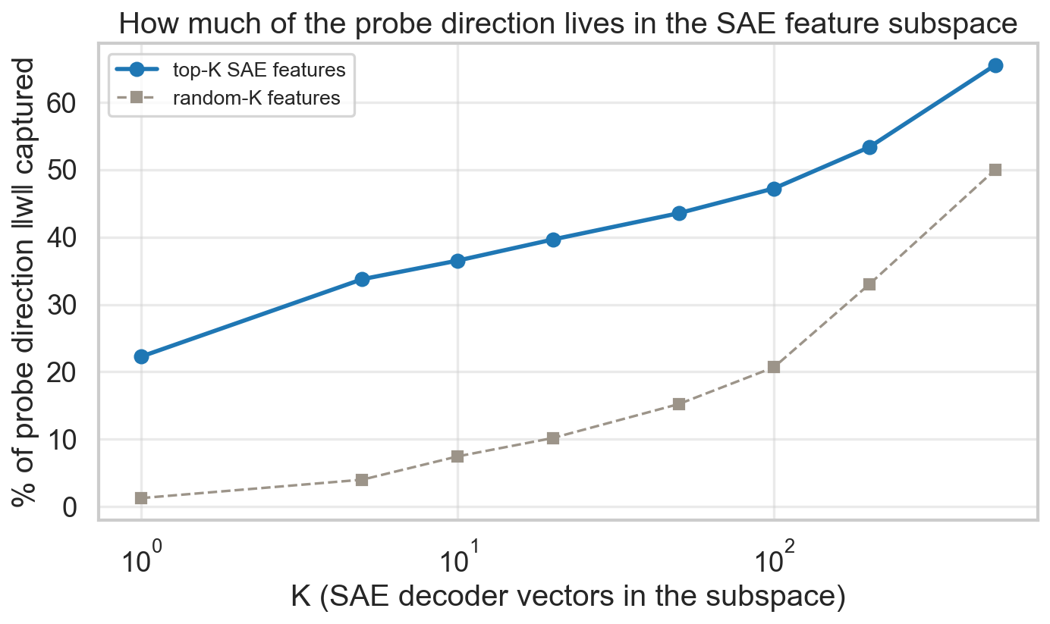
[ COMPARISON · 12 ]
How much of the probe lives in SAE features?
WHAT THIS SHOWS
How much of the probe’s direction the top SAE features recreate.
Top 100 features capture ~half of it (blue), vs ~20% for random (grey).
Real overlap — but no small set fully reproduces the probe.
IF ASKED
Q Do the two methods find the same thing or not?
A Both — they clearly point the same way (far above chance), but the SAE spreads sentiment across many features, so no handful exactly equals the probe’s single direction. Same concept, described differently.
Aabid Karim · ID 30468176 · Figures Discussion Deck

