Slide 1
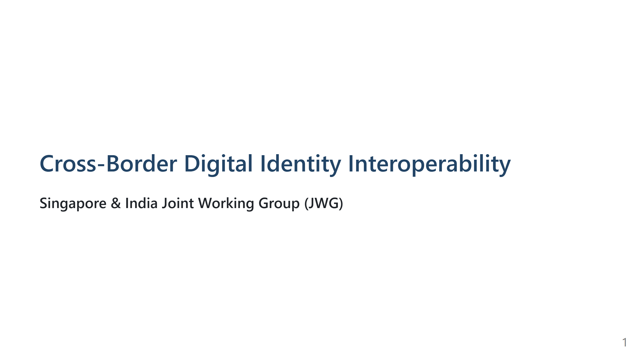

Slide 2
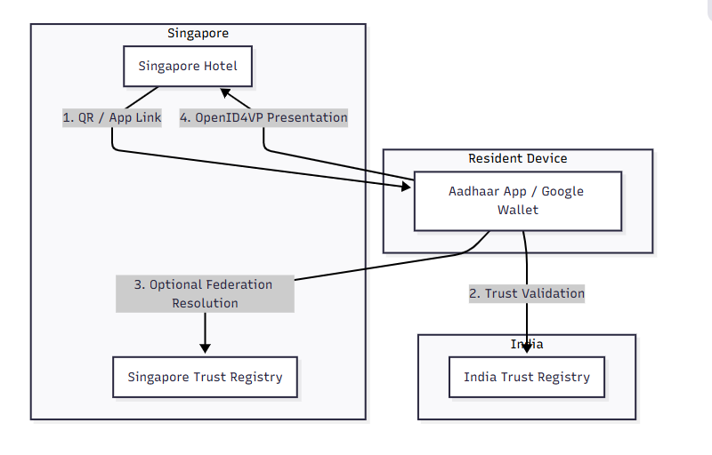
Interoperable Wallet Flow
Wallet has access to both trust registries

Slide 3
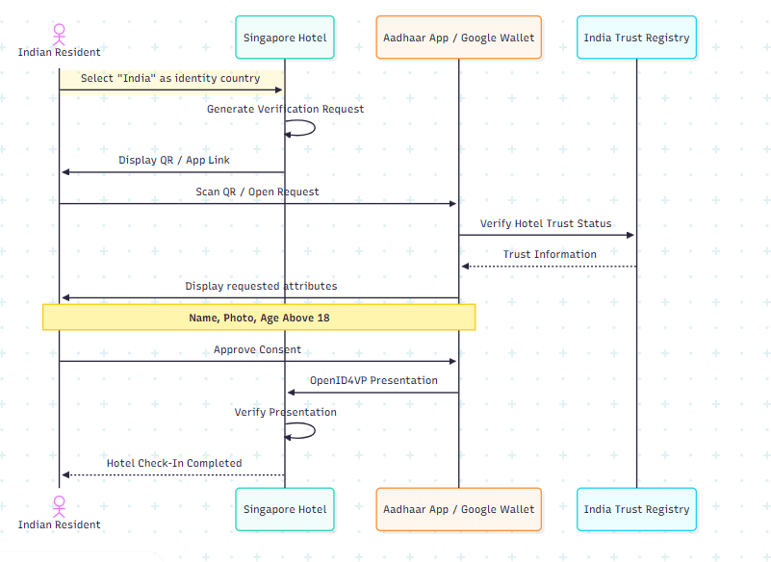
User Journey – Cross-Border Hotel Check-In

Slide 4
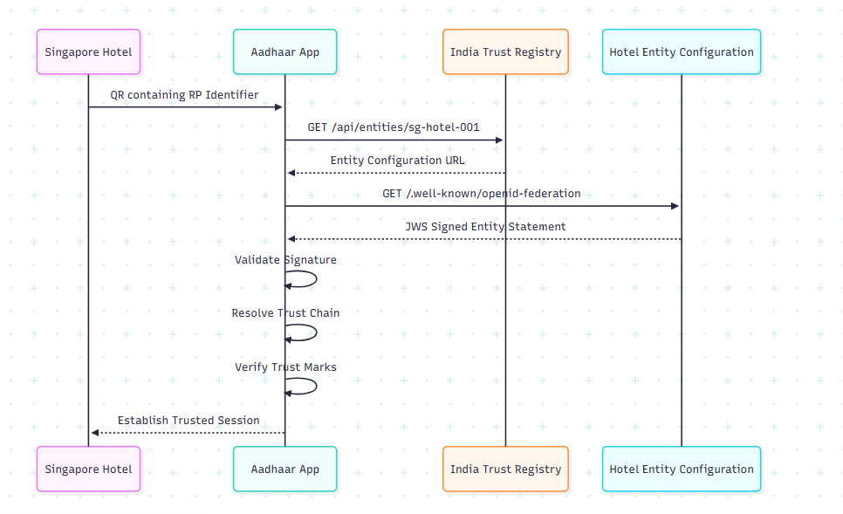
Trust Registry Flow- OpenID Federation Flow

Slide 5
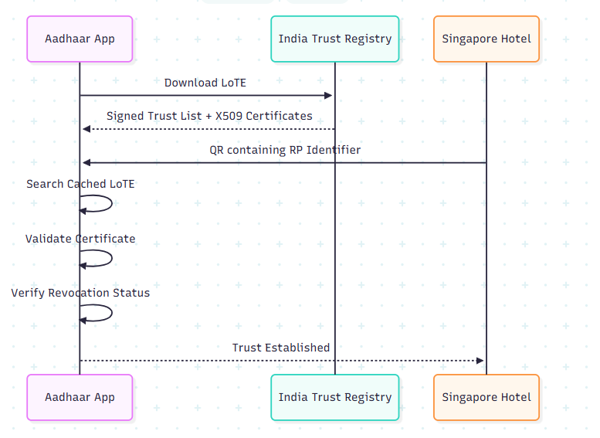
Trust Registry Flow- Offline Flow

Slide 6
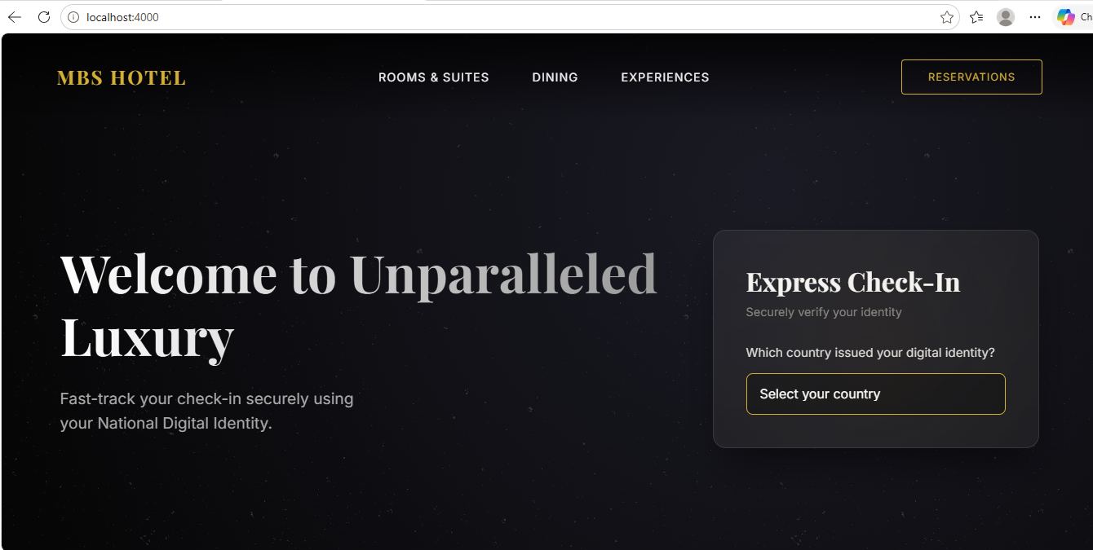


Slide 7
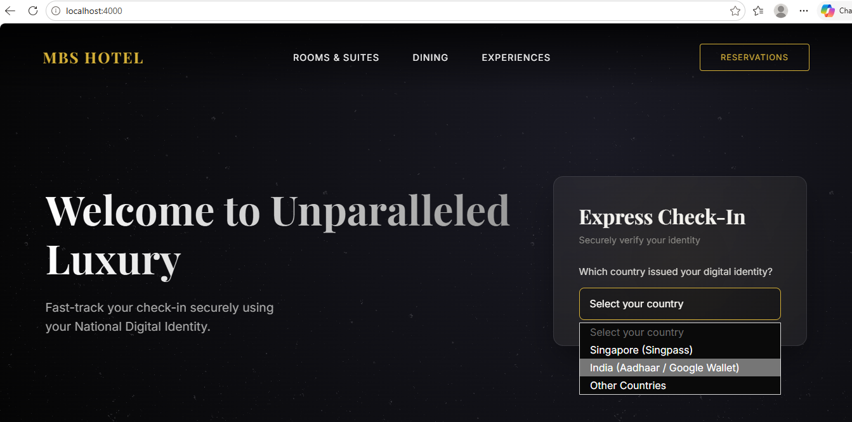

Slide 8
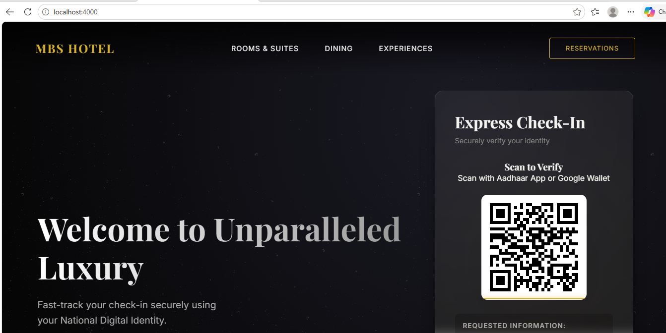

Slide 9

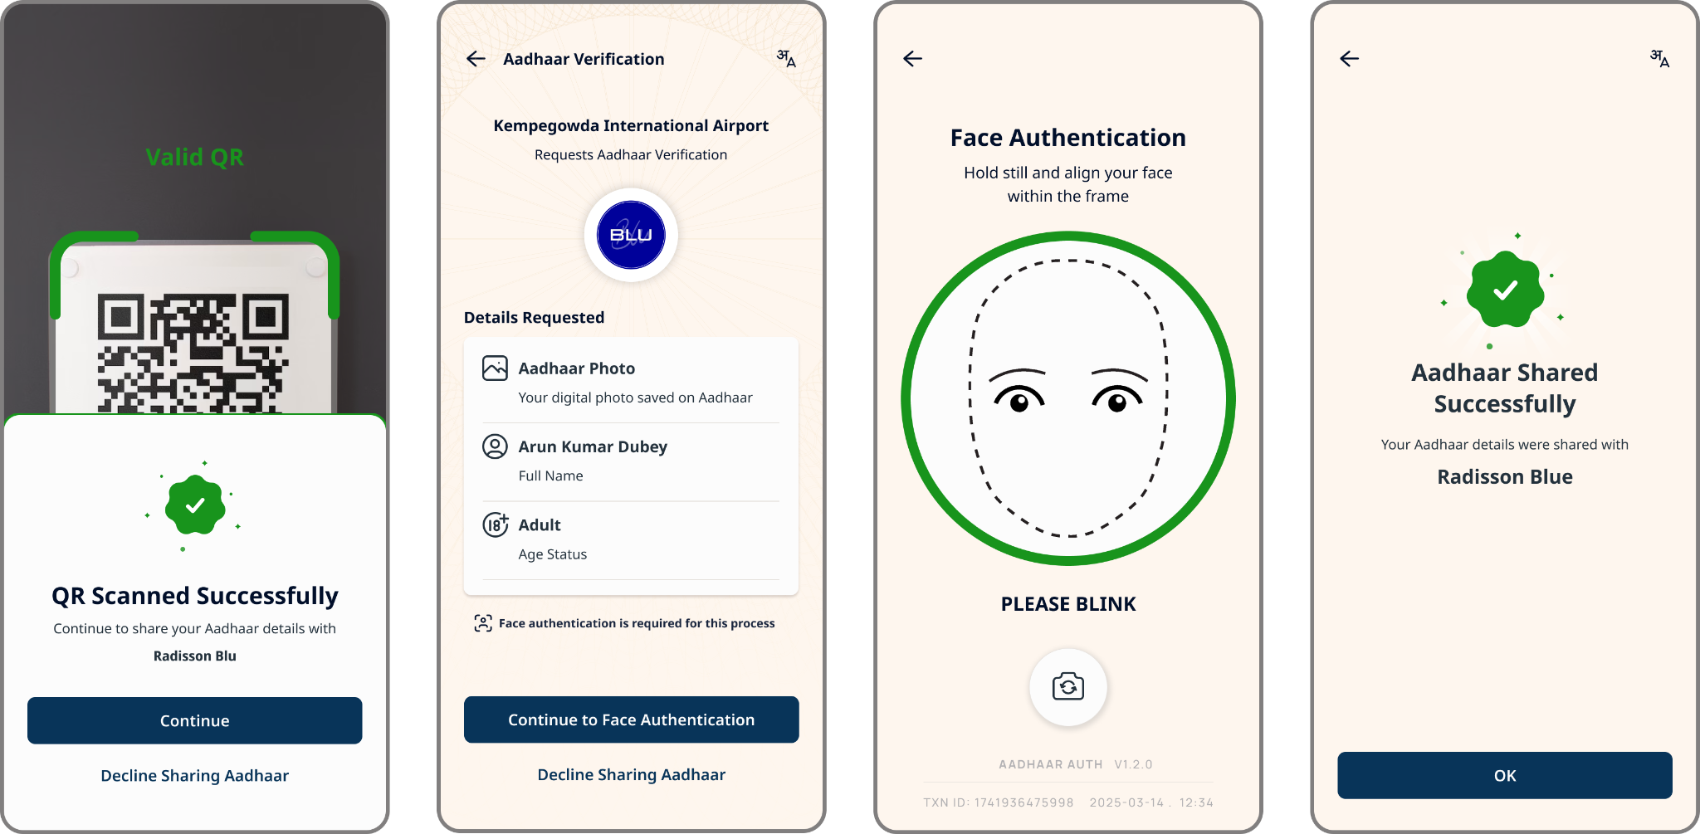
App Flows
Verify With Aadhaar
Entity can generate request for Aadhaar data and verification through QR, App and web-based Intent calls
We are also building Bluetooth & NFC based sharing

