Slide 1

ONLINE BUS TICKET BOOKING
Project done by:
N.Bhavana-2022BCSE07AED444
Y.Chaitanya-2022BCSE07AED445
Shaik Abeedali- 2022BCSE07AED460
Shaik AmeerAli-2022BCSE07AED270

Slide 2
INTRODUCTION:
In the current busy world, individuals like to have easy and convenient means to reserve traveling tickets. The Online Bus Booking System is an internet-based system that provides ease in the reservation process of bus tickets, minimizes manual reservations, and improves users' experience.
This system enables registration, login, searching for available buses, choice of seats, payment, and instant e-tickets. It offers an easy-to-use, smooth interface that simplifies navigation for administrators as well as customers.
The primary objective of this project is to mechanize the conventional bus ticket reservation system, reduce human intervention, remove errors, and offer real-time confirmation of bookings. The system can be accessed from any device, which makes it extremely accessible and efficient.

Slide 3
Problem statement:
1️⃣ Traditional bus ticket booking involves long queues, manual entries, and lack of real-time seat availability, causing inconvenience to passengers.
2️⃣ Errors in manual record-keeping, overbooking, and mismanagement create difficulties for both customers and bus operators.
3️⃣ The absence of a centralized digital system limits accessibility, making it hard for passengers to book tickets remotely and check schedules.
4️⃣ There is a need for a secure, automated, and user-friendly platform that provides real-time updates, seamless payments, and instant e-ticket generation.
5️⃣ The Online Bus Booking System solves these problems by enabling easy ticket reservations, payment processing, and efficient bus management, enhancing overall convenience and efficiency.

Slide 4
Possible solution??
1️⃣ Develop a web-based application where users can register, log in, and book bus tickets online.
2️⃣ Implement a real-time seat availability feature to allow users to select seats without overbooking issues.
3️⃣ Integrate secure online payment options for a smooth and hassle-free booking process.
4️⃣ Provide an automated e-ticket system that generates digital tickets instantly upon successful booking.
5️⃣ Create an admin dashboard for bus operators to manage routes, schedules, bookings, and cancellations efficiently.
This solution ensures a convenient, error-free, and efficient ticket booking experience for passengers and operators.

Slide 5
Software Requirement Specification
Functional Requirements:
1. User Management: Role-based access with user registration, login, and profile management.
2. Ticket Booking: Search schedules, book tickets, and generate digital tickets with QR codes.
3. Bus Management: Operators can manage routes, schedules, and seat availability.
4. Real-Time Updates: Notify users about schedule changes.
5. Payment Processing: Secure online transactions through integrated payment gateways.
6. Reports and Analytics: Dashboards and reports on bookings .

Slide 6
Software Requirement Specification
Non-Functional Requirements
1. Performance: Ensure smooth operation and support multiple users simultaneously with minimal delay.
2. Security: Implement data encryption, secure transactions, and role-based access control.
3. Scalability: Easily scale the system to handle an increasing number of users and bookings.
4. Reliability: Maintain high system availability with regular backups and quick recovery options.
System Architecture
1. Frontend: Notepad
2. Backend: MySQL
3. Database: MySQL.

Slide 7
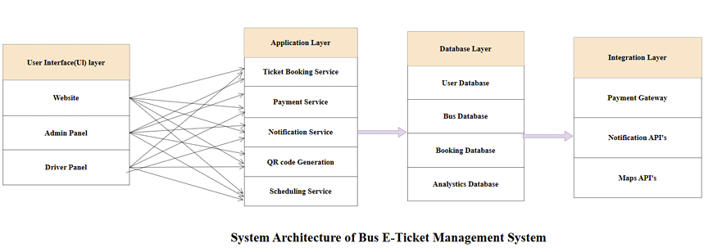
System architecture:
1️⃣ User Interface (UI) Layer: This includes the Website, Admin Panel, and Driver Panel, which allow passengers, administrators, and drivers to interact with the system.
2️⃣ Application Layer: Handles the core functionality like ticket booking, payments, notifications, QR code generation, and bus scheduling, ensuring smooth operations.
3️⃣ Database Layer: Stores and manages essential data, including user details, bus information, booking records, and analytics, for efficient system performance.
4️⃣ Integration Layer: Connects the system to external services like payment gateways, notification APIs, and map services, improving functionality and user experience.
5️⃣ Overall Functioning: The system works by taking inputs from users, processing requests in the application layer, storing data in the database, and integrating with third-party services for payments and notifications.

Slide 8
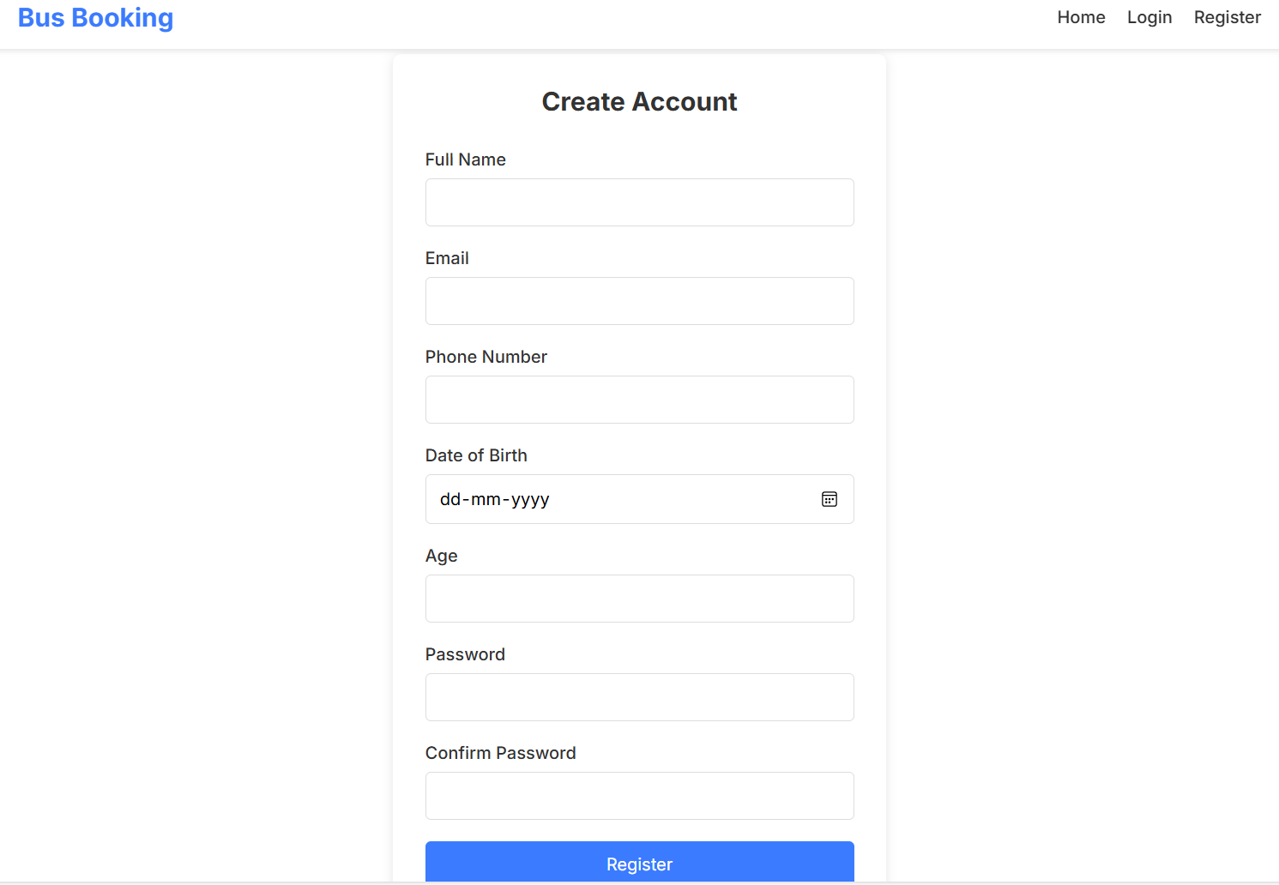
Look up of page!
Register page:
User Input Fields: The registration form collects essential user details like Full Name, Email, Phone Number, Date of Birth, Age, Password, and Confirm Password to create an account securely.

Slide 9
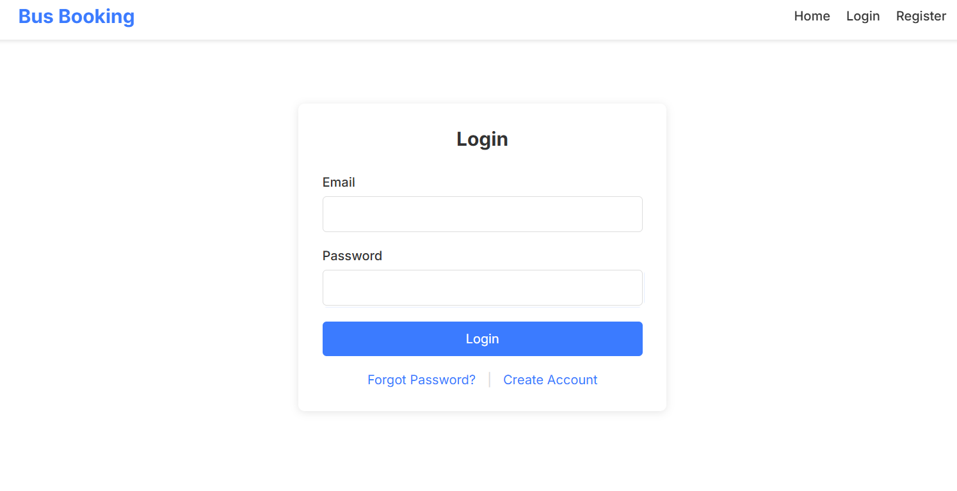
Look up of page!
Login:
We are implementing a Login Page for the Bus Booking System, where users enter their email and password to access their accounts. It also provides options for password recovery and new account creation.

Slide 10
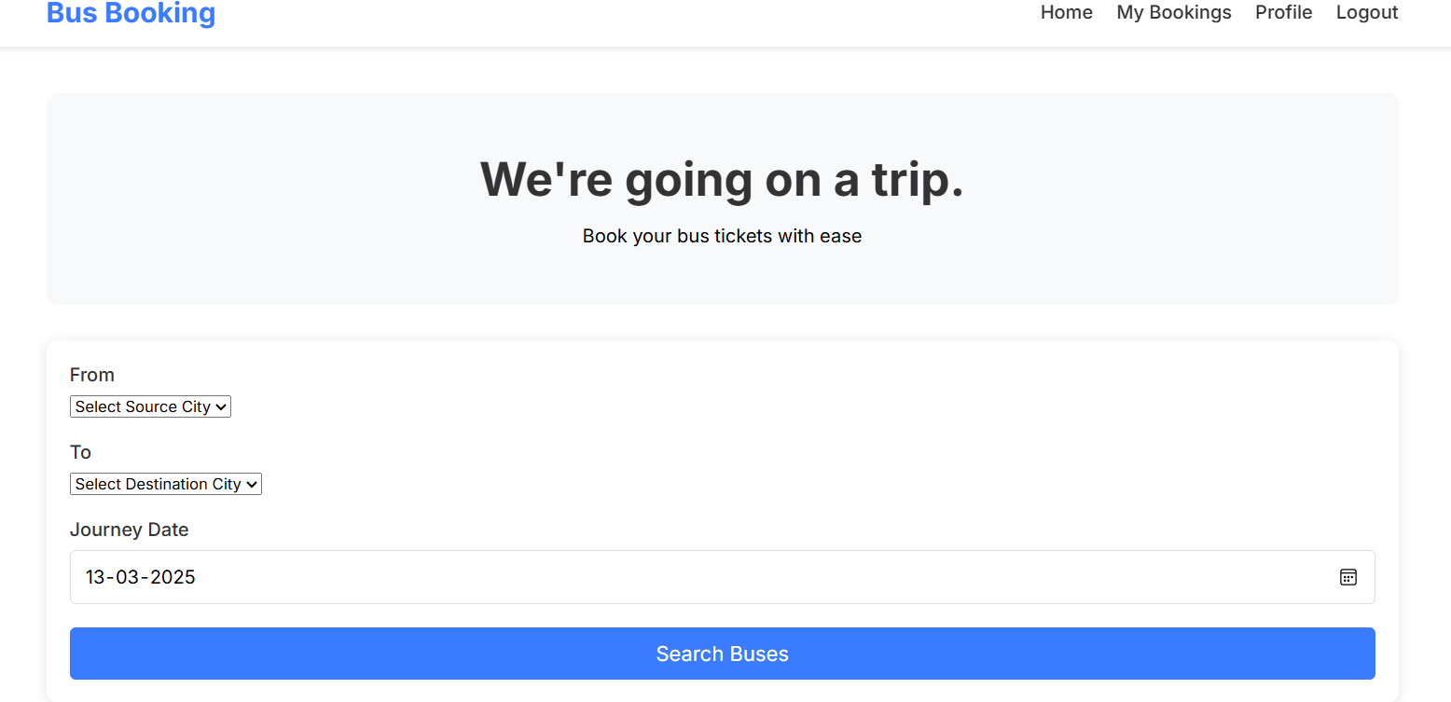
Look up of page!
Bus Booking:
This page allows users to search for available buses by selecting the source city, destination city, and journey date, making the booking process simple and efficient.

Slide 11
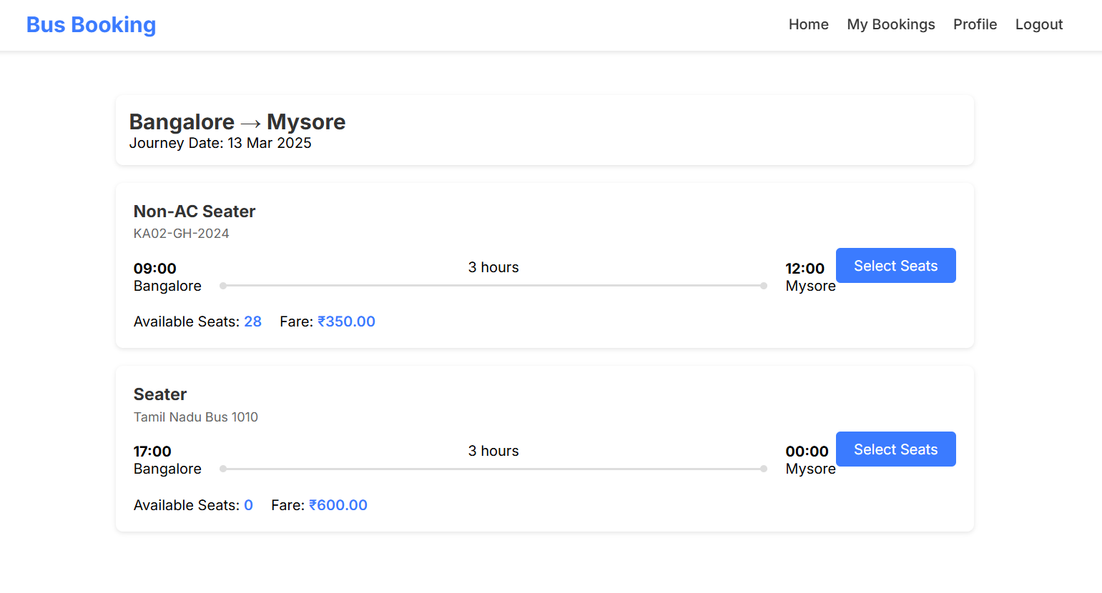
Look up of page!
Bus Selection:
This page displays available buses for the selected route (Bangalore → Mysore) along with departure time, duration, fare, and available seats, allowing users to select and book their seats easily.

Slide 12
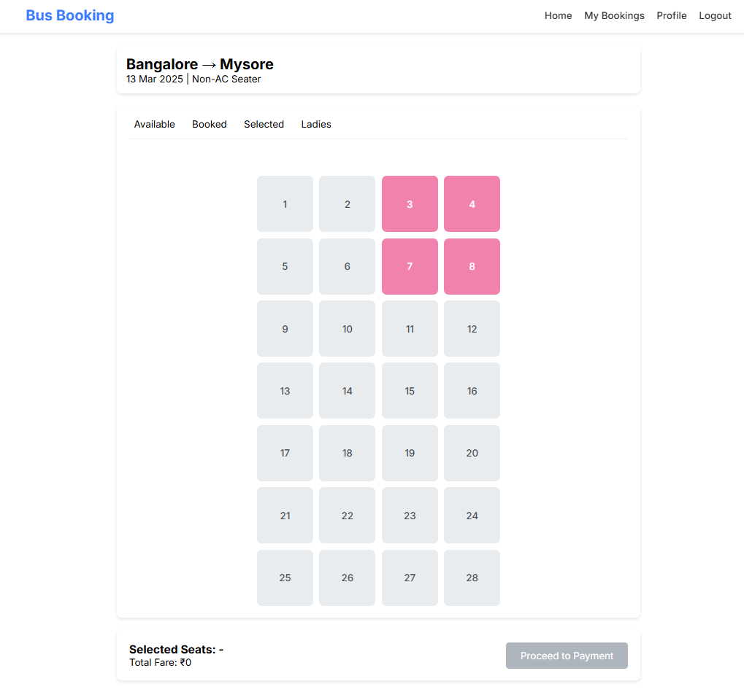
Look up of page!
Seat Selection:
This page allows users to choose their preferred seats from available options, with booked seats highlighted in pink. Once selected, users can proceed to payment for booking confirmation.

Slide 13
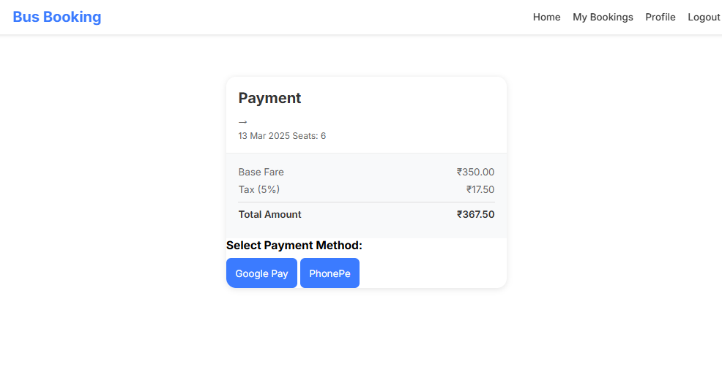
Look up of page!
Payment method:
Users can complete their booking by choosing from available digital payment options like Google Pay and PhonePe, ensuring a secure and convenient transaction.

Slide 14
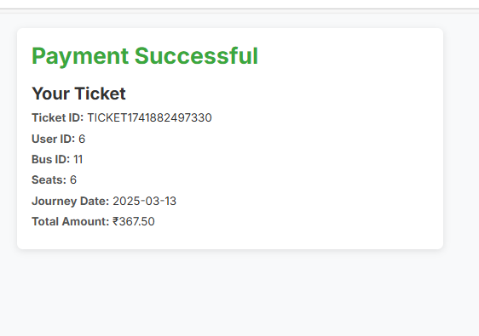
Look up of page!
Payment successful:
The system generates a unique Ticket ID for confirmation.

Slide 15
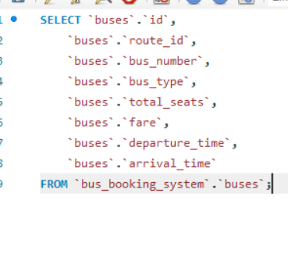
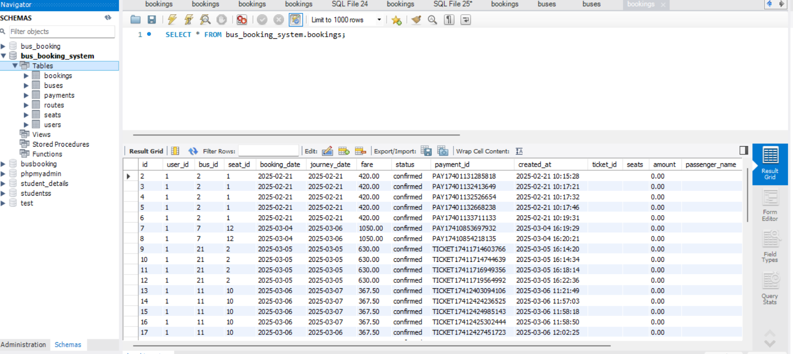
Database?

Slide 16
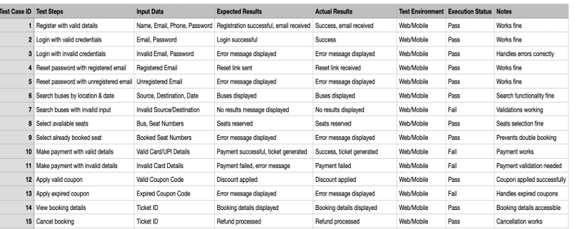
Test cases?

Slide 17
Conclusion:
This bus booking system successfully streamlines the process of selecting seats, making payments, and generating tickets. Users can easily choose their seats, view real-time availability, and proceed with secure payments via Google Pay or PhonePe. The system ensures transparency by displaying detailed booking information, including fare breakdowns and ticket confirmation. With a user-friendly interface, it enhances the overall ticket booking experience. The automated confirmation system eliminates manual errors, making it efficient and reliable. This project effectively simplifies online bus reservations, ensuring a hassle-free journey for users.

Slide 18
Result:
The bus booking system efficiently enables users to select seats, make secure payments, and receive instant ticket confirmations. The implementation successfully displays seat availability, calculates fares, and processes transactions through digital payment methods like Google Pay and PhonePe. After payment, a ticket is generated with journey details, ensuring a smooth and hassle-free booking experience. The system enhances efficiency, reduces errors, and provides a user-friendly interface for seamless travel reservations.

Slide 19

Thank you

