Slide 1
The Maze(BFS)
By
Muhammed Abeed Nabith
Prepared under the direction of Prof. Henry Chang
School of Engineering
San Francisco Bay University, Fremont, CA

Slide 2
Table of Content
Introduction
Design
Implementation
Test
Enhancement Ideas
Conclusion
Bibliography / References
Appendix

Slide 3
Introduction
What is a maze and use?
A Maze is given as N*N binary matrix of blocks where source block is the upper left most block i.e., maze[0][0] and destination block is lower rightmost block i.e., maze[N-1][N-1].
The most important task for maze solving robots is the fast and reliable finding of its shortest path from its initial point to its final destination point. This paper proposes an intelligent maze solving robot that can determine its shortest path on a line maze based on image processing and artificial intelligence algorithms.
Given problem and informations:
There is a ball in a maze with empty spaces and walls. The ball can go through empty spaces by rolling up, down, left or right, but it won’t stop rolling until hitting a wall. When the ball stops, it could choose the next direction.
Given the ball’s start position, the destination and the maze, determine whether the ball could stop at the destination.
The maze is represented by a binary 2D array. 1 means the wall and 0 means the empty space. You may assume that the borders of the maze are all walls. The start and destination coordinates are represented by row and column indexes.
Algorithms used to solve this maze problems:
Backtracking is an algorithmic-technique for solving problems recursively by trying to build a solution incrementally. Solving one piece at a time, and removing those solutions that fail to satisfy the constraints of the problem at any point of time (by time, here, is referred to the time elapsed till reaching any level of the search tree) is the process of backtracking.
BFS, stands for Breadth First Search.
Real world applications of Maza problem:
Applications of maze solving systems include intelligent traffic control that helps ambulances, cleaning robots, self driving cars, fire fighters, or rescuing robots to find their shortest path to their destination.

Slide 4
Breadth First Traversal
The ball can go through the empty spaces by rolling right, left, up, down, but it won't stop rolling until hitting a wall. When the ball stops, it could choose the next direction.
The same search space tree can also be explored in a Breadth First Search manner.
In this case, we try to explore the search space on a level by level basis.
i.e., we try to move in all the directions at every step.
When all the directions have been explored and we still don't reach the destination, then only we proceed to the new set of traversals from the new positions obtained.
In order to implement this, we make use of a queue.
We start with the ball at the start position.
For every current position, we add all the new positions possible by traversing in all the four directions(till reaching the wall or boundary) into the queue to act as the new start positions and mark these positions as True in the visited array.
When all the directions have been covered up, we remove a position value, ss, from the front of the queue and again continue the same process with ss acting as the new start position.
Further, in order to choose the direction of travel, we make use of a dir array, which contains 4 entries.
Each entry represents a one-dimensional direction of travel.
To travel in a particular direction, we keep on adding the particular entry of the dirs array till we hit a wall or a boundary.
For a particular start position, we do this process of dir addition for all all the four directions possible.
If we hit the destination position at any moment, we return a True directly indicating that the destination position can be reached starting from the start position.

Slide 5
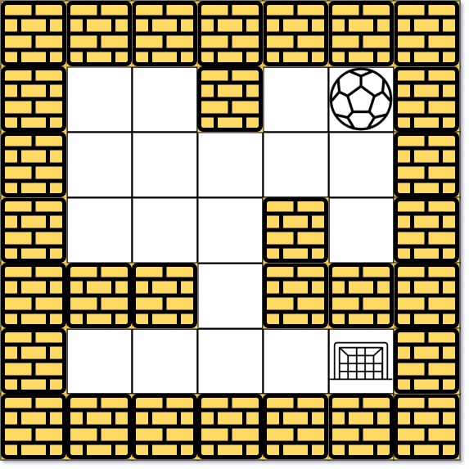
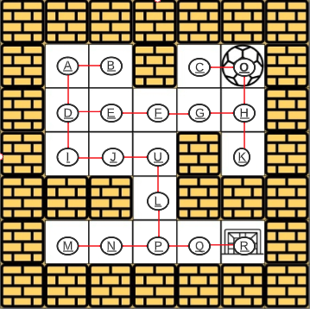
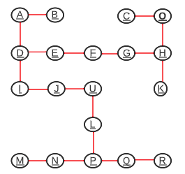
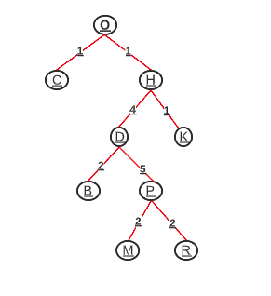
Solution1: Breadth First Traversal (TREE)
step1
step2
step3
step4

Slide 6
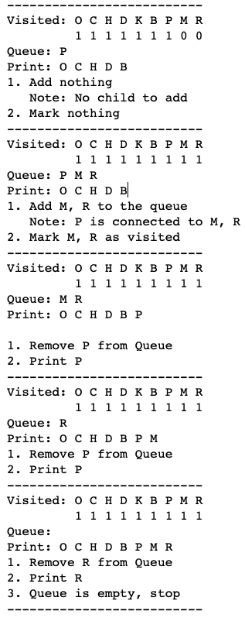
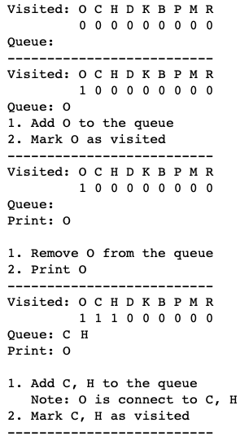
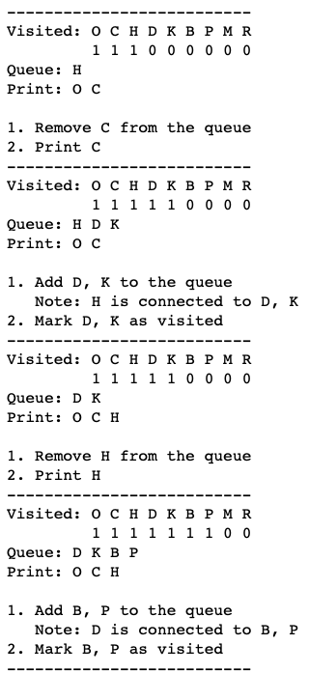
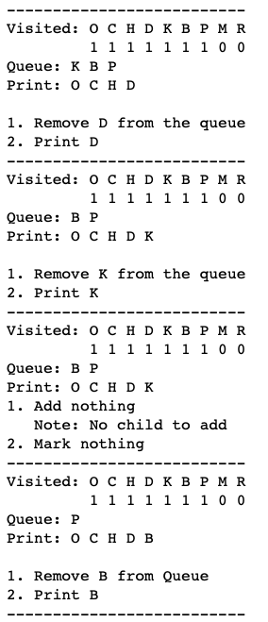
Solution1: Breadth First Traversal

Slide 7
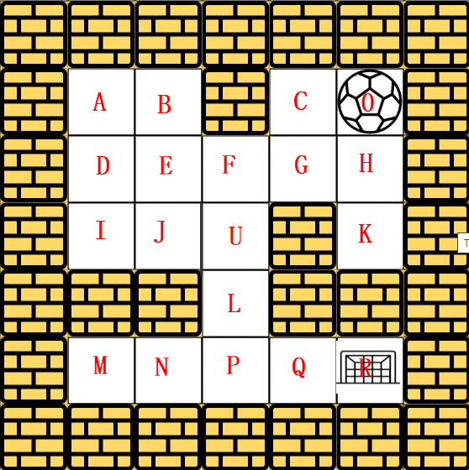
Solution2: Breadth First Traversal(MATRIX)

Slide 8
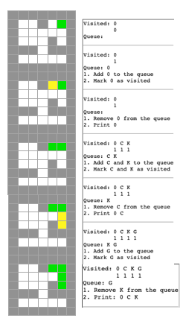
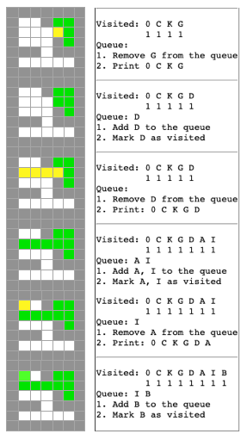
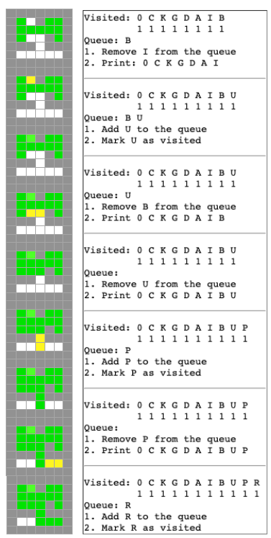
Leetcode manual Solution

Slide 9
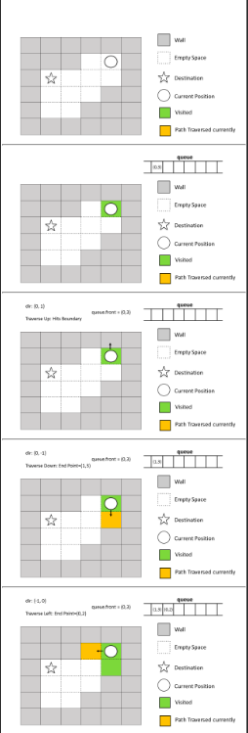
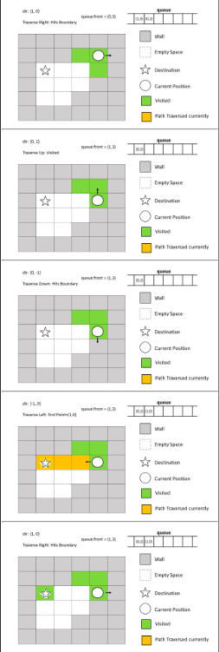
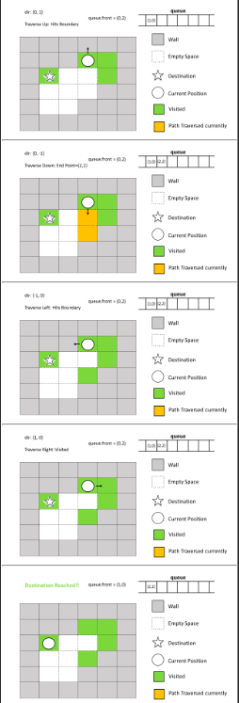
Maze general manual solution

Slide 10
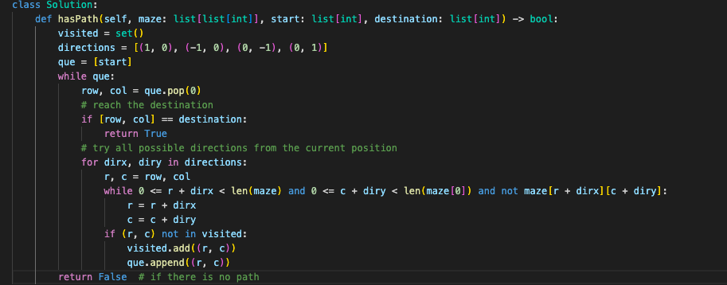
Implementation - DFS

Slide 11
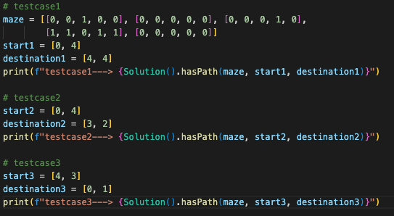
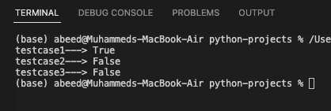
Test
Test case outputs

Slide 12
Conclusion
Maze problems are very helpful and intelligent problems to understand and study the important algorithms DFS, BFS, Backtracking.
Depends on the structure of graph or trees or maze, the time complexity or performance varies for DFS and BFS.
Backtracking algorithm is another most important concepts in the Maze problem, this is an algorithmic-technique for solving problems recursively by trying to build a solution incrementally.
Applications of maze solving systems include intelligent traffic control that helps ambulances, cleaning robots, self driving cars, fire fighters, or rescuing robots to find their shortest path to their destination.
Maze solutions in python are available in GitHub

Slide 13
Bibliography/References
BFS: https://hc.labnet.sfbu.edu/~henry/npu/classes/algorithm/tutorialpoints_dsa/slide/depth_first_traversal.html
Maze: https://hc.labnet.sfbu.edu/~henry/npu/classes/algorithm/graph_alg/slide/maze.html
Leet code: https://leetcode.com/problems/the-maze/
Geek for geek: https://www.geeksforgeeks.org/rat-in-a-maze-backtracking-2/
StackOverflow:https://stackoverflow.com/questions/47222855/in-what-sense-is-dfs-faster-than-bfs

