Slide 1
The Maze(DFS)
By
Muhammed Abeed Nabith
Prepared under the direction of Prof. Henry Chang
School of Engineering
San Francisco Bay University, Fremont, CA

Slide 2
Table of Content
Introduction
Design
Implementation
Test
Enhancement Ideas
Conclusion
Bibliography / References
Appendix

Slide 3
Introduction
What is a maze and use?
A Maze is given as N*N binary matrix of blocks where source block is the upper left most block i.e., maze[0][0] and destination block is lower rightmost block i.e., maze[N-1][N-1].
The most important task for maze solving robots is the fast and reliable finding of its shortest path from its initial point to its final destination point. This paper proposes an intelligent maze solving robot that can determine its shortest path on a line maze based on image processing and artificial intelligence algorithms.
Given problem and informations:
There is a ball in a maze with empty spaces and walls. The ball can go through empty spaces by rolling up, down, left or right, but it won’t stop rolling until hitting a wall. When the ball stops, it could choose the next direction.
Given the ball’s start position, the destination and the maze, determine whether the ball could stop at the destination.
The maze is represented by a binary 2D array. 1 means the wall and 0 means the empty space. You may assume that the borders of the maze are all walls. The start and destination coordinates are represented by row and column indexes.
Algorithms used to solve this maze problems:
Backtracking is an algorithmic-technique for solving problems recursively by trying to build a solution incrementally. Solving one piece at a time, and removing those solutions that fail to satisfy the constraints of the problem at any point of time (by time, here, is referred to the time elapsed till reaching any level of the search tree) is the process of backtracking.
DFS, stands for Depth First Search.
Real world applications of Maza problem:
Applications of maze solving systems include intelligent traffic control that helps ambulances, cleaning robots, self driving cars, fire fighters, or rescuing robots to find their shortest path to their destination.

Slide 4
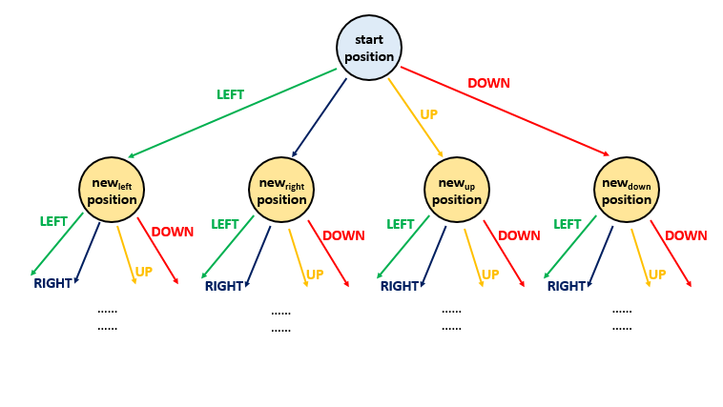
Design
Forming a tree to analysis:
The root node of the tree represents the starting position. Four different routes are possible from each position i.e. left, right, up or down. These four options can be represented by 4 branches of each node in the given tree. Thus, the new node reached from the root traversing over the branch represents the new position occupied by the ball after choosing the corresponding direction of travel.
In order to do this traversal, one of the simplest schemes is to undergo depth first search. In this case, we choose one path at a time and try to go as deep as possible into the levels of the tree before going for the next path. In order to implement this, we make use of a recursive function dfs(maze, start, destination, visited). This function takes the given maze array, the start position and the destination position as its arguments along with a
visited array. visited array is a 2D boolean array of the same size as that of maze.
A True value at visited[i][j] represents that the current position has already been reached earlier during the path traversal. We make use of this array so as to keep track of the same paths being repeated over and over. We mark a True at the current position in the visited array once we reach that particular position in the maze.
From every start position, we can move continuously in either left, right, upward or downward direction till we reach the boundary or a wall. Thus, from the start position, we determine all the end points which can be reached by choosing the four directions. For each of the cases, the new endpoint will now act as the new start point for the traversals. The destination, obviously remains unchanged. Thus, now we call the same function four times for the four directions, each time with a new start point obtained previously.
If any of the function call returns a True value, it means we can reach the destination.

Slide 5
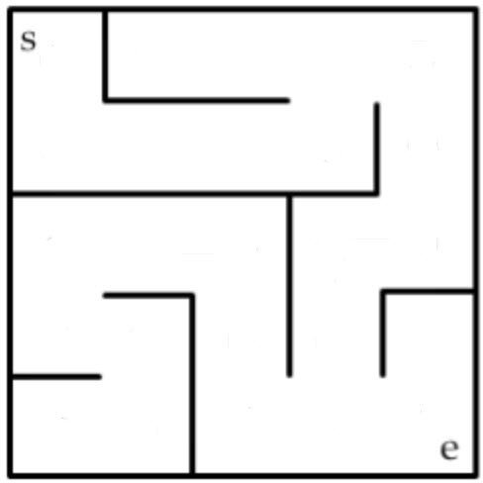
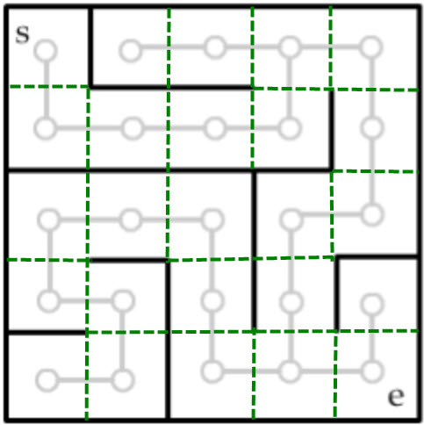
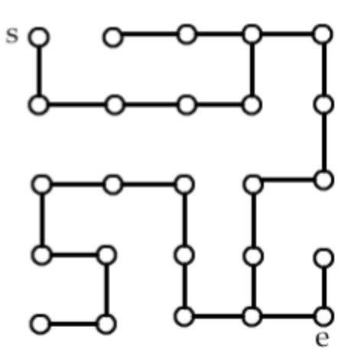
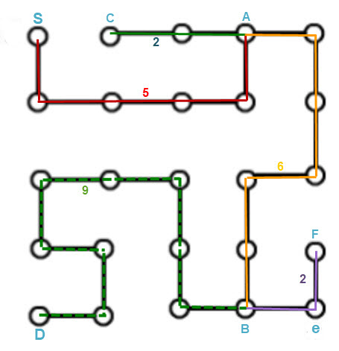
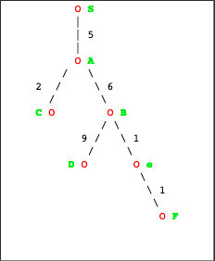
Solution1: Depth First Traversal (MATRIX)

Slide 6
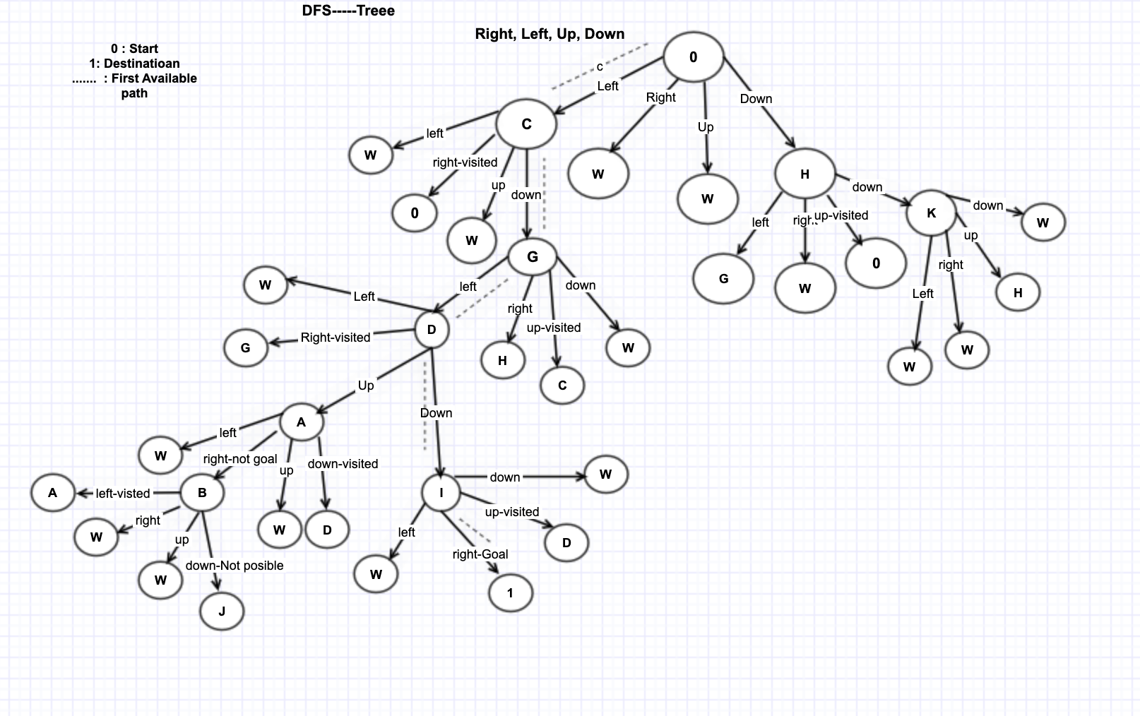
Solution (Tree)

Slide 7
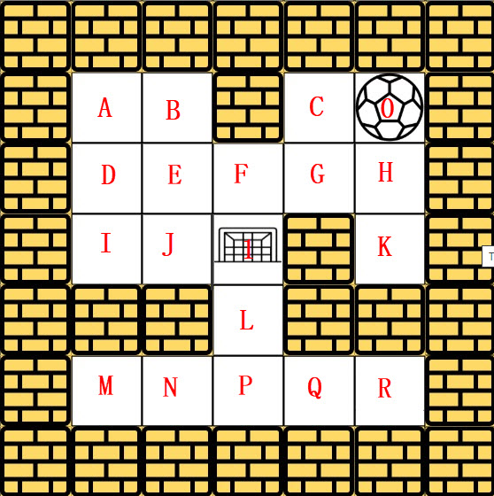
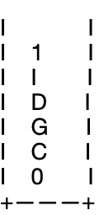

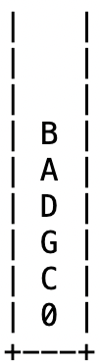




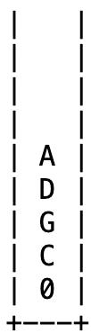



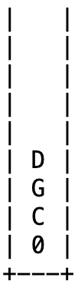
Solution1: Depth First Traversal (MATRIX)
The ball can go through the empty spaces by rolling right, left, up, down, but it won't stop rolling until hitting a wall. When the ball stops, it could choose the next direction.
Stack in each iteration

Slide 8
Solution1: Depth First Search(cont..)
We can view the given search space in the form of a tree.
The root node of the tree represents the starting position.
Four different routes are possible from each position i.e. right, left, up or down.
These four options can be represented by 4 branches of each node in the given tree.
Thus, the new node reached from the root traversing over the branch represents the new position occupied by the ball after choosing the corresponding direction of travel.

Slide 9
Design(cont..) - Comparison between DFS and BFS
The maze problem can be easily solve by using either DFS or BFS.
BFS uses Queue to find the shortest path and DFS uses Stack to find the shortest path. The stack size is bound by the depth whereas the queue size is bound by the width.
BFS is better when target is closer to Source and DFS is better when target is far from source.
Time complexity for both BFS and DFS are same that is: O(mn). Complete traversal of maze will be done in the worst case. Here, m and n refers to the number of rows and columns of the maze.
Both BFS and DFS cases visit all the nodes without significant extra overhead. If the search can be aborted when a matching element is found, BFS should typically be faster if the searched element is typically higher up in the search tree because it goes level by level. DFS might be faster if the searched element is typically relatively deep and finding one of many is sufficient.
In our maze problem we define using a single path with the backtracking so, BFS will generally use more memory, as we'll need to keep multiple paths in memory at the same time, where DFS only needs to keep track of a single path at any given time.

Slide 10
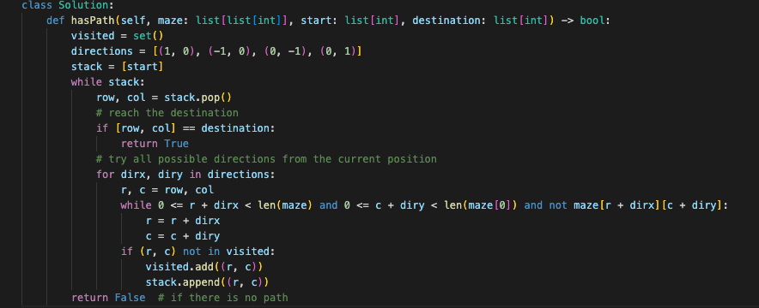
Implementation - DFS

Slide 11
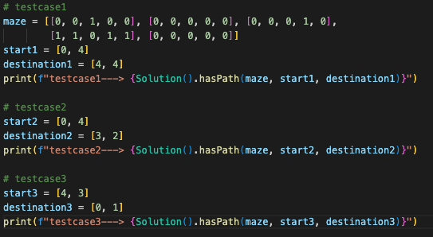
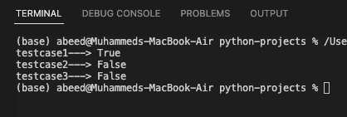
Test
Test case outputs

Slide 12
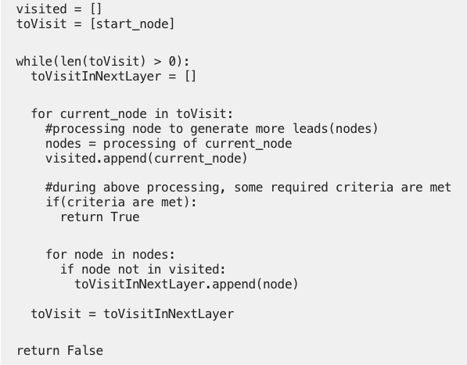
Enhancement Idea: DFS with recursion
There is one additional solution for DFS search with a recursion call. This helps in faster processing than typical iteration and stack process using DFS.
Pseudocode:

Slide 13
Conclusion
Maze problems are very helpful and intelligent problems to understand and study the important algorithms DFS, BFS, Backtracking.
Depends on the structure of graph or trees or maze, the time complexity or performance varies for DFS and BFS.
Backtracking algorithm is another most important concepts in the Maze problem, this is an algorithmic-technique for solving problems recursively by trying to build a solution incrementally.
Applications of maze solving systems include intelligent traffic control that helps ambulances, cleaning robots, self driving cars, fire fighters, or rescuing robots to find their shortest path to their destination.
Maze solutions in python are available in GitHub

Slide 14
Bibliography/References
BFS and DFS: https://hc.labnet.sfbu.edu/~henry/npu/classes/algorithm/tutorialpoints_dsa/slide/depth_first_traversal.html
Maze: https://hc.labnet.sfbu.edu/~henry/npu/classes/algorithm/graph_alg/slide/maze.html
Leet code: https://leetcode.com/problems/the-maze/
Geek for geek: https://www.geeksforgeeks.org/rat-in-a-maze-backtracking-2/
StackOverflow: https://stackoverflow.com/questions/47222855/in-what-sense-is-dfs-faster-than-bfs

