Slide 1

Verify ohm’s law
Abeeq Jafar (L16-4253)
Saad tayyab (L16-4083)

Slide 2
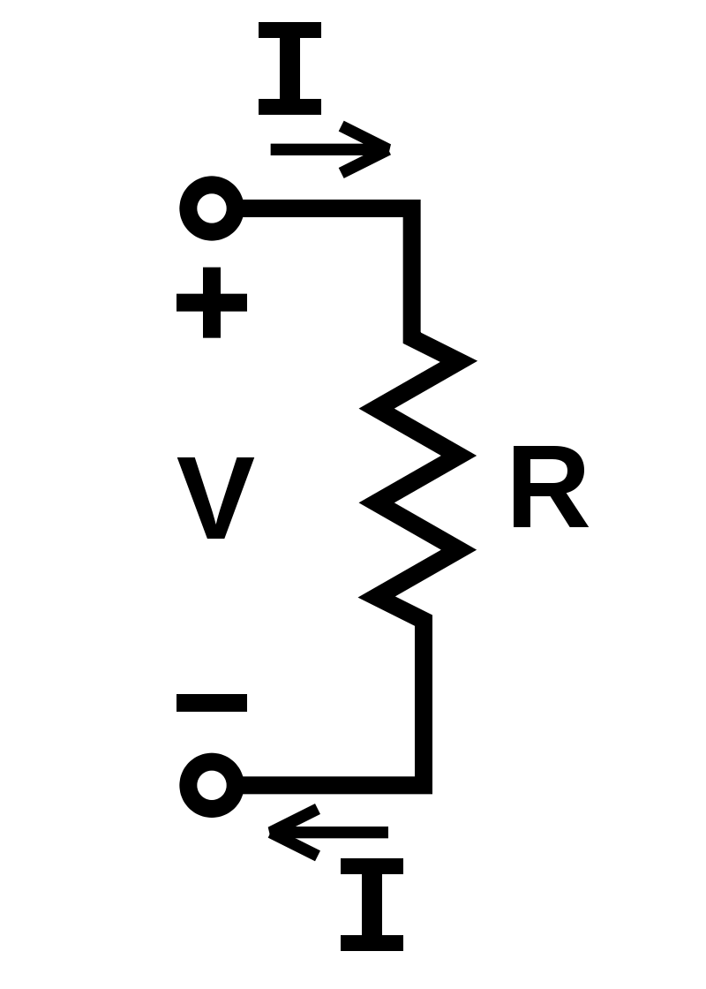
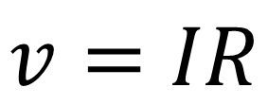
OHM’s Law
Ohm's law states that the current through a conductor between two points is directly proportional to the voltage across the two points.
$$v=IR$$

Slide 3
Voltage is the difference in charge between two points
Current is the rate at which charge is flowing
Resistance is a material's tendency to resist the flow of charge (current)
Notes:
Voltage is pressure applied by power source to move charges through the conductor.

Slide 4
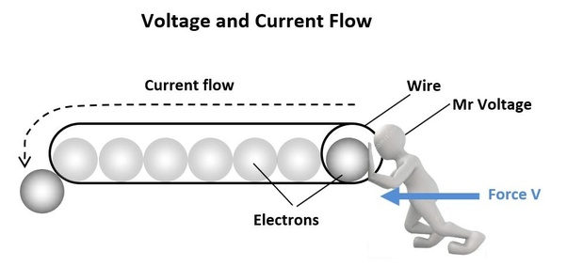
Notes:
Visual Description

Slide 5
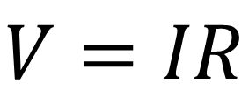
OHM’s Law
Ohm's law states that the current through a conductor between two points is directly proportional to the voltage across the two points.
$$V=IR$$

Slide 6
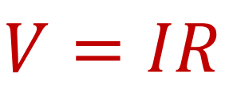
To find the Voltage, ( V ) [ V = I x R ] V (volts) = I (amps) x R (Ω) To find the Current, ( I ) [ I = V ÷ R ] I (amps) = V (volts) ÷ R (Ω) To find the Resistance, ( R ) [ R = V ÷ I ] R (Ω) = V (volts) ÷ I (amps)
$$V=IR$$
Notes:
Base Equation : V = IR

Slide 7
Material Required
Nichrome wire (>10ohm)
Voltmeter (0 – 15V)
Ammeter (0 – 0.6A)
Rheostat (50 ohm)
Power supply (0 -12V, 1A)
Switch

Slide 8
Modeling apparatus and functions
We will make 3D models of martials required
Each material is its an object and will have state and functionality

Slide 9
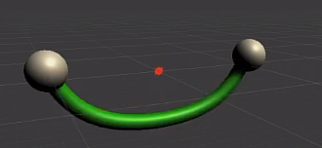
Nichrome wire
It connects two electrical components
State
Current flowing status
Color ( dim green or dim red)
1st connector
2nd connecter
left connector
right
connector

Slide 10
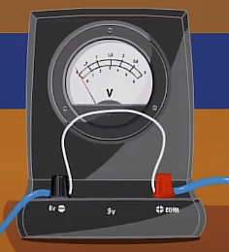
Voltmeter
A voltmeter is an instrument that measures the difference in electrical potential between two points in an electric circuit
State
Current voltage
ON/OFF status
Wires connected status
1st wire connected
2nd wire connected
Functions
Calculates potential difference across both end connectors

Slide 11
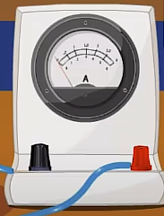
Ammeter
An ammeter is a measuring instrument used to measure the current in a circuit.
State
Current value
ON/OFF status
Wires connected status
1st wire connected
2nd wire connected
Functions
Calculates current

Slide 12
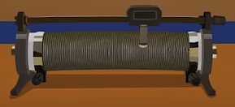
Rheostat
an electrical instrument used to control a current by varying the resistance
State
Slider Current value
Current Resistance
ON/OFF status
Wires connected status
1st wire connected
2nd wire connected
Functions
Controls current by applying resistance using Ohm law formula

Slide 13
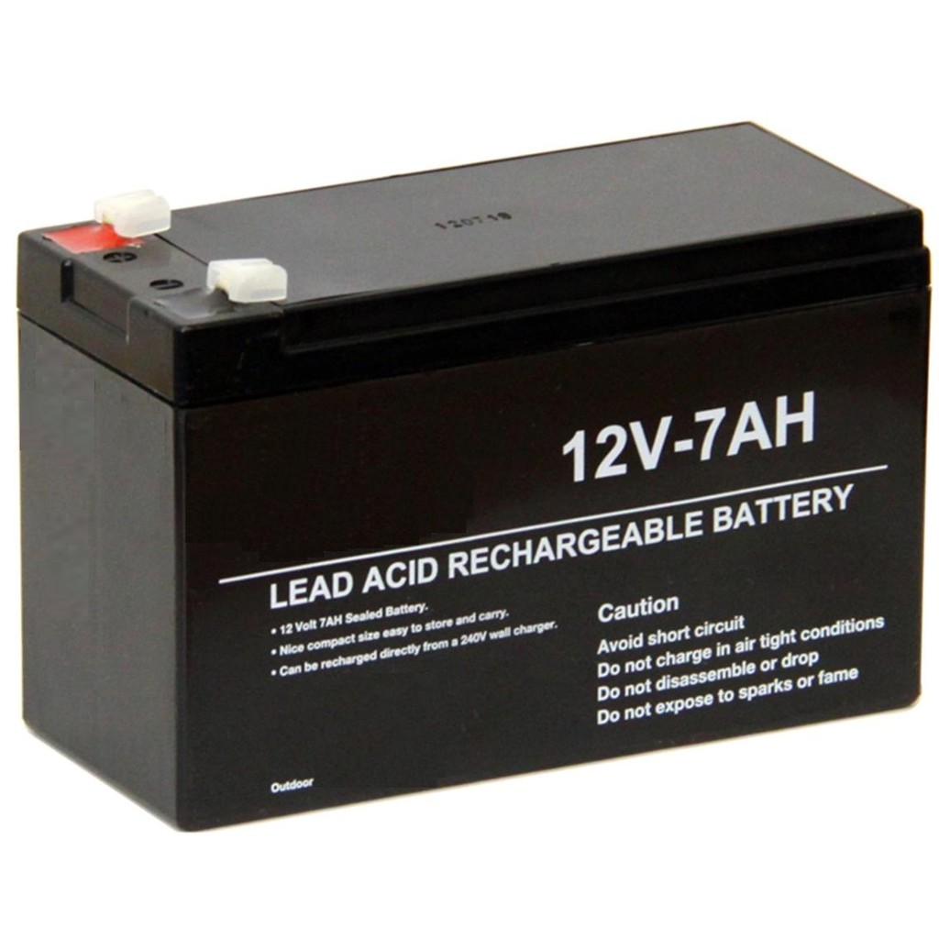
Power supply
The primary function of a power supply is to convert electric current from a source to the correct voltage, current, and frequency to power the load.
State
Voltage value (0 -12)
Current value (1)
ON/OFF status
Wires connected status
1st wire connected
2nd wire connected
Functions
Supply power to flow of current

Slide 14

Switch
Turn ON/OFF flow of current.
State
ON/OFF status (RED or Green)
Wires connected status
1st wire connected
2nd wire connected

Slide 15
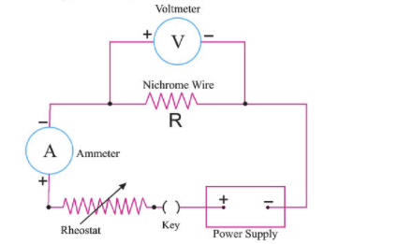
Connecting components

Slide 16
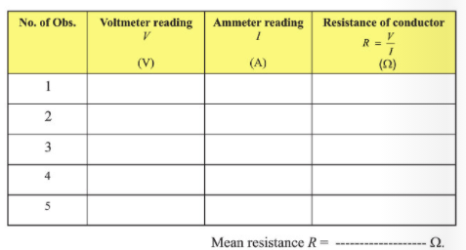
Making observation Scene
Add observation entry button
Add reset observation entry button
Clear observation table

Slide 17
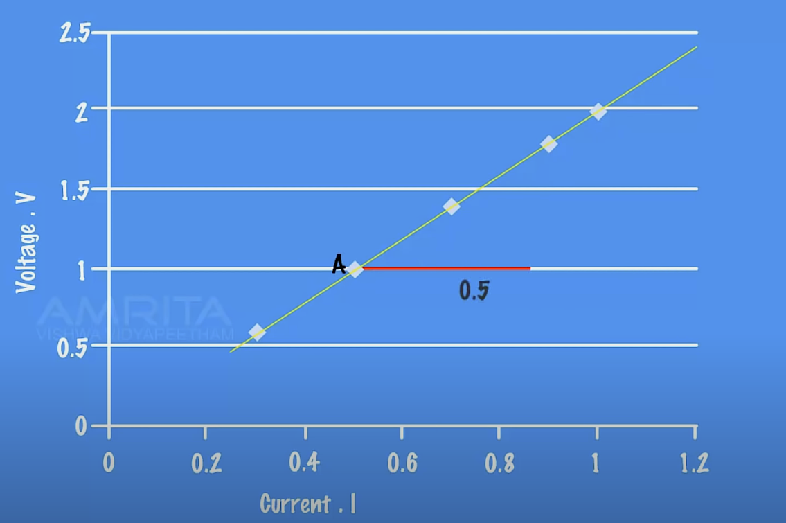
Making Graph Scene (Voltage-Ampere)
Make table of observation table using current and voltages

Slide 18
Post Activity Questions
Notes:
Ohm's Law - MeitY OLabs - YouTube

Slide 19
Why nichrome wire is used instead of kantal?
Nichrome has lower resistance and heats faster.
Nichrome is easy to coil and holds its shape well when wicking.
It has a lower melting temperature than Kanthal, so you need to be careful when dry burning your coils—they will burn open if you aren't careful
These facts makes it an easy and safe to use for 9th grade Lab experiments.

Slide 20
Can we experiment using high power source(battery supply)?
Yes, we can
This is the main benefits of using virtual lab.
we can experiment with any value of power supply (such as 12KV)
Our non-virtual practical labs limits us to only low voltage supply which makes us hard to imagine at production scale.

Slide 21
What are its benefits at production scale?
Conventional Domestic Fans
Electric Heaters
Electric Kettles and Irons
Electric Devices
Every electric appliance follows ohm laws since it is relationship between current, charge and resistance
This experiment can create a base mental model of ohms laws inside the mind of student.

Slide 22
Can we derive current and resistance from ohm’s law?
Yes, we can
To find the Voltage, ( V ) [ V = I x R ] V (volts) = I (amps) x R (Ω) To find the Current, ( I ) [ I = V ÷ R ] I (amps) = V (volts) ÷ R (Ω) To find the Resistance, ( R ) [ R = V ÷ I ] R (Ω) = V (volts) ÷ I (amps)

Slide 23
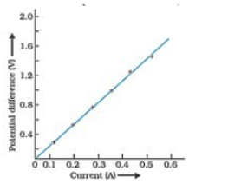
What is relationship between current and voltage observed in experiments?
We plot the values on XY Plane
We observe the Line is straight
It is linear relationship

