Slide 1

QUALITY ASSESSMENT
FOR AL-RAJHI BANK
1

Slide 2
Introduction
2

Slide 3


Mobile App analysis results
APK
01
Docker
02
3

Slide 4
Discussion Results
Codacy-Github
MOBFSs
Code Style
Error Prone
Performance
App premission
Network Security
4

Slide 5
Codacy-github
5

Slide 6
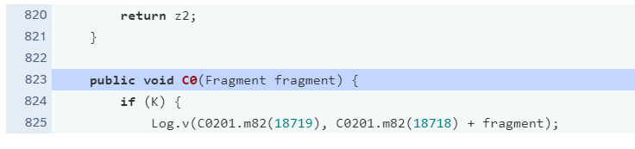
Code Style
Missing Javadoc for methods and variables
6

Slide 7
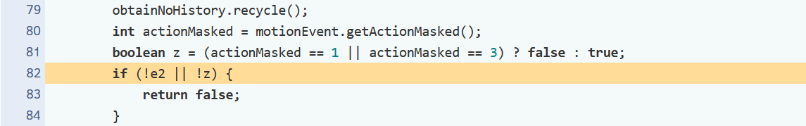
Error prone
Avoid unnecessary if..then..else statements when returning Booleans
7

Slide 8
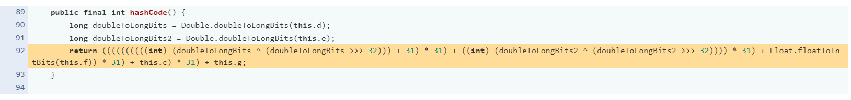
Performance
Useless parentheses
8

Slide 9
MOBFs
9

Slide 10
App Permission
android.permission.SYSTEM_ALERT_WINDOW
android.permission.CAMERA
android.permission.RECORD_AUDIO
android.permission.READ_CONTACTS
android.permission.ACCESS_FINE_LOCATION
android.permission.ACCESS_COARSE_LOCATION
android.permission.ACCESS_BACKGROUND_LOCATION
10

Slide 11
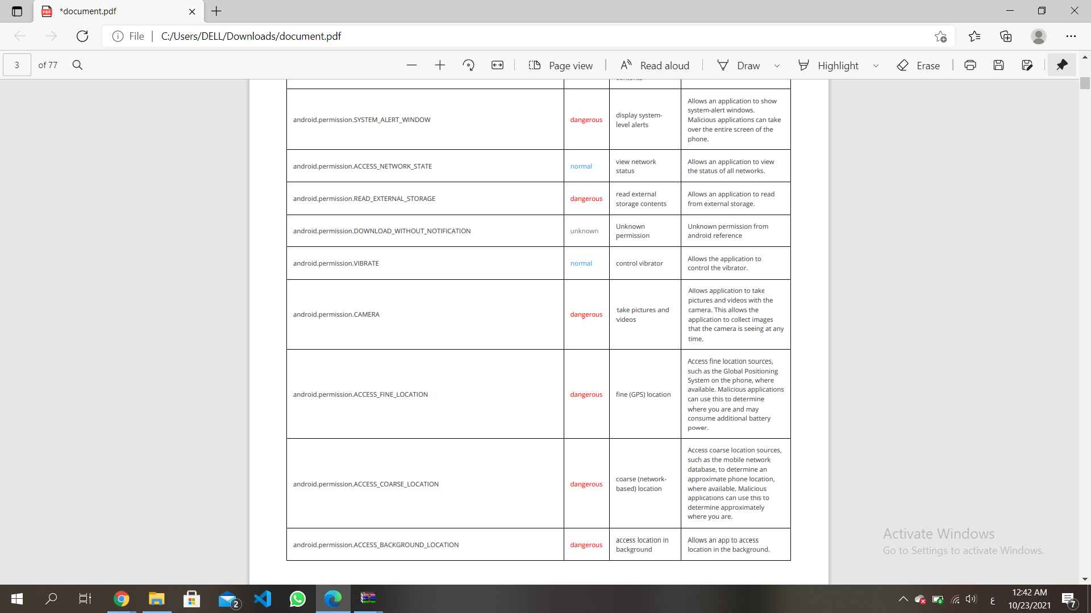
App Permission
android.permission.CAMERA
11

Slide 12
Network Security - Manifest Analysis
Clear text traffic is Enabled For App Launch Mode of Activity is not standard.
Launch Mode of Activity is not standard.
Activity-Alias is not Protected.
Service is not Protected.
Broadcast Receiver not Protected.
Broadcast Receiver Protected by permission.
12

Slide 13
Network Security – Code Analysis
App can read/write to External Storage. Any App can read data written to External Storage
The APP uses an insecure Random Number Generator
13

Slide 14
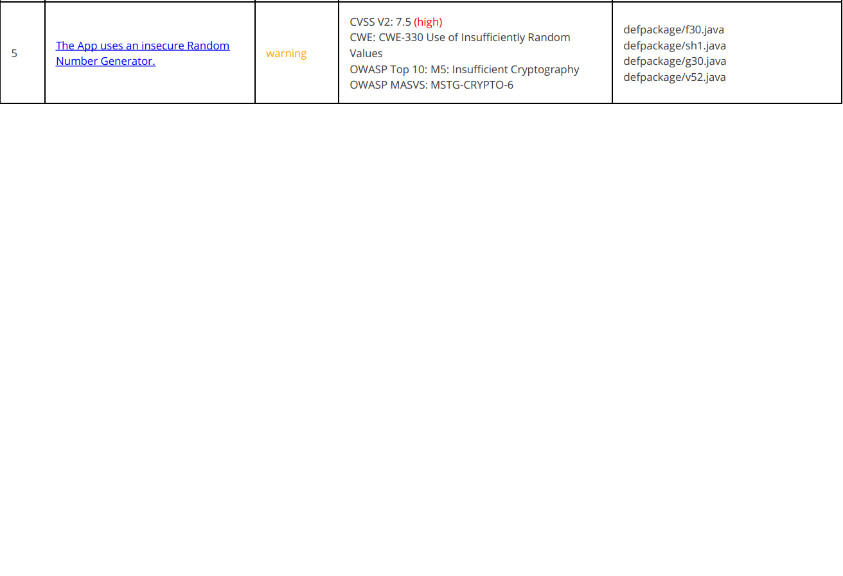
Network Security – Code Analysis
The APP uses an insecure Random Number Generator
14

Slide 15
Design
15

Slide 16
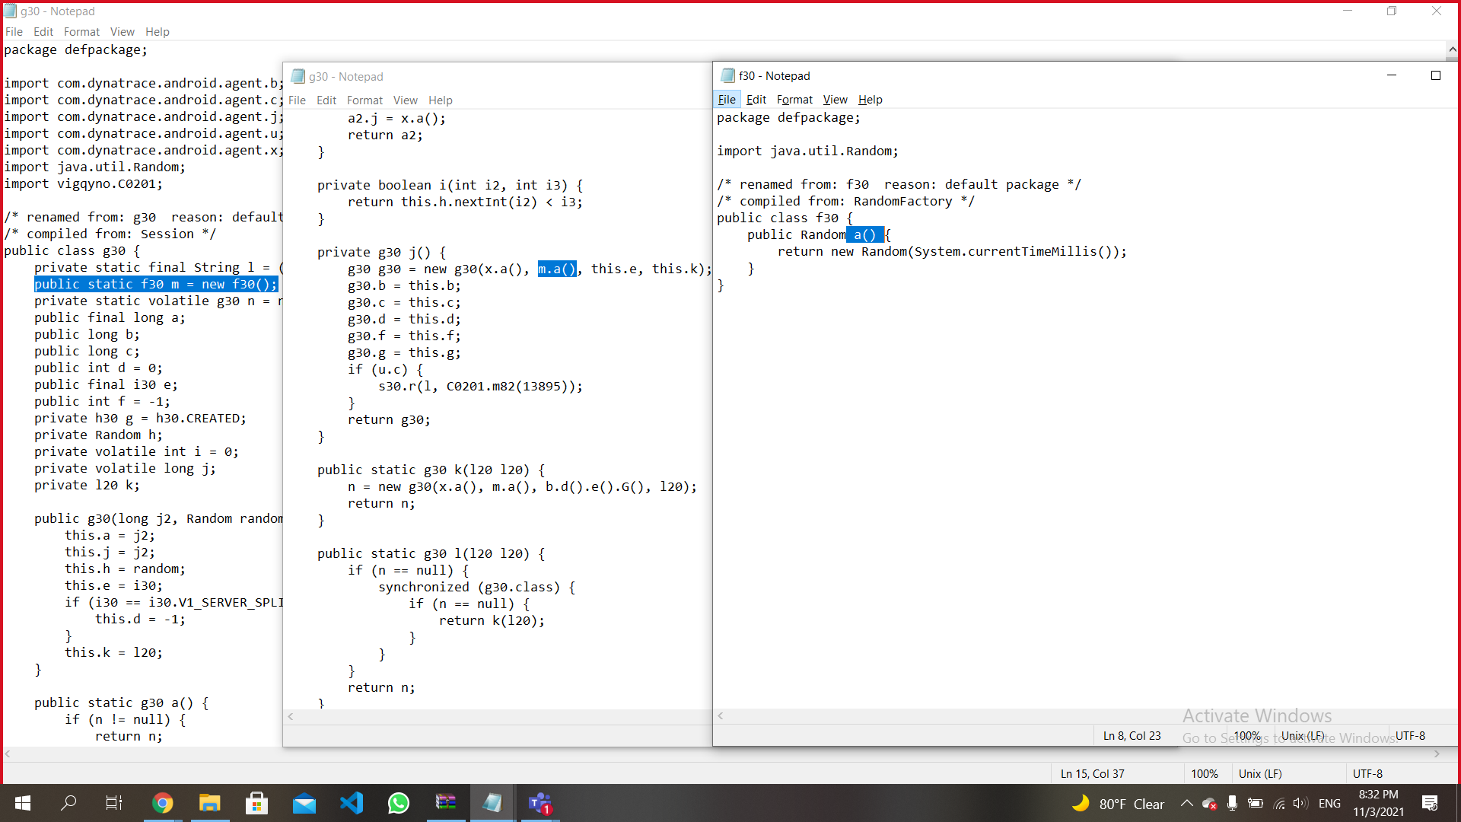
Coupling
16

Slide 17
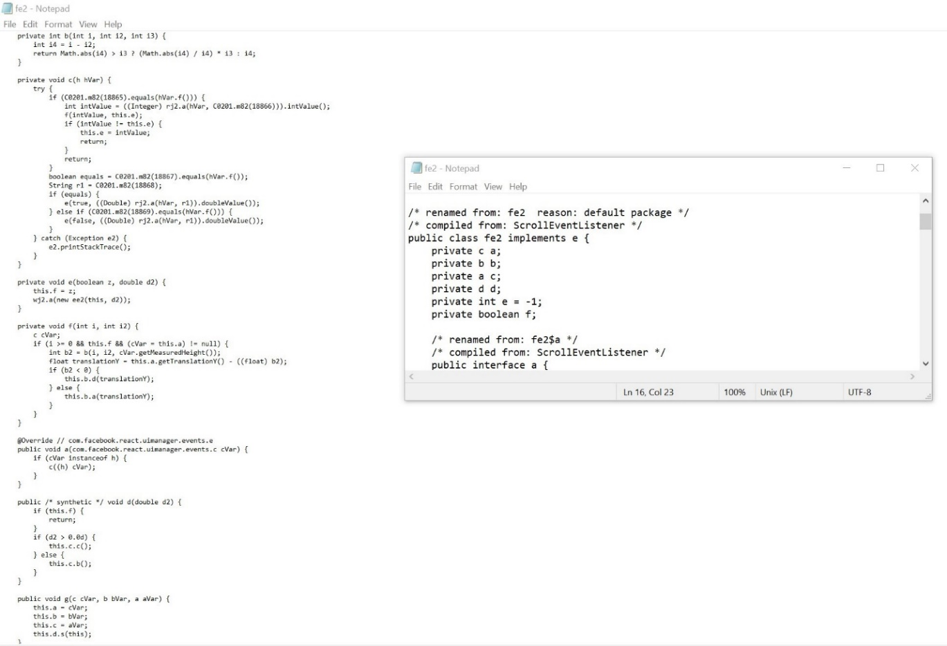
Cohesion
17

Slide 18
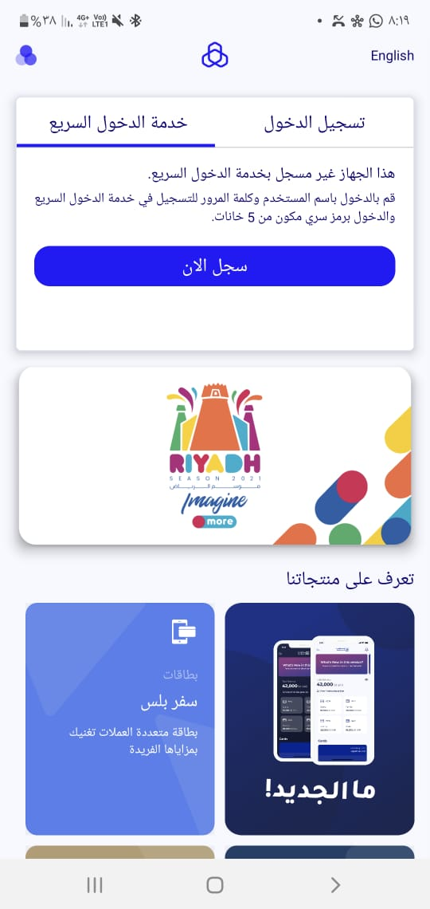
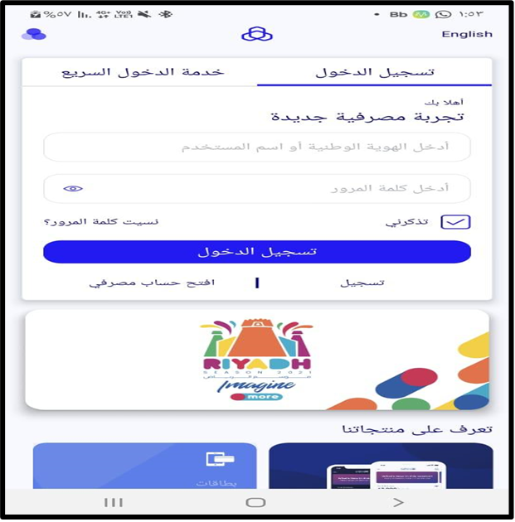
Design Interface
18

Slide 19
The End
19
Notes:
For more information Click here : https://github.com/abeer210/my-project-SE

