Slide 1



PREDICTIVE MAINTENANCE
Remaining Useful Life Prediction
using the PRONOSTIA Bearing Dataset
Ephraim Neke Kamalu | Pratiksha Satish Ramane | Abeera Biju | Geo Shajan
Team 1 | June 2, 2026
CRISP-DM Methodology | IEEE PHM 2012 Dataset

Slide 2

AGENDA
01 Problem Statement
05 Classification (6 models)
Why predictive maintenance matters
3-class bearing condition
02 PRONOSTIA Dataset
06 Regression (8 models)
6 bearings, 3 operating conditions
Continuous RUL prediction
03 Signal Processing
07 CNN+LSTM Highlight
Butterworth filter + feature extraction
Best model — only positive R²
04 Health Index
08 Key Findings
Composite degradation score
What we learned

Slide 3

PROBLEM STATEMENT
Ball bearing failures cause unplanned downtime, high repair costs, and safety risks.
Reactive
Preventive
Predictive
Fix after failure
High downtime cost
Replace on schedule
Wastes good parts
Predict failure time
Optimal maintenance
RUL = Total Lifetime - Current Usage Time
Our task: Develop a classification model (3 classes: Non-critical, Wear Detectable, Imminent Failure) + optional regression for continuous RUL.

Slide 4
PRONOSTIA DATASET
IEEE PHM 2012 Data Challenge — FEMTO-ST Institute
25.6 kHz
2 Sensors
6 Bearings
Sampling Rate
H + V Vibration
Learning Set
1-7 hrs
20g
Bearing Lifetime
Failure Threshold
Operating Conditions
Condition 1
Condition 2
Condition 3
Radial Force
4,000 N
4,200 N
5,000 N
Speed
1,800 rpm
1,650 rpm
1,500 rpm
Bearings
2
2
2
Vibration data only (no temperature) — vibration is the primary degradation indicator.

Slide 5
CRISP-DM METHODOLOGY
1. Business Understanding
2. Data Understanding
Define the maintenance prediction problem
Explore vibration signals, identify degradation patterns
3. Data Preparation
4. Modeling
Noise filtering, feature extraction (34 features via lambdas)
6 classifiers + 8 regressors (ML + Deep Learning)
5. Evaluation
6. Deployment
Cross-bearing validation, SHAP explainability
Operations dashboard (green/yellow/red)

Slide 6
SIGNAL PROCESSING & FEATURES
Noise Filtering
5th-order Butterworth bandpass filter
10 Hz - 10,000 Hz
Zero-phase (filtfilt) to avoid distortion
Feature Extraction (34 features via lambda functions)
TIME-DOMAIN
FREQUENCY-DOMAIN
RMS, Kurtosis, Skewness
Peak-to-Peak, Crest Factor
Shape Factor
Dominant Frequency
Spectral Energy
Spectral Entropy

Slide 7
CLASSIFICATION: 3-CLASS MODEL
Non-critical
< 70% life used
5,276 samples (70%)
Wear Detectable
70-90% life used
1,507 samples (20%)
Imminent Failure
> 90% life used
751 samples (10%)
Why 70/90 boundaries? Degradation onset analysis showed most bearings stay stable until ~95% life.
Train/Test Split
Split by BEARING (not random) to avoid data leakage.
4 bearings for training, 2 for testing.
Model must generalize to unseen bearings.

Slide 8


HEALTH INDEX & ANOMALY DETECTION
Z-score anomaly detection (threshold = 2.0) for degradation onset
Two degradation patterns found:
Gradual Onset (~55% life)
Sudden Failure (~95%+ life)
Bearing1_1, Bearing2_2
Slow, steady vibration increase
Bearing1_2, Bearing2_1, 3_1, 3_2
Stable until abrupt spike at end
A robust system must handle both patterns.

Slide 9
CLASSIFICATION MODELS
6 models compared — 3 classical ML + 3 deep learning
Random Forest
200 trees, balanced class weights
Classical ML
XGBoost
200 estimators, lr=0.1
Classical ML
Gradient Boosting
200 estimators
Classical ML
BiLSTM
64 units/direction, dropout 0.3
Deep Learning
CNN + Attention
Conv1D + multi-head self-attention
Deep Learning
CNN + LSTM
Conv1D feature extraction + LSTM temporal
Deep Learning

Slide 10
CLASSIFICATION RESULTS
RF: best accuracy (69.8%)
XGBoost: best F1 (0.537) — most balanced
Deep learning under performs: small dataset (4 training bearings)
Model
Accuracy
Macro F1
Random Forest
69.8%
0.529
BiLSTM
68.3%
0.453
XGBoost
66.5%
0.537
Gradient Boosting
65.4%
0.533
CNN + Attention
59.4%
0.387
CNN + LSTM
52.5%
0.462
All models struggle with Wear Detectable class — transitional features overlap with both healthy and failing states.

Slide 11
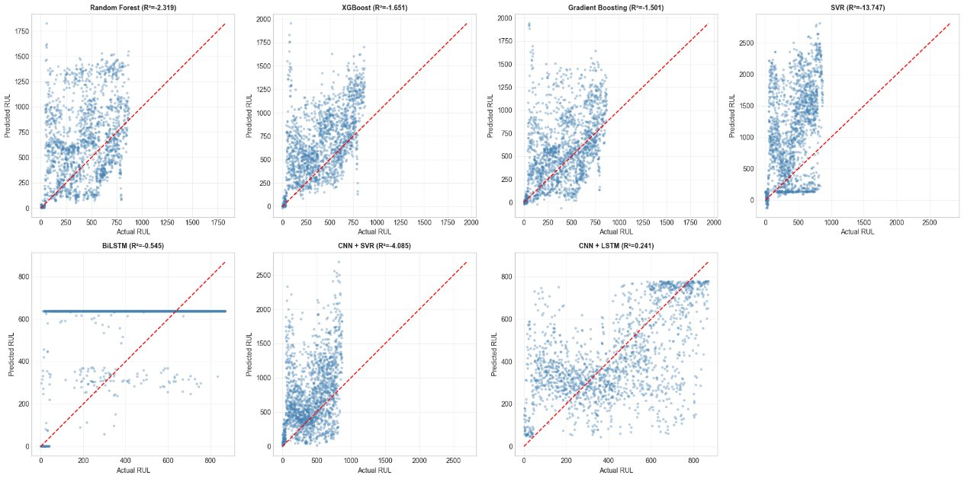

Slide 12
REGRESSION RESULTS
Model
RMSE
MAE
R²
CNN+LSTM is the only model with positive R²
RMSE = 211 recordings
= ~35 minutes error
Negative R² is expected
for cross-bearing evaluation
(documented in PHM 2012)
CNN + LSTM
211.0
160.0
0.241
Ensemble
254.1
188.6
-0.101
BiLSTM
301.1
241.7
-0.545
Gradient Boosting
383.0
275.0
-1.501
XGBoost
394.3
299.9
-1.651
Random Forest
441.2
334.1
-2.319
CNN + SVR
546.1
403.7
-4.085
SVR
930.0
760.0
-13.747

Slide 13
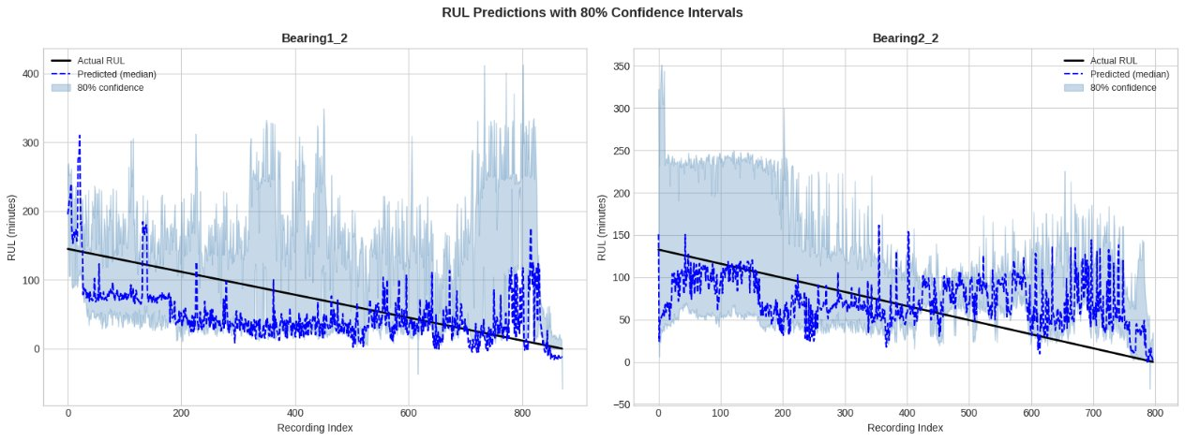

Slide 14


WHY CNN+LSTM WORKS BEST
Architecture
Conv1D (64)
Conv1D (128)
Detect local feature patterns
Learn complex interactions
MaxPool
LSTM (64)
Compress representation
Learn temporal degradation
LSTM (32)
Dense (1)
Refine temporal patterns
Output: RUL value
Why it wins regression but loses classification:
Regression (wins)
Classification (loses)
Needs temporal sequence modeling.
CNN spots which features spike together.
LSTM tracks how those spikes evolve.
R² = 0.241 (only positive!)
Only needs broad category separation.
Too many parameters for 4 training bearings.
Overfits on small data (52.5% accuracy).
Simpler trees (RF 69.8%) do better.

Slide 15
EXPLAINABILITY & CONFIDENCE
SHAP Analysis
Confidence Intervals
Top features driving predictions:
1. RMS vibration amplitude
2. Spectral energy
Consistent with Sutrisno et al. (2012)
80% quantile regression intervals
Coverage: 73.0%
(below 80% target — slightly overconfident)
Avg width: ~2 hours
(actionable maintenance window)
Cross-Bearing Evaluation
We train on 4 bearings and test on 2 completely unseen bearings. This is harder than testing on the same bearing (which gives R² > 0.9 but is not realistic). Our CNN+LSTM achieves R² = 0.241 — the only model to beat the mean baseline on this honest evaluation.

Slide 16
KEY FINDINGS
Classification
RF best accuracy (69.8%), XGBoost best F1 (0.537). Classical ML beats deep learning on small datasets.
Regression
CNN+LSTM best (RMSE=211, R²=0.241). Only positive R² — CNN extracts spatial patterns, LSTM learns temporal evolution.
Feature Importance
SHAP confirms RMS vibration and spectral energy as top predictors — consistent with published literature.
Degradation Modes
Two patterns: gradual onset (~55%) and sudden failure (~95%+). Any deployed system must handle both.
Practical Value
~35 min average prediction error with operations dashboard (green/yellow/red) for production managers.

Slide 17
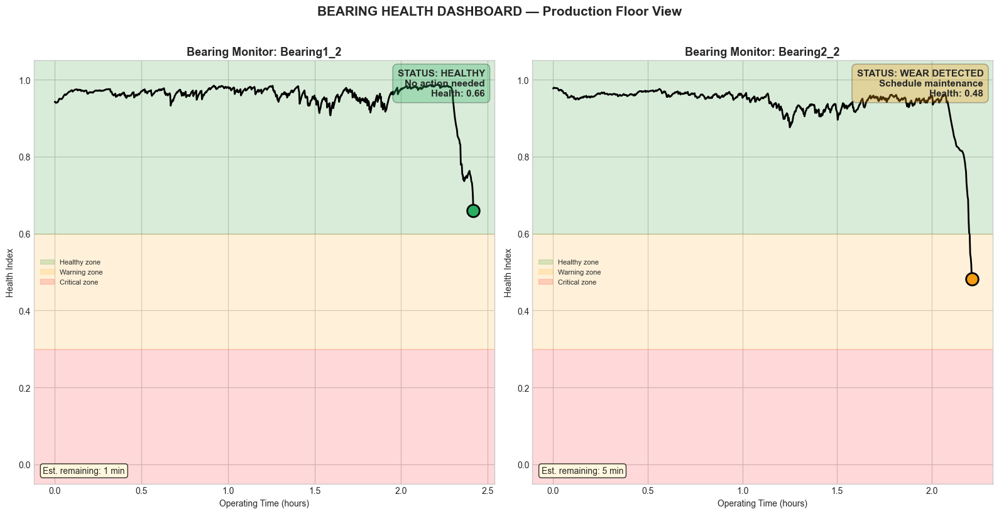

Slide 18
THANK YOU
6 classification models — RF best (69.8%)
8 regression models — CNN+LSTM best (RMSE=211, R²=0.241)
34 features extracted via lambda functions
CRISP-DM methodology applied end-to-end
~35 min average prediction error
Ephraim Neke Kamalu | Pratiksha Satish Ramane | Abeera Biju | Geo Shajan
Team B5 | Group 1

