Slide 1

Robust Fake Review Detection with Large Language Models: A Prompt Rewording and Review Length Analysis
Jose Barral, Victoria Gonzalez,
John Ayoola, Arjun Moitra
DATA*6400 / Dr. Abeer Badawi / March 19th, 2026
Notes:
Speaker 1 Victoria:
Today we’ll be presenting our project titled Robust Fake Review Detection with Large Language Models: A Prompt Rewording and Review Length Analysis.

Slide 2
Overview
01
02
03
04
05
06
Motivation & Problem
Related Work
Methodology
Results
Discussion
Limitations
07
Conclusion & Next Steps
Notes:
Speaker 1 Victoria:
Here’s an overview of the presentation.
We’ll begin by introducing the motivation and problem setting, followed by a brief discussion of related work and the research gap we aim to address.
We’ll then describe the methodology we used, followed by discussion.
Next, we’ll outline our limitations .
Finally, we’ll wrap up with an overview of our project and the next steps we will towards completing the final report.

Slide 3
Motivation: Reliability of LLM-Based Detection
01
Online reviews strongly influence purchasing decisions
Fake reviews undermine trust in digital platforms
LLMs are increasingly used for moderation tasks
Raises concerns about reliability in real-world systems
KEY CONCERN
Are LLM-based classifiers robust to variations in prompt wording and review length?
*We define robustness as prediction stability under prompt rewording and variation in review length
Notes:
Speaker 1 Victoria:
Online reviews play a major role in influencing purchasing decisions, but fake reviews undermine trust in digital platforms.
As a result, automated detection has become essential, and large language models are increasingly used for moderation tasks.
However, in real-world systems, it’s not enough for models to be accurate — they also need to be robust.
So this leads to our key question:
Are LLM-based classifiers robust to variations in prompt wording and review length?

Slide 4
Problem Statement & Research Gap
01
What's the Problem?
LLM-based classifiers achieve strong performance*
However, predictions may change under small input variations
This raises concerns for real-world reliability
*typically measured through high accuracy and F1-scores on benchmark datasets
What's Missing?
Prior work focuses on overall accuracy
Limited evaluation of robustness to prompt wording and input characteristics
Notes:
Speaker 1 Victoria:
While LLM-based classifiers achieve strong performance, their predictions can change under small input variations.
This creates concerns for real-world reliability, especially in moderation systems.
Looking at prior work, most studies focus on overall accuracy, but they do not evaluate robustness to prompt wording or input characteristics.
So there is a clear gap in understanding how stable these models actually are.

Slide 5
Our Research Objective
01
Main Objective​
Evaluate robustness
of LLM-based fake
review detection
What we study
Sensitivity to prompt rewording
​Performance across review lengths​
Our ultimate goal​
Move beyond accuracy & understand prediction stability
Notes:
To address this gap, our objective is to evaluate the robustness of LLM-based fake review detection.
Specifically, we study two factors:
First, how prediction stability changes under prompt rewording, and second, how performance varies across different review lengths.
Our goal is to move beyond accuracy and better understand the reliability of these systems.

Slide 6
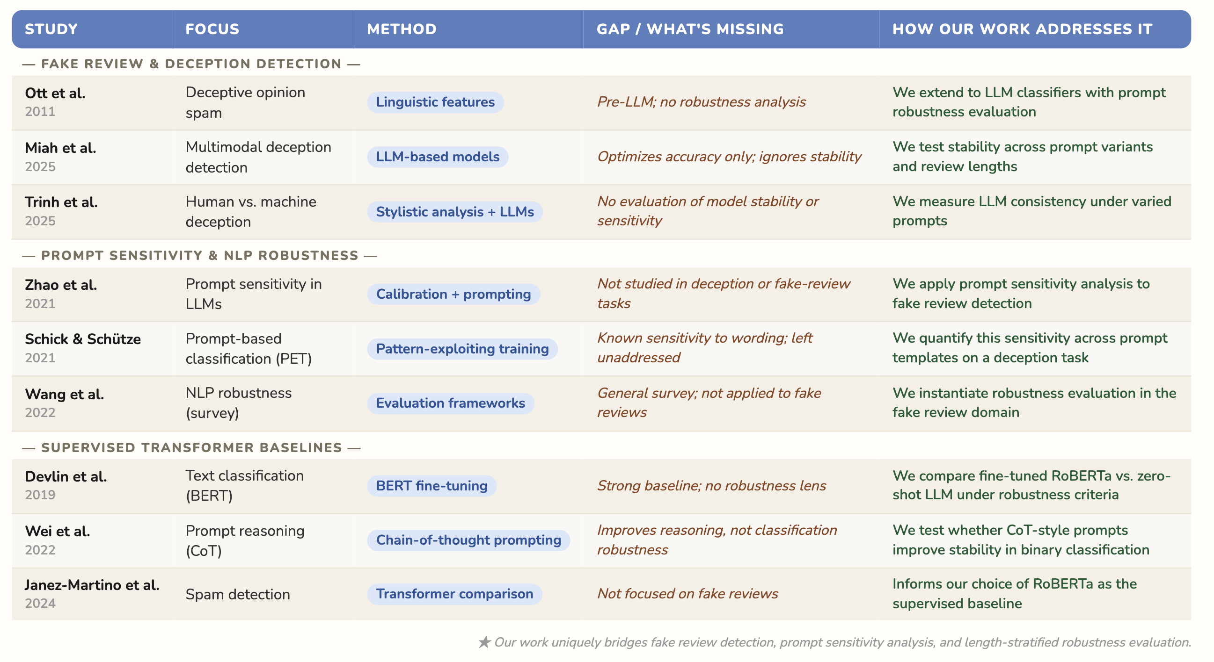
02
Related Work- Positioning in the Literature
Notes:
This table summarizes key prior work relevant to our study.
Early work, such as Ott et al., focuses on linguistic patterns for deception detection, while more recent studies apply large language models across domains, including multimodal and cross-cultural settings.
At the same time, research in NLP shows that LLM predictions can vary depending on prompt formulation.
However, these two areas have not been connected.
So overall, there are two key gaps in the literature.
First, prior work on fake review detection focuses on accuracy, but does not evaluate prediction stability.
Second, robustness studies show that LLMs are sensitive to prompt formulation, but this has not been studied in the context of deception detection tasks.
Our work addresses both gaps by performing a task-specific robustness analysis of LLM-based fake review detection.
Specifically, we evaluate how predictions change under prompt rewording and how performance varies across different review lengths.

Slide 7
Positioning Our Work
03
Our work addresses both gaps by performing a task-specific robustness analysis of LLM-based fake review detection.
Specifically, we evaluate how predictions change under prompt rewording and how performance varies across different review lengths.

Slide 8
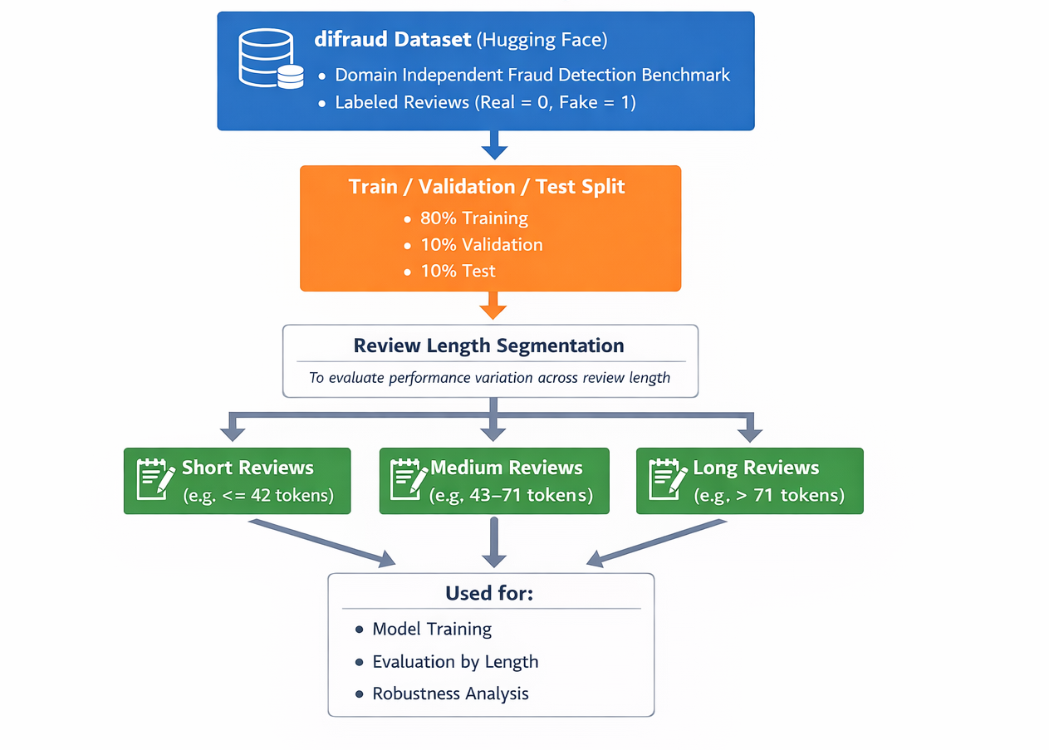
Methodology: Dataset
03
Notes:
Explain:
why the dataset
Why we are using the split
Review length

Slide 9
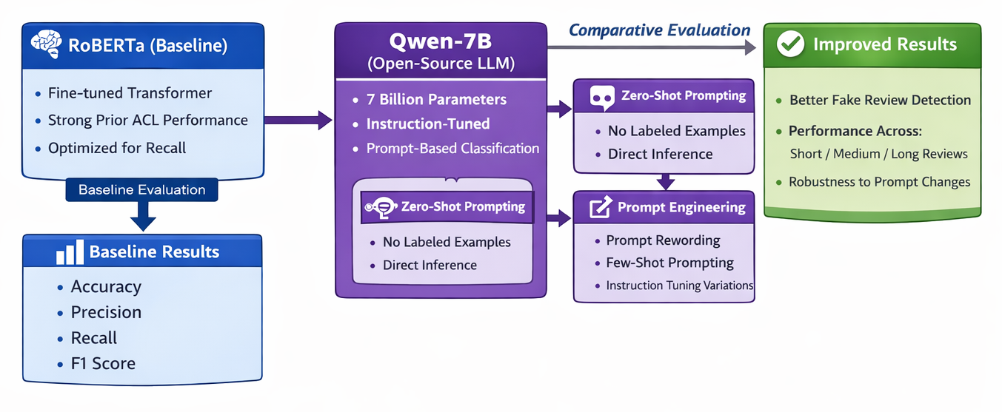
Methodology: LLM
03
Notes:
Explain:
Why roberta
Why Qwen

Slide 10
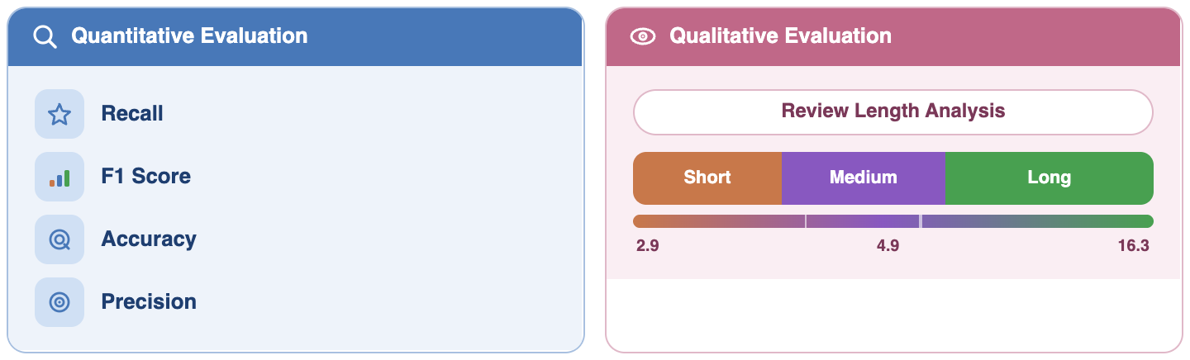
Methodology: Evaluation
03
Notes:
Quantitative and Qualitative Evaluation

Slide 11
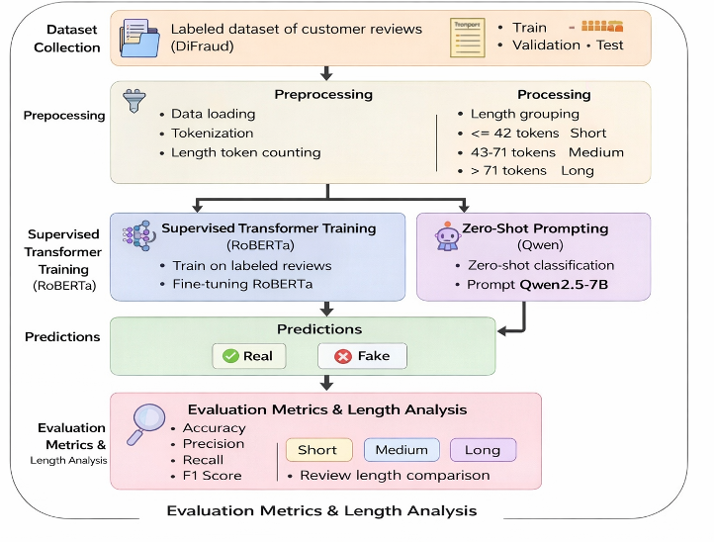
Methodology: System Architecture
03
Notes:
So overall, there are two key gaps in the literature.
First, prior work on fake review detection focuses on accuracy, but does not evaluate prediction stability.
Second, robustness studies show that LLMs are sensitive to prompt formulation, but this has not been studied in the context of deception detection tasks.
Our work addresses both gaps by performing a task-specific robustness analysis of LLM-based fake review detection.
Specifically, we evaluate how predictions change under prompt rewording and how performance varies across different review lengths.

Slide 12
Experiment 1: RoBERTa (Fine-Tuned)
04
Results
RoBERTa’s ability to model contextual language makes it effective at detecting subtle signals of deception, while serving as a strong supervised benchmark for this task.
Experimental Setup
Binary classification: Fake vs real
Tokenization with max length 512
Truncation and padding applied
Trained using Hugging Face Trainer
Batch size: 16 (train & eval)
Number of epochs: 2
Length | Accuracy | Precision | Recall | F1
Short | 0.70 | 0.66 | 0.69 | 0.68
Medium | 0.70 | 0.72 | 0.84 | 0.77
Long | 0.75 | 0.73 | 0.71 | 0.72
Consistent performance across lengths
Highest Recall: Medium Rev
Short less context, long noise
Notes:
Speaker 3 Jose:
RoBERTa was selected as the baseline model due to its strong performance in natural language understanding tasks, particularly in text classification problems. The architecture is specifically designed to capture contextual relationships between words, which is essential for identifying linguistic patterns with deceptive reviews. This allows RoBERTa to detect signals such as exaggerated language, inconsistencies, or unnatural phrasing that are often present in fake reviews. Additionally, as a pre-trained transformer model, RoBERTa can be effectively fine-tuned on domain-specific datasets, making it well-suited for supervised fake review detection. So, as I said, fine-tuned the model to create a binary classification task, with a 0 for non deceptive reviews and a 1 for deceptive reviews. Before training, the review texts were tokenized using the RoBERTa tokenizer with truncation and padding applied to a maximum sequence length of 512 tokens, as this is the amount of tokens of the longest review. The model was trained using the Hugging Face Trainer API and evaluated on the test dataset after training. The important hyperparameters used during finetuning were a batch size of q6 and a number of epochs 2 to reduce the amount of time spent in training. Then, the results shows with this model there are consistency across different review lengths. The highest recall is observed for medium-length reviews, suggesting that reviews with a moderate amount of detail provide clearer signals for detecting deceptive patterns.

Slide 13
Experiment 2: Qwen2.5-7B
04
Results
It can detect deceptive vs genuine reviews by leveraging general language understanding, even without additional training.
Experimental Setup
Zero-shot classification (Fake vs real)
Prompt-based input (instruction format)
Max input length: 512 tokens
Output parsed to binary label
No fine-tuning (pre-trained knowledge only)
Same preprocessing & length groups
Length | Accuracy | Precision | Recall | F1
Short | 0.61 | 0.62 | 0.55 | 0.58
Medium | 0.64 | 0.60 | 0.51 | 0.55
Long | 0.73 | 0.66 | 0.60 | 0.63
Strong generalization without training
Performance varies across lengths
Long reviews: better context understanding
Notes:
Speaker 3 Jose:
The second experiment evaluates large language model (LLM) performance for fake review detection using zero-shot prompting. The Qwen2.5-7BInstruct model receives each review embedded in a classification prompt instructing the model to label the review as genuine or deceptive. Inputs are limited to 512 tokens, and the generated output is parsed to obtain a binary prediction. Because the model is used in a zero-shot setting, predictions rely entirely on the model’s pre-trained knowledge. To ensure comparability with the supervised baseline, the same preprocessing steps and review length groupings were used. Predictions on the test dataset were evaluated using the same metrics as the RoBERTa baseline, and performance was analyzed as well across short, medium, and long review groups. As can be seen in the figure, the highest recall and f1 in these case belong to the long reviews.
As a third experiment, we applied chain-of-thought prompting. However, recall and F1-score were really low (less than 0.1), as the model often produced explanatory outputs instead of a clear binary label, making it unsuitable for this classification task.

Slide 14

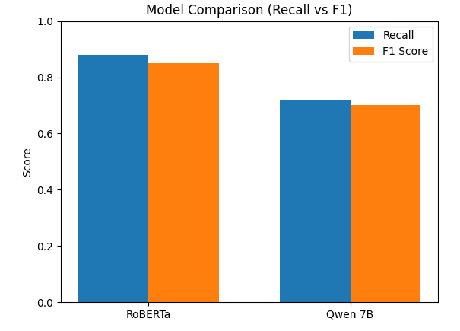
05
Discussion: Our Findings
05
RoBERTa
Qwen2.5-7B
Fine-tuned on fake review detection
Learns deception-specific linguistic patterns
Optimized for recall (fake detection)
More stable predictions
No task adaptation
Relies on general language knowledge
Struggles with subtle deception cues
Lower recall and less stable performance
Fine-tuned model has better performance. Zero-shot shows general understanding but likely lacks sensitivity to domain-specific patterns.

Slide 15
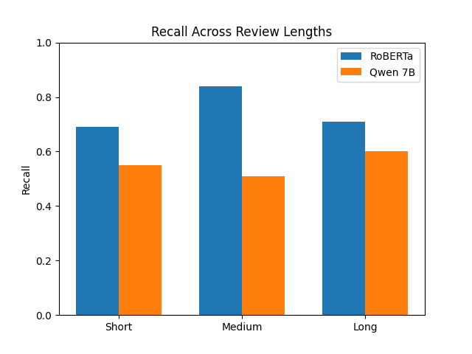

05
Discussion: Observations & Strengths
Review Length vs Recall
Short Reviews
Limited contextual information
Lower recall overall
Medium Reviews
Best balance of signal and clarity
Highest recall performance overall
Long Reviews
More contextual cues
Possible noise introduced
Different models benefit from context differently. Fine-tuned model performs best with balanced input, while zero-shot model benefit more from longer context

Slide 16
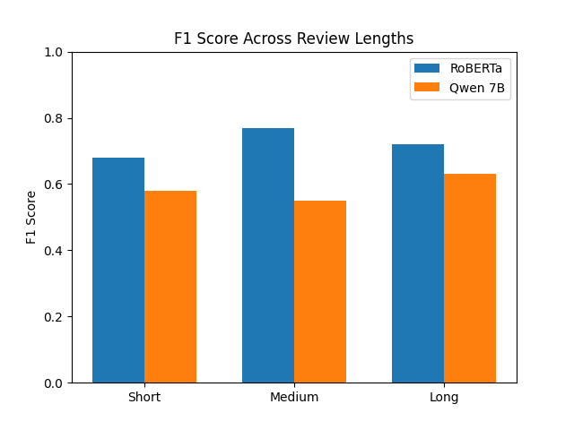
05
Discussion: Observations & Strengths
Review Length vs F1 score
Short Reviews
Limited contextual information
Lower F1 score for both models
Medium Reviews
Best balance of signal and clarity
Highest recall performance overall but Qwen performs worse
Long Reviews
More contextual cues
Possible noise introduced
F1 results show that model effectiveness depends on both context length and training. Fine-tuned model performs best with balanced input, while the zero-shot model requires more context to improve.

Slide 17
Limitations in Various Contexts
06
Dataset
Benchmark dataset may not reflect real-world review distributions
Potential stylistic bias in DiFraud reviews
Model
Zero-shot LLM evaluation may not reflect full model capability
Comparison limited to a small set of models
Experimental
Limited number of prompt variations evaluated
Review length grouping simplifies continuous variation
Computational
Limited resources restrict experiment scale
Sequential LLM inference limits evaluation breadth
Notes:
While our study provides useful insights, there are several important limitations to consider.
First, from a dataset perspective, we rely on a benchmark dataset, which may not fully reflect real-world review distributions and may introduce stylistic bias.
Second, our experimental setup evaluates a limited number of prompt variations, and our review length grouping simplifies what is actually a continuous variable.
Third, from a modeling perspective, the LLM is evaluated in a zero-shot setting, which may not fully capture its capabilities, and we only compare a small set of models.
Finally, computational constraints limit the scale of our experiments, particularly due to the cost of sequential LLM inference.
Overall, these limitations primarily affect the generalizability and completeness of our robustness evaluation.

Slide 18
Conclusion & Next Steps
07
Project Summary
Core Contribution
Next Steps
Fake review detection as a binary classification task
Compared RoBERTa vs zero-shot LLM (Qwen)
Evaluated performance across review lengths
Analyzed robustness under input variation
Task-specific robustness evaluation for fake reviews
Focus on prediction stability (not just accuracy)
Analysis of prompt sensitivity & input length
Empirical comparison of supervised vs zero-shot LLMs
Systematic prompt rewording evaluation
Explore more zero shot prompting strategies
Compare with stronger open/closed LLMs
Perform deeper error and stability analysis
Notes:
In conclusion, we study fake review detection as a binary classification task using both supervised transformers and large language models.
Our key contribution is a task-specific robustness evaluation that focuses on prediction stability rather than accuracy alone.
We show that model performance varies across review length, and that zero-shot LLMs are less stable compared to fine-tuned models in this setting.
Looking ahead, we plan to extend this work by systematically evaluating prompt rewording, exploring different zero, prompting strategies, and comparing with stronger open and closed-source models.
These steps will allow us to build a more comprehensive understanding of robustness and move toward a complete ACL-style study.

