Slide 1
Business Reasoning
Group 4 -
From Accuracy to Reliability: Risk-Aware Evaluation of Large Language Models for Decision-Support under Sampling Variability
By Barath Sanjeevan, Sanika Rozario, Aadesh Vijayaraghavan

Slide 2
MOTIVATION & PROBLEM STATEMENT
Motivation:
Large Language Models (LLMs) generate thousands of reasoning paths for a single problem.
On complex tasks like MATH, models often repeat the same logical fallacies.
Standard selection methods (e.g., Majority Voting / Self-Consistency) assume:
The most frequent answer is the most likely correct.
In high-error scenarios, this leads to a “Consensus of Error.”
We need methods that improve reliability without increasing model size.
Problem Statement:
Can LLMs be trusted for decision-support when considering stability, hallucination risk, and reliability under sampling variability?

Slide 3
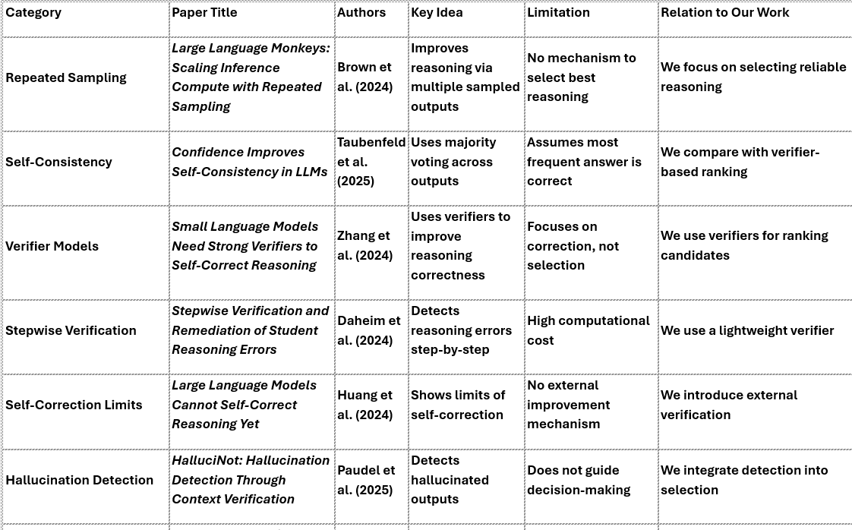
2. RELATED WORK & RESEARCH GAP

Slide 4
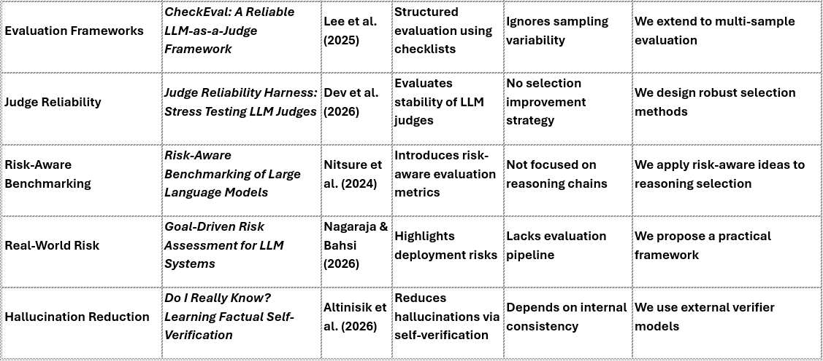
2. RELATED WORK & RESEARCH GAP

Slide 5
RESEARCH GAP
There is no systematic framework for comparing reasoning selection methods under sampling variability using reliability-focused evaluation metric
CONTRIBUTION
Risk-aware evaluation framework
Structured hallucination detection
Stability-based reliability analysis
Comparative study: Raw vs Majority vs Verifier
Our approach emphasizes trust and safety in decision-support systems.

Slide 6
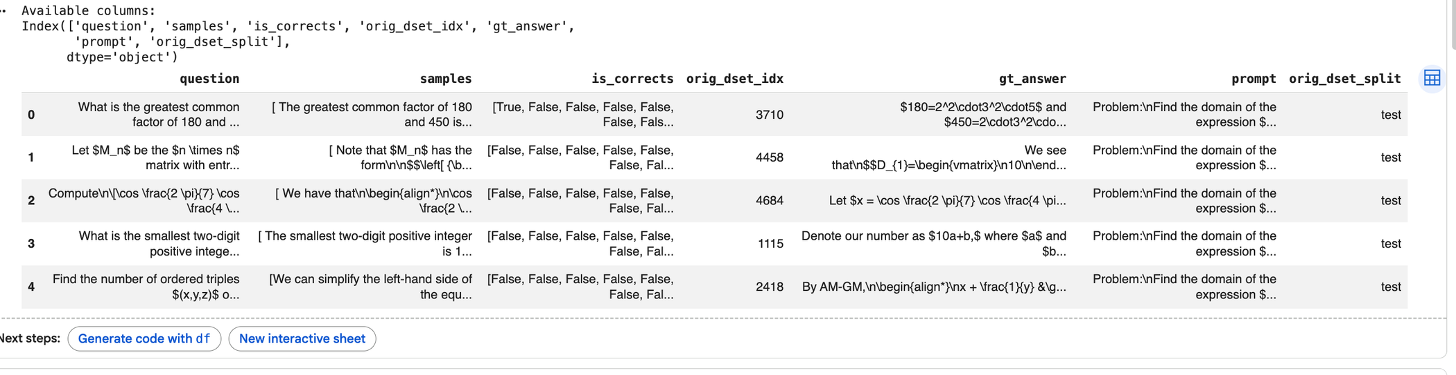
3. DATASET & TASK DEFINITION
Dataset: ScalingIntelligence/monkey_business (Llama-3-8B-Instruct on MATH,Llama-3-8B-Instruct on GSM8K).
Input: We provide the prompt and the "Chain of Thought" (CoT) reasoning leading to 10000 Samples.
Ground Truth: The is_corrects labels derived from symbolic math matching.
Task: Binary Classification (Correct vs. Incorrect) of reasoning chains providing correctness labels

Slide 7
MATH DATASET
GSM8K DATASET
Consists of competition-level mathematical problems with complex, multi-step reasoning and detailed solutions.
Used via HuggingFace (MATH_Llama-3-8B-Instruct) to evaluate deep reasoning; chosen to test verifier performance on hard problems.
Contains grade-school math word problems focusing on arithmetic and logical reasoning steps.
Loaded from HuggingFace (GSM8K_Llama-3-8B-Instruct) in code; used to test generalization on simpler, structured reasoning tasks.

Slide 8
4.EVALUATION METRICS
DRS (Decision Reliability Score)
DSI (Decision Stability Index)
HR (Hallucination Rate)
SHR (Severe Hallucination Rate)
REM (Risk Exposure Metric)
Accuracy

Slide 9
5.SYSTEM ARCHITECTURE & METHODOLOGY
Sampling: Utilize the existing 200,000 Sampling
Generate multiple reasoning paths per problem (e.g., 50–100 questions)
Feature Extraction:
Extract structural & reasoning signals:
Length / token usage
Keyword / step density
DRS (Reasoning Score)
DSI (Consistency Score)
Candidate Pool
All generated responses form a diverse reasoning set
Selection Strategies:
Raw: Use single output (baseline)
Majority Voting: Select most frequent answer
Verifier-Based: Rank and select best reasoning path samples per problem.
Sampling: Utilize the existing 10,000 saSampling
Generate multiple reasoning paths per problem (e.g., 10–100 samples)
Feature Extraction
Extract structural & reasoning signals:
Length / token usage
Keyword / step density
DRS (Reasoning Score)
DSI (Consistency Score)
Candidate Pool
All generated responses form a diverse reasoning set
Selection Strategies
Raw: Use single output (baseline)
Majority Voting: Select most frequent answer
Verifier-Based: Rank and select best reasoning path
mples per problem.

Slide 10
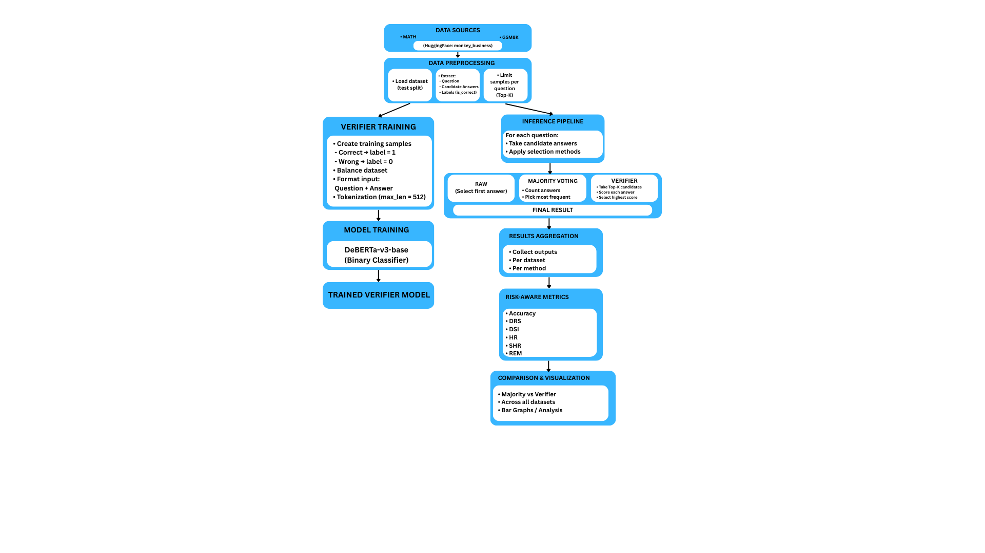

Slide 11
VERIFIER-BASED SELECTION
Core Idea
Train a lightweight model as a Verifier
Input: reasoning trace
Output: Correctness / reliability score
How It Works
Score all candidate reasoning paths
Rank based on verifier confidence
Select Top-1 highest scored output
Why It Matters
Filters out incorrect but confident reasoning
Moves beyond answer frequency → focuses on reasoning quality
Key Advantages
↓ Hallucination Rate (HR)
↓ Severe Hallucination Rate (SHR)
↓ Risk Exposure (REM)
↑ Reliability of final predictions

Slide 12
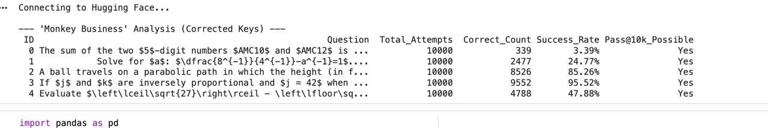
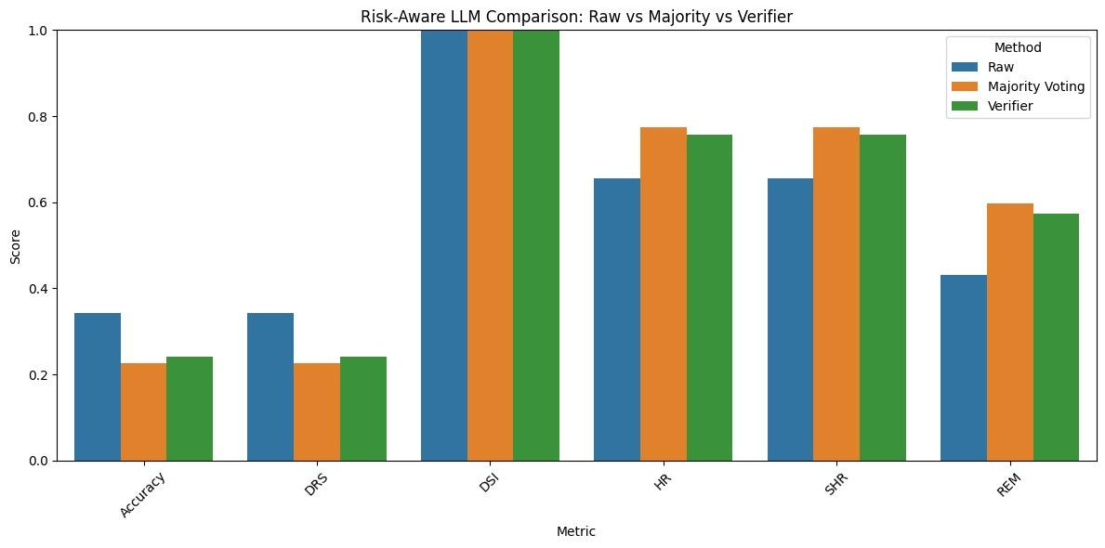
6. EXPECTED OUTCOMES
PREVIOUS OUTCOMES:

Slide 13
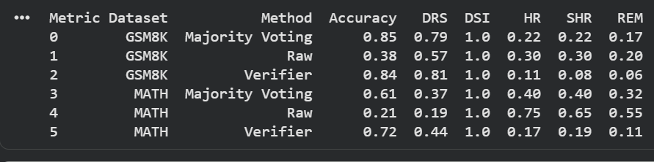
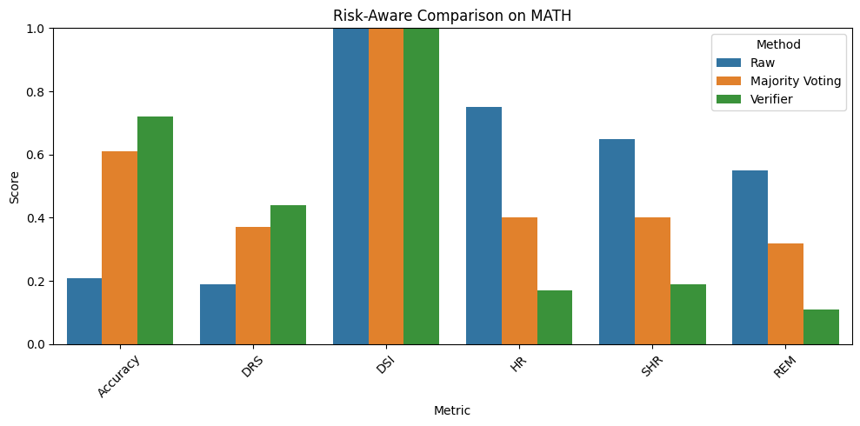
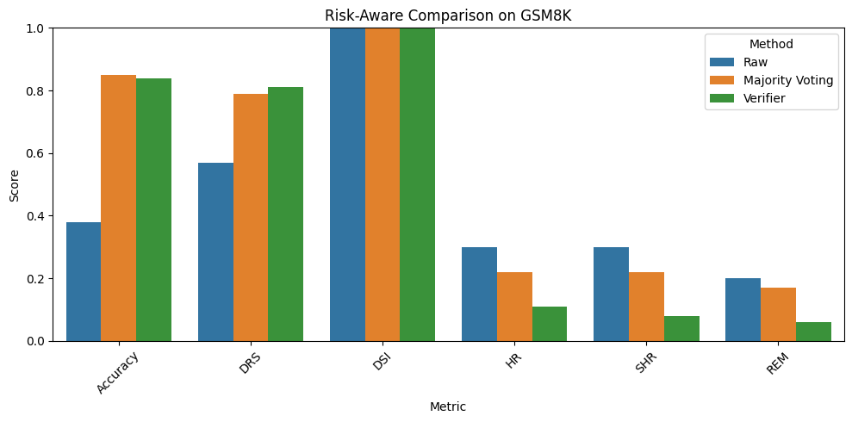
UPDATED OUTCOMES:
MATH
GSM8K

Slide 14
7. DISCUSSION
Observed Patterns: Majority voting shows strong consistency, while the verifier consistently enhances risk-sensitive metrics (HR, SHR, REM) and maintains competitive accuracy.
Strengths: Verifier-based selection prioritizes reasoning quality over frequency, leading to more reliable and safer predictions across datasets.
Adaptability: Performance trends across both MATH and GSM8K highlight the verifier’s ability to generalize across varying difficulty levels.
Refinements: Model upgrades (DeBERTa), multi-dataset evaluation, and improved selection strategy contributed to overall system improvement.

Slide 15
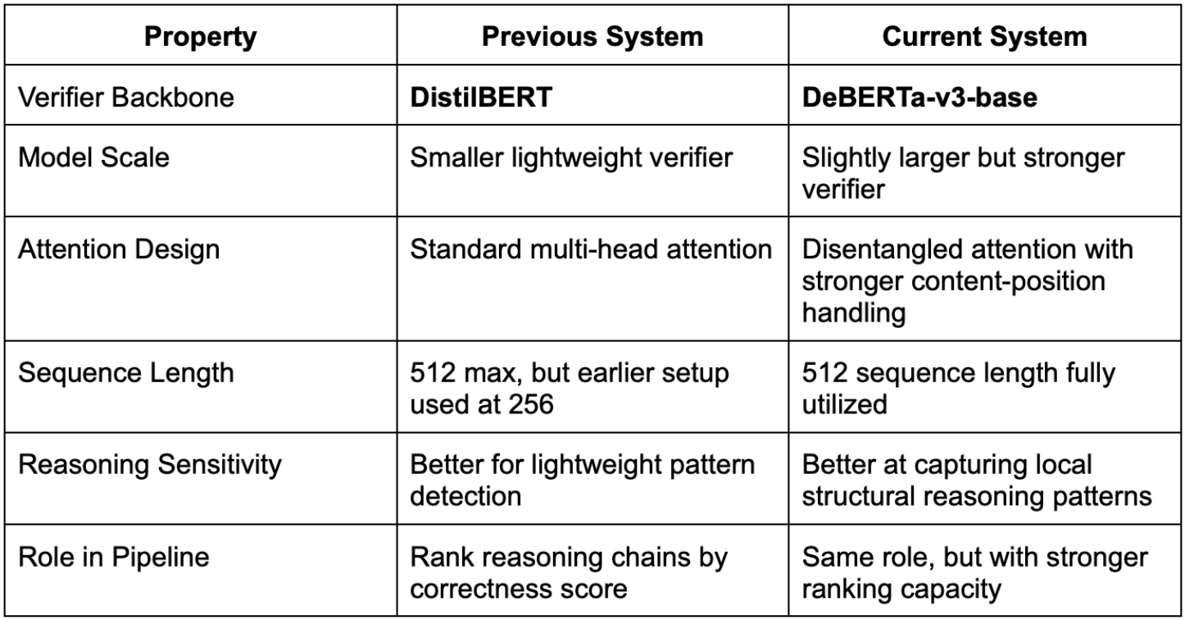
MODEL SELECTION & WHY?

Slide 16
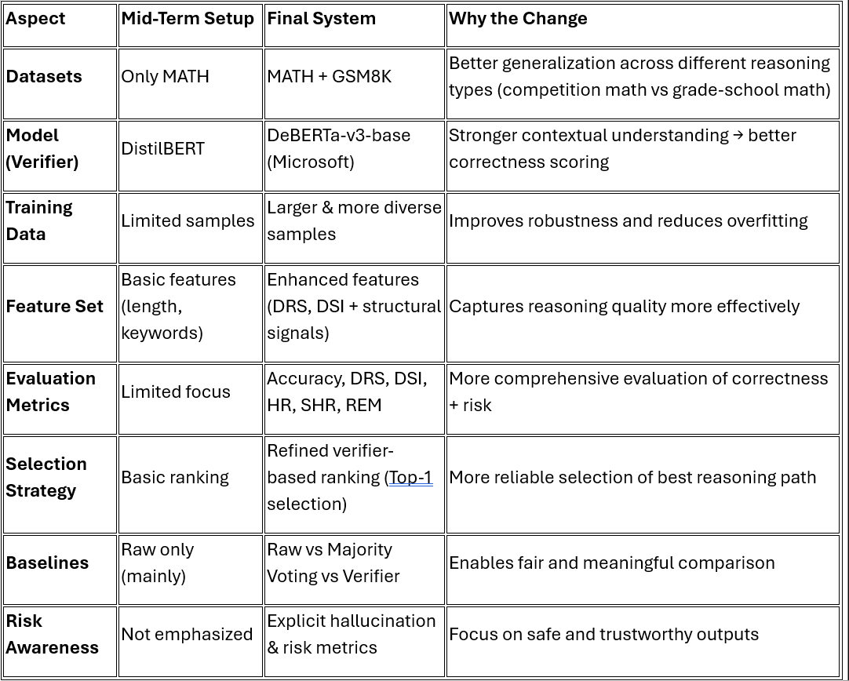
OVERALL IMPROVEMENT’S:

Slide 17
8. PROGRESS TO DATE & TIMELINE
Phase / Component | Status | Details & Accomplishments
Dataset Integration | Completed | Integrated GSM8K and MATHdatasets; loaded reasoning samples, ground truth, and correctness labels.
Data Processing | Completed | Implemented balanced flattening and equal sampling per question to eliminate bias.
Decision Strategies | Completed | Implemented and compared Raw, Majority, and Verifier selection mechanisms.
Metrics & Risk Framework | Completed | Computed reliability and hallucination-aware metrics (Accuracy, DRS, DSI, HR, SHR, and REM).
Comparative Analysis | Completed | Conducted cross-dataset evaluation; generated graphs for reliability, stability, and risk analysis.
Final Paper | In Progress | Synthesis of results and discussion; drafting final ACL-style research paper for submission.

Slide 18
9. LIMITATIONS
Training the verifier introduces additional computational and memory overhead, requires labeled data, and adds complexity due to dependence on training quality.
Verifier-based ranking increases inference latency because each reasoning candidate must be individually scored, making it less suitable for real-time applications.
The approach faces scalability challenges as computational cost grows with the number of samples and dataset size, limiting large-scale deployment.
Experimental setup is constrained by limited resources such as GPU availability, memory, and runtime limits, necessitating the use of smaller dataset subsets.

Slide 19
CONCLUSION & NEXT STEPS
Accuracy alone is insufficient for evaluating LLMs in decision support systems
We incorporate risk-aware metrics (HR, SHR, REM) alongside correctness
Compared: Raw vs Majority Voting vs Verifier-based selection across multiple datasets
Developed an improved pipeline: multi-dataset evaluation + enhanced verifier (DeBERTa) + refined metrics
Results show the verifier as the overall best performer, balancing accuracy and risk
Future Work:
Larger and more diverse dataset evaluation
Improved verifier training and calibration
Efficiency optimization for faster inference
Goal: Reliable and risk-aware LLM deployment in real-world applications.
Larger and more diverse dataset evaluation
Improved verifier training and calibration
Efficiency optimization for faster inference

Slide 20
THANK YOU

