Slide 1

Beyond Accuracy:
A Survival-Based Evaluation Framework for Elimination Reasoning in Medical Multiple-Choice Question Answering
Notes:
Hello everyone. We are presenting our project titled “Beyond Accuracy: A Survival-Based Evaluation Framework for Elimination Reasoning in Medical Multiple-Choice Question Answering.”

Slide 2
The Problem with Standard Accuracy
Standard MCQA Evaluation
LLM → directly selects one option (A/B/C/D)
Evaluation metric:
Accuracy = Final answer correct ?
Model A
70% Accuracy
Two models, both with 70% accuracy.
Both look identical.
But Accuracy metrics is fundamentally blind to how the model reasoned
Model B
70% Accuracy
Notes:
In standard multiple-choice evaluation, LLM model receives a question and four options, and it directly predicts the final answer - usually A, B, C, or D.
The only evaluation metric we use is accuracy, which simply checks whether the final answer is correct.
However, this evaluation ignores the reasoning process that leads to the answer.
Two models can have identical accuracy but behave very differently internally.
Because accuracy only measures the final outcome, it cannot detect the differences in reasoning behavior of LLM models.
This blind spot in evaluation is the core problem our project addresses.

Slide 3
Why This Matters: Clinical Stakes & Our Approach
5
4,183
2
Medical exam
questions evaluated
Open-source LLMs
tested
New survival-based
metrics proposed
Research Questions
RQ1: Can LLMs perform meaningful elimination reasoning on medical MCQs, protecting the correct answer across sequential rounds beyond what chance predicts?
RQ2: Can survival-based metrics reveal reliability properties that final accuracy alone conceals, and what is the root cause of elimination failures?
Notes:
Our study evaluates 4,183 medical exam questions across two open-source language models, and proposes 5 new metrics to make this reasoning behavior visible.
To study this behavior, we compare three inference strategies: Direct selection from model;
Confidence Guided Elimination in a zero-shot setting; and
Confidence-Guided Elimination with few-shot prompting.
3. We ask two research questions:
RQ1: Can LLMs perform meaningful elimination reasoning on medical MCQs, protecting the correct answer across rounds beyond what chance would predict?
And RQ2: Can survival-based metrics reveal reliability properties that final accuracy cannot and if so, what is the root cause of elimination failures?
I will now hand over to Member 2.

Slide 4
Related Work: Three Themes and the Gap We Fill
Theme | What prior work does | Limitation
Medical MCQA | Evaluates medical knowledge(Pal et al., 2022) | Focus mostly accuracy-only
Prompting/CoT | Improves reasoning(Wei et al., 2022) | No elimination trajectory
Elimination methods/PoE | Removes options iteratively(Ma & Du, 2023) | No survival analysis
Calibration | Studies confidence reliability(Tian et al., 2023) | No sequential elimination view
The Gap We Fill: No prior work applies elimination to MedMCQA data, measures round-by-round survival of the correct answer, or investigates why models fail to express reliable numerical confidence.
Notes:
Prior work related to our project falls into four areas. 1. First, medical MCQA studies evaluate how well LLMs answer medical exam questions, but they usually focus only on final accuracy. 2. Second, reasoning approaches such as Chain-of-Thought improve structured reasoning, yet they still measure success through final correctness. 3. Third, elimination-based methods like Process of Elimination show that models can remove options iteratively, but they do not analyze whether the correct answer survives through each round. 4. Finally, calibration research studies whether model confidence is reliable, but not how confidence behaves during sequential elimination.
So the main gap in the literature is that these areas remain disconnected. Existing work does not provide a framework for analyzing round-by-round survival of the correct answer during elimination reasoning. Our work addresses this gap through a survival-based evaluation framework for medical MCQA.

Slide 5



Contribution/Novel Work
Contribution 1
Survival-Based Evaluation Framework
Contribution 2
Confidence-Guided Elimination, or CGE
Contribution 3
Verbalization Gap
Notes:
Our work have 3 main contributions.
First, we introduce a Survival-Based Evaluation Framework with five new metrics.
Second, we propose Confidence-Guided Elimination inference strategy.
Third, we analyze elimination failures and identify a phenomenon we call the verbalization gap, where models internally know the correct answer but fail to express that knowledge through numerical confidence scores.

Slide 6
Methodology: Dataset, Task & Models
Dataset: MedMCQA (Pal et al., 2022)
Model Selection
Indian medical entrance exams (AIIMS PG, INICET)
21 clinical subjects (anatomy, pharmacology, surgery...)
4 options MCQ format
4,183 validation questions evaluated (SEED=42)
Qwen2.5-7B-Instruct
Strong structured output compliance → critical for parsing 0 - 10 scores every round
Competitive medical knowledge at 7B scale
Fits within A100 40GB VRAM → reproducible without multi-GPU
LLaMA-3.1-8B-Instruct
Most widely adopted open-source LLM family in NLP research
Strong baseline → results directly comparable to existing literature
Fits within A100 40GB VRAM → same compute budget
Setup & Preprocessing
Google Colab Pro - A100 40GB VRAM
Greedy decoding
Max 512 tokens
End-truncation preserving all options
Notes:
For our dataset we used MedMCQA data, it has Indian medical entrance exam questions covering 21 clinical subjects. It has exactly four options per question.
2. Dataset has three splits - train, validation, and test. We do not use the training set because our models are not trained or fine-tuned on MedMCQA.
We are measuring pre-trained knowledge, not learned performance.
We evaluate the full 4,183-question validation split because the test set labels are not publicly released.
3. For models, we chose Qwen2.5-7B-Instruct and LLaMA-3.1-8B-Instruct. Both are evaluated purely on pre-trained medical knowledge.
The LLM is used purely at inference time through prompting.
For sequential data handling, each question is tokenized using each model's native tokenizer with a maximum of 512 tokens.

Slide 7
Confidence Guided Elimination (CGE)
Medical MCQ
Question + Option(A B C D)
LLM assigns confidence scores to each option and the lowest-scored option is eliminated in each round.
Round 1: Confidence Scoring
A:7 B:3 C:9 D:2
D Eliminated
Round 2: Confidence Scoring
A:7 B:4 C:9
Properties of CGE
Iterative elimination across 3 rounds
Lowest confidence option removed each round
Final surviving option = model answer
B Eliminated
Round 3: Confidence Scoring
A:5 C:9
A Eliminated
Final Answer = C
Notes:
Confidence Guided Elimination works as follows.
In first round, the model assigns a score from 0 to 10 to each option. The option with the lowest score gets eliminated.
2. In the second round, the model scores the remaining three options, and the lowest is eliminated again.
3. Finally, in the third round, the model scores the remaining two options and the lowest is eliminated.
The last surviving option becomes the model’s final answer.

Slide 8
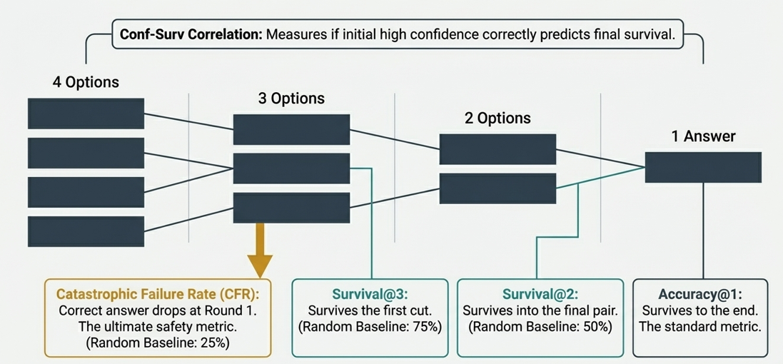
Survival-Based Evaluation Framework: 5 Metrics
Survival@3
Survival@2
Correct answer survives Round 1
(3 options remain)
Correct answer survives Round 2
(2 options remain)
Catastrophic Failure Rate(CFR)
Accuracy@1
Correct answer is final survivor
= standard accuracy
Correct answer eliminated
in Round 1 (catastrophic)
Confidence Survival Correlation
When model ranks correct
option #1 in R1,
→ how often it survives to final answer
Notes:
To analyze the elimination process, we introduce five survival-based metrics.
Survival@3 measures whether the correct answer survives the first elimination round.
Survival@2 measures whether it survives the second round.
Accuracy@1 measures the final answer accuracy.
Catastrophic Failure Rate measures how often the correct answer is eliminated in the first round itself.
Lastly Confidence-Survival Correlation - It measures how often the model’s highest-confidence option in round 1 actually survives the elimination process and becomes the final correct answer.

Slide 9
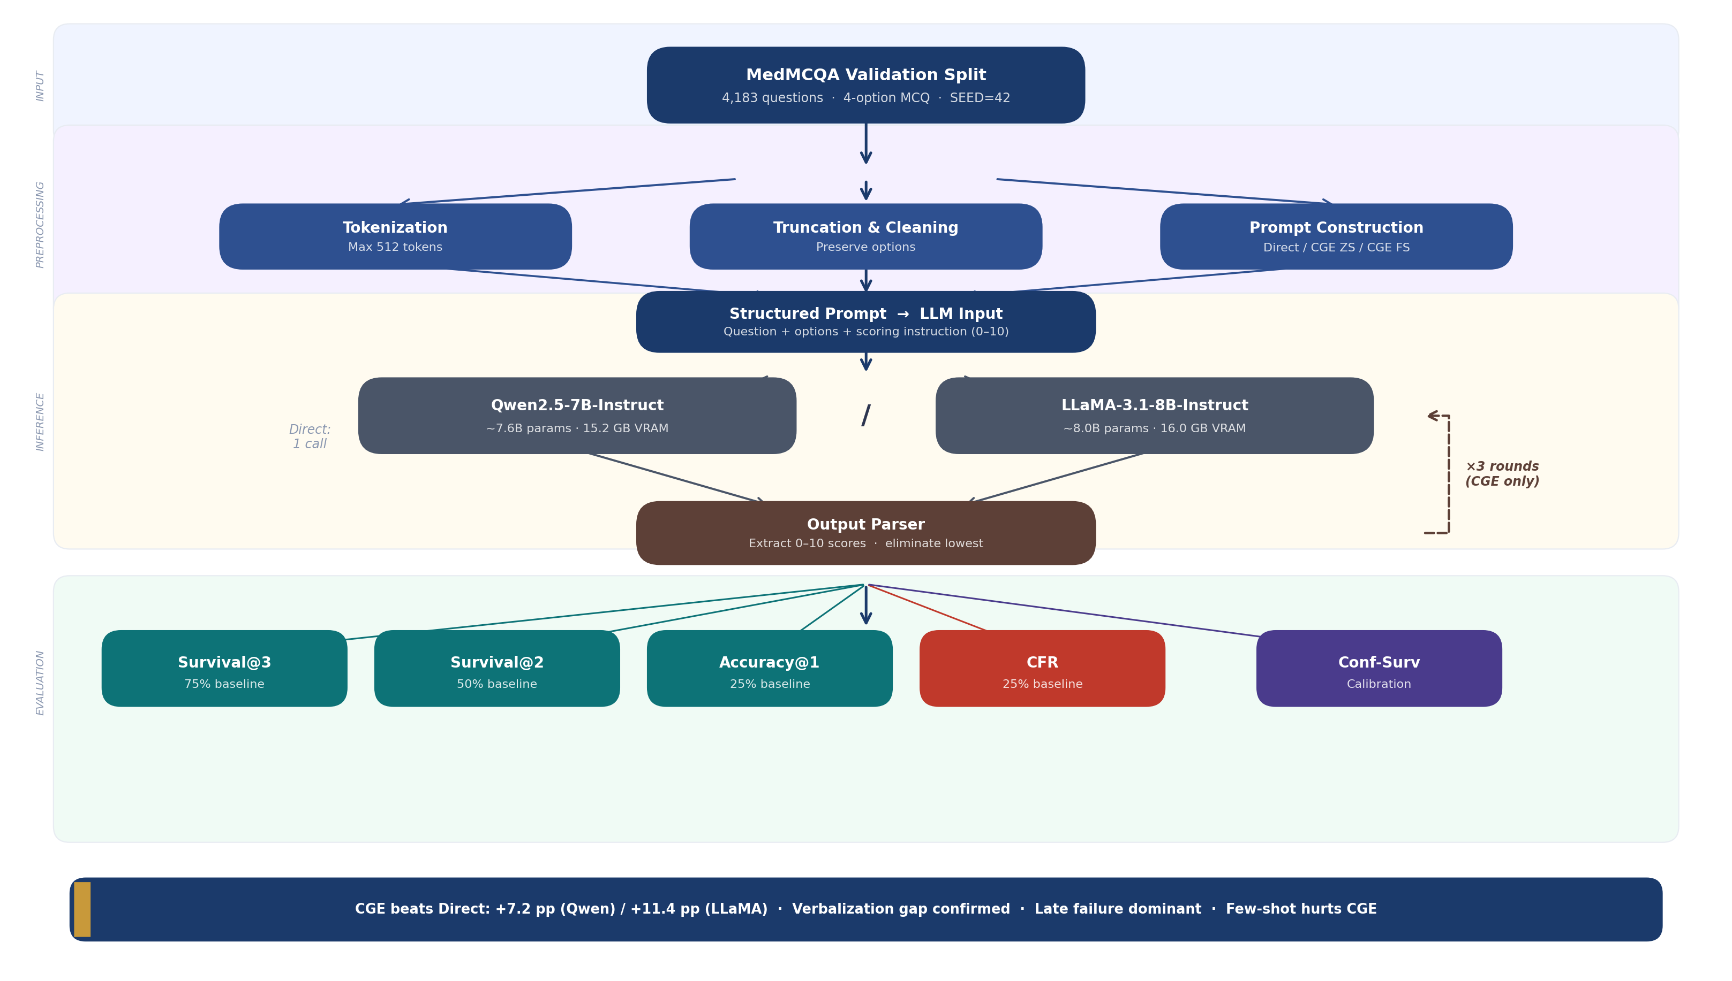
System Pipeline
Input
Preprocessing
Inference
Evaluation
Notes:
This diagram shows our system pipeline
We begin with the MedMCQA validation split data. The data then goes through three preprocessing steps.
First, the questions are tokenized using the model’s native tokenizer.
Second, we perform truncation and cleaning, removing null bytes and ensuring inputs fit within the token limit.
Third, we perform prompt construction, where we prepare prompts for three strategies: Direct prediction, CGE zero-shot, and CGE few-shot.
These prompts are then fed into two large language models: Qwen and LLaMA.
For the elimination strategies, the model assigns confidence scores from 0 to 10 for each option, and this process runs for three elimination rounds.
The outputs are then processed by our output parser.
Finally, we compute our evaluation metrics which together allow us to analyze the model’s reasoning behavior rather than just final accuracy.

Slide 10
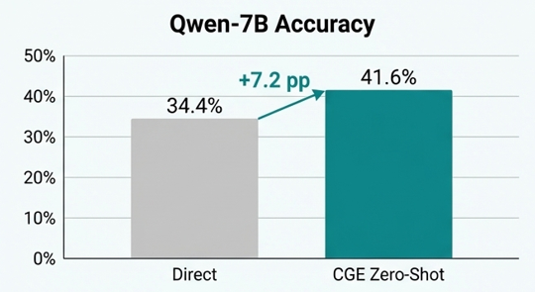
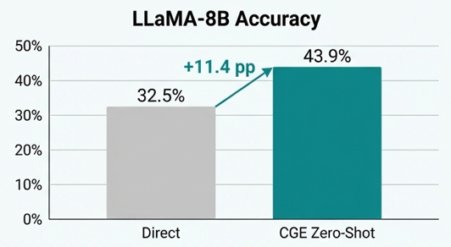
Results: CGE Outperforms Direct Prediction
Model | Strategy | S@3 | S@2 | Acc@1 | CFR | Conf-Surv Corr.
Random | Baseline | 75.0 | 50.0 | 25.0 | 25.0 | —
Qwen-7B | Direct | — | — | 34.4 | — | —
 | CGE Zero Shot | 81.1 ↑ | 63.6 ↑ | 41.6 ↑ | 18.9 ↓ | 73.1
 | CGE Few Shot | 78.5 | 63.1 | 41.0 | 21.5 | —
LLaMA-8B | Direct | — | — | 32.5 | — | —
 | CGE Zero Shot | 78.8 ↑ | 62.7 ↑ | 43.9 ↑ | 21.2 | 69.1
 | CGE Few Shot | 78.8 | 62.4 | 42.0 | 21.2 | —
Higher accuracy comes from active, correct reasoning at every step.
Notes:
Our main results show that Confidence-Guided Elimination improves performance compared to direct prediction.
For Qwen, CGE Zero-shot raises accuracy from 34.4% to 41.6%
For LLaMA, the gain is even larger: 32.5% to 43.9%
Both models achieve survival rates above the random baseline and lower catastrophic failure rates than random elimination.
This indicates CGE is not just getting more questions right. It is doing so while reasoning more carefully at every step of elimination.

Slide 11
Results: Failure Distribution & Few-Shot Finding
Failure Distribution (CGE Zero-shot)
Finding: Few-shot Hurts CGE
Outcome | Qwen-7B | LLaMA-8B
Catastrophic (R1) | 18.9% (792) | 21.2% (885)
Late Failure | 39.5% (1,653) | 35.0% (1,462)
Success | 41.5% (1,738) | 43.9% (1,836)
 | CGE ZS | CGE FS | Δ
Qwen Acc | 41.6% | 41.0% | −0.6
Qwen CFR | 18.9% | 21.5% | +2.6 ↑bad
LLaMA Acc | 43.9% | 42.0% | −1.9
LLaMA CFR | 21.2% | 21.2% | 0.0
Late failure dominates (35 - 40%). Models successfully protect the correct answer in Round 1, but fail at the final 2-option stage, the bottleneck is fine-grained discrimination, not gross elimination errors.
3 examples hurt both models. Interpretation: examples introduce pattern-matching bias. Model copies the example's scoring pattern rather than reasoning about the specific question.
Question Length: Short (<10words): 34.9% / 33.4% · Medium (10-20words): 33.2% / 30.9% · Long (>20words): 35.5% /34.3% Near-uniform across lengths. Questions Length is not a confound.
Notes:
So let's look at how the models actually fail.
The biggest failure mode is not catastrophic — it's late. About 35 to 40 percent of questions, the model correctly protects the right answer in Round 1, but then picks the wrong one at the final two-option stage. So the bottleneck is fine-grained discrimination at the end, not gross errors at the beginning.
On the right side, we have our few-shot finding. We added three worked examples to help the model — but it actually hurt. Qwen's catastrophic failure rate went up. Our interpretation is that the model just copied the scoring pattern from the examples instead of actually reasoning about the question. So zero-shot is more reliable for this kind of task.
Finally, we checked if question length was causing any of this. It wasn't. Accuracy was almost the same across short, medium, and long questions."
Looking at how failures are distributed: the dominant failure mode is late failure, not catastrophic failure.
About 35 to 40% of questions result in the correct answer surviving Round 1 but failing at the final two-option stage.
On the right is few-shot finding. Adding three worked examples slightly hurts both models. Qwen's CFR increases from with few shot examples.
Our interpretation is it happened bcz of pattern and matching bias, the model copies the example's scoring structure rather than reasoning about the specific question in front of it. Zero-shot CGE is more reliable.
We also confirm that question length is not a problem, accuracy is near-uniform across short, medium, and long questions.

Slide 12
Results: Diagnosing Failures: Verbalization Gap
Experiment 3: CoT Investigation (n=30 per set)
Experiment 4: Logit Analysis (n=25 per set)
Question Set | CGE | CoT | Δ
Qwen — Catastrophic Failures | 0.0% | 36.7% | +36.7
Qwen — Flat Confidence | 33.3% | 26.7% | −6.7
Qwen — Model Disagreement | 23.3% | 13.3% | −10.0
LLaMA — Catastrophic Failures | 0.0% | 43.3% | +43.3
LLaMA — Flat Confidence | 33.3% | 30.0% | −3.3
LLaMA — Model Disagreement | 40.0% | 53.3% | +13.3
Model / Set | Internal Spread | Verbalized Spread | Gap?
Qwen flat cases | 0.791 | 0.52 | YES
Qwen baseline | 0.928 | 7.56 | —
LLaMA flat cases | 0.379 | 0.24 | YES
LLaMA baseline | 0.513 | 8.40 | —
What this means:
Internal softmax spread is high (model internally knows which answer is most likely) but verbalized spread is near zero (scores assigned are nearly identical). The model cannot translate internal knowledge into numerical scores, this is the verbalization gap.
Same questions, same models → CoT recovers 36.7% and 43.3% on questions CGE failed catastrophically on. Medical knowledge exists internally. The numerical format is the problem, not the model's knowledge.
Notes:
This is our most important diagnostic finding. When CGE fails catastrophically, eliminating the correct answer in Round 1. The question comes: is this because the model does not know the answer, or because it cannot express that knowledge as numerical scores?
Experiment 3 tests this with Chain-of-Thought prompting on the exact questions CGE failed. CGE has 0% accuracy on these questions. But CoT achieves 36.7% for Qwen and 43.3% for LLaMA on the same questions. Same models, same questions but better results under free-form reasoning.
This proves the knowledge exists in models. The numerical format is the problem.
Experiment 4 confirms this at the internal level. We extract raw softmax probabilities over the four answer tokens directly from model weights. On flat confidence cases, where verbalized scores are nearly identical, Qwen's internal softmax spread is 0.791. Its verbalized spread is only 0.52. LLaMA shows the same pattern: 0.379 internal versus 0.24 verbalized.
The model internally knows which answer is most likely. It simply cannot translate that into discriminative numerical scores. We call this the verbalization gap.

Slide 13
Discussion
RQ1 Findings - LLMs perform meaningful elimination reasoning
Both models beat all random baselines. Survival@3 > 75%, CFR < 25%, Accuracy@1 significantly above 25% chance. CGE actively protects the correct answer rather than eliminating randomly.
RQ2 Findings - Survival metrics reveal what accuracy hides
Two models with similar accuracy (41.6% vs 43.9%) have measurably different calibration (73.1% vs 69.1% Conf-Surv). Failure distribution reveals late failure dominates, not catastrophic — a finding invisible to accuracy alone.
Surprising Finding: Few-shot hurts CGE
Adding worked examples slightly hurts both models and increases Qwen's CFR. Pattern matching on example scoring overrides question-specific reasoning. Suggests zero-shot is more reliable for structured scoring tasks.
Verbalization Gap, Not Knowledge Gap
CoT recovery (+36.7%, +43.3%) and logit analysis (internal spread 0.791 vs verbalized 0.52) together prove: CGE failures are a format problem, not a knowledge problem. Models know the answer but cannot express it numerically.
Notes:
Both models beat all random baselines across all survival metrics.
Two models with similar accuracy have measurably different confidence calibration versus Confidence-Survival Correlation.
The survival framework reveals this difference; accuracy alone cannot.
The most surprising finding is that few-shot hurts CGE. We expected examples to help.
This suggests zero-shot is the more reliable condition for structured scoring tasks.
Also CGE failures are caused by the verbalization gap, not knowledge gaps. Models possess the medical knowledge internally but cannot express it as numerical confidence scores.

Slide 14
Limitations
01 Scale: 7–8B Models Only
Results may not generalize to larger models (70B+) or smaller ones (3B). Compute constraints prevented testing at different scales.
02 Single Dataset
MedMCQA is Indian medical exam content. Generalization to US USMLE (MedQA), biomedical literature (PubMedQA), or general reasoning benchmarks is untested.
03 Small CoT / Logit Sample Sizes
CoT investigation uses n=30 per set; logit analysis n=25. These are targeted diagnostics rather than statistically robust estimates.
Notes:
Some of the limitations are:
We only tested 7 to 8B models. Results may not generalize to larger scales.
We evaluated one dataset so generalization to general reasoning benchmarks is untested.
Our Chain and Thoughts and logit analyses use small targeted samples - 30 and 25 questions, which are diagnostic rather than statistically robust.

Slide 15
Conclusion & Next Steps
1
2
3
Survival-Based Framework
CGE on MedMCQA
Verbalization Gap Discovery
5 new metrics (S@3, S@2, Acc@1, CFR, Conf-Surv) that characterize full elimination trajectory, not just final accuracy.
First application of iterative confidence-guided elimination to 4,183 medical exam questions. +7.2 pp / +11.4 pp accuracy gains.
Models know answers internally but cannot express them numerically.
Next Steps
Finalize & clean codebase
Complete final paper
Notes:
In summary, we identified a major limitation in standard evaluation of LLM reasoning for medical MCQ tasks.
We proposed a survival-based evaluation framework that tracks the correct answer across elimination rounds.
Using our Confidence-Guided Elimination strategy, we demonstrated improved accuracy and reduced catastrophic failures compared to direct prediction.
Finally, our analysis revealed a verbalization gap, where models possess correct internal knowledge but struggle to express it through numerical confidence scores.
We believe our framework can serve as a useful diagnostic tool for evaluating reasoning reliability in high-stakes domains such as healthcare.
Our next steps are to finalize and clean the codebase and complete the full ACL-style paper for submission.

Slide 16
Thank You
Notes:
Thank you. We are happy to take questions

