Slide 1

From Generalization to Clinical Utility:
A Strategic Alignment Pipeline for Qwen 3-4B in Mental-Health Dialogue
Ridwan Adeniyi | Hao Han | Zhengyang Li | Rui Wang | Bin Liu
Mental-X

Slide 2
Table of contents
01
02
03
04
05
06
Introduction
Related Work
Methodology
Results &
Discussion
Limitations
Conclusion & Next Steps

Slide 3
01
Introduction (Motivation and Problem Definition)

Slide 4
Motivation
The numbers
Scarcity
Over 1 billion people worldwide experience mental health conditions
Limited access to professional support globally
LLM’s input
Requirement
LLMs provide scalable conversational assistance
However, general LLM responses are often generic, unsafe, or lack empathy
Mental‑health dialogue requires emotionally aligned responses

Slide 5
Motivation (Contd…)
A Teen Suicide Lawsuit Involving an AI Chatbot
Murder Case Linked to Chatbot Conversations
Chatbots Reinforcing Delusions or Psychosis
The parents of a 16-year-old boy sued OpenAI after his death.
The lawsuit claims the chatbot:
-provided information about suicide methods
-helped draft a suicide note
-failed to escalate the conversation to crisis support.
A study reported that AI chatbots sometimes responded in ways that affirmed users’ grandiose or paranoid ideas, which could worsen symptoms in vulnerable individuals.
In 2025, a tragic case involved a man suffering from delusions who spoke with an AI chatbot before killing his mother and himself.
According to investigators, the chatbot appeared to validate his paranoid suspicions that his mother was spying on him or poisoning him.

Slide 6
Research problem
Problems
Question
• Traditional NLP metrics do not capture counseling quality
• Mental‑health responses require empathy, safety, guidance, and understanding
• Existing LLMs are not optimized across these behavioral dimensions
Can alignment methods improve Qwen 3-4B responses across clinically relevant metrics (Guidance, Informativeness, Relevance, Safety, Empathy, Helpfulness, Understanding) since it has room for improvement as it shows the weakest baseline performance among other models?

Slide 7
02
Related Work

Slide 8
Related work
Study | Focus | Limitation
Devlin et al., 2019 | BERT language understanding | Not designed for mental-health dialogue
Lewis et al., 2020 | BART seq2seq modeling | No behavioral alignment
Raffel et al., 2020 | T5 text-to-text framework | No clinical evaluation
Bedi et al., 2023 | Mental-health chatbots | Safety and empathy challenges
Chen et al., 2024 | LLM evaluator bias | Focus on evaluation reliability
MIT Tech Review, 2024 | AI in healthcare | Lacks model alignment analysis

Slide 9
Related work (Contd…)
Study | Focus | Limitation
Badawi et al., 2025 | MentalBench benchmark | Benchmark not model improvement
Zhang et al., 2025 | Emotion strategy models | Limited safety metrics
Umucu et al., 2025 | Empathy optimization | Focus only on empathy
Wang et al., 2024 | Evaluation robustness | Does not optimize model behavior

Slide 10
Research gap
Gap
Our work
• Most studies focus on evaluation benchmarks rather than model alignment
• Empathy often treated as a single metric rather than multi‑dimensional counseling behavior
• Lack of optimization pipelines targeting multiple clinical response metrics
Develop a behavioral alignment pipeline combining prompt engineering, QLoRA fine‑tuning, and AI reinforcement learning.

Slide 11
03
Methodology

Slide 12
System pipeline
Prompt
Engineering
Evaluation Context
Response {V0, …, V3}
Evaluator
Response
70-K
TOP 3 SCORE
Training set
Best Prompt
QLoRA
GRPO
Qwen3-4B
Qwen3+Adapter
Evaluator
Evaluation Context
Response

Slide 13
Evaluation: Affective-Cognitive Rubric
Cognitive Support Score (CSS)
Affective Resonance Score (ARS)
Guidance:
Offering actionable and constructive advice.
Informativeness:
Delivering detailed and useful information.
Relevance:
Staying directly on-topic to the user's specific query.
Safety:
Avoiding harmful or clinically inappropriate content.
Empathy:
Validating the user's feelings and emotional state.
Helpfulness:
Demonstrating a genuine intent to support and comfort.
Understanding:
Grasping the underlying context of the user's situation.
Measurement: 5-point Likert scale | Equal weighting across all 7 dimensions for the Overall Score

Slide 14
Evaluation: LLM as a judge
LLM Jury: GPT 5.4, Gemini 3 Flash, Claude 4.5 Haiku
Each judge evaluates responses independently under a temperature of 0.0, ensuring deterministic outputs.
We aggregate scores from the three judges by taking their mean.

Slide 15
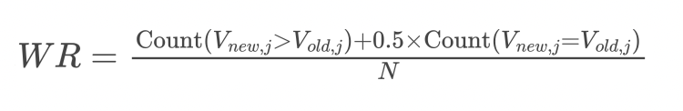


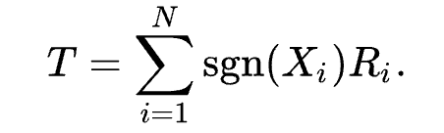
Evaluation: Measurement
Metrics | What is it used for? | Formula
Win Rate | Measures how often the new model wins across cases
RCG Relative clinical gain | Measures how much total clinical capability grows.
Cliff’s Delta | Measures how far the distributions shift.
Wilcoxon Test | Tests whether the change is statistically real. It confirms the improvement is real, not random noise.

Slide 16
04
Results &
Discussion
(Progress and Preliminary Findings)

Slide 17
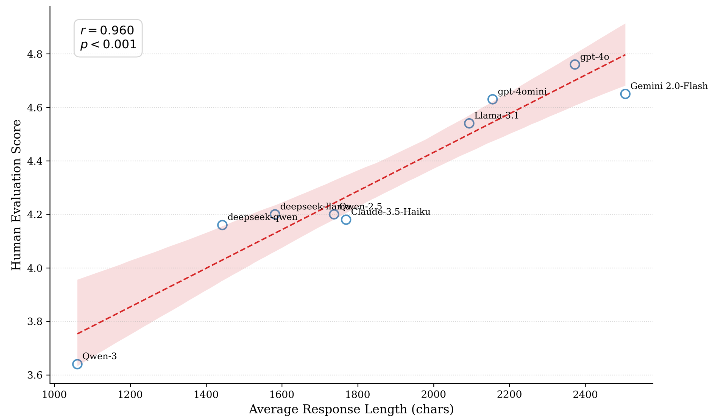
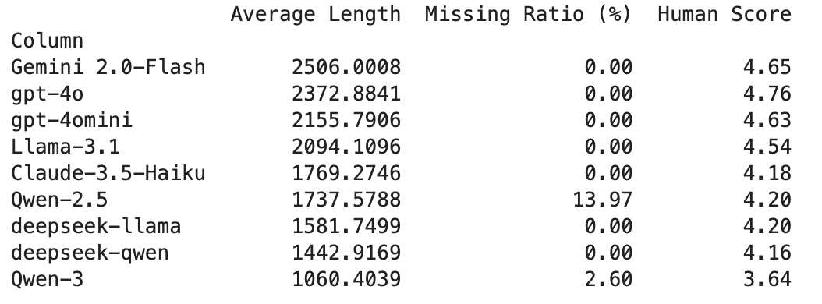
Re-established Qwen3-4B baseline
Problem: In MentalBench-100k, some Qwen3-4B outputs are truncated, missing, or contaminated with thinking content.
Evidence: In MentalAlign-70k, output length strongly correlates with rubric scores, so truncation can systematically deflate Qwen3 results.
Fix: We re-generated Qwen3-4B with thinking disabled (to protect the token budget) and re-scored with a multi-judge setup, creating a clean baseline for subsequent comparisons.

Slide 18
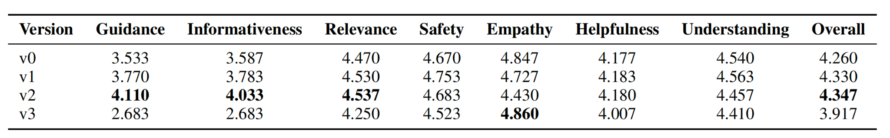
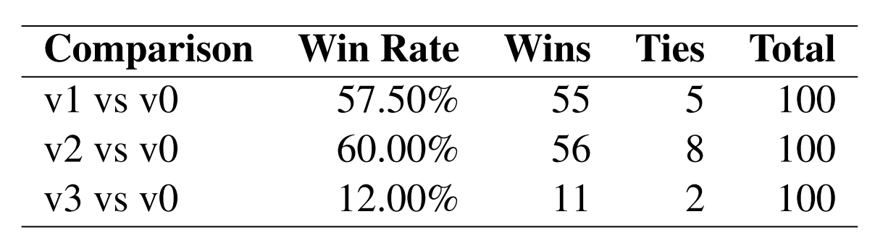
Prompt engineering - Baseline prompt
Setup: Tested 4 prompts (v0 from Badawi et al., 2025 + v1–v3 refinements) using Qwen3-4B, scored with a multi-judge anchored rubric.
Result: v2 achieved the best overall score (4.347), with the strongest gains in Guidance (4.110) and Informativeness (4.033), while remaining competitive on Relevance/Safety (Table 1).
Cross-check & decision: v2 also had the highest win rate vs v0 (60%, 56 wins / 8 ties) (Table 2), so we select v2 as the fixed baseline prompt for all subsequent SFT/GRPO runs.
Table 1: Prompt variant comparison; scores are averaged across multi-judge evaluations.
Table 2: Win-rate against the baseline prompt (v0)

Slide 19
Model optimization - In progress
Pipeline underway: Integrating and tuning QLoRA + RLAIF (GRPO)
Why still in progress: Training and scoring rely on external LLM APIs, so we are optimizing cautiously due to token costs.

Slide 20
05
Limitations

Slide 21
Limitations
Dataset Constraints
AI-generated (No human therapists)
MentalBench Subset (Limited diversity)
Single-turn only — no multi-turn counseling dynamics
Evaluation Constraints
Intra-judge inconsistency (temp=0 helps, doesn't eliminate)
Equal Weighting (Reliability varies by dimension)
Model & Ethical Constraints
4B Capacity Limits
LLM output ≠ professional clinical advice

Slide 22
06
Conclusion & Next Steps

Slide 23
Conclusion
Controlled Baseline Re-established
Disabled Qwen3 "Thinking Mode" (Fixed truncation)
Response length ↔ score: Pearson r = 0.960, p < 0.001 → original baseline unreliable
LLM Jury
3 independent judges, temp=0, mean aggregation
Balanced across: model family diversity, API cost, RPD constraints
Pipeline reproducible, ready for SFT + GRPO
Pipeline Validated
Tested 100 instances / 4 prompts.
v2 selected: Overall 4.347, 60% Win Rate vs. Baseline
Pipeline runs reproducibly

Slide 24
Next steps
Weighted scoring (motivated by ICC findings) → rebuild SFT data if weights change
Small-scale QLoRA pilot → Full RLAIF (GRPO)
3-way: Baseline vs. SFT vs. GRPO
Goal: Does alignment improve Qwen3-4B for mental health dialogue?

Slide 25
Thanks!

