Slide 1




SMART INDIA HACKATHON 2025
HAL / हल (Harvest Advisory with Linguistic intelligence)
Problem Statement ID: SIH25010
Problem Statement Title: Smart Crop Advisory System For Small And Marginal Farmers
Theme: Agriculture, FoodTech & rural development
PS Category: Software
Team ID:
Team Name (Registered on portal):

Slide 2


HAL (Harvest Advisory with Linguistic intelligence)
..
from soil to solutions
by
Detailed Explanation of the Solution
HAL is a multilingual, AI-powered smart crop advisory system for small and marginal farmers.
It integrates Machine Learning, IoT, NLP, climate sensors, and satellite datasets to provide real-time advice.
How It Addresses the Problem
Reduces guesswork: Provides data-driven insights to lower risk and improve yields.
Promotes organic & sustainable farming: Offers soil health monitoring to reduce overuse of chemicals and environmental harm.
Bridges digital & language barriers
Integrated solution: Combines soil–weather–crop–market insights, enabling farmers to make profitable and informed decisions.
The solution is accessible via a low-cost mobile app and voice-enabled chatbot, breaking language and literacy barriers.
By using government APIs (SHC, AI4Bharat, Mandi API), Google APIs, and NASA/ISRO data, HAL ensures scientific, scalable, and sustainable recommendations and provide government scheme that improve both technical efficiency and farmers’ financial outcomes.
Provides hyper-local guidance on soil health, weather, pest management, fertilizer use, and market trends.
Innovation & Uniqueness of the Solution
Unified & Scalable Platform: Integrates sensors + satellites + government APIs + ML for a single, easy-to-use advisory system
Feedback-Driven Self-Learning System: Continuously improves through farmer feedback, increasing accuracy over time.
Low-Cost & Sustainable: Directly connects with government resources, making the solution affordable, scalable, and financially beneficial for farmers.

Slide 3





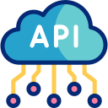





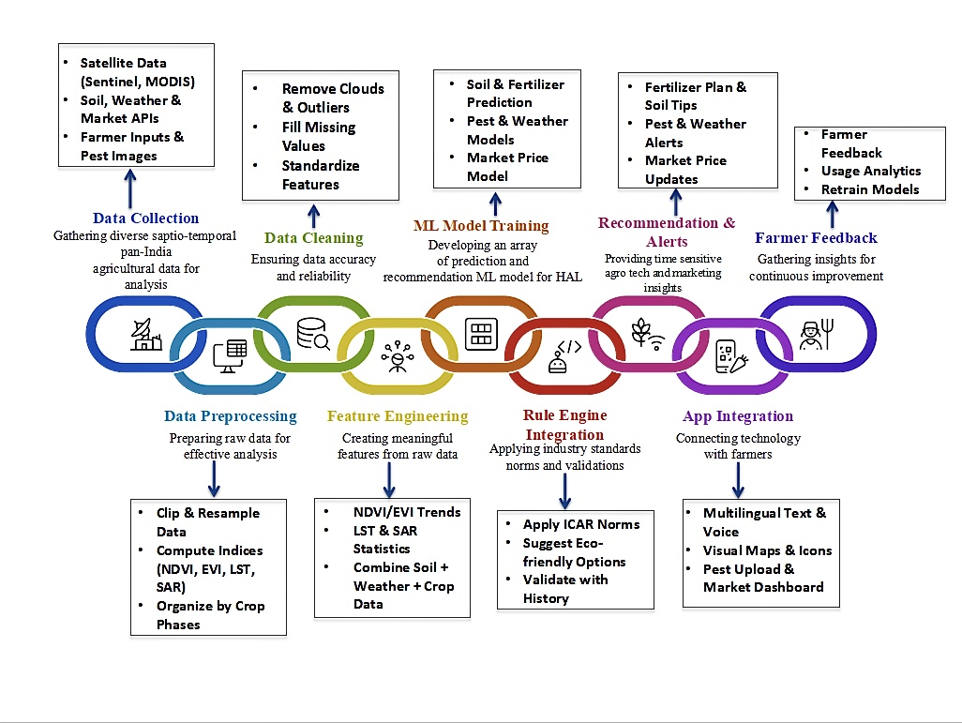





HAL (Harvest Advisory with Linguistic intelligence)
from soil to solutions
Proposed Methodology
by

Slide 4
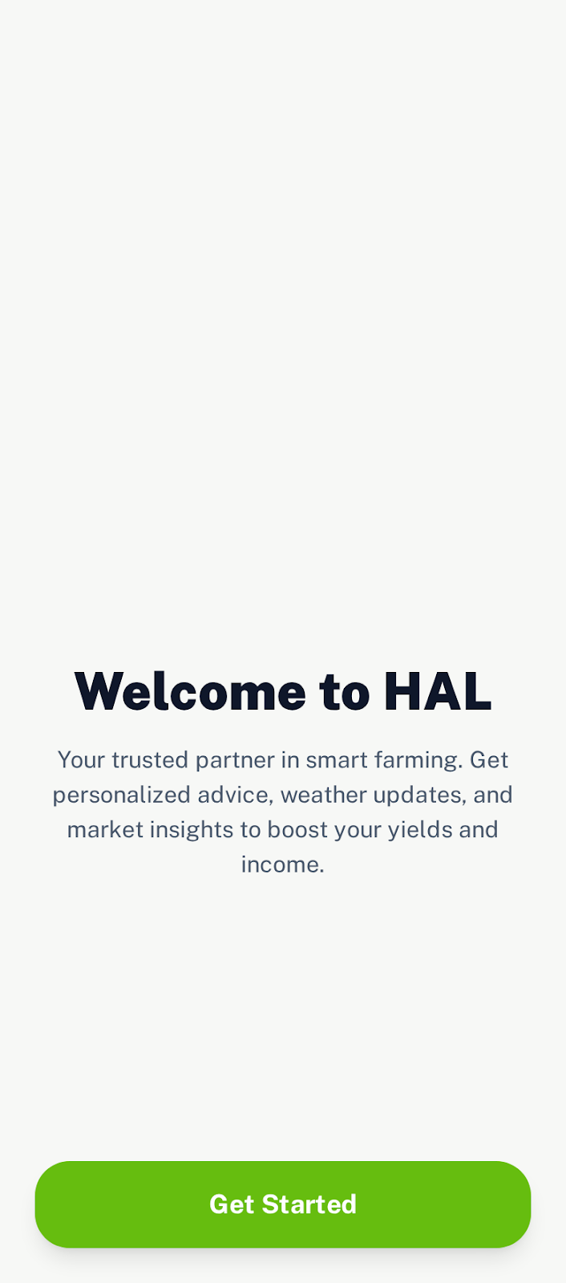
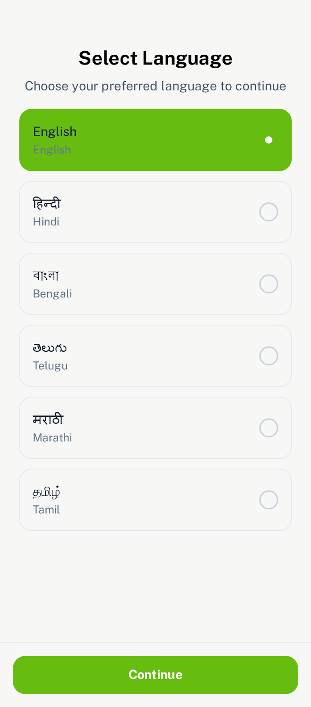
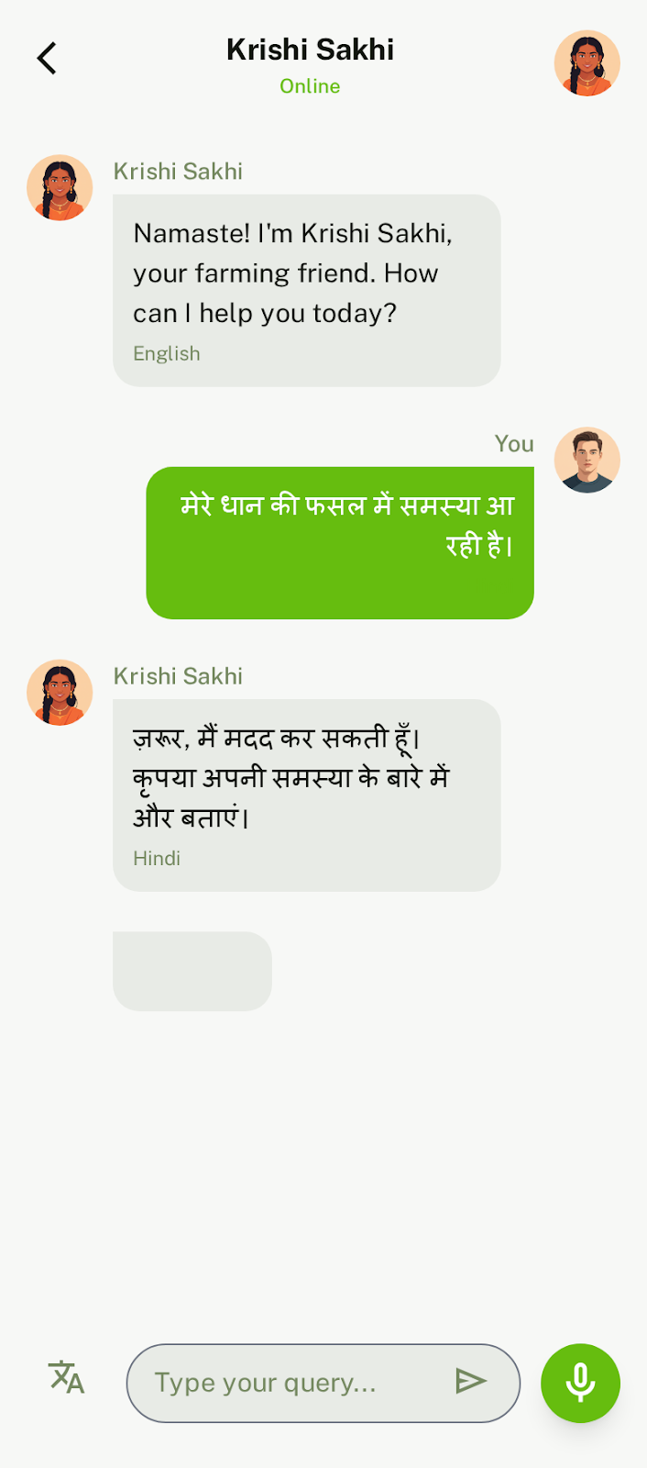
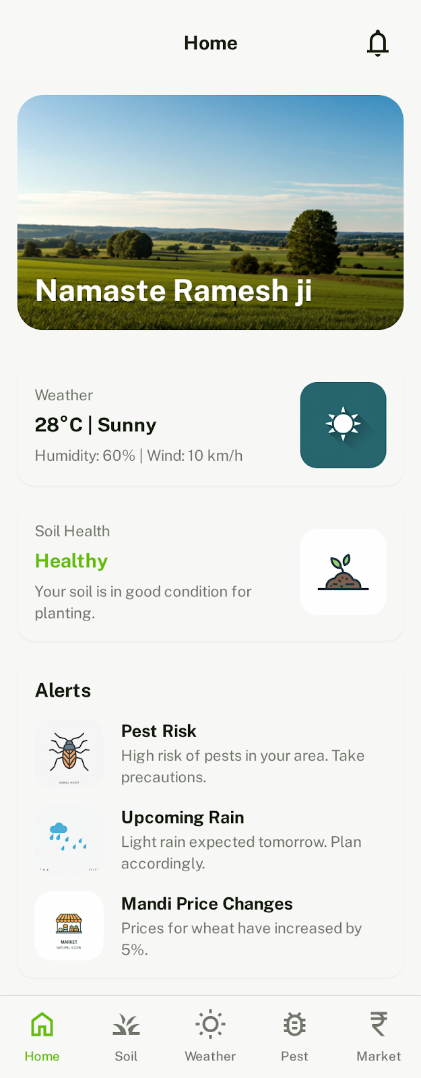
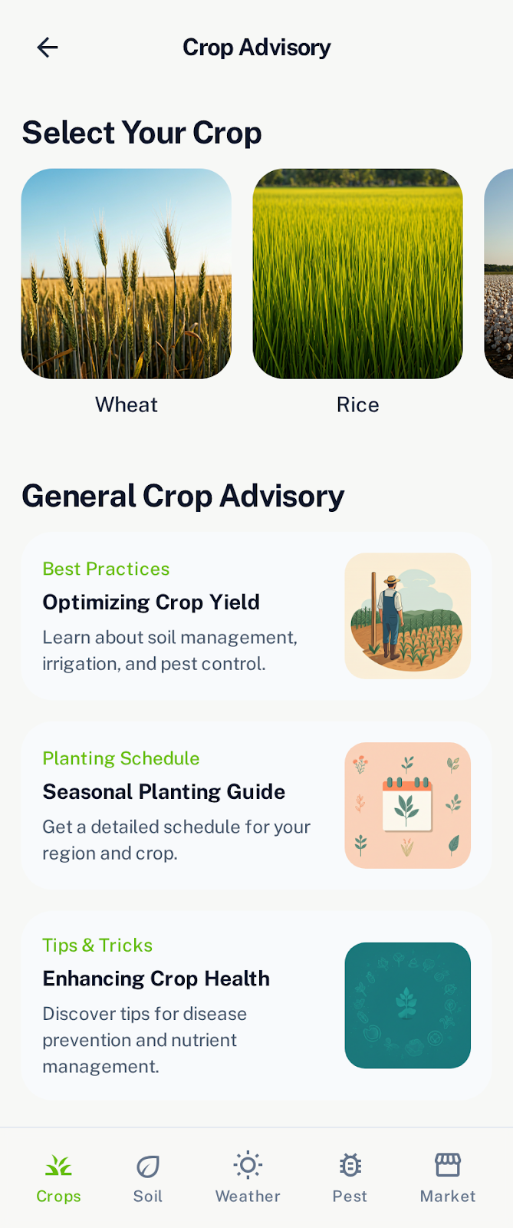
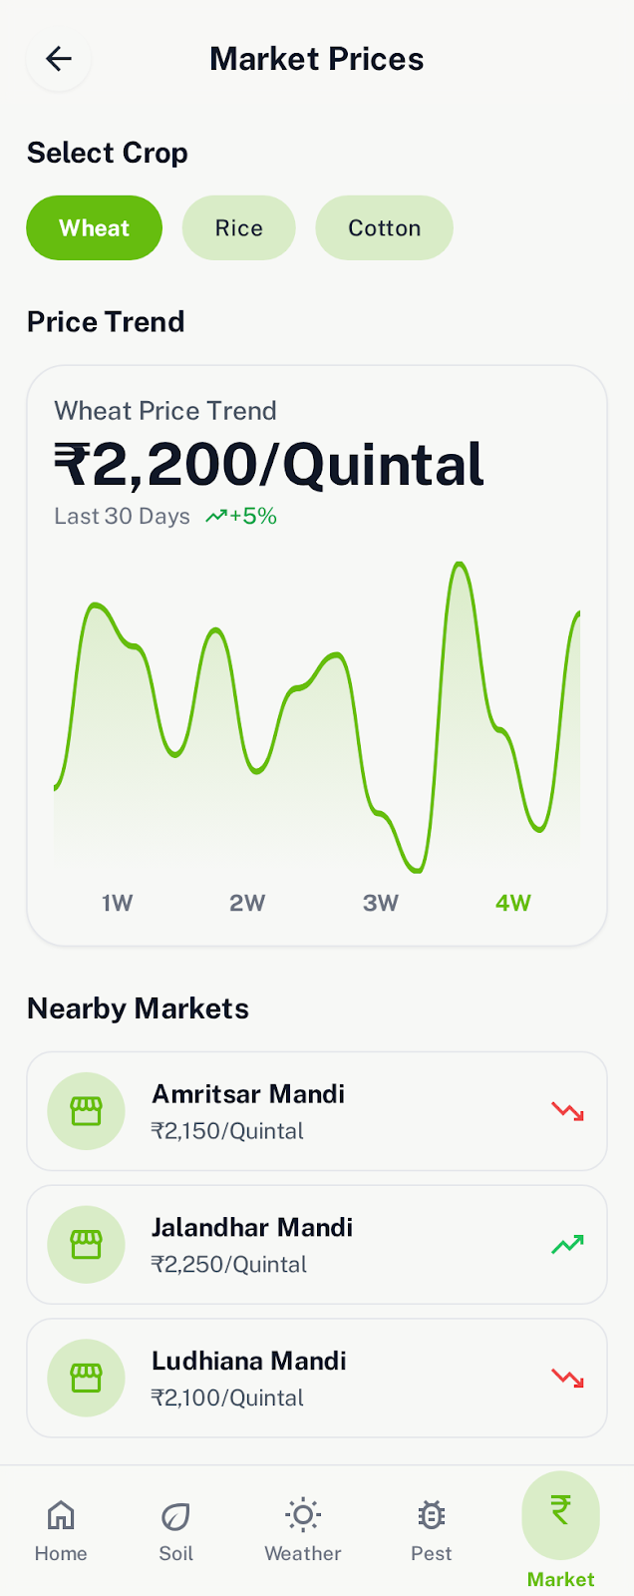

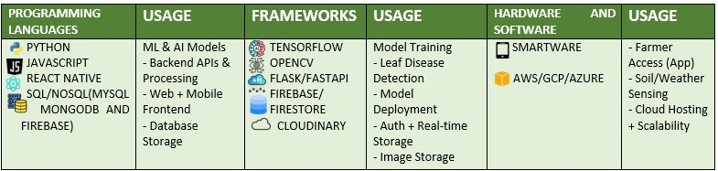
HAL (Harvest Advisory with Linguistic intelligence)
HAL INTERFACE
from soil to solutions
by
TECHNOLOGIES TO BE USED

Slide 5
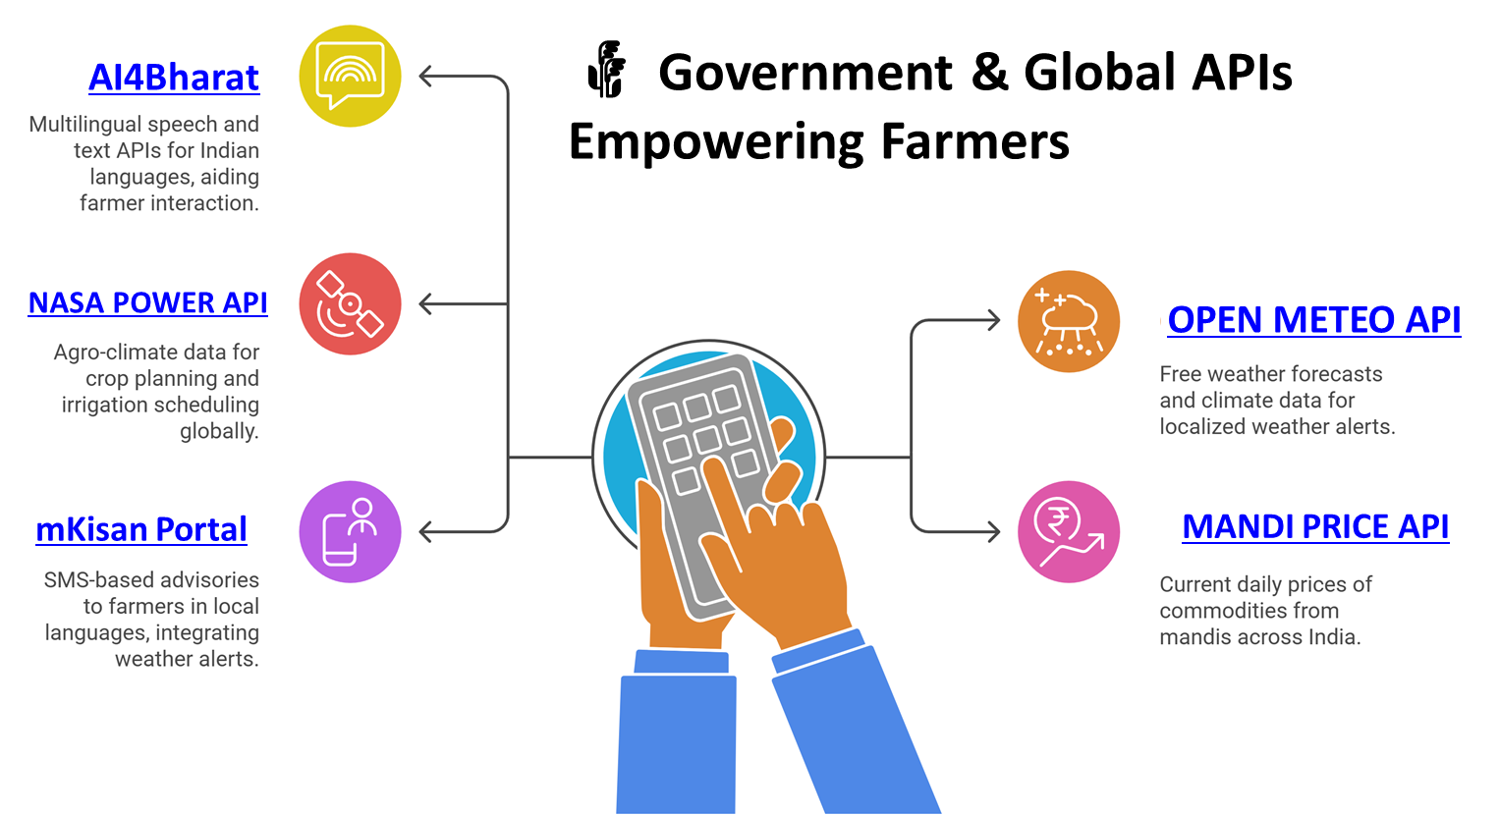
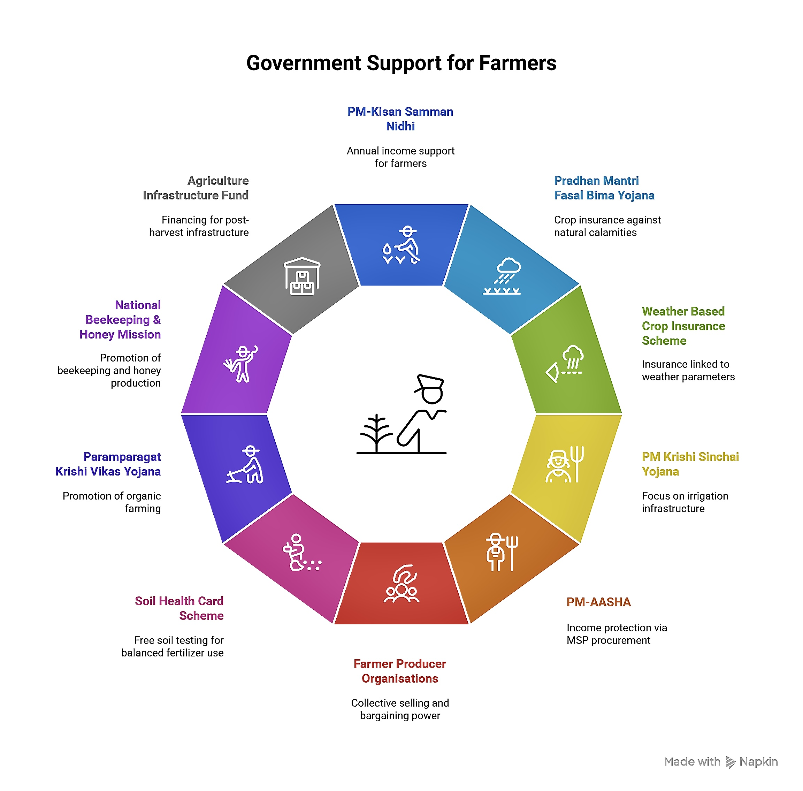
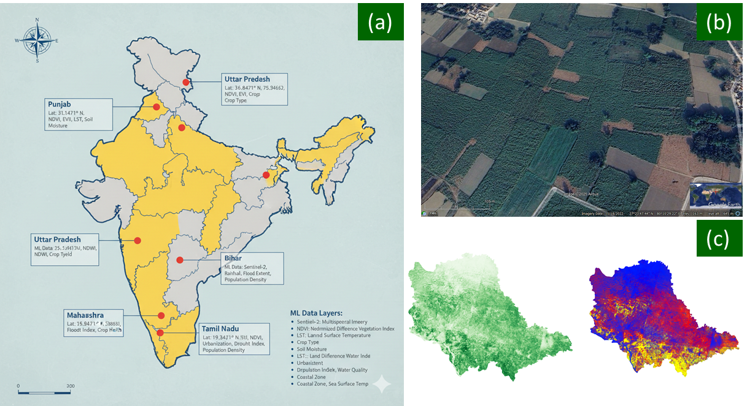
HAL (Harvest Advisory with Linguistic intelligence)
from soil to solutions
by
Fig: (a) Pan- India study area, (b) Google Earth dataset as ground truth and (c) Green-ness (vegetation health) and indices stacking on Sentinel dataset

Slide 6
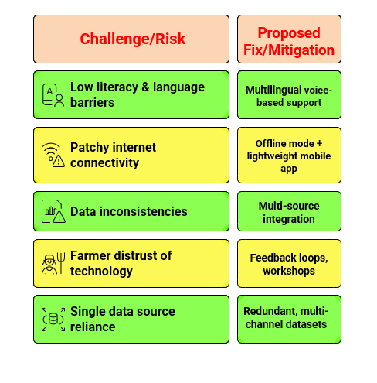
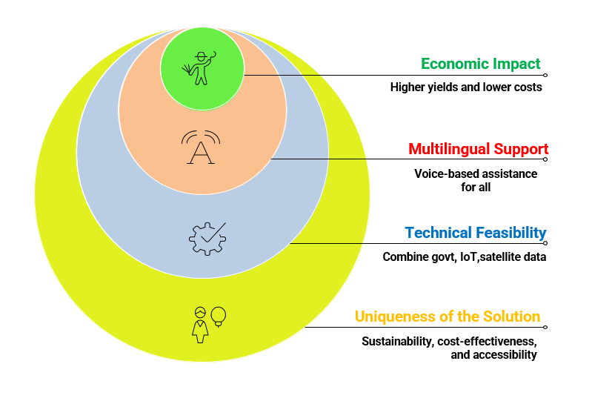
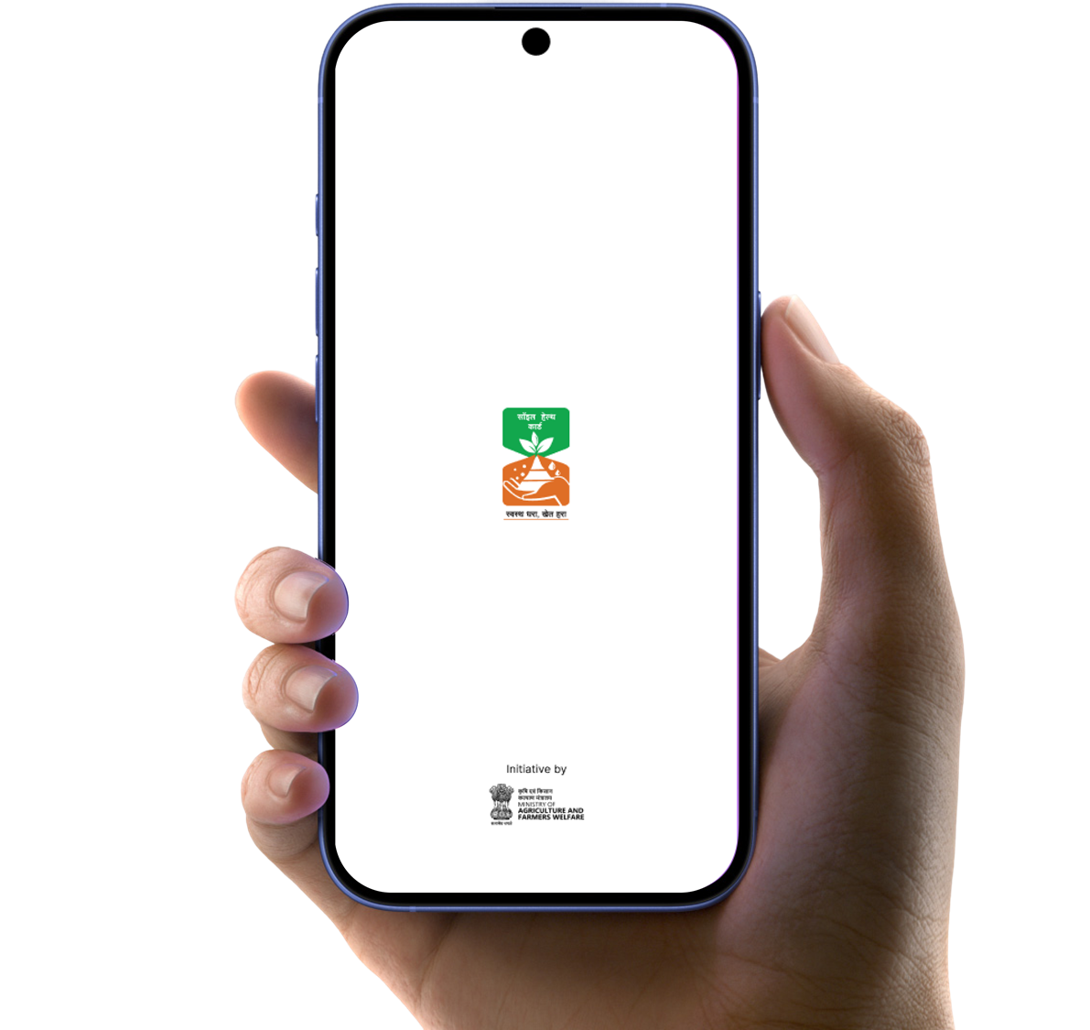

HAL (Harvest Advisory with Linguistic intelligence)
from soil to solutions
by
Challenges and Mitigations
Feasibility and Viability of the Solution

Slide 7
HAL (Harvest Advisory with Linguistic intelligence)
from soil to solutions
by
References, used in the research (in IEEE format):
[1] L. Klerkx, “Advisory services and transformation, plurality and disruption of agriculture and food systems: towards a new research agenda for agricultural education and extension studies,” The Journal of Agricultural Education and Extension, vol. 26, no. 2, pp. 131–140, Mar. 2020, doi: 10.1080/1389224X.2020.1738046.
[2] K. G. Liakos, P. Busato, D. Moshou, S. Pearson, and D. Bochtis, “Machine Learning in Agriculture: A Review,” Sensors, vol. 18, no. 8, Art. no. 8, Aug. 2018, doi: 10.3390/s18082674.
[3] L. Klerkx and J. Jansen, “Building knowledge systems for sustainable agriculture: supporting private advisors to adequately address sustainable farm management in regular service contacts,” International Journal of Agricultural Sustainability, vol. 8, no. 3, pp. 148–163, Aug. 2010, doi: 10.3763/ijas.2009.0457.
[4] M. Molina-Villa and L. Solaque, “Machine vision system for weed detection using image filtering in vegetables crops,” Revista Facultad de Ingeniería Universidad de Antioquia, vol. 2016, Sept. 2016, doi: 10.17533/udea.redin.n80a13.
[5] H. F. Abouziena and W. M. Haggag, “Weed Control in Clean Agriculture: A Review¹,” Planta daninha, vol. 34, pp. 377–392, June 2016, doi: 10.1590/S0100-83582016340200019.
[6] “ENVI® Deep Learning Software | Geospatial Deep Learning Technology.” Accessed: Jan. 11, 2023. [Online]. Available: https://www.l3harrisgeospatial.com/Software-Technology/ENVI-Deep-Learning
[7] C. Reid Turner, A. Fuggetta, L. Lavazza, and A. L. Wolf, “A conceptual basis for feature engineering,” Journal of Systems and Software, vol. 49, no. 1, pp. 3–15, Dec. 1999, doi: 10.1016/S0164-1212(99)00062-X.
References of APIs and resources used:
Open meteo : https://open-meteo.com/
NASA power API : https://power.larc.nasa.gov
Current Daily Price of Various Commodities from Various Markets (Mandi) : https://www.data.gov.in/resource/current-daily-price-various-commodities-various-markets-mandi
Mkisan gov : https://mkisan.gov.in/
Ai4Bharat : https://ai4bharat.iitm.ac.in/

