Slide 2
TSP (Travelling Salesman Problem)
Input: Set of nodes with coordinates x,y (generally in the Euclidean 2D space).
The TSP can be modelled as an undirected weighted graph, such that cities are the graph's vertices, paths are the graph's edges, and a path's distance is the edge's weight.
Objective: Minimize total cost (distance travelled).
Constraints:
    Salesman must return to the starting vertex
    Each other vertex (city) must be visited exactly once

Slide 3
mTSP (multiple Travelling Salesman Problem)
With m Salesmen located at a single depot node, tours must be found for all Salesmen such that each city is visited exactly once.
Objective: Minimize total cost (distance travelled).
Constraints:
    Salesmen must return to the starting “depot” vertex
    Each other vertex (city) must be visited exactly once

Slide 4
FSTSP (Flying Sidekick Travelling Salesman Problem)
With a Truck and a Drone located at a single depot node, a set of customers must be visited exactly once such that their demand fulfilled.
Objective: Minimize total time.
Key Characteristics:
    The two vehicles may depart and return either in tandem or independently
    While travelling in tandem the Drone is transported by the Truck thus conserving energy
    Some customers cannot be served by Drone
    Truck may visit multiple customers while Drone is in flight
    If Drone returns to Depot it’s taken out of service
    Drone is subject to maximum flight endurance

Slide 5
PDSTSP (Parallel Drone Scheduling Travelling Salesman Problem)
With a Truck and a fleet of one or more Drones located at a single depot node, a set of customers must be visited exactly once such that their demand fulfilled.
Objective: Minimize total time.
Key Characteristics:
    Drones serve customers directly from the Depot
    Some customers cannot be served by Drone (demand exceeds Drone’s capacity, parcel requires signature, safe landing space)
    Truck must complete exactly one route and return to the Depot
    (Murray 2015)

Slide 6
MfcmTSP (mixed fleet capacitated multiple Travelling Salesman Problem)
With a Truck, a Motorbike and a Drone in a depot located at the center of the space, serve all customers.
Vehicles can have different speeds
Capacity of vehicles:
    Truck – Infinite
    Motorbike – Arbitrary
    Drone - 1

Slide 7
MfcmTSP (mixed fleet capacitated multiple Travelling Salesman Problem)
Objective: Minimize total makespan i.e.
Constraints:
    Certain edges are inaccessible by specific vehicles (Truck)
    Each vehicle can visit at most as many customers as its capacity before it returns back to the depot
    Not all customers are available for Drone delivery

Slide 8
CVRP (Capacitated Vehicle Routing Problem)
Basic version of the VRP
With a set of K identical vehicles located at a depot node, each vehicle may perform at most one route such that each customer is visited exactly once and their demand is fulfilled
Objective: Minimize total cost
Key characteristics:
    Each customer has a non-negative demand
    Homogenous fleet of vehicles with a capacity C, available at the depot
    Each vehicle may perform at most one route and return to the depot
    Graph must be strongly connected and is generally assumed to be complete (Toth, Vigo 2002)

Slide 9
SDVRP (Split Delivery Vehicle Routing Problem)
Relaxed version of the CVRP
Objective: Minimize total cost
Key characteristics:
    Each customer has a non-negative demand
    Each customer may be visited any number of times
    Cost savings up to 50% compared to the CVRP (Archetti et al. 2006)

Slide 10
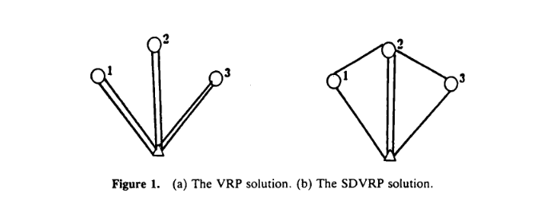
SDVRP (Split Delivery Vehicle Routing Problem)
Example with 3 customers with a demand of 3,4,3 respectively, and a depot with 3 vehicles with a capacity of 5 (Dror 1990)

Slide 11
VRP-D (VRP with Drones)
Objective: Minimize total cost
Given a fleet of homogenous Trucks, each of them equiped with a single Drone, visit each customer exactly once while fulfilling their demand
Extension of the FSTSP (multiple vehicles, demand, Truck time limit)
Key characteristics:
    A time cost is associated with the launch and recovery of the Drone, as well as a service time for the customers
    Drone has a maximum flying endurance due to battery capacity
    The Truck routes must not exceed a certain time limit
    Capacity/Demand measured in kg; Drone’s capacity = 5
    (Sacramento 2019)

Slide 12
FSMVRP (Fleet Size and Mix VRP)
Objective: Minimize total cost
Determine the amount of vehicles of different types (fleet) needed such that to visit every customer exactly once while fulfilling their demand
Key characteristics:
    Infinite supply of each vehicle type is available
    Each vehicle type has a fixed capacity and a fixed (leasing) cost
    Variable cost for each vehicle is equal to distance traveled (independent of vehicle type)
    Each vehicle may perform at most one route
    (Golden et al. 1984)

Slide 13
MDVRP (Multi-Depot Vehicle Routing Problem)
Objective: Minimize total cost
With a set of K identical vehicles located at multiple depot nodes, each vehicle may perform at most one route such that each customer is visited exactly once and their demand is fulfilled
Key characteristics:
    Two or more depots, each having their own subset of vehicles for which they serve as a starting and ending point
    Each depot has the same number of vehicles
    Homogenous fleet; all vehicles are identical, same capacity
    Each vehicle may perform at most one route

Slide 14
MDHVRP (Multi-Depot Heterogenous VRP)
Objective: Minimize total cost
Key characteristics:
    Known number of different vehicle types
    Each depot has a known number of different types of vehicles and product
    Each vehicle may perform at most one route and end at its depot

Slide 15
MDFSM (Multi-Depot Fleet Size and Mix)
Objective: Minimize total cost
Simultaneously determines the allocation of customers to depots, the formation of the vehicle routes and the composition of the vehicle fleet for each and all depots (Salhi 1997)
Key characteristics:
    Known number of vehicle types
    Unrestricted number of vehicles per type; is a decision variable
    Each depot has unlimited capacity
    Vehicles with known capacities and fixed and variable costs; which increase with vehicle capacity
    Each vehicle may perform at most one route and start and end at the same depot

Slide 16
MDVRP-D (MDVRP with Drones)
Objective: Minimize duration i.e. minimize the longest route
Extension of the VRP-D
Key characteristics:
    Each depot contains one Truck which is equipped with a single Drone
    Trucks as well as Drones can be heterogeneous
    Each customer has a delivery service time associated with each vehicle
    Each Drone has a launch and recover time cost
    Trucks have a maximum route duration constraint
    Drones have a maximum flight endurance constraint (launch to recovery)

Slide 17
NEW MD-mfcmTSP (Multi-Depot mfcmTSP)
Objective: Minimize makespan i.e.
Makespan for each vehicle type K is equal to the max makespan that is produced by routes made with vehicles K from each depot containing vehicles K
Key characteristics:
    Each depot must have at least one vehicle of any vehicle type
    Composition of each depot’s fleet is known
    Depots act as a start, end and reload point for their vehicles
    Each vehicle may perform unlimited routes (multi-trip)
    Not every customer can be visited by Trucks and Drones, but every customer can be visited by Motorbikes

Slide 18
 | Multiple Vehicles at each Depot (except Drones) | Multiple Depots | Drone use | Multi-Trip | Time limit per route
mTSP | YES | NO | NO | NO | NO
FSTSP | NO | NO | YES | NO | YES
PDSTSP | NO | NO | YES | Truck NO | YES
mfcmTSP | YES | NO | YES | YES | NO
CVRP | YES | NO | NO | NO | NO
SDVRP | YES | NO | NO | NO | NO
VRP-D | NO | NO | YES | NO | YES
MDVRP | YES | YES | NO | NO | Maybe
MDHVRP | YES | YES | NO | NO
MDVRP-D | NO | YES | YES | NO | YES
MD-mfcmTSP | YES | YES | YES | YES | NO

Slide 19
How the MD-mfcmTSP compares
Capacitated vehicles (CVRP)
Multiple Depots with a Heterogeneous Fleet (MDHVRP)
Drone usage (PDSTSP)
Multi-trip (mfcmTSP)
Customer demand?
    1 parcel (mfcmTSP, FSTSP, PDSTSP)
    Measured in kg (VRP)

Slide 20
MDVRP to MD-mfcmTSP
Extension of homogeneous fleet to heterogeneous
Restriction of one route per vehicle relaxed
Limited stock at each Depot relaxed, is a decision variable in the MD-mfcmTSP
Restricted vehicle access to customers

Slide 21
Comparison
 | Customer restrictions | Multi-Trip | Depot Product Bound | Fixed vehicle costs | Customer Demand | Objective
MDVRP | NO | NO | YES | NO | weight
MD-mfcmTSP | YES | YES | NO | NO | 1 | Min time
MDHVRP | NO | NO | YES | YES | weight | Min cost
MDFSM | NO | NO | NO | YES | weight | Min cost

Slide 22
MD-mfcmTSP Results
Instances to test the MD-mfcmTSP heuristic were created, by altering the Cordeau VRP instances such that
  Each customer has a demand equal to 1
  Accessibility of each customer was added as followed;
      80% chance to be available for delivery by Truck
      100% by Motorbike
      85% by Drone
  Each depot has 1 Truck with capacity 8, 1 Motorbike with capacity 3 and 1 Drone with capacity 1 available, while having equal speed

Slide 23
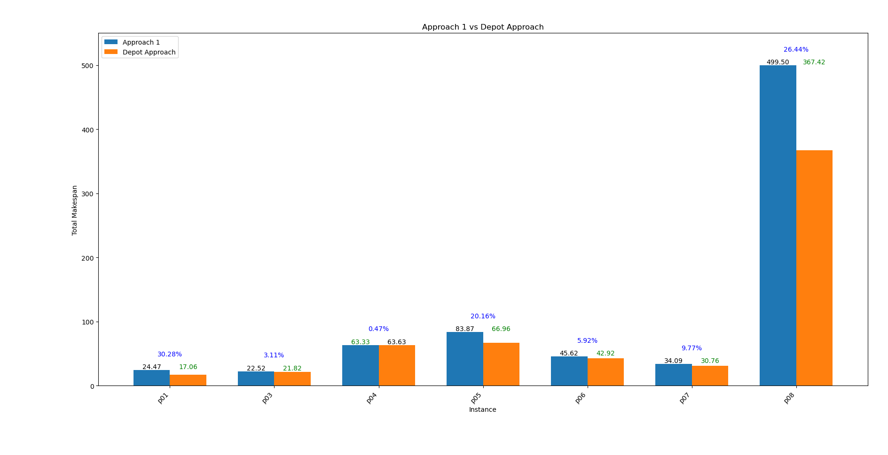

Slide 24
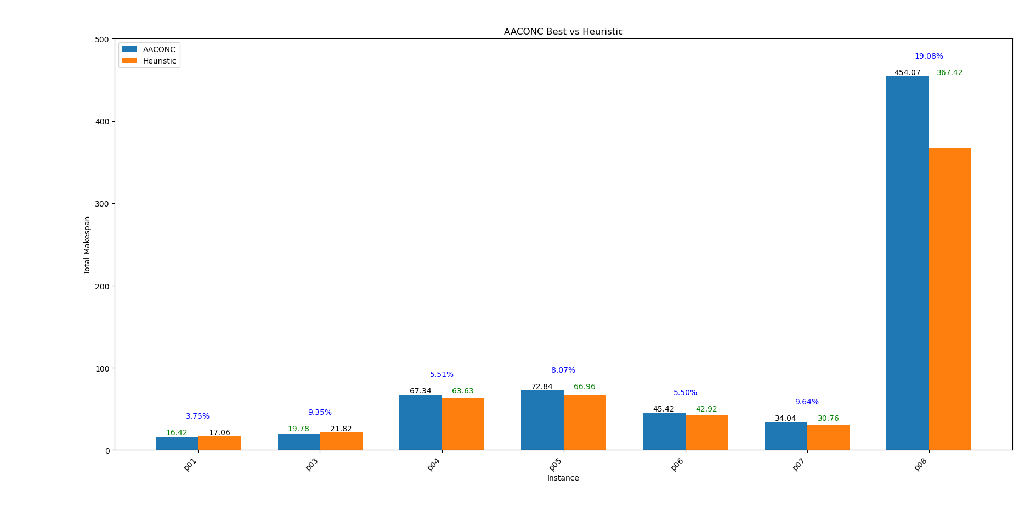

Slide 25
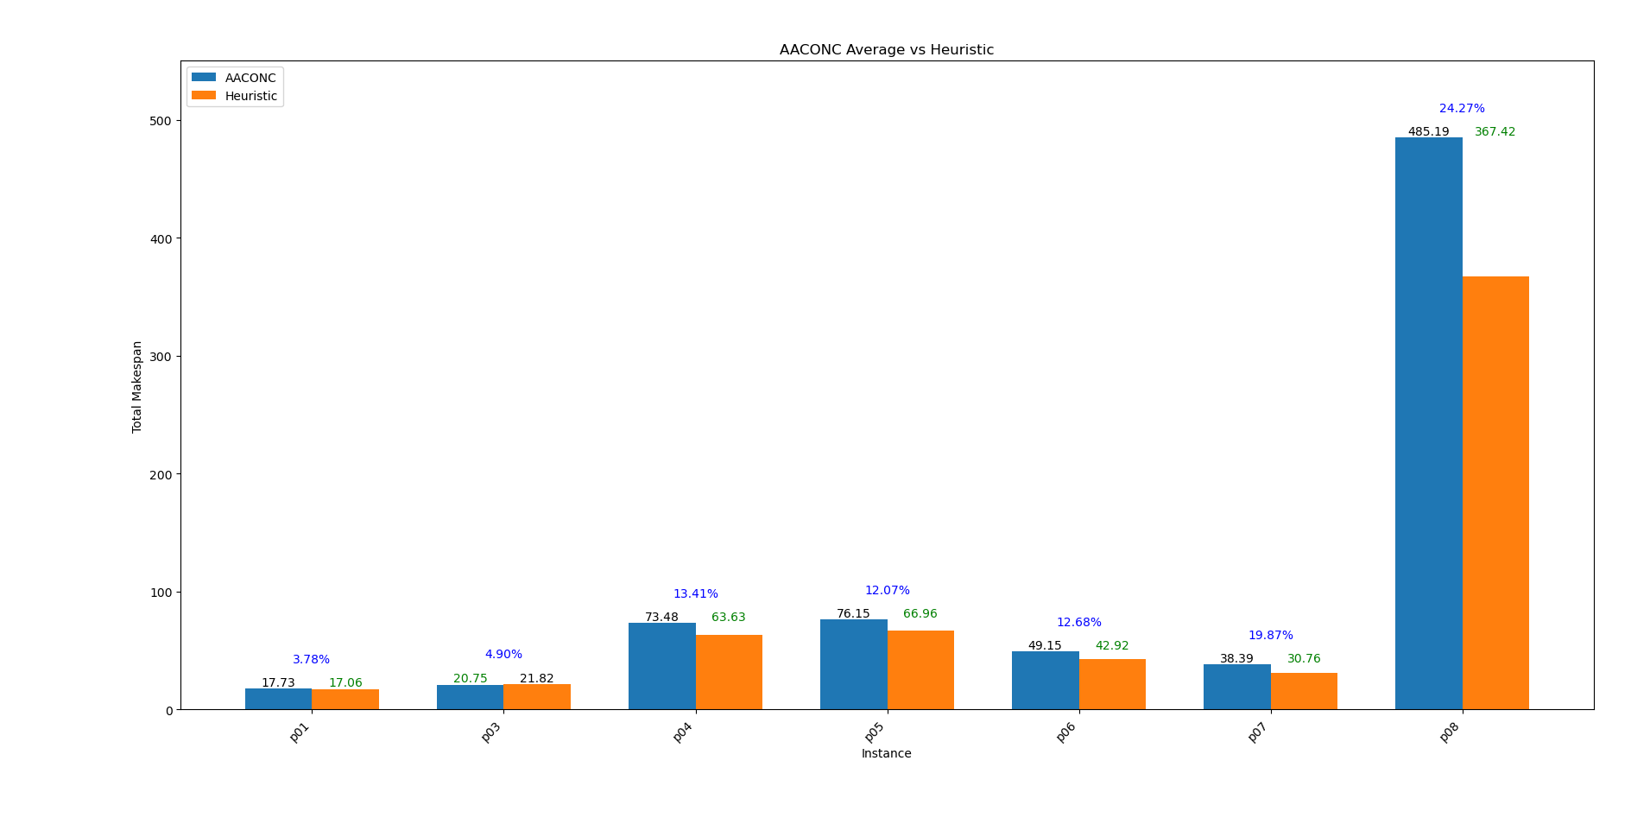

Slide 26


Slide 27
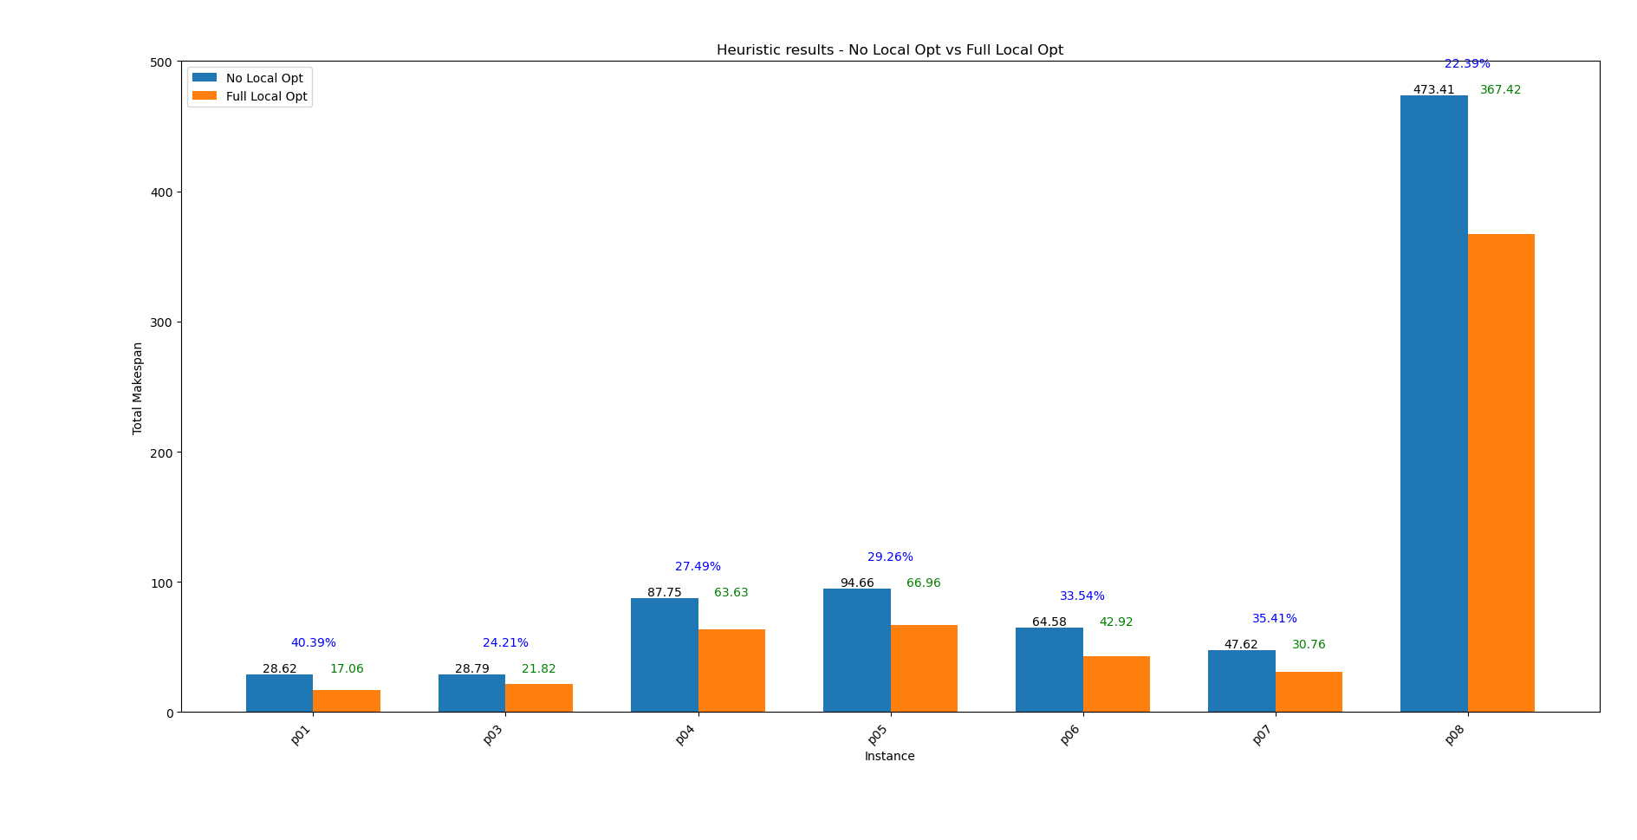

Slide 28
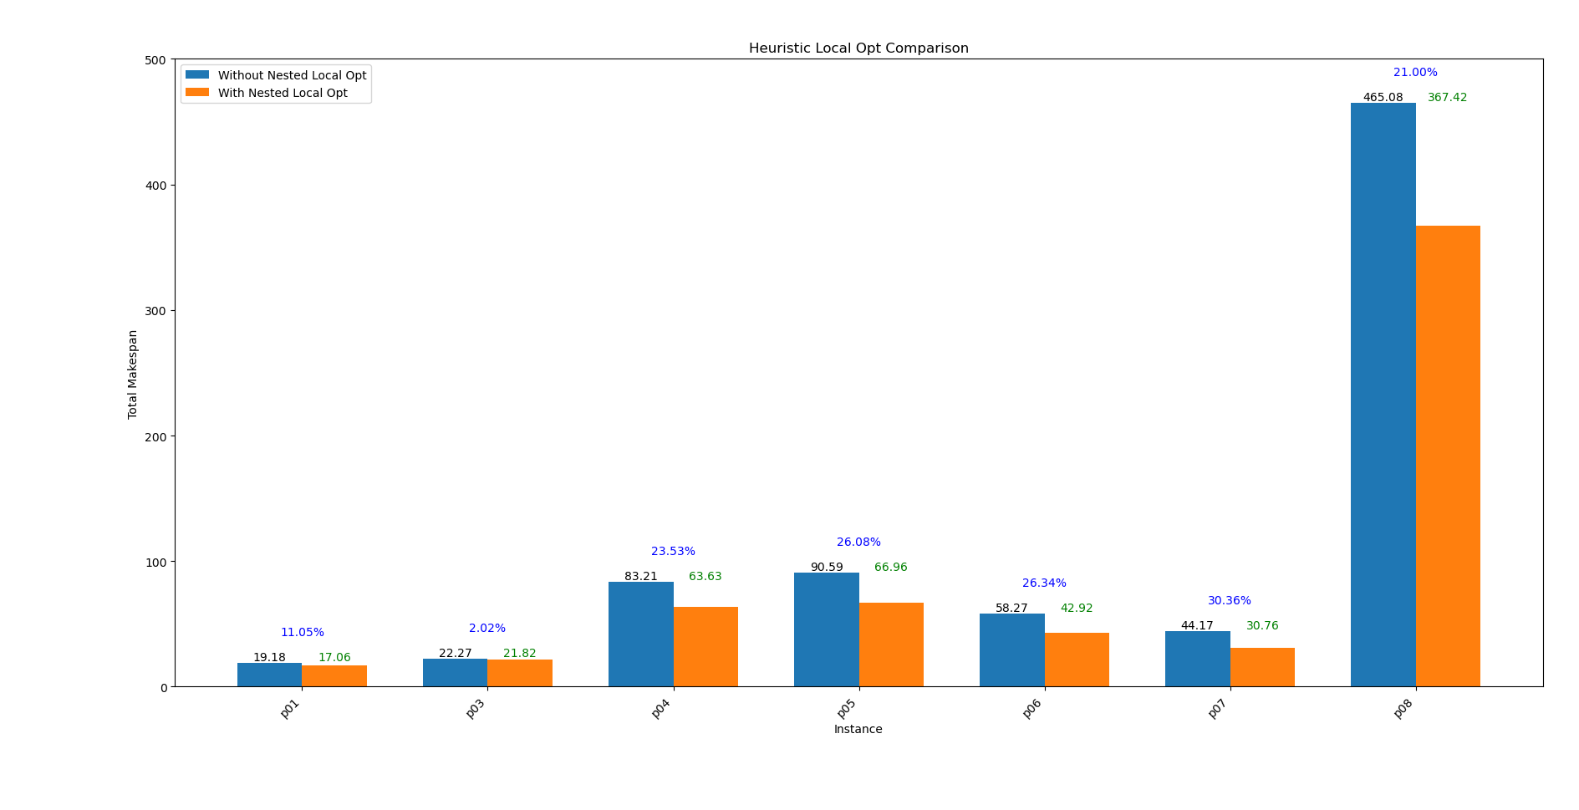

Slide 29
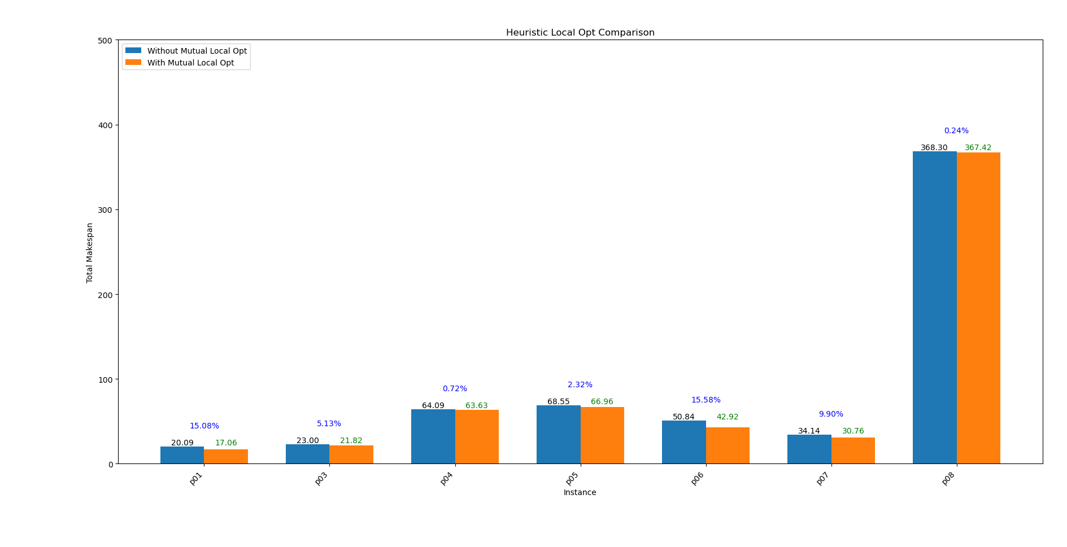

Slide 30
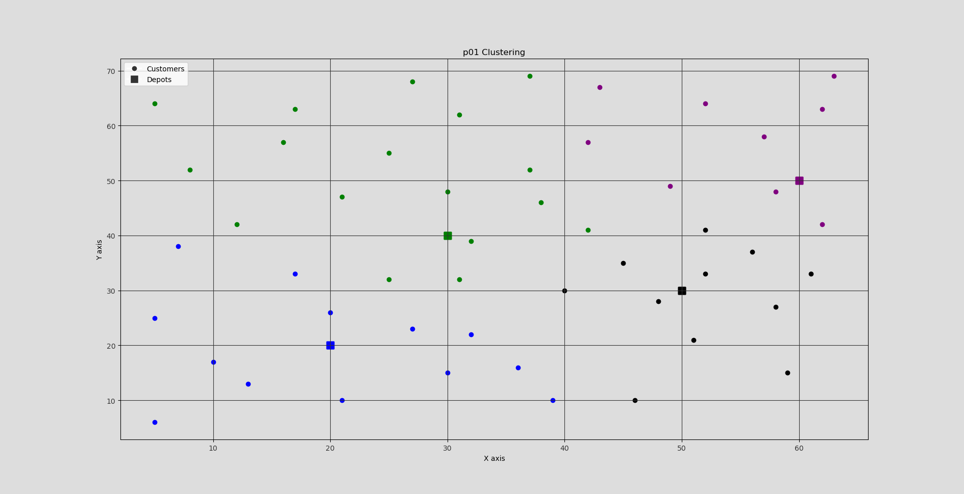

Slide 31
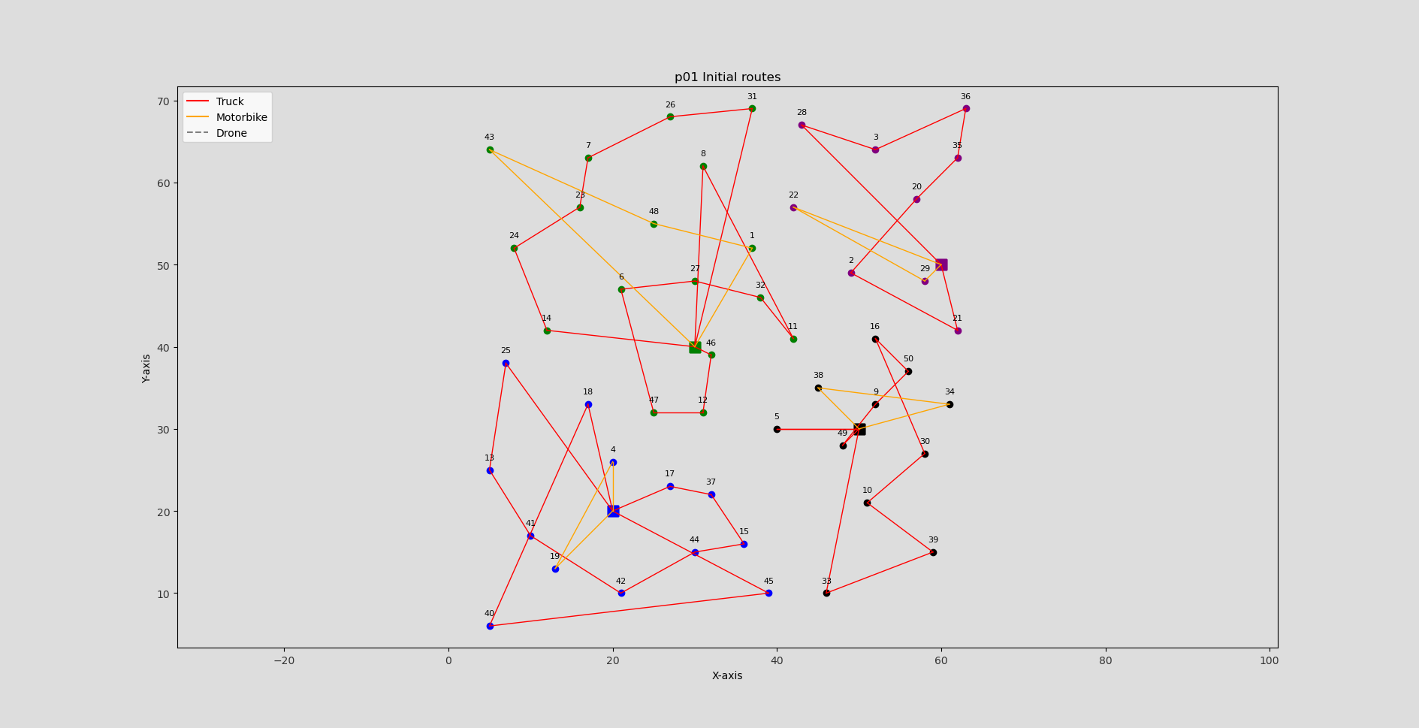
Total Makespan: 39.15

Slide 32
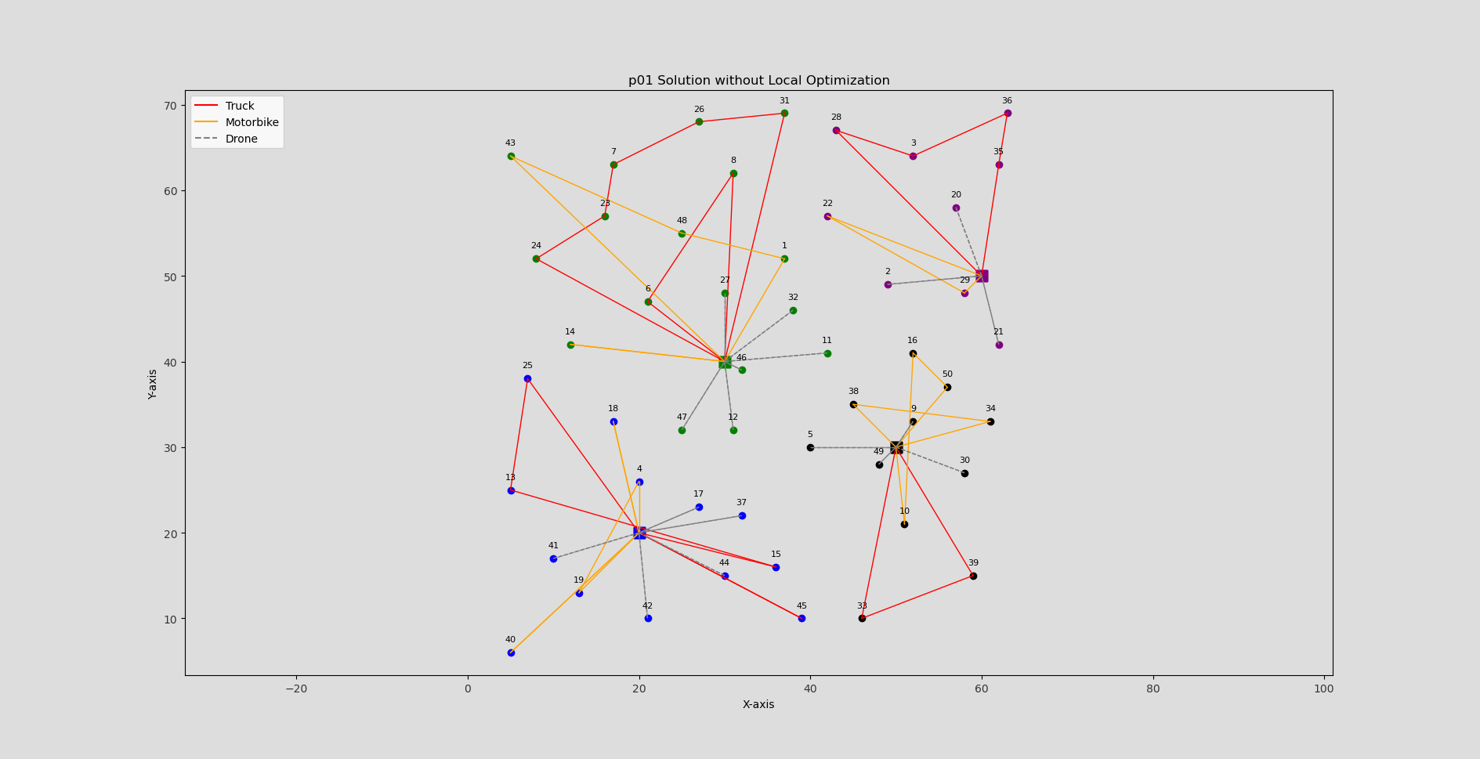
Total Makespan: 28.62

Slide 33
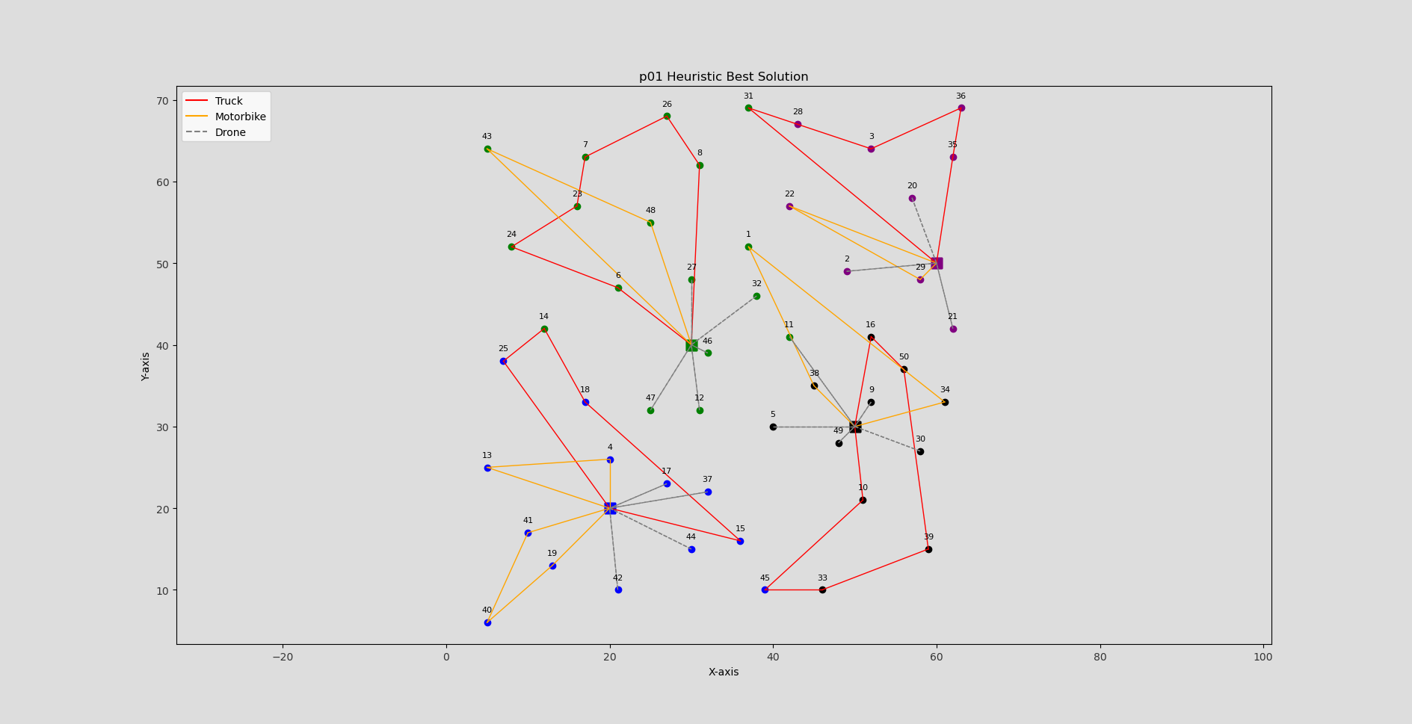
Total Makespan: 17.06

Slide 34
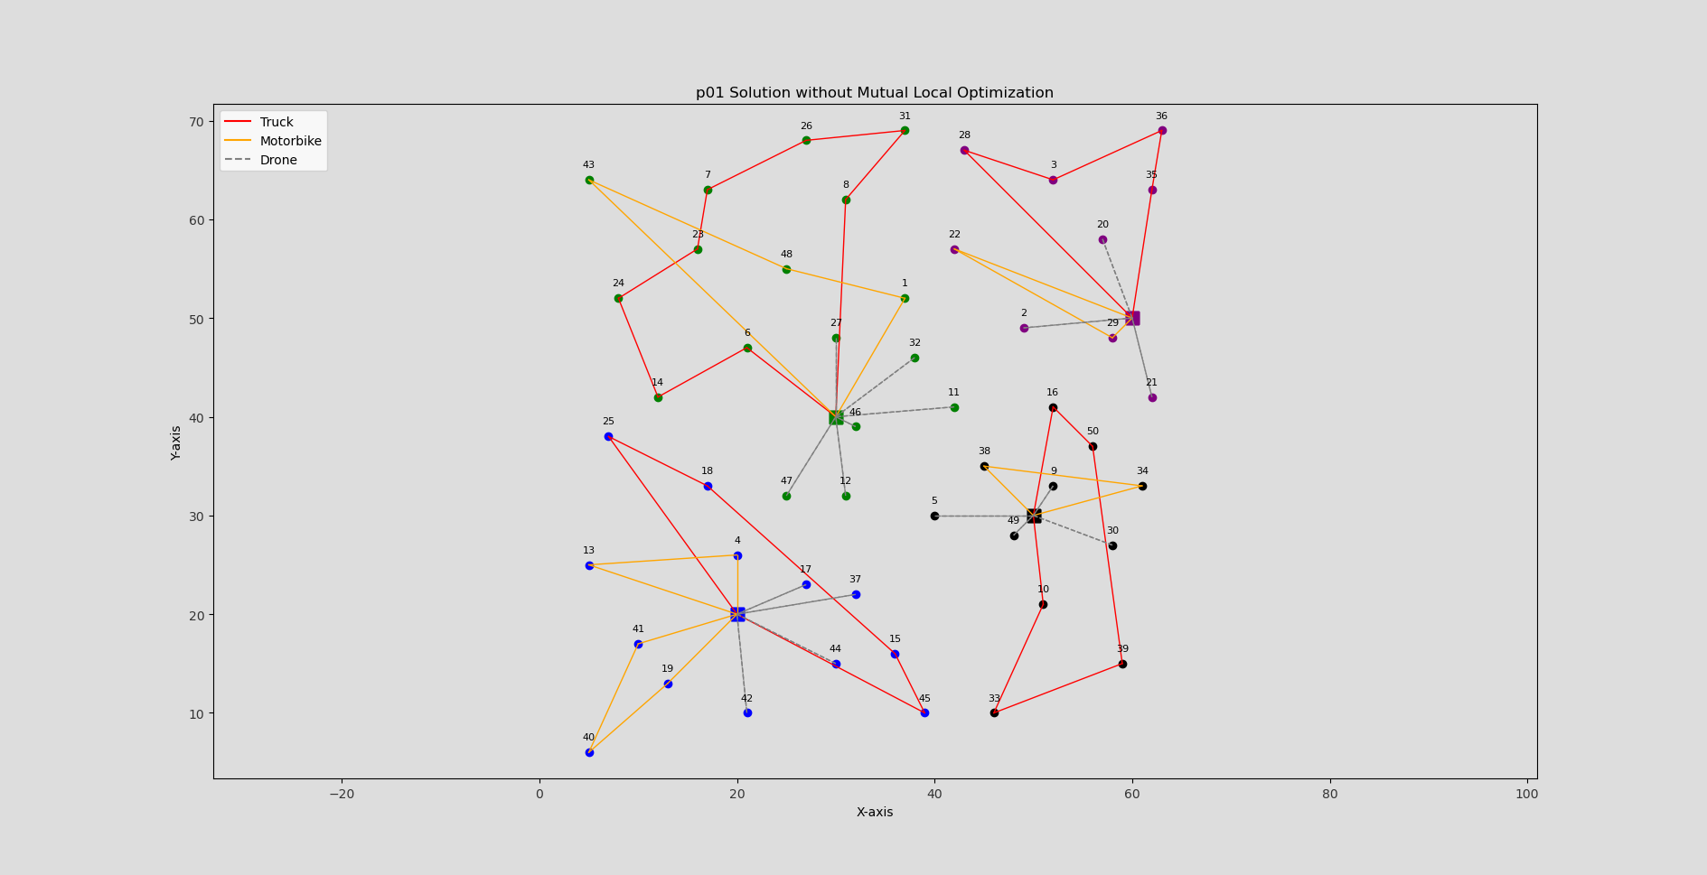
Total Makespan: 20.09

Slide 35
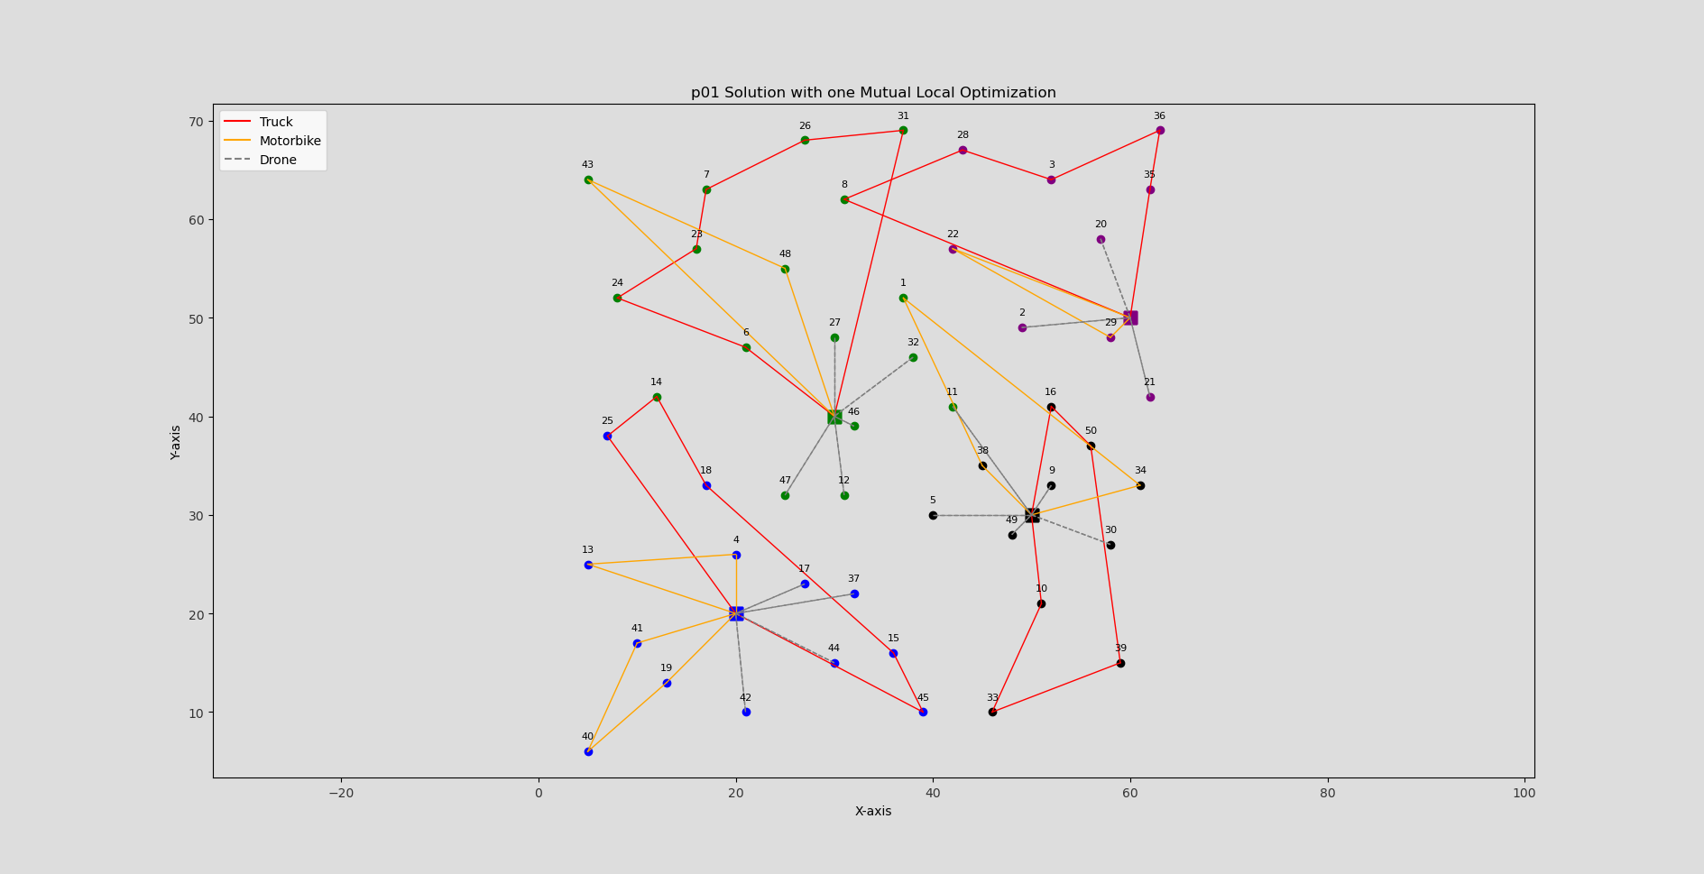
Total Makespan: 18.52

Slide 36

Total Makespan: 19.18

