Slide 1
SUMMER GETAWAY PLAN
javierto, Erwin
Quiroga, abegail
Carillo, mary fretch
Embudo, mary jane

Slide 2
Functional Requirements
The user can input budget for vacation
The user can determine/know where his/her budget vacation belong
Allows user to book for a vacation

Slide 3
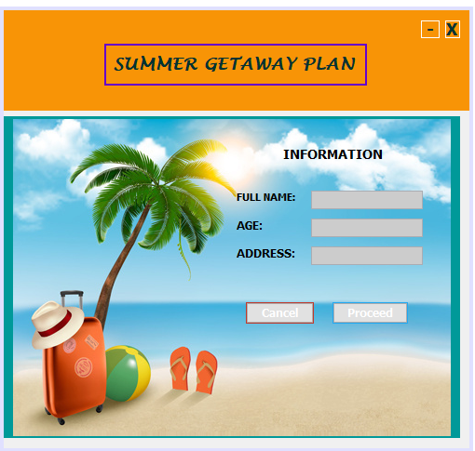

Slide 4
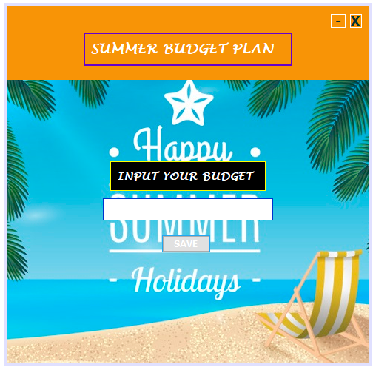

Slide 5


Slide 6
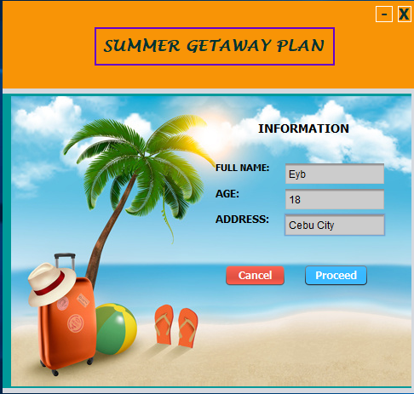
EXAMPLE
Step 1

Slide 7
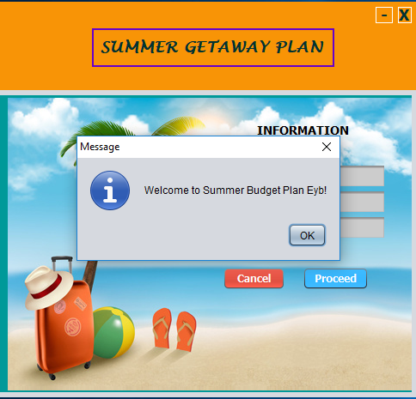
Step 2

Slide 8
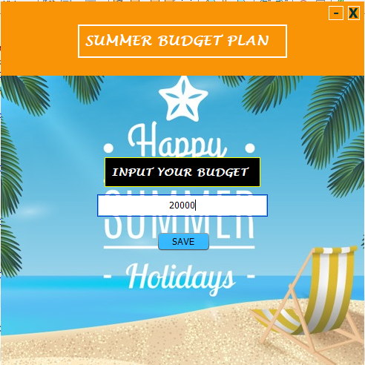
Step 3

Slide 9
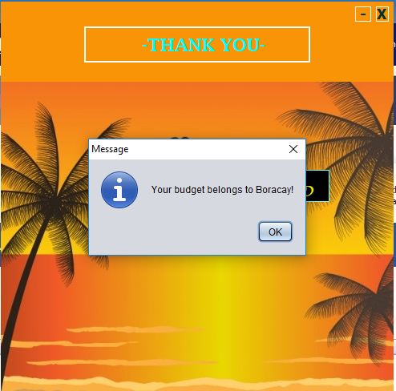
Step 4

Slide 10
Step 5

