Slide 1
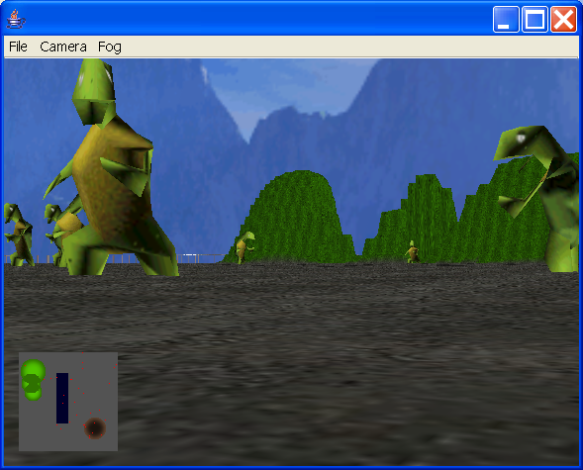
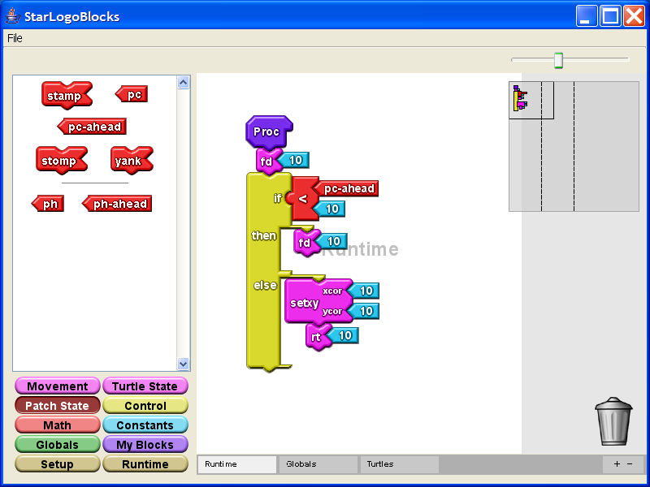
StarLogo TNG
Eric Klopfer (klopfer@mit.edu)
MIT Teacher Education Program
Andrew Begel (abegel@cs.berkeley.edu)
UC Berkeley, Computer Science

Slide 2
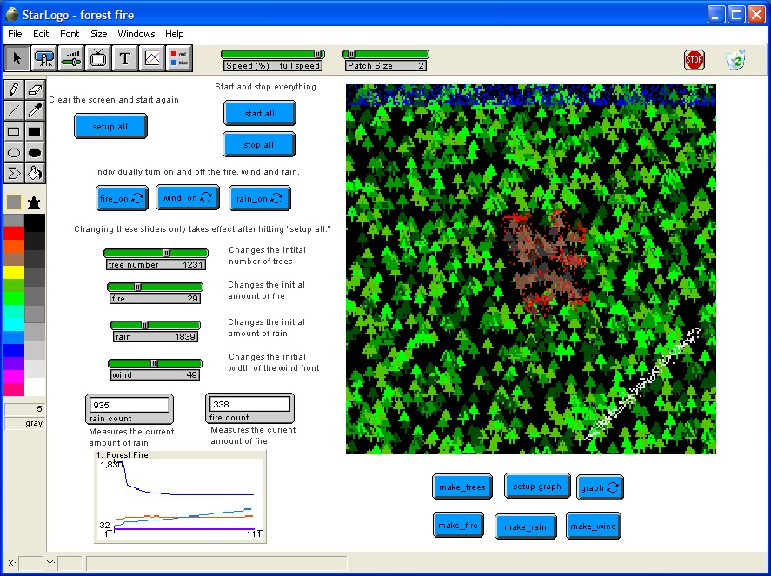
Platforms for Simulating Complex Systems
StarLogo
Users create simulations by writing simple rules for individual “creatures”
No sophisticated mathematics or programming required
Opportunity to explore emergent and complex systems

Slide 3
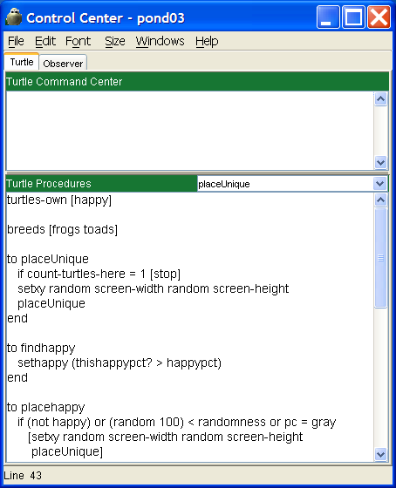
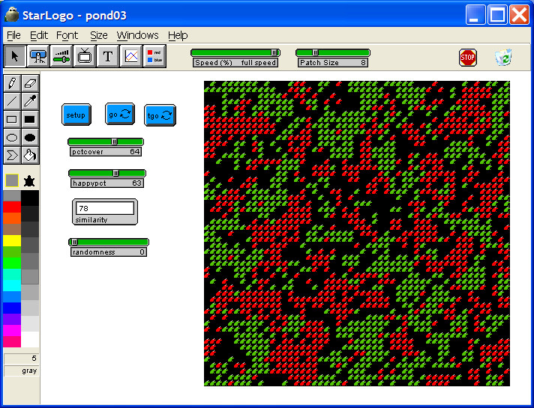
Example
Pond
Frogs and Toads
Happy when % similar around
Move when unhappy

Slide 4
StarLogo History
Originally created by Mitchel Resnick @ MIT on parallel Connection Machine 2
Port to PCs Required “Pseudo-Parallel” Implementation
Brought to Macintosh - 1994
Brought to Java - 1999
Continued development at MIT to make modeling accessible to more students

Slide 5
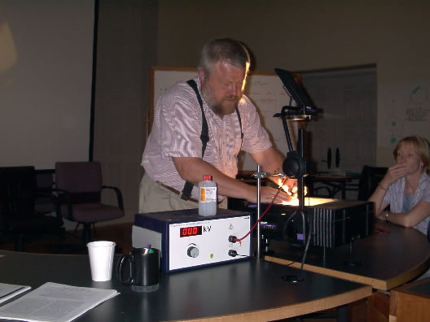
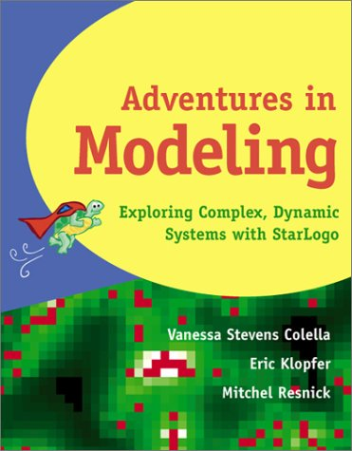
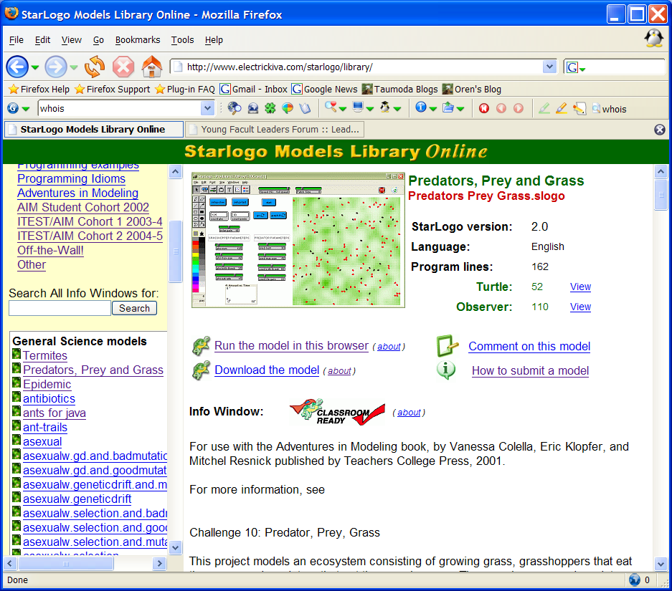
Learning About Complex Systems
Collaboration between MIT and the Santa Fe Institute
Learning by creating
For teachers and/or students
NSF Supported ITEST Project

Slide 6
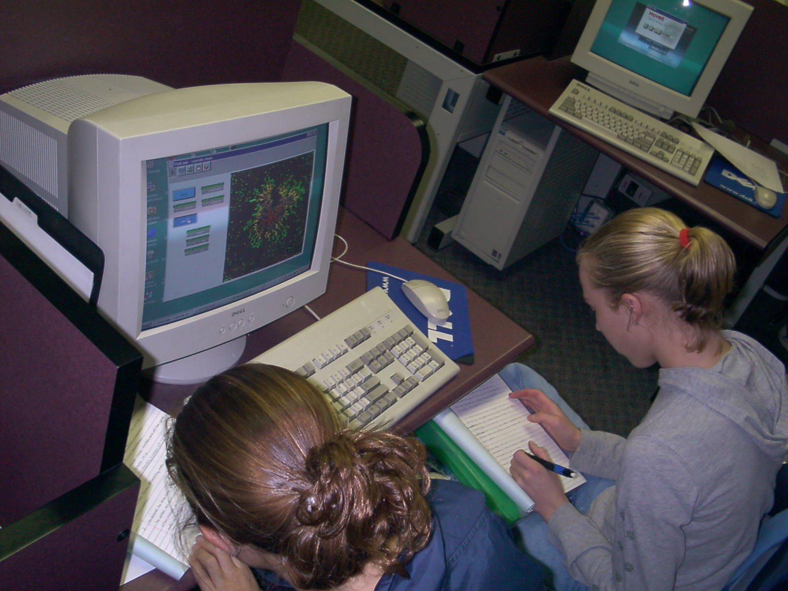
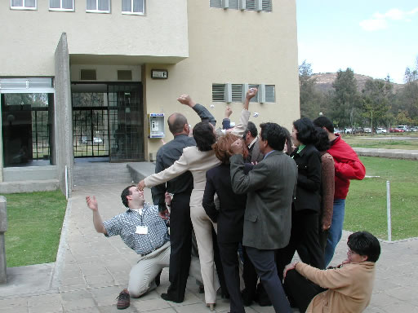
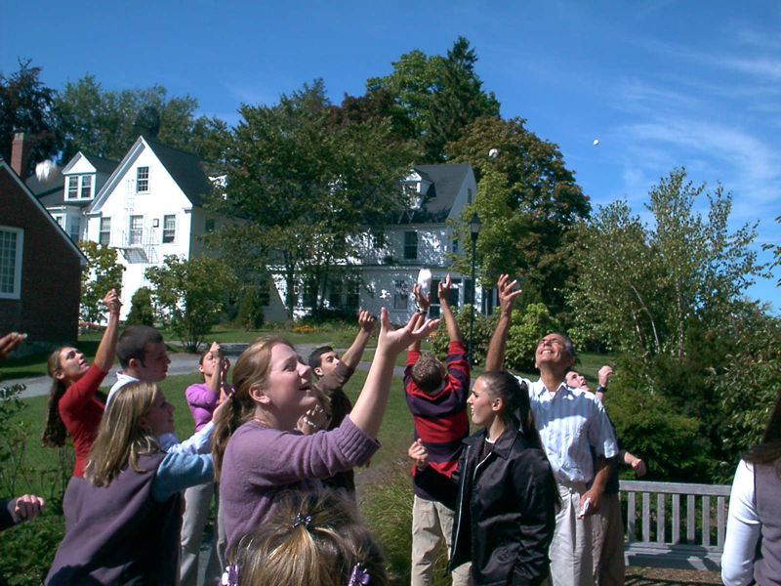
Where is this Used?
Middle School ⇒ Grad School
Teacher Training
Informal Learning (Museums)
New England, New Mexico, Mexico…
Single Labs ⇒ Whole Courses

Slide 7
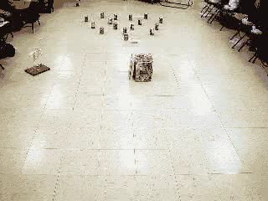
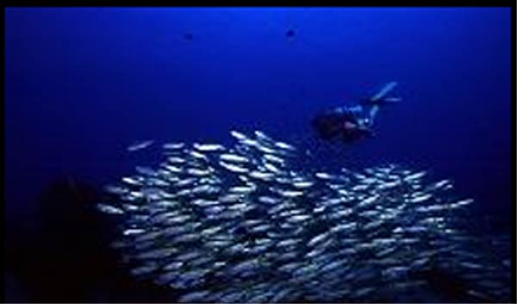
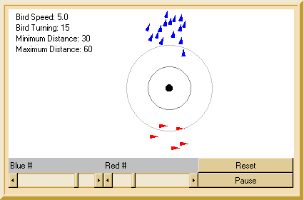
Learning about…
Complex Systems

Slide 8
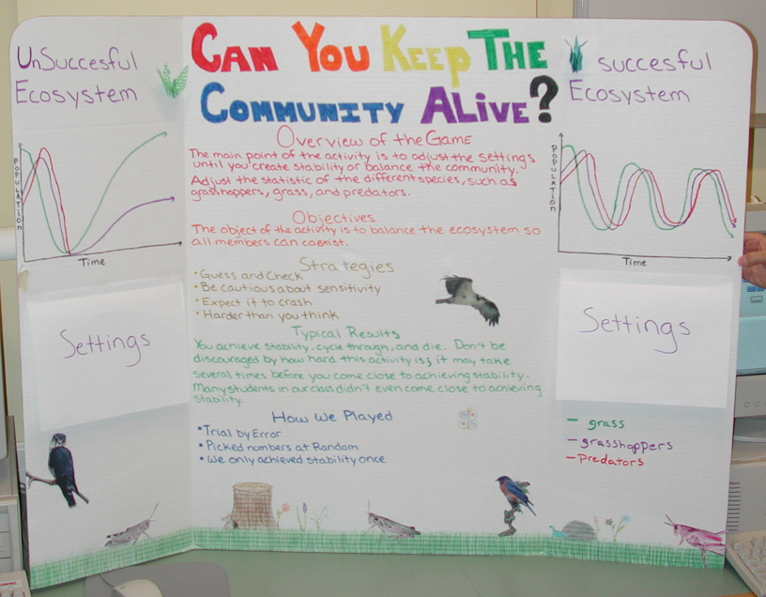
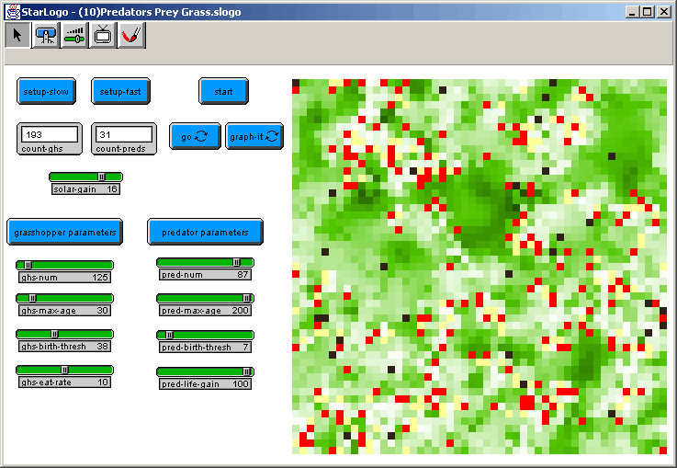
Learning about…
Simulations and the Scientific Method

Slide 9
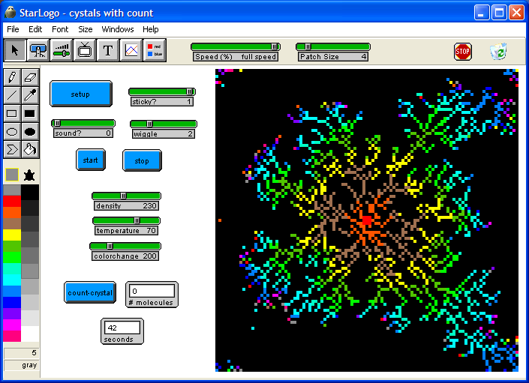
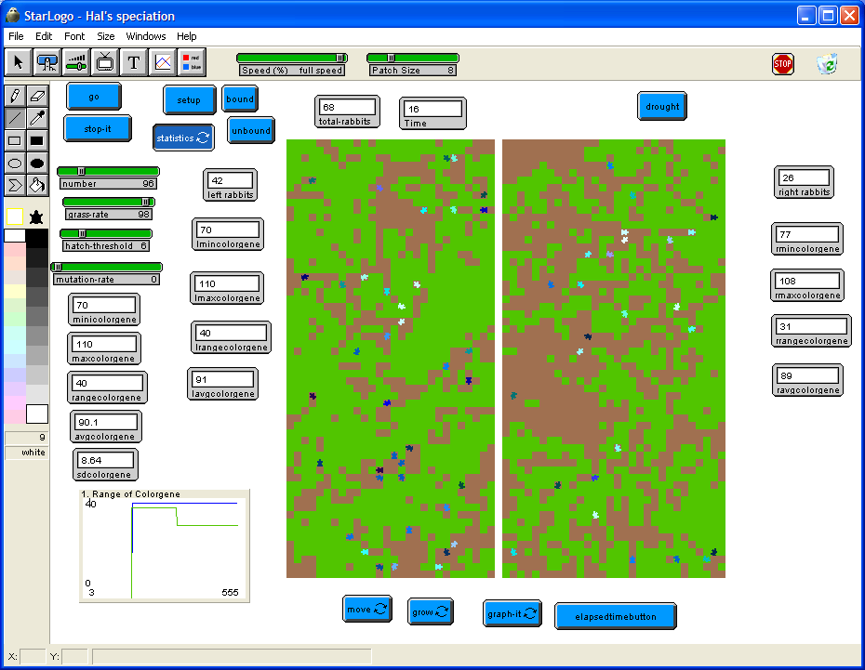
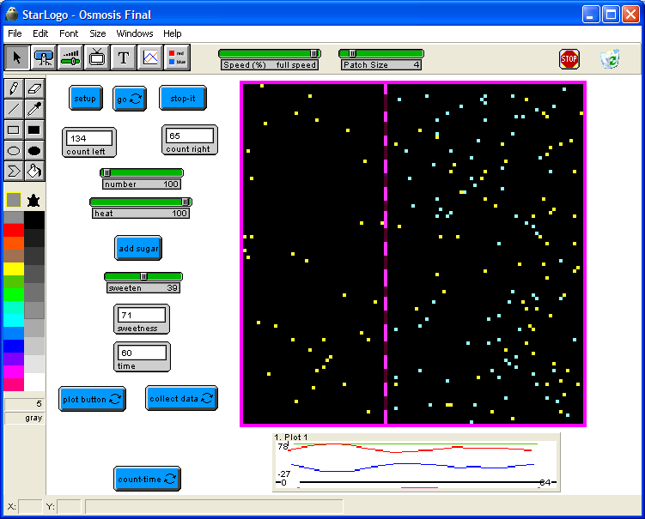
Learning about…
Content (e.g. speciation, crystallization, osmosis) created by teachers

Slide 10
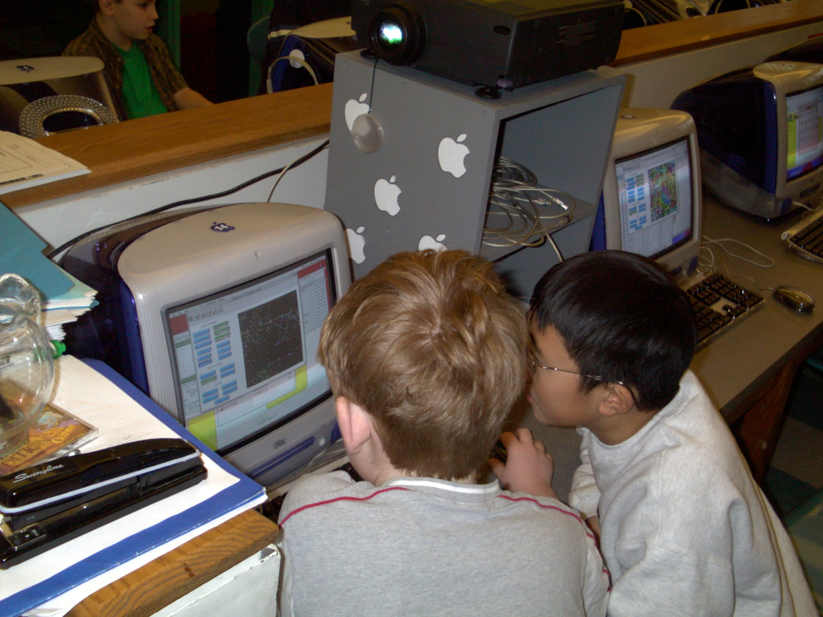
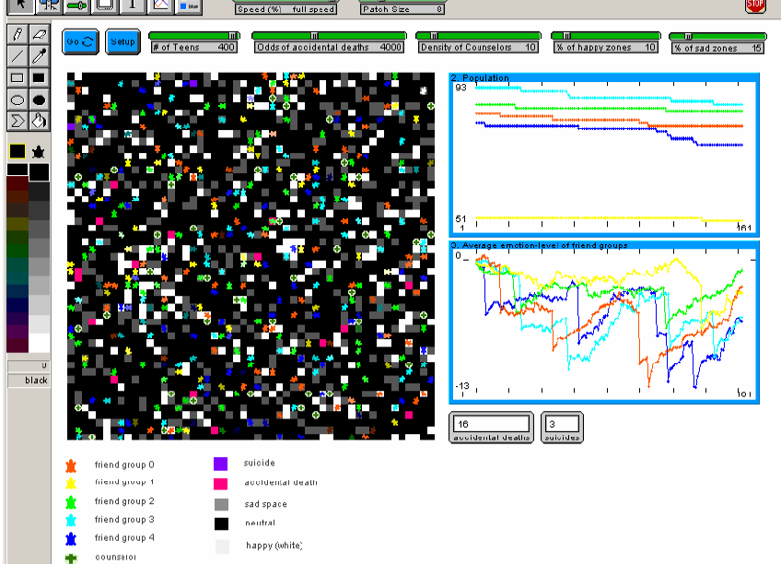
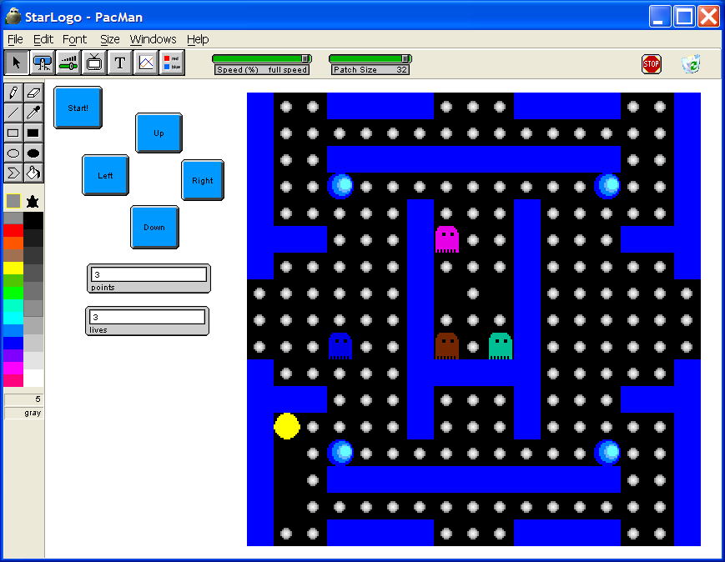
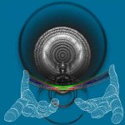
Learning about…
Design, Technology, and Programming by Students
AIS

Slide 11
But Our Research Has Shown…
Hard to find the time in classes to teach programming vocabulary
Syntax of text-based programming is intimidating to students and teachers
High expectations for video game aesthetics

Slide 12
Goals
Easier to build compelling games
Easier to integrate into science classes
Easier to connect kinesthetic learning activities to computer models
Easier for kids to learn to program

Slide 13
StarLogoBlocks
Makes vocabulary visible
Allows direct manipulation of commands
reifies commands into objects that can be played with
makes for an experimenting environment
Facilitates construction / deconstruction of models in subject matter classes
Lowers the barrier to entry for programming (avoids syntax problems)
Enables learners to concentrate on logic and behavior

Slide 14
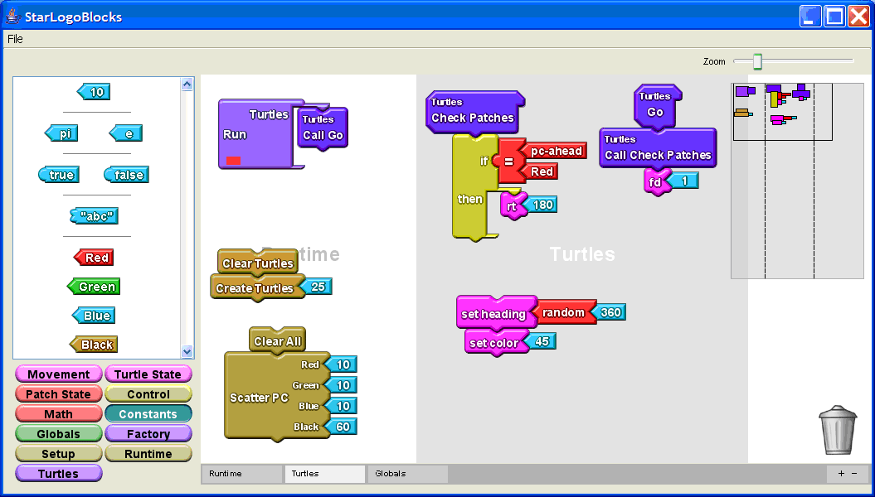
StarLogoBlocks
Removing the syntax barrier

Slide 15
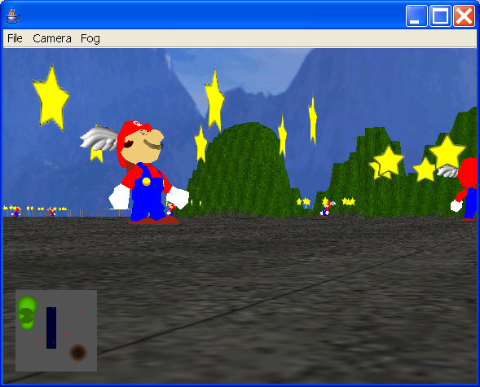
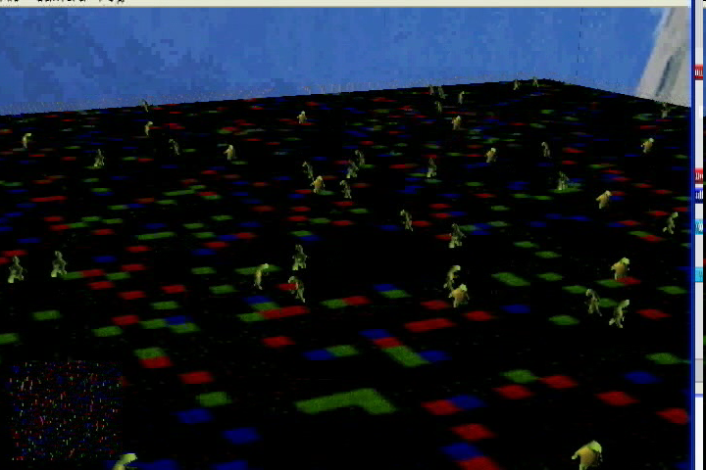
3D Graphics
Providing motivation through making games
Bridges gap between abstract 2D models and real-world Participatory Simulations.
Displaying better "characters" (turtles) means more concrete models

Slide 16
Demo

Slide 17
StarLogo TNG in Action
Pilot testing with high school students
Pairs of students in class who had used Starlogo models
Challenged to create same project in both environments

Slide 18
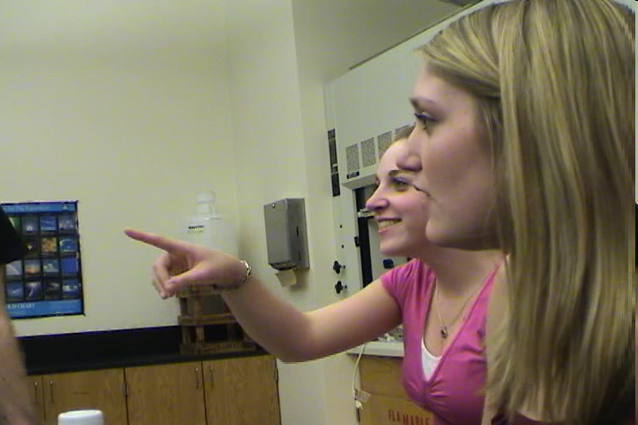
Lessons Learned
Top down view is important for seeing system level dynamics
Seeing in 2D and 3D is important
Easier to see control flow with blocks
Zoom out blocks to see bigger picture
“Coders" say they like text
3D view visualizes individual interactions
Realistic representations are important for connecting kids to models
Customization to make world look the way they want it

Slide 19
Next Steps
Switching camera views
Creating better ways of organizing blocks as programs scale larger
Developing libraries of functions for specific domains
Introducing hooks to make games
Renaming StarLogo… anyone? anyone?

