Slide 1
Spoken Language Support for Software Development
Andrew Begel
Advisor: Susan L. Graham
Computer Science Division, EECS
University of California, Berkeley
Notes:
Broader research goal in building tools for programmers to improve productivity and
access. Study programmers first and build tools second. and then build analyses to support tools
People spend a lot of time developing software.
There’s a continuing demand for more people.
Make people more productive. b. Enlarge the pool of developers.
1b. Better education and helping people with disabilities
1a. To serve community requires understanding of PL, SE and HCI.

Slide 2
Interactive Software Development
Human-Computer
Interaction
Programming
Languages
Human-Centric
Software Tools
Software Engineering
Notes:
i have background in each of these areas, my research lies in the center of all of them.

Slide 3
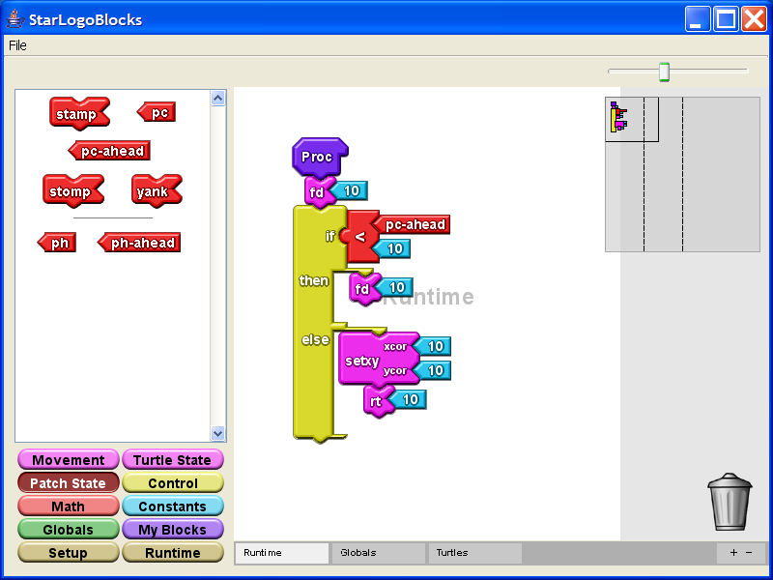
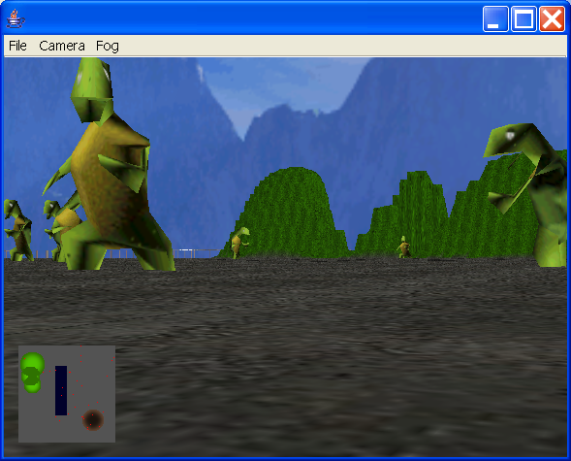
CS Education Projects
StarLogo TNG: Game Construction Kit

Slide 4

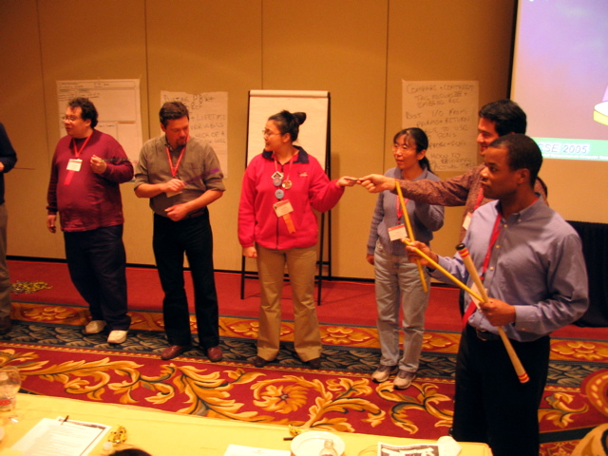
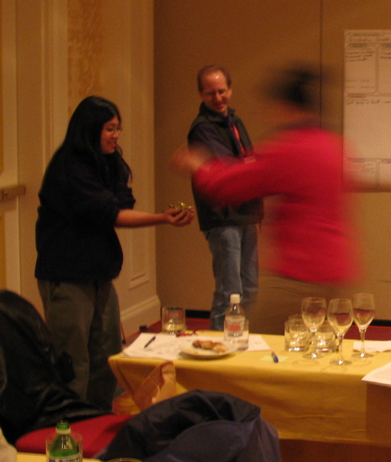
CS Education Projects
inesthetic earning ctivities

Slide 5
Motivation
while (counter < limit) {

}
Programmers conventionally use keyboard
Long hours at keyboard leads to higher risk of RSI
Can speech-based programming be an alternative?
Combines an unambiguous domain (programming) with an inherently ambiguous input modality (speech)
Great for exploring ambiguity handling in a new context
Notes:
Keyboard is unambiguous. Computers lacked processing power to do the work
people are the precious resource. we need to make the computers resolve the ambiguities
for us. not we for them.
addresses ambiguity and RSI. is a playpen to explore ambiguity.
Mankoff Ambiguity mediators, bring amibugity throughout system.

Slide 6
Programming by Voice
while counter is less than limit do ...
My Goal
Find out how developers use code verbally. Use this to develop a naturally verbalizable input form.
Build development environment that supports verbal authoring, navigation, modification.
Extend conventional compiler analyses to support ambiguities generated by speech.
Learn how developers can use voice-based programming, and iterate design.
Notes:
rewritre to work with previous slide.
push on technology for ambiguity resolution and see what it’s capable of.
say human-centered again.
methodology slide

Slide 7
Challenges
Programming languages were not designed to be spoken.
Speech is inherently ambiguous. Programming tools were not designed for ambiguity.
Speech tools are poorly suited for programming tasks.
Programmers are not used to verbal software development.
Notes:
Not the best way to do things, but too hard to change, so instead we’ll modify the input to the programming language to make it easier for people.
i made progress on each of these. none of these is done yet.

Slide 8
Talk Outline
Introduction and Motivation
Programming by Voice
Program Analyses for Ambiguous Inputs
Program Navigation and Editing
Conclusion
Notes:
target 5 minutes

Slide 9
Programming by Voice
for (int i = 0; i < 10; i++ ) {
▌
}

Slide 10
Current Tools are Awkward!
VoiceCode
[Desilets 2004]
for loop … after left paren … declare india of type integer … assign zero … after semi … recall one … less than ten … after semi … recall one … increment … after left brace
for (▌ ; ; ) {
}
Notes:
Existing tools badly adapt VR to programming
(No compiler technology)
More explicitly list out loud what the awkwardness is.
Requires users to spell identifiers
VR finds small words hard to understand.
prescriptive way to enter the program
once code is in editor, it can no longer be edited by template.
code entry is over-stylized
no solution for nav and editing

Slide 11
Current Tools are Awkward!
VoiceCode
[Desilets 2004]
for loop … after left paren … declare india of type integer … assign zero … after semi … recall one … less than ten … after semi … recall one … increment … after left brace
i
1
i
for (int i = 0;▌ ; ) {
}
2
3
4
Notes:
More explicitly list out loud what the awkwardness is.

Slide 12
Current Tools are Awkward!
VoiceCode
[Desilets 2004]
for loop … after left paren … declare india of type integer … assign zero … after semi … recall one … less than ten … after semi … recall one … increment … after left brace
i
1
i
for (int i = 0; i < 10;▌ ) {
}
2
3
4
Notes:
More explicitly list out loud what the awkwardness is.

Slide 13
Current Tools are Awkward!
VoiceCode
[Desilets 2004]
for loop … after left paren … declare india of type integer … assign zero … after semi … recall one … less than ten … after semi … recall one … increment … after left brace
i
i
1
i
1
for (int i = 0; i < 10; i++ ) {
▌
}
2
2
3
3
4
4
Notes:
More explicitly list out loud what the awkwardness is.
explain that template disappears and explain what it is (behind the scenes)

Slide 14
Programming by Voice Related Work
Multiple
Tasks
Begel ‘05
Arnold ‘00
Snell ‘00
Desilets ‘01 ‘04
Price ‘00 ‘02
Authoring Only
Gray ‘03
Computer-Centric
Human-Centric
Notes:
My goal is to create a solution that is both complete and human-centric
complete in that it enables authoring, navigation, and editing.
Human centric in that the machine adapts to the programmer.
Everyone knows this is important work
but no one has accomplished it yet. My work
goes the farthest

Slide 15
How do Programmers Speak Code?
10 programmers read Java code out loud
Most programmers spoke the same way
But, there were some interesting differences...

Slide 16
How do Programmers Speak Code?
Awkwardness by Design (Structural)
(int)foo
(3 + 5) * 7
Notes:
“Think about how to say this”

Slide 17
How do Programmers Speak Code?
Individual Inconsistency System.out.println vs. System out println
bar sub i vs. bar of i vs. i from bar

Slide 18
How do Programmers Speak Code?
Native English speakers vs. non-native speakers (Pronunciation)
tur vs. t u r
println
array[i++] vs. array[i]++

Slide 19
A More Natural Way to Code
for int i equals zero i less than ten i plus plus
for (int i = 0; i < 10; i++ ) {
▌
}
Notes:
Didn’t have to verbalize parens, semicolons, etc.

Slide 20
Too Many Ambiguities
for int i equals zero i less than ten i plus plus
Spelling of ID?
KW or ID?
KW or #?
4 int eye equals 0 aye less then ten i plus plus
for (int i = 0; i < 10; i++ ) {
▌
}
Notes:
A human could eyeball this.

Slide 21
Sometimes It’s Non-Obvious
for times equals 8 file 2 load times equals one
for (times = 8; file(2, load); times == one) {
▌
}
fore *= 8; file.tooLode.times = won ▌
4; times = ate(file).to(load).equals(1) ▌

Slide 22
Design Tradeoffs
Command
Language
Easy to analyze,
but prescriptive
Natural Language
Flexible,
but ambiguous
Programming
by Voice

Slide 23
Spoken Java
Semantically identical to Java
Syntactically easier to say than Java
Methodology generalizable to any computer language
All punctuation has English equivalents
Open Brace, End For Loop
Most punctuation is optional
Provide verbalization for all abbreviations
Relaxed phrasing for better fit with English
(int)foo  “cast foo to integer”
foo = 6  “set foo to 6”
foo[i]++  “increment the ith element of array foo”

Slide 24
SPEED: Speech Editor
Build an editor that supports naturally verbalized programs
SPEED: SPEech EDitor
Based on IBM ViaVoice, Eclipse IDE
Spoken Java Language for Composition
Spoken Command language for Navigation, Editing, Template instantiation, Refactorings, Search
Audible and visual feedback
Similar to JavaSpeak [Smith 2000]

Slide 25
Talk Outline
Introduction and Motivation
Programming by Voice
Program Analyses for Ambiguous Inputs
Program Navigation and Editing
Conclusion
Notes:
Spoken input requires new compiler analyses
Existing analyses are not built for ambiguity
Target 20 minutes.

Slide 26
Traditional Compiler Analyses
for (i = 0; i < 10; i++ ) {

}
Programming languages are designed to be unambiguous
Lexical Analysis
Parsing
Semantic Analysis
For Loop
i | LocalVar | int
FOR
I
FOR
Assign Expr
I
=
0

Slide 27
Ambiguity-Aware Analyses
for i equals zero ...
Handles input stream, syntactic and semantic ambiguities
Lexical Analysis
Ambiguous Parsing
Semantic Ambiguity Resolution
Ambig Stmt

i | LocalVar | int
foureye | LocalVar | ?
FOR
I
For Loop
Assign Expr
4
EYE
FOUREYE
=
0

FOR
Assign Expr
I
=
0
Notes:
Insight here is to generalize GLR algorithm for lexical ambiguities
totally changes the algorithm.

Slide 28

Scan Input Stream
Homophone
Dictionary
Lexical Analysis
Commercial Speech Recognizer

Slide 29
Homophones Cause Ambiguities
4
for
i
equals
fore
eye
four
aye
Concatenated words cause them too
for i equals
foreeye equals
foriequals
4 i equals
fore ayeequals
foureyeequals
Notes:
// Edit me

Slide 30
Ambiguity-Aware Analyses
for i equals zero ...
Lexical Analysis
XGLR Ambiguous Parsing
Semantic Ambiguity Resolution
Ambig Stmt

i | LocalVar | int
foureye | LocalVar | ?
FOR
I
For Loop
Assign Expr
4
EYE
FOUREYE
=
0

FOR
Assign Expr
I
=
0

Slide 31
GLR Parsing [ Tomita 85 ]
Expr
Expr
IF
IF
FOO
ELSE
BAR
KW
KW
ID
KW
ID
Notes:
Expr is previously parsed. Incremental setting you’re not updating everything.
Dangling else problem.

Slide 32
GLR Parsing [ Tomita 85 ]
Expr
Expr
IF
IF
FOO
ELSE
BAR
KW
KW
ID
KW
ID

Slide 33
GLR Parsing [ Tomita 85 ]
Expr
Expr
IF
IF
FOO
ELSE
BAR
KW
KW
ID
KW
ID

Slide 34
GLR Parsing [ Tomita 85 ]
Expr
Expr
IF
IF
FOO
ELSE
BAR
KW
KW
ID
KW
ID

Slide 35
GLR Parsing [ Tomita 85 ]
Expr
Expr
IF
IF
FOO
ELSE
BAR
KW
KW
ID
KW
ID

Slide 36
GLR Parsing [ Tomita 85 ]
Expr
Expr
IF
IF
FOO
ELSE
BAR
KW
KW
ID
KW
ID

Slide 37
GLR Parsing [ Tomita 85 ]
Expr
Expr
IF
IF
FOO
KW
KW
ID
Expr
Expr
IF
IF
FOO
ELSE
BAR
KW
KW
ID
KW
ID
Notes:
Why fork? - 1. There actually are two possible parses
2. Need more lookahead to figure out which parse is right.
3. Need semantics to determine which parse is right.

Slide 38
GLR Parsing [ Tomita 85 ]
Expr
Expr
IF
IF
FOO
KW
KW
ID
Stmt
Expr
Expr
IF
IF
FOO
ELSE
BAR
KW
KW
ID
KW
ID
Notes:
Why fork? - 1. There actually are two possible parses
2. Need more lookahead to figure out which parse is right.
3. Need semantics to determine which parse is right.
change Expr to Stmt.

Slide 39
GLR Parsing [ Tomita 85 ]
Expr
Expr
IF
IF
FOO
ELSE
KW
KW
ID
KW
Stmt
Expr
Expr
IF
IF
FOO
ELSE
BAR
KW
KW
ID
KW
ID

Slide 40
GLR Parsing [ Tomita 85 ]
Expr
Expr
IF
IF
FOO
ELSE
BAR
KW
KW
ID
KW
ID
Stmt
Expr
Expr
IF
IF
FOO
ELSE
BAR
KW
KW
ID
KW
ID

Slide 41
GLR Parsing [ Tomita 85 ]
Stmt
Expr
Expr
IF
IF
FOO
ELSE
BAR
KW
KW
ID
KW
ID
Stmt
Expr
Expr
IF
IF
FOO
ELSE
BAR
KW
KW
ID
KW
ID

Slide 42
GLR Parsing [ Tomita 85 ]
Stmt
Stmt
Expr
Expr
IF
IF
FOO
ELSE
BAR
KW
KW
ID
KW
ID
Stmt
Expr
Expr
IF
IF
FOO
ELSE
BAR
KW
KW
ID
KW
ID

Slide 43
GLR Parsing [ Tomita 85 ]
Stmt
Stmt
Expr
Expr
IF
IF
FOO
ELSE
BAR
KW
KW
ID
KW
ID
Stmt
Stmt
Expr
Expr
IF
IF
FOO
ELSE
BAR
KW
KW
ID
KW
ID
Notes:
Yield is identical. We do structural sharing so we don’t use up too much space.

Slide 44
GLR Ambiguity Support
Fork when there is more than one possible interpretation (tree)

Slide 45
XGLR Ambiguity Support
Fork when there is more than one possible interpretation (tree)
Fork when the lexical input is ambiguous
Notes:
forces a lot of changes to algorithm.
No longer true that all parses have the same yield.

Slide 46
XGLR Parsing [Begel 04]
IF
FIFTY
FIVE
<
X
Notes:
state contributions now. so that everyone is aware of what’s coming up.

Slide 47
XGLR Parsing [ Begel 04 ]
IF
FIFTY
FIVE
<
X
KW

Slide 48
XGLR Parsing [ Begel 04 ]
IF
FIFTY
FIVE
<
X
KW

Slide 49
XGLR Parsing [ Begel 04 ]
55
<
X
#
50
5
<
X
#
#
50
FIVE
<
X
#
ID
FIFTY
5
<
X
ID
#
IF
FIFTY
FIVE
<
X
KW
ID
ID

Slide 50
XGLR Parsing [ Begel 04 ]
IF
55
<
X
KW
#
Op
IF
50
5
<
X
KW
#
#
IF
50
FIVE
<
X
KW
#
ID
IF
FIFTY
5
<
X
KW
ID
#
IF
FIFTY
FIVE
<
X
KW
ID
ID

Slide 51
XGLR Parsing [ Begel 04 ]
IF
FIFTY
.
KW
ID
IF
FIFTY
.
KW
ID
IF
FIFTY
(
KW
ID
IF
FIFTY
(
KW
ID
IF
55
<
X
KW
#
Op
IF
50
5
<
X
KW
#
#
IF
50
FIVE
<
X
KW
#
ID
IF
FIFTY
5
<
X
KW
ID
#
IF
FIFTY
FIVE
<
X
KW
ID
ID

Slide 52
XGLR Parsing [ Begel 04 ]
IF
FIFTY
.
5
<
X
KW
ID
#
IF
FIFTY
.
FIVE
<
X
KW
ID
ID
IF
FIFTY
(
5
<
X
KW
ID
#
IF
FIFTY
(
FIVE
<
X
KW
ID
ID
IF
55
<
X
KW
#
Op
IF
50
5
<
X
KW
#
#
IF
50
FIVE
<
X
KW
#
ID
IF
FIFTY
5
<
X
KW
ID
#
IF
FIFTY
FIVE
<
X
KW
ID
ID

Slide 53
XGLR Parsing [ Begel 04 ]
IF
FIFTY
.
5
<
X
KW
ID
#
IF
FIFTY
.
FIVE
<
X
KW
ID
ID
IF
FIFTY
(
5
<
X
KW
ID
#
IF
FIFTY
(
FIVE
<
X
KW
ID
ID
IF
55
<
X
KW
#
Op
IF
50
5
<
X
KW
#
#
IF
50
FIVE
<
X
KW
#
ID
IF
FIFTY
5
<
X
KW
ID
#
IF
FIFTY
FIVE
<
X
KW
ID
ID

Slide 54
XGLR Parsing [ Begel 04 ]
IF
FIFTY
.
5
<
X
KW
ID
#
IF
FIFTY
.
FIVE
<
X
KW
ID
ID
IF
FIFTY
(
5
<
X
KW
ID
#
IF
FIFTY
(
FIVE
<
X
KW
ID
ID
IF
55
<
X
KW
#
Op
IF
50
5
<
X
KW
#
#
IF
50
FIVE
<
X
KW
#
ID
IF
FIFTY
5
<
X
KW
ID
#
IF
FIFTY
FIVE
<
X
KW
ID
ID

Slide 55
XGLR Parsing [ Begel 04 ]
IF
FIFTY
.
FIVE
<
X
KW
ID
ID
IF
FIFTY
(
5
<
X
KW
ID
#
IF
FIFTY
(
FIVE
<
X
KW
ID
ID
IF
55
<
X
KW
#
Op

Slide 56
XGLR Parsing [ Begel 04 ]
IF
FIFTY
(
5
)
<
X
KW
ID
#
IF
FIFTY
(
FIVE
)
<
X
KW
ID
ID
IF
FIFTY
.
FIVE
.
<
X
KW
ID
ID
IF
FIFTY
.
FIVE
(
<
X
KW
ID
ID
IF
FIFTY
(
FIVE
.
<
X
KW
ID
ID
IF
FIFTY
(
FIVE
(
<
X
KW
ID
ID
IF
FIFTY
.
FIVE
<
X
KW
ID
ID
IF
FIFTY
(
5
<
X
KW
ID
#
IF
FIFTY
(
FIVE
<
X
KW
ID
ID
IF
55
<
X
KW
#
Op

Slide 57
XGLR Parsing [ Begel 04 ]
IF
FIFTY
(
5
)
<
X
KW
ID
#
Op
IF
FIFTY
(
FIVE
)
<
X
KW
ID
ID
Op
IF
FIFTY
.
FIVE
.
<
X
KW
ID
ID
Op
IF
FIFTY
.
FIVE
(
<
X
KW
ID
ID
Op
IF
FIFTY
(
FIVE
.
<
X
KW
ID
ID
Op
IF
FIFTY
(
FIVE
(
<
X
KW
ID
ID
Op
IF
FIFTY
.
FIVE
<
X
KW
ID
ID
Op
IF
FIFTY
(
5
<
X
KW
ID
#
Op
IF
FIFTY
(
FIVE
<
X
KW
ID
ID
Op
IF
55
<
X
KW
#
Op
ID

Slide 58
XGLR Parsing [ Begel 04 ]
IF
FIFTY
(
5
)
<
X
KW
ID
#
Op
IF
FIFTY
(
FIVE
)
<
X
KW
ID
ID
Op
IF
FIFTY
.
FIVE
.
<
X
KW
ID
ID
Op
IF
FIFTY
.
FIVE
(
<
X
KW
ID
ID
Op
IF
FIFTY
(
FIVE
.
<
X
KW
ID
ID
Op
IF
FIFTY
(
FIVE
(
<
X
KW
ID
ID
Op
IF
FIFTY
.
FIVE
<
X
KW
ID
ID
Op
IF
FIFTY
(
5
<
X
KW
ID
#
Op
IF
FIFTY
(
FIVE
<
X
KW
ID
ID
Op
IF
55
<
X
KW
#
Op
ID

Slide 59
XGLR Parsing [ Begel 04 ]
IF
FIFTY
(
5
)
<
X
KW
ID
#
Op
IF
FIFTY
(
FIVE
)
<
X
KW
ID
ID
Op
IF
FIFTY
.
FIVE
<
X
KW
ID
ID
Op
IF
FIFTY
(
5
<
X
KW
ID
#
Op
IF
FIFTY
(
FIVE
<
X
KW
ID
ID
Op
IF
55
<
X
KW
#
Op
ID

Slide 60
XGLR Parsing [ Begel 04 ]
IF
FIFTY
(
5
)
<
X
KW
ID
#
Op
ID
IF
FIFTY
(
FIVE
)
<
X
KW
ID
ID
Op
ID
IF
FIFTY
.
FIVE
<
X
KW
ID
ID
Op
ID
IF
FIFTY
(
5
<
X
KW
ID
#
Op
ID
IF
FIFTY
(
FIVE
<
X
KW
ID
ID
Op
ID
IF
55
<
X
KW
#
Op
ID

Slide 61
XGLR Parsing [ Begel 04 ]
IF
FIFTY
(
5
)
<
X
KW
ID
#
Op
ID
IF
FIFTY
(
FIVE
)
<
X
KW
ID
ID
Op
ID
IF
FIFTY
.
FIVE
<
X
KW
ID
ID
Op
ID
IF
FIFTY
(
5
<
X
KW
ID
#
Op
ID
IF
FIFTY
(
FIVE
<
X
KW
ID
ID
Op
ID
IF
55
<
X
KW
#
Op
ID

Slide 62
XGLR Parsing [ Begel 04 ]
IF
FIFTY
(
5
)
<
X
KW
ID
#
Op
ID
IF
FIFTY
(
FIVE
)
<
X
KW
ID
ID
Op
ID
IF
FIFTY
.
FIVE
<
X
KW
ID
ID
Op
ID
IF
FIFTY
(
5
<
X
KW
ID
#
Op
ID
IF
FIFTY
(
FIVE
<
X
KW
ID
ID
Op
ID
IF
55
<
X
KW
#
Op
ID

Slide 63
XGLR Parsing [ Begel 04 ]
Expr
FuncCall
IF
FIFTY
(
5
)
<
X
KW
ID
#
Op
ID
Expr
FuncCall
IF
FIFTY
(
FIVE
)
<
X
KW
ID
ID
Op
ID
Expr
Expr
IF
FIFTY
.
FIVE
<
X
KW
ID
ID
Op
ID
IF
FIFTY
(
5
<
X
KW
ID
#
Op
ID
IF
FIFTY
(
FIVE
<
X
KW
ID
ID
Op
ID
Expr
IF
55
<
X
KW
#
Op
ID
Notes:
Describe what semantic analysis will do for you here.
Syntactically well formed but only valid in certain cases.

Slide 64
XGLR Summary
Generalized traditional GLR algorithm
Many algorithm and engineering challenges
New combined lexer and parser generator
Preserve subtree sharing when parses have different yields
Preserve efficiency when parses get out of sync
Determine parse position w.r.t. ambiguous input
The devil is in the details

Slide 65
GLR Parsing Genealogy
Scannerless
Visser 1997
van den Brand 2002
Tomita 1985
Farshi 1991
Rekers 1992
Wagner
1997
Begel 2004
Input Stream
Ambiguities
Incremental
Johnstone et. al.
2002
Notes:
GLR Parsing Algorithm
Tomita [1985]
Farshi [1991]
Rekers [1992]
Johnstone et. al. [2002]
Incremental GLR
Wagner [1997]
Ambiguous Input Streams
Aycock and Horspool [2001]

Slide 66
Ambiguity-Aware Analyses
for i equals zero ...
Lexical Analysis
XGLR Ambiguous Parsing
Semantic Ambiguity Resolution
Ambig Stmt

i | LocalVar | int
foureye | LocalVar | ?
FOR
I
For Loop
Assign Expr
4
EYE
FOUREYE
=
0

FOR
Assign Expr
I
=
0
Notes:
37 minutes in practice.
40 minutes.
Please be here at 30 minutes.

Slide 67
Disambiguation Example
class Loader {
public void load() {
String filetoload = null;
InputStream stream = getStream();
...
▌
}
}
file to load equals stream dot read string
filetoload = stream.readString();
Notes:
Say you don’t need to understand code (just defining a string named file to load and setting its value)
This is a Java example.
Verbally switch argument into how to do the analysis.

Slide 68
Many Interpretations
file.toload
file(to, load)
filetoload()
(file, 2, load)
file(to.lode)
filetoload
file.to(load)
file(to(lode))
file.to.load
file(toload)
file(2, load)
Notes:
Just a small number of the possibilities

Slide 69
Incremental Semantics
What does this name mean?
What names are visible at this program point?
Or, What can I say here?
Visibility Graph [Garrison 1987]
Incrementally updated data structure for scopes, names and bindings
Designed Visibility Graph algorithms for name propagation and incremental update
Used for type checking, too
Doesn’t <insert favorite IDE here> do this?
Notes:
Lied about concatenation. It’s really done in name lookup to avoid ambiguities

Slide 70
Program Context Can Help
class Loader {
public void load() {
String filetoload = null;
InputStream stream = getStream();
...
▌
}
}
class Loader scope
[ load, Method, ()  void ]
[ filetoload, LocalVar, String ]
[ stream, LocalVar, InputStream ]
method load scope

Slide 71
Program Context Can Help
class Loader {
public void load() {
String filetoload = null;
InputStream stream = getStream();
...
▌
}
}
class Loader scope
[ load, Method, ()  void ]
[ filetoload, LocalVar, String ]
[ stream, LocalVar, InputStream ]
method load scope
[ load, Method, ()  void ]
Notes:
Name propagation moves data around the tree so that lookups are super-fast.

Slide 72
Semantic Disambiguation
class Loader scope
[ load, Method, ()  void ]
[ filetoload, LocalVar, String ]
[ stream, LocalVar, InputStream ]
method load scope
[ load, Method, ()  void ]
file.toload
file(to, load)
filetoload()
(file, 2, load)
file(to.lode)
filetoload
file(to(lode))
file.to(load)
file(toload)
file.to.load
file(2, load)
Notes:
Lookups need to be super fast when you are doing a lot of them for disambiguation

Slide 73
Semantic Disambiguation
class Loader scope
[ load, Method, ()  void ]
[ filetoload, LocalVar, String ]
[ stream, LocalVar, InputStream ]
method load scope
[ load, Method, ()  void ]
Is “file” a visible variable name?
file.toload
file(to, load)
filetoload()
(file, 2, load)
file(to.lode)
filetoload
file(to(lode))
file.to(load)
file(toload)
file.to.load
file(2, load)

Slide 74
Semantic Disambiguation
class Loader scope
[ load, Method, ()  void ]
[ filetoload, LocalVar, String ]
[ stream, LocalVar, InputStream ]
method load scope
[ load, Method, ()  void ]
Is “file” a visible method name?
file(to, load)
filetoload()
file(to.lode)
filetoload
file(to(lode))
file(toload)
file(2, load)

Slide 75
Semantic Disambiguation
class Loader scope
[ load, Method, ()  void ]
[ filetoload, LocalVar, String ]
[ stream, LocalVar, InputStream ]
method load scope
[ load, Method, ()  void ]
Is “filetoload” a visible method name?
filetoload()
filetoload
Notes:
These queries may look simple in this example, but they can be as complicated as the program itself.

Slide 76
Manual Disambiguation
Some ambiguities cannot (and should not) be automatically resolved:
print(“line”) vs. println()
if (pred1) then if (pred2) then foo() else bar()
If ambiguities remain, ask the user how to resolve them. (e.g. [Mankoff 00])
if
if
if
if
bar()
foo()
bar()
foo()

Slide 77
Talk Outline
Introduction and Motivation
Programming by Voice
Program Analyses for Ambiguous Inputs
Program Navigation and Editing
Conclusion
Notes:
40 minutes.

Slide 78
Study - Navigation by Speech
Eight navigation tasks with commercial VR tools
Search through text (w/o Find dialog), e.g.
Find the sentence where Romeo cries out about his fate after killing Tybalt.
Metrics
Time to scroll to right page
Number of commands
Number of recognition errors
Number of system mistakes
Results
Cognitive load is too high - too many commands, misestimation errors
Voice recognition induces too much delay/errors for accurate control

Slide 79
SPEED Navigation
class Loader {
public void load() {
String filetoload = null;
InputStream stream = getStream();
...
▌
}
public void save() {
...
}
}
class MenuLoader extends Loader {
...
}
Mouse Grid [Dragon 2002]
Context-Sensitive Mouse Grid [Begel]
Related Work: Tree Hierarchy Navigation [Smith 2004]
Notes:
Punctuation-independent

Slide 80
SPEED Navigation
1
class Loader {
public void load() {
String filetoload = null;
InputStream stream = getStream();
...
▌
}
public void save() {
...
}
}
class MenuLoader extends Loader {
...
}
Mouse Grid [Dragon 2002]
Context-Sensitive Mouse Grid [Begel]
Tree Hierarchy Navigation [Smith 2004]
2
Notes:
Punctuation-independent

Slide 81
SPEED Navigation
class Loader {
public void load() {
String filetoload = null;
InputStream stream = getStream();
...
▌
}
public void save() {
...
}
}
class MenuLoader extends Loader {
...
}
1
Mouse Grid [Dragon 2002]
Context-Sensitive Mouse Grid [Begel]
Tree Hierarchy Navigation [Smith 2004]
1
2
Notes:
Punctuation-independent

Slide 82
SPEED Navigation
class Loader {
public void load() {
String filetoload = null;
InputStream stream = getStream();
...
▌
}
public void save() {
...
}
}
class MenuLoader extends Loader {
...
}
Mouse Grid [Dragon 2002]
Context-Sensitive Mouse Grid [Begel]
Tree Hierarchy Navigation [Smith 2004]
1 1
1
2
3
4
Notes:
Punctuation-independent

Slide 83
SPEED Navigation
class Loader {
public void load() {
String filetoload = null;
InputStream stream = getStream();
...
▌
}
public void save() {
...
}
}
class MenuLoader extends Loader {
...
}
Mouse Grid [Dragon 2002]
Context-Sensitive Mouse Grid [Begel]
Tree Hierarchy Navigation [Smith 2004]
1 1 2
1
2
3
4
Notes:
Punctuation-independent

Slide 84
SPEED Navigation
class Loader {
public void load() {
String filetoload = null;
InputStream stream = getStream();
...
▌
}
public void save() {
...
}
}
class MenuLoader extends Loader {
...
}
Mouse Grid [Dragon 2002]
Context-Sensitive Mouse Grid [Begel]
Tree Hierarchy Navigation [Smith 2004]
1 1 2 2 select
Notes:
Punctuation-independent

Slide 85
SPEED Navigation
2
class Loader {
public void load() {
String filetoload = null;
InputStream stream = getStream();
...
▌
}
public void save() {
...
}
}
class MenuLoader extends Loader {
...
}
Mouse Grid [Dragon 2002]
Context-Sensitive Mouse Grid [Begel]
Tree Hierarchy Navigation [Smith 2004]
Phonetics-based subtoken search
1
3
4
5
find lode
Notes:
Punctuation-independent
say editing out loud at end of navgiation.

Slide 86
SPEED Coding
Edit ed style!
Structurally select code
1
class Loader {
public void load() {
String filetoload = null;
InputStream stream = getStream();
filetoload = “file.txt”;
▌
}
public void save() {
...
}
}
class MenuLoader extends Loader {
...
}
2

Slide 87
SPEED Modification
Edit ed style!
Structurally select code 1
class Loader {
public void load() {
String filetoload = null;
InputStream stream = getStream();
filetoload = “file.txt”;
▌
}
public void save() {
...
}
}
class MenuLoader extends Loader {
...
}
1
2

Slide 88
SPEED Modification
Edit ed style!
Structurally select code 1 2
class Loader {
public void load() {
String filetoload = null;
InputStream stream = getStream();
filetoload = “file.txt”;
▌
}
public void save() {
...
}
}
class MenuLoader extends Loader {
...
}
1
2
3
4

Slide 89
SPEED Modification
Edit ed style!
Structurally select code 1 2 3 select
class Loader {
public void load() {
String filetoload = null;
InputStream stream = getStream();
filetoload = “file.txt”;
▌
}
public void save() {
...
}
}
class MenuLoader extends Loader {
...
}

Slide 90
SPEED Modification
Edit ed style!
Structurally select code
Convert Java to Spoken Java
class Loader {
public void load() {
String filetoload = null;
InputStream stream = getStream();
filetoload = “file.txt”;
▌
}
public void save() {
...
}
}
class MenuLoader extends Loader {
...
}
filetoload equals quote file.txt quote

Slide 91
SPEED Modification
Edit ed style!
Structurally select code
Convert Java to Spoken Java
Edit using voice recognition
class Loader {
public void load() {
String filetoload = null;
InputStream stream = getStream();
filetoload = “file.txt”;
▌
}
public void save() {
...
}
}
class MenuLoader extends Loader {
...
}
file to load equals stream dot read string

Slide 92
SPEED Modification
Edit ed style!
Structurally select code
Convert Java to Spoken Java
Edit using voice recognition
Convert back to Java and reinsert in buffer
class Loader {
public void load() {
String filetoload = null;
InputStream stream = getStream();
filetoload = “file.txt”;
▌
}
public void save() {
...
}
}
class MenuLoader extends Loader {
...
}
file to load equals stream dot read string

Slide 93
SPEED Modification
Edit ed style!
Structurally select code
Convert Java to Spoken Java
Edit using voice recognition
Convert back to Java and reinsert in buffer
class Loader {
public void load() {
String filetoload = null;
InputStream stream = getStream();
filetoload = stream.readString();
▌
}
public void save() {
...
}
}
class MenuLoader extends Loader {
...
}
file to load equals stream dot read string

Slide 94
Study - Compare with VoiceCode
Goal: Understand how SPEED can be used by experts and compare it with VoiceCode
Train expert Java programmers on SPEED and VoiceCode
Author new code
Build a Linked List data structure with associated algorithms
Modify existing code
Change abstraction representation and update algorithms
Notes:
Say this is for expert java programmers.
Rephrase system understanding (everything else is about the person, but this is about the system).
Find some terminology from AI systems evaluations (false positive rate etc)

Slide 95
Metrics
User Metrics
Speed
Vocabulary mistakes, Forgotten vocabulary
Grammatical mistakes, Grammatical substitutions
SPEED Metrics
Word tokenization errors
Disambiguation errors
Irresolvable ambiguities

Slide 96
Talk Outline
Introduction and Motivation
Programming by Voice
Program Analyses for Ambiguous Inputs
Program Navigation and Editing
Conclusion
Notes:
48 minutes.

Slide 97
Contributions
A study of programmers to understand and design a naturally verbalizable input for programming
An interactive editor designed for spoken interaction
The use of syntax and semantics of programming for disambiguation
Enhanced lexical, syntactic, semantic analyses for support of verbal ambiguities
Evaluation of design and tools by studying programmers using voice for software development

Slide 98
Future of Programming by Voice
Early pruning of ambiguities using analysis feedback
Learn individual’s programming style
Improve automation of semantic disambiguation
Use ideas from NLP, Machine Learning
Support higher-level linguistic programming
Paraphrasing
Design spoken variants of formal languages
Scripting (PL, OS), Design (HCI), Command (Robotics), Domain-specific languages (SQL)
Use programming by voice as platform for studies of program comprehension and expression
Study novice programmers to see if using voice can make learning to program easier

Slide 99
Future Research Directions
Data mining the program edit history
Synthesizing high-level schemas (Machine Learning)
Commenting by voice
Easier input (HCI)
More frequent (SoftEng)
Higher quality (SoftEng)
More maintainable (NLP)
Visualizing effects of compilation and optimization
Program visualization (HCI)

Slide 100
Any Questions?
Andrew Begel: abegel@cs.berkeley.edu

Slide 101
SPEED Navigation
class Loader {
public void load() {
String filetoload = null;
InputStream stream = getStream();
...
▌
}
public void save() {
...
}
}
class MenuLoader extends Loader {
...
}
Mouse Grid [Dragon 2002]
Notes:
Punctuation-independent

Slide 102
SPEED Navigation
class Loader {
public void load() {
String filetoload = null;
InputStream stream = getStream();
...
▌
}
public void save() {
...
}
}
class MenuLoader extends Loader {
...
}
Mouse Grid [Dragon 2002]
1
2
3
4
5
6
7
8
9
Notes:
Punctuation-independent

Slide 103
SPEED Navigation
class Loader {
public void load() {
String filetoload = null;
InputStream stream = getStream();
...
▌
}
public void save() {
...
}
}
class MenuLoader extends Loader {
...
}
1
2
3
Mouse Grid [Dragon 2002] 2
4
5
6
7
8
9
Notes:
Punctuation-independent

Slide 104
SPEED Navigation
class Loader {
public void load() {
String filetoload = null;
InputStream stream = getStream();
...
▌
}
public void save() {
...
}
}
class MenuLoader extends Loader {
...
}
Mouse Grid [Dragon 2002] 2 8
Notes:
Punctuation-independent

Slide 105
SPEED Navigation
class Loader {
public void load() {
String filetoload = null;
InputStream stream = getStream();
...
▌
}
public void save() {
...
}
}
class MenuLoader extends Loader {
...
}
Mouse Grid [Dragon 2002] 2 8 2 select
Notes:
Punctuation-independent

