Slide 1
Spoken Language Support for Software Development
Andrew Begel
University of California, Berkeley
Advisor: Prof. Susan L. Graham

Slide 2
Introduction and Motivation
High-Level
Code and
Commands
Development mechanisms mostly unchanged for 30 years
Enable people to program linguistically rather than textually
Program by Voice
Intended to help RSI sufferers, as well as students learning to program
Programming
Language
Analysis
Source
Code

Slide 3
Current Tools Are Painful!
for statement … next … declare variable name india variable type integer … assign zero … next … recall one … less than ten … next … recall one … post increment … next
for (int i = 0; i < 10; i++ ) {

}
Program editing and navigation are much worse!
Notes:
Why haven’t we solved it this way. What does our technology do?

Slide 4
Hard Problems
Disambiguation
User says ARGS SUB ARG NUM PLUS PLUS
Possible interpretations:
args[arg.num]++
args[arg(num)]++
args[argNum]++
Must support navigation and editing
Go to the second if statement and replace the predicate by x is less than 7
Programming languages aren’t spoken
Modify syntax to be easier to say without changing semantics

Slide 5
Cognitive Questions
How do programmers express themselves?
Does everyone speak the same language?
Vocal expressiveness is important: x[i]++ vs. x[i++]
Abstraction is natural
Consistency and correctness are inferred by context
How does speaking affect programming concentration?
How hard is it to learn to program by voice?
How fast or slow can one write code?
What kinds of mistakes are made?

Slide 6
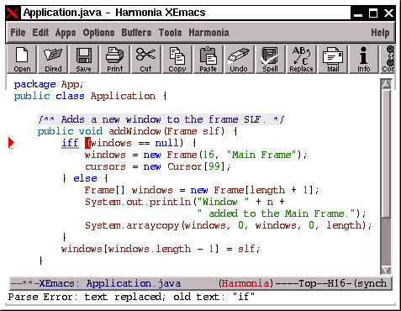
Where are we?
Harmonia-Mode for XEmacs
Provides interactive, on-line program analysis services
Deployed in undergraduate compiler class
Program by voice prototype: Code template expansion by voice
Initial design for Spoken Java language

Slide 7
Conclusions and Questions
Programming by voice won’t be for everyone
How can we apply this to novices?
Will it be easier to learn to code?
Could this change how we teach programming?
How do we study this in a real course?
Next up
Document navigation by voice
Voice-over program comments

