Slide 1
EUD at Scale
Andrew Begel, Microsoft Research

Slide 2
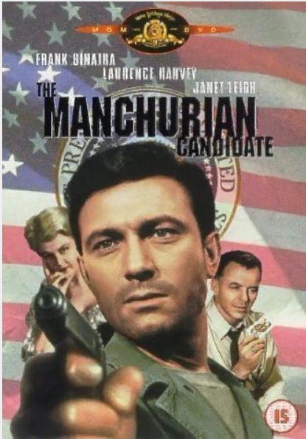
Classic Human Programming
Madlibs
http://www.madlibs.com/
http://www.madlibs.org/cgi-bin/madlib?princess.ml2

Slide 3
Programming Humans for Work
Participatory Simulations
Colella, V., Borovoy, R., and Resnick, M. (1998) Participatory Simulations: Using Computational Objects to Learn about Dynamic Systems Proceedings of the Computer Human Interface (CHI) '98 conference, Los Angeles, April 1998.
Citizen Science
eBird http://ebird.org/ebird/livesubs
Word Processing
Michael Bernstein, Greg Little, Rob Miller, Bjoern Hartmann, Mark Ackerman, David Karger, David Crowell, and Katrina Panovich. Soylent: A Word Processor with a Crowd Inside. UIST: ACM Symposium on User Interface Software and Technology, 2010.

Slide 4
Programming Humans for Art
Virtual Choir: http://www.youtube.com/watch?v=D7o7BrlbaDs
Virtual Choir 2.0: http://www.youtube.com/watch?v=6WhWDCw3Mng
Ten Thousand Cents: http://www.youtube.com/watch?v=xGqWEQXpbBc (http://www.tenthousandcents.com/)
The Voting Booth: http://nateboxer.net/garden/voting/
Results: http://nateboxer.net/art/2009/
Electric LED Sheep: http://www.youtube.com/watch?v=D2FX9rviEhw

