Slide 1

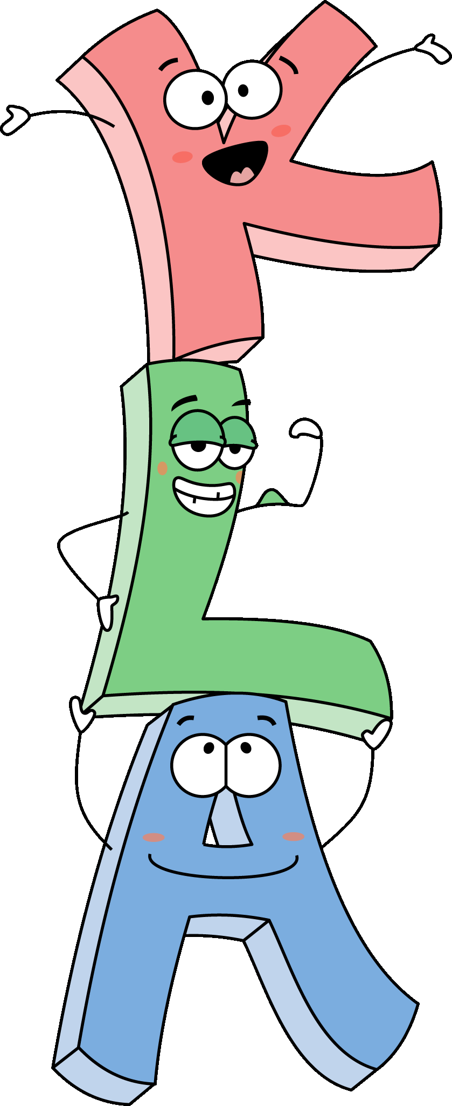


inesthetic earning ctivities
Steve Wolfman, UW Andrew Begel, UCB Dan Garcia, UCB
www.cs.washington.edu/research/edtech/KLA
08:45
2004-03-05
Norfolk, VA
Special Session

Slide 2
KLA Warm-up: Mob Topo-Sort
First, choose a nearby neighbor
Don’t tell them they’re chosen
To participate, stand up
Put a hand on their shoulder
We’ve just created a graph!
You are the node/vertex
Your hand is a directed edge
Are there any cycles?
Let’s run Topological-sort to find out!

Slide 3
KLA: Mob Topological Sort
“The Godfather answers all of life’s questions” – Heard in “You’ve got Mail”
B
C
Iterate until graph stops changing
If nobody is on your shoulder you’re a “mob boss” (CSpeak: indegree=0)
Raise and waive your free hand
You were too conspicuous! You’re “whacked”, given a #, & sit down.
Put your hands in your lap
The rest remain standing
When graph stops changing
Either all sitting, #ed OR cycles left
A
D
E
A sits
B
C
D
E
B sits
C
D
E

Slide 4
Kinesthetic Learning Activities?
Active learning exercises that physically engage students in the learning process

Slide 5
Why KLAs?
Combat physical disengagement (e.g., [Stuart & Rutherford], [Bligh], [Picard])
Tap different learning styles
active, sensing, inductive [Felder & Silverman]
kinesthetic [Fleming]
sensorimotor learning [Piaget]
Construct knowledge by analogy
Makes learning fun!

Slide 6
What will you get out of this?
Abiding love of KLAs
“Triangulated” KLA examples
Structure for designing KLAs that…
communicates key ideas of the KLA
encourages consideration of pitfalls
Practice designing your own KLA
Community to collect/discuss KLAs

Slide 7
Session Structure
Activity Time Leader
Mob KLA 5 Dan
Intro 8 Steve
Two KLAs 15 Andy
Group work 25 Andy et al.
Posters 10 Andy et al.
Best KLA 5 Dan
Wrap-up 5 Steve
We’re
here
Start thinking of your KLA now!

Slide 8
KLA: Counting Rows Recursively
Embedded
Tail

Slide 9
KLA: Embedded/Tail Recursion
Embedded …called with (distance *back*)
(define (distance place) (if (on-stage? place) 0 (+ 1 (distance (take-step place)))))
Tail …called with (distance *back* 0)
(define (distance place ans) (if (on-stage? place) ans (distance (take-step place) (+ 1 ans))))

Slide 10

KLA: Letter Writing
Four people are helping me to write job application letters
How efficient can we be?
Hire
Andy!
Write message on paper
Fold paper in half
Stuff paper in envelope
Put stamp on envelope

Slide 11
Sequential Letter Writing
Time
1
2
3
4
5
6
7
8
Hire
Andy!
Sequential
Hire
Andy!
Each letter takes 4 steps
We can do 2 letters in 8 steps
At this rate, I’m never gonna get a job!

Slide 12
Pipelined Letter Writing
Time
1
2
3
4
5
6
7
8
Hire
Andy!
Hire
Andy!
Pipelined
Hire
Andy!
Hire
Andy!
Hire
Andy!
Each letter still takes 4 steps
But, we can now do 5 letters in 8 steps!

Slide 13
Let’s Group-Brainstorm KLAs!
Design your own KLAs for 25 minutes
Pick a topic, an activity and some partners
Be aware of participants’ sensitivities
Describe KLA on poster
We’ve scaffolded the organization for you
When done, everyone will roam around and comment on other posters
The best KLA will be presented at end
We’ll post all your KLAs on the web!

Slide 14
Choose KLA Topic & Scatter!
We’ve placed 12 topics about the room
CS0, CS1, CS2
Architecture
Operating Systems and Networks
Artificial Intelligence
Programming Languages and Compilers
Software Engineering
Theory and Algorithms
Human-Computer Interaction
Graphics and Vision
Databases
Find the topic you want and go there (sort yourself!)
Ensure even group size and distribution (~5/group)
You have 20 minutes. Take your Post-its™ with you.

Slide 15
Now, wander about room…
Read your neighbors’ KLAs
Put comments on Post-its™ & affix
Take ~10 minutes

Slide 16
Please return to your seats
“What a fun, learning activity that was!”

Slide 17
What was the best KLA?
Authors of the best KLA come on up to demonstrate their activity for ~5 min

Slide 18
Wrap-up
Things to keep in mind
Survey
Web site
www.cs.washington.edu/research/edtech/KLA
All the KLAs you authored will be available there

