Slide 1
Spoken Language Support for Software Development
Andrew Begel
Advisor: Susan L. Graham
Computer Science Division, EECS
University of California, Berkeley
Notes:
Broader research goal in building tools for programmers to improve productivity and
access. Study programmers first and build tools second. and then build analyses to support tools
People spend a lot of time developing software.
There’s a continuing demand for more people.
Make people more productive. b. Enlarge the pool of developers.
1b. Better education and helping people with disabilities
1a. To serve community requires understanding of PL, SE and HCI.

Slide 2
Motivation
while (counter < limit) {

}
Programmers conventionally use keyboard
Long hours at keyboard leads to higher risk of RSI
Can a programmer code using speech?
Can a computer understand what the developer says?
Notes:
Keyboard is unambiguous. Computers lacked processing power to do the work
people are the precious resource. we need to make the computers resolve the ambiguities
for us. not we for them.
addresses ambiguity and RSI. is a playpen to explore ambiguity.
Mankoff Ambiguity mediators, bring amibugity throughout system.

Slide 3
Programming by Voice
while counter is less than limit do ...
My Goal
Find out how developers use code verbally. Use this to develop a naturally verbalizable input form.
Build development environment that supports verbal authoring, navigation, modification.
Extend conventional compiler analyses to support ambiguities generated by speech.
Learn how developers can use voice-based programming, and iterate design.
Notes:
rewritre to work with previous slide.
push on technology for ambiguity resolution and see what it’s capable of.
say human-centered again.
methodology slide

Slide 4
Challenges
Speech is inherently ambiguous.
Programming tools were not designed for ambiguity.
Speech tools are poorly suited for programming tasks.
Programmers are not used to verbal software development.
Notes:
Not the best way to do things, but too hard to change, so instead we’ll modify the input to the programming language to make it easier for people.
i made progress on each of these. none of these is done yet.

Slide 5
Talk Outline
Introduction and Motivation
Programming by Voice
Program Analyses for Ambiguous Inputs
SPEech EDitor Programming Environment
SPEED User Study
Conclusion
Notes:
target 5 minutes

Slide 6
How do Programmers Speak Code?
10 programmers read Java code out loud (Begel ‘05)
Graduate students in Computer Science
Five knew Java, five did not
Five were native English speakers, five were not
Five were educated in U.S.A., five were not
Read pre-written code into tape recorder
As if speaking to a sophomore-level CS undergrad who knows Java, but does not know the program
Most programmers spoke the same way

Slide 7
How do Programmers Speak Code?
for int i equals zero i less than ten i plus plus
for (int i = 0; i < 10; i++ ) {
▌
}
Notes:
Didn’t have to verbalize parens, semicolons, etc.

Slide 8
How Do Programmers Speak Code?
Spoken Words Can Be Hard To Write Down
2
Notes:
“Think about how to say this”

Slide 9
How Do Programmers Speak Code?
Spoken Words Can Be Hard To Write Down
2  2, two, to, too
Notes:
“Think about how to say this”

Slide 10
How Do Programmers Speak Code?
Spoken Words Can Be Hard To Write Down
2  2, two, to, too
print
Notes:
“Think about how to say this”

Slide 11
How Do Programmers Speak Code?
Spoken Words Can Be Hard To Write Down
2  2, two, to, too
print  print, Print
Notes:
“Think about how to say this”

Slide 12
How Do Programmers Speak Code?
Spoken Words Can Be Hard To Write Down
2  2, two, to, too
print  print, Print
drop stack process
Notes:
“Think about how to say this”

Slide 13
How Do Programmers Speak Code?
Spoken Words Can Be Hard To Write Down
2  2, two, to, too
print  print, Print
drop stack process  drop stack process drop stackprocess dropstack process dropstackprocess
Notes:
“Think about how to say this”

Slide 14
How Do Programmers Speak Code?
Many Ways to Say the Same Thing
bar[i]
Notes:
“Think about how to say this”

Slide 15
How Do Programmers Speak Code?
Many Ways to Say the Same Thing
bar[i]  bar sub i, bar of i, i from bar
Notes:
“Think about how to say this”

Slide 16
How Do Programmers Speak Code?
Many Ways to Say the Same Thing
bar[i]  bar sub i, bar of i, i from bar
.
Notes:
“Think about how to say this”

Slide 17
How Do Programmers Speak Code?
Many Ways to Say the Same Thing
bar[i]  bar sub i, bar of i, i from bar
. period, dot
Notes:
“Think about how to say this”

Slide 18
How Do Programmers Speak Code?
Many Ways to Say the Same Thing
bar[i]  bar sub i, bar of i, i from bar
. period, dot
}
Notes:
“Think about how to say this”

Slide 19
How Do Programmers Speak Code?
Many Ways to Say the Same Thing
bar[i]  bar sub i, bar of i, i from bar
. period, dot
}  right brace, close the if, end method
Notes:
“Think about how to say this”

Slide 20
How Do Programmers Speak Code?
Many Ways to Say the Same Thing
bar[i]  bar sub i, bar of i, i from bar
. period, dot
}  right brace, close the if, end method
println
Notes:
“Think about how to say this”

Slide 21
How Do Programmers Speak Code?
Many Ways to Say the Same Thing
bar[i]  bar sub i, bar of i, i from bar
. period, dot
}  right brace, close the if, end method
println  print line, print lin, print l n
Notes:
“Think about how to say this”

Slide 22
How Do Programmers Speak Code?
One Utterance May Mean Many Things
object stack
Notes:
“Think about how to say this”

Slide 23
How Do Programmers Speak Code?
One Utterance May Mean Many Things
object stack  Object stack; object.stack object(stack) object().stack()
Notes:
“Think about how to say this”

Slide 24
How Do Programmers Speak Code?
One Utterance May Mean Many Things
object stack  Object stack; object.stack object(stack) object().stack()
array sub i plus plus
Notes:
“Think about how to say this”

Slide 25
How Do Programmers Speak Code?
One Utterance May Mean Many Things
object stack  Object stack; object.stack object(stack) object().stack()
array sub i plus plus  array[i]++ array[i++]
Notes:
“Think about how to say this”

Slide 26
How Do Programmers Speak Code?
People Have Trouble Saying Some Things
System.out.println
Notes:
“Think about how to say this”

Slide 27
How Do Programmers Speak Code?
People Have Trouble Saying Some Things
System.out.println  system out print line system dot out print line system dot out dot print line
Notes:
“Think about how to say this”

Slide 28
How Do Programmers Speak Code?
People Have Trouble Saying Some Things
System.out.println  system out print line system dot out print line system dot out dot print line
(int)foo
Notes:
“Think about how to say this”

Slide 29
How Do Programmers Speak Code?
People Have Trouble Saying Some Things
System.out.println  system out print line system dot out print line system dot out dot print line
(int)foo  cast foo to integer int foo cast something to integer. that something is foo.
Notes:
“Think about how to say this”

Slide 30
How Do Programmers Speak Code?
Sometimes They Describe the Code
And then there’s a class.
Notes:
“Think about how to say this”

Slide 31
How Do Programmers Speak Code?
Sometimes They Describe the Code
And then there’s a class.
Set all the fields of that object to null.
Notes:
“Think about how to say this”

Slide 32
How Do Programmers Speak Code?
Sometimes They Describe the Code
And then there’s a class.
Set all the fields of that object to null.
All of these are just assignment operations.
Notes:
“Think about how to say this”

Slide 33
Design Tradeoffs
Command
Language
Easy to analyze,
but prescriptive
Natural Language
Flexible,
but ambiguous
Programming
by Voice

Slide 34
Programming by Voice Related Work
Multiple
Tasks
Begel ‘05
Arnold ‘00
Snell ‘00
Desilets ‘01 ‘04
Price ‘00 ‘02
Authoring Only
Gray ‘03
Computer-Centric
Human-Centric
Notes:
My goal is to create a solution that is both complete and human-centric
complete in that it enables authoring, navigation, and editing.
Human centric in that the machine adapts to the programmer.
Everyone knows this is important work
but no one has accomplished it yet. My work
goes the farthest

Slide 35
A More Natural Way to Code
public class symbol implements serializable
public class Symbol implements Serializable {
▌
}
Notes:
Didn’t have to verbalize parens, semicolons, etc.

Slide 36
A More Natural Way to Code
static hash map hash table gets new hash map
public class Symbol implements Serializable {
static HashMap hashtbl = new HashMap(); ▌
}
Notes:
All punctuation has English equivalents
Open Brace, End For Loop
Most punctuation is optional
Provide verbalization for all abbreviations
Relaxed phrasing for better fit with English
(int)foo  “cast foo to integer”
foo = 6  “set foo to 6”
foo[i]++  “increment the ith element of array foo”

Slide 37
A More Natural Way to Code
end the class
public class Symbol implements Serializable {
static HashMap hashtbl = new HashMap();
}
▌
Notes:
All punctuation has English equivalents
Open Brace, End For Loop
Most punctuation is optional
Provide verbalization for all abbreviations
Relaxed phrasing for better fit with English
(int)foo  “cast foo to integer”
foo = 6  “set foo to 6”
foo[i]++  “increment the ith element of array foo”

Slide 38
A More Natural Way to Code
for int i equals zero i less than ten i plus plus
for (int i = 0; i < 10; i++ ) {
▌
}
Notes:
Didn’t have to verbalize parens, semicolons, etc.

Slide 39
Too Many Ambiguities
for int i equals zero i less than ten i plus plus
Spelling of ID?
KW or ID?
KW or #?
4 int eye equals 0 aye less then ten i plus plus
for (int i = 0; i < 10; i++ ) {
▌
}
Notes:
A human could eyeball this.

Slide 40
Sometimes It’s Non-Obvious
for times equals 8 file 2 load times equals one
for (times = 8; file(2, load); times == one) {
▌
}
fore *= 8; file.tooLode.times = won ▌
4; times = ate(file).to(load).equals(1) ▌

Slide 41
Spoken Java
Semantically identical to Java
Syntactically easier to say than Java
Methodology generalizable to any computer language
All punctuation has English equivalents
Open Brace, End For Loop
Most punctuation is optional
Provide verbalization for all abbreviations
Relaxed phrasing for better fit with English
(int)foo  “cast foo to integer”
foo = 6  “set foo to 6”
foo[i]++  “increment the ith element of array foo”

Slide 42
SPEED: Speech Editor
Build an editor that supports naturally verbalized programs
SPEED: SPEech EDitor
Based on IBM ViaVoice, Eclipse IDE, Harmonia
Spoken Java Language for Composition
Spoken Command language for Navigation, Editing, Template instantiation, Refactorings, Search
Audible and visual feedback
Similar to JavaSpeak (Smith 2000)

Slide 43
Harmonia Analysis Framework
Framework to support interactive editors
Language-based, programmer-oriented tools
Incremental analyses
Lexing (Wagner ‘97), GLR Parsing (Wagner ‘97, Begel ‘04), Static Semantics (Garrison ‘87, Begel, Jamison)
C, Java, Titanium, Cool, Flex, Bison
Also, languages where indentation and CRs are significant
Interactive Program Transformations (Boshernitsan)
CodeLink (Toomim et. al. ‘04)
Shorthand Editing
Notes:
Compile Errors
Structural Navigation,v Browsing, Search, Code Folding
Semantic Info Display, Indentation, Syntax Highlighting

Slide 44
Talk Outline
Introduction and Motivation
Programming by Voice
Program Analyses for Ambiguous Inputs
SPEech EDitor Programming Environment
SPEED User Study
Conclusion
Notes:
Spoken input requires new compiler analyses
Existing analyses are not built for ambiguity
Target 20 minutes.

Slide 45
Traditional Compiler Analyses
for (i = 0; i < 10; i++ ) {

}
Programming languages are designed to be unambiguous
Lexical Analysis
Parsing
Semantic Analysis
For Loop
i | LocalVar | int
FOR
I
FOR
Assign Expr
I
=
0

Slide 46
Ambiguity-Aware Analyses
for i equals zero ...
Handles input stream, syntactic and semantic ambiguities
Lexical Analysis
Ambiguous Parsing
Semantic Ambiguity Resolution
Ambig Stmt

i | LocalVar | int
foureye | LocalVar | ?
FOR
I
For Loop
Assign Expr
4
EYE
FOUREYE
=
0

FOR
Assign Expr
I
=
0
Notes:
Insight here is to generalize GLR algorithm for lexical ambiguities
totally changes the algorithm.

Slide 47

Scan Input Stream
Homophone
Dictionary
Lexical Analysis
Commercial Speech Recognizer

Slide 48
Homophones Cause Ambiguities
4
for
i
equals
fore
eye
=
four
aye
==
Concatenated words cause them too
for i =
foreeye ==
foriequals
4 i equals
fore ayeequals
foureyeequals
Notes:
Capitalization, abbreviation

Slide 49
Ambiguity-Aware Analyses
for i equals zero ...
Lexical Analysis
XGLR Ambiguous Parsing
Semantic Ambiguity Resolution
Ambig Stmt

i | LocalVar | int
foureye | LocalVar | ?
FOR
I
For Loop
Assign Expr
4
EYE
FOUREYE
=
0

FOR
Assign Expr
I
=
0

Slide 50
XGLR Parsing [Begel 04]
IF
FIFTY
FIVE
<
X
Notes:
state contributions now. so that everyone is aware of what’s coming up.

Slide 51
XGLR Parsing [ Begel 04 ]
IF
FIFTY
FIVE
<
X
KW

Slide 52
XGLR Parsing [ Begel 04 ]
IF
FIFTY
FIVE
<
X
KW

Slide 53
XGLR Parsing [ Begel 04 ]
55
<
X
#
50
5
<
X
#
#
50
FIVE
<
X
#
ID
FIFTY
5
<
X
ID
#
IF
FIFTY
FIVE
<
X
KW
ID
ID

Slide 54
XGLR Parsing [ Begel 04 ]
IF
55
<
X
KW
#
Op
IF
50
5
<
X
KW
#
#
IF
50
FIVE
<
X
KW
#
ID
IF
FIFTY
5
<
X
KW
ID
#
IF
FIFTY
FIVE
<
X
KW
ID
ID

Slide 55
XGLR Parsing [ Begel 04 ]
IF
FIFTY
.
KW
ID
IF
FIFTY
.
KW
ID
IF
FIFTY
(
KW
ID
IF
FIFTY
(
KW
ID
IF
55
<
X
KW
#
Op
IF
50
5
<
X
KW
#
#
IF
50
FIVE
<
X
KW
#
ID
IF
FIFTY
5
<
X
KW
ID
#
IF
FIFTY
FIVE
<
X
KW
ID
ID

Slide 56
XGLR Parsing [ Begel 04 ]
IF
FIFTY
.
5
<
X
KW
ID
#
IF
FIFTY
.
FIVE
<
X
KW
ID
ID
IF
FIFTY
(
5
<
X
KW
ID
#
IF
FIFTY
(
FIVE
<
X
KW
ID
ID
IF
55
<
X
KW
#
Op
IF
50
5
<
X
KW
#
#
IF
50
FIVE
<
X
KW
#
ID
IF
FIFTY
5
<
X
KW
ID
#
IF
FIFTY
FIVE
<
X
KW
ID
ID

Slide 57
XGLR Parsing [ Begel 04 ]
IF
FIFTY
.
5
<
X
KW
ID
#
IF
FIFTY
.
FIVE
<
X
KW
ID
ID
IF
FIFTY
(
5
<
X
KW
ID
#
IF
FIFTY
(
FIVE
<
X
KW
ID
ID
IF
55
<
X
KW
#
Op
IF
50
5
<
X
KW
#
#
IF
50
FIVE
<
X
KW
#
ID
IF
FIFTY
5
<
X
KW
ID
#
IF
FIFTY
FIVE
<
X
KW
ID
ID

Slide 58
XGLR Parsing [ Begel 04 ]
IF
FIFTY
.
5
<
X
KW
ID
#
IF
FIFTY
.
FIVE
<
X
KW
ID
ID
IF
FIFTY
(
5
<
X
KW
ID
#
IF
FIFTY
(
FIVE
<
X
KW
ID
ID
IF
55
<
X
KW
#
Op
IF
50
5
<
X
KW
#
#
IF
50
FIVE
<
X
KW
#
ID
IF
FIFTY
5
<
X
KW
ID
#
IF
FIFTY
FIVE
<
X
KW
ID
ID

Slide 59
XGLR Parsing [ Begel 04 ]
IF
FIFTY
.
FIVE
<
X
KW
ID
ID
IF
FIFTY
(
5
<
X
KW
ID
#
IF
FIFTY
(
FIVE
<
X
KW
ID
ID
IF
55
<
X
KW
#
Op

Slide 60
XGLR Parsing [ Begel 04 ]
IF
FIFTY
(
5
)
<
X
KW
ID
#
IF
FIFTY
(
FIVE
)
<
X
KW
ID
ID
IF
FIFTY
.
FIVE
.
<
X
KW
ID
ID
IF
FIFTY
.
FIVE
(
<
X
KW
ID
ID
IF
FIFTY
(
FIVE
.
<
X
KW
ID
ID
IF
FIFTY
(
FIVE
(
<
X
KW
ID
ID
IF
FIFTY
.
FIVE
<
X
KW
ID
ID
IF
FIFTY
(
5
<
X
KW
ID
#
IF
FIFTY
(
FIVE
<
X
KW
ID
ID
IF
55
<
X
KW
#
Op

Slide 61
XGLR Parsing [ Begel 04 ]
IF
FIFTY
(
5
)
<
X
KW
ID
#
Op
IF
FIFTY
(
FIVE
)
<
X
KW
ID
ID
Op
IF
FIFTY
.
FIVE
.
<
X
KW
ID
ID
Op
IF
FIFTY
.
FIVE
(
<
X
KW
ID
ID
Op
IF
FIFTY
(
FIVE
.
<
X
KW
ID
ID
Op
IF
FIFTY
(
FIVE
(
<
X
KW
ID
ID
Op
IF
FIFTY
.
FIVE
<
X
KW
ID
ID
Op
IF
FIFTY
(
5
<
X
KW
ID
#
Op
IF
FIFTY
(
FIVE
<
X
KW
ID
ID
Op
IF
55
<
X
KW
#
Op
ID

Slide 62
XGLR Parsing [ Begel 04 ]
IF
FIFTY
(
5
)
<
X
KW
ID
#
Op
IF
FIFTY
(
FIVE
)
<
X
KW
ID
ID
Op
IF
FIFTY
.
FIVE
.
<
X
KW
ID
ID
Op
IF
FIFTY
.
FIVE
(
<
X
KW
ID
ID
Op
IF
FIFTY
(
FIVE
.
<
X
KW
ID
ID
Op
IF
FIFTY
(
FIVE
(
<
X
KW
ID
ID
Op
IF
FIFTY
.
FIVE
<
X
KW
ID
ID
Op
IF
FIFTY
(
5
<
X
KW
ID
#
Op
IF
FIFTY
(
FIVE
<
X
KW
ID
ID
Op
IF
55
<
X
KW
#
Op
ID

Slide 63
XGLR Parsing [ Begel 04 ]
IF
FIFTY
(
5
)
<
X
KW
ID
#
Op
IF
FIFTY
(
FIVE
)
<
X
KW
ID
ID
Op
IF
FIFTY
.
FIVE
<
X
KW
ID
ID
Op
IF
FIFTY
(
5
<
X
KW
ID
#
Op
IF
FIFTY
(
FIVE
<
X
KW
ID
ID
Op
IF
55
<
X
KW
#
Op
ID

Slide 64
XGLR Parsing [ Begel 04 ]
IF
FIFTY
(
5
)
<
X
KW
ID
#
Op
ID
IF
FIFTY
(
FIVE
)
<
X
KW
ID
ID
Op
ID
IF
FIFTY
.
FIVE
<
X
KW
ID
ID
Op
ID
IF
FIFTY
(
5
<
X
KW
ID
#
Op
ID
IF
FIFTY
(
FIVE
<
X
KW
ID
ID
Op
ID
IF
55
<
X
KW
#
Op
ID

Slide 65
XGLR Parsing [ Begel 04 ]
IF
FIFTY
(
5
)
<
X
KW
ID
#
Op
ID
IF
FIFTY
(
FIVE
)
<
X
KW
ID
ID
Op
ID
IF
FIFTY
.
FIVE
<
X
KW
ID
ID
Op
ID
IF
FIFTY
(
5
<
X
KW
ID
#
Op
ID
IF
FIFTY
(
FIVE
<
X
KW
ID
ID
Op
ID
IF
55
<
X
KW
#
Op
ID

Slide 66
XGLR Parsing [ Begel 04 ]
IF
FIFTY
(
5
)
<
X
KW
ID
#
Op
ID
IF
FIFTY
(
FIVE
)
<
X
KW
ID
ID
Op
ID
IF
FIFTY
.
FIVE
<
X
KW
ID
ID
Op
ID
IF
FIFTY
(
5
<
X
KW
ID
#
Op
ID
IF
FIFTY
(
FIVE
<
X
KW
ID
ID
Op
ID
IF
55
<
X
KW
#
Op
ID

Slide 67
XGLR Parsing [ Begel 04 ]
Expr
FuncCall
IF
FIFTY
(
5
)
<
X
KW
ID
#
Op
ID
Expr
FuncCall
IF
FIFTY
(
FIVE
)
<
X
KW
ID
ID
Op
ID
Expr
Expr
IF
FIFTY
.
FIVE
<
X
KW
ID
ID
Op
ID
IF
FIFTY
(
5
<
X
KW
ID
#
Op
ID
IF
FIFTY
(
FIVE
<
X
KW
ID
ID
Op
ID
Expr
IF
55
<
X
KW
#
Op
ID
Notes:
Describe what semantic analysis will do for you here.
Syntactically well formed but only valid in certain cases.

Slide 68
XGLR Summary
Generalization of traditional GLR algorithm
Forks on structural and lexical ambiguity
Preserves subtree sharing when parses have different yields
Retains efficiency when parses get out of sync
Determine parse position w.r.t. ambiguous input
Blender: Combined lexer and parser generator for XGLR

Slide 69
GLR Parsing Genealogy
Scannerless
Visser 1997
van den Brand 2002
Tomita 1985
Farshi 1991
Rekers 1992
Wagner
1997
Begel 2004
Input Stream
Ambiguities
Incremental
Johnstone, Scott
2002
Notes:
GLR Parsing Algorithm
Tomita [1985]
Farshi [1991]
Rekers [1992]
Johnstone et. al. [2002]
Incremental GLR
Wagner [1997]
Ambiguous Input Streams
Aycock and Horspool [2001]

Slide 70
Ambiguity-Aware Analyses
for i equals zero ...
Lexical Analysis
XGLR Ambiguous Parsing
Semantic Ambiguity Resolution
Ambig Stmt

i | LocalVar | int
foureye | LocalVar | ?
FOR
I
For Loop
Assign Expr
4
EYE
FOUREYE
=
0

FOR
Assign Expr
I
=
0
Notes:
37 minutes in practice.
40 minutes.
Please be here at 30 minutes.

Slide 71
Disambiguation Example
class Loader {
public void load() {
String filetoload = null;
InputStream stream = getStream();
...
▌
}
}
file to load equals stream dot read string
filetoload = stream.readString();
Notes:
Say you don’t need to understand code (just defining a string named file to load and setting its value)
This is a Java example.
Verbally switch argument into how to do the analysis.

Slide 72
Many Interpretations
file.toload
file(to, load)
filetoload()
(file, 2, load)
file(to.lode)
filetoload
file.to(load)
file(to(lode))
file.to.lowed
file(toload)
file(2, lowed)
Notes:
Just a small number of the possibilities

Slide 73
Incremental Semantics
What does this name mean?
What names are visible at this program point?
Or, What can I say here?
Visibility Graph [Garrison 1987]
Incrementally updated data structure for scopes, names and bindings
Designed Visibility Graph algorithms for name propagation and incremental update
Used for type checking, too
Doesn’t <insert favorite IDE here> do this?
Notes:
Lied about concatenation. It’s really done in name lookup to avoid ambiguities

Slide 74
Program Context Can Help
class Loader {
public void load() {
String filetoload = null;
InputStream stream = getStream();
...
▌
}
}
class Loader scope
[ load, Method, ()  void ]
[ filetoload, LocalVar, String ]
[ stream, LocalVar, InputStream ]
method load scope

Slide 75
Program Context Can Help
class Loader {
public void load() {
String filetoload = null;
InputStream stream = getStream();
...
▌
}
}
class Loader scope
[ load, Method, ()  void ]
[ filetoload, LocalVar, String ]
[ stream, LocalVar, InputStream ]
method load scope
[ load, Method, ()  void ]
Notes:
Name propagation moves data around the tree so that lookups are super-fast.

Slide 76
Semantic Disambiguation
class Loader scope
[ load, Method, ()  void ]
[ filetoload, LocalVar, String ]
[ stream, LocalVar, InputStream ]
method load scope
[ load, Method, ()  void ]
file.toload
file(to, load)
filetoload()
(file, 2, load)
file(to.lode)
filetoload
file(to(lode))
file.to(load)
file(toload)
file.to.lowed
file(2, lowed)
Notes:
Lookups need to be super fast when you are doing a lot of them for disambiguation

Slide 77
Semantic Disambiguation
class Loader scope
[ load, Method, ()  void ]
[ filetoload, LocalVar, String ]
[ stream, LocalVar, InputStream ]
method load scope
[ load, Method, ()  void ]
Is “file” a visible variable name?
file.toload
file(to, load)
filetoload()
(file, 2, load)
file(to.lode)
filetoload
file(to(lode))
file.to(load)
file(toload)
file.to.lowed
file(2, lowed)

Slide 78
Semantic Disambiguation
class Loader scope
[ load, Method, ()  void ]
[ filetoload, LocalVar, String ]
[ stream, LocalVar, InputStream ]
method load scope
[ load, Method, ()  void ]
Is “file” a visible method name?
file(to, load)
filetoload()
file(to.lode)
filetoload
file(to(lode))
file(toload)
file(2, lowed)

Slide 79
Semantic Disambiguation
class Loader scope
[ load, Method, ()  void ]
[ filetoload, LocalVar, String ]
[ stream, LocalVar, InputStream ]
method load scope
[ load, Method, ()  void ]
Is “filetoload” a visible method name?
filetoload()
filetoload
Notes:
These queries may look simple in this example, but they can be as complicated as the program itself.

Slide 80
Manual Disambiguation
Some ambiguities cannot (and should not) be automatically resolved:
print(“line”) vs. println()
if (pred1) then if (pred2) then foo() else bar()
If ambiguities remain, ask the user how to resolve them. (e.g. [Mankoff 00])
if
if
if
if
bar()
foo()
bar()
foo()

Slide 81
Talk Outline
Introduction and Motivation
Programming by Voice
Program Analyses for Ambiguous Inputs
SPEech EDitor Programming Environment
SPEED User Study
Conclusion
Notes:
40 minutes.

Slide 82
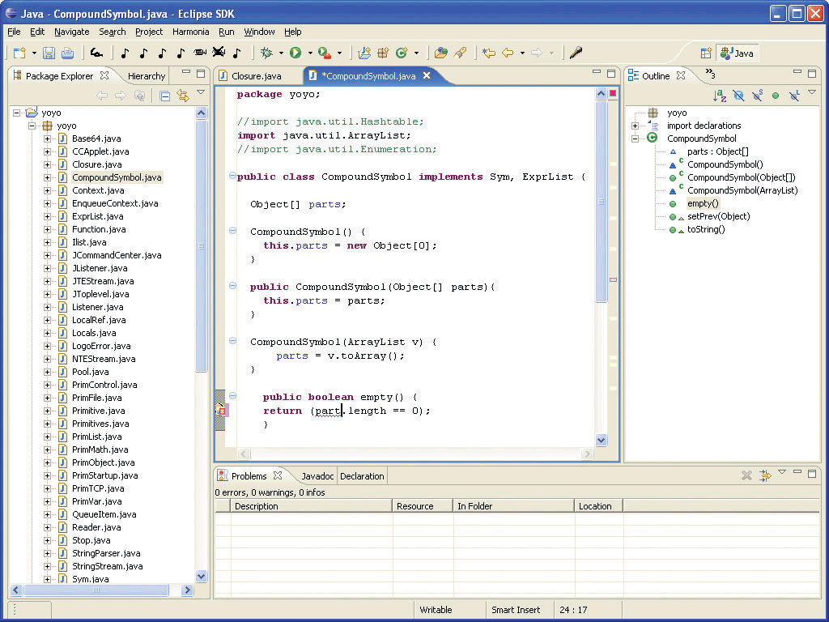
SPEED Editor
Notes:
40 minutes.

Slide 83
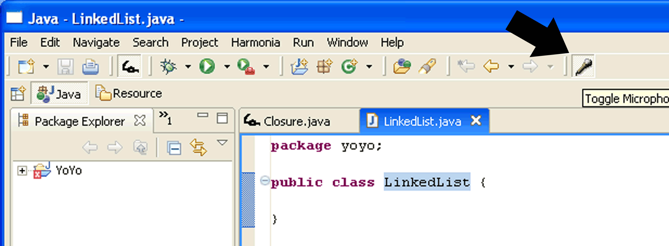
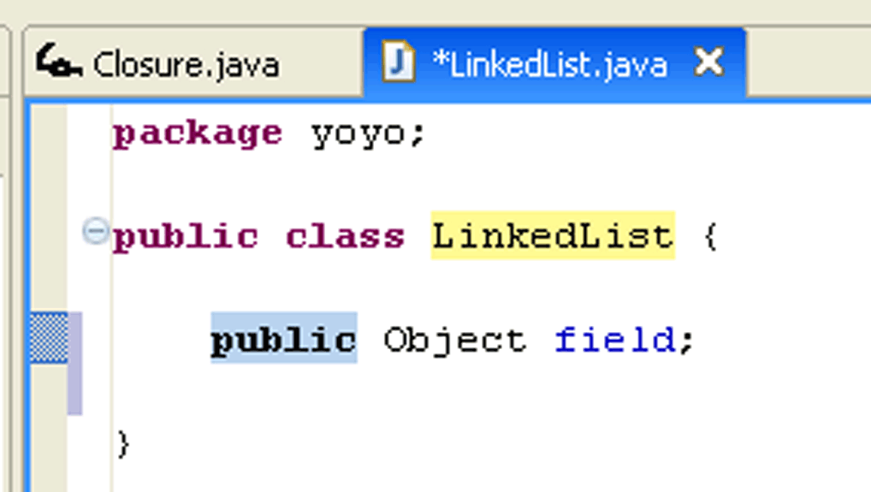
Speech Editing Model
Toggle
Microphone
Code Template
Insertion

Slide 84
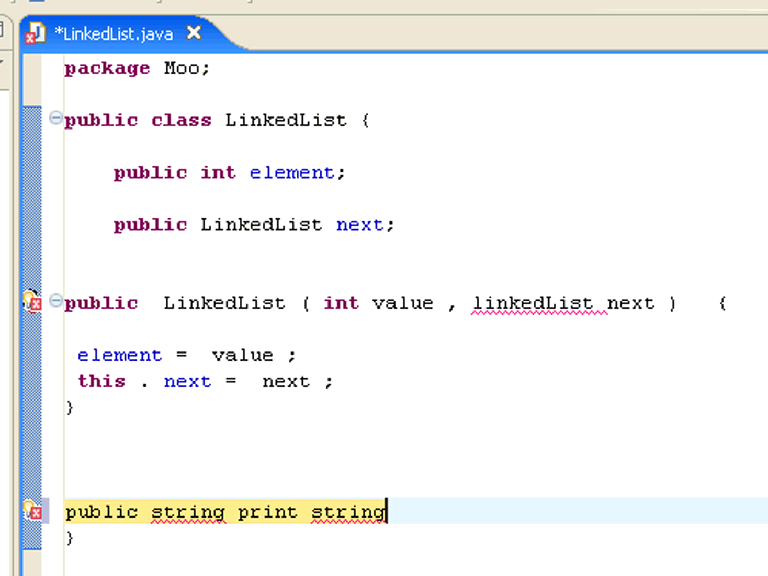
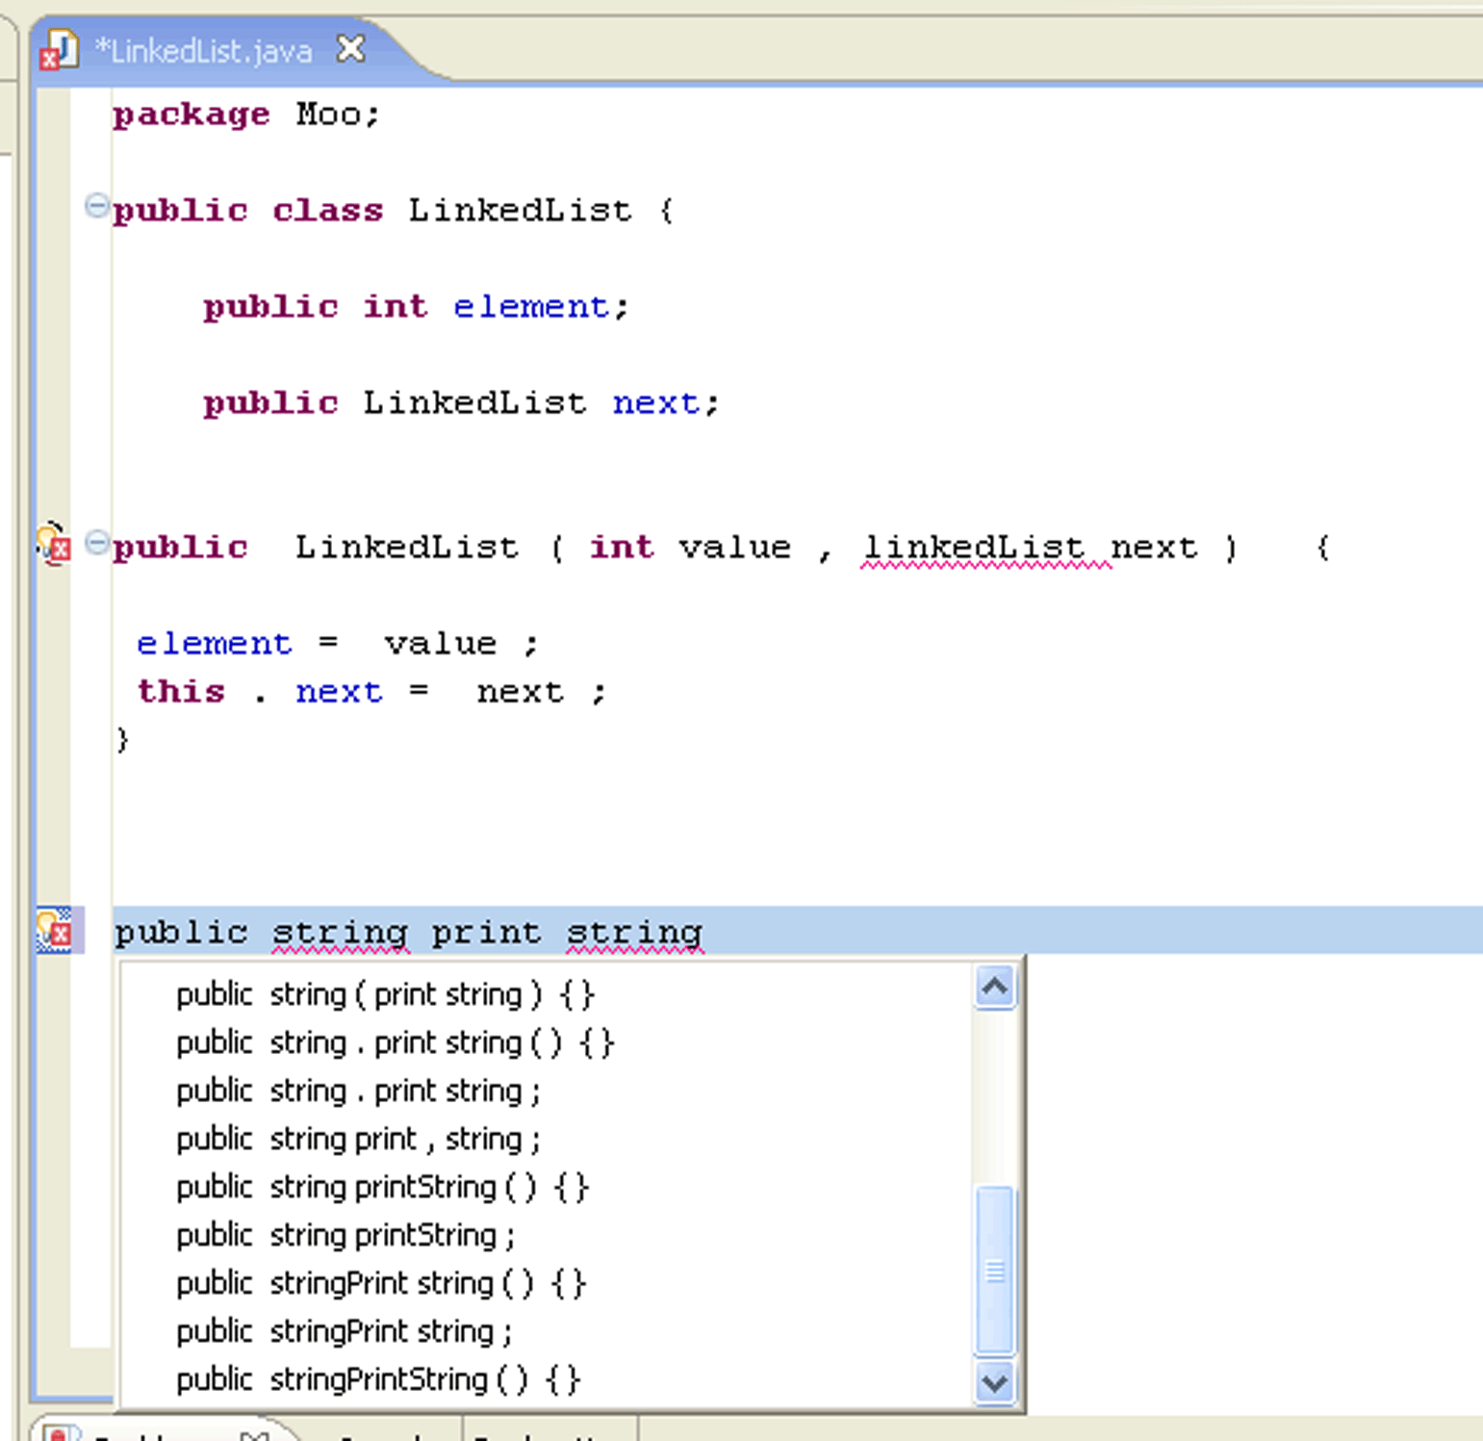
Speech Editing Model
Choose From
Alternatives

Slide 85
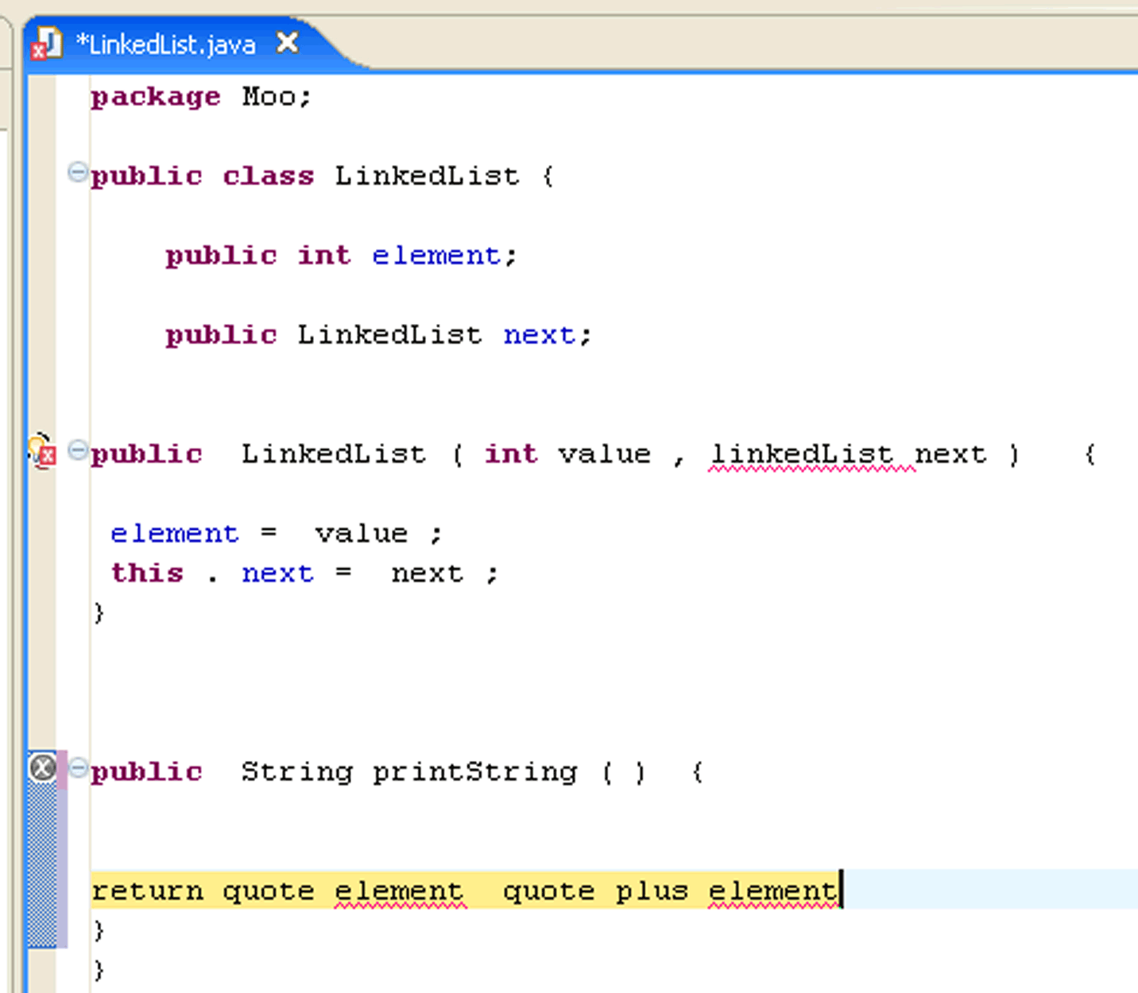
Speech Editing Model

Slide 86
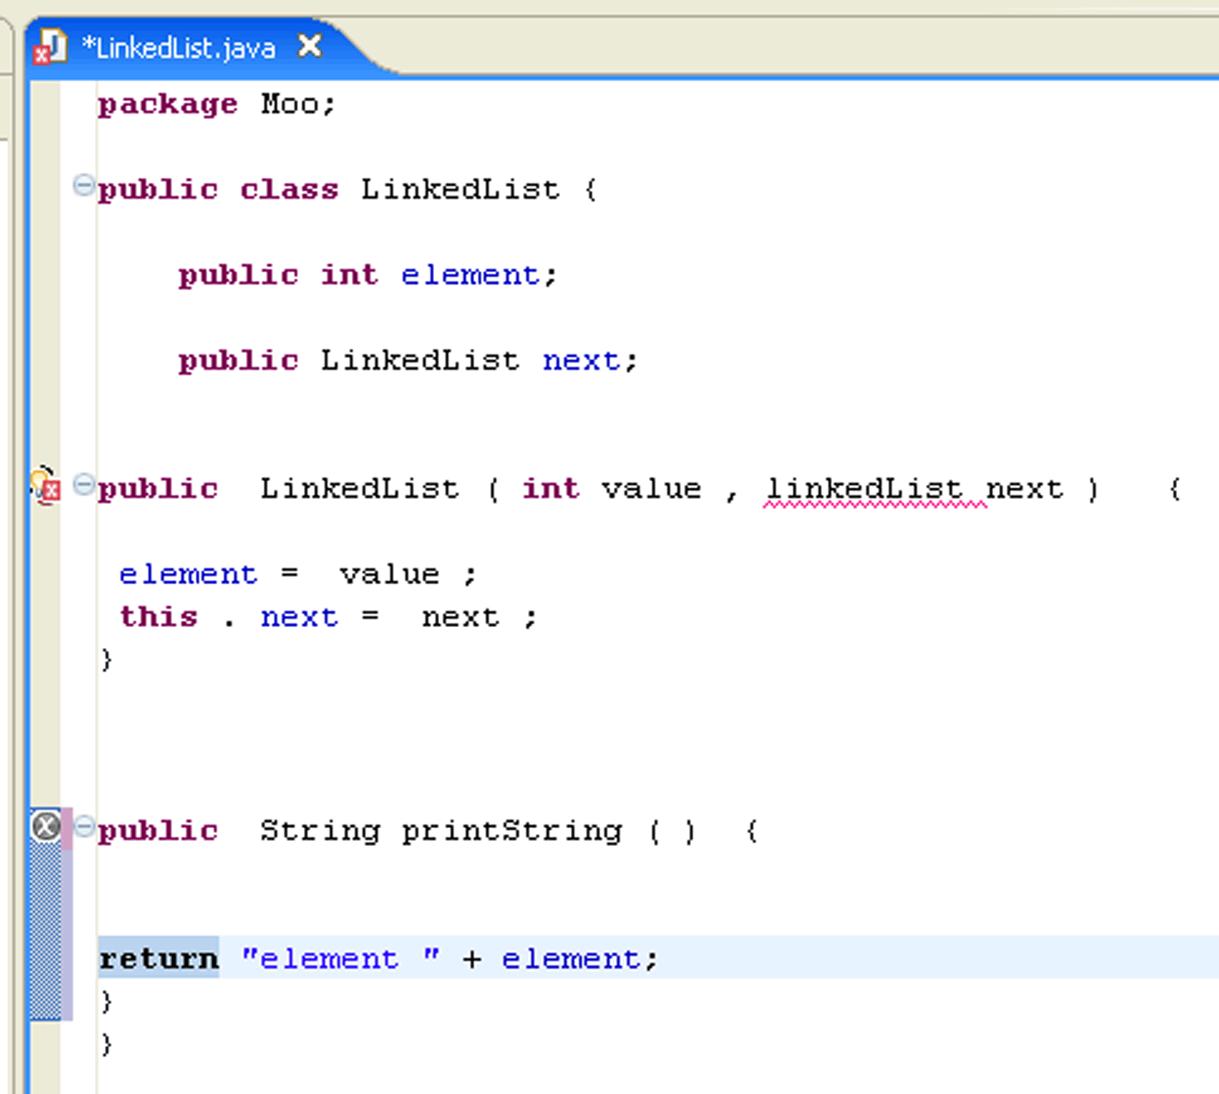
Speech Editing Model

Slide 87
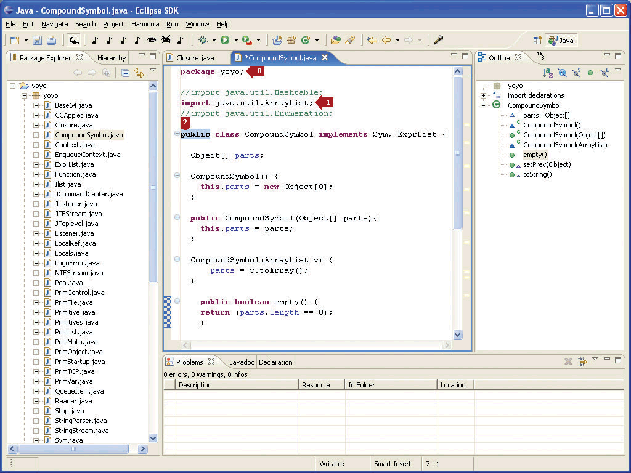
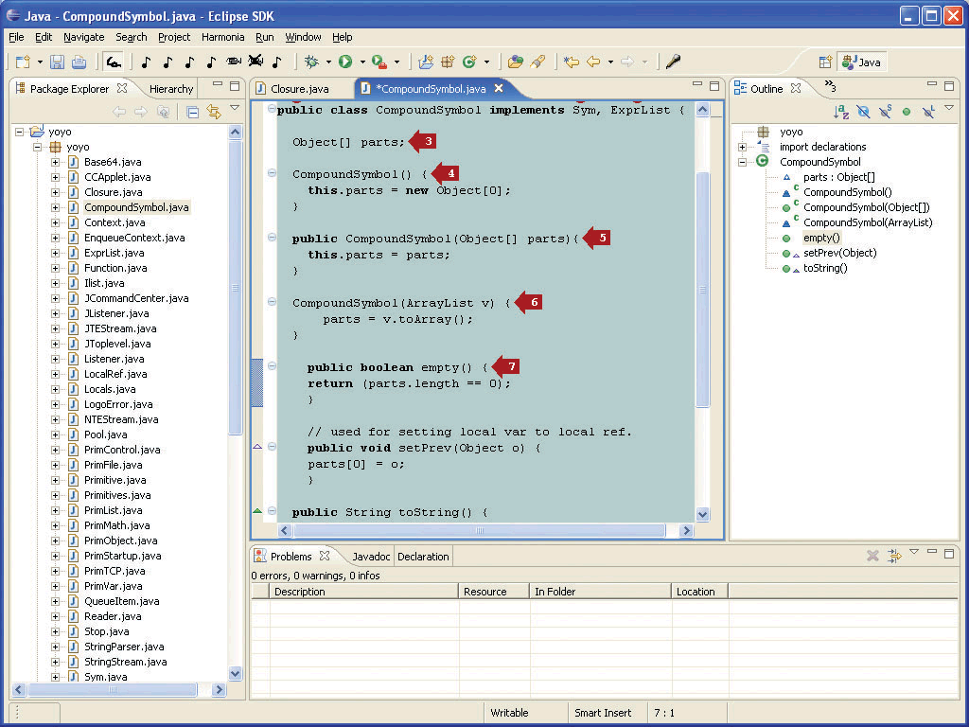
Context-Sensitive Mouse Grid

Slide 88
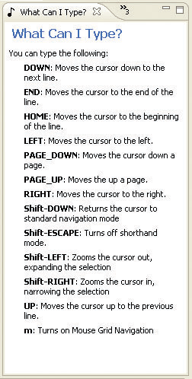
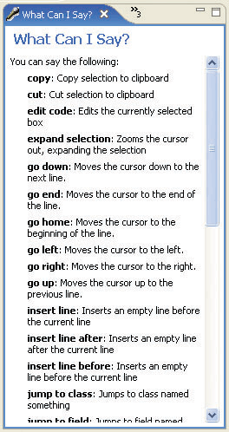
What Can I Say/Type?

Slide 89
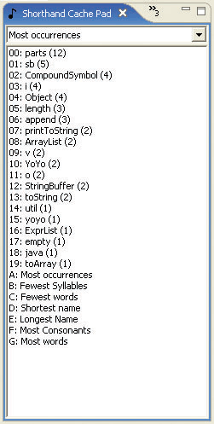
Cache Pad

Slide 90
Talk Outline
Introduction and Motivation
Programming by Voice
Program Analyses for Ambiguous Inputs
SPEech EDitor Programming Environment
SPEED User Study
Conclusion
Notes:
48 minutes.

Slide 91
Study - SPEED Usability
Goal: Understand how SPEED can be used by expert programmers
Hypothesis: SPEED is learnable and usable for standard programming tasks
Train 5 expert Java programmers on SPEED
Create and modify code
Build a Linked List data structure with associated algorithms
3 programmers used commercial speech recognizer 2 programmers used human speech recognizer
Notes:
Say this is for expert java programmers.
Rephrase system understanding (everything else is about the person, but this is about the system).
Find some terminology from AI systems evaluations (false positive rate etc)

Slide 92
Metrics
Number of Commands/Dictations
Features Used
Code Templates, Dictation, Navigation, Editing, Fixing Mistakes
Quantity and Kinds of Mistakes
Speech Recognition, SPEED, User

Slide 93
Results
Accuracy of commercial speech recognizers was horrible (25-50%). Human SR was much better (10-20%).
Recognition delay was equal for both recognizers (0.5-0.75 sec)

Slide 94
Results
Commands were easy to learn and remember.
Very few user mistakes
Most commands spoken for code templates and editing.
GOMS analysis predicts speech will be slower until you can get a lot of text for each utterance
Speakers were apprehensive about speaking code instead of describing it via code templates.

Slide 95
Study Conclusion
SPEED is learnable in a short amount of time
Programming-by-voice is slower than typing
Programmers would not want to use it until they had to
Programmers believed they would be efficient enough using SPEED to remain in software engineering jobs

Slide 96
Talk Outline
Introduction and Motivation
Programming by Voice
Program Analyses for Ambiguous Inputs
SPEech EDitor Programming Environment
SPEED User Study
Conclusion
Notes:
48 minutes.

Slide 97
Contributions
A study of programmers to understand and design a naturally verbalizable input for programming
An interactive editor designed for spoken interaction
The use of syntax and semantics of programming for disambiguation
Enhanced lexical, syntactic, semantic analyses for support of verbal ambiguities
Evaluation of design and tools by studying programmers using voice for software development

Slide 98
SPEED Next Steps
Add more code templates
Enable users to write their own
Add “Jump To <arbitrary code here>”
Find new ways to edit strings by voice
Integrate speech recognition with other IDE features
GUI, code completion, debugger

Slide 99
Further SPEED Studies
Develop methodology for short-term voice recognition studies
Find out why programmers felt code dictation was weird.
Evaluate more complex code editing operations by voice
Evaluate context-sensitive mouse grid usability

Slide 100
Future of Programming by Voice
Improved automation of semantic disambiguation
Use ideas from NLP, Machine Learning (team styles)
Early pruning of ambiguities using analysis feedback
Higher-level linguistic programming tools
Transformations, Paraphrasing
Phonetic search, Audible feedback
Support more software engineering tasks by voice
Debuggers, IDEs, Comments, Code reviews
Design spoken variants of other formal languages
General (C, C#) Scripting (PL, OS), Design (HCI), Command (Robotics), Domain-specific languages (SQL)

Slide 101
Any Questions?
Andrew Begel: abegel@cs.berkeley.edu

