Slide 1
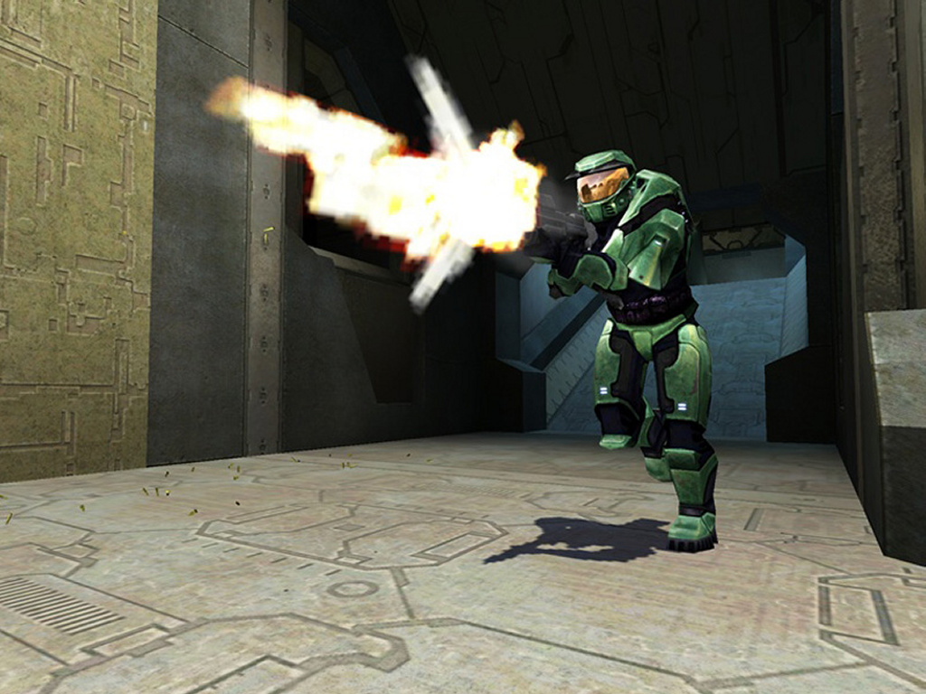
1 m TH3 L33t M45t3r. J00 H34R M3? J00 12 901n' d0wN. 1 W1ll 34t j00R n3w8 50ul PH0r 8R34kF45t.
(I am incredibly skilled. Do you understand that? Your attempts to defeat me will fail. I will gorge myself on your inexperienced soul this morning.)

Slide 2


Game Programming for High School Using XNA
Andrew Begel and Krishna Kumar
Microsoft
CS/IT Symposium - June 28, 2007

Slide 3
Let’s make a game!
Today we’re going to show you how to teach a unit on game design and implementation
Game Design
Storyline, Character Development, Interactivity
Game Implementation
C# programming, XNA libraries

Slide 4
Why Games?
Enables students to be creative, develop new ideas, communicate ideas, collaborate with others
Incorporates aspects of drawing, movie making, logic, math, and programming.
Programming promotes problem solving, systematic reasoning, deductive analysis
Entice students to the other half of computer literacy – writing.

Slide 5
Three Steps of Game Design
Game design is about 3 things:
Storyline
What is the game about?
Why would you play it?
How do you win?
Character Development
Who are the characters?
What do they look like?
How do they behave?
Interactivity
How do you play?
How does more than one player play?

Slide 6
Storyline
What games have you played?
What games do your students play?
Why do you play these games?
Where’s the fun?
How do you win?

Slide 7
Let’s design a new game!
To constrain it to what we can implement today, let’s stick to a 3D first-person game:
Doom, Quake, Mario Kart, Halo, etc.
What is your existential conflict?
Good vs. Evil
Brother vs. Brother
Man/Animal vs. Nature
Man vs. Man (Xenophobia)

Slide 8






Character Development
Who are the characters?
Who are your characters?
Let’s see what we’ve got!

Slide 9
Characters Can Move
What are your characters’ behaviors?
Moving
Jumping
Shooting
Kicking
Flying
Climbing
Hunting
Blowing Things Up
Dying

Slide 10
Back to Conflicts
Now that we have characters and a storyline...
How do you win?
Corollary: How do you score points?

Slide 11
Designing Play
What kinds of inputs do we have?
Keyboard, Mouse, Game Controller, DDR Pad, Wiimote?
What does each joystick/D-pad/button do?
Do combinations matter?
Easter Eggs: A A B A Jump Down Down B could give you super powers!

Slide 12
Encouraging Long Term Play
How hard is the game?
Beginner/Expert Mode
Increasing difficulty
How interesting is the game?
Puzzles, Prizes
How many people can play at once?
Two player: Fostering competition
Network: Fostering cooperation

Slide 13
Game Implementation
Let’s install some software!
Visual Studio C# 2005 Express
Visual Studio SP1 for all computers
Visual Studio SP1 for Vista (if applicable)
XNA SDK
Microsoft Paint or Paint Shop Pro

Slide 14

What is XNA
A new game development platform based on .NET 2.0
An extension of the Visual C# 2005 Express Edition IDE
A cross-platform set of libraries optimized for games
Targets PCs and XBOX 360

Slide 15













XNA Game Studio Express overview
XNA Game Studio Express
Managed DirectX
XNA Framework
Notes:
8/11/2012 8:01 PM
15

Slide 16
Interactive Session
Game Creation
Creating Scenery
Creating Characters
Adding Behaviors
Collision Behaviors
Hook Up Controllers
Play Your Game

Slide 17





















XNA Support in Academia
Notes:
Academia
Talk about the problems we see with the academic pipe for all computing. Describe why gaming is so relevant and why GSE is the perfect solution. Talk about what we are doing to help the academic uptake.
40 universities signed up (last count in November)
100 universities we are actively talking to.
World-wide: USA, Canada, Brazil, UK, Germany, Finland, Sweden, Japan, Australia, China
Iwatani-san (Pac-Man) teaching at Tokyo Polytechnic using XNA

Slide 18

Learn by Example: Spacewar
Full mini-game Starter Kits
Can be final destination or starting point
Growing library of genres over time
Focus on several key educational topics per Starter Kit

Slide 19
Resources
Andrew.Begel@microsoft.com Krishna.Kumar@microsoft.com
http://xnarocks.spaces.live.com
XNA Developer Center http://msdn.com/xna
DirectX Developer Center http://msdn.com/directx Game Development MSDN Forums (current) http://forums.microsoft.com/msdn
XNA Creators Club Online
http://creators.xna.com
Game Development MSDN Forums (future) http://forums.xna.com

Slide 20



Game Studio Express
Your World. Your Game
© 2007 Microsoft Corporation. All rights reserved.
This presentation is for informational purposes only. Microsoft makes no warranties, express or implied, in this summary.

