Slide 1
The software architects role in Green IT
Christian Abegg, Gregor Stöckli, Jürg Keller
Notes:
Christian
Jumped in for …
Who is … unfortunately
Happy to be back in Winterthur
Studied here
AND Met my employer
Software Engineer
Love job
Useful
Progress humand kind
No really, fantastic
Learn new stuff all the time – like here
Play around with the latest gadgets!
BUT

Slide 2
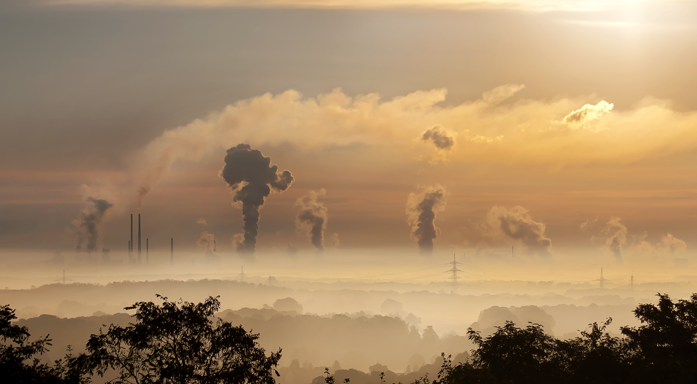
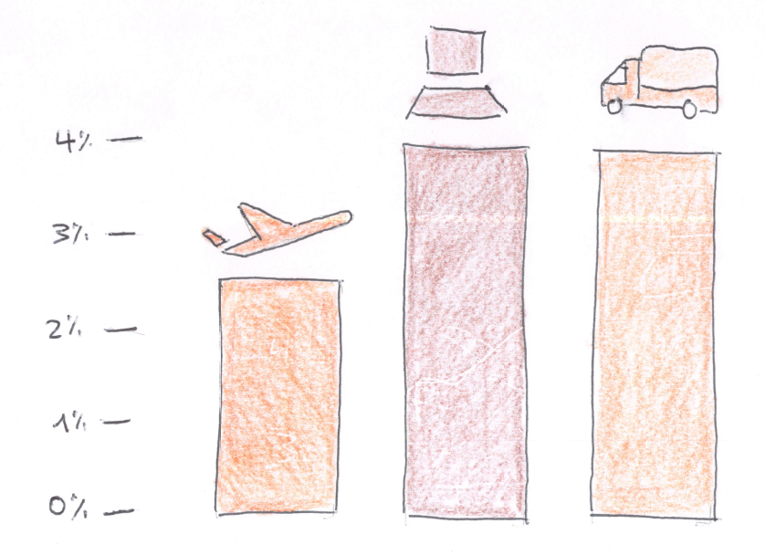
GREENHOUSE GAS EMISSIONS
Source: Digital Collage
Notes:
Let’s jump to another negative point: the greenhouse gas emissions.
Greenhouse gas is emitted for the production of the electricity we use to operate our hardware
and during the manufacturing
The digital sector is responsible…

Slide 3
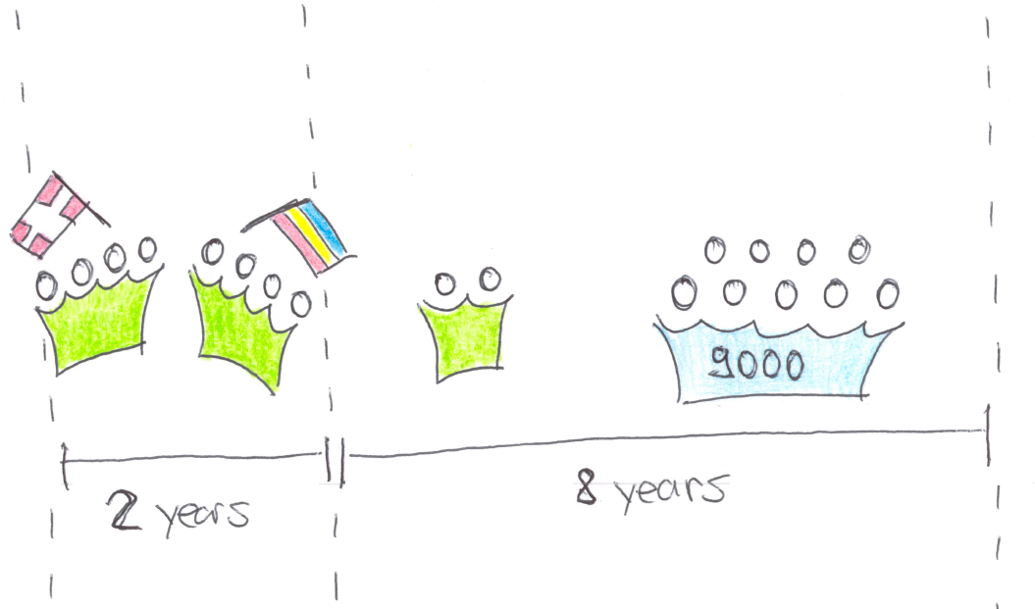
SIMULATED PROJECT

Slide 5
import {UseCloud} from "./UseCloud";
import {ReduceCoresAndMemoryBy50Percent} from "./ReduceCoresAndMemoryBy50Percent";
import {ExtendHardwareLifespanBy1Year} from "./ExtendHardwareLifespanBy1Year";
import {NoDistributedDevelopment} from "./NoDistributedDevelopment";
import {NoZombieServers} from "./NoZombieServers";
import {IncreaseHomeOfficeTo60Percent} from "./IncreaseHomeOfficeTo60Percent";
import {ReduceIndividualTrafficBy25Percent} from "./ReduceIndividualTrafficBy25Percent";
import {ReduceInternetTrafficBy25Percent} from "./ReduceInternetTrafficBy25Percent";
import {ScaleToZero} from "./ScaleToZero";
import {UseGreenEnergy} from "./UseGreenEnergy";
import {UseContinuousIntegrationAsService} from "./UseContinuousIntegrationAsService";
import {NoHotStandby} from "./NoHotStandby";
import {EatVegetarian} from "./EatVegetarian";
import {ApplyCarbonAwareness} from "./ApplyCarbonAwareness";

Slide 6
huge usage impact
-62%

Slide 7
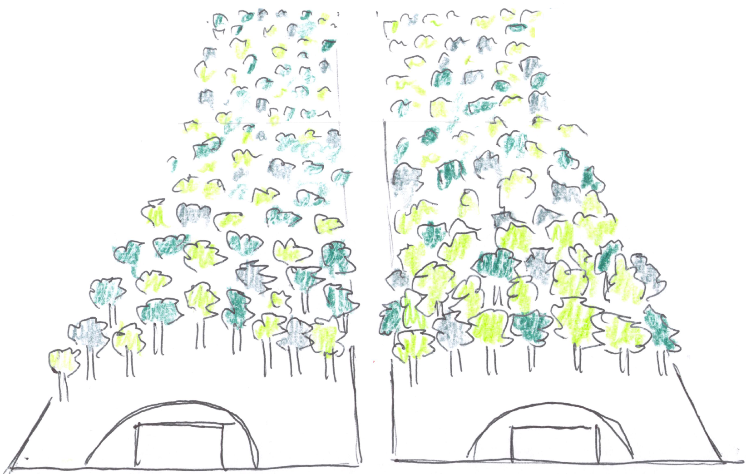
GREENHOUSE GAS EMISSIONS
Notes:
100t
In the area we can influence directly
300 000 fire extinguishers
2 footbal fields, during 10 years
https://www.pexels.com/photo/sky-clouds-building-industry-39553/

Slide 8
Total emissions
Engineers
Servers
Network Traffic
Notes:
Engineers: 65%
DevBoxes, Screens
Travel
Commute
Eat
Servers: 31%
Production, Staging, Test
CI/CD solution
Network Traffic 4%
- To end users
Let’s reduce these emission
ordered by their impact in the simulated software

Slide 9
Work in the same country
25%
Notes:
Avoiding flights

Slide 10
CUtting the number of cores and the memory in half
15%
25%
Notes:
VM
Case for optimized programming
Or to avoid overprovisioning

Slide 11
increase power usage EFFICIENCY by moving to a HYPERSCALER + lower emission factor per kwh
8%
Notes:
PUE from 2 to 1.1
Greener energy products

Slide 12
Switch off unused resources (i.e. outside of business hours)
8%

Slide 13
Decomission the 30% of zombie resources
7%

Slide 14
USE CLOUD BASED CI/CD solution
7%

Slide 15
USE A GREEN ENERGY PRODUCT
7%
Notes:
ProNatur: 19g/kwH
CH consumption: 153g/kwh
Easter Europe: 500g/kwh

Slide 16
INCREASE HOME OFFICE FROM 1 TO 3 DAYS
7%
Notes:
Avoiding commute
Other measures with the same angle
Means of transport

Slide 17
Eat Vegetarian lunches
6%

Slide 18
EXTENDING HARDWARE LIFESPAN BY ONE YEAR
5%
Notes:
Gain comes from embodied emissions

Slide 19
Relaxing hot-standby requirements - use IaC
4%

Slide 20
REDUCING network TRAFFIC BY 25%
3%
Notes:
Not a traffic intensive application
Don’t apply it to your scenario 1:1
And another warning: it’s not scientific!

Slide 21
Combined measures
75% reduced
25%
Notes:
Cannot just add together
Saved 75tons!

Slide 22
Combined effort
25%

Slide 23
github.com/abeggchr/ environmental-impact-estimator
Notes:
You find all the calculations in my github repo
And I look forward to exchange on it
So, to close:
Let us reduce the environmental impact …

