Slide 1
The software architects role in Green IT
Christian Abegg, Gregor Stöckli, Jürg Keller

Slide 2
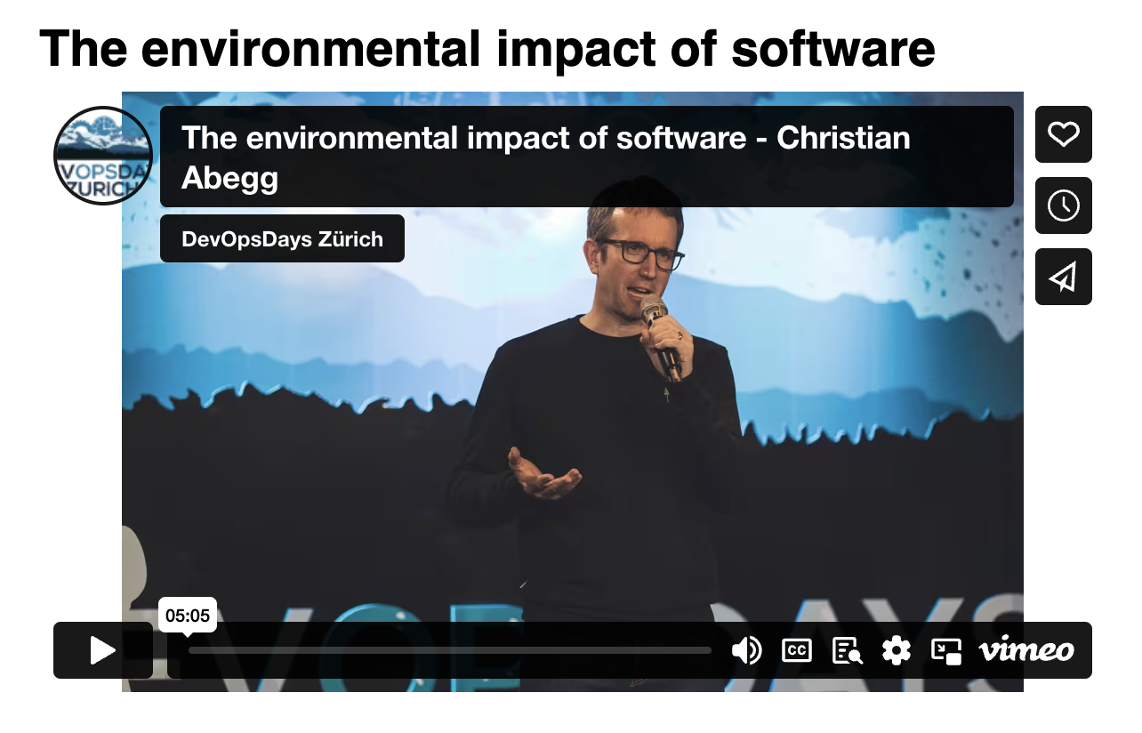

Slide 3
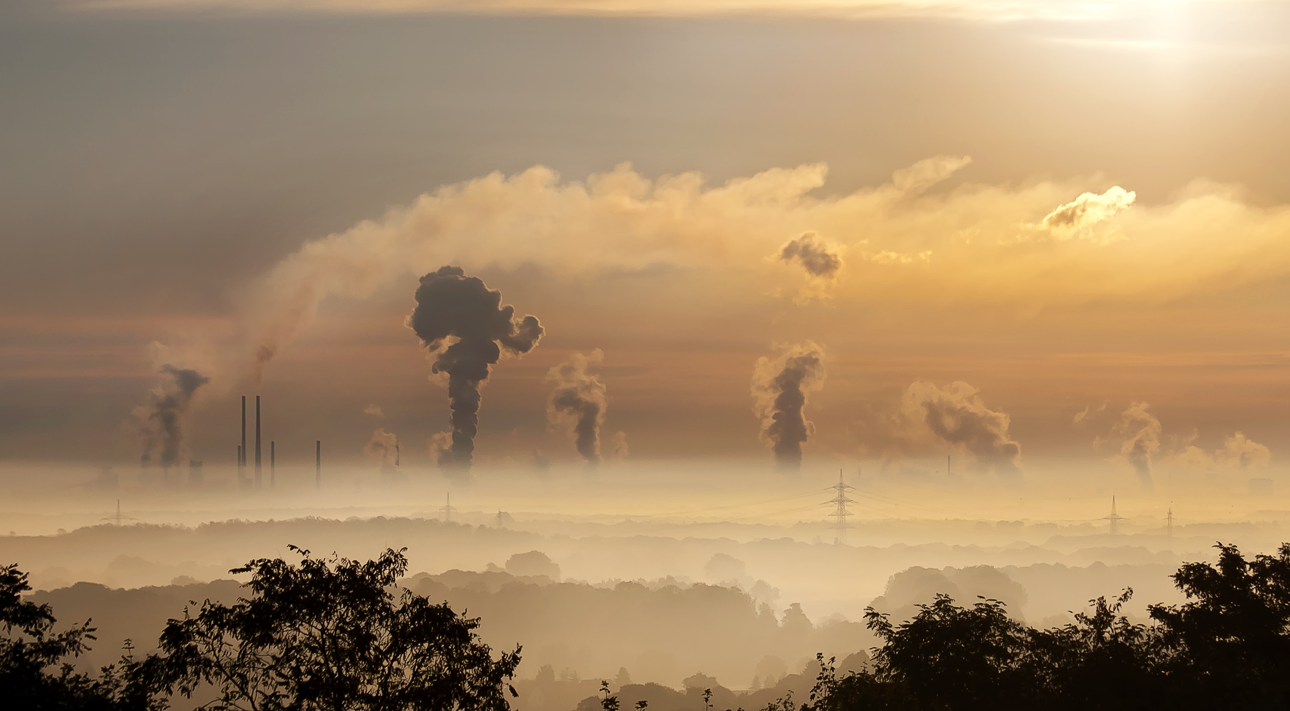
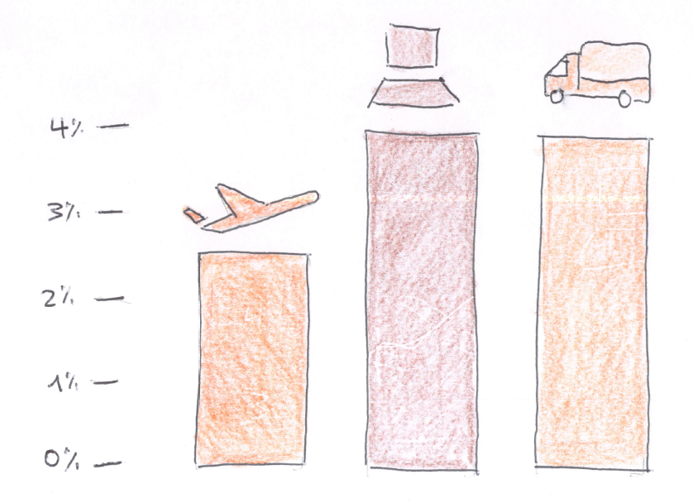
GREENHOUSE GAS EMISSIONS
Source: Digital Collage
Notes:
The digital sector is responsible…

Slide 4
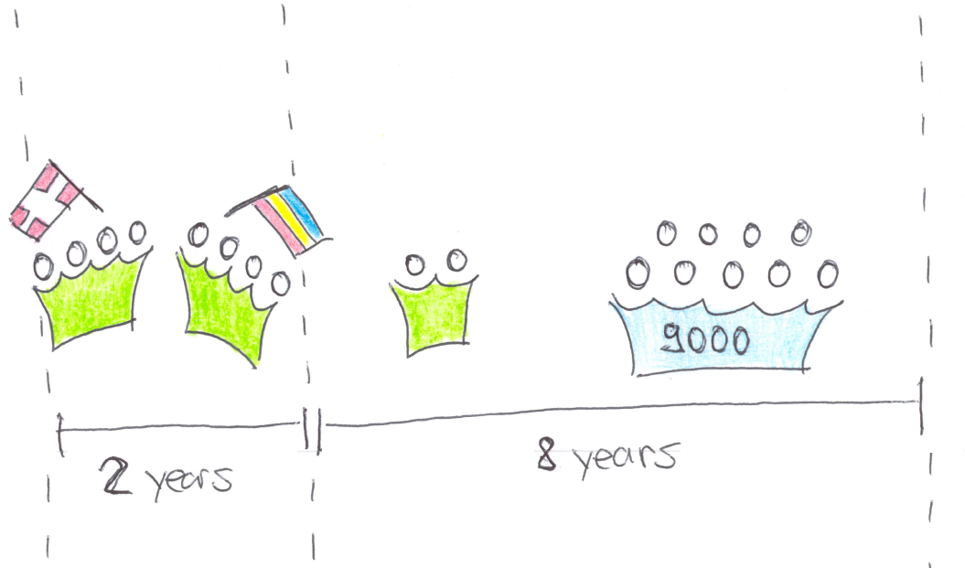
SIMULATED PROJECT

Slide 5
SIMULATED PROJECT
The application is a single page application served by a web-server which gets the data from a database-server. A job-server takes care of long-running jobs.
Webserver
Database
Jobserver

Slide 6
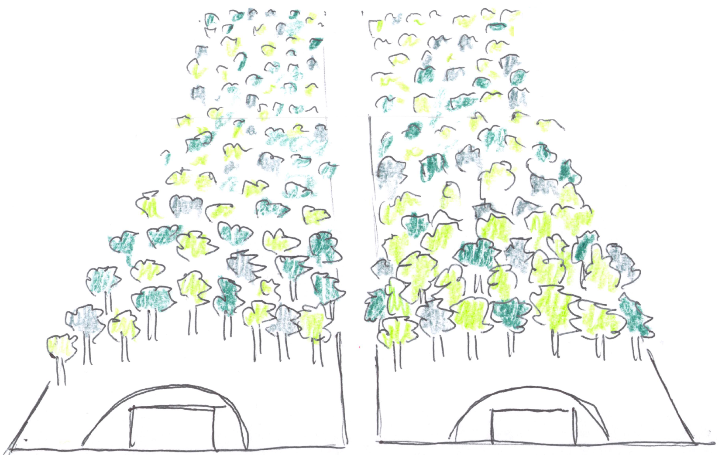
GREENHOUSE GAS EMISSIONS
100t
Notes:
100t
In the area we can influence directly
300 000 fire extinguishers
2 footbal fields, during 10 years
https://www.pexels.com/photo/sky-clouds-building-industry-39553/

Slide 9
The impact of data centres and networks is much lower in the
example project. Why? A) the example does not reflect how
digital services are used in general B) some calculations are
wrong
Notes:
Other studies report up to 45% for data centres.

Slide 10
import {UseCloud} from "./UseCloud";
import {ReduceCoresAndMemoryBy50Percent} from "./ReduceCoresAndMemoryBy50Percent";
import {ExtendHardwareLifespanBy1Year} from "./ExtendHardwareLifespanBy1Year";
import {NoDistributedDevelopment} from "./NoDistributedDevelopment";
import {NoZombieServers} from "./NoZombieServers";
import {IncreaseHomeOfficeTo60Percent} from "./IncreaseHomeOfficeTo60Percent";
import {ReduceIndividualTrafficBy25Percent} from "./ReduceIndividualTrafficBy25Percent";
import {ReduceInternetTrafficBy25Percent} from "./ReduceInternetTrafficBy25Percent";
import {ScaleToZero} from "./ScaleToZero";
import {UseGreenEnergy} from "./UseGreenEnergy";
import {UseContinuousIntegrationAsService} from "./UseContinuousIntegrationAsService";
import {NoHotStandby} from "./NoHotStandby";
import {EatVegetarian} from "./EatVegetarian";
import {ApplyCarbonAwareness} from "./ApplyCarbonAwareness";

Slide 11
huge usage impact
-62% usage + team + machine
-75% team + machine

Slide 12
Where does it most make sense? Where less?
Hardware Lifespan / Backward compatibility
Selection of energy provider for hosting (green energy)
Selection of hosting provider (highly efficient)
Keeping team efforts low
Keeping travels short
…?

Slide 13
Questions
What do we optimize in Green IT:
Energy
Carbon
Water
Natural resources
Where does it make sense for us to take action? Where does it not make sense?

Slide 14
Hypothesis to prove wrong
Sustainable software engineering reduces the carbon impact of the digital sector, but is not able to specify to what extend.
Sustainable software engineering reduces the carbon impact of the digital sector only by a small percentage.
All improvements made by optimizing software are overtaken the ever growing demand for digital services.

Slide 15
Anhang

Slide 16
Total emissions
Scope: what software engineers can influence (= without usage)
Engineers
Servers
Network Traffic
Notes:
Engineers: 65%
DevBoxes, Screens
Travel
Commute
Eat
Servers: 31%
Production, Staging, Test
CI/CD solution
Network Traffic 4%
- To end users
Let’s reduce these emission
ordered by their impact in the simulated software

Slide 17
Work in the same country
25%
Notes:
Avoiding flights

Slide 18
CUtting the number of cores and the memory in half
15%
25%
Notes:
VM
Case for optimized programming
Or to avoid overprovisioning

Slide 19
increase power usage EFFICIENCY by moving to a HYPERSCALER + lower emission factor per kwh
8%
Notes:
PUE from 2 to 1.1
Greener energy products

Slide 20
Switch off unused resources (i.e. outside of business hours)
8%

Slide 21
Decomission the 30% of zombie resources
7%

Slide 22
USE CLOUD BASED CI/CD solution
7%

Slide 23
USE A GREEN ENERGY PRODUCT
7%
Notes:
ProNatur: 19g/kwH
CH consumption: 153g/kwh
Easter Europe: 500g/kwh

Slide 24
INCREASE HOME OFFICE FROM 1 TO 3 DAYS
7%
Notes:
Avoiding commute
Other measures with the same angle
Means of transport

Slide 25
Eat Vegetarian lunches
6%

Slide 26
EXTENDING HARDWARE LIFESPAN BY ONE YEAR
5%
Notes:
Gain comes from embodied emissions

Slide 27
Relaxing hot-standby requirements - use IaC
4%

Slide 28
REDUCING network TRAFFIC BY 25%
3%
Notes:
Not a traffic intensive application
Don’t apply it to your scenario 1:1
And another warning: it’s not scientific!

Slide 29
Combined measures
75% reduced
25%
Notes:
Cannot just add together
Saved 75tons!

Slide 30
Combined effort
25%

Slide 31
github.com/abeggchr/ environmental-impact-estimator
Notes:
You find all the calculations in my github repo
And I look forward to exchange on it
So, to close:
Let us reduce the environmental impact …

