Slide 1


UI Testing Travel Guide

Slide 2
How to develop

Slide 3
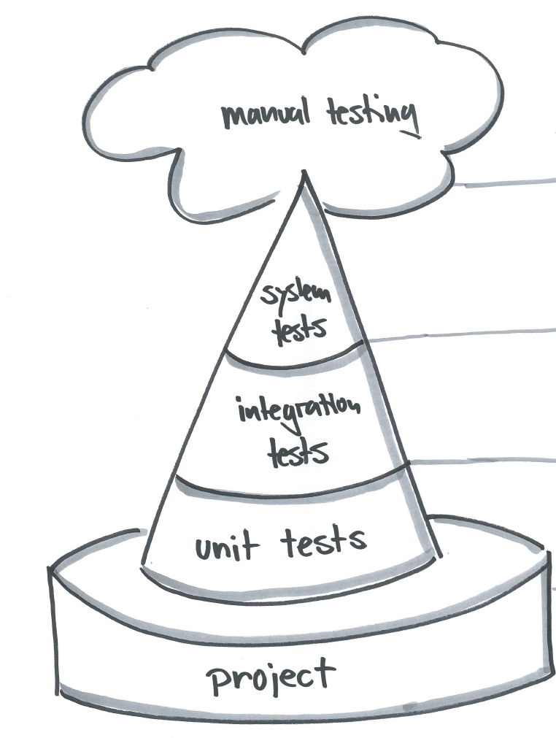
What to test

Slide 4
Granularity

Slide 5




Target Browser
Technical View Business View

Slide 6
How to setup a stable environment

Slide 7
How to implement maintainable tests

Slide 8

ElementNotVisibleException
NoSuchElementException
How to implement reliable tests

Slide 9
Wait Strategies
Implicit
Explicit
Explicit (generic)
Protractor
Wrapper
Cypress
driver.manage().timeouts().implicitlyWait(10,TimeUnit.SECONDS);

Slide 10
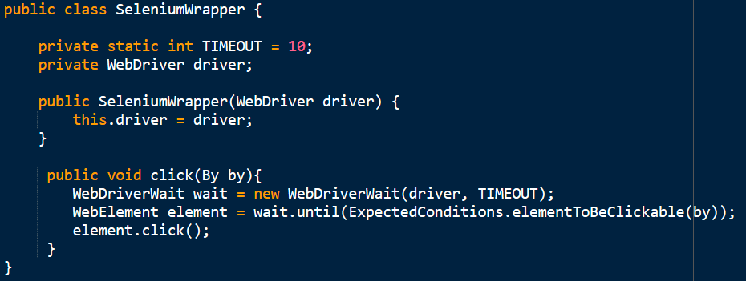
Wait Strategies
Implicit
Explicit
Explicit (generic)
Protractor
Wrapper
Cypress

Slide 11
Wait Strategies
Implicit
Explicit
Explicit (generic)
Protractor
Wrapper
Cypress

Slide 12

Wait Strategies
Implicit
Explicit
Explicit (generic)
Protractor
Wrapper
Cypress

Slide 13
Wait Strategies
Implicit
Explicit
Explicit (generic)
Protractor
Wrapper
Cypress
Notes:
public class SeleniumWrapper { private static int TIMEOUT = 10; private WebDriver driver; public SeleniumWrapper(WebDriver driver) { this.driver = driver; } public void click(By by){ WebDriverWait wait = new WebDriverWait(driver, TIMEOUT); WebElement element = wait.until(ExpectedConditions.elementToBeClickable(by)); element.click(); }}

Slide 14

Wait Strategies
Implicit
Explicit
Explicit (generic)
Protractor
Wrapper
Cypress
Notes:
public class SeleniumWrapper { private static int TIMEOUT = 10; private WebDriver driver; public SeleniumWrapper(WebDriver driver) { this.driver = driver; } public void click(By by){ WebDriverWait wait = new WebDriverWait(driver, TIMEOUT); WebElement element = wait.until(ExpectedConditions.elementToBeClickable(by)); element.click(); }}

Slide 15
Questions

Slide 21
How to develop

