Slide 1
Decision Tree for Default Analysis using R

Slide 2
Decision Tree for Default Analysis using R
Load Data
Fit a classification tree
da_tree_classifier1 <- rpart(default_indicator ~ . - default_event - default_flag, data = def, cp = 10^(-6)) rpart.plot(da_tree_classifier1, extra=101, type=4)

Slide 3
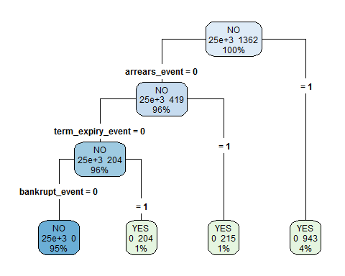

Slide 4
da_tree_classifier2 <- rpart(default_indicator ~ cc_util + arrears_months, data = def, cp = 10^(-6))
Prune to two branches
cp2 = which(da_tree_classifier2$cptable[,2] == 2) da_tree_classifier2 <- prune(da_tree_classifier2, da_tree_classifier2$cptable[cp2,1]) rpart.plot(da_tree_classifier2, extra=108, type=4)

Slide 5
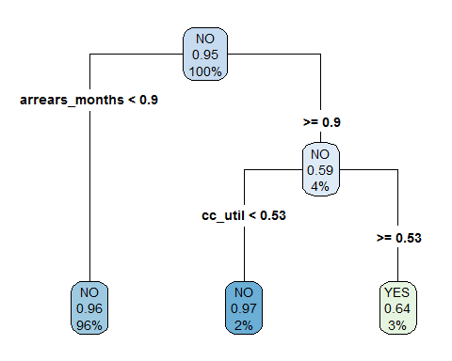

Slide 6
Fit a regression tree classifier
da_tree_regression <- rpart(default_event ~ ., method='anova', data = subset(def, select=-c(default_indicator, default_flag)), cp = 10^(-6), model=TRUE) rpart.plot(da_tree_regression, extra=101, type=4)

Slide 7
