Slide 1

Ambulance Retrieval System
Coder0
(Abel Philip - 001059118)

Slide 2

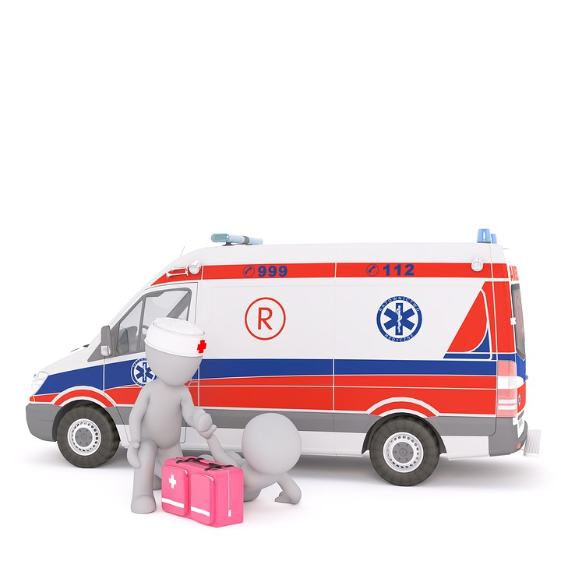
Current Flow
Call placed to 911 Operator for emergency
Call placed to 911 Operator for emergency
Confirms Ambulance with local departments by call
Confirms police officers with nearest Police Department by call
Both Ambulance & Police reach the emergency location. Patient is taken to hospital
POLICE

Slide 3

Problem Statement
Change traditional way of retrieving ambulance
Decrease Response Time
Patients’ vital signs recorded at the hospital
Allotment of ambulances

Slide 4
Solution:
Automate allocation of ambulances & police officers
Record vital signs of patient on the way to hospital to avoid delays in treatment
Identify locations with frequent emergencies & allocate ambulances accordingly to furthermore decrease response time

Slide 5
Approach:
911 Operator enters details into the application post receiving an emergency call
Ambulance allotted basis availability and current location
Ambulance Driver receives notification for a ride
Post patient pick-up, paramedic starts recording vital signs
Staff receives the records while patient is on the way to hospital to make necessary arrangements

Slide 6
Use Case
Driver & Paramedic updates ambulance info in the application
Ride entity created after 911 operator enters details
Ride entity created after 911 operator enters details
Police & Ambulance allocated basis location and availability
Visit entity created for hospital staff to record details easily
After picking up patient, paramedic notes vital signs
Driver navigates to the emergency location and updates ride details
Visit entity created for hospital staff to record details easily
Hospital Staff updates payment details
Health departments allocate ambulances to locations basis demand and timings

Slide 7
Sample Architecture
US Federal Health Department
State Health Department Directory
State Health Department
Local Health Department Directory
Local Health Department
Local Health Department
Hospital Directory
Police Directory
Hospital
Police
911 Operator
Ambulance Driver
Paramedic
Staff
Police Officer

Slide 8
Work Flow
Caller
911 Operator
Ambulance Driver
Paramedic
Hospital Staff
Police Officer

Slide 9
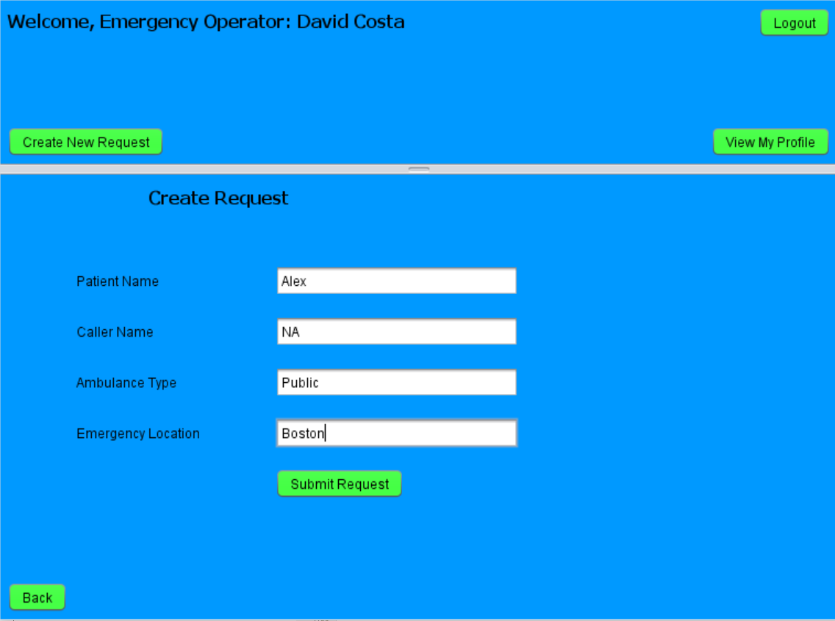
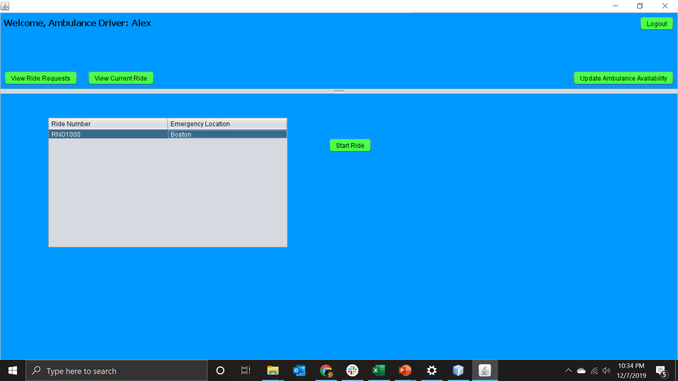
911 Operator Submitting Ride Request
Ambulance Driver Starting Rides

Slide 10
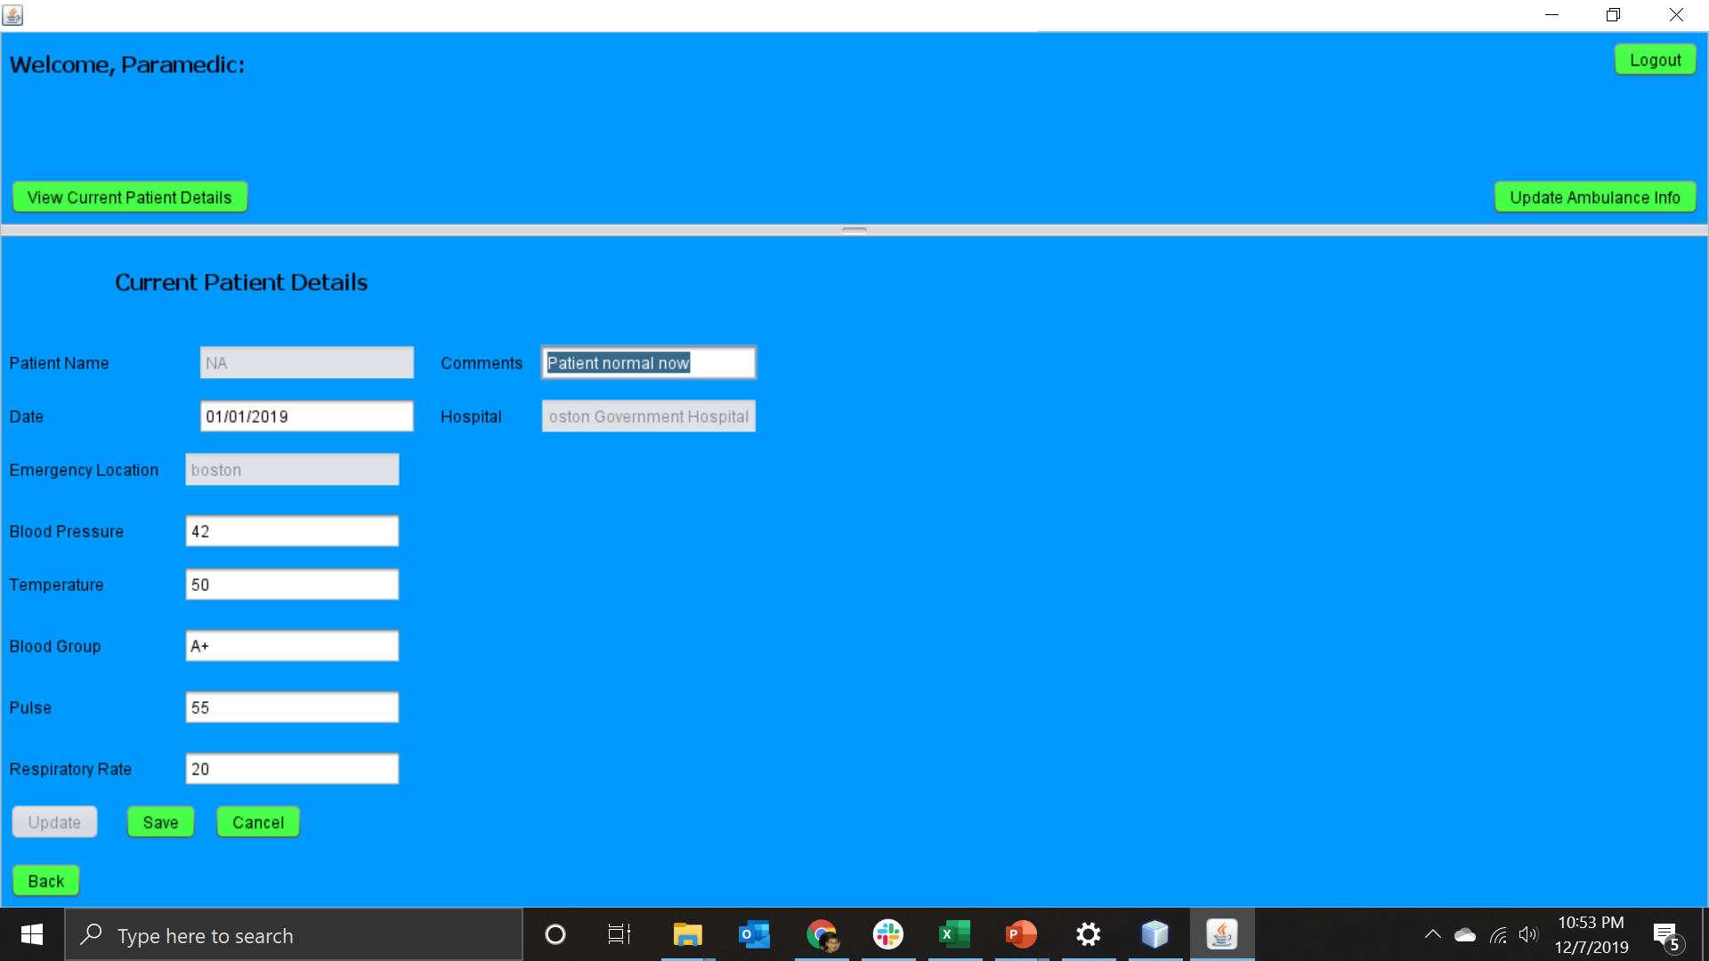
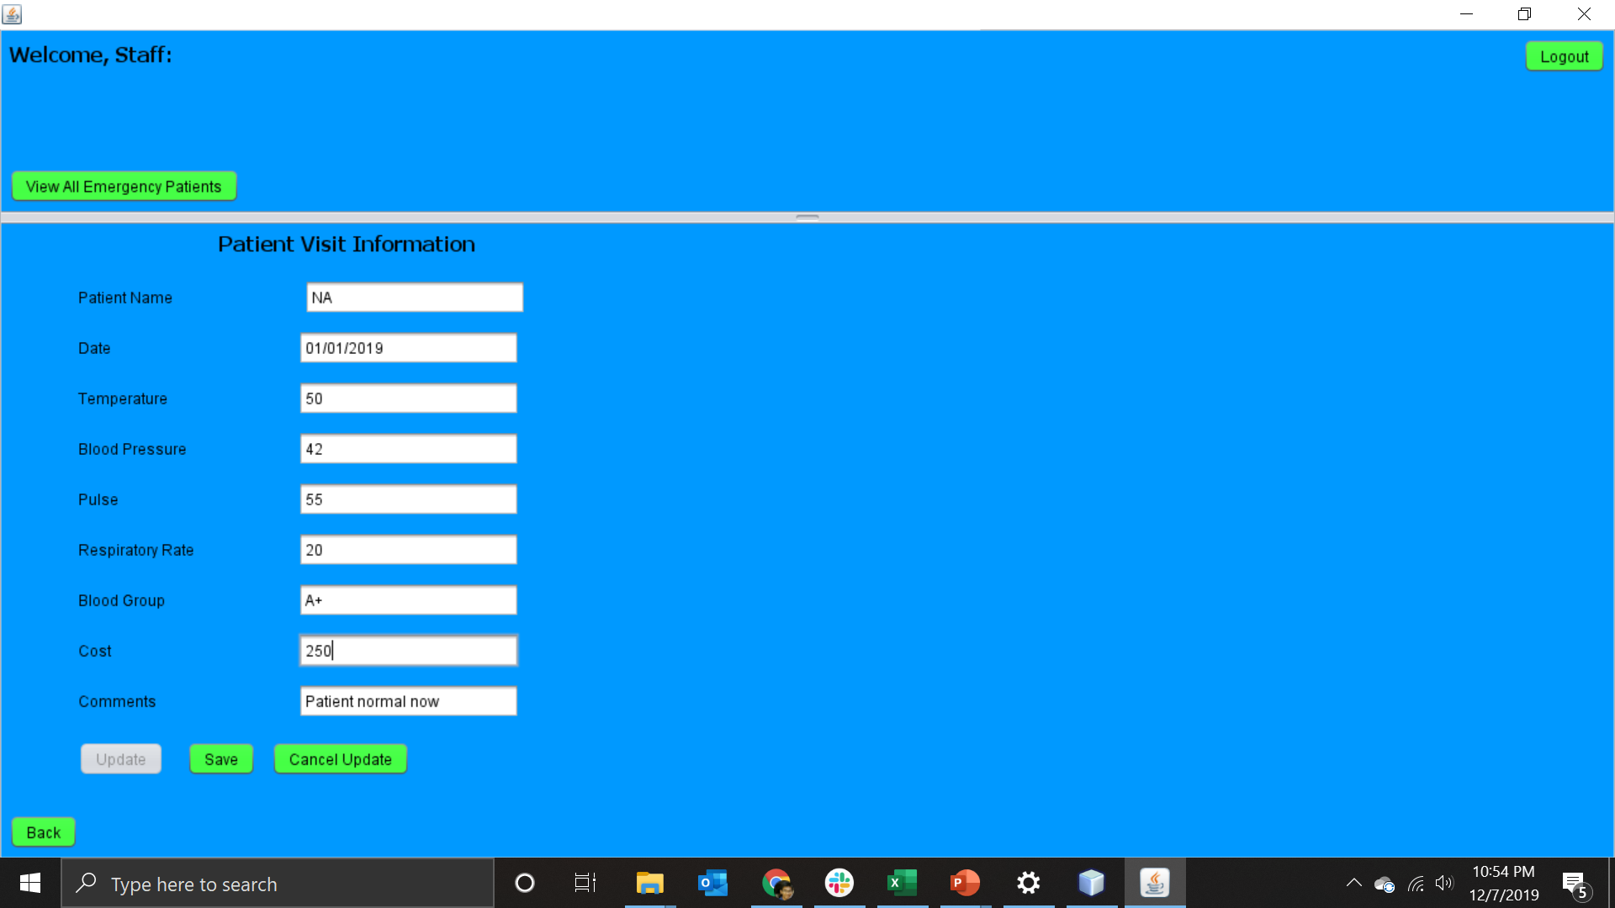
Paramedic Recording vital signs
Hospital Staff entering cost details
Hospital Staff entering cost details

Slide 11
Thank You!

