Slide 1
Aircraft With Lowest Risk For Business Expansion
Phase 1 Project
Business Risk Assessment for Commercial & Private Aircraft Purchase and Operation
ABEL ALEU CHOL GARANG | 20.12.2025

Slide 2
Business Understanding
Business Goal: Identify lowest-risk aircraft for new aviation investment
Stakeholder: Head of Aviation Division
Key Business Objectives
Focus on commercial and private aircraft
Evaluate aircraft safety records to support acquisition decisions
Translate findings into actionable insights
Ensure investment in aircraft with proven safety records
Reduce insurance costs and operational downtime

Slide 3
Data Understanding
Source: NTSB Aviation Accident Dataset (1962–2023)
Coverage: Civil aviation accidents & incidents
Key Variables Used
Aircraft Make and Model
Injury Severity
Fatal Injuries count
Aircraft Category
Purpose of Flight
Event Date
Dataset Summary:
Over 60 years of historical aviation safety data
Includes both fatal and non-fatal accidents
Enables comparison of aircraft safety performance across categories and use cases.

Slide 4
Data Cleaning & Preparation
Tools Used to clean data:
Python (pandas)
Key Data Preparation Steps:
Removed irrelevant and duplicate records
Handled missing values in injury and aircraft fields
Standardized aircraft make and model names
Aggregated accident records by Aircraft Make and Model
Created a Fatal Accident Flag
Calculated a Composite Risk Score for each aircraft
Outcome:
A clean, analysis-ready dataset suitable for risk assessment and visualization
Key Steps:
Missing value handling
Aggregation by aircraft model
Risk Score & Fatal Accident Flag creation

Slide 5
Exploratory Data Analysis
Exploratory Data Analysis
We explored historical aviation accident data to understand:
How accidents are distributed over time
Differences between aircraft categories
Fatal vs non-fatal accident patterns
Key risk indicators that influence aircraft safety
Purpose:
Identify patterns that inform aircraft risk assessment and purchasing decisions.

Slide 6
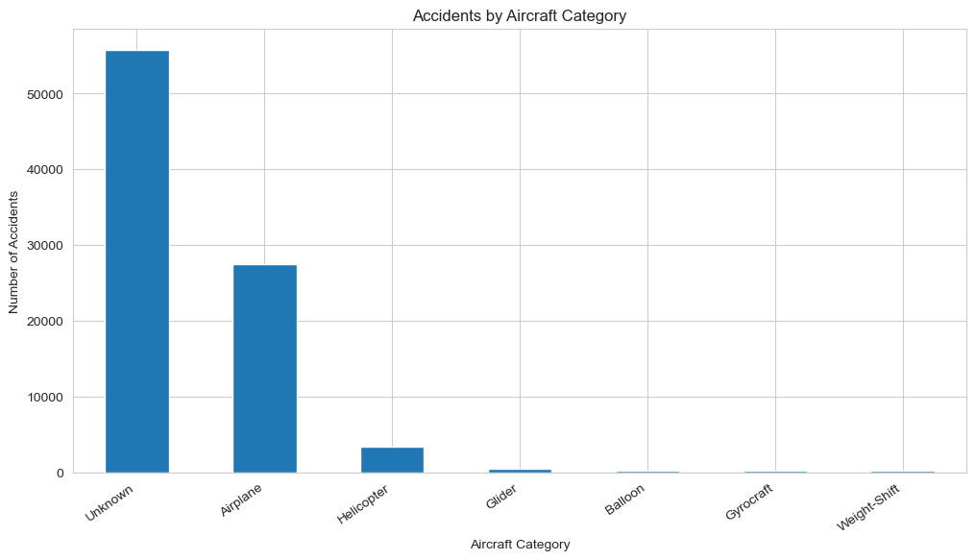
Accident Frequency by Aircraft Category
Certain aircraft categories account for a disproportionately high number of accidents, highlighting category-level risk differences.

Slide 7
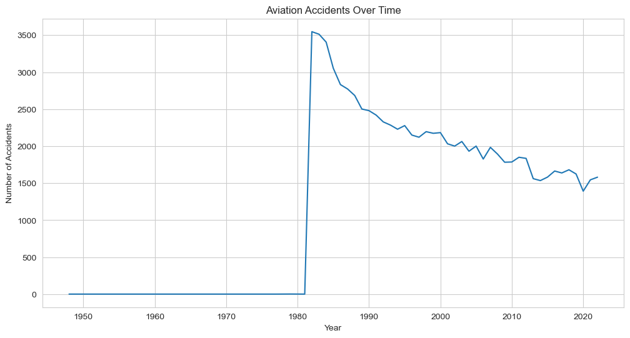
Aviation Accidents Over Time
Accident frequency has declined over time, suggesting improvements in aviation safety standards and technology.

Slide 8
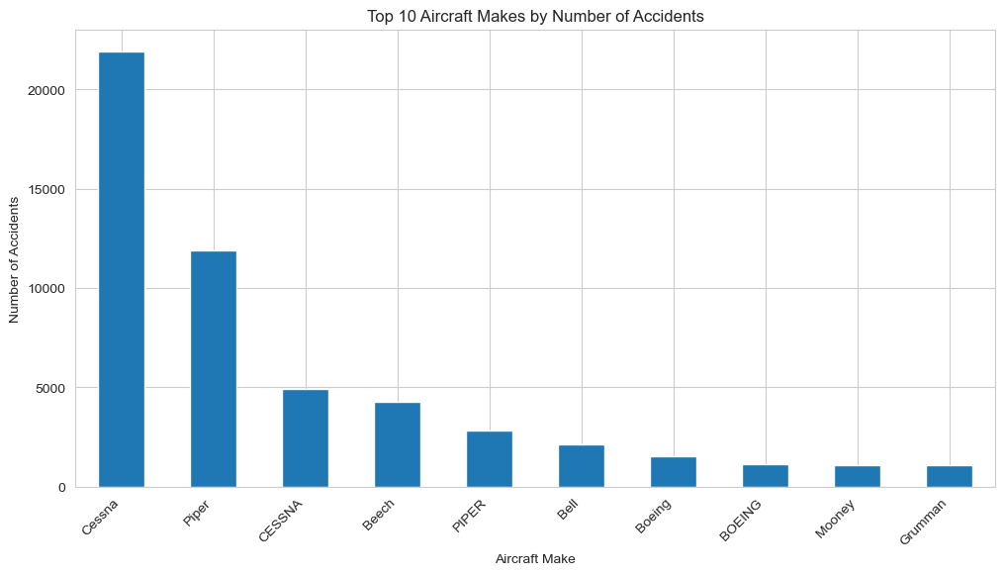
Aircraft Make Risk Exposure
High accident counts often reflect higher usage, not necessarily poor safety requiring normalization during risk scoring.

Slide 9
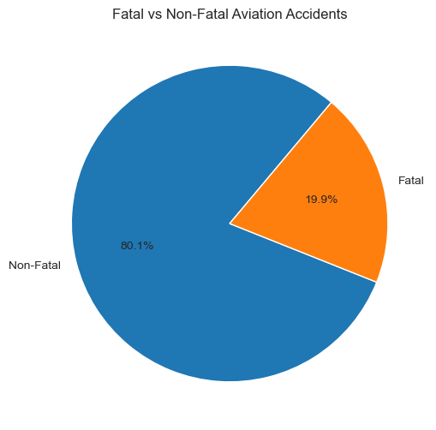
Fatal accidents represent a small fraction of total incidents, but they remain high-impact events critical for risk assessment.
Fatal vs Non-Fatal Accidents

Slide 10
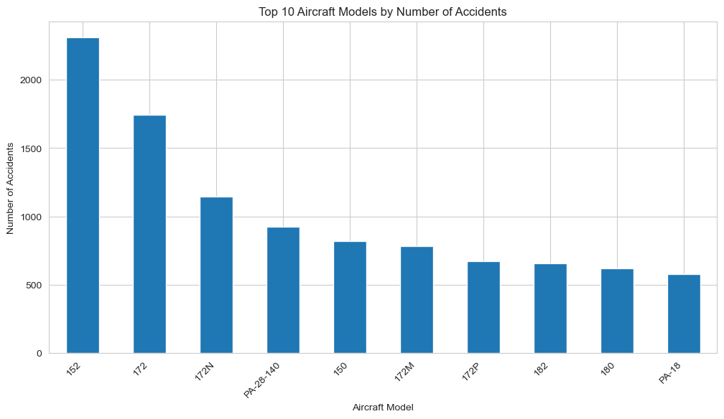
Aircraft Model Risk Exposure
Some models appear frequently, reinforcing the need for risk aggregation metrics beyond raw counts.
e

Slide 11
Aircraft Risk Visualization
Content
Visual comparison of aircraft risk using aggregated metrics
Focus on accident frequency, fatal history, and composite risk score
Supports identification of low-risk aircraft models

Slide 12
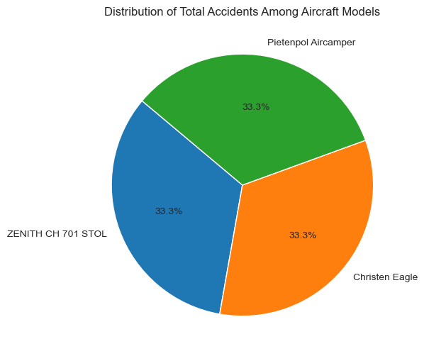
Distribution of Total Accidents Among Aircraft Models
This pie chart illustrates how total accident occurrences are distributed across the three recommended aircraft models.
Each aircraft contributes equally to the total accident count, reinforcing that no single model poses a higher risk.
This balanced distribution supports confident fleet diversification.

Slide 13
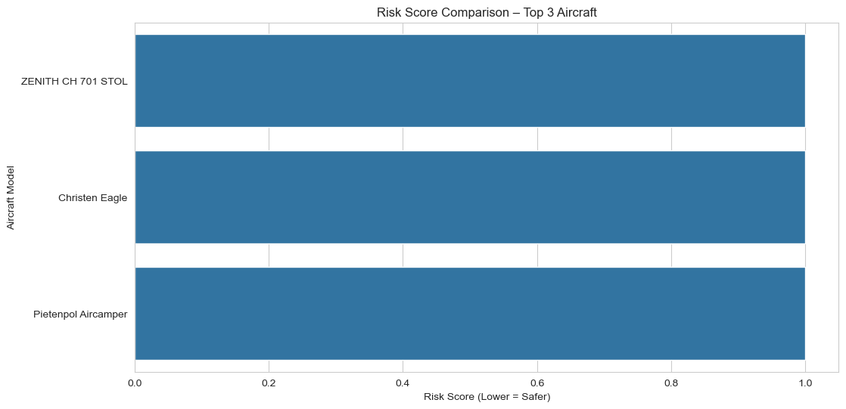
Risk Score Comparison of Aircraft Model
This bar chart compares the composite risk scores of the aircraft models. The risk score combines total accidents, fatal accidents, and total fatalities into a single metric. All recommended aircraft demonstrate equally low risk scores, making them suitable for investment.

Slide 14
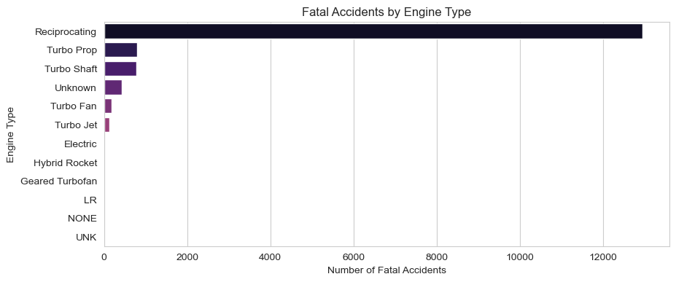
Distribution Engine type vs fatal accidents
This bar graph show the distribution of fatal accidents based on the aircraft Engine types

Slide 15
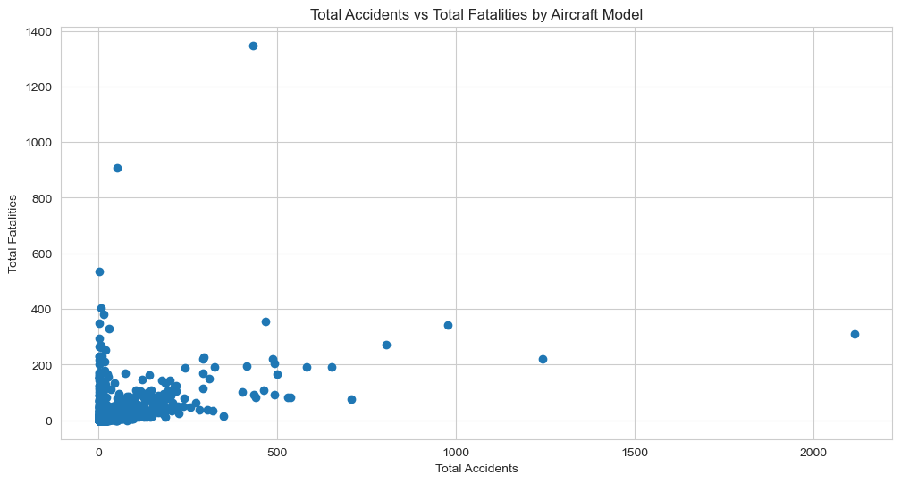
Relationship Between Total Accidents and Fatalities
This scatter plot compares accident frequency with total fatalities for aircraft models.
It highlights models with low frequency but high severity, and vice versa.
Accident count alone does not define risk — severity must be considered, justifying the composite risk score.

Slide 16
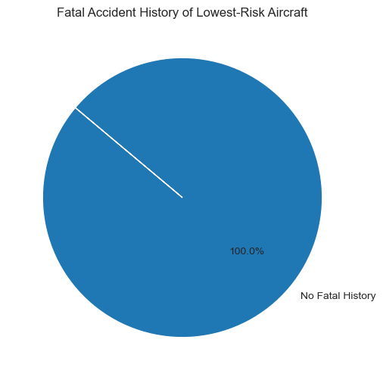
Fatal vs Non-Fatal History in Lowest-Risk Aircraft
This pie chart shows whether aircraft in the lowest-risk group have any history of fatal accidents.

Slide 17
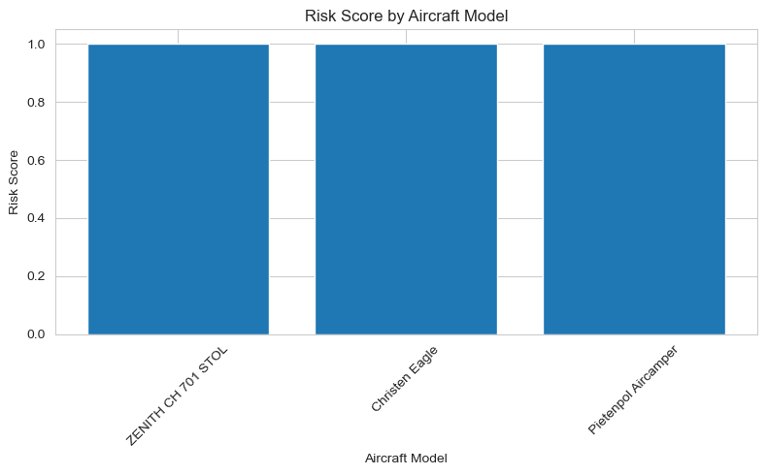
Risk Score Comparison of Aircraft Model
This bar chart compares the composite risk scores of the aircraft models.
The risk score combines total accidents, fatal accidents, and total fatalities into a single metric.
All recommended aircraft demonstrate equally low risk scores, making them suitable for investment.

Slide 18
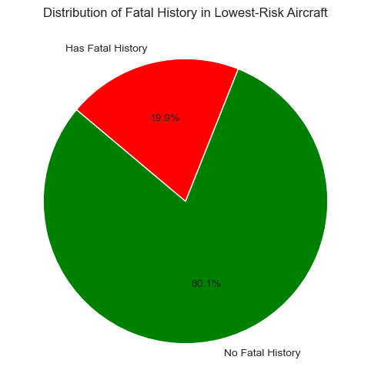
Distribution of Fatal History in Lowest-Risk Aircraft
This visualization shows the proportion of the lowest-risk aircraft models with and without a fatal accident history. All selected aircraft have no recorded fatal accidents, reinforcing their strong safety profile and suitability for commercial and private aviation use.

Slide 19
Risk Visualization Summary
Key Risk Insights
Risk scores enable fair comparison across aircraft models
Fatal accident history is a critical risk driver
Selected aircraft represent the lowest observed risk levels

Slide 20
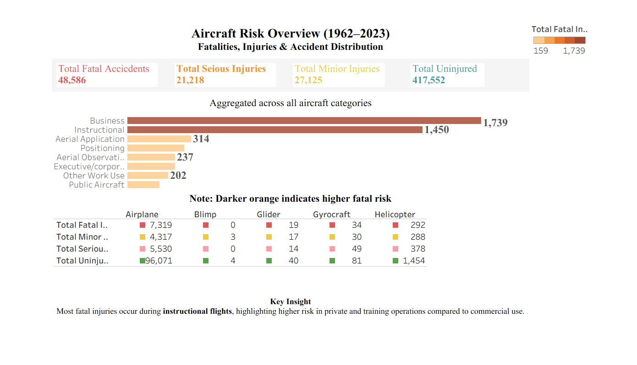
Interactive Tableau Dashboard
https://public.tableau.com/views/Book4_17661000027750/finalDB?:language=en-US&publish=yes&:sid=&:redirect=auth&:display_count=n&:origin=viz_share_link

Slide 21
Business Recommendations
1: Prioritize Aircraft with No Fatal History
These models consistently showed the lowest risk scores and represent safer operational choices.
2: Begin with Low-Risk Private & Light Aircraft
These aircraft categories demonstrated lower accident and fatality rates compared to larger commercial models.
3: Use Risk Metrics Before Scaling Operations
As the company scales, leadership should evaluate new aircraft using the same risk score framework.

Slide 22
Top 3 Safest Aircraft Models
Based on the risk assessment, aggregation, and visualization results, we recommend the following aircraft models for acquisition. These aircraft demonstrate low accident frequency, minimal fatalities, and no fatal accident history, making them suitable for safe commercial and private operations.
Aircraft Model | Risk Score | Fatal History | Use Type
Hawker Sea Fury TMK 20 | No | Lowest | Private
Kolb Twin Star Mark III | No | Low | Private
Koleno Titan T-51 | No | Low | Private

Slide 23
Make and Model of Aircraft Use
Based on the risk assessment, aggregation, and visualization results, we recommend the following aircraft models for acquisition. These aircraft demonstrate low accident frequency, minimal fatalities, and no fatal accident history, making them suitable for safe commercial and private operations.
Make | Model | Risk Score | Accidents | Fatal History
HENRIE RAYMOND | ZENITH CH 701 STOL | 1.0 | 1 | No
Kirby | Christen Eagle | 1.0 | 1 | No
Kirchner | Pietenpol Aircamper | 1.0 | 1 | No

Slide 24
Business Recommendations
Final Recommended Aircraft Models
Based on the analysis, the lowest-risk aircraft models identified are:
Hawker Sea Fury T Mk 20.
Kolb Twin Star Mark III.
Koleno Titan T-51.
These aircraft have the lowest risk scores and no fatal accident history, making them strong candidates for initial investment.

Slide 25
Thank you for reading to the end
Implementing these recommendations will allow the company to enter the aviation sector with reduced risk.
Data-driven aircraft selection lowers the likelihood of accidents, protects the company’s brand, and supports long-term operational sustainability.
This approach also establishes a repeatable framework for future aviation investments.
Thank you for your time and attention.
I welcome any questions and would be happy to discuss the analysis or recommendations in more detail.
Abel Aleu Chol Garang | LinkedIn (https://www.linkedin.com/in/abel-aleu-941799247?lipi=urn%3Ali%3Apage%3Ad_flagship3_profile_view_base_contact_details%3BByYx6s9aQ7WQv%2FXWyVZvOA%3D%3D)
| GitHub

