Slide 1
The $20 Million Question “In a public health crisis, every dollar spent on the wrong outreach can cost lives.”
How do we predict who will say ‘Yes’ in advance?
The Mission
Transform health 2009 H1N1 data from reactive guesswork → predictive precision
Identify key drivers of vaccine uptake
Target the right communities at the right time
Measure the population’s Trust Threshold
Key Insight
This is not just a model — it’s a strategic decision-making tool
Prepared and Presented By: Abel Aleu Chol Garang | Data Scientist
Notes:
Introduce yourself and the strategic question. Highlight the mission of moving public health to a proactive strategy.

Slide 2
The Data Blueprint & Strategic Gap Decoding Hidden Behavioral Patterns
The Core Conflict
“Vaccine hesitancy is not just personal — it is a barrier to herd immunity.”
When public health relies on guesswork:
Resources are wasted
Outreach becomes ineffective
The Dataset: 26,707 individuals | 35 variables
Psychological: Risk perception, trust, opinions
Behavioral: Hygiene habits, preventive actions
Demographic: Income, education, access
The Challenge:
Only 21% vaccinated → a hidden minority
Difficult to identify (“needle-in-a-haystack”)
Traditional approaches miss them
Requires a high-recall model
Key Insight
From mass marketing → precision outreach
Notes:
Introduce yourself and the strategic question. Highlight the mission of moving public health to a proactive strategy.

Slide 3
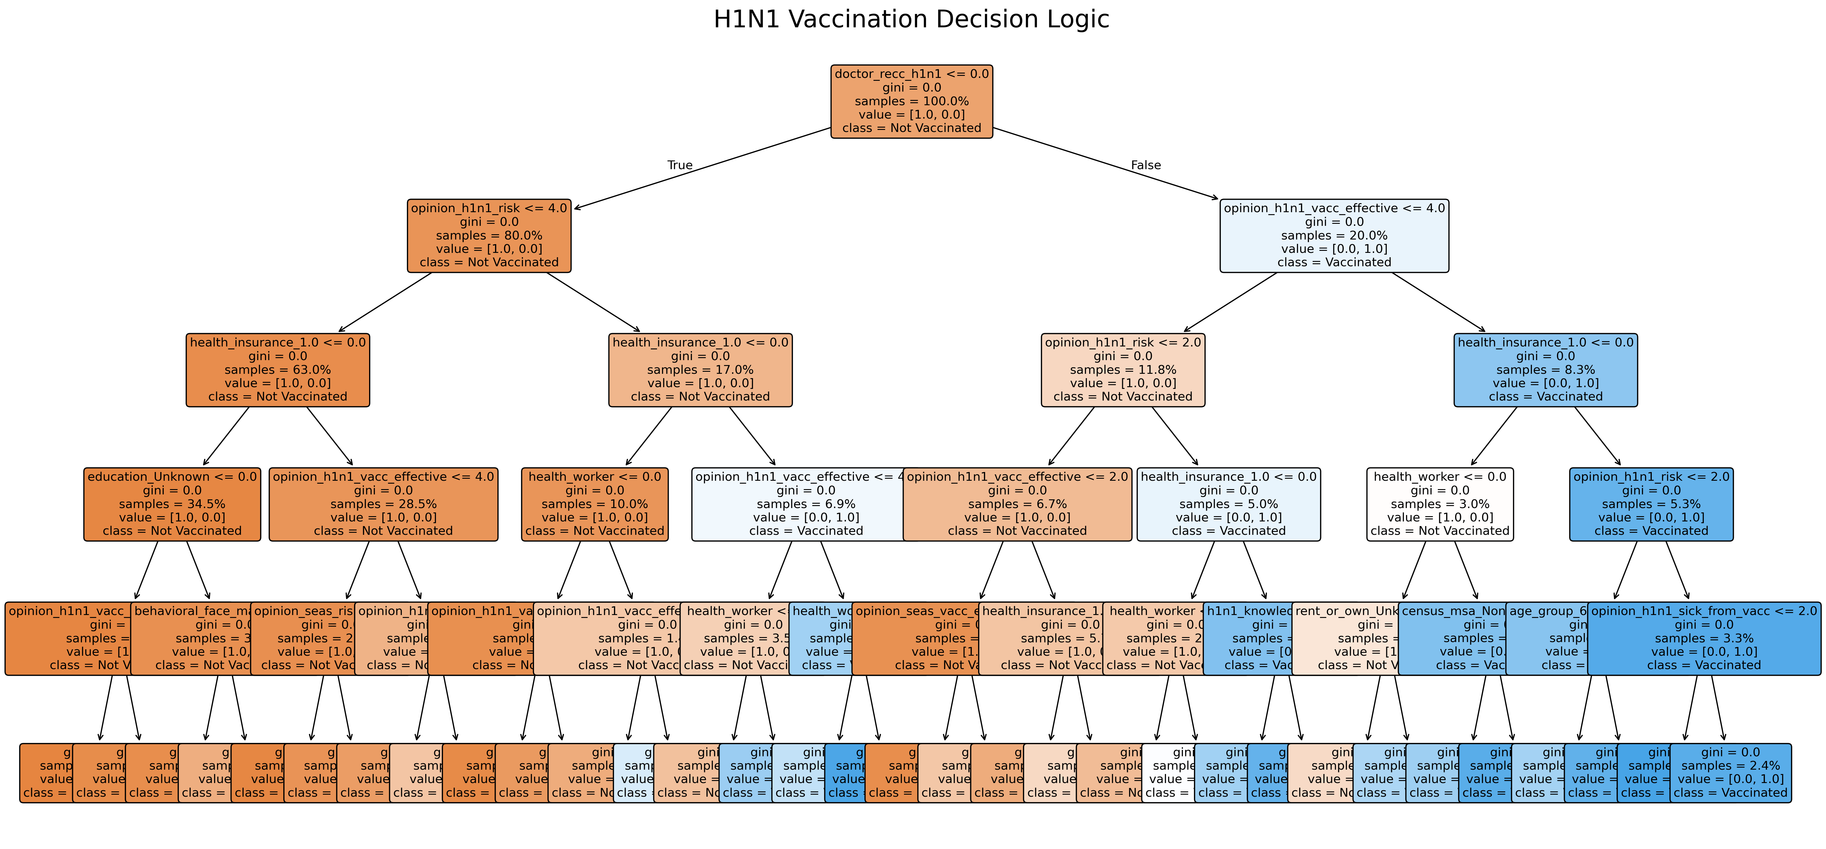
Decision tree Model
Notes:
Introduce yourself and the strategic question. Highlight the mission of moving public health to a proactive strategy.

Slide 4
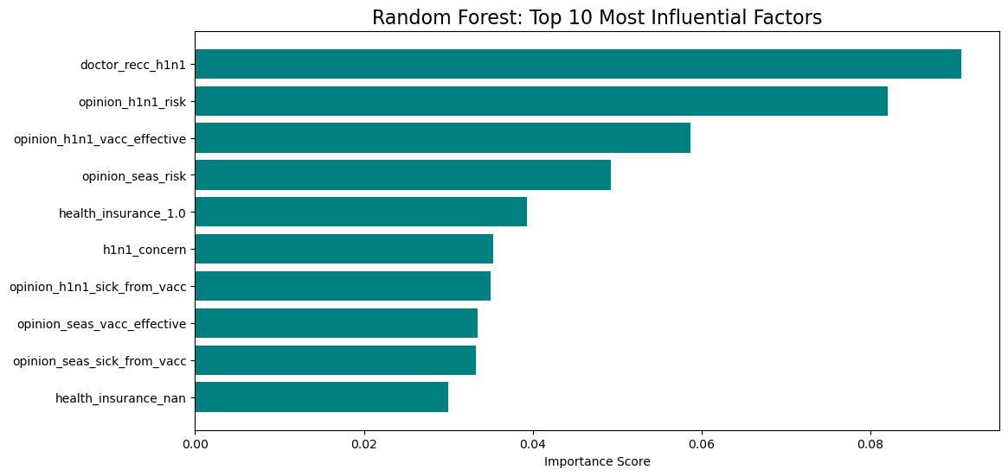
Random Forest Model Perception vs. Reality
Notes:
Introduce yourself and the strategic question. Highlight the mission of moving public health to a proactive strategy.

Slide 5
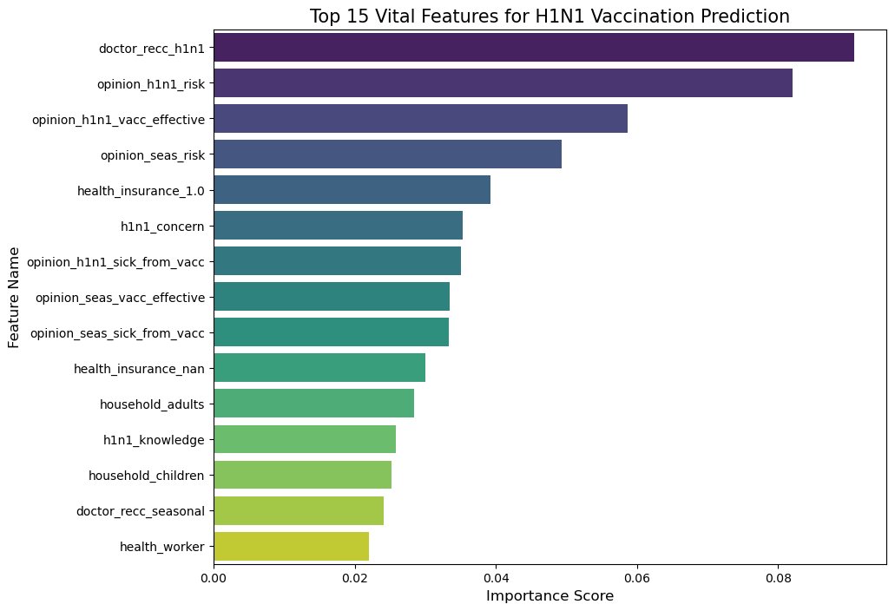
The Hierarchy of Influence The most influential factors driving an individual’s decision to get vaccinated.
Notes:
Introduce yourself and the strategic question. Highlight the mission of moving public health to a proactive strategy.

Slide 6
The Anatomy of Decision-Making Trust vs. Habit: What Really Drives Vaccination
The Data Landscape 26,707 individuals | 35 variables
Who: Age, race, income, education
Actions: Hygiene habits, preventive behavior
Beliefs: Risk perception, vaccine confidence
Challenge: 21% vaccinated → class imbalance
The Strategic Discovery
“Vaccination is not a habit — it is an act of trust.”
Hygiene behaviors → weak predictors
Trust in vaccine effectiveness → strongest driver
Concern alone does not translate into action
Strategic Shift
Move from general awareness → trust-building communication
From: “Wash your hands”
To: “Why the vaccine works”
Key Insight
Trust, not habit, determines vaccine uptake
Notes:
Introduce yourself and the strategic question. Highlight the mission of moving public health to a proactive strategy.

Slide 7
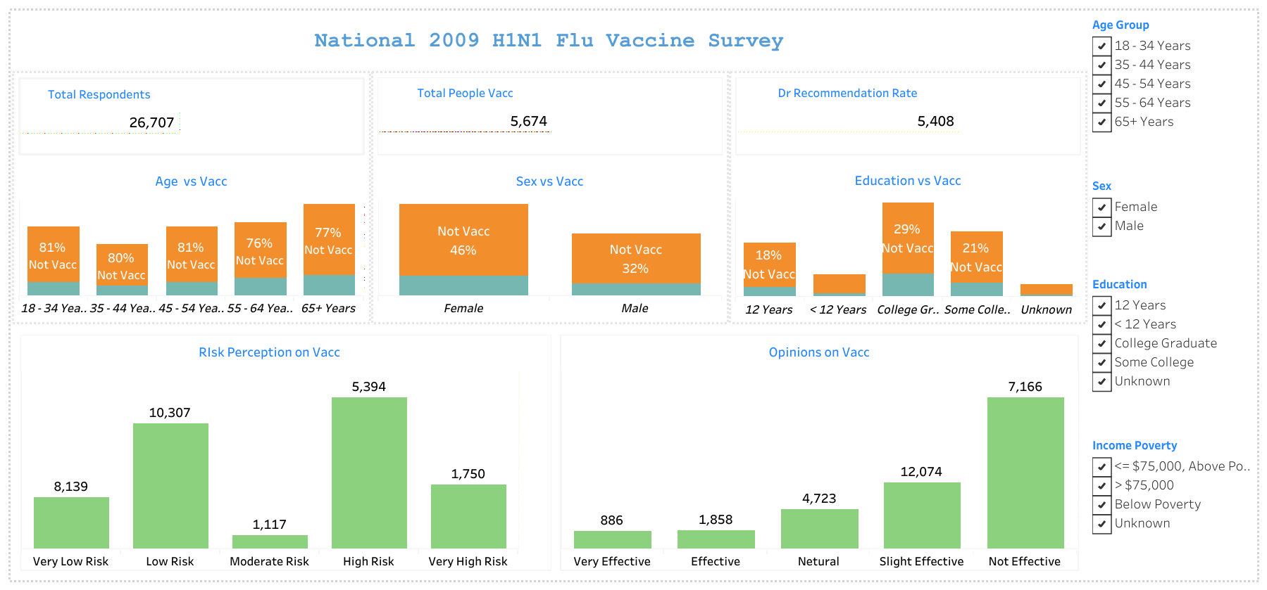
Tableau Representation of the analysis
Notes:
Introduce yourself and the strategic question. Highlight the mission of moving public health to a proactive strategy.

Slide 8
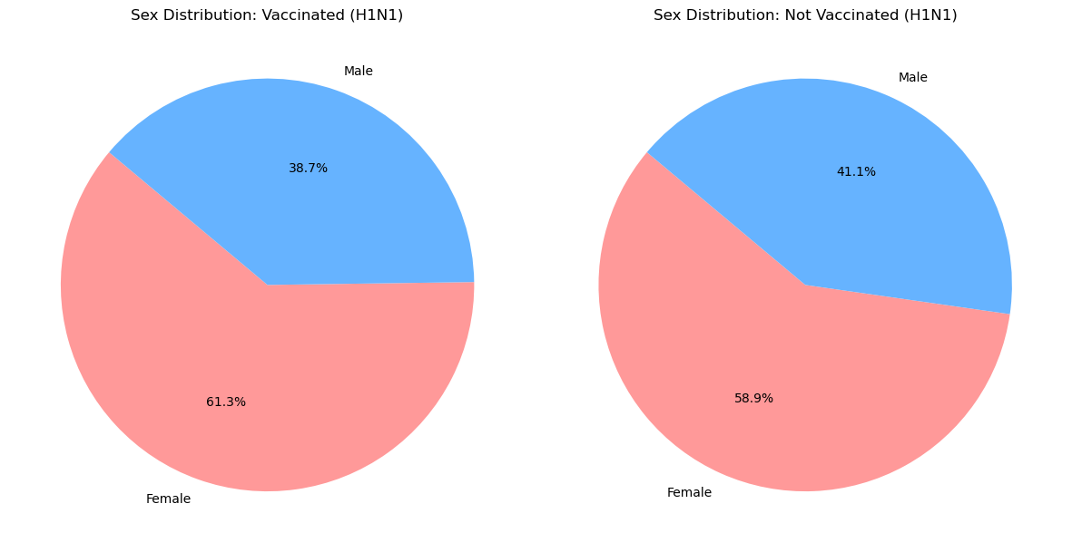
Vaccinated vs. Unvaccinated The slices are nearly identical, indicating that gender was not a primary driver for H1N1 vaccination allowing us to focus on behavioral drivers
Notes:
Introduce yourself and the strategic question. Highlight the mission of moving public health to a proactive strategy.

Slide 9
Engineering Equity & The Information Gap From Data Processing to Socioeconomic Insight
Data Preparation
Imputation: handled missing values
Encoding: converted categorical variables
Scaling: normalized numerical features
The Discovery
Vaccination gap = Information gap
Lower income & education → lower uptake
Complex messaging limits understanding
Trust breaks where clarity is missing
Strategic Shift
From academic jargon → community-first communication
Key Insight
Access to clear information drives equity
Notes:
Explain the dataset, objective, and the challenge of predicting a rare event.

Slide 10
Escaping the Accuracy Trap Prioritizing Recall Over Accuracy
The Core Discovery
Hygiene ≠ vaccination
Trust in effectiveness = key driver
The Problem with Accuracy
79% accuracy possible by predicting “No”
High accuracy can still fail in practice
The Strategic Pivot
Focus on Recall (find potential vaccinees)
Minimize missed opportunities
Key Insight
Better to reach more than to miss the willing
Notes:
Explain the dataset, objective, and the challenge of predicting a rare event.

Slide 11
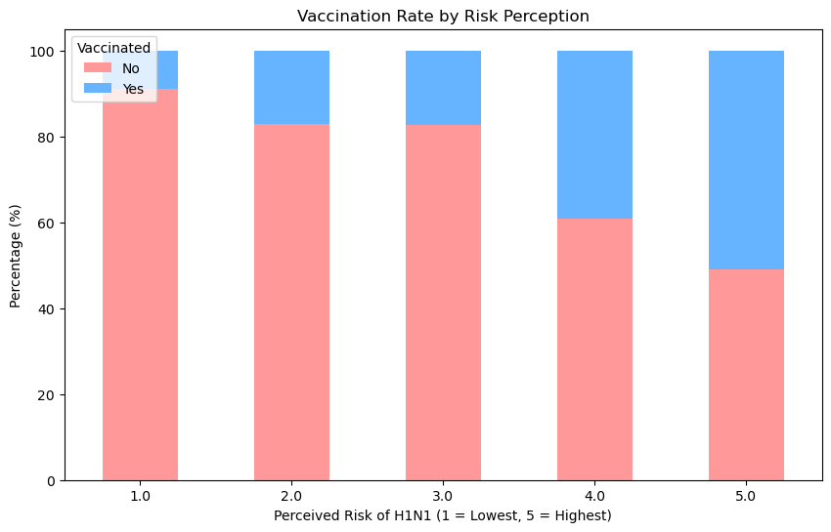
Perception of Risk as a Vaccination Drive The upward trend in the blue segments shows that while few who felt Low Risk got vaccinated, nearly half of those perceiving Highest Risk took action.
Notes:
Introduce yourself and the strategic question. Highlight the mission of moving public health to a proactive strategy.

Slide 12
The Strategy of Selection Choosing Coverage Over Precision
The Gap Identified
Socioeconomic divide in vaccination
Underserved groups missed by outreach
Model Comparison
Random Forest → High accuracy, low coverage
Logistic Regression → Lower accuracy, high recall
The Decision
Selected: Logistic Regression (Coverage Specialist)
Captures more potential vaccinees
Reduces missed outreach opportunities
Key Insight
Coverage saves more lives than precision
Notes:
Explain the dataset, objective, and the challenge of predicting a rare event.

Slide 13
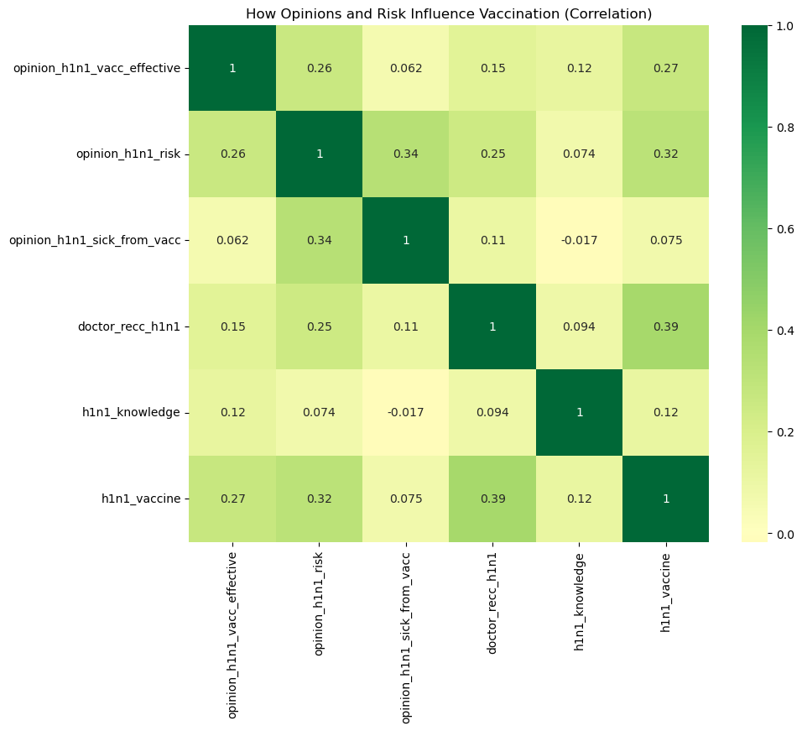
The Interconnected Drivers of Vaccination Notice the strong positive correlation between Doctor Recommendation and Vaccination Status. This confirms that clinical intervention isn't just a minor factor.
Notes:
Introduce yourself and the strategic question. Highlight the mission of moving public health to a proactive strategy.

Slide 14
The Predictive Engine From Data to Strategic Action
Robust Foundation
Cleaned, encoded, and scaled data
Built for real-world generalization
Model Performance
ROC-AUC: 0.80+
Strong ability to distinguish “Yes” vs “No”
Strategic Optimization
Prioritized recall over accuracy
Avoided overfitting
Key Insight
A useful model finds people, not just patterns
Notes:
Explain that perception/trust drives vaccination more than behavior.

Slide 15
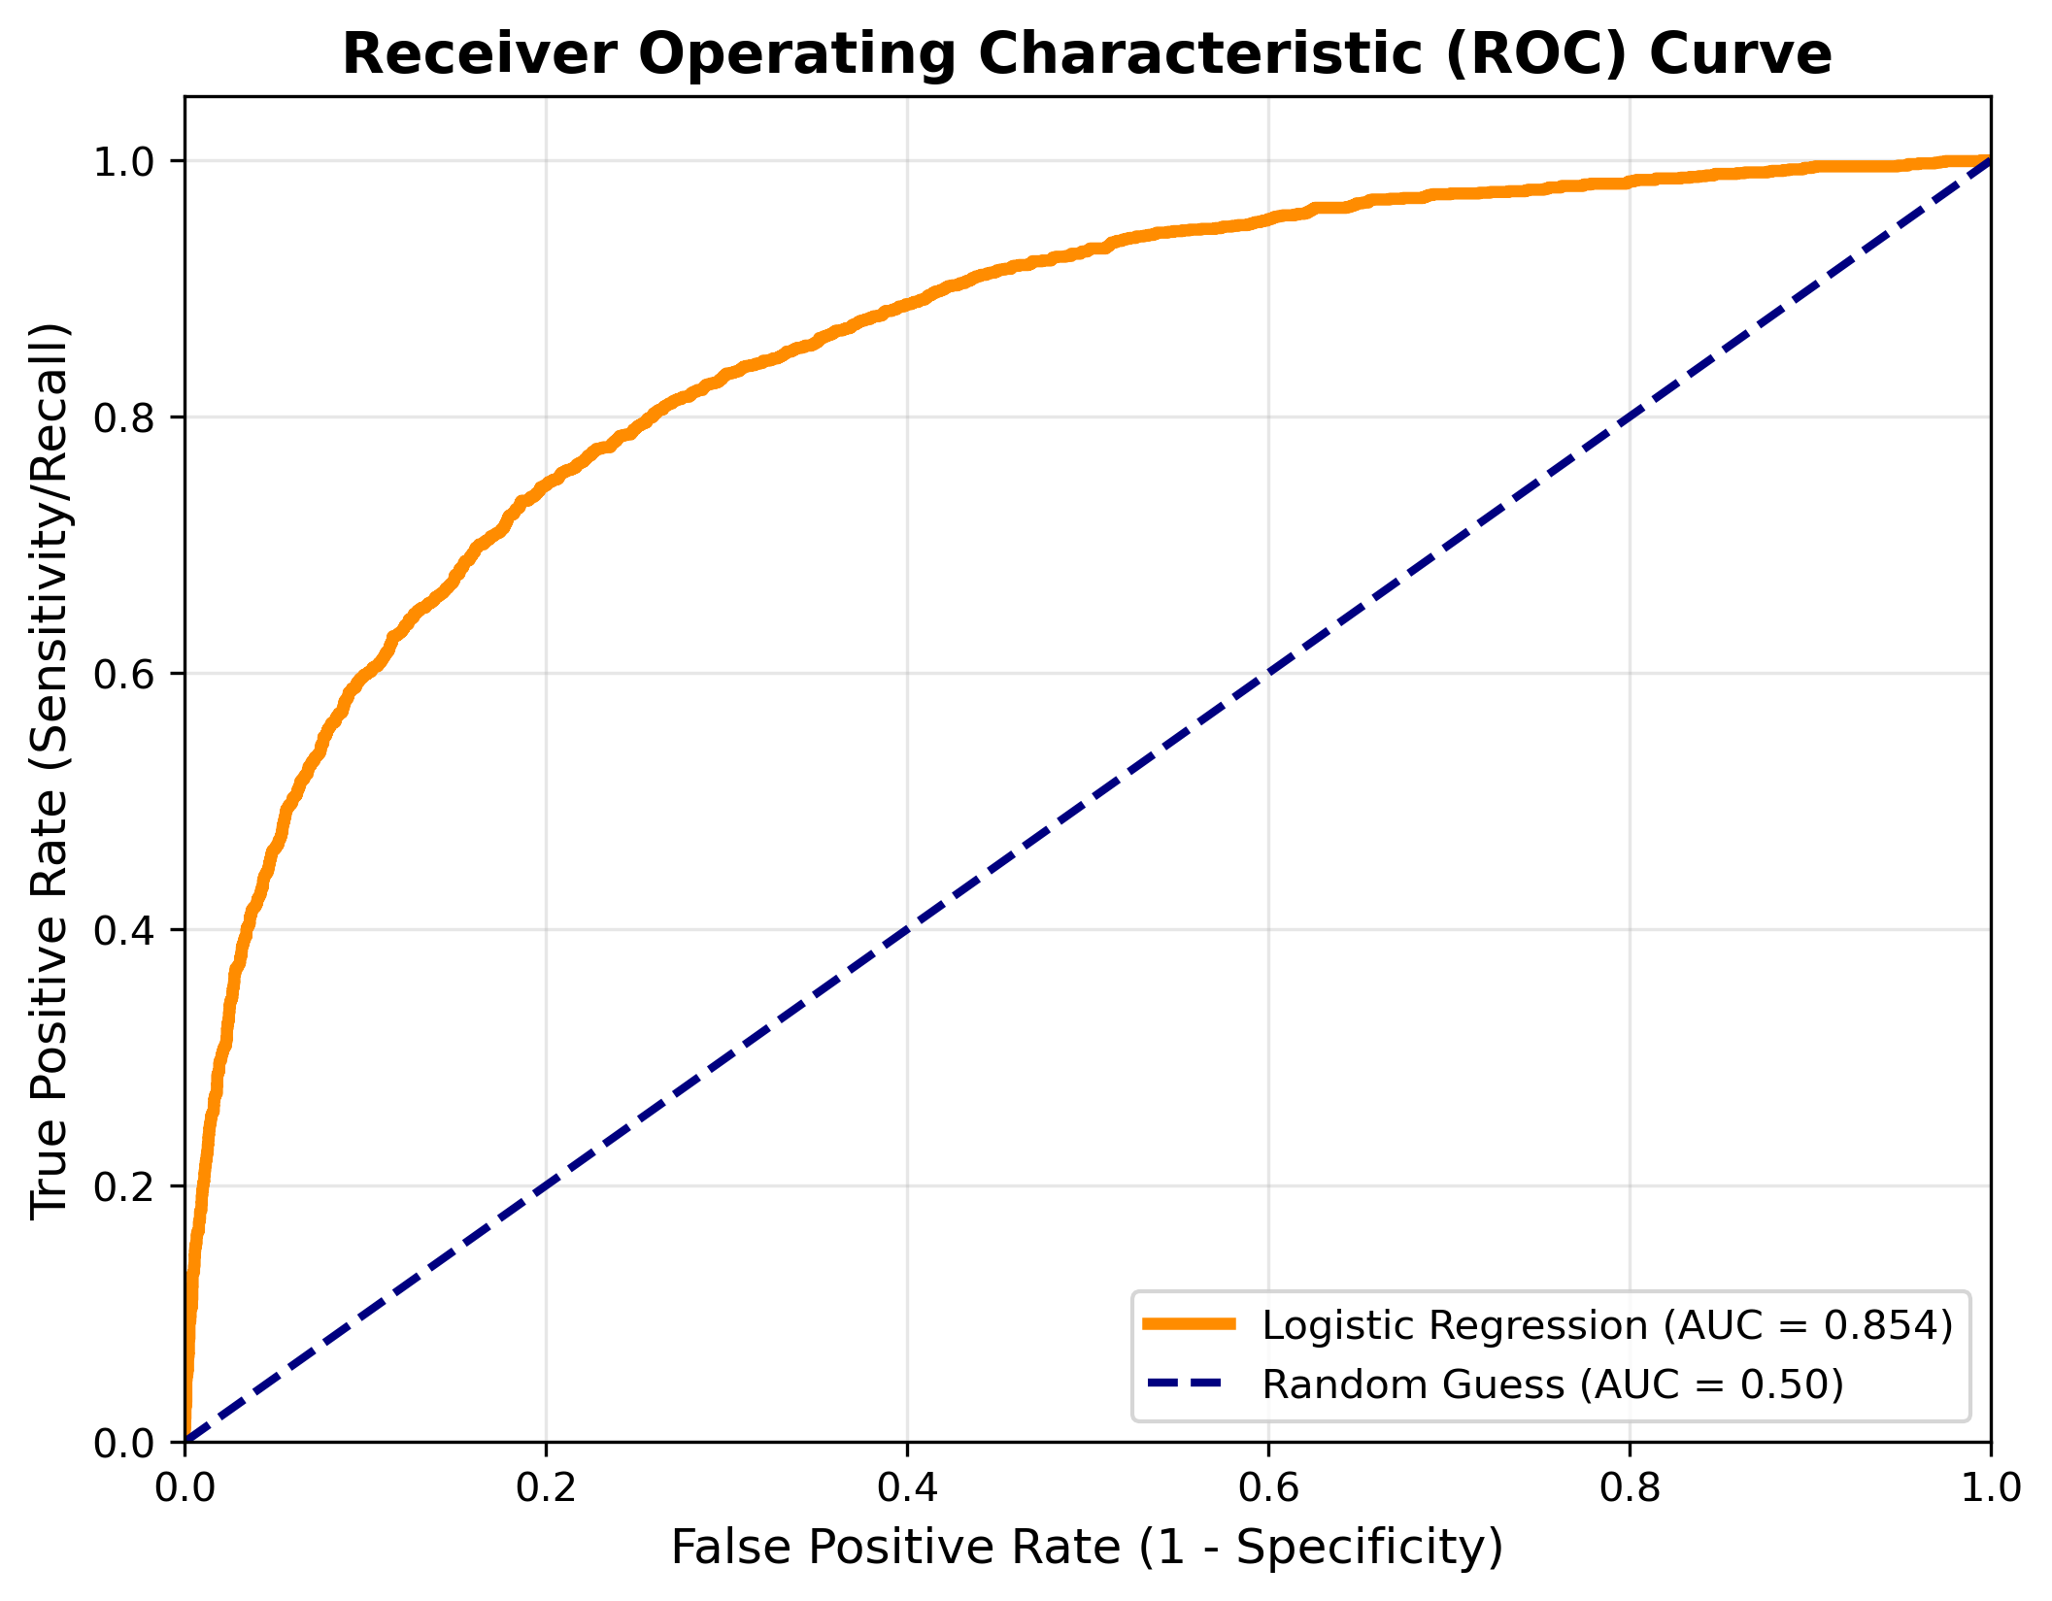
Predictive Confidence Index At 0.85, the model has an 85% success rate in telling the 'Yes' group apart from the 'No' group.
Notes:
Introduce yourself and the strategic question. Highlight the mission of moving public health to a proactive strategy.

Slide 16
The Predictors of Impact What Actually Drives Vaccination
Model Strength
High discrimination (ROC-AUC 0.80+)
Recall-focused → fewer missed vaccinees
Top 3 Drivers
Doctor Recommendation (Strongest)
Past Behavior (Flu shot history)
Trust in Effectiveness
Key Insight
Trust + influence + habit = action
Notes:
Explain that perception/trust drives vaccination more than behavior.

Slide 17
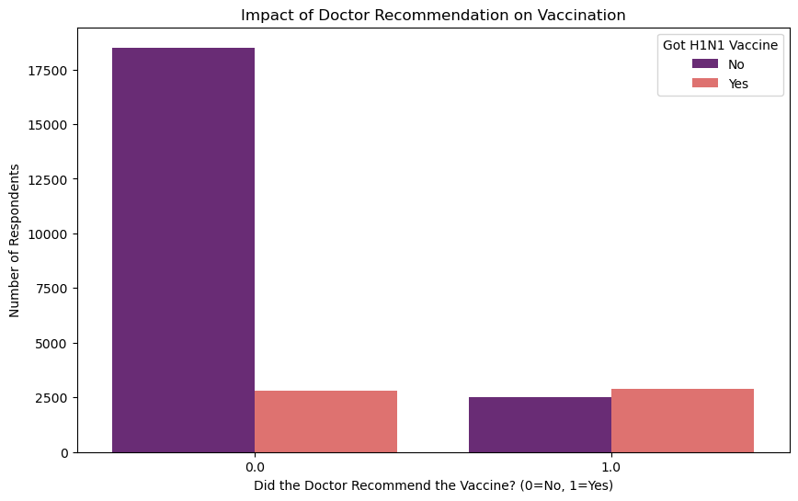
The 'Doctor Effect’ The group on the right (1.0) shows a higher vaccination rate despite being smaller. This indicates that a conversation with a healthcare provider is one of the most effective ways to increase vaccination uptake.
Notes:
Introduce yourself and the strategic question. Highlight the mission of moving public health to a proactive strategy.

Slide 18
From Prediction to Protection A Strategic Action Plan
Key Drivers
Doctor influence
Behavioral history
Trust in vaccine effectiveness
Action Plan
Empower doctors as primary messengers
Simplify communication for underserved groups
Target flu-shot individuals first
Key Insight
Strategy turns predictions into impact
Notes:
Explain that perception/trust drives vaccination more than behavior.

Slide 19
The Future of Public Health Intelligence Closing the Trust Gap with Data
Final Verdict
Vaccination is driven by trust, not just health awareness
Model captures ~72% of potential vaccinees
Enables proactive intervention
Strategic Roadmap
Equip doctors with communication tools
Eliminate jargon in outreach
Track trust & information sources
Closing Statement
“Data-driven trust is our strongest defense.”
Notes:
Discuss how education and income influence uptake and the importance of simplifying messages.

Slide 20
Dialogue Bridging Data & Strategy
Quick Summary
Model: High-recall Logistic Regression maximizes community coverage
Insight: Trust outweighs habits in driving vaccination.
Strategy: Clear, targeted communication to close information Gap.
Discussion
welcome your technical inquiries, strategic critiques, or thoughts on how we can better map the 'Trust Threshold' for the next global health challenge.
For Questions, Inbox me at garangabel262@gmail.com. I will get to you within 24 hours.
Notes:
Discuss how education and income influence uptake and the importance of simplifying messages.

